Slide 1
SPOMS Progresso – Sprint C
1200871 José Monteiro
1200587 Paulo Couto
1200972 José Rocha
1201008 Luis Ferreira
1192221 João Marques
Data 30/05/2022
Equipa 2DI-2

Slide 2
Resumo
Fases do projeto
Planeamento
Implementação
Revisão
Outros assuntos

Slide 3
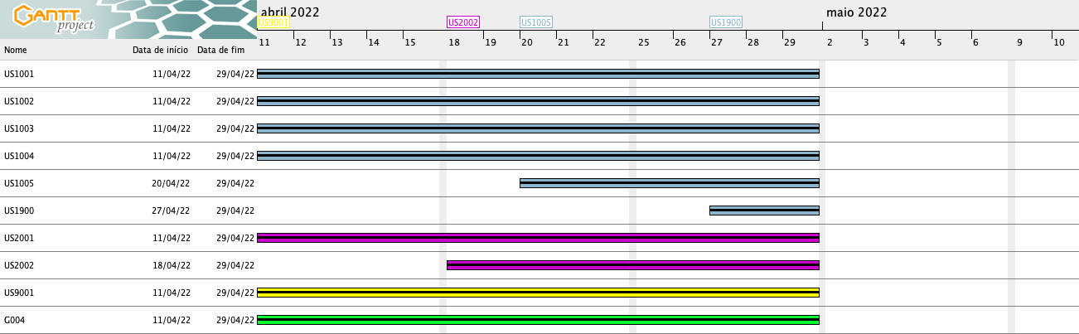
Planeamento
http://www.ganttproject.biz/ ​

Slide 4
Atividades Concluídas
ID | Atividade | Responsável | Baseline | Real | Estado
US1501 | As Customer, I want to view/search the product catalog and be able to add a product to the shopping cart. | José Monteiro | Início: 11-04-2022 Fim: 01-05-2022 | Início: 13-04-2022 Fim: 30-05-2022 | ✓
US1901 | As Project Manager, I want that the "OrdersServer" component supports properly, at request, the needs of the "CustomerApp" application. | Luís Ferreira | Início: 11-04-2022 Fim: 01-05-2022 | Início: 16-04-2022 Fim: 30/05/2022 | ✓
US2003 | As Warehouse Employee, I want to access the list of orders that need to be prepared by an AGV and be able to ask/force any of those orders to be immediately prepared by an AGV available. | Paulo Couto | Início: 11-04-2022 Fim: 01-05-2022 | Início: 20-04-2022 Fim: 30/05/2022 | ✓
US2004 | As Warehouse Employee, I want to access the list of orders that have already been prepared by the AGVs and be able to update any of those orders as having been dispatched for customer delivery. | José Rocha | Início: 11-04-2022 Fim: 01-05-2022 | Início: 18-04-2022 Fim: 30/05/2022 | ✓
US2005 | As Warehouse Employee, I want to open a web dashboard presenting the current status of the AGVs as well as their position in the warehouse layout and keeps updated automatically (e.g.: at each minute). | José Monteiro | Início: 27-04-2022 Fim: 01-05-2022 | Início: 13-04-2022 Fim: 30/05/2022 | ✓

Slide 5
Atividades Concluídas
ID | Atividade | Responsável | Baseline | Real | Estado
US3000 | As Project Manager, I want the team to specify a grammar allowing to express several kinds of questionnaires. | João Marques/José Monteiro |  |  | ✓
US3001 | As Sales Manager, I want to create a new questionnaire to be further answered by customers meeting the specified criteria (e.g.: have ordered a given product; belong to a given age group). | Luís Ferreira / José Rocha |  |  | ✓
US4001 | As Project Manager, I want that the "AGVManager" component supports properly, at request, the needs of the "BackOfficeApp" application as well as the needs the AGV digital twin. | José Rocha |  |  | ✓
US4002 | As Project Manager, I want that the "AGVManager" component is enhanced with a basic FIFO algorithm to automatically assign tasks to AGVs. | Paulo Couto |  |  | ✓
US5001 | As Project Manager, I want that the team start developing the input communication module of the AGV digital twin to accept requests from the "AGVManager". | João Marques | Início: 11-04-2022 Fim: 01-05-2022 | Início: 13-04-2022 Fim: 30-05-2022 | ✓
US5002 | As Project Manager, I want that the team start developing the output communication module of the AGV digital twin to update its status on the "AGVManager". | Luís Ferreira | Início: 11-04-2022 Fim: 01-05-2022 | Início: 16-04-2022 Fim: 30/05/2022 | ✓

Slide 6
Atividades Em Curso/A Iniciar
ID | Atividade | Responsável | Baseline | Real | Estado
G004 | As Project Manager, I want the team to configure the project structure to facilitate / accelerate the development of upcoming user stories. | Team | Início: 16-05-2022 Fim: 29-05-2022 | Início: 16-05-2022 Fim: 29-05-2022 | ●

Slide 7
SPOMS
principais objetivos do sistema;
processo de desenvolvimento adotado e planeamento;
metodologia de trabalho em equipa e estratégia para resolução de conflitos;
qualidade do produto;
resultados esperados;

Slide 8
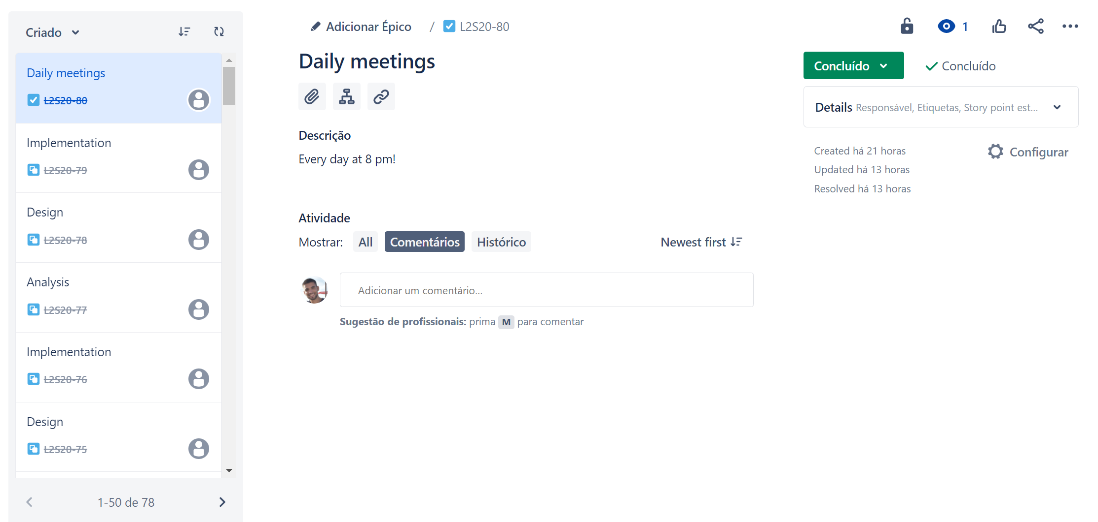
Daily Meetings

Slide 9
SPOMS Progresso – Sprint C
Data 30/05/2022

