Slide 1
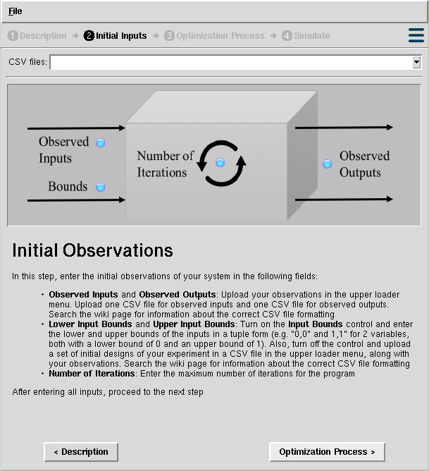
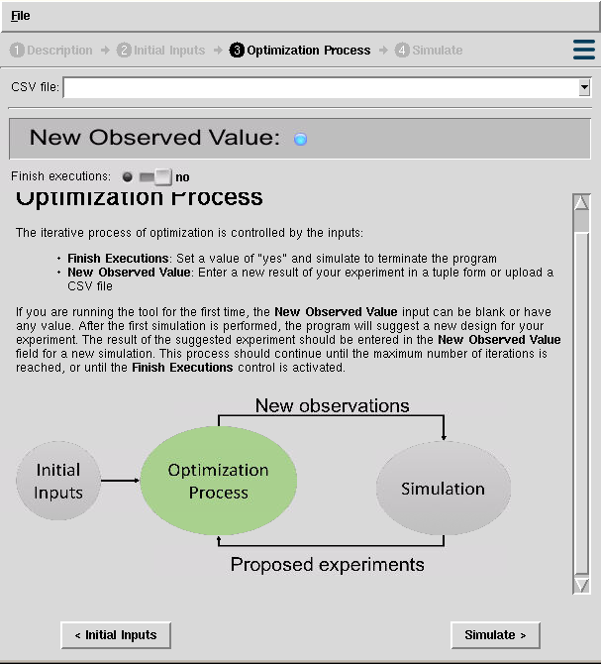
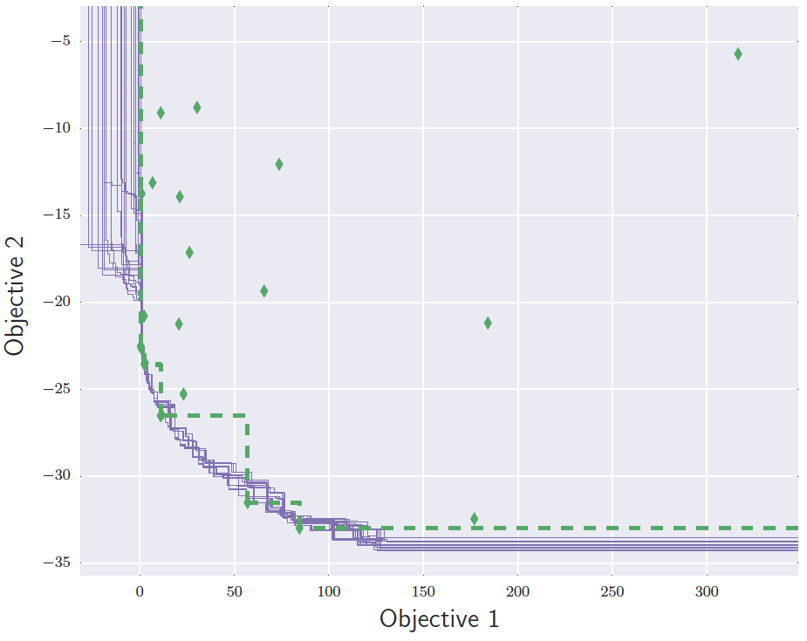
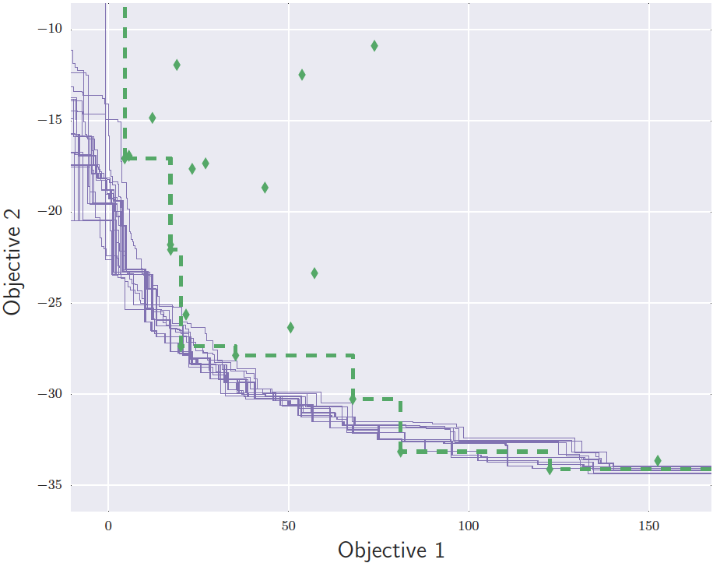
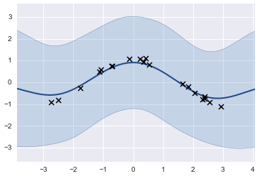
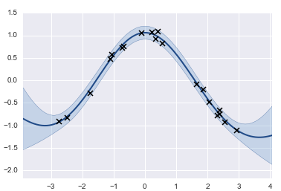
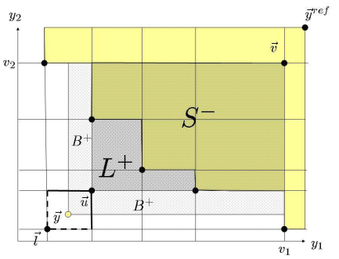
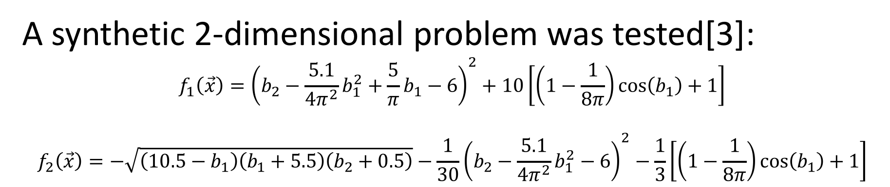
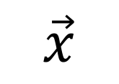
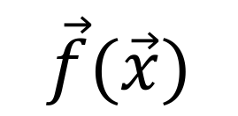
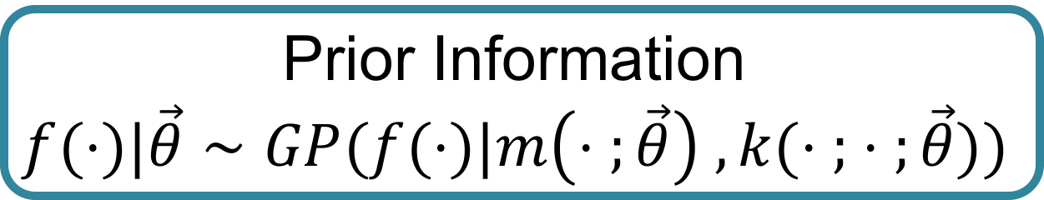

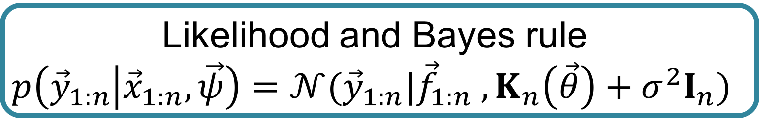
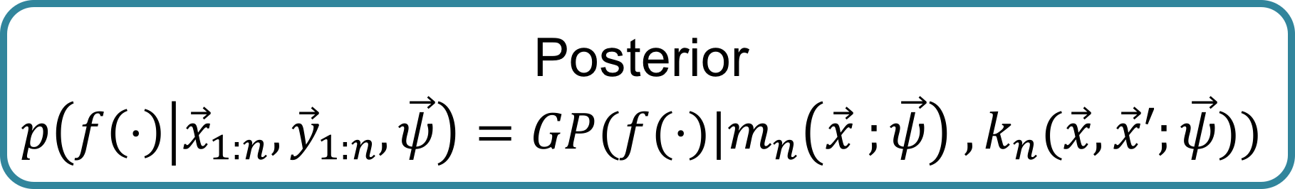
Gaussian Process Regressions for Objective Surrogates in Stochastic Multi-objective Optimization
Juan Sebastian Martinez*, Piyush Pandita†,Rohit Tripathy†, Ilias Bilionis†
*Department of Electric and Electronic Engineering, Universidad de Los Andes, Bogota DC, Bogota, 111711, Colombia
†Department of Mechanical Engineering, Purdue University, West Lafayette, Indiana, IN 47907, USA
Abstract: Global optimization of expensive, multi-modal and noisy multi-objective functions is a common problem that comes up frequently in various areas of computational and experimental research. Along with being expensive to evaluate and noisy, we are also particularly interested in cases where the objective function under consideration is a black box and does not provide gradient information of the quantity of interest (QoI) with reference to the inputs. Because of the high cost of every single evaluation of such objective functions, we can only obtain a limited number of evaluations. This necessarily induces epistemic uncertainty (lack of knowledge due to limited data) on our problem. The Bayesian approach provides a natural framework to tackle this problem, building Gaussian process surrogates that model the objective functions and allow a sequential optimization process. The method applies the expected improvement (EI) information acquisition function in each iteration to perform an efficient global optimization (EGO) and discover the Pareto front of the problem, which contains the set of optimal solutions of the objectives. We implemented this method in a NanoHUB tool and tested it with synthetic examples and real observations of an expensive experiment, where it proved to be efficient in finding the corresponding set of optimal solutions for each problem. This methodology demonstrates how the efficiency of the Bayesian approach for handling epistemic uncertainty in multi-objective optimization problems, dealing with limited observations and avoiding a high amount of evaluations of time-consuming codes or expensive experiments.
The Problem…
The Methods…
Our Results...
Optimization is a widely studied and applied area in science and engineering. Unfortunately, real life optimization problems in science and engineering share similar issues:
Multiple objectives
Limited observations
Expensive experiments or evaluations of computer code
Black box systems
Noise in observations
Epistemic uncertainty
Initial observations
Train GP surrogates
Project observations
Compute expected improvement
Add new observation
Propose a design
General methodology
Gaussian process regressions to build objective surrogates:
A Gaussian process (GP) is a collection of random variables, any finite number of which have a joint Gaussian distribution [1]
SMOOT (Stochastic Multi-Objective Optimization Tool):
https://nanohub.org/tools/smoot/
Prior Information
$$f(⋅)|\vec{θ}∼GP(f(⋅)|m\left(⋅ ;\vec{θ}\right) , k(⋅ ; ⋅ ;\vec{θ}))$$
Likelihood and Bayes rule
$$p\left({\vec{y}}_{1:n} | {\vec{x}}_{1:n},\vec{ψ}\right)=𝒩({\vec{y}}_{1:n}|{\vec{f}}_{1:n} , K_{n}\left(\vec{θ}\right)+σ^{2}I_{n})$$
A synthetic 2-dimensional problem was tested[3]:
$$f_{1}\left(\vec{x}\right)={\left(b_{2}−\frac{5.1}{4π^{2}}b_{1}^{2}+\frac{5}{π}b_{1}−6\right)}^{2}+10\left[\left(1−\frac{1}{8π}\right)\cos\left(b_{1}\right)+1\right]$$
$$f_{2}\left(\vec{x}\right)=−\sqrt{\left(10.5−b_{1}\right)\left(b_{1}+5.5\right)\left(b_{2}+0.5\right)}−\frac{1}{30}{\left(b_{2}−\frac{5.1}{4π^{2}}b_{1}^{2}−6\right)}^{2}−\frac{1}{3}\left[\left(1−\frac{1}{8π}\right)\cos\left(b_{1}\right)+1\right]$$
?
$$\vec{x}$$
$$\vec{f}(\vec{x})$$
Data Observations
$${\vec{x}}_{1:n} ; {\vec{y}}_{1:n}$$
Posterior
$$p\left(f\left(⋅\right) | {\vec{x}}_{1:n},{\vec{y}}_{1:n},\vec{ψ}\right)=GP(f(⋅)|m_{n}\left(\vec{x} ;\vec{ψ}\right) , k_{n}(\vec{x},\vec{x}′;\vec{ψ}))$$
Black box system
Different approaches have been taken through evolutionary algorithms:
Large amount of observations required
Uncertainty is not considered
Our objective…
A Gaussian process regression
At the end...
Using Gaussian process regressions is an effective method for building objective surrogates under uncertainty
The method allows experimentalists to obtain an optimal set of designs to apply in their experiments, with no extra costs or inefficient use of resources
The expected improvement defines a metric to determine the contribution of a point to improving the set of optimal solutions.
References
Computing the expected improvement [2]
[1] M. Seeger, Gaussian processes for machine learning. , vol. 14. 2004.
[2] Emmerich, Michael, and Jan-willem Klinkenberg. "The computation of the expected improvement in dominated hypervolume of Pareto front approximations." Rapport technique, Leiden University (2008).
[3] J. Parr, Improvement criteria for constraint handling and multiobjective optimization . PhD
thesis, University of Southampton, 2013.
Pareto Front

