Slide 1
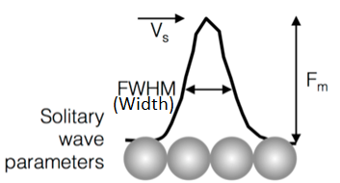



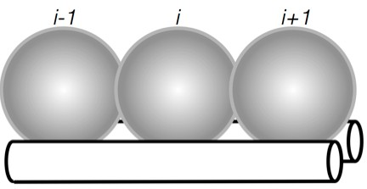
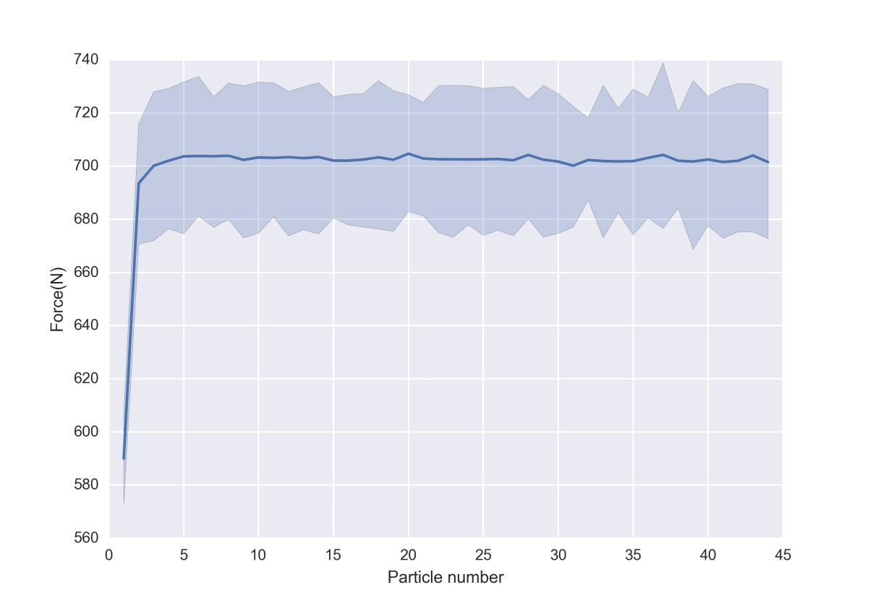
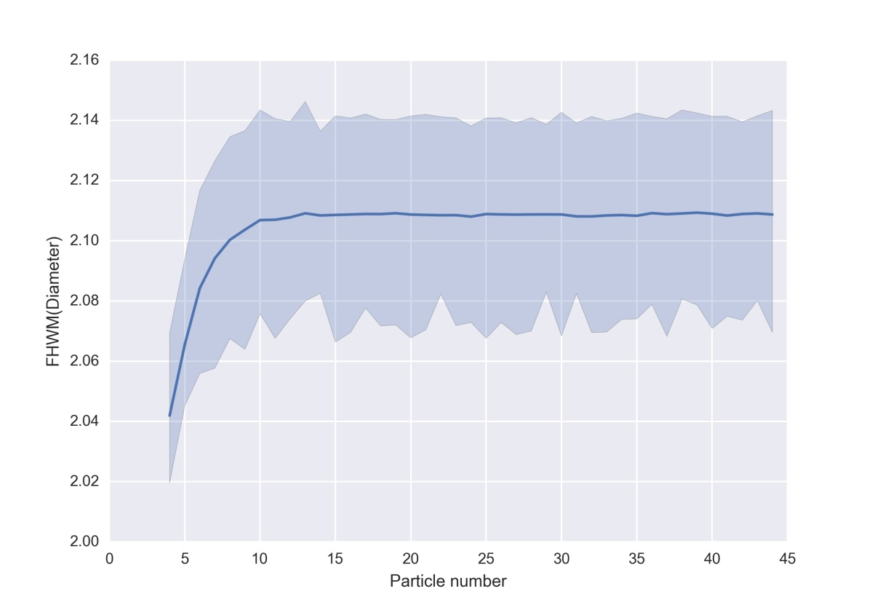


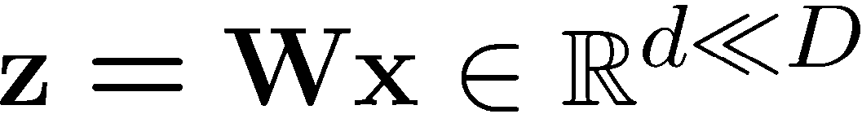

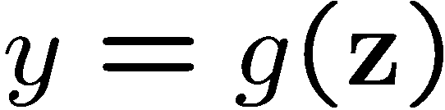
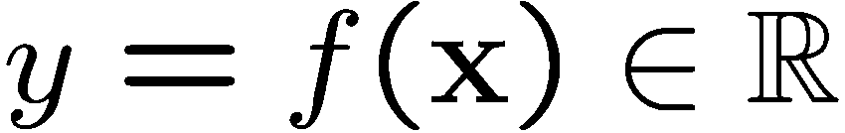
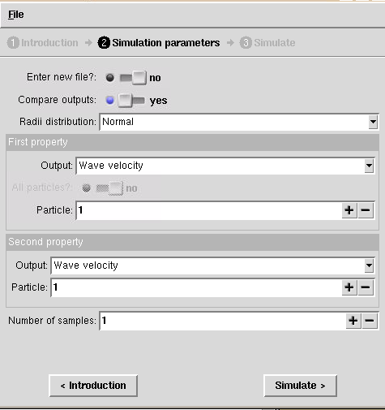
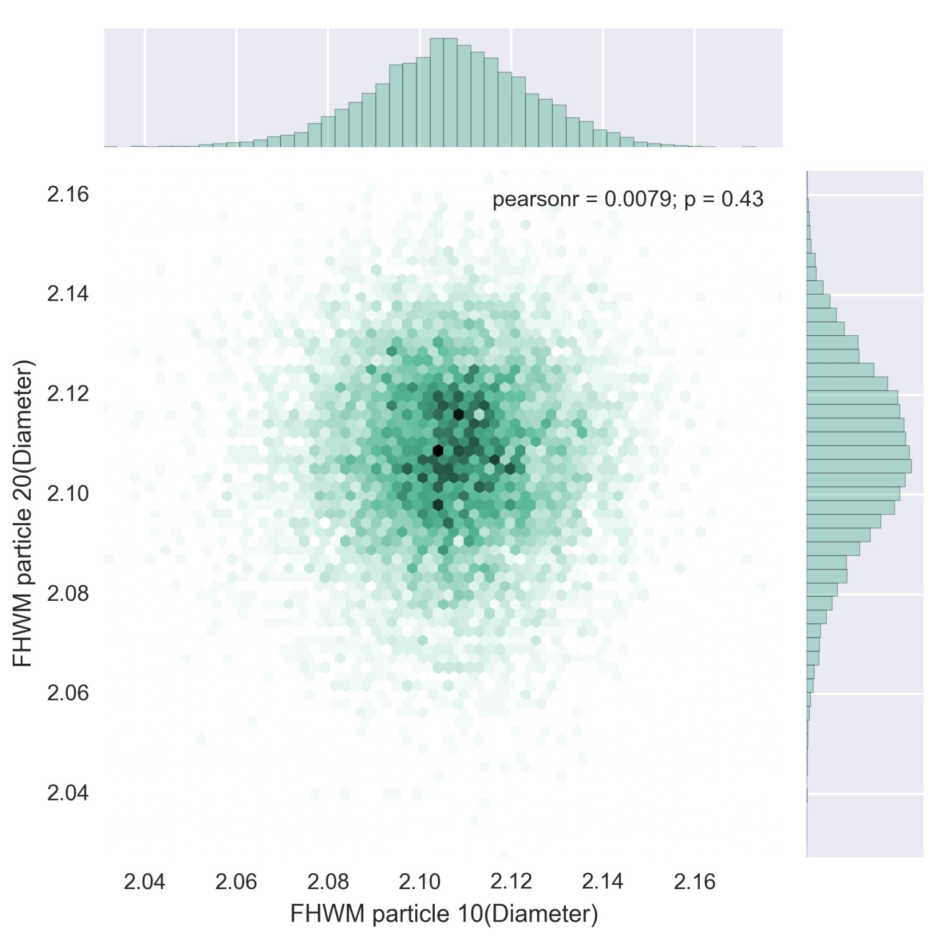
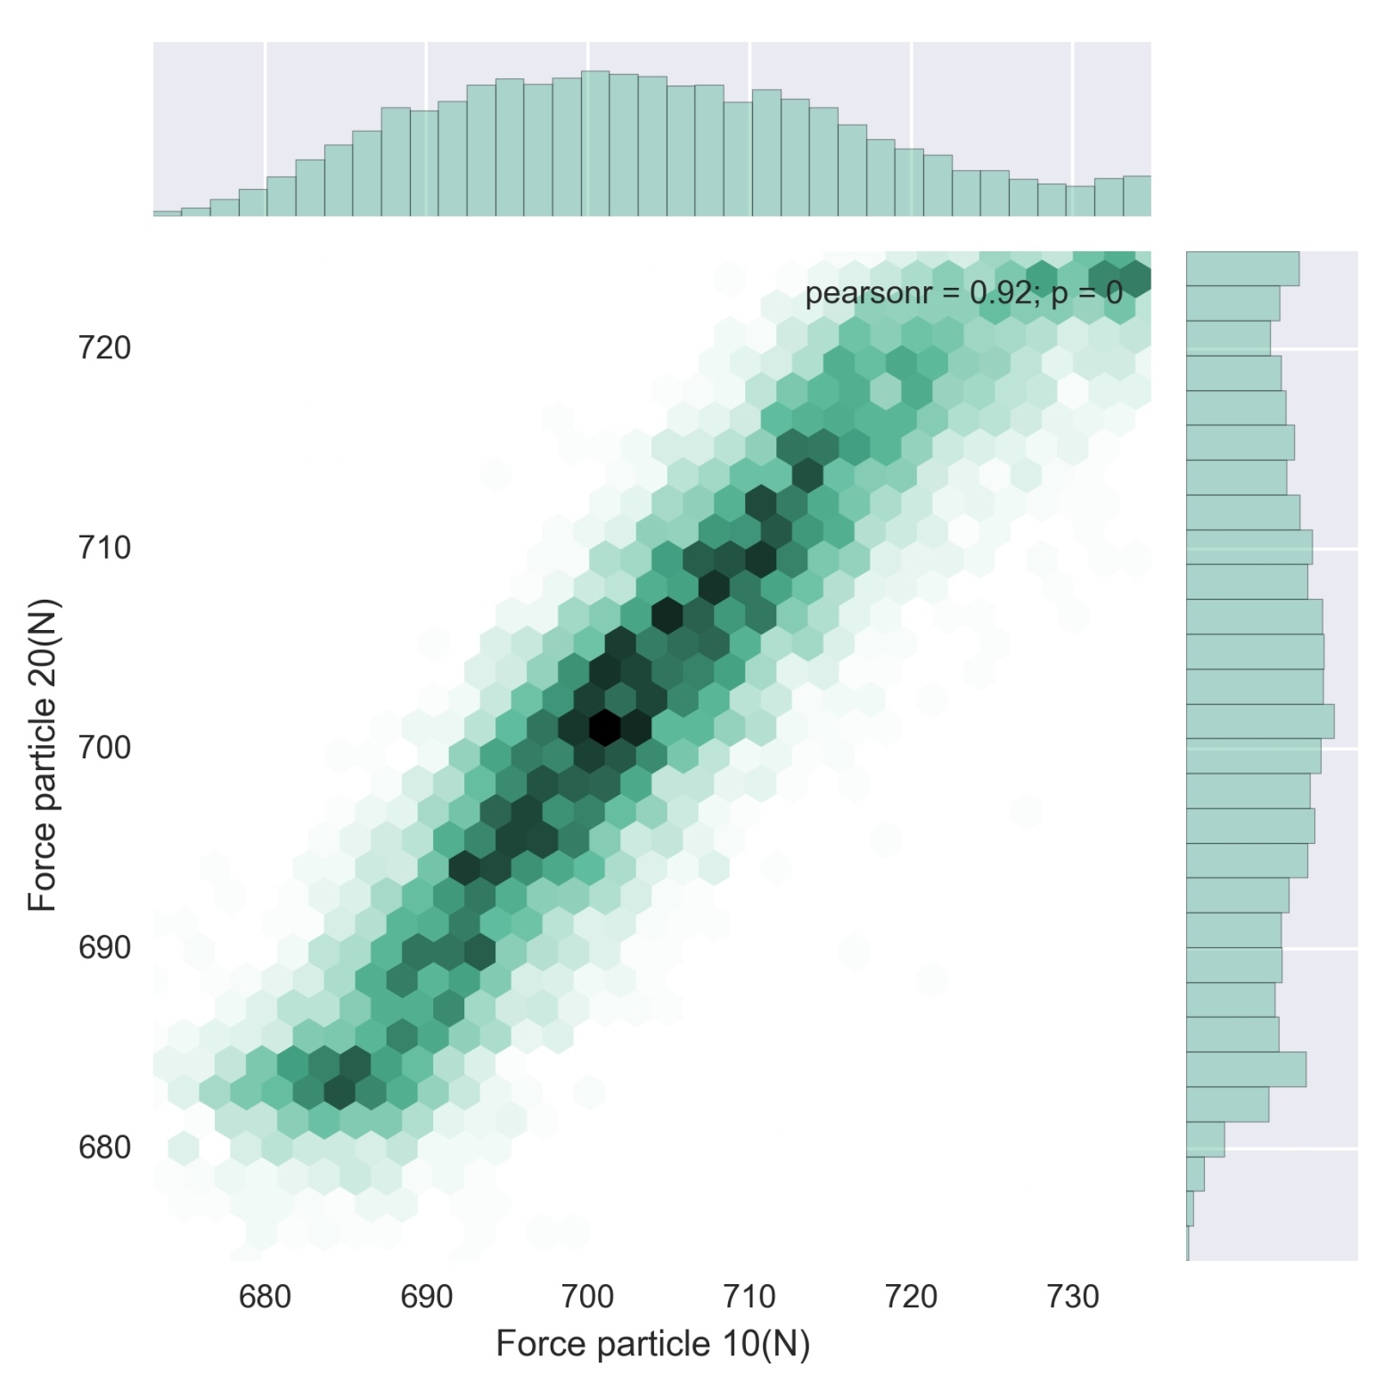
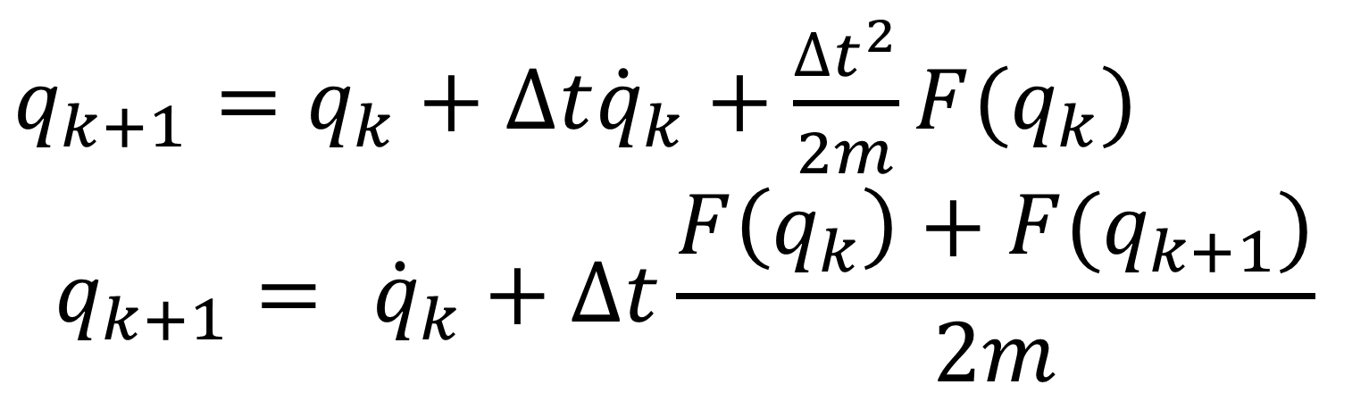
Efficient Exploration of Quantified Uncertainty in Granular Materials
Juan Lopez*, Rohit Tripathy†, Ilias Bilionis†, Marcial Gonzalez†
*Department of Electric and Electronic Engineering, University of Los Andes, Bogota DC, Bogota, 111711, Colombia
†Department of Mechanical Engineering, Purdue University, West Lafayette, Indiana, IN 47907, USA
Abstract: Granular crystals present unique nonlinear behaviors that support standing waves. These can be controlled through precompression and impurities for different applications, such as impact and shock dissipation, and energy harvesting devices. Even though, the study of granular crystals is relatively new, there exist different models that describe them. As many models in other fields, they rely on particular approximations and suppositions, and experimental results show agreement with them. However there are experimental errors that are not easily accounted for and are usually attributed to some of the approximations made or phenomena that is not considered in the models. The errors observed might be the result of not quantifying uncertainty in the models. This work presents a way of doing uncertainty propagation through the method of active subspaces and Gaussian process regression, in a computationally efficient way.
What are Granular Crystals?
Array of elastic particles in contact with each other.
They present strong nonlinear behavior and solitary waves can exist inside them.
The particle size and Young modulus can be controlled, changing the properties.
1D granular chain. There are multiple contacts.
[1][2]
The optimization problem
The input space is high dimensional and the computational cost of finding functions (surrogates) that fit the data grows exponentially.
Surrogate functions with a confidence interval of 97.5%
Inputs (sources of uncertainty)
Tool available at: https://nanohub.org/tools/gransurrogate
Discover and exploit
Active Subspaces
(where response exhibits maximal variability)
Granular chain with beads of different materials and size. (http://www.mechmat.ethz.ch/research.html)
Reduced inputs
Constantine-2013 (math@C.Mines)
Conclusions
Chain Motion
It is possible to produce error bounds for measurements and have an idea of where the error comes from.
The model is applicable to models of various properties, such as particle size and number of particles.
The properties can be defined in terms of the motion of the chain.
Bilionis-2015 (gradient free, reduces to an optimization process)
Use a Gaussian Process regression as surrogate
Output (quantities of interest)
Check condition for collision
A tool for researchers and students
Future work
No
Finish
A graphical user interface gives easy access to the surrogates for simulations, and properties.
One model is available for simulation. Future versions of the tool will include more models and an option to upload personalized models.
These methods can be applied to more complex systems.
Is it in a collision process?
Yes
Update variables
Time-stepping integration of the equations of motion
References
[1] Gonzalez M., Yang J., Daraio C. and Ortiz M., Mesoscopic approach to granular crystal dynamics, Physical Review E, 85, 016604, 2012.
[2] Yang J., Gonzalez M., Kim E., Agbasi C., and Sutton M., Attenuation of solitary waves and localization of breathers in 1D granular crystals visualized via high speed photography, Experimental Mechanics, 54, 1043–1057, 2014.
[3] Marcial Gonzalez and Alberto M. Cuitiño. A nonlocal contact formulation for confined˜ granular systems. Journal of the Mechanics and Physics of Solids, 60(2):333–350, 2012
[4] Caishan Liu, Zhen Zhao, and Bernard Brogliato. Theoretical Analysis and Numerical Algorithm for Frictionless Multiple Impacts in Multibody Systems. Inria, 2008
[5]C. E. Rasmussen and C-K. Williams, Gaussian processes for machine learning, USA: MIT Press, 2006
[6] [1] Ilias Bilionis and Nicholas Zabaras. Bayesian uncertainty propagation.
$q_{k+1}=$ $q_{k}+∆t{\dot{q}}_{k}+\frac{∆t^{2}}{2m}F(q_{k})$
$$q_{k+1}= {\dot{q}}_{k}+∆t\frac{F\left(q_{k}\right)+F(q_{k+1})}{2m}$$
Graphical user interface
Joint plots for different properties in different particles.

Slide 2
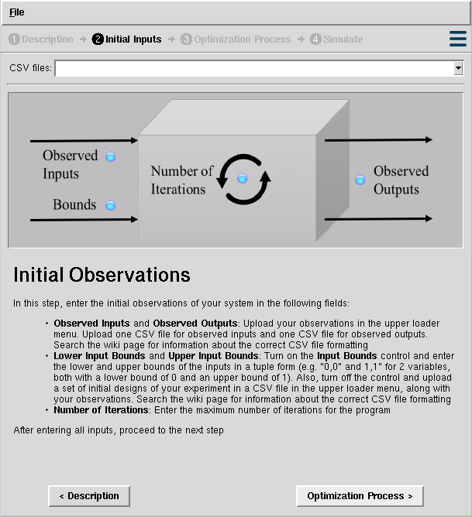
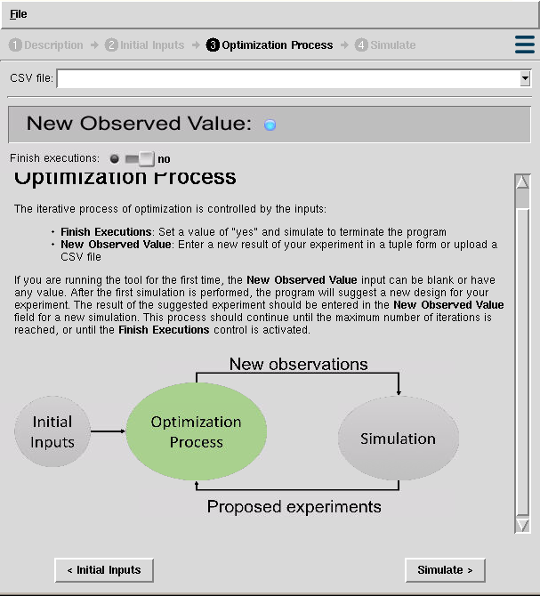
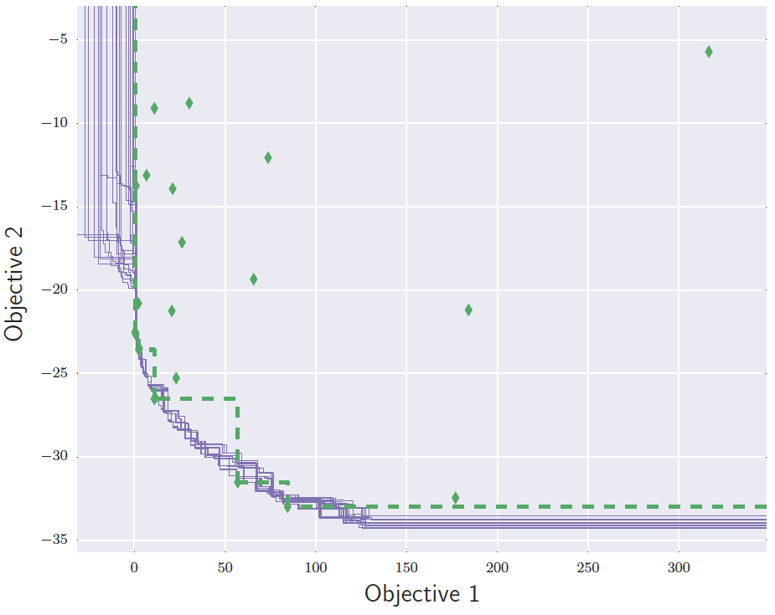
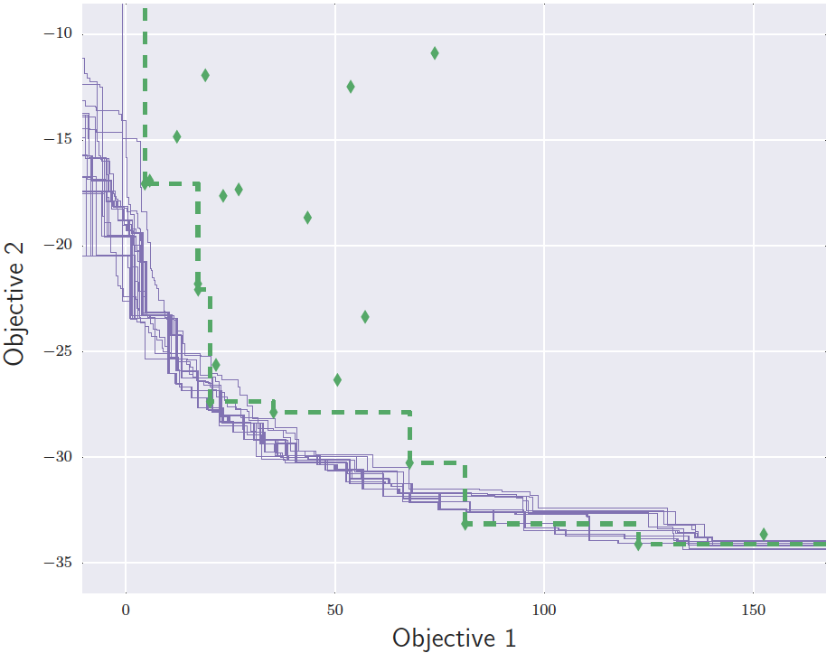
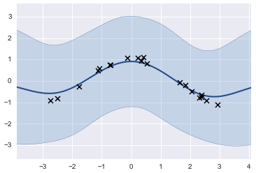
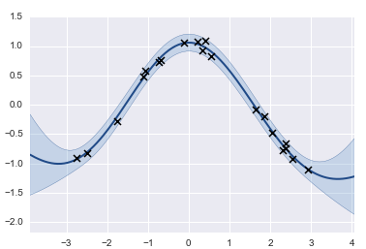
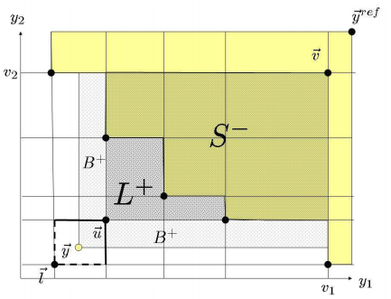
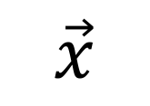
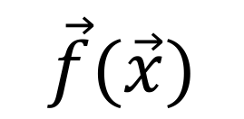
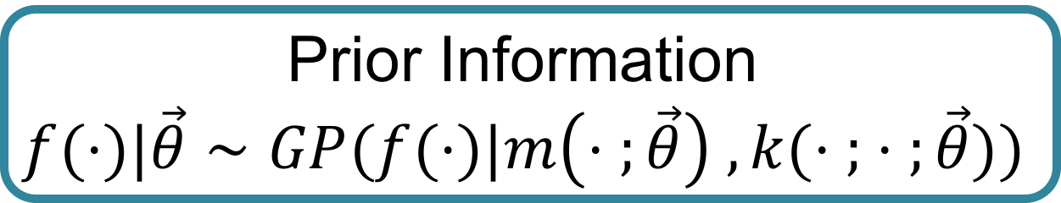

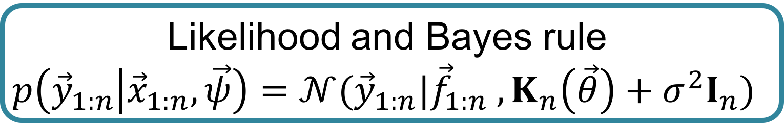
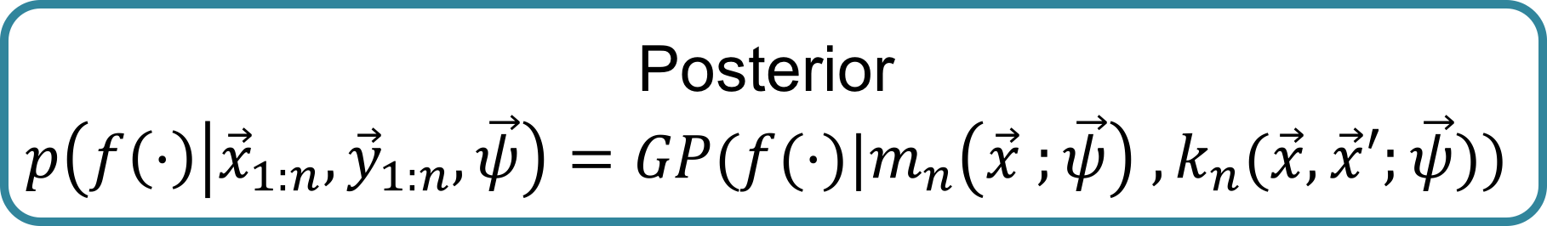
Gaussian Process Regressions for Objective Surrogates in Stochastic Multi-objective Optimization
Juan Sebastian Martinez*, Piyush Pandita†,Rohit Tripathy†, Ilias Bilionis†
*Department of Electric and Electronic Engineering, University of Los Andes, Bogota DC, Bogota, 111711, Colombia
†Department of Mechanical Engineering, Purdue University, West Lafayette, Indiana, IN 47907, USA
Abstract: Global optimization of expensive, multi-modal and noisy multi-objective functions is a common problem that comes up frequently in various areas of computational and experimental research. Along with being expensive to evaluate and noisy, we are also particularly interested in cases where the objective function under consideration is a black box and does not provide gradient information of the quantity of interest (QoI) with reference to the inputs. Because of the high cost of every single evaluation of such objective functions, we can only obtain a limited number of evaluations. This necessarily induces epistemic uncertainty (lack of knowledge due to limited data) on our problem. The Bayesian approach provides a natural framework to tackle this problem, building Gaussian process surrogates that model the objective functions and allow a sequential optimization process. The method applies the expected improvement (EI) information acquisition function in each iteration to perform an efficient global optimization (EGO) and discover the Pareto front of the problem, which contains the set of optimal solutions of the objectives. We implemented this method in a NanoHUB tool and tested it with synthetic examples and real observations of an expensive experiment, where it proved to be efficient in finding the corresponding set of optimal solutions for each problem. This methodology demonstrates how the efficiency of the Bayesian approach for handling epistemic uncertainty in multi-objective optimization problems, dealing with limited observations and avoiding a high amount of evaluations of time-consuming codes or expensive experiments.
The Problem…
The Methods…
Our Results...
Optimization is a widely studied and applied area in science and engineering. Unfortunately, real life optimization problems in science and engineering share similar issues:
Multiple objectives
Limited observations
Expensive experiments or evaluations of computer code
Black box systems
Noise in observations
Epistemic uncertainty
Initial observations
Train GP surrogates
Project observations
Compute expected improvement
Add new observation
Propose a design
General methodology
Gaussian process regressions to build objective surrogates:
A Gaussian process (GP) is a collection of random variables, any finite number of which have a joint Gaussian distribution (Seeger-2004)
SMOOT (Stochastic Multi-Objective Optimization Tool)
Prior Information
$$f(⋅)|\vec{θ}∼GP(f(⋅)|m\left(⋅ ;\vec{θ}\right) , k(⋅ ; ⋅ ;\vec{θ}))$$
Likelihood and Bayes rule
$$p\left({\vec{y}}_{1:n} | {\vec{x}}_{1:n},\vec{ψ}\right)=𝒩({\vec{y}}_{1:n}|{\vec{f}}_{1:n} , K_{n}\left(\vec{θ}\right)+σ^{2}I_{n})$$
A synthetic 2-dimensional problem was tested:
?
$$\vec{x}$$
$$\vec{f}(\vec{x})$$
Data Observations
$${\vec{x}}_{1:n} ; {\vec{y}}_{1:n}$$
Posterior
$$p\left(f\left(⋅\right) | {\vec{x}}_{1:n},{\vec{y}}_{1:n},\vec{ψ}\right)=GP(f(⋅)|m_{n}\left(\vec{x} ;\vec{ψ}\right) , k_{n}(\vec{x},\vec{x}′;\vec{ψ}))$$
Black box system
Different approaches have been taken through evolutionary algorithms:
Large amount of observations required
Uncertainty is not considered
At the end...
Our goal…
A Gaussian process regression
The expected improvement defines a metric to determine the contribution of a point to improving the set of optimal solutions.
References
[1] M. Seeger, Gaussian processes for machine learning. , vol. 14. 2004.
[2] Emmerich, Michael, and Jan-willem Klinkenberg. "The computation of the expected improvement in dominated hypervolume of Pareto front approximations." Rapport technique, Leiden University (2008).
Computing the expected improvement [2]
Pareto Front

