Slide 1





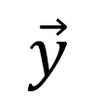
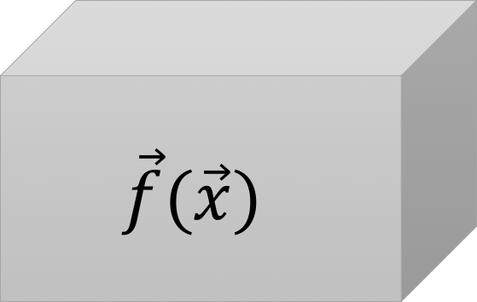
$$x_{1}$$
$$\vec{f}(\vec{x})$$
$$y_{1}$$
$$\vec{x}$$
$$\vec{y}$$
$$x_{n}$$
$$y_{n}$$

Slide 2
Observed Inputs
Number of Iterations
Observed Outputs
Design & Bounds

Slide 3
New observations
Optimization Process
Initial Inputs
Simulation
Proposed experiments

Slide 4
New observations
Optimization Process
Initial Inputs
Simulation
Proposed experiments

Slide 5
New observations
Optimization Process
Initial Inputs
Simulation
Proposed experiments

Slide 6
SMOOT
No Pareto front generated for this iteration, run the proposed experiment
New Observed Value:

