Slide 1
Lecture 7:
Working with NumPy Arrays
SCIF10002 – Introduction to Coding and Data
James S Martin
12th November 2026
Slide 0/14

Slide 2
Today’s Lecture
Lecture 7: Working with NumPy Arrays
  Array indexing and slicing
  Boolean indexing
  Array generation functions
  Random data generation
  Practical
Lecture 8: Plotting with Matplotlib
  Figures and axes
  Annotating and adding features
  Types of plot
  Anatomy of a plot
  Practical
Slide 1/14

Slide 3
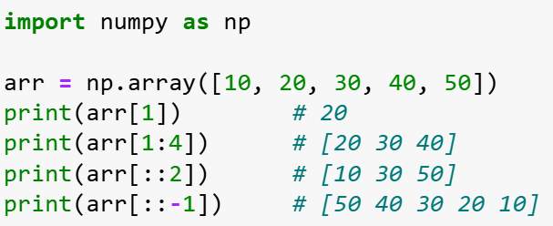

Array Indexing and Slicing
Slide 2/13

Slide 4
Array Indexing and Slicing
We can access array elements using integer indices and slicing:
  Single element: arr[1] gets element at position 1
Slide 2/13

Slide 5
Array Indexing and Slicing
We can access array elements using integer indices and slicing:
  Single element: arr[1] gets element at position 1
Slide 2/13

Slide 6
Array Indexing and Slicing
We can access array elements using integer indices and slicing:
  Single element: arr[1] gets element at position 1
  Slice range: arr[1:4] extracts elements 1 to 3 (end exclusive)
Slide 2/13

Slide 7
Array Indexing and Slicing
We can access array elements using integer indices and slicing:
  Single element: arr[1] gets element at position 1
  Slice range: arr[1:4] extracts elements 1 to 3 (end exclusive)
Slide 2/13

Slide 8
Array Indexing and Slicing
We can access array elements using integer indices and slicing:
  Single element: arr[1] gets element at position 1
  Slice range: arr[1:4] extracts elements 1 to 3 (end exclusive)
  Step size: arr[::2] takes every 2nd element
Slide 2/13

Slide 9
Array Indexing and Slicing
We can access array elements using integer indices and slicing:
  Single element: arr[1] gets element at position 1
  Slice range: arr[1:4] extracts elements 1 to 3 (end exclusive)
  Step size: arr[::2] takes every 2nd element
  Reverse: arr[::-1] reverses the entire array
Slide 2/13

Slide 10
Array Indexing and Slicing
We can access array elements using integer indices and slicing:
  Single element: arr[1] gets element at position 1
  Slice range: arr[1:4] extracts elements 1 to 3 (end exclusive)
  Step size: arr[::2] takes every 2nd element
  Reverse: arr[::-1] reverses the entire array
Taking a step size of 1, but backwards!
Slide 2/13

Slide 11
Array Indexing and Slicing
We can access array elements using integer indices and slicing:
  Single element: arr[1] gets element at position 1
  Slice range: arr[1:4] extracts elements 1 to 3 (end exclusive)
  Step size: arr[::2] takes every 2nd element
  Reverse: arr[::-1] reverses the entire array
  General syntax: arr[a:b:c] start at a, end at b, and take steps of size c
Slide 2/13

Slide 12
Views vs Copies
Important memory concept:
  Slicing creates views that share the same underlying data
  Modifying a view changes the original array
Slide 3/13

Slide 13
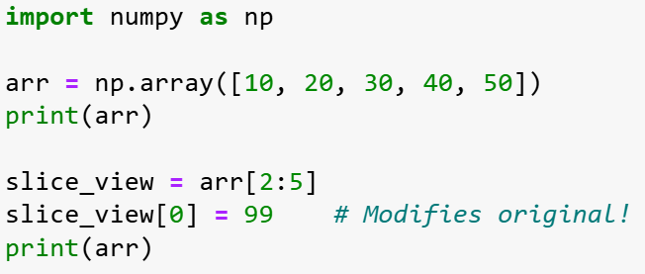
Views vs Copies
View
Important memory concept:
  Slicing creates views that share the same underlying data
  Modifying a view changes the original array
Slide 3/13

Slide 14
Views vs Copies
View
Important memory concept:
  Slicing creates views that share the same underlying data
  Modifying a view changes the original array
Slide 3/13

Slide 15
Views vs Copies
View
Important memory concept:
  Slicing creates views that share the same underlying data
  Modifying a view changes the original array
Slide 3/13

Slide 16
Views vs Copies
View
Important memory concept:
  Slicing creates views that share the same underlying data
  Modifying a view changes the original array
Slide 3/13

Slide 17

Views vs Copies
View
Important memory concept:
  Slicing creates views that share the same underlying data
  Modifying a view changes the original array
Slide 3/13

Slide 18
Views vs Copies
View
Important memory concept:
  Slicing creates views that share the same underlying data
  Modifying a view changes the original array
Modifying slice_view changes arr!
Slide 3/13

Slide 19
Views vs Copies
View
Important memory concept:
  Slicing creates views that share the same underlying data
  Modifying a view changes the original array
  Use .copy() to create independent arrays when needed
Slide 3/13

Slide 20
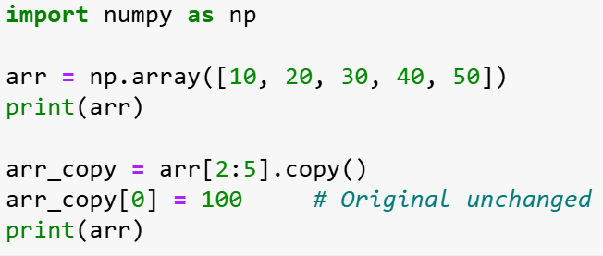
Views vs Copies
View
Important memory concept:
  Slicing creates views that share the same underlying data
  Modifying a view changes the original array
  Use .copy() to create independent arrays when needed
Copy
Slide 3/13

Slide 21
Views vs Copies
View
Important memory concept:
  Slicing creates views that share the same underlying data
  Modifying a view changes the original array
  Use .copy() to create independent arrays when needed
Copy
Slide 3/13

Slide 22
Views vs Copies
View
Important memory concept:
  Slicing creates views that share the same underlying data
  Modifying a view changes the original array
  Use .copy() to create independent arrays when needed
Copy
Slide 3/13

Slide 23
Views vs Copies
View
Important memory concept:
  Slicing creates views that share the same underlying data
  Modifying a view changes the original array
  Use .copy() to create independent arrays when needed
Copy
Slide 3/13

Slide 24
Views vs Copies
View
Important memory concept:
  Slicing creates views that share the same underlying data
  Modifying a view changes the original array
  Use .copy() to create independent arrays when needed
Copy
Slide 3/13

Slide 25

Views vs Copies
View
Important memory concept:
  Slicing creates views that share the same underlying data
  Modifying a view changes the original array
  Use .copy() to create independent arrays when needed
Copy
Slide 3/13

Slide 26
Views vs Copies
View
Important memory concept:
  Slicing creates views that share the same underlying data
  Modifying a view changes the original array
  Use .copy() to create independent arrays when needed
Copy
Modifying arr_copy does not change arr!
Slide 3/13

Slide 27
Views vs Copies
View
Important memory concept:
  Slicing creates views that share the same underlying data
  Modifying a view changes the original array
  Use .copy() to create independent arrays when needed
  This behaviour is efficient but can cause unexpected side effects!
Copy
Slide 3/13

Slide 28
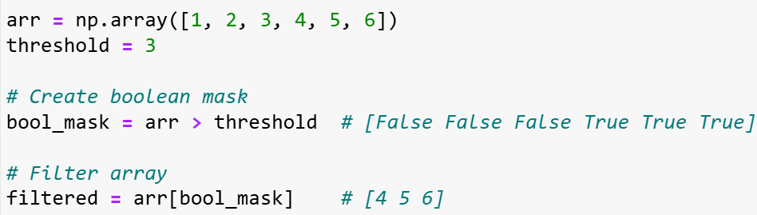
Boolean Indexing
Slide 4/13

Slide 29
Boolean Indexing
We’ve seen that we can access elements of an array using integer indices
(e.g. arr[1])
We can also access array entries using Booleans!
(e.g. arr[False, True, False, False, False, False])
Boolean indexing allows data filtering based on conditions
Slide 4/13

Slide 30
Boolean Indexing
We’ve seen that we can access elements of an array using integer indices
(e.g. arr[1])
We can also access array entries using Booleans!
(e.g. arr[False, True, False, False, False, False])
Boolean indexing allows data filtering based on conditions
Let’s see how this is usually done…
  Step 1: Apply a condition to create
  a boolean mask (True/False array)
Slide 4/13

Slide 31
Boolean Indexing
We’ve seen that we can access elements of an array using integer indices
(e.g. arr[1])
We can also access array entries using Booleans!
(e.g. arr[False, True, False, False, False, False])
Boolean indexing allows data filtering based on conditions
Let’s see how this is usually done…
  Step 1: Apply a condition to create
  a boolean mask (True/False array)
Slide 4/13

Slide 32
Boolean Indexing
We’ve seen that we can access elements of an array using integer indices
(e.g. arr[1])
We can also access array entries using Booleans!
(e.g. arr[False, True, False, False, False, False])
Boolean indexing allows data filtering based on conditions
Let’s see how this is usually done…
  Step 1: Apply a condition to create
  a boolean mask (True/False array)
Slide 4/13

Slide 33
Boolean Indexing
We’ve seen that we can access elements of an array using integer indices
(e.g. arr[1])
We can also access array entries using Booleans!
(e.g. arr[False, True, False, False, False, False])
Boolean indexing allows data filtering based on conditions
Let’s see how this is usually done…
  Step 1: Apply a condition to create
  a boolean mask (True/False array)
  Step 2: Use the mask to select only
  elements that meet the condition
Slide 4/13

Slide 34
Boolean Indexing
We’ve seen that we can access elements of an array using integer indices
(e.g. arr[1])
We can also access array entries using Booleans!
(e.g. arr[False, True, False, False, False, False])
Boolean indexing allows data filtering based on conditions
Let’s see how this is usually done…
  Step 1: Apply a condition to create
  a boolean mask (True/False array)
  Step 2: Use the mask to select only
  elements that meet the condition
Slide 4/13

Slide 35
Boolean Indexing
We’ve seen that we can access elements of an array using integer indices
(e.g. arr[1])
We can also access array entries using Booleans!
(e.g. arr[False, True, False, False, False, False])
Boolean indexing allows data filtering based on conditions
Let’s see how this is usually done…
  Step 1: Apply a condition to create
  a boolean mask (True/False array)
  Step 2: Use the mask to select only
  elements that meet the condition
Slide 4/13

Slide 36
The np.where function
Slide 5/13

Slide 37
The np.where function
Advanced conditional operations:
  np.where(condition) returns the indices where a condition is True
Slide 5/13

Slide 38
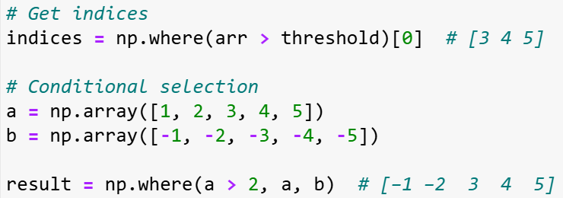

The np.where function
Advanced conditional operations:
  np.where(condition) returns the indices where a condition is True
Slide 5/13

Slide 39
The np.where function
Advanced conditional operations:
  np.where(condition) returns the indices where a condition is True
  np.where(condition, x, y) creates a new array
  This array elements from x where condition is True, from y where False
Slide 5/13

Slide 40
The np.where function
Advanced conditional operations:
  np.where(condition) returns the indices where a condition is True
  np.where(condition, x, y) creates a new array
  This array elements from x where condition is True, from y where False
Slide 5/13

Slide 41
The np.where function
Advanced conditional operations:
  np.where(condition) returns the indices where a condition is True
  np.where(condition, x, y) creates a new array
  This array elements from x where condition is True, from y where False
  Powerful for element-wise conditional logic without loops
Slide 5/13

Slide 42
Array Generation: Sequences
Slide 6/13

Slide 43
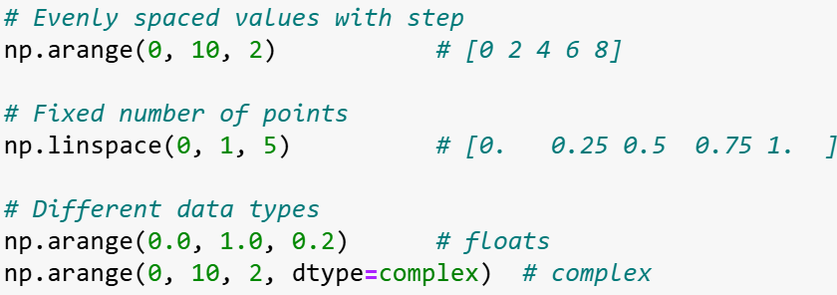
Array Generation: Sequences
Creating ordered numerical sequences:
  np.arange(start, stop, step)
  np.linspace(start, stop, num)
Slide 6/13

Slide 44
Array Generation: Sequences
Creating ordered numerical sequences:
  np.arange(start, stop, step)- like Python's range() but for arrays
  np.linspace(start, stop, num)
Slide 6/13

Slide 45
Array Generation: Sequences
Creating ordered numerical sequences:
  np.arange(start, stop, step)- like Python's range() but for arrays
  np.linspace(start, stop, num)
Slide 6/13

Slide 46
Array Generation: Sequences
Creating ordered numerical sequences:
  np.arange(start, stop, step)- like Python's range() but for arrays
  np.linspace(start, stop, num)- exactly num evenly spaced points
Slide 6/13

Slide 47
Array Generation: Sequences
Creating ordered numerical sequences:
  np.arange(start, stop, step)- like Python's range() but for arrays
  np.linspace(start, stop, num)- exactly num evenly spaced points
Slide 6/13

Slide 48
Array Generation: Sequences
Creating ordered numerical sequences:
  np.arange(start, stop, step)- like Python's range() but for arrays
  np.linspace(start, stop, num)- exactly num evenly spaced points
  Choose arange when you know the step size
Slide 6/13

Slide 49
Array Generation: Sequences
Creating ordered numerical sequences:
  np.arange(start, stop, step)- like Python's range() but for arrays
  np.linspace(start, stop, num)- exactly num evenly spaced points
  Choose arange when you know the step size, linspace when you know the number of points
Slide 6/13

Slide 50
Array Generation: Sequences
Creating ordered numerical sequences:
  np.arange(start, stop, step)- like Python's range() but for arrays
  np.linspace(start, stop, num)- exactly num evenly spaced points
  Choose arange when you know the step size, linspace when you know the number of points
Slide 6/13

Slide 51
Array Generation: Filled Arrays
Slide 7/13

Slide 52
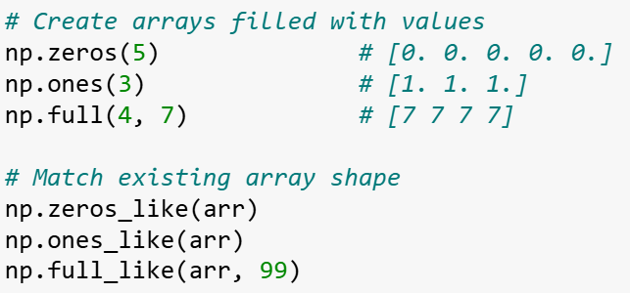

Array Generation: Filled Arrays
Functions to initialize arrays with specific values
Useful for creating placeholders before computations or initializing data structures.
Slide 7/13

Slide 53
Array Generation: Filled Arrays
Functions to initialize arrays with specific values
Useful for creating placeholders before computations or initializing data structures.
  np.zeros(): array of zeros
  np.ones(): array of ones
  np.full(): fill an array with a specific value
Slide 7/13

Slide 54
Array Generation: Filled Arrays
Functions to initialize arrays with specific values
Useful for creating placeholders before computations or initializing data structures.
  np.zeros(): array of zeros
  np.ones(): array of ones
  np.full(): fill an array with a specific value
  np.*_like(): functions preserve shape and data type of existing arrays
Slide 7/13

Slide 55

Array Generation: Filled Arrays
Functions to initialize arrays with specific values
Useful for creating placeholders before computations or initializing data structures.
  np.zeros(): array of zeros
  np.ones(): array of ones
  np.full(): fill an array with a specific value
  np.*_like(): functions preserve shape and data type of existing arrays
  np.empty(): fastest but contains arbitrary values
Slide 7/13

Slide 56
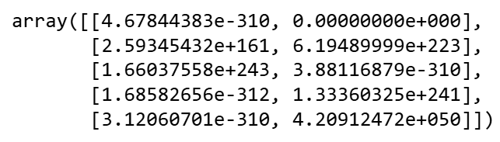
Array Generation: Filled Arrays
Functions to initialize arrays with specific values
Useful for creating placeholders before computations or initializing data structures.
  np.zeros(): array of zeros
  np.ones(): array of ones
  np.full(): fill an array with a specific value
  np.*_like(): functions preserve shape and data type of existing arrays
  np.empty(): fastest but contains arbitrary values
These arbitrary values are not meaningfully random
Slide 7/13

Slide 57
Random Data Generation
Slide 8/13

Slide 58
Random Data Generation
Pseudo-random Numbers
  Often when coding you might want to generate a random number.
Slide 8/13

Slide 59

Random Data Generation
Pseudo-random Numbers
  Often when coding you might want to generate a random number.
If you did the week 5 data science challenge, think of the robot!
Slide 8/13

Slide 60
Random Data Generation
Pseudo-random Numbers
  Often when coding you might want to generate a random number.
  Computers are deterministic machines
  (same input → same output)
Slide 8/13

Slide 61

Random Data Generation
Pseudo-random Numbers
  Often when coding you might want to generate a random number.
  Computers are deterministic machines
  (same input → same output)
  Pseudo-Random Number Generators (PRNGs) use mathematical algorithms to make sequences of numbers that ‘look’ random enough
Slide 8/13

Slide 62
Random Data Generation
Pseudo-random Numbers
  Often when coding you might want to generate a random number.
  Computers are deterministic machines
  (same input → same output)
  Pseudo-Random Number Generators (PRNGs) use mathematical algorithms to make sequences of numbers that ‘look’ random enough
  The “seed” value determines the starting point of the sequence
  Same seed = same sequence (crucial for reproducible research!)
Slide 8/13

Slide 63
Random Data Generation
Slide 9/13

Slide 64
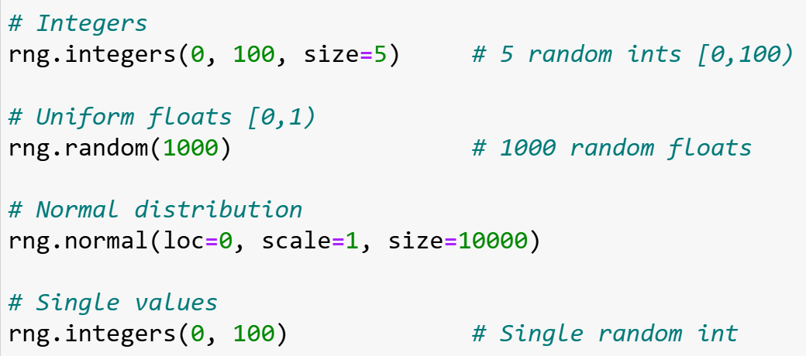
Random Data Generation
Numpy offers many tools to generate samples from different distributions
You can generate:
Slide 9/13

Slide 65
Random Data Generation
Numpy offers many tools to generate samples from different distributions
You can generate:
  Uniform random integers from {1,…, k}
  using rng.integers
Slide 9/13

Slide 66
Random Data Generation
Numpy offers many tools to generate samples from different distributions
You can generate:
  Uniform random integers from {1,…, k}
  using rng.integers
  Uniform random floats from [0,1) or a
  custom range using rng.random
Slide 9/13

Slide 67
Random Data Generation
Numpy offers many tools to generate samples from different distributions
You can generate:
  Uniform random integers from {1,…, k}
  using rng.integers
  Uniform random floats from [0,1) or a
  custom range using rng.random
  Gaussian distributed floats with specified
  mean and standard deviation
  using rng.normal
Slide 9/13

Slide 68
Random Data Generation
Numpy offers many tools to generate samples from different distributions
You can generate:
  Uniform random integers from {1,…, k}
  using rng.integers
  Uniform random floats from [0,1) or a
  custom range using rng.random
  Gaussian distributed floats with specified
  mean and standard deviation
  using rng.normal
  And many more… (see documentation)
Slide 9/13

Slide 69
Random Data Generation
Numpy offers many tools to generate samples from different distributions
You can generate:
  Uniform random integers from {1,…, k}
  using rng.integers
  Uniform random floats from [0,1) or a
  custom range using rng.random
  Gaussian distributed floats with specified
  mean and standard deviation
  using rng.normal
  And many more… (see documentation)
Slide 9/13

Slide 70
Performance Tip
Memory vs. Speed Trade-off:
  Generating random numbers one-by-one in loops is slow due to function call overhead.
Slide 10/13

Slide 71
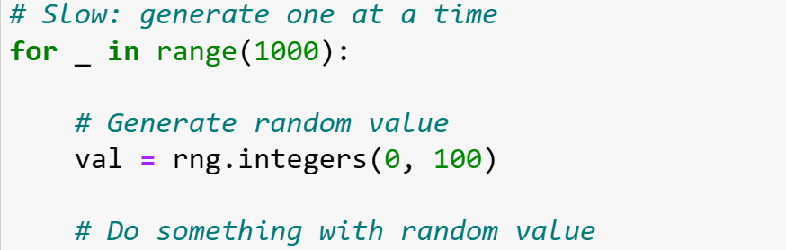
Performance Tip
Memory vs. Speed Trade-off:
  Generating random numbers one-by-one in loops is slow due to function call overhead.
Slide 10/13

Slide 72
Performance Tip
Memory vs. Speed Trade-off:
  Generating random numbers one-by-one in loops is slow due to function call overhead.
  Pre-allocating larger arrays is much faster!
Slide 10/13

Slide 73
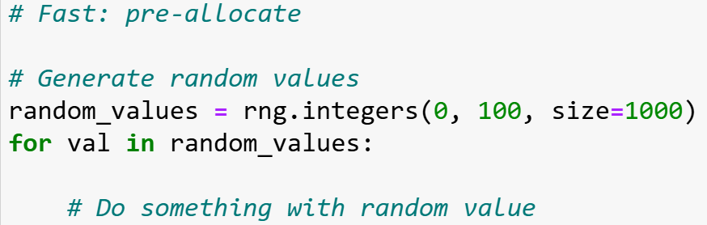
Performance Tip
Memory vs. Speed Trade-off:
  Generating random numbers one-by-one in loops is slow due to function call overhead.
  Pre-allocating larger arrays is much faster!
Slide 10/13

Slide 74
Performance Tip
Memory vs. Speed Trade-off:
  Generating random numbers one-by-one in loops is slow due to function call overhead.
  Pre-allocating larger arrays is much faster!
  I.e. if you think you will need to save a large quantity of values, plan ahead!
Slide 10/13

Slide 75
Summary
Indexing: Integer, slicing, Boolean
Slide 11/13

Slide 76
Summary
Indexing: Integer, slicing, Boolean
Views vs Copies: Slicing creates views
Slide 11/13

Slide 77
Summary
Indexing: Integer, slicing, Boolean
Views vs Copies: Slicing creates views
Slide 11/13

Slide 78
Summary
Indexing: Integer, slicing, Boolean
Views vs Copies: Slicing creates views
Slide 11/13

Slide 79
Summary
Indexing: Integer, slicing, Boolean
Views vs Copies: Slicing creates views
Generation: arange, linspace, filled arrays
Slide 11/13

Slide 80
Summary
Indexing: Integer, slicing, Boolean
Views vs Copies: Slicing creates views
Generation: arange, linspace, filled arrays
Slide 11/13

Slide 81
Summary
Indexing: Integer, slicing, Boolean
Views vs Copies: Slicing creates views
Generation: arange, linspace, filled arrays
Slide 11/13

Slide 82
Summary
Indexing: Integer, slicing, Boolean
Views vs Copies: Slicing creates views
Generation: arange, linspace, filled arrays
Random: Seed for reproducibility, pre-allocate for speed
Slide 11/13

Slide 83
Summary
Indexing: Integer, slicing, Boolean
Views vs Copies: Slicing creates views
Generation: arange, linspace, filled arrays
Random: Seed for reproducibility, pre-allocate for speed
Slide 11/13

Slide 84
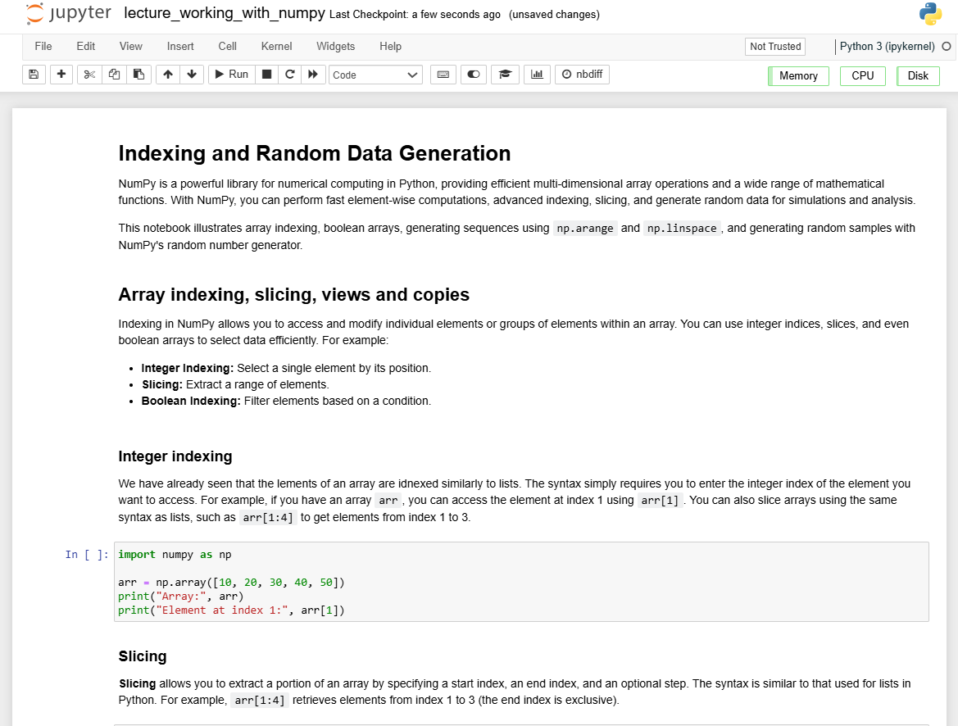
Practical
We now move over to Python
For the rest of today, you should do the following:
Slide 12/13

Slide 85
Practical
We now move over to Python
For the rest of today, you should do the following:
  First, read through:
  lecture_working_with_numpy.ipynb
Slide 12/13

Slide 86
Practical
We now move over to Python
For the rest of today, you should do the following:
  First, read through:
  lecture_working_with_numpy.ipynb
  Then, work through the exercises in:
  exercises_lecture_working_with_numpy.ipynb
Slide 12/13

Slide 87
Practical
We now move over to Python
For the rest of today, you should do the following:
  First, read through:
  lecture_working_with_numpy.ipynb
  Then, work through the exercises in:
  exercises_lecture_working_with_numpy.ipynb
If you finish early, work through intermediate or advanced notebooks from weeks 1-5 that you haven’t yet tried!
Slide 12/13

Slide 88
Practical
We now move over to Python
For the rest of today, you should do the following:
  First, read through:
  lecture_working_with_numpy.ipynb
  Then, work through the exercises in:
  exercises_lecture_working_with_numpy.ipynb
Slide 12/13

Slide 89
Next Time
Lecture 7: Working with NumPy Arrays
  Array Indexing and Slicing
  Boolean Indexing
  Array Generating Functions
  Random Data Generation
  Practical
Lecture 8: Plotting with Matplotlib
  Figures and axes
  Annotating and adding features
  Types of plot
  Anatomy of a plot
  Practical
Slide 13/13

