Slide 1
Lecture 3:
Functions
SCIF10002 – Introduction to Coding and Data
James S Martin
15th October 2026
Slide 0/12

Slide 2
Today’s Lecture
Lecture 4: Functions
  Recap: For and While Loops
  Functions
  Inputs and Outputs
  Practical
Lecture 5: Consolidation Week
  Recap: The course so far
  Recap: Why learn to code
  Tackling Problems: A Worked Example
  What’s next
  Practical
Slide 1/12

Slide 3
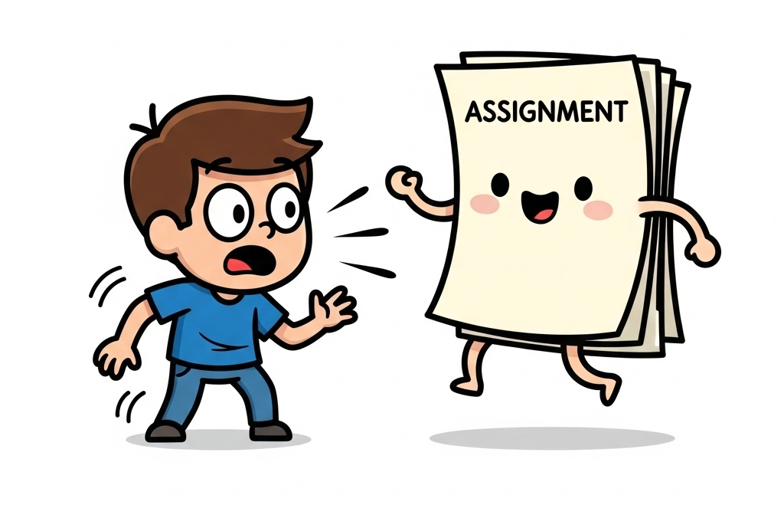
Important: Assessed Coursework 1
Slide 2/12

Slide 4
Important: Assessed Coursework 1
The first assignment has been released!
  Released Wednesday 7th October at 12:00PM
  Due Wednesday 21st October at 12:00PM
Slide 2/12

Slide 5
Important: Assessed Coursework 1
The first assignment has been released!
  Released Wednesday 7th October at 12:00PM
  Due Wednesday 21st October at 12:00PM
This is assessed (15% of your grade!)
Submission is via Noteable
You can submit as many times as you like up until the submission date
Slide 2/12

Slide 6
Noteable Submission
Slide 3/12

Slide 7
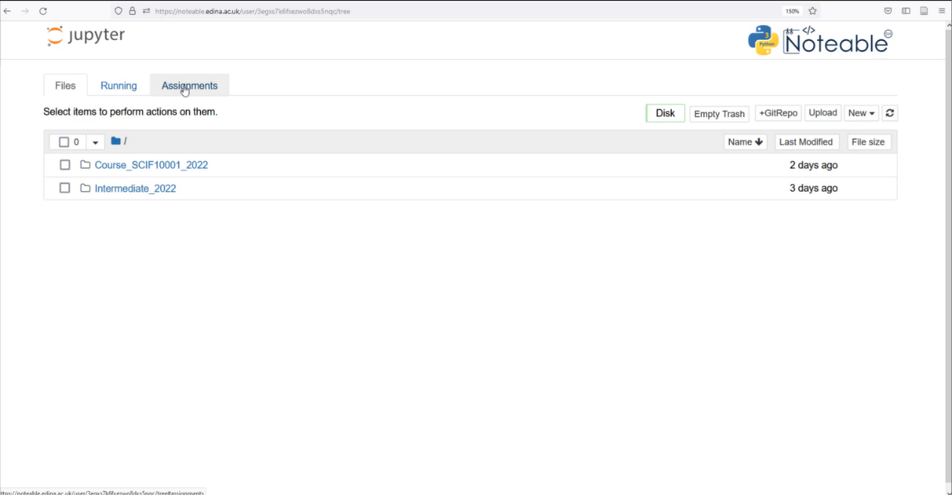
Noteable Submission
Download using the Assignments tab on noteable
Slide 3/12

Slide 8
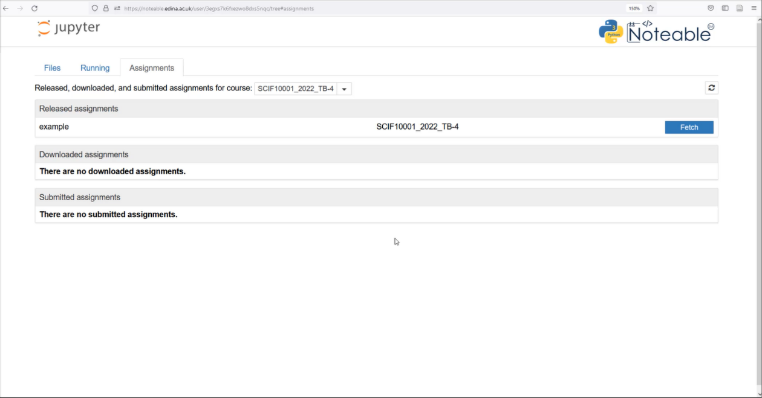
Noteable Submission
Download using the Assignments tab on noteable
Press Fetch and click on the assignment
Slide 3/12

Slide 9
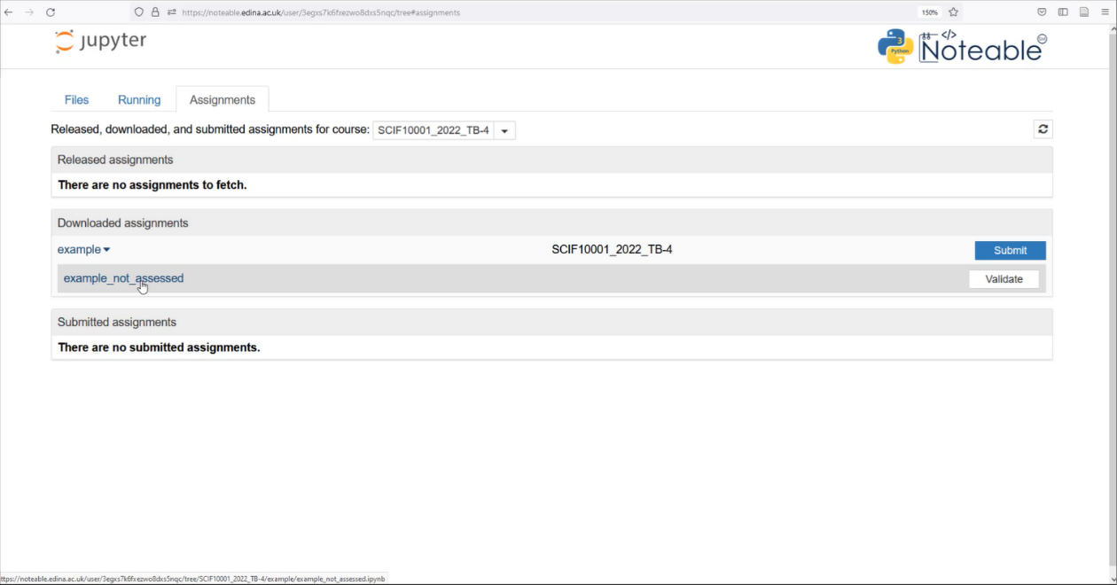
Noteable Submission
Download using the Assignments tab on noteable
Press Fetch and click on the assignment
Slide 3/12

Slide 10
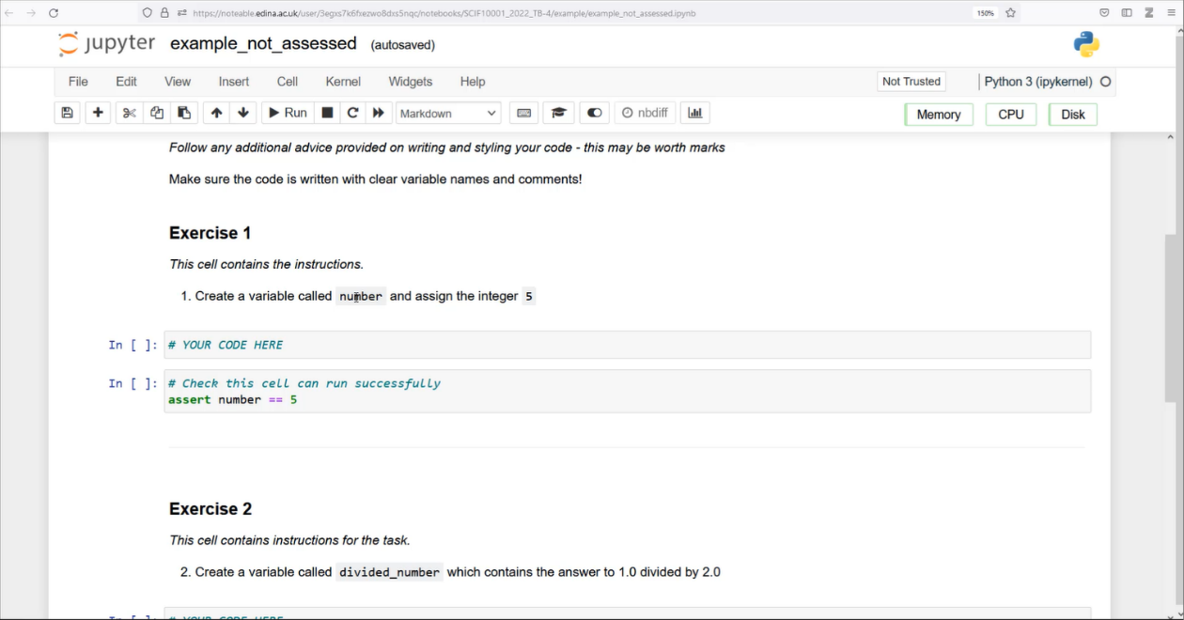
Noteable Submission
Download using the Assignments tab on noteable
Press Fetch and click on the assignment
Fill your answers in and Validate
Slide 3/12

Slide 11
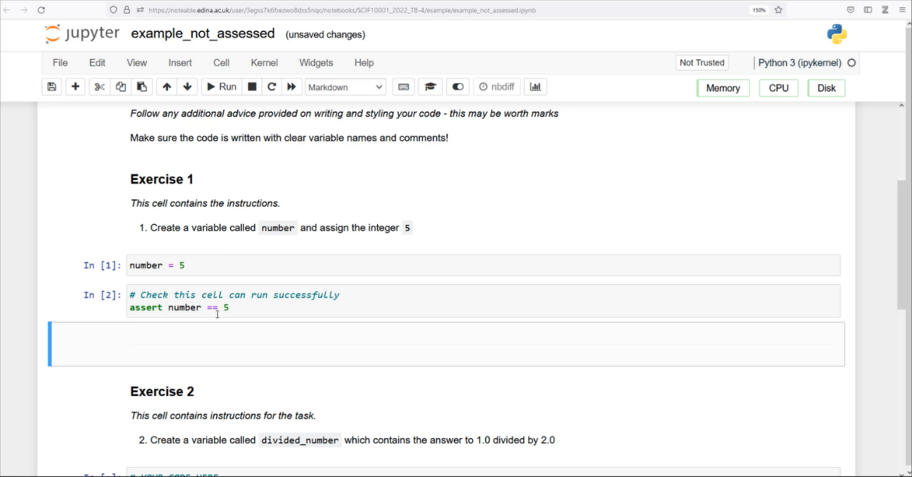
Noteable Submission
Download using the Assignments tab on noteable
Press Fetch and click on the assignment
Fill your answers in and Validate
Slide 3/12

Slide 12
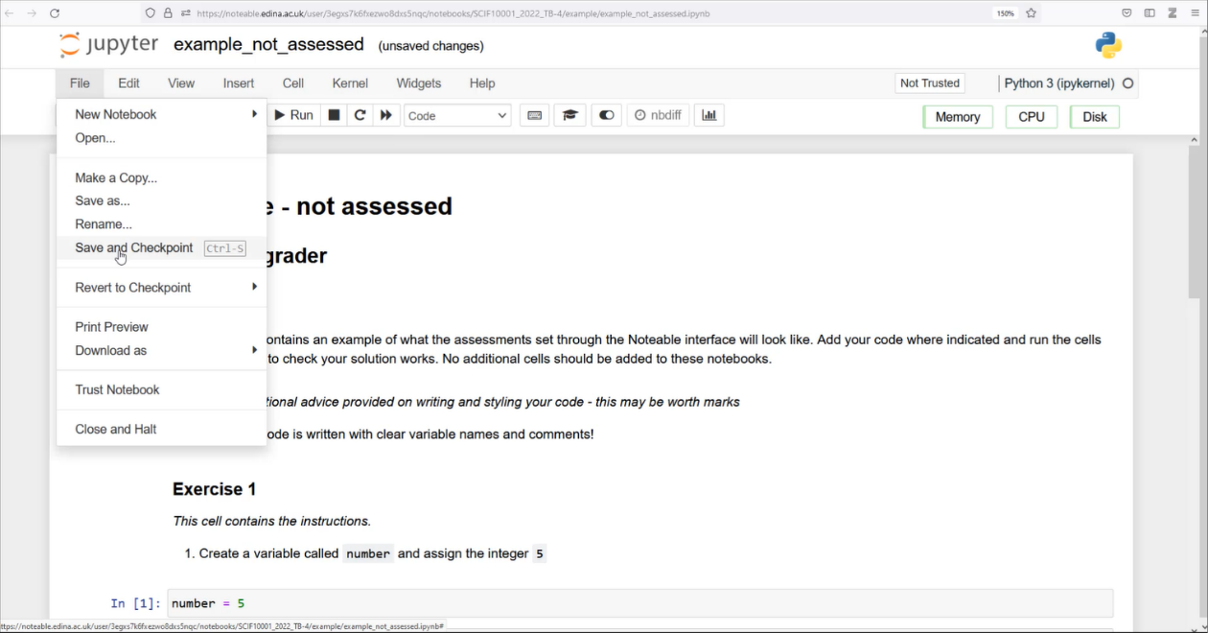
Noteable Submission
Download using the Assignments tab on noteable
Press Fetch and click on the assignment
Fill your answers in and Validate
Slide 3/12

Slide 13
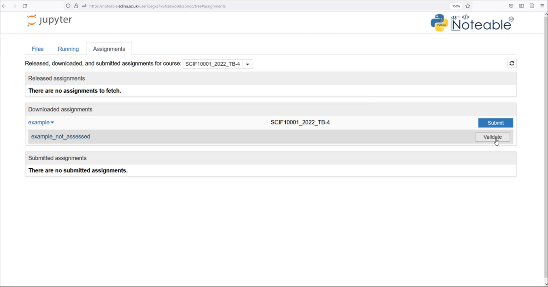
Noteable Submission
Download using the Assignments tab on noteable
Press Fetch and click on the assignment
Fill your answers in and Validate
Slide 3/12

Slide 14
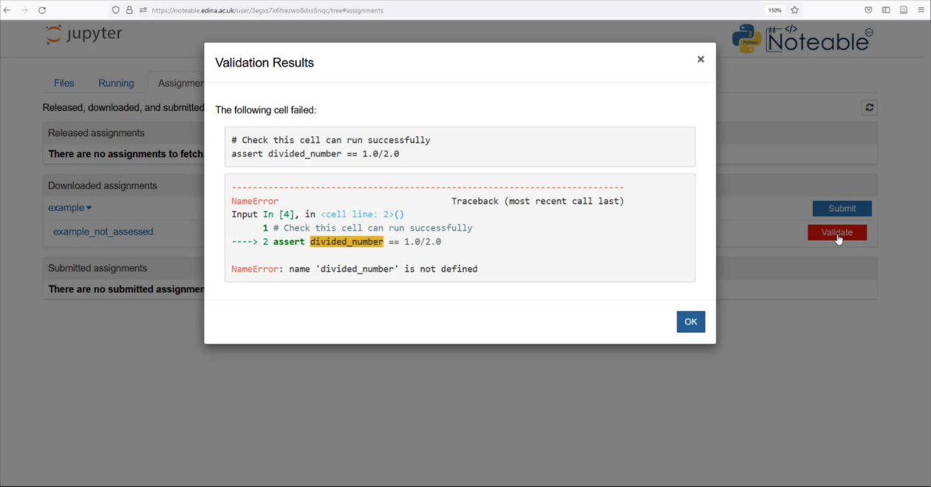
Noteable Submission
Download using the Assignments tab on noteable
Press Fetch and click on the assignment
Fill your answers in and Validate
Slide 3/12

Slide 15
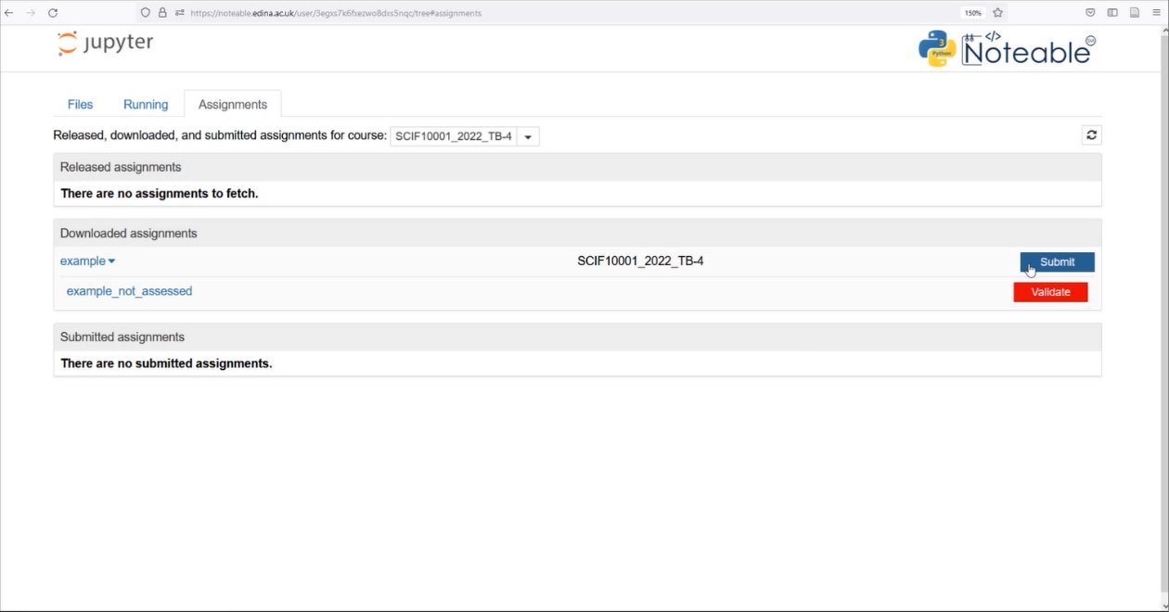
Noteable Submission
Download using the Assignments tab on noteable
Press Fetch and click on the assignment
Fill your answers in and Validate
Once done, save your answers and Submit
Slide 3/12

Slide 16
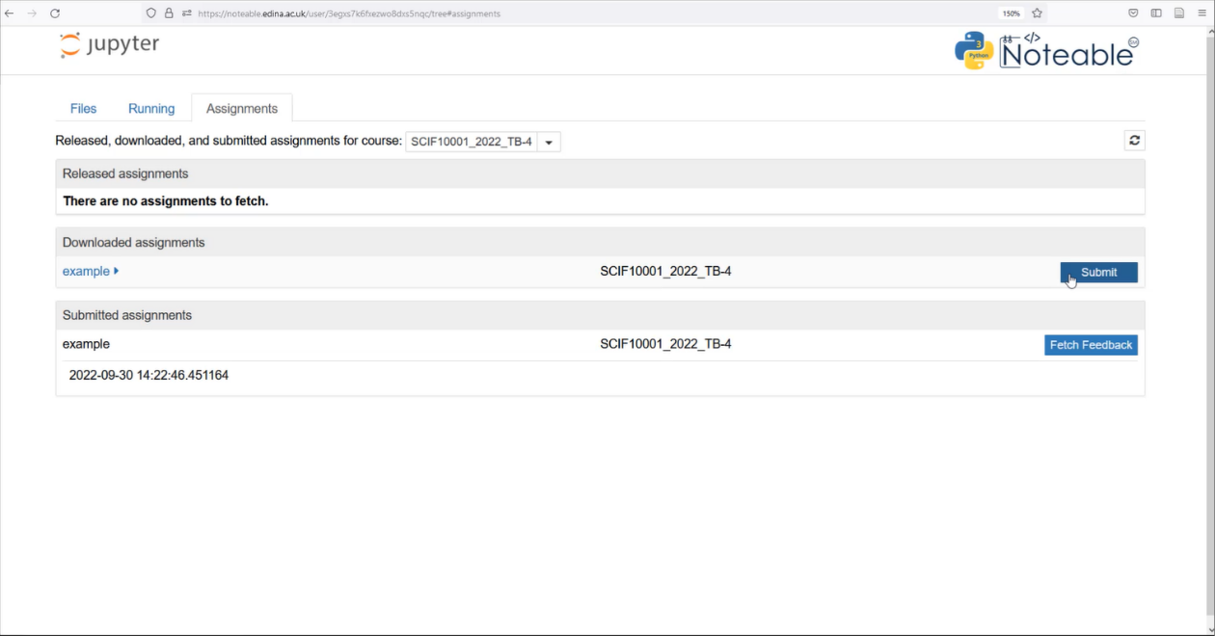
Noteable Submission
Download using the Assignments tab on noteable
Press Fetch and click on the assignment
Fill your answers in and Validate
Once done, save your answers and Submit
Slide 3/12

Slide 17
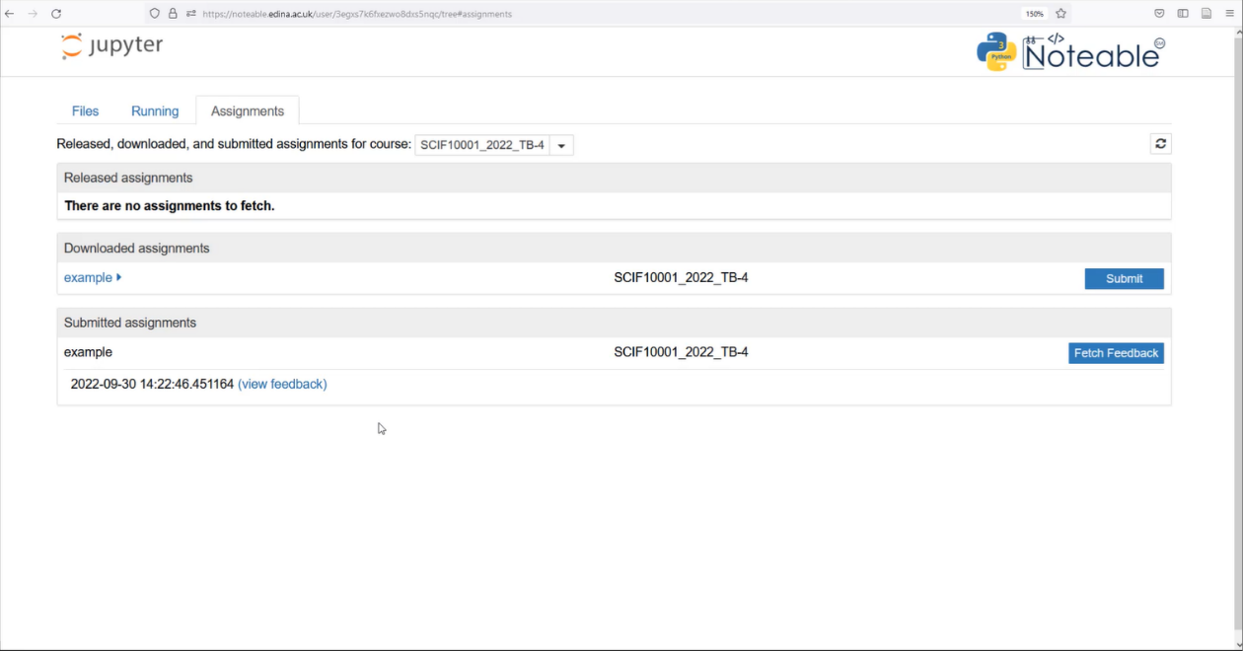
Noteable Submission
Download using the Assignments tab on noteable
Press Fetch and click on the assignment
Fill your answers in and Validate
Once done, save your answers and Submit
Feedback will be available when you see the (view feedback) option
Slide 3/12

Slide 18
Recap: For and While Loops
Slide 4/12

Slide 19

Recap: For and While Loops
Loops can be used to simplify repetitive computation
  Last week, we saw an example where we wanted to print the square of each item in this list
Slide 4/12

Slide 20
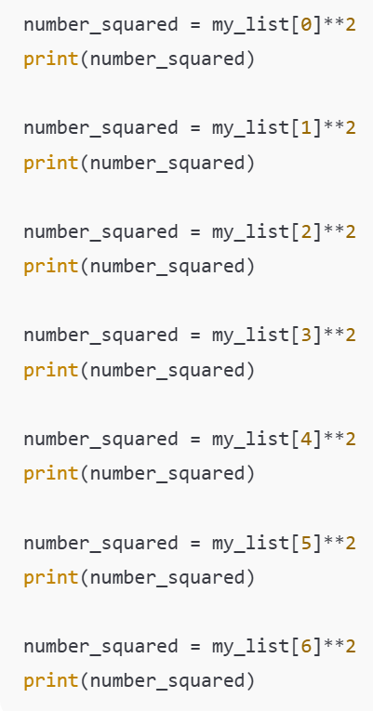
Recap: For and While Loops
Loops can be used to simplify repetitive computation
  Last week, we saw an example where we wanted to print the square of each item in this list
Instead of writing something like this…
Slide 4/12

Slide 21
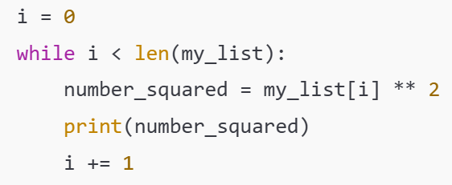
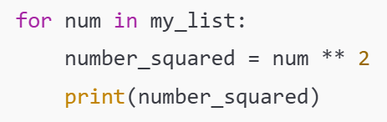
Recap: For and While Loops
Loops can be used to simplify repetitive computation
  Last week, we saw an example where we wanted to print the square of each item in this list
Instead of writing something like this…
Loops let us do all this automatically!
While Loop
For Loop
Slide 4/12

Slide 22
Motivation
Slide 5/12

Slide 23
Motivation
Loops let you simplify code which repeats over and over again.
However, sometimes you have code that repeats itself in a less straightforward manner…
Slide 5/12

Slide 24
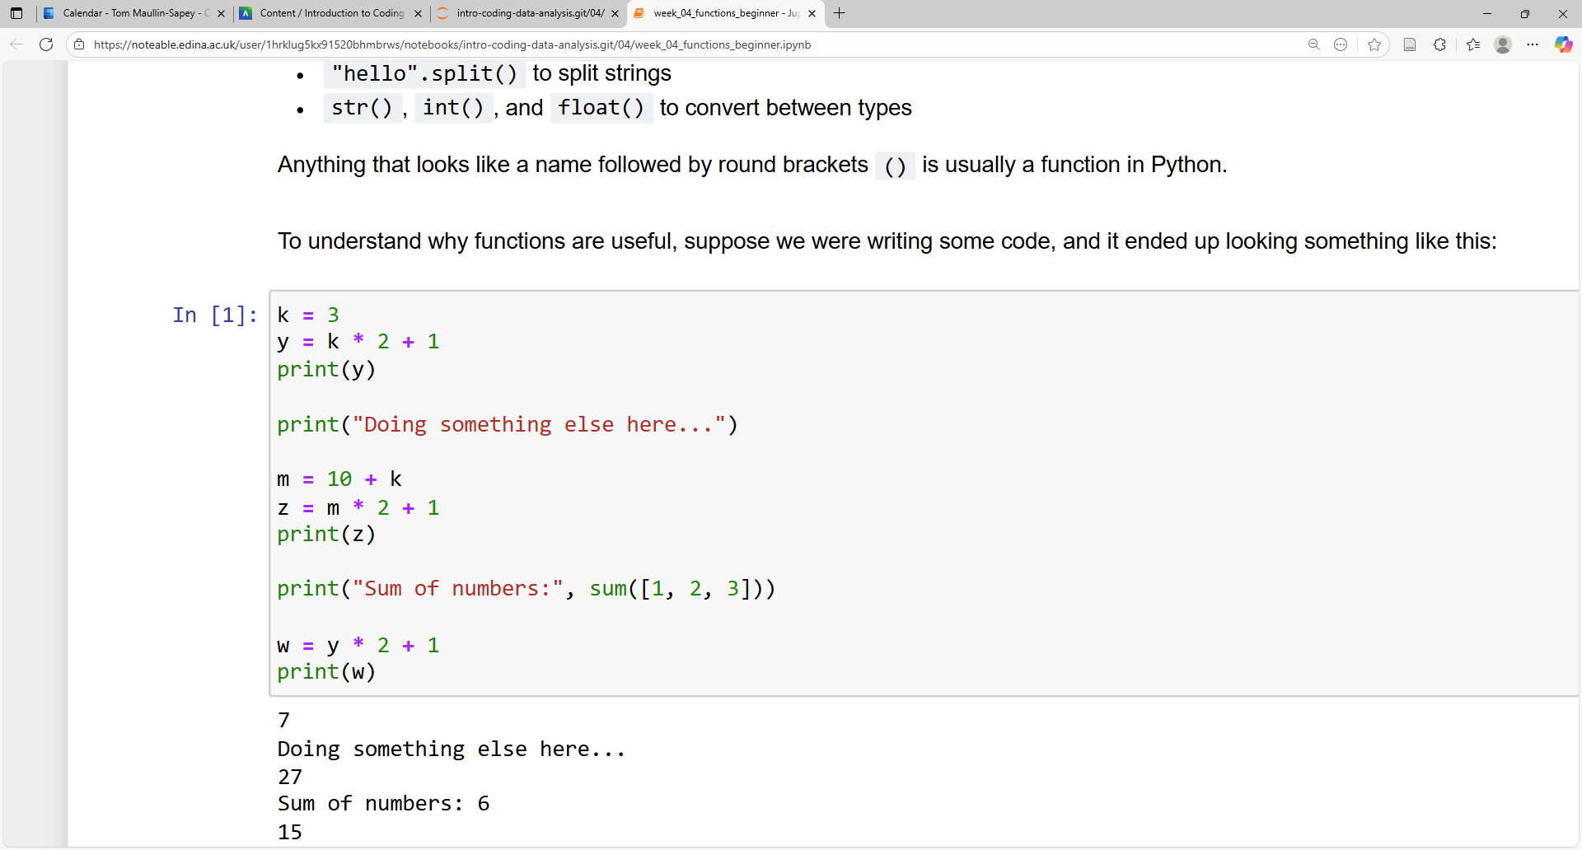
Motivation
Loops let you simplify code which repeats over and over again.
However, sometimes you have code that repeats itself in a less straightforward manner…
Slide 5/12

Slide 25
Motivation
Loops let you simplify code which repeats over and over again.
However, sometimes you have code that repeats itself in a less straightforward manner…
  Do some computation
Slide 5/12

Slide 26
Motivation
Loops let you simplify code which repeats over and over again.
However, sometimes you have code that repeats itself in a less straightforward manner…
  Do some computation
  Do some other stuff
Slide 5/12

Slide 27
Motivation
Loops let you simplify code which repeats over and over again.
However, sometimes you have code that repeats itself in a less straightforward manner…
  Do some computation
  Do some other stuff
  Do the same computation again
Slide 5/12

Slide 28
Motivation
Loops let you simplify code which repeats over and over again.
However, sometimes you have code that repeats itself in a less straightforward manner…
  Do some computation
  Do some other stuff
  Do the same computation again
Slide 5/12

Slide 29
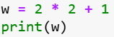
Motivation
Loops let you simplify code which repeats over and over again.
However, sometimes you have code that repeats itself in a less straightforward manner…
  Do some computation
  Do some other stuff
  Do the same computation again
Slide 5/12

Slide 30
Motivation
Loops let you simplify code which repeats over and over again.
However, sometimes you have code that repeats itself in a less straightforward manner…
  Do some computation
  Do some other stuff
  Do the same computation again
This is repetitive…
Slide 5/12

Slide 31
Motivation
Loops let you simplify code which repeats over and over again.
However, sometimes you have code that repeats itself in a less straightforward manner…
  Do some computation
  Do some other stuff
  Do the same computation again
Slide 5/12

Slide 32
Motivation
Loops let you simplify code which repeats over and over again.
However, sometimes you have code that repeats itself in a less straightforward manner…
  Do some computation
  Do some other stuff
  Do the same computation again
But these lines don’t repeat…
Loops aren’t as useful here
Slide 5/12

Slide 33
Motivation
Loops let you simplify code which repeats over and over again.
However, sometimes you have code that repeats itself in a less straightforward manner…
  Do some computation
  Do some other stuff
  Do the same computation again
Slide 5/12

Slide 34
Motivation
Loops let you simplify code which repeats over and over again.
However, sometimes you have code that repeats itself in a less straightforward manner…
  Do some computation
  Do some other stuff
  Do the same computation again
We want a way of doing the same computation whenever we like…
…without repeatedly writing the same code
Slide 5/12

Slide 35
Motivation
Loops let you simplify code which repeats over and over again.
However, sometimes you have code that repeats itself in a less straightforward manner…
  Do some computation
  Do some other stuff
  Do the same computation again
We want a way of doing the same computation whenever we like…
…without repeatedly writing the same code
Slide 5/12

Slide 36
Motivation
Loops let you simplify code which repeats over and over again.
However, sometimes you have code that repeats itself in a less straightforward manner…
  Do some computation
  Do some other stuff
  Do the same computation again
In such cases, you might want to use a Function
You can think of a function as a block of pre-prepared code that you might want to run over and over again.
Slide 5/12

Slide 37
Functions
Let’s look at an example
Slide 6/12

Slide 38
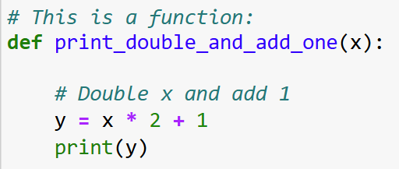
Functions
Let’s look at an example
Slide 6/12

Slide 39
Functions
Let’s look at an example
def keyword
(short for define)
Colon
Slide 6/12

Slide 40
Functions
Let’s look at an example
Name of the function
Slide 6/12

Slide 41
Functions
Let’s look at an example
Input
Slide 6/12

Slide 42
Functions
Let’s look at an example
Body of the function
Slide 6/12

Slide 43
Functions
Let’s look at an example
Indentation
(This tells us what lies inside the function)
Slide 6/12

Slide 44
Functions
Let’s look at an example
Slide 6/12

Slide 45
Functions
Let’s look at an example
You can think of this as a black box
Slide 6/12

Slide 46
Functions
Let’s look at an example
You can think of this as a black box
Function
Slide 6/12

Slide 47
Functions
Let’s look at an example
You can think of this as a black box
- Put a variable x in
Function
x
Slide 6/12

Slide 48
Functions
Let’s look at an example
You can think of this as a black box
- Put a variable x in
- Double x and add 1
Function
x
Slide 6/12

Slide 49
Functions
Let’s look at an example
You can think of this as a black box
- Put a variable x in
- Double x and add 1
- print the result
Function
x
Print x*2 + 1
Slide 6/12

Slide 50
Functions
Let’s look at an example
Function
Slide 6/12

Slide 51

Functions
Let’s look at an example
Suppose we ran this:
Function
Slide 6/12

Slide 52
Functions
Let’s look at an example
Suppose we ran this:
This will run the code inside the function, but with x replaced by k.
Function
Slide 6/12

Slide 53
Functions
Let’s look at an example
Suppose we ran this:
This will run the code inside the function, but with x replaced by k:
Function
Slide 6/12

Slide 54
Functions
Let’s look at an example
Suppose we ran this:
This will run the code inside the function, but with x replaced by k:
y = k * 2 + 1
Function
Slide 6/12

Slide 55
Functions
Let’s look at an example
Suppose we ran this:
This will run the code inside the function, but with x replaced by k:
y = k * 2 + 1
Function
Slide 6/12

Slide 56
Functions
Let’s look at an example
Suppose we ran this:
This will run the code inside the function, but with x replaced by k:
y = k * 2 + 1
print(y)
Function
Slide 6/12

Slide 57
Functions
Let’s look at an example
Suppose we ran this:
This will run the code inside the function, but with x replaced by k:
y = k * 2 + 1
print(y)
Function
Slide 6/12

Slide 58
Functions
Let’s look at an example
Suppose we ran this:
This will run the code inside the function, but with x replaced by k:
y = k * 2 + 1
print(y)
Function
k=3
Slide 6/12

Slide 59
Functions
Let’s look at an example
Suppose we ran this:
This will run the code inside the function, but with x replaced by k:
y = k * 2 + 1
print(y)
Function
k=3
Print 3*2+1
(i.e. 7)
Slide 6/12

Slide 60
Functions
Slide 7/12

Slide 61
Functions
We can use this function to simplify the code from earlier!
Slide 7/12

Slide 62
Functions
We can use this function to simplify the code from earlier!
Slide 7/12

Slide 63
Functions
We can use this function to simplify the code from earlier!
Slide 7/12

Slide 64
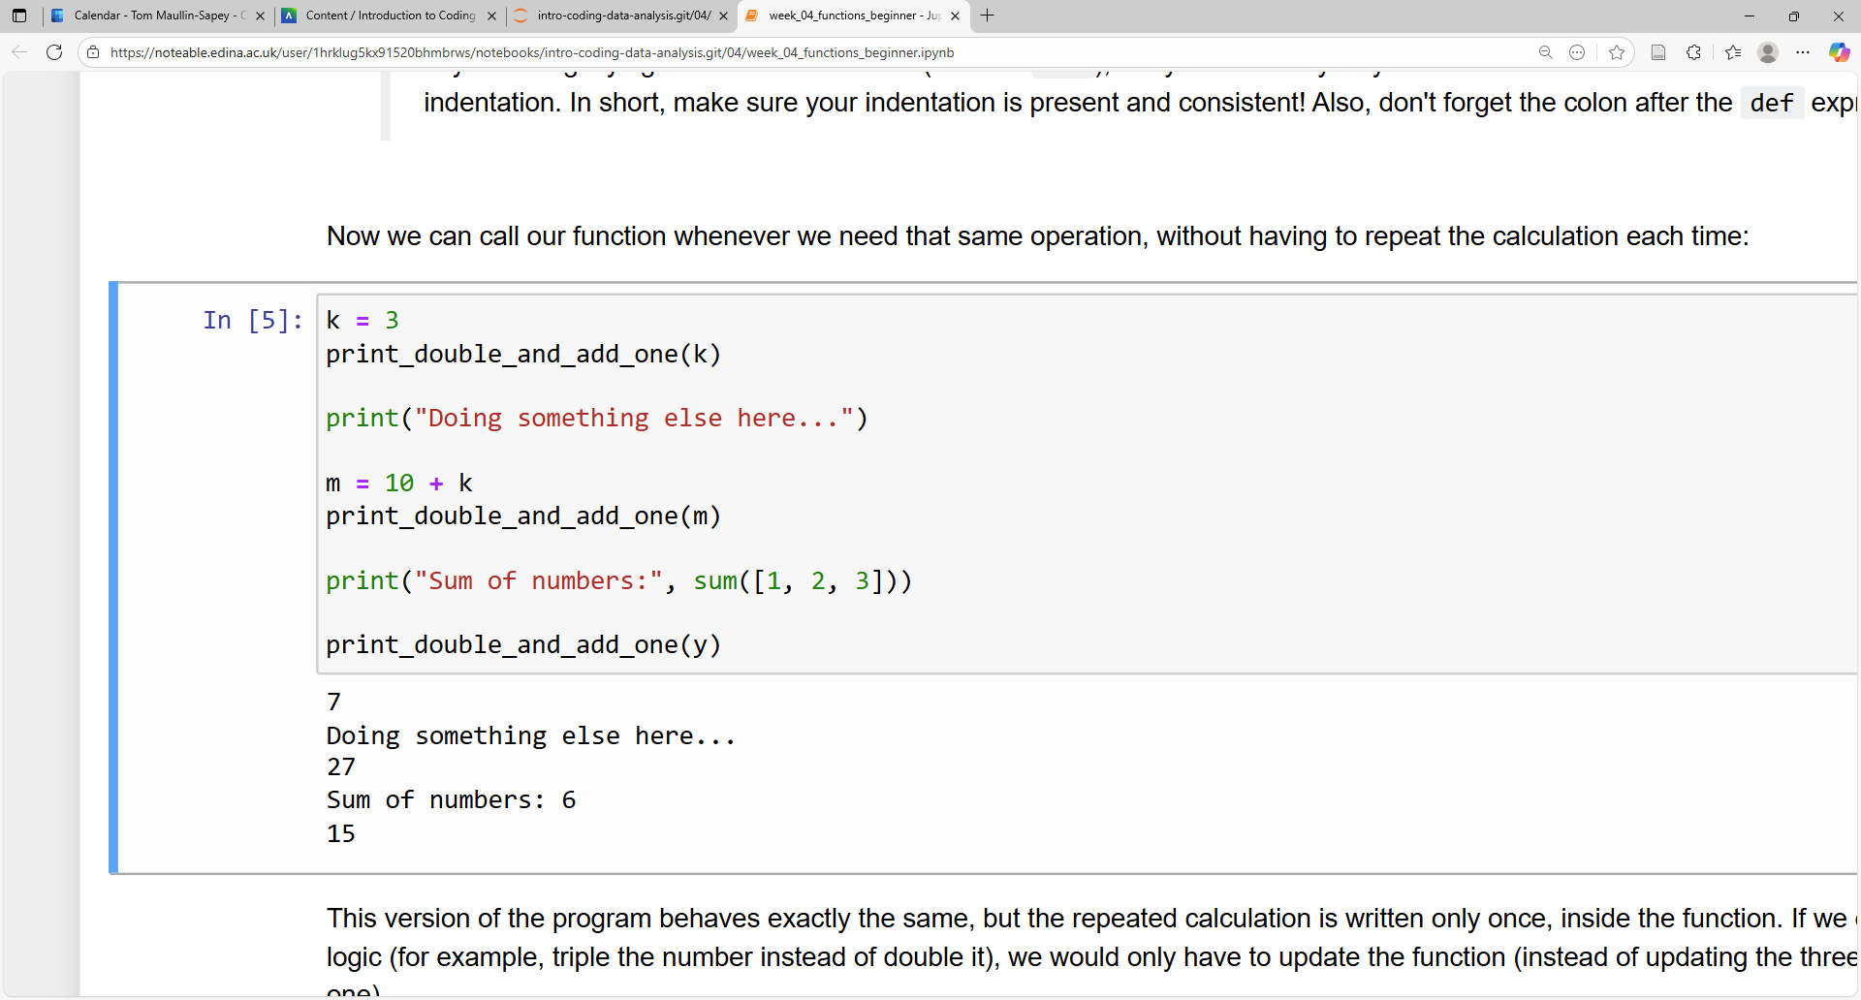
Functions
We can use this function to simplify the code from earlier!
Slide 7/12

Slide 65
Functions
We can use this function to simplify the code from earlier!
Slide 7/12

Slide 66
Functions
We can use this function to simplify the code from earlier!
Slide 7/12

Slide 67
Functions
We can use this function to simplify the code from earlier!
Slide 7/12

Slide 68
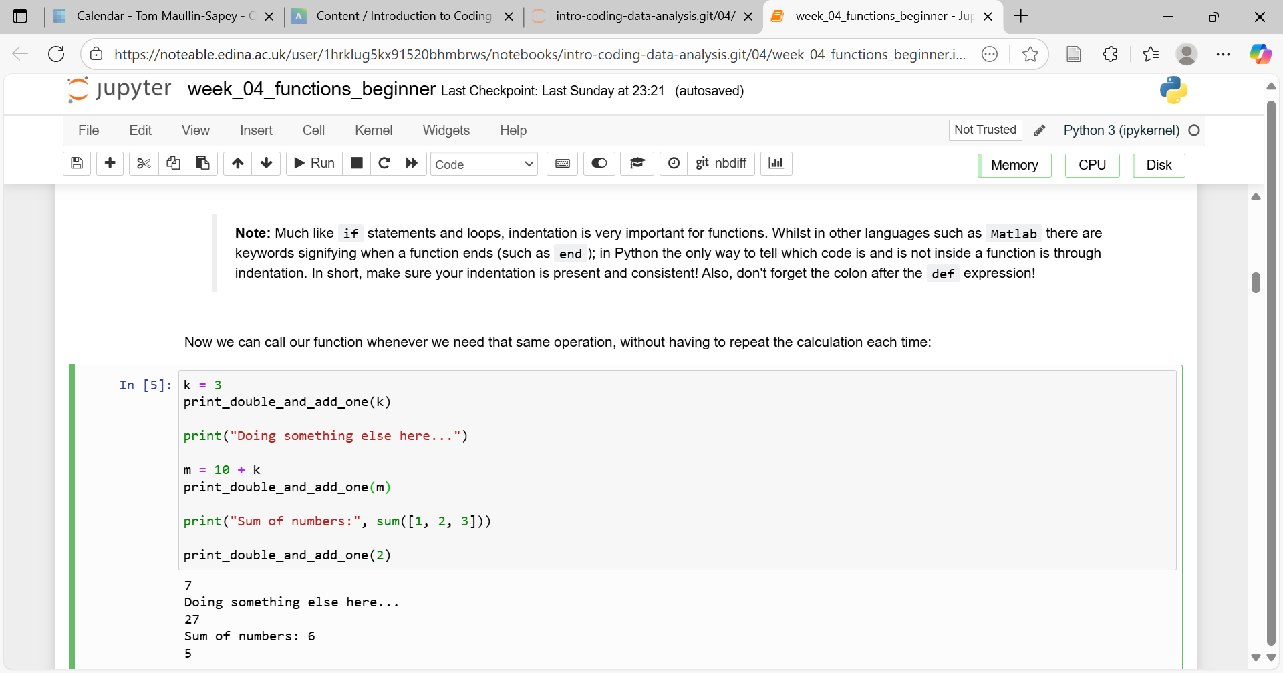
Functions
We can use this function to simplify the code from earlier!
Slide 7/12

Slide 69
Functions
We can use this function to simplify the code from earlier!
Slide 7/12

Slide 70
Functions
Slide 8/12

Slide 71
Functions
To this…
We’ve reduced this…
Slide 8/12

Slide 72
Functions
To this…
We’ve reduced this…
Slide 8/12

Slide 73
Motivation
Functions are useful for a number of reasons
Slide 9/12

Slide 74
Motivation
Functions are useful for a number of reasons
  Reduce repetitiveness in code
Slide 9/12

Slide 75
Motivation
Functions are useful for a number of reasons
  Reduce repetitiveness in code
  Help organise code
Slide 9/12

Slide 76
Motivation
Functions are useful for a number of reasons
  Reduce repetitiveness in code
  Help organise code
  Easier to edit, maintain and debug
Slide 9/12

Slide 77
Motivation
Functions are useful for a number of reasons
  Reduce repetitiveness in code
  Help organise code
  Easier to edit, maintain and debug
  Makes code easier to share
Slide 9/12

Slide 78
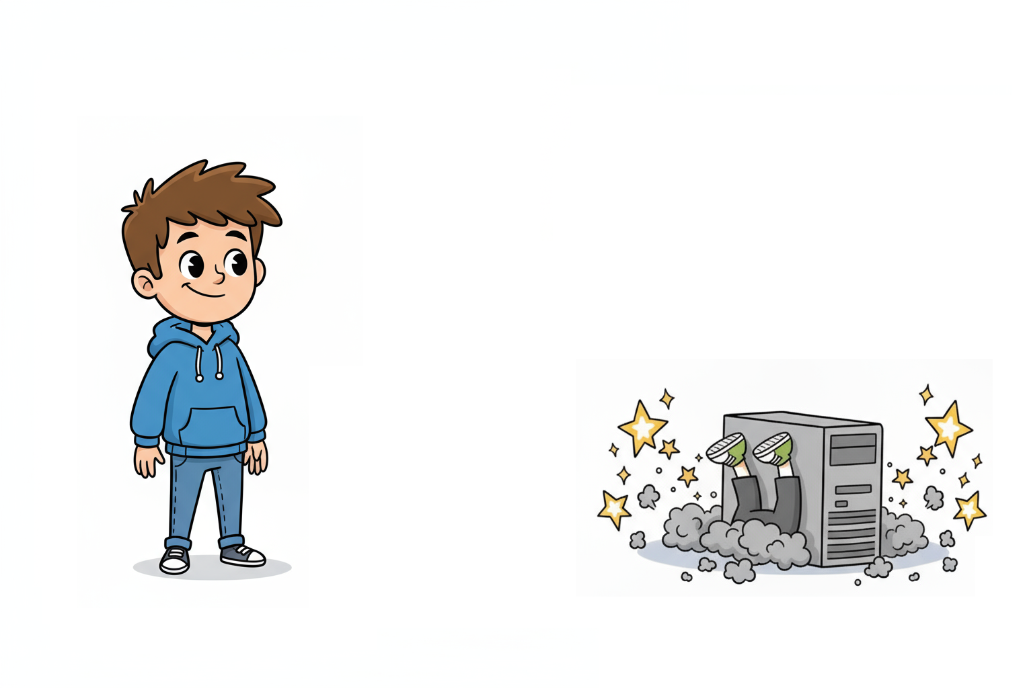
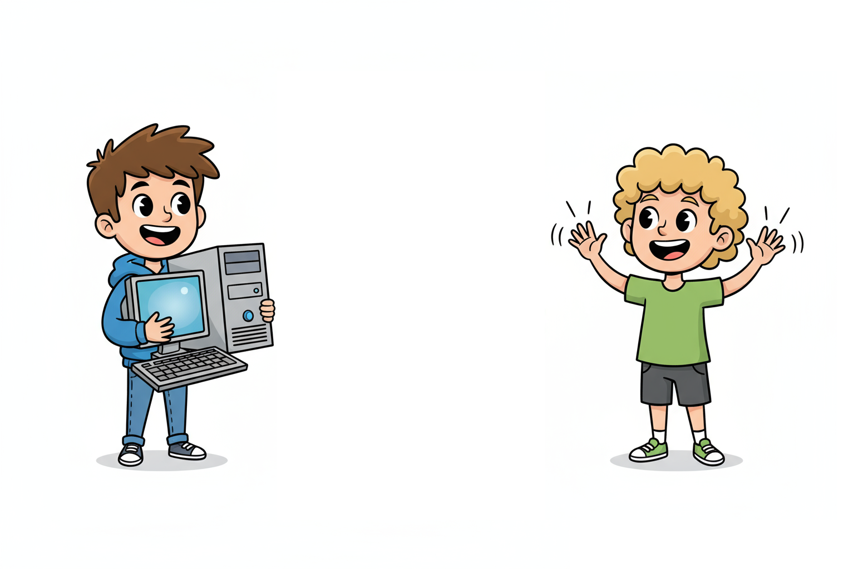
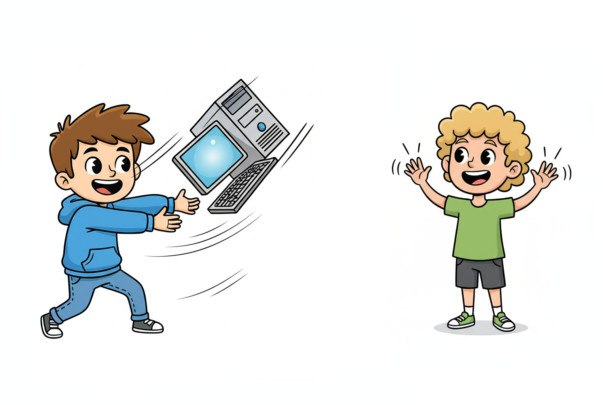
Motivation
Functions are useful for a number of reasons
  Reduce repetitiveness in code
  Help organise code
  Easier to edit, maintain and debug
  Makes code easier to share
Slide 9/12

Slide 79
Motivation
Functions are useful for a number of reasons
  Reduce repetitiveness in code
  Help organise code
  Easier to edit, maintain and debug
  Makes code easier to share
Hey can you share that bit of code with me?
Slide 9/12

Slide 80
Motivation
Functions are useful for a number of reasons
  Reduce repetitiveness in code
  Help organise code
  Easier to edit, maintain and debug
  Makes code easier to share
Sure!
Slide 9/12

Slide 81
Motivation
Functions are useful for a number of reasons
  Reduce repetitiveness in code
  Help organise code
  Easier to edit, maintain and debug
  Makes code easier to share
Slide 9/12

Slide 82
Motivation
Functions are useful for a number of reasons
  Reduce repetitiveness in code
  Help organise code
  Easier to edit, maintain and debug
  Makes code easier to share
Entire codebase
Slide 9/12

Slide 83
Motivation
Functions are useful for a number of reasons
  Reduce repetitiveness in code
  Help organise code
  Easier to edit, maintain and debug
  Makes code easier to share
Slide 9/12

Slide 84
Motivation
Functions are useful for a number of reasons
  Reduce repetitiveness in code
  Help organise code
  Easier to edit, maintain and debug
  Makes code easier to share
  Improve readability
Slide 9/12

Slide 85
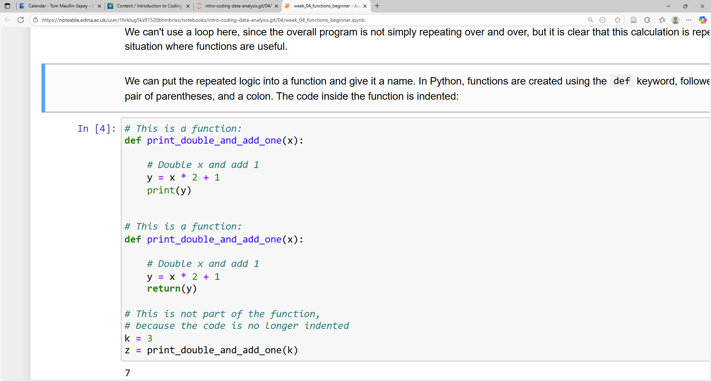
Inputs and Outputs
Slide 10/12

Slide 86
Inputs and Outputs
Instead of printing the result of our function, we can return it
Slide 10/12

Slide 87
Inputs and Outputs
Instead of printing the result of our function, we can return it
Slide 10/12

Slide 88
Inputs and Outputs
Instead of printing the result of our function, we can return it
This means that the function will “spit out” the value of y, and we can save it using the = operator
Slide 10/12

Slide 89
Inputs and Outputs
Instead of printing the result of our function, we can return it
This means that the function will “spit out” the value of y, and we can save it using the = operator
This will save the result as z
Slide 10/12

Slide 90
Inputs and Outputs
Instead of printing the result of our function, we can return it
This means that the function will “spit out” the value of y, and we can save it using the = operator
For this example:
Slide 10/12

Slide 91
Inputs and Outputs
Instead of printing the result of our function, we can return it
This means that the function will “spit out” the value of y, and we can save it using the = operator
For this example:
  x is an input: A variable specified in the function definition
Slide 10/12

Slide 92
Inputs and Outputs
Instead of printing the result of our function, we can return it
This means that the function will “spit out” the value of y, and we can save it using the = operator
For this example:
  x is an input: A variable specified in the function definition
  y is an output: A variable given back using the return statement
Slide 10/12

Slide 93
Inputs and Outputs
Instead of printing the result of our function, we can return it
This means that the function will “spit out” the value of y, and we can save it using the = operator
For this example:
  x is an input: A variable specified in the function definition
  y is an output: A variable given back using the return statement
You can have multiple inputs and outputs
Slide 10/12

Slide 94
Inputs and Outputs
Instead of printing the result of our function, we can return it
This means that the function will “spit out” the value of y, and we can save it using the = operator
For this example:
  x is an input: A variable specified in the function definition
  y is an output: A variable given back using the return statement
You can have multiple inputs and outputs
More on this in the practical…
Slide 10/12

Slide 95
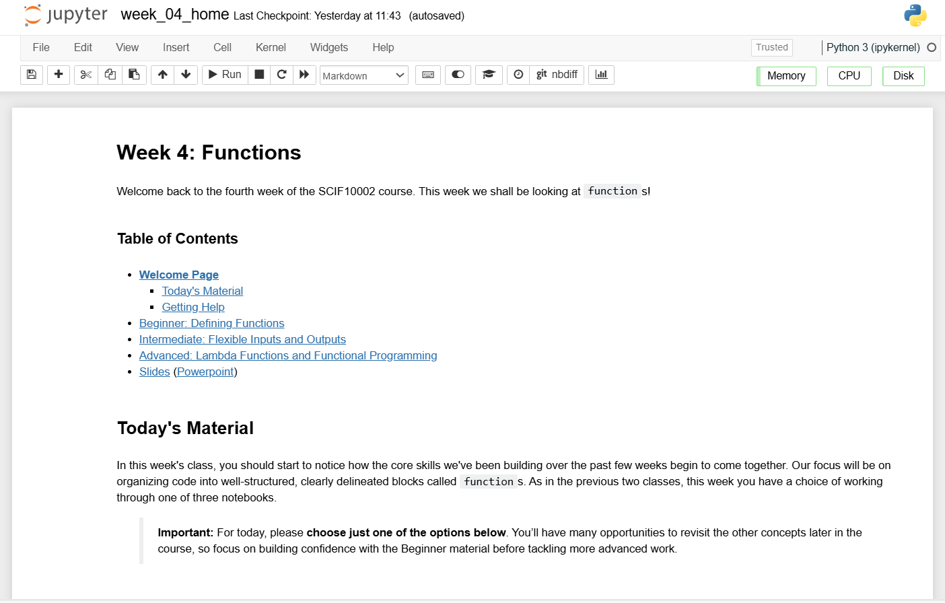
Practical
We now move over to Python
  Please open `week_04_home.ipynb`
For the rest of today, you must work through a Python notebook
You have a choice of one of three options
  Option 1: Beginner – Defining Functions
  Option 2: Intermediate – Flexible Inputs and Outputs
  Option 3: Advanced – Lambda Functions and Functional Programming
Slide 11/12

Slide 96
Practical
We now move over to Python
  Please open `week_04_home.ipynb`
For the rest of today, you must work through a Python notebook
You have a choice of one of three options
  Option 1: Beginner – Defining Functions
  Option 2: Intermediate – Flexible Inputs and Outputs
  Option 3: Advanced – Lambda Functions and Functional Programming
Do this if you are relatively new to Python
Slide 11/12

Slide 97
Practical
We now move over to Python
  Please open `week_04_home.ipynb`
For the rest of today, you must work through a Python notebook
You have a choice of one of three options
  Option 1: Beginner – Defining Functions
  Option 2: Intermediate – Flexible Inputs and Outputs
  Option 3: Advanced – Lambda Functions and Functional Programming
Do this if you have some prior experience writing functions in Python
Slide 11/12

Slide 98
Practical
We now move over to Python
  Please open `week_04_home.ipynb`
For the rest of today, you must work through a Python notebook
You have a choice of one of three options
  Option 1: Beginner – Defining Functions
  Option 2: Intermediate – Flexible Inputs and Outputs
  Option 3: Advanced – Lambda Functions and Functional Programming
Do this if you are already a pro at Python
Slide 11/12

Slide 99
Practical
We now move over to Python
  Please open `week_04_home.ipynb`
For the rest of today, you must work through a Python notebook
You have a choice of one of three options
  Option 1: Beginner – Defining Functions
  Option 2: Intermediate – Flexible Inputs and Outputs
  Option 3: Advanced – Lambda Functions and Functional Programming
Slide 11/12

Slide 100
Next Time
Lecture 4: Functions
  Recap: For and While Loops
  Functions
  Inputs and Outputs
  Practical
Lecture 5: Consolidation Week
  Recap: The course so far
  Recap: Why learn to code?
  Tackling Problems: A Worked Example
  What’s next?
  Practical
Slide 12/12

