Slide 1
Lecture 2:
Booleans and Conditionals
SCIF10002 – Introduction to Coding and Data
James S Martin
1st October 2026
Slide 0/10

Slide 2
Today’s Lecture
Lecture 2: Booleans and Conditionals
  Recap: Accessing Noteable
  Recap: Booleans
  If statements
  Practical
Lecture 3: Loops
  Recap: Accessing Noteable
  Recap: If Statements
  For Loops
  While Loops
  Practical
Slide 1/10

Slide 3
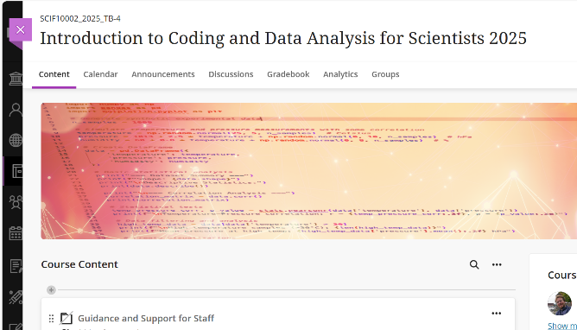
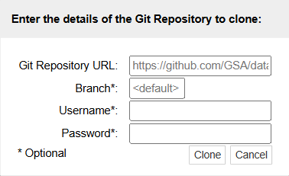
Recap: Accessing Noteable
Open Blackboard
  Go to “Introduction to Coding and Data Analysis for Scientists 2026”
  Click “Unit Information and Resources”
  Open Noteable
    Make sure “Jupyter Classic (Legacy)” is selected.
    Click Start
  Click “+GitRepo”
  Paste into Git Repository URL:
  https://github.com/jsmartinstats/SCIF10002-2026
  Press clone
Slide 3/10

Slide 4
Why learn to code?
Whichever course you are taking you will likely need to write code at some point
Slide 2/10

Slide 5
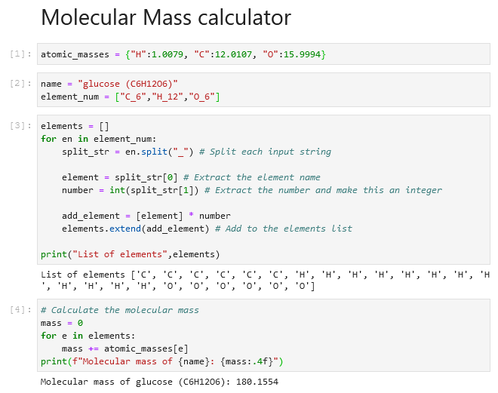
Why learn to code?
Whichever course you are taking you will likely need to write code at some point
Chemistry
  Analyse experimental data
  Automate repetitive calculations
  Model chemical reactions/simulations
Slide 2/10

Slide 6
Why learn to code?
Whichever course you are taking you will likely need to write code at some point
Chemistry
  Analyse experimental data
  Automate repetitive calculations
  Model chemical reactions/simulations
Slide 2/10

Slide 7
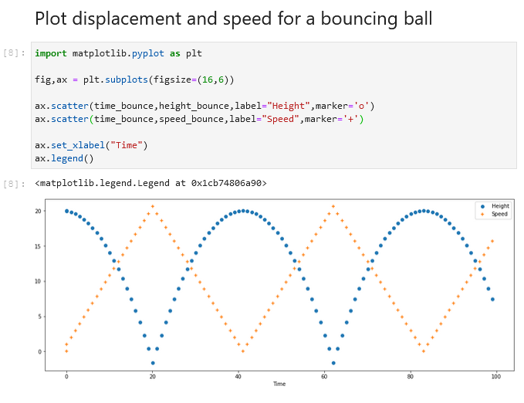
Why learn to code?
Whichever course you are taking you will likely need to write code at some point
Chemistry
  Analyse experimental data
  Automate repetitive calculations
  Model chemical reactions/simulations
Physics
  Simulate physical systems
  Process experimental measurements
  Visualise complex phenomena
Slide 2/10

Slide 8
Why learn to code?
Whichever course you are taking you will likely need to write code at some point
Chemistry
  Analyse experimental data
  Automate repetitive calculations
  Model chemical reactions/simulations
Physics
  Simulate physical systems
  Process experimental measurements
  Visualise complex phenomena
Slide 2/10

Slide 9
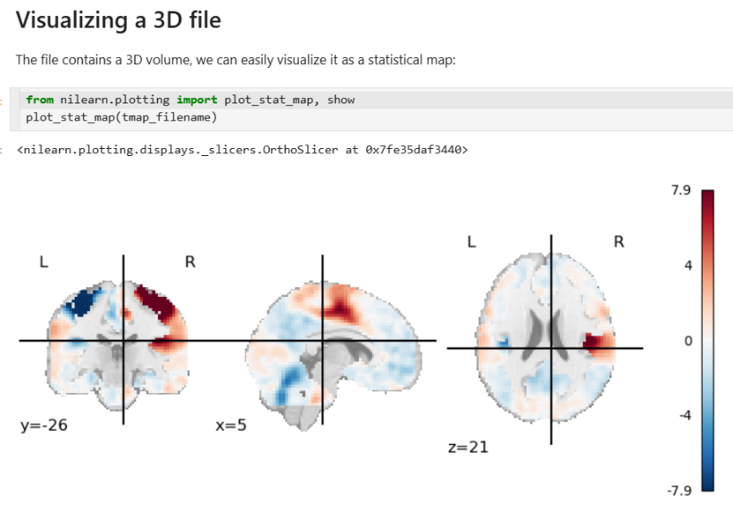
Why learn to code?
Whichever course you are taking you will likely need to write code at some point
Chemistry
  Analyse experimental data
  Automate repetitive calculations
  Model chemical reactions/simulations
Physics
  Simulate physical systems
  Process experimental measurements
  Visualise complex phenomena
Data Science
  Clean and organise datasets
  Apply statistical methods and machine learning
  Communicate insights with visualisations
Slide 2/10

Slide 10
Recap: Last Time
Last week, we started looking at the Python language
Slide 4/10

Slide 11

Recap: Last Time
Last week, we started looking at the Python language
We saw that variables can be assigned values using =
To display the values of variables we can use print
Slide 4/10

Slide 12
Recap: Last Time
Last week, we started looking at the Python language
We saw that variables can be assigned values using =
To display the values of variables we can use print
Variables have their own Data Types
Slide 4/10

Slide 13

Recap: Last Time
Last week, we started looking at the Python language
We saw that variables can be assigned values using =
To display the values of variables we can use print
Variables have their own Data Types
  Strings are sequences of characters
Slide 4/10

Slide 14
Recap: Last Time
Last week, we started looking at the Python language
We saw that variables can be assigned values using =
To display the values of variables we can use print
Variables have their own Data Types
  Strings are sequences of characters
  Floats are decimals, Ints are integers
Slide 4/10

Slide 15

Recap: Last Time
Last week, we started looking at the Python language
We saw that variables can be assigned values using =
To display the values of variables we can use print
Variables have their own Data Types
  Strings are sequences of characters
  Floats are decimals, Ints are integers
  Booleans are True/False values
Slide 4/10

Slide 16

Recap: Last Time
Last week, we started looking at the Python language
We saw that variables can be assigned values using =
To display the values of variables we can use print
Variables have their own Data Types
  Strings are sequences of characters
  Floats are decimals, Ints are integers
  Booleans are True/False values
  Lists are ordered groups of items
Slide 4/10

Slide 17
Recap: Last Time
Last week, we started looking at the Python language
We saw that variables can be assigned values using =
To display the values of variables we can use print
Variables have their own Data Types
  Strings are sequences of characters
  Floats are decimals, Ints are integers
  Booleans are True/False values
  Lists are ordered groups of items
We spent some time looking at various things we could do with some of these data types
Slide 4/10

Slide 18
Recap: Booleans
A Boolean is variable that can be either True or False
Booleans represent logical statements.
Slide 5/10

Slide 19
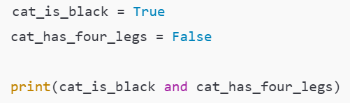
Recap: Booleans
A Boolean is variable that can be either True or False
Booleans represent logical statements.
For instance, we saw an example where:
cat_is_black represented the sentence “The cat is black”
cat_has_four_legs represented the sentence “The cat has four legs”
Slide 5/10

Slide 20
Recap: Booleans
A Boolean is variable that can be either True or False
Booleans represent logical statements.
For instance, we saw an example where:
cat_is_black represented the sentence “The cat is black”
cat_has_four_legs represented the sentence “The cat has four legs”
We used logical operators to combine Boolean statements
cat_is_black and cat_has_four_legs represented the sentence “The cat is black and has four legs”
Slide 5/10

Slide 21




Recap: Booleans
A Boolean is variable that can be either True or False
Booleans represent logical statements.
For instance, we saw an example where:
cat_is_black represented the sentence “The cat is black”
cat_has_four_legs represented the sentence “The cat has four legs”
We used logical operators to combine Boolean statements
cat_is_black and cat_has_four_legs represented the sentence “The cat is black and has four legs”
Slide 5/10

Slide 22



If Statements
We should be starting to feel comfortable with giving a computer instructions via code
Slide 6/10

Slide 23
If Statements
We should be starting to feel comfortable with giving a computer instructions via code
But sometimes, we don’t want every line to run automatically
Slide 6/10

Slide 24
If Statements
We should be starting to feel comfortable with giving a computer instructions via code
But sometimes, we don’t want every line to run automatically
Instead, we may want Python to act only when a specific condition is true
Slide 6/10

Slide 25
If Statements
We should be starting to feel comfortable with giving a computer instructions via code
But sometimes, we don’t want every line to run automatically
Instead, we may want Python to act only when a specific condition is true
True/False…
should be thinking Booleans!
Slide 6/10

Slide 26
If Statements
We should be starting to feel comfortable with giving a computer instructions via code
But sometimes, we don’t want every line to run automatically
Instead, we may want Python to act only when a specific condition is true
This is where the if statement comes in…
Slide 6/10

Slide 27
If Statements
An if statement lets you run code when a Boolean statement is True
Slide 7/10

Slide 28
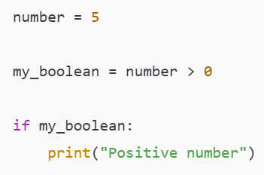
If Statements
An if statement lets you run code when a Boolean statement is True
Slide 7/10

Slide 29
If Statements
An if statement lets you run code when a Boolean statement is True
Integer value
Slide 7/10

Slide 30
If Statements
An if statement lets you run code when a Boolean statement is True
Boolean value
This is True if the number is positive, False otherwise
Slide 7/10

Slide 31
If Statements
An if statement lets you run code when a Boolean statement is True
Boolean value
This is True if the number is positive, False otherwise
Slide 7/10

Slide 32
If Statements
An if statement lets you run code when a Boolean statement is True
Translation:
If the number is positive, print “positive number”
Slide 7/10

Slide 33
If Statements
An if statement lets you run code when a Boolean statement is True
Slide 7/10

Slide 34
If Statements
An if statement lets you run code when a Boolean statement is True
If keyword
Slide 7/10

Slide 35
If Statements
An if statement lets you run code when a Boolean statement is True
Colon
Slide 7/10

Slide 36
If Statements
An if statement lets you run code when a Boolean statement is True
Body of the if statement
Everything here will be run if the Boolean is True
Slide 7/10

Slide 37
If Statements
An if statement lets you run code when a Boolean statement is True
Slide 7/10

Slide 38
If Statements
An if statement lets you run code when a Boolean statement is True
Indentation: This is important!
Python tells what is in the body by looking at which code is indented!
Slide 7/10

Slide 39
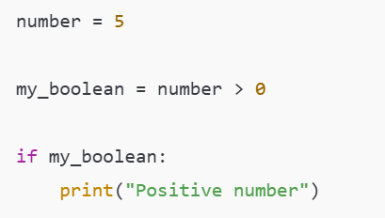
If Statements
An if statement lets you run code when a Boolean statement is True
Slide 8/10

Slide 40
If Statements
An if statement lets you run code when a Boolean statement is True
Often we don’t bother naming the boolean, and instead write it directly inside the if statement
Slide 8/10

Slide 41
If Statements
An if statement lets you run code when a Boolean statement is True
Often we don’t bother naming the boolean, and instead write it directly inside the if statement
Slide 8/10

Slide 42


If Statements
An if statement lets you run code when a Boolean statement is True
Often we don’t bother naming the boolean, and instead write it directly inside the if statement
Slide 8/10

Slide 43
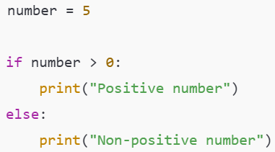
If Statements
An if statement lets you run code when a Boolean statement is True
Slide 8/10

Slide 44
If Statements
An if statement lets you run code when a Boolean statement is True
We can also tell the if statement what to do when the Boolean is False by using else
Slide 8/10

Slide 45
If Statements
An if statement lets you run code when a Boolean statement is True
We can also tell the if statement what to do when the Boolean is False by using else
Slide 8/10

Slide 46
If Statements
An if statement lets you run code when a Boolean statement is True
We can also tell the if statement what to do when the Boolean is False by using else
Translation: If the number is positive, print “positive number”, otherwise print “Non-positive number”
Slide 8/10

Slide 47
If Statements
An if statement lets you run code when a Boolean statement is True
We can also tell the if statement what to do when the Boolean is False by using else
An elif (short for else if) can be added to check more conditions.
Slide 8/10

Slide 48
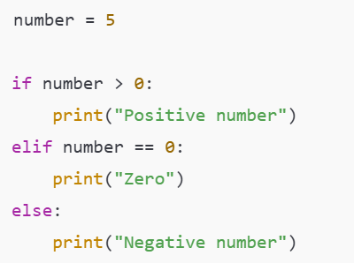
If Statements
An if statement lets you run code when a Boolean statement is True
We can also tell the if statement what to do when the Boolean is False by using else
An elif (short for else if) can be added to check more conditions.
Slide 8/10

Slide 49
If Statements
An if statement lets you run code when a Boolean statement is True
We can also tell the if statement what to do when the Boolean is False by using else
An elif (short for else if) can be added to check more conditions.
Slide 8/10

Slide 50
If Statements
An if statement lets you run code when a Boolean statement is True
We can also tell the if statement what to do when the Boolean is False by using else
An elif (short for else if) can be added to check more conditions.
First, the if statement is checked…
Slide 8/10

Slide 51
If Statements
An if statement lets you run code when a Boolean statement is True
We can also tell the if statement what to do when the Boolean is False by using else
An elif (short for else if) can be added to check more conditions.
First, the if statement is checked…
Slide 8/10

Slide 52
If Statements
An if statement lets you run code when a Boolean statement is True
We can also tell the if statement what to do when the Boolean is False by using else
An elif (short for else if) can be added to check more conditions.
First, the if statement is checked…
If the condition in the if is False, the elif is checked…
Slide 8/10

Slide 53
If Statements
An if statement lets you run code when a Boolean statement is True
We can also tell the if statement what to do when the Boolean is False by using else
An elif (short for else if) can be added to check more conditions.
First, the if statement is checked…
If the condition in the if is False, the elif is checked…
Slide 8/10

Slide 54
If Statements
An if statement lets you run code when a Boolean statement is True
We can also tell the if statement what to do when the Boolean is False by using else
An elif (short for else if) can be added to check more conditions.
First, the if statement is checked…
If the condition in the if is False, the elif is checked…
Lastly, if the if and elif conditions are False, the else is checked
Slide 8/10

Slide 55
If Statements
An if statement lets you run code when a Boolean statement is True
We can also tell the if statement what to do when the Boolean is False by using else
An elif (short for else if) can be added to check more conditions.
Slide 8/10

Slide 56
If Statements
An if statement lets you run code when a Boolean statement is True
We can also tell the if statement what to do when the Boolean is False by using else
An elif (short for else if) can be added to check more conditions.
  Multiple elif can be added.
Slide 8/10

Slide 57
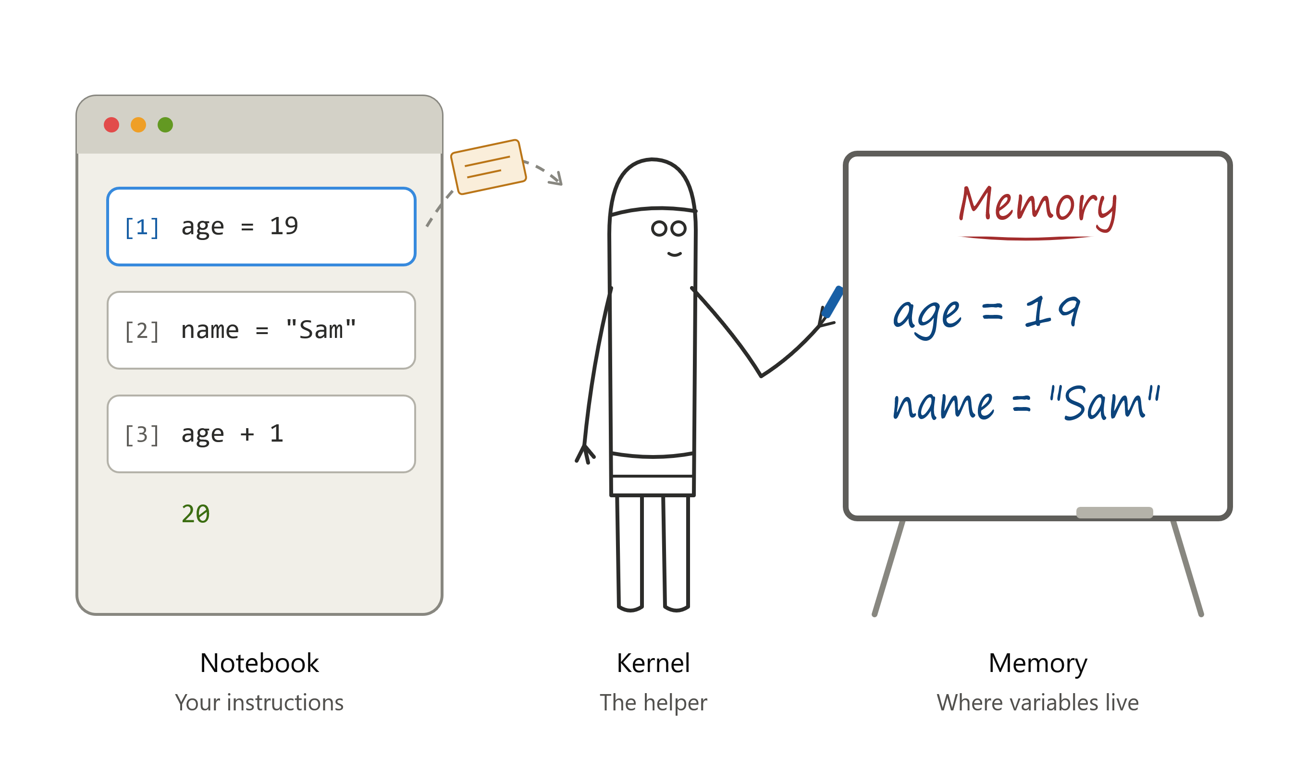
Jupyter notebooks – a basic analogy
Think of your notebook cells as a set of separable instructions
The kernel is like your helper, with a whiteboard in the next room
  Running a cell = handing an instruction to your helper.
  Your helper writes the instruction on their whiteboard
  The whiteboard is the memory
Slide 9/10

Slide 58
Jupyter notebooks – a basic analogy
The helper only knows what you've handed over. A cell you haven't run never reached them.
The helper works in the order you hand things over, not the order on the page.
Deleting a cell doesn't rub anything off the board. The helper already wrote it down.
Restarting the kernel wipes the board clean, so you need to run your cells again from the top.
Saving the notebook saves your instructions, not the whiteboard.
Slide 9/10

Slide 59
Practical
We now move over to Python
Slide 9/10

Slide 60
Recap: Accessing Noteable
Open Blackboard
  Go to “Introduction to Coding and Data Analysis for Scientists 2026”
  Click “Unit Information and Resources”
  Open Noteable
    Make sure “Jupyter Classic (Legacy)” is selected.
    Click Start
  Click “+GitRepo”
  Paste into Git Repository URL:
  https://github.com/jsmartinstats/SCIF10002-2026
  Press clone
Slide 3/10

Slide 61
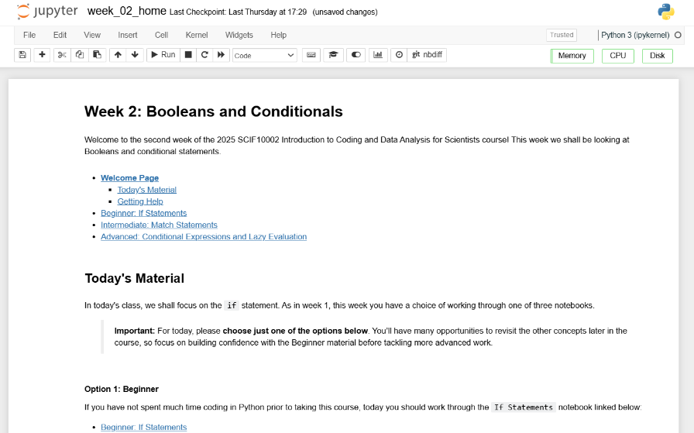
Practical
We now move over to Python
  Please open `week_02_home.ipynb`
Slide 9/10

Slide 62
Practical
We now move over to Python
  Please open `week_02_home.ipynb`
For the rest of today, you must work through a Python notebook
You have a choice of one of three options
Slide 9/10

Slide 63
Practical
We now move over to Python
  Please open `week_02_home.ipynb`
For the rest of today, you must work through a Python notebook
You have a choice of one of three options
  Option 1: Beginner – If Statements
  Option 2: Intermediate – Match Statements
  Option 3: Advanced – Conditional Expressions and Lazy Evaluation
Slide 9/10

Slide 64
Practical
We now move over to Python
  Please open `week_02_home.ipynb`
For the rest of today, you must work through a Python notebook
You have a choice of one of three options
  Option 1: Beginner – If Statements
  Option 2: Intermediate – Match Statements
  Option 3: Advanced – Conditional Expressions and Lazy Evaluation
Choose this if you are not familiar with, or confident on, if statements
Slide 9/10

Slide 65
Practical
We now move over to Python
  Please open `week_02_home.ipynb`
For the rest of today, you must work through a Python notebook
You have a choice of one of three options
  Option 1: Beginner – If Statements
  Option 2: Intermediate – Match Statements
  Option 3: Advanced – Conditional Expressions and Lazy Evaluation
Choose this if you have strong experience coding if statements in Python
Slide 9/10

Slide 66
Practical
We now move over to Python
  Please open `week_02_home.ipynb`
For the rest of today, you must work through a Python notebook
You have a choice of one of three options
  Option 1: Beginner – If Statements
  Option 2: Intermediate – Match Statements
  Option 3: Advanced – Conditional Expressions and Lazy Evaluation
Choose this if you are a strong Python programmer with several years experience
Slide 9/10

Slide 67
Practical
We now move over to Python
  Please open `week_02_home.ipynb`
For the rest of today, you must work through a Python notebook
You have a choice of one of three options
  Option 1: Beginner – If Statements
  Option 2: Intermediate – Match Statements
  Option 3: Advanced – Conditional Expressions and Lazy Evaluation
Slide 9/10

Slide 68
Practical
We now move over to Python
  Please open `week_02_home.ipynb`
For the rest of today, you must work through a Python notebook
You have a choice of one of three options
  Option 1: Beginner – If Statements
  Option 2: Intermediate – Match Statements
  Option 3: Advanced – Conditional Expressions and Lazy Evaluation
Important: If you choose the intermediate or advanced options, make sure you are comfortable with the material in Beginner first!!
Slide 9/10

Slide 69
Practical
We now move over to Python
  Please open `week_02_home.ipynb`
For the rest of today, you must work through a Python notebook
You have a choice of one of three options
  Option 1: Beginner – If Statements
  Option 2: Intermediate – Match Statements
  Option 3: Advanced – Conditional Expressions and Lazy Evaluation
Slide 9/10

Slide 70
Recap: Accessing Noteable
Open Blackboard
  Go to “Introduction to Coding and Data Analysis for Scientists 2026”
  Click “Unit Information and Resources”
  Open Noteable
    Make sure “Jupyter Classic (Legacy)” is selected.
    Click Start
  Click “+GitRepo”
  Paste into Git Repository URL:
  https://github.com/jsmartinstats/SCIF10002-2026
  Press clone
Slide 3/10

Slide 71
Next Time
Lecture 2: Booleans and Conditionals
  Recap Accessing Noteable
  Recap: Booleans
  If statements
  Practical
Lecture 3: Loops
  Recap: Accessing Noteable
  Recap: If Statements
  For Loops
  While Loops
  Practical
Slide 10/10

