Slide 1
Lecture 3:
Loops
SCIF10002 – Introduction to Coding and Data
James S Martin
8th October 2026
Slide 0/11

Slide 2
Today’s Lecture
Lecture 3: Loops
  Recap: Accessing Noteable
  Recap: If Statements
  For Loops
  While Loops
  Practical
Lecture 4: Functions
  Recap: For and While Loops
  Functions
  Inputs and Outputs
  Practical
Slide 1/11

Slide 3
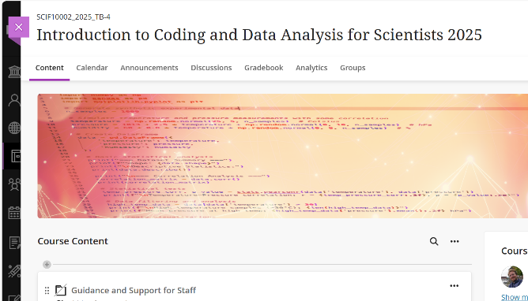
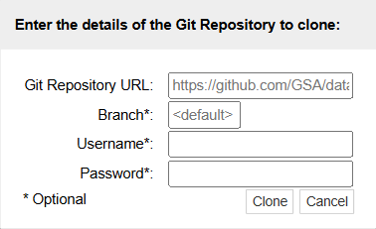
Recap: Accessing Noteable
Open Blackboard
  Go to “Introduction to Coding and Data Analysis for Scientists 2025”
  Click “Unit Information and Resources”
  Open Noteable
    Make sure “Jupyter Classic (Legacy)” is selected.
    Click Start
  Click “+GitRepo”
  Paste into Git Repository URL:
  https://github.com/jsmartinstats/SCIF10002-2026
  Press clone
Slide 3/10

Slide 4
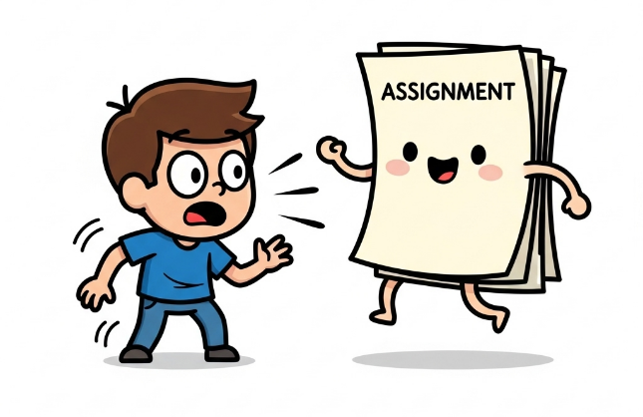
Important: Assessed Coursework 1
The first assignment has been released this week!
  Released Wednesday 7th October at 12:00PM
  Due Wednesday 21st October at 12:00PM
Slide 3/11

Slide 5
Important: Assessed Coursework 1
The first assignment has been released this week!
  Released Wednesday 7th October at 12:00PM
  Due Wednesday 21st October at 12:00PM
This is assessed (15% of your grade!)
Submission is via Noteable
You can submit as many times as you like up until the submission date
Slide 3/11

Slide 6
Noteable Submission
Slide 4/11

Slide 7
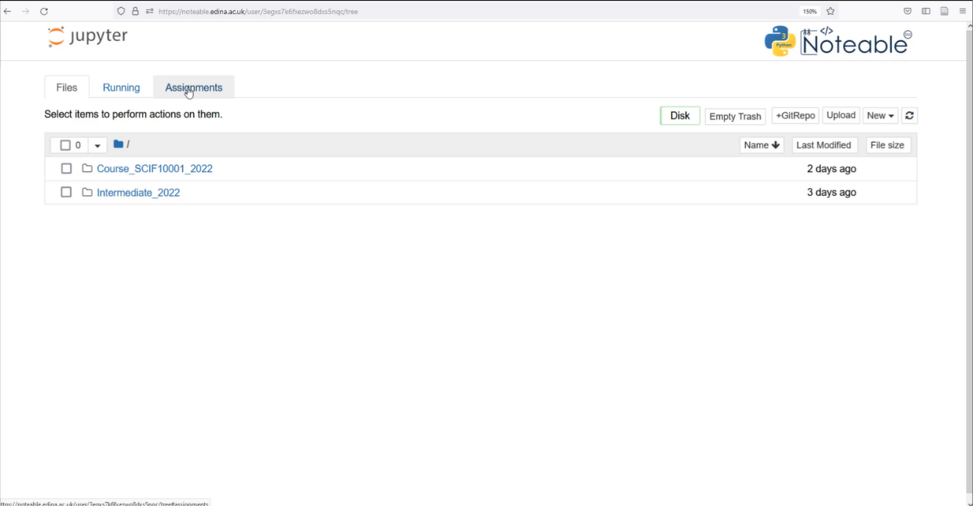
Noteable Submission
Download using the Assignments tab on noteable
Slide 4/11

Slide 8
Noteable Submission
Download using the Assignments tab on noteable
Slide 4/11

Slide 9
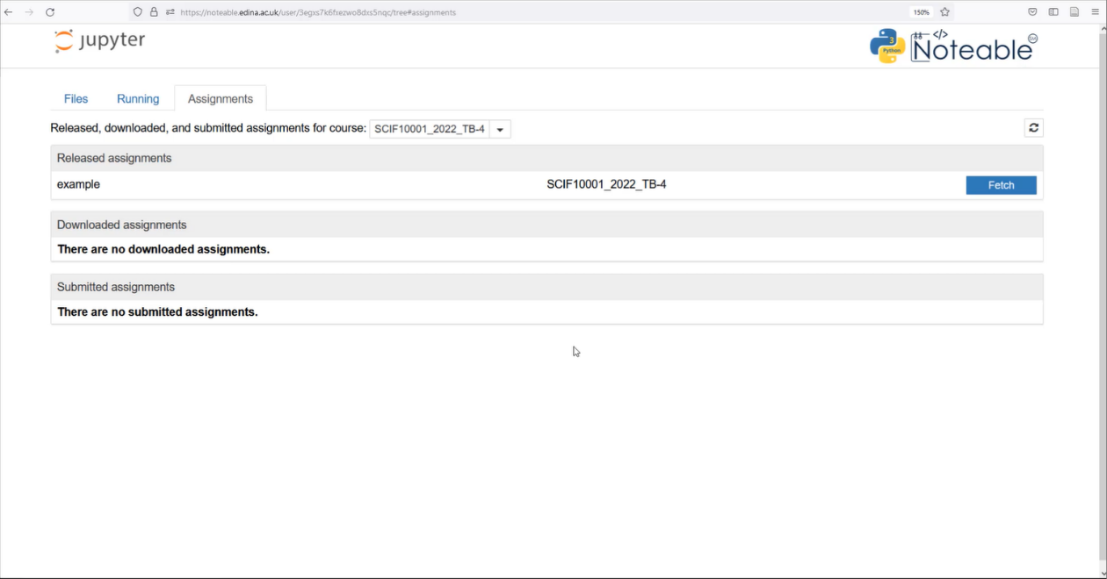
Noteable Submission
Download using the Assignments tab on noteable
Slide 4/11

Slide 10
Noteable Submission
Download using the Assignments tab on noteable
Press Fetch and click on the assignment
Slide 4/11

Slide 11
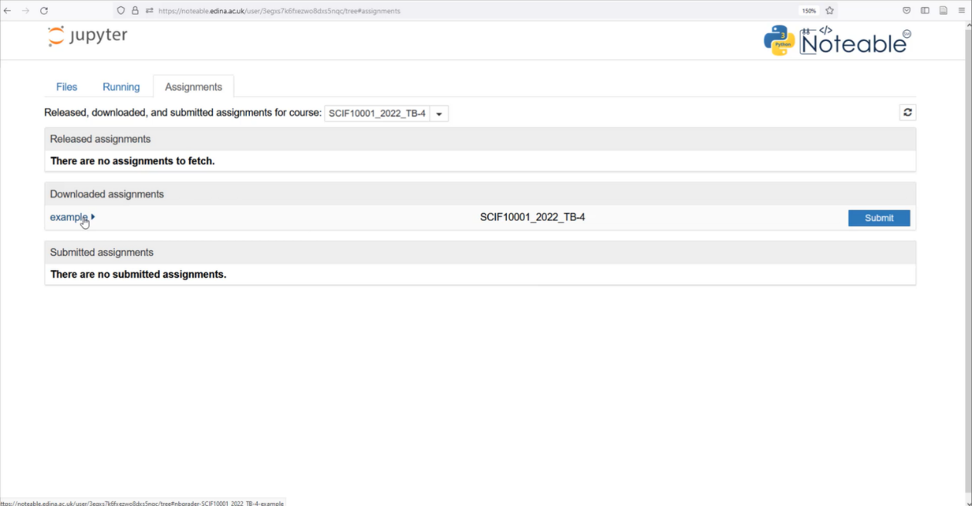
Noteable Submission
Download using the Assignments tab on noteable
Press Fetch and click on the assignment
Slide 4/11

Slide 12
Noteable Submission
Download using the Assignments tab on noteable
Press Fetch and click on the assignment
Slide 4/11

Slide 13
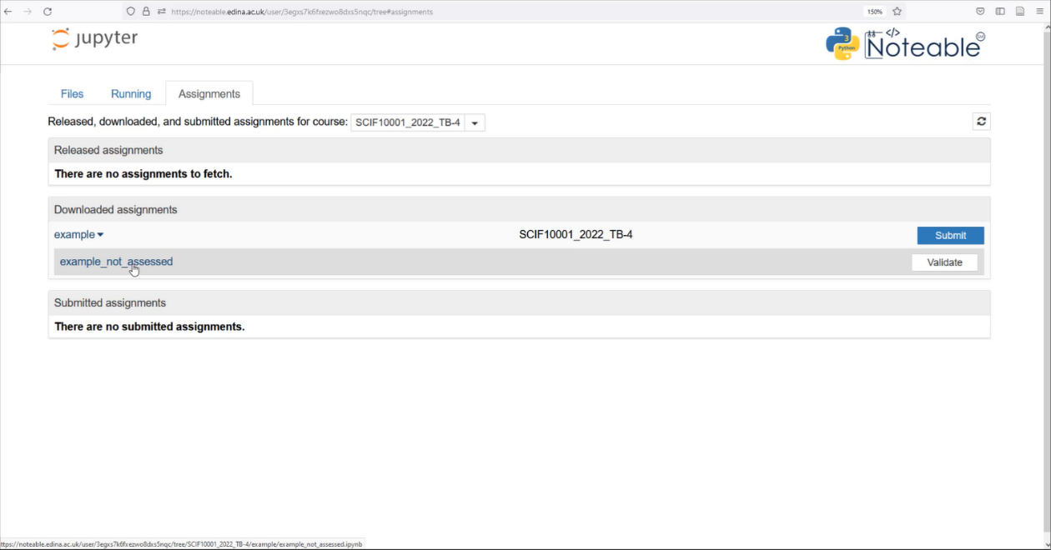
Noteable Submission
Download using the Assignments tab on noteable
Press Fetch and click on the assignment
Slide 4/11

Slide 14
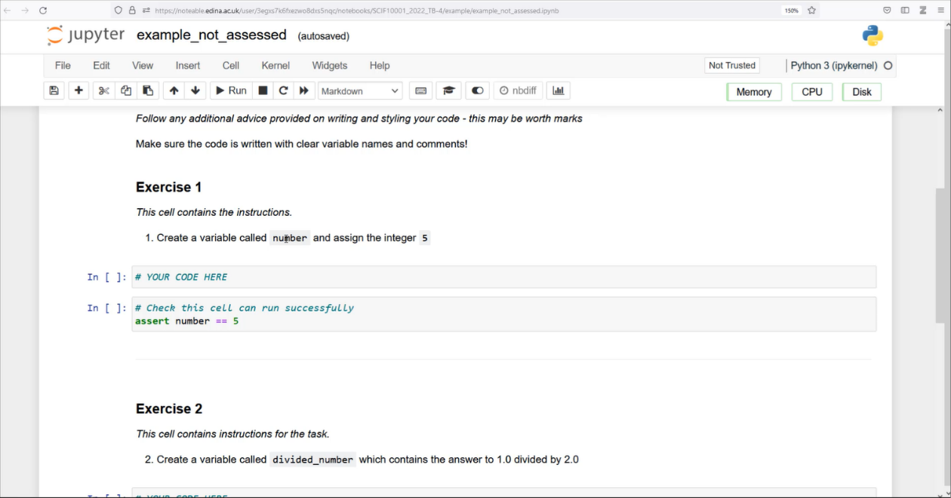
Noteable Submission
Download using the Assignments tab on noteable
Press Fetch and click on the assignment
Slide 4/11

Slide 15
Noteable Submission
Download using the Assignments tab on noteable
Press Fetch and click on the assignment
Fill your answers in and Validate
Slide 4/11

Slide 16
Noteable Submission
Download using the Assignments tab on noteable
Press Fetch and click on the assignment
Fill your answers in and Validate
Slide 4/11

Slide 17
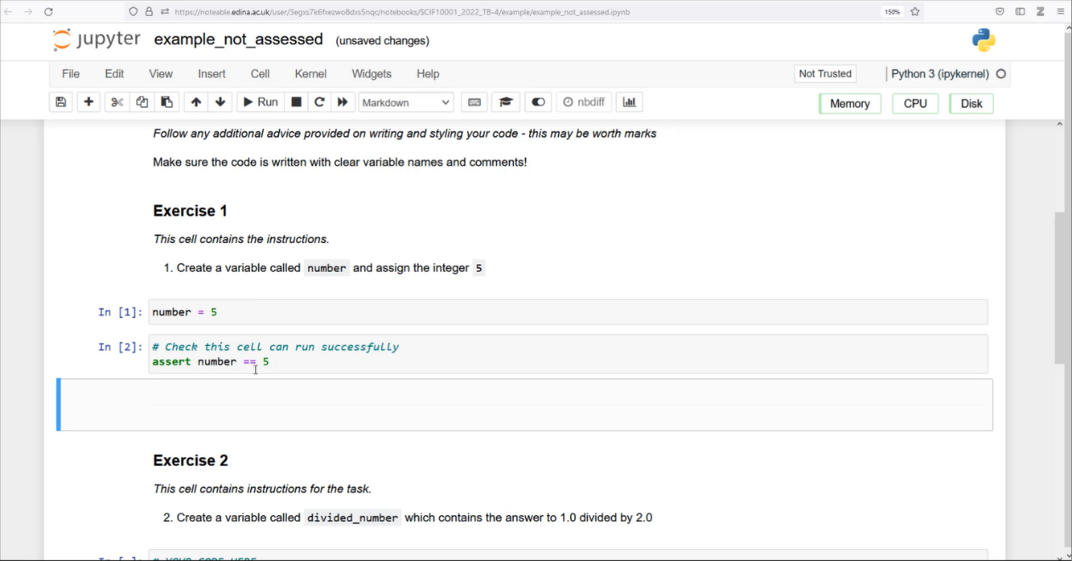
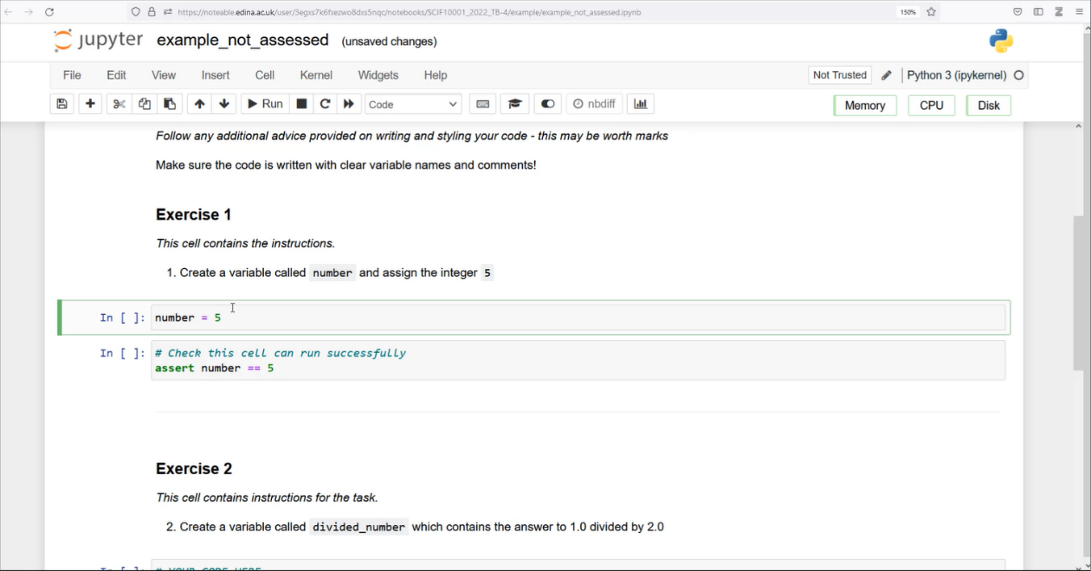
Noteable Submission
Download using the Assignments tab on noteable
Press Fetch and click on the assignment
Fill your answers in and Validate
Slide 4/11

Slide 18
Noteable Submission
Download using the Assignments tab on noteable
Press Fetch and click on the assignment
Fill your answers in and Validate
Slide 4/11

Slide 19
Noteable Submission
Download using the Assignments tab on noteable
Press Fetch and click on the assignment
Fill your answers in and Validate
Slide 4/11

Slide 20
Noteable Submission
Download using the Assignments tab on noteable
Press Fetch and click on the assignment
Fill your answers in and Validate
Slide 4/11

Slide 21
Noteable Submission
Download using the Assignments tab on noteable
Press Fetch and click on the assignment
Fill your answers in and Validate
Slide 4/11

Slide 22
Noteable Submission
Download using the Assignments tab on noteable
Press Fetch and click on the assignment
Fill your answers in and Validate
Slide 4/11

Slide 23
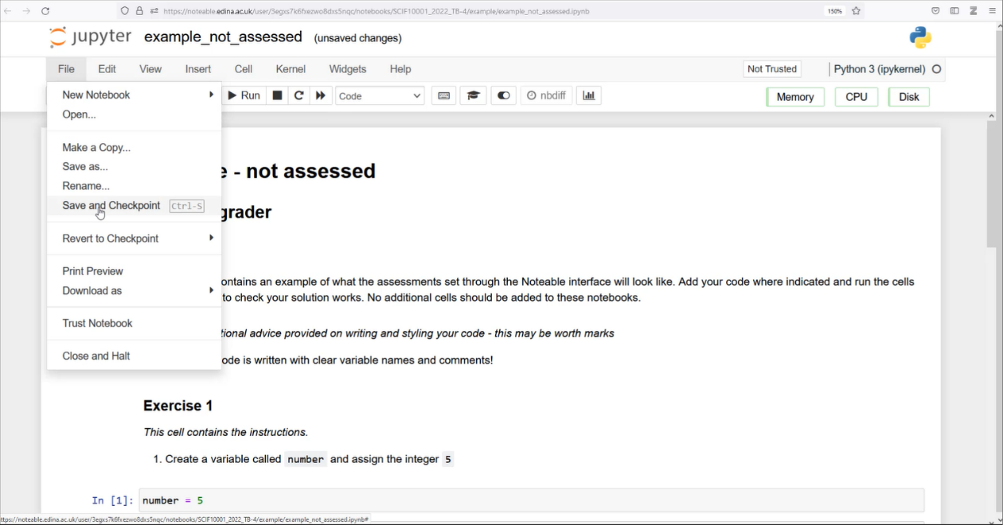
Noteable Submission
Download using the Assignments tab on noteable
Press Fetch and click on the assignment
Fill your answers in and Validate
Slide 4/11

Slide 24
Noteable Submission
Download using the Assignments tab on noteable
Press Fetch and click on the assignment
Fill your answers in and Validate
Slide 4/11

Slide 25
Noteable Submission
Download using the Assignments tab on noteable
Press Fetch and click on the assignment
Fill your answers in and Validate
Slide 4/11

Slide 26
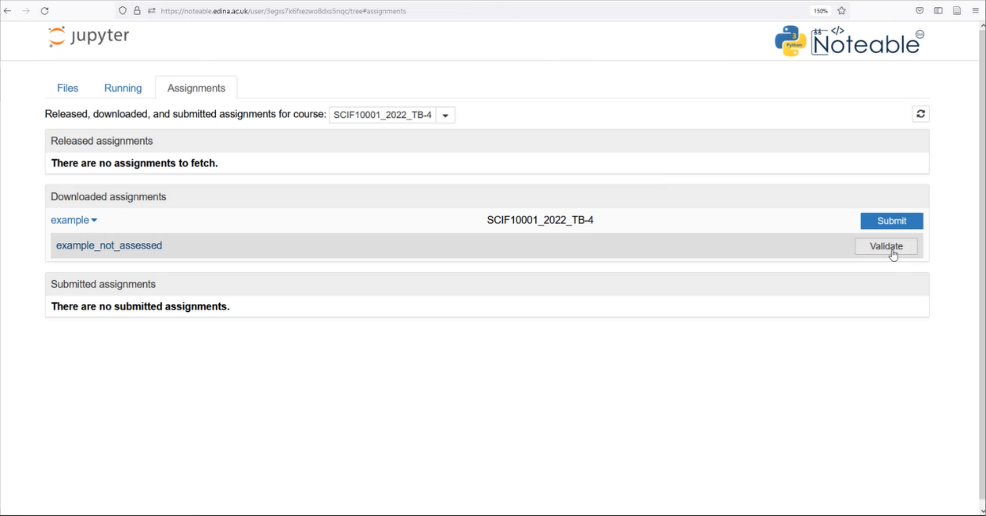
Noteable Submission
Download using the Assignments tab on noteable
Press Fetch and click on the assignment
Fill your answers in and Validate
Slide 4/11

Slide 27
Noteable Submission
Download using the Assignments tab on noteable
Press Fetch and click on the assignment
Fill your answers in and Validate
Slide 4/11

Slide 28

Noteable Submission
Download using the Assignments tab on noteable
Press Fetch and click on the assignment
Fill your answers in and Validate
Slide 4/11

Slide 29
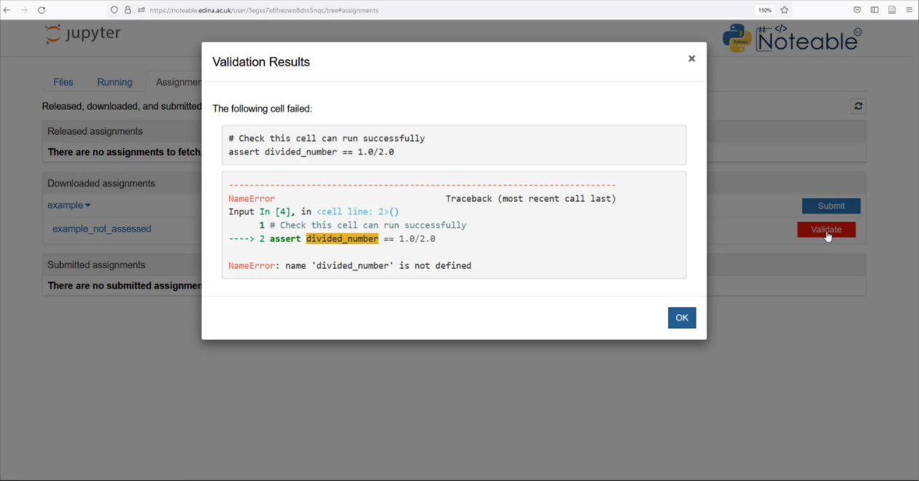
Noteable Submission
Download using the Assignments tab on noteable
Press Fetch and click on the assignment
Fill your answers in and Validate
Slide 4/11

Slide 30
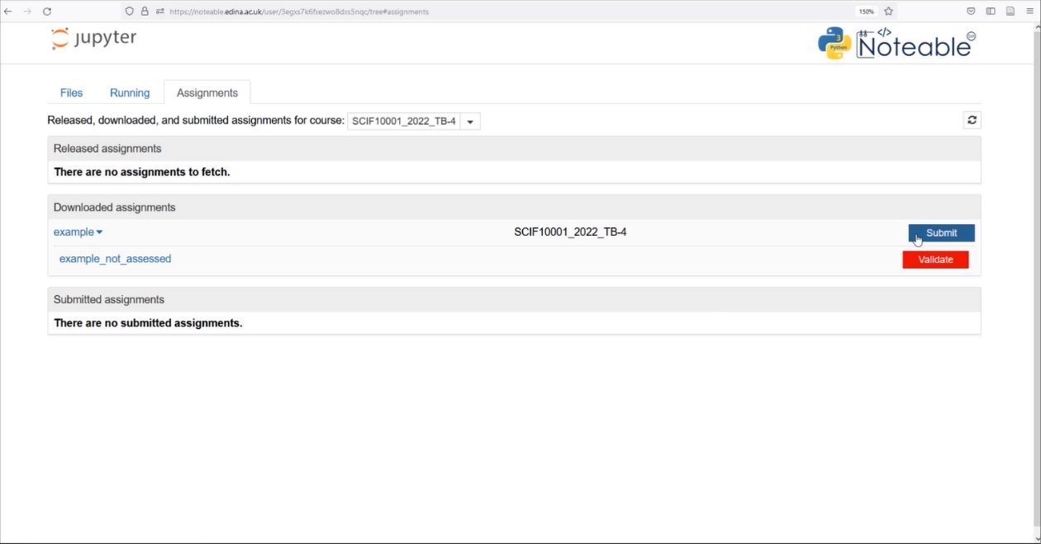
Noteable Submission
Download using the Assignments tab on noteable
Press Fetch and click on the assignment
Fill your answers in and Validate
Slide 4/11

Slide 31
Noteable Submission
Download using the Assignments tab on noteable
Press Fetch and click on the assignment
Fill your answers in and Validate
Once done, save your answers and Submit
Slide 4/11

Slide 32
Noteable Submission
Download using the Assignments tab on noteable
Press Fetch and click on the assignment
Fill your answers in and Validate
Once done, save your answers and Submit
Slide 4/11

Slide 33
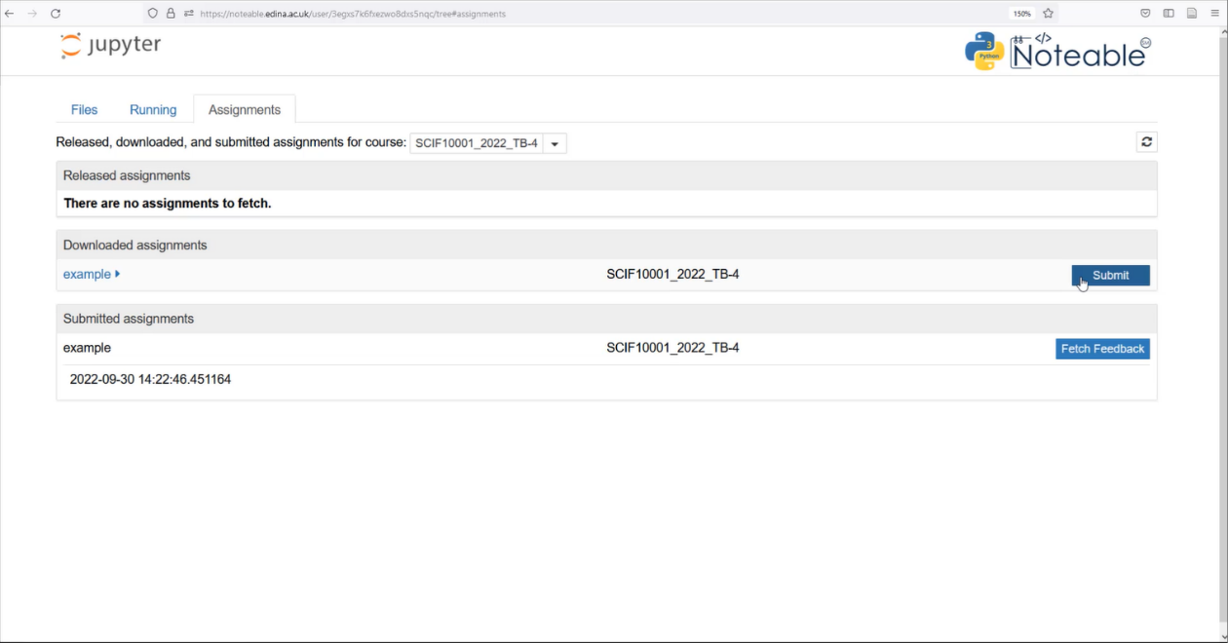
Noteable Submission
Download using the Assignments tab on noteable
Press Fetch and click on the assignment
Fill your answers in and Validate
Once done, save your answers and Submit
Slide 4/11

Slide 34
Noteable Submission
Download using the Assignments tab on noteable
Press Fetch and click on the assignment
Fill your answers in and Validate
Once done, save your answers and Submit
Slide 4/11

Slide 35
Noteable Submission
Download using the Assignments tab on noteable
Press Fetch and click on the assignment
Fill your answers in and Validate
Once done, save your answers and Submit
Slide 4/11

Slide 36
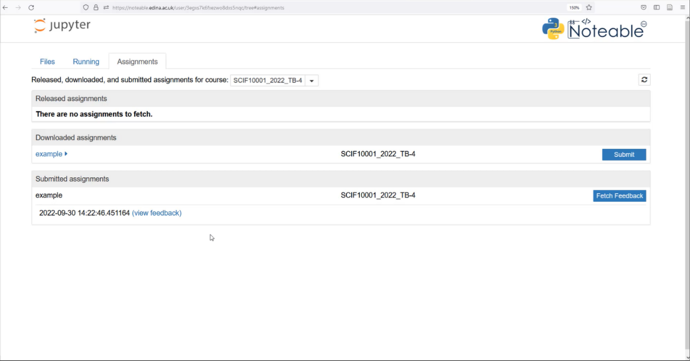
Noteable Submission
Download using the Assignments tab on noteable
Press Fetch and click on the assignment
Fill your answers in and Validate
Once done, save your answers and Submit
Feedback will be available when you see the (view feedback) option
Slide 4/11

Slide 37
Noteable Submission
Download using the Assignments tab on noteable
Press Fetch and click on the assignment
Fill your answers in and Validate
Once done, save your answers and Submit
Feedback will be available when you see the (view feedback) option
Slide 4/11

Slide 38
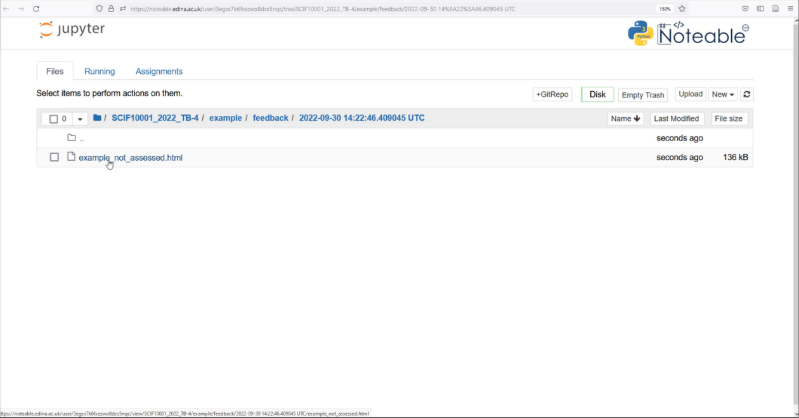
Noteable Submission
Download using the Assignments tab on noteable
Press Fetch and click on the assignment
Fill your answers in and Validate
Once done, save your answers and Submit
Feedback will be available when you see the (view feedback) option
Slide 4/11

Slide 39
Noteable Submission
Download using the Assignments tab on noteable
Press Fetch and click on the assignment
Fill your answers in and Validate
Once done, save your answers and Submit
Feedback will be available when you see the (view feedback) option
Slide 4/11

Slide 40
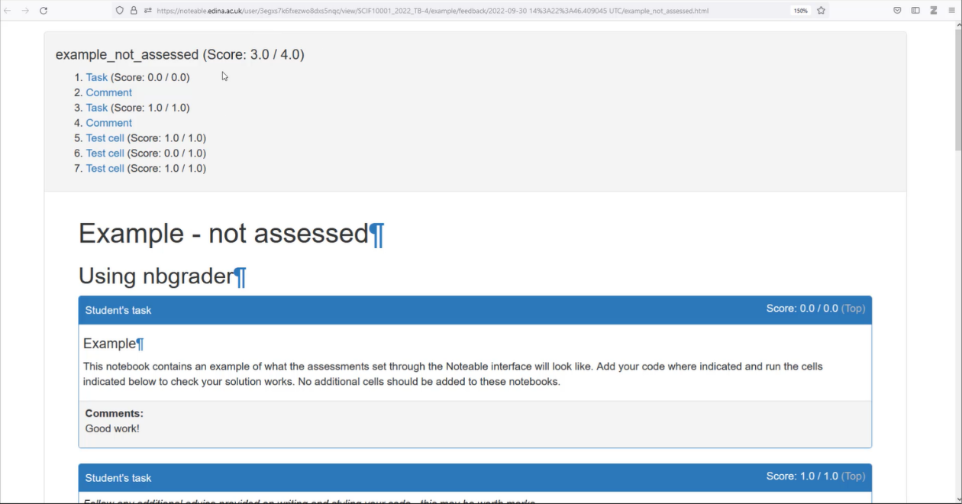
Noteable Submission
Download using the Assignments tab on noteable
Press Fetch and click on the assignment
Fill your answers in and Validate
Once done, save your answers and Submit
Feedback will be available when you see the (view feedback) option
Slide 4/11

Slide 41
Recap: If Statements
Last week, we looked at the if statement
Slide 5/11

Slide 42
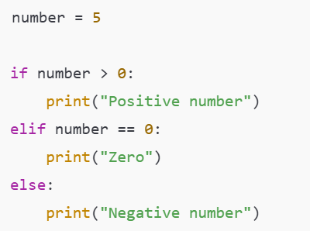

Recap: If Statements
Last week, we looked at the if statement
if statements allow us run code only when a specific condition is true
Slide 5/11

Slide 43
Recap: If Statements
Last week, we looked at the if statement
if statements allow us run code only when a specific condition is true
We can add elif and else statements to give us finer control over when code is executed
  An elif runs if it’s Boolean is True and all previous clauses (ifs and elifs) did not execute
  An else runs if all other clauses did not execute
Slide 5/11

Slide 44
Recap: If Statements
Last week, we looked at the if statement
if statements allow us run code only when a specific condition is true
We can add elif and else statements to give us finer control over when code is executed
  An elif runs if it’s Boolean is True and all previous clauses (ifs and elifs) did not execute
  An else runs if all other clauses did not execute
Slide 5/11

Slide 45
Recap: If Statements
Last week, we looked at the if statement
if statements allow us run code only when a specific condition is true
We can add elif and else statements to give us finer control over when code is executed
  An elif runs if it’s Boolean is True and all previous clauses (ifs and elifs) did not execute
  An else runs if all other clauses did not execute
Slide 5/11

Slide 46
Recap: If Statements
Last week, we looked at the if statement
if statements allow us run code only when a specific condition is true
We can add elif and else statements to give us finer control over when code is executed
  An elif runs if it’s Boolean is True and all previous clauses (ifs and elifs) did not execute
  An else runs if all other clauses did not execute
Today, we will look at another feature of Python that gives us finer control over our code - loops
Slide 5/11

Slide 47
Motivation
Suppose we want to do a very repetitive computation
Slide 6/11

Slide 48

Motivation
Suppose we want to do a very repetitive computation
  For instance, suppose we want to print the square of each item in this list
Slide 6/11

Slide 49
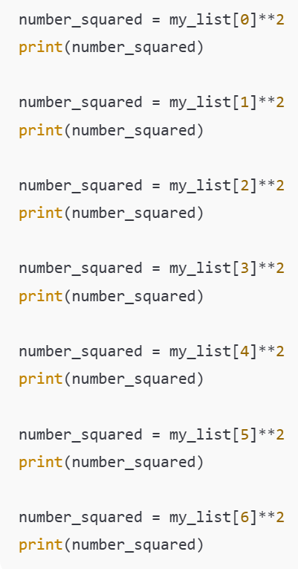
Motivation
Suppose we want to do a very repetitive computation
  For instance, suppose we want to print the square of each item in this list
We could just write something like this…
Slide 6/11

Slide 50
Motivation
Suppose we want to do a very repetitive computation
  For instance, suppose we want to print the square of each item in this list
We could just write something like this…
Slide 6/11

Slide 51
Motivation
Suppose we want to do a very repetitive computation
  For instance, suppose we want to print the square of each item in this list
We could just write something like this…
Slide 6/11

Slide 52
Motivation
Suppose we want to do a very repetitive computation
  For instance, suppose we want to print the square of each item in this list
We could just write something like this…
Slide 6/11

Slide 53
Motivation
Suppose we want to do a very repetitive computation
  For instance, suppose we want to print the square of each item in this list
We could just write something like this…
But it would be nice to be able to do this automatically!
Slide 6/11

Slide 54
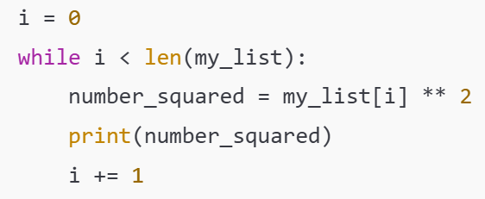
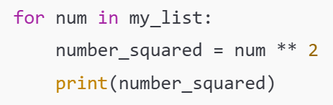
Motivation
Suppose we want to do a very repetitive computation
  For instance, suppose we want to print the square of each item in this list
We could just write something like this…
But it would be nice to be able to do this automatically!
This is what loops do!
Slide 6/11

Slide 55
Motivation
Suppose we want to do a very repetitive computation
  For instance, suppose we want to print the square of each item in this list
We could just write something like this…
But it would be nice to be able to do this automatically!
This is what loops do!
For Loop
Slide 6/11

Slide 56
Motivation
Suppose we want to do a very repetitive computation
  For instance, suppose we want to print the square of each item in this list
We could just write something like this…
But it would be nice to be able to do this automatically!
This is what loops do!
While Loop
Slide 6/11

Slide 57
Motivation
Suppose we want to do a very repetitive computation
  For instance, suppose we want to print the square of each item in this list
We could just write something like this…
But it would be nice to be able to do this automatically!
This is what loops do!
Both: much shorter code!
Slide 6/11

Slide 58
Iterable Objects
Slide 7/11

Slide 59
Iterable Objects
An iterable object is an object which contains lots of elements that we could list one by one
Slide 7/11

Slide 60
Iterable Objects
An iterable object is an object which contains lots of elements that we could list one by one
We’ve already seen an example – the list
Slide 7/11

Slide 61

Iterable Objects
An iterable object is an object which contains lots of elements that we could list one by one
We’ve already seen an example – the list
Other examples include:
  Tuples – like lists but use round brackets and can’t be changed
Slide 7/11

Slide 62

Iterable Objects
An iterable object is an object which contains lots of elements that we could list one by one
We’ve already seen an example – the list
Other examples include:
  Tuples – like lists but use round brackets and can’t be changed
  Dictionaries – records “keys” and “values” so that we can look up data using labels of our choosing
Slide 7/11

Slide 63
Iterable Objects
An iterable object is an object which contains lots of elements that we could list one by one
We’ve already seen an example – the list
Other examples include:
  Tuples – like lists but use round brackets and can’t be changed
  Dictionaries – records “keys” and “values” so that we can look up data using labels of our choosing
Slide 7/11

Slide 64

Iterable Objects
An iterable object is an object which contains lots of elements that we could list one by one
We’ve already seen an example – the list
Other examples include:
  Tuples – like lists but use round brackets and can’t be changed
  Dictionaries – records “keys” and “values” so that we can look up data using labels of our choosing
  A range object – a python object that represents a sequence of numbers, saved in a useful, memory-efficient way
Slide 7/11

Slide 65
Iterable Objects
An iterable object is an object which contains lots of elements that we could list one by one
We’ve already seen an example – the list
Other examples include:
  Tuples – like lists but use round brackets and can’t be changed
  Dictionaries – records “keys” and “values” so that we can look up data using labels of our choosing
  A range object – a python object that represents a sequence of numbers, saved in a useful, memory-efficient way
A for loop performs an operation on each element in an iterable object
Slide 7/11

Slide 66
For Loops
A for loop lets you run code for every element in an iterable object
Slide 8/11

Slide 67
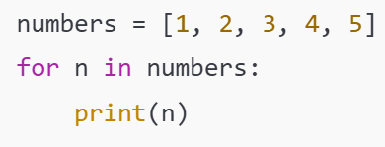
For Loops
A for loop lets you run code for every element in an iterable object
Let’s look at an example:
Slide 8/11

Slide 68
For Loops
A for loop lets you run code for every element in an iterable object
Let’s look at an example:
“for” keyword
Slide 8/11

Slide 69
For Loops
A for loop lets you run code for every element in an iterable object
Let’s look at an example:
“in” keyword
“for” keyword
Slide 8/11

Slide 70
For Loops
A for loop lets you run code for every element in an iterable object
Let’s look at an example:
“in” keyword
Colon
“for” keyword
Slide 8/11

Slide 71
For Loops
A for loop lets you run code for every element in an iterable object
Let’s look at an example:
“in” keyword
Colon
“for” keyword
Indentation – This is important!
This is how Python tells what is inside the loop!
Slide 8/11

Slide 72
For Loops
A for loop lets you run code for every element in an iterable object
Let’s look at an example:
Slide 8/11

Slide 73
For Loops
A for loop lets you run code for every element in an iterable object
Let’s look at an example:
Iterable object
(something we can list the elements in one by one)
Slide 8/11

Slide 74
For Loops
A for loop lets you run code for every element in an iterable object
Let’s look at an example:
Iterable object
(something we can list the elements in one by one)
Slide 8/11

Slide 75
For Loops
A for loop lets you run code for every element in an iterable object
Let’s look at an example:
Iterable object
(a collection of all the values we want to iterate through)
Slide 8/11

Slide 76
For Loops
A for loop lets you run code for every element in an iterable object
Let’s look at an example:
Slide 8/11

Slide 77
For Loops
A for loop lets you run code for every element in an iterable object
Let’s look at an example:
Variable name
This is a name we choose for an arbitrary element in the list
Slide 8/11

Slide 78
For Loops
A for loop lets you run code for every element in an iterable object
Let’s look at an example:
Slide 8/11

Slide 79
For Loops
A for loop lets you run code for every element in an iterable object
Let’s look at an example:
Body of the loop
This code will be run for every element in the iterable object
Slide 8/11

Slide 80
For Loops
A for loop lets you run code for every element in an iterable object
Let’s look at an example:
Slide 8/11

Slide 81
For Loops
A for loop lets you run code for every element in an iterable object
Let’s look at an example:
Translation:
“For every number in the list, print that number”
Slide 8/11

Slide 82
For Loops
A for loop lets you run code for every element in an iterable object
Let’s look at an example:
This code will print:
1
2
3
4
5
Slide 8/11

Slide 83
For Loops
A for loop lets you run code for every element in an iterable object
Let’s look at an example:
This code will print:
1
2
3
4
5
Slide 8/11

Slide 84
For Loops
A for loop lets you run code for every element in an iterable object
Let’s look at an example:
This code will print:
1
2
3
4
5
Slide 8/11

Slide 85
For Loops
A for loop lets you run code for every element in an iterable object
Let’s look at an example:
This code will print:
1
2
3
4
5
Slide 8/11

Slide 86
For Loops
A for loop lets you run code for every element in an iterable object
Let’s look at an example:
This code will print:
1
2
3
4
5
Slide 8/11

Slide 87
For Loops
A for loop lets you run code for every element in an iterable object
Let’s look at an example:
This code will print:
1
2
3
4
5
Slide 8/11

Slide 88
While Loops
A while loop lets you run code repeatedly so long as a Boolean statement is True
Slide 9/11

Slide 89
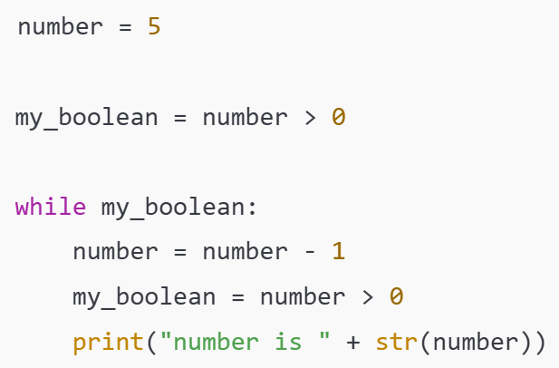
While Loops
A while loop lets you run code repeatedly so long as a Boolean statement is True
“while”
keyword
Slide 9/11

Slide 90
While Loops
A while loop lets you run code repeatedly so long as a Boolean statement is True
“while”
keyword
Colon
Slide 9/11

Slide 91
While Loops
A while loop lets you run code repeatedly so long as a Boolean statement is True
“while”
keyword
Colon
Indentation!
Slide 9/11

Slide 92
While Loops
A while loop lets you run code repeatedly so long as a Boolean statement is True
Slide 9/11

Slide 93
While Loops
A while loop lets you run code repeatedly so long as a Boolean statement is True
Boolean Condition
Slide 9/11

Slide 94
While Loops
A while loop lets you run code repeatedly so long as a Boolean statement is True
Body of the loop:
  This will execute over and over again until the Boolean is set to False
Slide 9/11

Slide 95
While Loops
A while loop lets you run code repeatedly so long as a Boolean statement is True
Body of the loop:
  This will execute over and over again until the Boolean is set to False
Slide 9/11

Slide 96
While Loops
A while loop lets you run code repeatedly so long as a Boolean statement is True
Body of the loop:
  This will execute over and over again until the Boolean is set to False
First, set number = 5.
Slide 9/11

Slide 97
While Loops
A while loop lets you run code repeatedly so long as a Boolean statement is True
Body of the loop:
  This will execute over and over again until the Boolean is set to False
First, set number = 5.
Define the Boolean condition.
Slide 9/11

Slide 98
While Loops
A while loop lets you run code repeatedly so long as a Boolean statement is True
Body of the loop:
  This will execute over and over again until the Boolean is set to False
First, set number = 5.
Define the Boolean condition.
Check the Boolean condition.
Slide 9/11

Slide 99
While Loops
A while loop lets you run code repeatedly so long as a Boolean statement is True
Body of the loop:
  This will execute over and over again until the Boolean is set to False
First, set number = 5.
Define the Boolean condition.
Check the Boolean condition.
Since number > 0, we move into the body of the while loop
Slide 9/11

Slide 100
While Loops
A while loop lets you run code repeatedly so long as a Boolean statement is True
Body of the loop:
  This will execute over and over again until the Boolean is set to False
First, set number = 5.
Define the Boolean condition.
Check the Boolean condition.
Since number > 0, we move into the body of the while loop
Slide 9/11

Slide 101
While Loops
A while loop lets you run code repeatedly so long as a Boolean statement is True
Body of the loop:
  This will execute over and over again until the Boolean is set to False
Next, set number = number – 1 = 4.
Define the Boolean condition.
Check the Boolean condition.
Since number > 0, we move into the body of the while loop
Slide 9/11

Slide 102
While Loops
A while loop lets you run code repeatedly so long as a Boolean statement is True
Body of the loop:
  This will execute over and over again until the Boolean is set to False
Next, set number = number – 1 = 4.
Redefine the Boolean condition.
Check the Boolean condition.
Since number > 0, we move into the body of the while loop
Slide 9/11

Slide 103
While Loops
A while loop lets you run code repeatedly so long as a Boolean statement is True
Body of the loop:
  This will execute over and over again until the Boolean is set to False
Next, set number = number – 1 = 4.
Redefine the Boolean condition.
Check the Boolean condition.
Since number > 0, we move into the body of the while loop
Slide 9/11

Slide 104
While Loops
A while loop lets you run code repeatedly so long as a Boolean statement is True
Body of the loop:
  This will execute over and over again until the Boolean is set to False
Next, set number = number – 1 = 4.
Redefine the Boolean condition.
We print the number
Check the Boolean condition.
Since number > 0, we move into the body of the while loop
Slide 9/11

Slide 105
While Loops
A while loop lets you run code repeatedly so long as a Boolean statement is True
Body of the loop:
  This will execute over and over again until the Boolean is set to False
Next, set number = number – 1 = 4.
Redefine the Boolean condition.
We print the number
Check the Boolean condition.
Since number > 0, we move into the body of the while loop
Slide 9/11

Slide 106
While Loops
A while loop lets you run code repeatedly so long as a Boolean statement is True
Body of the loop:
  This will execute over and over again until the Boolean is set to False
Next, set number = number – 1 = 4.
Redefine the Boolean condition.
We print the number
Check the Boolean condition.
Since number > 0 (still) we repeat the loop
Slide 9/11

Slide 107
While Loops
A while loop lets you run code repeatedly so long as a Boolean statement is True
Body of the loop:
  This will execute over and over again until the Boolean is set to False
Next, set number = number – 1 = 4.
Redefine the Boolean condition.
We print the number
Check the Boolean condition.
Since number > 0 (still) we repeat the loop
What will the final printed output be?
Slide 9/11

Slide 108
While Loops
A while loop lets you run code repeatedly so long as a Boolean statement is True
Body of the loop:
  This will execute over and over again until the Boolean is set to False
Next, set number = number – 1 = 3.
Redefine the Boolean condition.
We print the number
Check the Boolean condition.
Since number > 0 (still) we repeat the loop
Slide 9/11

Slide 109
While Loops
A while loop lets you run code repeatedly so long as a Boolean statement is True
Body of the loop:
  This will execute over and over again until the Boolean is set to False
Next, set number = number – 1 = 3.
Redefine the Boolean condition.
We print the number
Check the Boolean condition.
Since number > 0 (still) we repeat the loop
Slide 9/11

Slide 110
While Loops
A while loop lets you run code repeatedly so long as a Boolean statement is True
Body of the loop:
  This will execute over and over again until the Boolean is set to False
Next, set number = number – 1 = 2.
Redefine the Boolean condition.
We print the number
Check the Boolean condition.
Since number > 0 (still) we repeat the loop
Slide 9/11

Slide 111
While Loops
A while loop lets you run code repeatedly so long as a Boolean statement is True
Body of the loop:
  This will execute over and over again until the Boolean is set to False
Next, set number = number – 1 = 2.
Redefine the Boolean condition.
We print the number
Check the Boolean condition.
Since number > 0 (still) we repeat the loop
Slide 9/11

Slide 112
While Loops
A while loop lets you run code repeatedly so long as a Boolean statement is True
Body of the loop:
  This will execute over and over again until the Boolean is set to False
Next, set number = number – 1 = 1.
Redefine the Boolean condition.
We print the number
Check the Boolean condition.
Since number > 0 (still) we repeat the loop
Slide 9/11

Slide 113
While Loops
A while loop lets you run code repeatedly so long as a Boolean statement is True
Body of the loop:
  This will execute over and over again until the Boolean is set to False
Next, set number = number – 1 = 1.
Redefine the Boolean condition.
We print the number
Check the Boolean condition.
Since number > 0 (still) we repeat the loop
Slide 9/11

Slide 114
While Loops
A while loop lets you run code repeatedly so long as a Boolean statement is True
Body of the loop:
  This will execute over and over again until the Boolean is set to False
Next, set number = number – 1 = 0.
Redefine the Boolean condition.
We print the number
Check the Boolean condition.
Since number > 0 (still) we repeat the loop
Slide 9/11

Slide 115
While Loops
A while loop lets you run code repeatedly so long as a Boolean statement is True
Body of the loop:
  This will execute over and over again until the Boolean is set to False
Next, set number = number – 1 = 0.
Redefine the Boolean condition.
We print the number
Check the Boolean condition.
Now my_boolean is False!!
We stop here!
Slide 9/11

Slide 116
While Loops
A while loop lets you run code repeatedly so long as a Boolean statement is True
In the end we will have printed:
number is 4
number is 3
number is 2
number is 1
number is 0
Slide 9/11

Slide 117
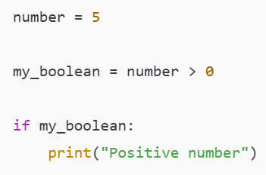
While Loops
A while loop lets you run code repeatedly so long as a Boolean statement is True
Slide 9/11

Slide 118
While Loops
A while loop lets you run code repeatedly so long as a Boolean statement is True
An if statement executes once if the Boolean is True
A while loop executes repeatedly until the Boolean is False
Slide 9/11

Slide 119
Practical
We now move over to Python
Slide 10/11

Slide 120
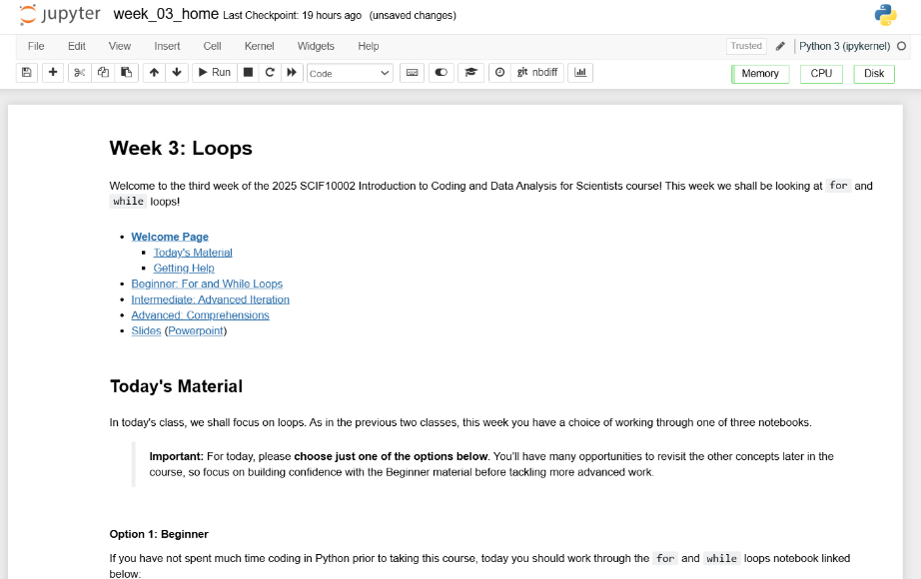
Practical
We now move over to Python
  Please open `week_03_home.ipynb`
For the rest of today, you must work through a Python notebook
You have a choice of one of three options
Slide 10/11

Slide 121
Practical
We now move over to Python
  Please open `week_03_home.ipynb`
For the rest of today, you must work through a Python notebook
You have a choice of one of three options
  Option 1: Beginner – For and While Loops
  Option 2: Intermediate – Advanced Iteration
  Option 3: Advanced – Comprehensions
Slide 10/11

Slide 122
Practical
We now move over to Python
  Please open `week_03_home.ipynb`
For the rest of today, you must work through a Python notebook
You have a choice of one of three options
  Option 1: Beginner – For and While Loops
  Option 2: Intermediate – Advanced Iteration
  Option 3: Advanced – Comprehensions
Choose this if you are just getting started with loops
Slide 10/11

Slide 123
Practical
We now move over to Python
  Please open `week_03_home.ipynb`
For the rest of today, you must work through a Python notebook
You have a choice of one of three options
  Option 1: Beginner – For and While Loops
  Option 2: Intermediate – Advanced Iteration
  Option 3: Advanced – Comprehensions
Choose this if you already have some experience with loops in Python and want to broaden pre-existing knowledge
Slide 10/11

Slide 124
Practical
We now move over to Python
  Please open `week_03_home.ipynb`
For the rest of today, you must work through a Python notebook
You have a choice of one of three options
  Option 1: Beginner – For and While Loops
  Option 2: Intermediate – Advanced Iteration
  Option 3: Advanced – Comprehensions
Choose this if you have a lot of experience already and have been programming for years
Slide 10/11

Slide 125
Practical
We now move over to Python
  Please open `week_03_home.ipynb`
For the rest of today, you must work through a Python notebook
You have a choice of one of three options
  Option 1: Beginner – For and While Loops
  Option 2: Intermediate – Advanced Iteration
  Option 3: Advanced – Comprehensions
Slide 10/11

Slide 126
Practical
We now move over to Python
  Please open `week_03_home.ipynb`
For the rest of today, you must work through a Python notebook
You have a choice of one of three options
  Option 1: Beginner – For and While Loops
  Option 2: Intermediate – Advanced Iteration
  Option 3: Advanced – Comprehensions
Important: If you choose the intermediate or advanced options, make sure you are comfortable with the material in Beginner first!!
Slide 10/11

Slide 127
Recap: Accessing Noteable
Open Blackboard
  Go to “Introduction to Coding and Data Analysis for Scientists 2025”
  Click “Unit Information and Resources”
  Open Noteable
    Make sure “Jupyter Classic (Legacy)” is selected.
    Click Start
  Click “+GitRepo”
  Paste into Git Repository URL:
  https://github.com/jsmartinstats/SCIF10002-2026
  Press clone
Slide 3/10

Slide 128
Next Time
Lecture 3: Loops
  Recap: Accessing Noteable
  Recap: If Statements
  For Loops
  While Loops
  Practical
Lecture 4: Functions
  Recap: For and While Loops
  Functions
  Inputs and Outputs
  Practical
Slide 11/11

