Slide 1
Lecture 6:
The NumPy Module
SCIF10002 – Introduction to Coding and Data
James S Martin
5th November 2026
Slide 0/19

Slide 2
Today’s Lecture
Slide 1/19

Slide 3
Today’s Lecture
Lecture 6: The NumPy Module
  What is NumPy?
  Arrays vs Lists
  Operations on Arrays
  Practical
Lecture 7: Working with NumPy Arrays
  Array indexing and slicing
  Boolean indexing
  Array generation functions
  Random data generation
  Practical
Slide 1/19

Slide 4
Aims
By the end of this lecture, you will be able to:
Slide 2/19

Slide 5
Aims
By the end of this lecture, you will be able to:
  Explain what the NumPy module is and why it is used
Slide 2/19

Slide 6
Aims
By the end of this lecture, you will be able to:
  Explain what the NumPy module is and why it is used
  Create and manipulate NumPy arrays
Slide 2/19

Slide 7
Aims
By the end of this lecture, you will be able to:
  Explain what the NumPy module is and why it is used
  Create and manipulate NumPy arrays
  Perform element-wise operations and mathematical functions on arrays
Slide 2/19

Slide 8
Aims
By the end of this lecture, you will be able to:
  Explain what the NumPy module is and why it is used
  Create and manipulate NumPy arrays
  Perform element-wise operations and mathematical functions on arrays
  Compare NumPy arrays with Python lists in terms of performance and functionality
Slide 2/19

Slide 9
Aims
By the end of this lecture, you will be able to:
  Explain what the NumPy module is and why it is used
  Create and manipulate NumPy arrays
  Perform element-wise operations and mathematical functions on arrays
  Compare NumPy arrays with Python lists in terms of performance and functionality
  Use basic aggregation and array manipulation functions in NumPy
Slide 2/19

Slide 10
What is NumPy ?
Slide 3/19

Slide 11
What is NumPy ?
Slide 3/19

Slide 12
What is NumPy ?
NumPy is a Python library that makes working with numbers and large collections of data fast and easy.
Slide 3/19

Slide 13
What is NumPy ?
NumPy is a Python library that makes working with numbers and large collections of data fast and easy.
It provides special array objects and tools for doing math efficiently, which is useful for data analysis and scientific computing.
Slide 3/19

Slide 14
What is NumPy ?
NumPy is a Python library that makes working with numbers and large collections of data fast and easy.
It provides special array objects and tools for doing math efficiently, which is useful for data analysis and scientific computing.
It is imported in your session using the following command
Slide 3/19

Slide 15

What is NumPy ?
NumPy is a Python library that makes working with numbers and large collections of data fast and easy.
It provides special array objects and tools for doing math efficiently, which is useful for data analysis and scientific computing.
It is imported in your session using the following command
Slide 3/19

Slide 16
What is NumPy ?
NumPy is a Python library that makes working with numbers and large collections of data fast and easy.
It provides special array objects and tools for doing math efficiently, which is useful for data analysis and scientific computing.
It is imported in your session using the following command
We will follow a common practice and use the as syntax
Slide 3/19

Slide 17
What is NumPy ?
NumPy is a Python library that makes working with numbers and large collections of data fast and easy.
It provides special array objects and tools for doing math efficiently, which is useful for data analysis and scientific computing.
It is imported in your session using the following command
We will follow a common practice and use the as syntax
Slide 3/19

Slide 18
What is NumPy ?
NumPy is a Python library that makes working with numbers and large collections of data fast and easy.
It provides special array objects and tools for doing math efficiently, which is useful for data analysis and scientific computing.
It is imported in your session using the following command
We will follow a common practice and use the as syntax
Load in numpy but “call it” np
Slide 3/19

Slide 19
What is NumPy ?
NumPy is a Python library that makes working with numbers and large collections of data fast and easy.
It provides special array objects and tools for doing math efficiently, which is useful for data analysis and scientific computing.
It is imported in your session using the following command
We will follow a common practice and use the as syntax
So, np will always mean numpy for us.
Slide 3/19

Slide 20
Arrays vs Lists
Slide 4/19

Slide 21
Arrays vs Lists
Python Lists
Ordered, Mutable
Mixed data types
Explicit operations needed
Slower performance
Slide 4/19

Slide 22
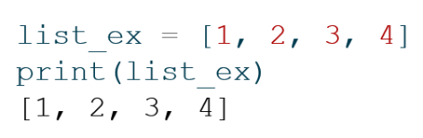

Arrays vs Lists
Python Lists
Ordered, Mutable
Mixed data types
Explicit operations needed
Slower performance
Slide 4/19

Slide 23
Arrays vs Lists
Python Lists
Ordered, Mutable
Mixed data types
Explicit operations needed
Slower performance
Slide 4/19

Slide 24
Arrays vs Lists
Python Lists
Ordered, Mutable
Mixed data types
Explicit operations needed
Slower performance
Slide 4/19

Slide 25
Arrays vs Lists
Python Lists
Ordered, Mutable
Mixed data types
Explicit operations needed
Slower performance
Slide 4/19

Slide 26
Arrays vs Lists
Python Lists
Ordered, Mutable
Mixed data types
Explicit operations needed
Slower performance
NumPy Arrays
Ordered, Mutable
One data type per array
Element-wise operations
Fast & memory efficient
Slide 4/19

Slide 27
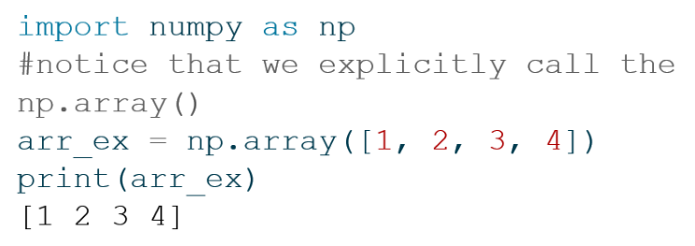
Arrays vs Lists
Python Lists
Ordered, Mutable
Mixed data types
Explicit operations needed
Slower performance
NumPy Arrays
Ordered, Mutable
One data type per array
Element-wise operations
Fast & memory efficient
Slide 4/19

Slide 28
Arrays vs Lists
Python Lists
Ordered, Mutable
Mixed data types
Explicit operations needed
Slower performance
NumPy Arrays
Ordered, Mutable
One data type per array
Element-wise operations
Fast & memory efficient
Slide 4/19

Slide 29
Arrays vs Lists
Python Lists
Ordered, Mutable
Mixed data types
Explicit operations needed
Slower performance
NumPy Arrays
Ordered, Mutable
One data type per array
Element-wise operations
Fast & memory efficient
Slide 4/19

Slide 30
Arrays vs Lists
Python Lists
Ordered, Mutable
Mixed data types
Explicit operations needed
Slower performance
NumPy Arrays
Ordered, Mutable
One data type per array
Element-wise operations
Fast & memory efficient
Slide 4/19

Slide 31
Arrays vs Lists
Python Lists
Ordered, Mutable
Mixed data types
Explicit operations needed
Slower performance
NumPy Arrays
Ordered, Mutable
One data type per array
Element-wise operations
Fast & memory efficient
Slide 4/19

Slide 32
Arrays vs Lists
Python Lists
Ordered, Mutable
Mixed data types
Explicit operations needed
Slower performance
NumPy Arrays
Ordered, Mutable
One data type per array
Element-wise operations
Fast & memory efficient
Slide 4/19

Slide 33
Arrays from Lists
Slide 5/19

Slide 34
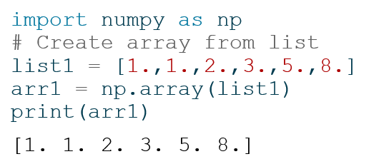
Arrays from Lists
A purely numerical list can readily be converted to an array.
Slide 5/19

Slide 35
Arrays from Lists
A purely numerical list can readily be converted to an array.
Slide 5/19

Slide 36
Arrays from Lists
A purely numerical list can readily be converted to an array.
Slide 5/19

Slide 37
Arrays from Lists
A purely numerical list can readily be converted to an array.
The dtype of the array yields the data type of the elements inside it.
Slide 5/19

Slide 38

Arrays from Lists
A purely numerical list can readily be converted to an array.
The dtype of the array yields the data type of the elements inside it.
Slide 5/19

Slide 39
Arrays from Lists
A purely numerical list can readily be converted to an array.
The dtype of the array yields the data type of the elements inside it.
If we cast the elements in list1 to integers, the dtype would be int64
Slide 5/19

Slide 40
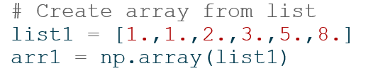
Array Properties
Arrays possess plenty of properties (also known as attributes).
These are accessed with the . notation.
Slide 6/19

Slide 41
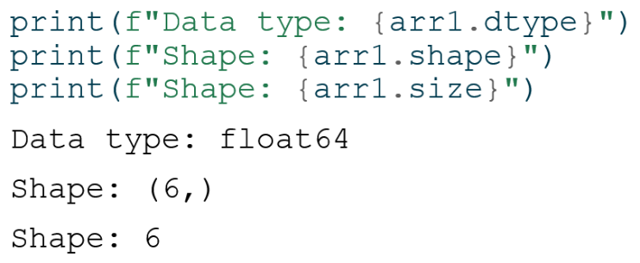
Array Properties
Arrays possess plenty of properties (also known as attributes).
These are accessed with the . notation.
Slide 6/19

Slide 42
Array Properties
Arrays possess plenty of properties (also known as attributes).
These are accessed with the . notation.
Slide 6/19

Slide 43
Array Properties
Arrays possess plenty of properties (also known as attributes).
These are accessed with the . notation.
For now, we consider only 1d arrays, i.e. sequences.
  Their length is their size and corresponds to the first element of the property shape.
Slide 6/19

Slide 44
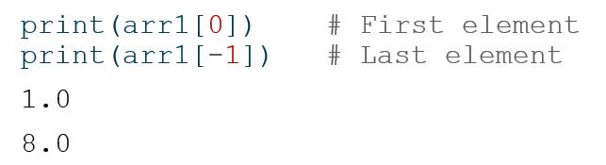
Accessing Array Elements
Similarly to lists, we access an element in an array via zero-based indexing
Slide 7/19

Slide 45
Accessing Array Elements
Similarly to lists, we access an element in an array via zero-based indexing
Slide 7/19

Slide 46
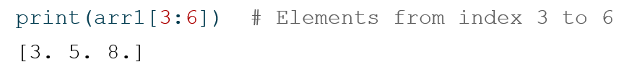
Accessing Array Elements
Similarly to lists, we access an element in an array via zero-based indexing
Again, much like with lists, we can access collections of elements via slicing
Slide 7/19

Slide 47
Accessing Array Elements
Similarly to lists, we access an element in an array via zero-based indexing
Again, much like with lists, we can access collections of elements via slicing
Slide 7/19

Slide 48
Element-wise Operations
The main motivation to use arrays is that lists are cumbersome when performing maths.
Slide 8/19

Slide 49

Element-wise Operations
The main motivation to use arrays is that lists are cumbersome when performing maths.
Suppose we have a list and want to double each of its elements:
Slide 8/19

Slide 50
Element-wise Operations
The main motivation to use arrays is that lists are cumbersome when performing maths.
Suppose we have a list and want to double each of its elements:
We need to loop over all elements in list1 and create a new list
Slide 8/19

Slide 51
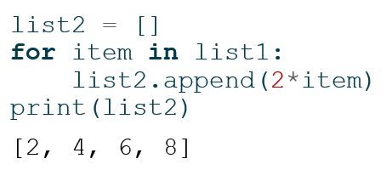
Element-wise Operations
The main motivation to use arrays is that lists are cumbersome when performing maths.
Suppose we have a list and want to double each of its elements:
We need to loop over all elements in list1 and create a new list
Slide 8/19

Slide 52
Element-wise Operations
The main motivation to use arrays is that lists are cumbersome when performing maths.
Suppose we have a list and want to double each of its elements:
We need to loop over all elements in list1 and create a new list
Slide 8/19

Slide 53
Element-wise Operations
The main motivation to use arrays is that lists are cumbersome when performing maths.
Suppose we have a list and want to double each of its elements:
We need to loop over all elements in list1 and create a new list
Slide 8/19

Slide 54
Element-wise Operations
The main motivation to use arrays is that lists are cumbersome when performing maths.
Suppose we have a list and want to double each of its elements:
We need to loop over all elements in list1 and create a new list
We can also do this computation using a list comprehension
Slide 8/19

Slide 55
Element-wise Operations
The main motivation to use arrays is that lists are cumbersome when performing maths.
Suppose we have a list and want to double each of its elements:
We need to loop over all elements in list1 and create a new list
We can also do this computation using a list comprehension
See week 3 advanced notebook for more on list comprehensions
Slide 8/19

Slide 56
Element-wise Operations
The main motivation to use arrays is that lists are cumbersome when performing maths.
Suppose we have a list and want to double each of its elements:
We need to loop over all elements in list1 and create a new list
We can also do this computation using a list comprehension
Still, an explicit loop is needed. Loops in Python are slow.
Slide 8/19

Slide 57
Element-wise Operations
Slide 9/19

Slide 58
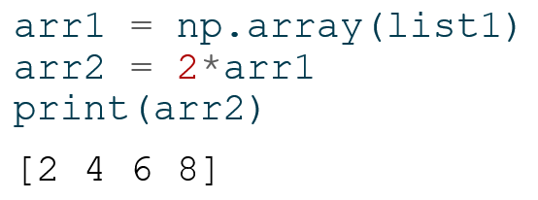
Element-wise Operations
The NumPy syntax avoids the explicit Python loop.
Slide 9/19

Slide 59
Element-wise Operations
The NumPy syntax avoids the explicit Python loop.
Slide 9/19

Slide 60
Element-wise Operations
The NumPy syntax avoids the explicit Python loop.
Slide 9/19

Slide 61
Element-wise Operations
The NumPy syntax avoids the explicit Python loop.
Slide 9/19

Slide 62
Element-wise Operations
The NumPy syntax avoids the explicit Python loop.
This is not just a cosmetic change!
  Under the hood, numpy uses an efficient architecture that performs operations in compiled code, making it much faster than Python loops.
Slide 9/19

Slide 63
Performance Advantage
We can track the performance difference explicitly.
Slide 10/19

Slide 64
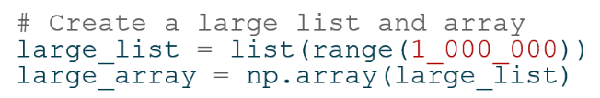
Performance Advantage
We can track the performance difference explicitly.
We create a large list and array with identical elements.
Slide 10/19

Slide 65
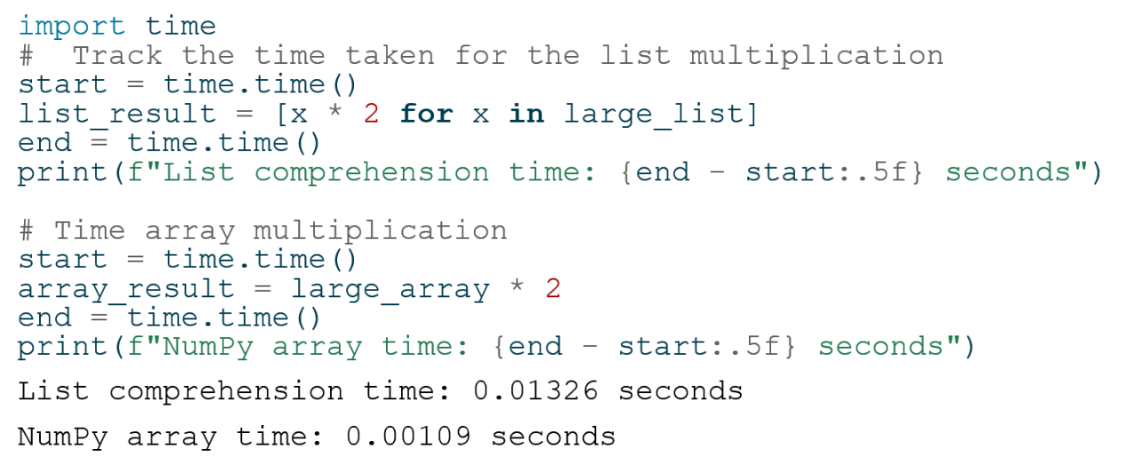
Performance Advantage
We can track the performance difference explicitly.
We create a large list and array with identical elements.
And then track the time for the two operations
Slide 10/19

Slide 66
Performance Advantage
We can track the performance difference explicitly.
We create a large list and array with identical elements.
And then track the time for the two operations
Slide 10/19

Slide 67
Performance Advantage
We can track the performance difference explicitly.
We create a large list and array with identical elements.
And then track the time for the two operations
Slide 10/19

Slide 68
Performance Advantage
We can track the performance difference explicitly.
We create a large list and array with identical elements.
And then track the time for the two operations
Slide 10/19

Slide 69
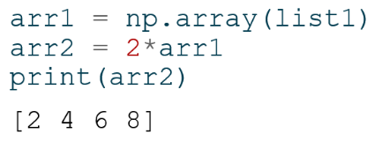
Mathematical Operations in NumPy
The multiplication we saw earlier was performed element-wise
Slide 11/19

Slide 70
Mathematical Operations in NumPy
The multiplication we saw earlier was performed element-wise
  That is, each element was updated according to the same rule.
Slide 11/19

Slide 71
Mathematical Operations in NumPy
The multiplication we saw earlier was performed element-wise
  That is, each element was updated according to the same rule.
We can apply plenty of element-wise operations to NumPy arrays.
Slide 11/19

Slide 72

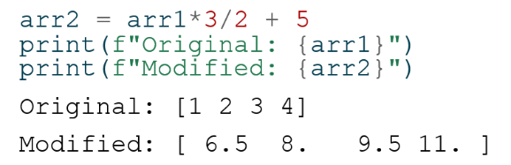
Mathematical Operations in NumPy
The multiplication we saw earlier was performed element-wise
  That is, each element was updated according to the same rule.
We can apply plenty of element-wise operations to NumPy arrays.
Many of these are available as NumPy functions directly accessed from the np. module
Slide 11/19

Slide 73
Mathematical Operations in NumPy
The multiplication we saw earlier was performed element-wise
  That is, each element was updated according to the same rule.
We can apply plenty of element-wise operations to NumPy arrays.
Many of these are available as NumPy functions directly accessed from the np. module
Slide 11/19

Slide 74
Mathematical Operations in NumPy
The multiplication we saw earlier was performed element-wise
  That is, each element was updated according to the same rule.
We can apply plenty of element-wise operations to NumPy arrays.
Many of these are available as NumPy functions directly accessed from the np. module
Slide 11/19

Slide 75
Mathematical Operations in NumPy
The multiplication we saw earlier was performed element-wise
  That is, each element was updated according to the same rule.
We can apply plenty of element-wise operations to NumPy arrays.
Many of these are available as NumPy functions directly accessed from the np. module
Slide 11/19

Slide 76
Mathematical Operations in NumPy
The multiplication we saw earlier was performed element-wise
  That is, each element was updated according to the same rule.
We can apply plenty of element-wise operations to NumPy arrays.
Many of these are available as NumPy functions directly accessed from the np. module
Slide 11/19

Slide 77
Mathematical Operations in NumPy
The multiplication we saw earlier was performed element-wise
  That is, each element was updated according to the same rule.
We can apply plenty of element-wise operations to NumPy arrays.
Many of these are available as NumPy functions directly accessed from the np. module
Slide 11/19

Slide 78
Mathematical Operations in NumPy
The multiplication we saw earlier was performed element-wise
  That is, each element was updated according to the same rule.
We can apply plenty of element-wise operations to NumPy arrays.
Many of these are available as NumPy functions directly accessed from the np. module
Slide 11/19

Slide 79
Mathematical Operations in NumPy
The multiplication we saw earlier was performed element-wise
  That is, each element was updated according to the same rule.
We can apply plenty of element-wise operations to NumPy arrays.
Many of these are available as NumPy functions directly accessed from the np. module
These operations do not modify the original array, but produce new copies
Slide 11/19

Slide 80
Sums
There are also many convenient NumPy functions allow you to accumulate values without loops.
Slide 12/19

Slide 81
Sums
There are also many convenient NumPy functions allow you to accumulate values without loops.
  For instance, we can compute the sum of all elements in an array
  using np.sum
Slide 12/19

Slide 82
Sums
There are also many convenient NumPy functions allow you to accumulate values without loops.
  For instance, we can compute the sum of all elements in an array
  using np.sum
Assume we have an array 𝑥 and we wish to the sum of its elements
Slide 12/19

Slide 83
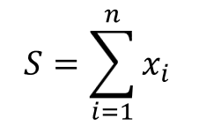
Sums
There are also many convenient NumPy functions allow you to accumulate values without loops.
  For instance, we can compute the sum of all elements in an array
  using np.sum
Assume we have an array 𝑥 and we wish to the sum of its elements
Slide 12/19

Slide 84
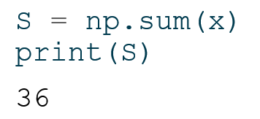
Sums
There are also many convenient NumPy functions allow you to accumulate values without loops.
  For instance, we can compute the sum of all elements in an array
  using np.sum
Assume we have an array 𝑥 and we wish to the sum of its elements
We can do this with the below code:
Slide 12/19

Slide 85
Cumulative Sums
Slide 13/19

Slide 86
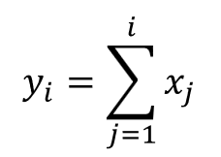
Cumulative Sums
We can also perform cumulative sums using np.cumsum
  A cumulative sum is a sequence where each element is the sum of all previous elements up to that position.
Slide 13/19

Slide 87
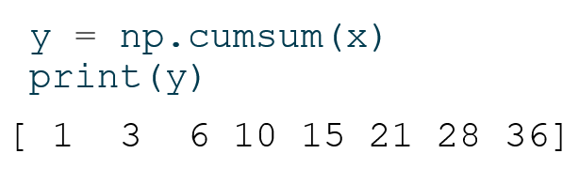
Cumulative Sums
We can also perform cumulative sums using np.cumsum
  A cumulative sum is a sequence where each element is the sum of all previous elements up to that position.
For instance, if we take the array 𝑥 from the previous slide
We can compute the cumulative sums of 𝑥 as follows:
Slide 13/19

Slide 88
Cumulative Sums
We can also perform cumulative sums using np.cumsum
  A cumulative sum is a sequence where each element is the sum of all previous elements up to that position.
For instance, if we take the array 𝑥 from the previous slide
We can compute the cumulative sums of 𝑥 as follows:
Slide 13/19

Slide 89
Example: Molecular Masses
Slide 14/19

Slide 90
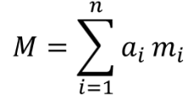
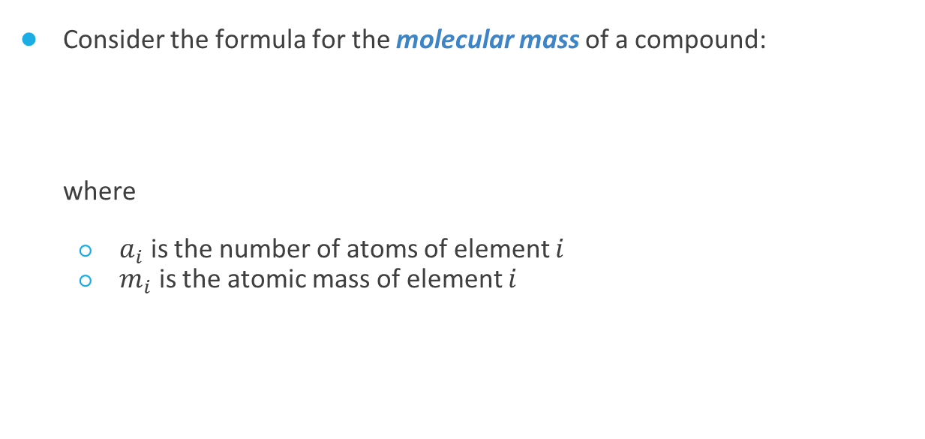
Example: Molecular Masses
Consider the formula for the molecular mass of a compound:
where
  $a_{i}$ is the number of atoms of element $i$
  $m_{i}$ is the atomic mass of element $i$
Slide 14/19

Slide 91
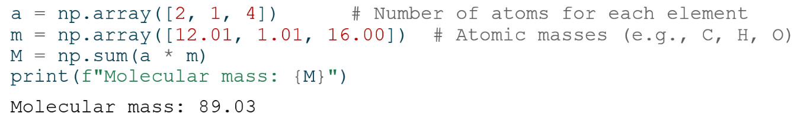
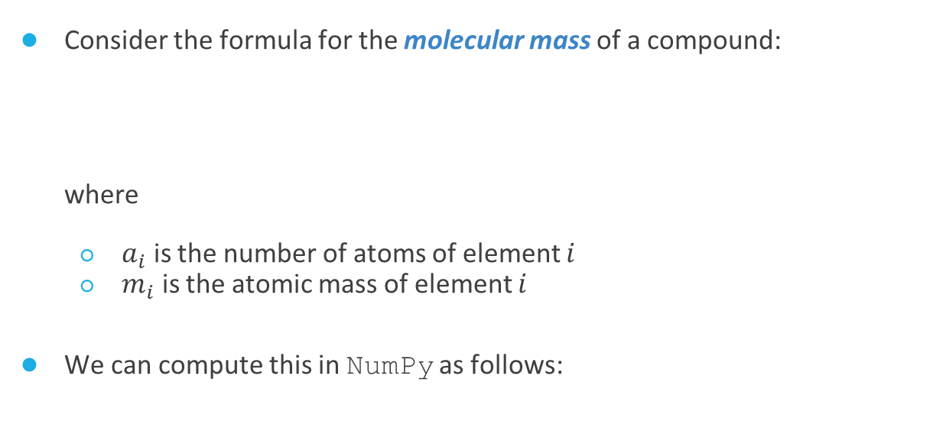
Example: Molecular Masses
Consider the formula for the molecular mass of a compound:
where
  $a_{i}$ is the number of atoms of element $i$
  $m_{i}$ is the atomic mass of element $i$
We can compute this in NumPy as follows:
Slide 14/19

Slide 92
Example: Molecular Masses
Consider the formula for the molecular mass of a compound:
where
  $a_{i}$ is the number of atoms of element $i$
  $m_{i}$ is the atomic mass of element $i$
We can compute this in NumPy as follows:
Slide 14/19

Slide 93
Example: Molecular Masses
Consider the formula for the molecular mass of a compound:
where
  $a_{i}$ is the number of atoms of element $i$
  $m_{i}$ is the atomic mass of element $i$
We can compute this in NumPy as follows:
Slide 14/19

Slide 94
Example: Molecular Masses
Consider the formula for the molecular mass of a compound:
where
  $a_{i}$ is the number of atoms of element $i$
  $m_{i}$ is the atomic mass of element $i$
We can compute this in NumPy as follows:
Slide 14/19

Slide 95
Example: Molecular Masses
Consider the formula for the molecular mass of a compound:
where
  $a_{i}$ is the number of atoms of element $i$
  $m_{i}$ is the atomic mass of element $i$
We can compute this in NumPy as follows:
Slide 14/19

Slide 96
Working with Multiple Arrays
You can perform arithmetic operations directly between arrays of the same shape.
Slide 15/19

Slide 97
Working with Multiple Arrays
You can perform arithmetic operations directly between arrays of the same shape.
  Operations like addition, subtraction, multiplication, and division are applied element-wise.
Slide 15/19

Slide 98
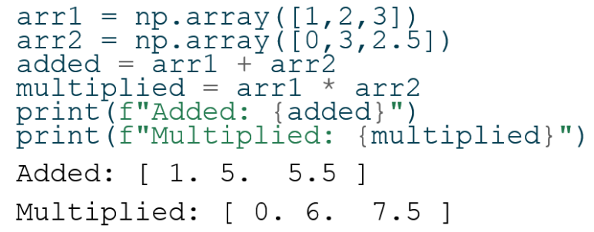
Working with Multiple Arrays
You can perform arithmetic operations directly between arrays of the same shape.
  Operations like addition, subtraction, multiplication, and division are applied element-wise.
Slide 15/19

Slide 99
Working with Multiple Arrays
You can perform arithmetic operations directly between arrays of the same shape.
  Operations like addition, subtraction, multiplication, and division are applied element-wise.
Slide 15/19

Slide 100
Working with Multiple Arrays
You can perform arithmetic operations directly between arrays of the same shape.
  Operations like addition, subtraction, multiplication, and division are applied element-wise.
Slide 15/19

Slide 101
Working with Multiple Arrays
You can perform arithmetic operations directly between arrays of the same shape.
  Operations like addition, subtraction, multiplication, and division are applied element-wise.
Slide 15/19

Slide 102
Working with Multiple Arrays
You can perform arithmetic operations directly between arrays of the same shape.
  Operations like addition, subtraction, multiplication, and division are applied element-wise.
Slide 15/19

Slide 103
Working with Multiple Arrays
You can perform arithmetic operations directly between arrays of the same shape.
  Operations like addition, subtraction, multiplication, and division are applied element-wise.
Note: Arrays must have compatible shapes!
Slide 15/19

Slide 104
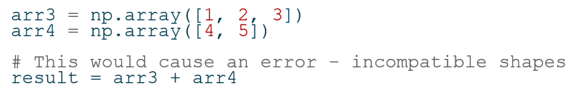
Working with Multiple Arrays
You can perform arithmetic operations directly between arrays of the same shape.
  Operations like addition, subtraction, multiplication, and division are applied element-wise.
Note: Arrays must have compatible shapes!
Slide 15/19

Slide 105
Working with Multiple Arrays
You can perform arithmetic operations directly between arrays of the same shape.
  Operations like addition, subtraction, multiplication, and division are applied element-wise.
Note: Arrays must have compatible shapes!
Slide 15/19

Slide 106
Working with Multiple Arrays
You can perform arithmetic operations directly between arrays of the same shape.
  Operations like addition, subtraction, multiplication, and division are applied element-wise.
Note: Arrays must have compatible shapes!
Slide 15/19

Slide 107
Concatenation
For lists, the + operator performs list concatenation!
Slide 16/19

Slide 108
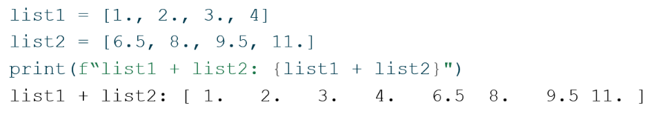
Concatenation
For lists, the + operator performs list concatenation!
Slide 16/19

Slide 109
Concatenation
For lists, the + operator performs list concatenation!
Slide 16/19

Slide 110
Concatenation
For lists, the + operator performs list concatenation!
But for arrays, it performs elementwise addition!
Slide 16/19

Slide 111
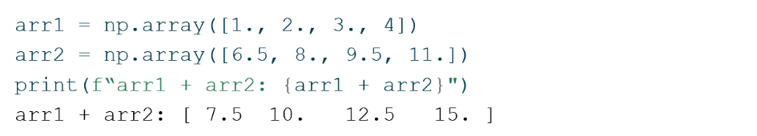
Concatenation
For lists, the + operator performs list concatenation!
But for arrays, it performs elementwise addition!
Slide 16/19

Slide 112
Concatenation
For lists, the + operator performs list concatenation!
But for arrays, it performs elementwise addition!
Slide 16/19

Slide 113
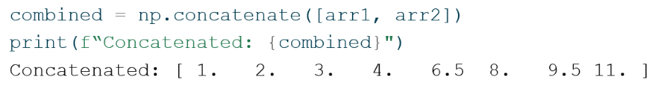
Concatenation
For lists, the + operator performs list concatenation!
But for arrays, it performs elementwise addition!
If you want to concatenate arrays, you can use np.concatenate
Slide 16/19

Slide 114
Concatenation
For lists, the + operator performs list concatenation!
But for arrays, it performs elementwise addition!
If you want to concatenate arrays, you can use np.concatenate
Slide 16/19

Slide 115
Key Takeaways
Slide 17/19

Slide 116
Key Takeaways
NumPy arrays are optimized for numerical operations
Slide 17/19

Slide 117
Key Takeaways
NumPy arrays are optimized for numerical operations
Element-wise operations in NumPy work implicitly
Slide 17/19

Slide 118
Key Takeaways
NumPy arrays are optimized for numerical operations
Element-wise operations in NumPy work implicitly
NumPy provides performance benefits for large datasets
Slide 17/19

Slide 119
Key Takeaways
NumPy arrays are optimized for numerical operations
Element-wise operations in NumPy work implicitly
NumPy provides performance benefits for large datasets
Mathematical functions can be applied to entire arrays
Slide 17/19

Slide 120
Key Takeaways
NumPy arrays are optimized for numerical operations
Element-wise operations in NumPy work implicitly
NumPy provides performance benefits for large datasets
Mathematical functions can be applied to entire arrays
Array shapes must be compatible for many operations
Slide 17/19

Slide 121
Key Takeaways
NumPy arrays are optimized for numerical operations
Element-wise operations in NumPy work implicitly
NumPy provides performance benefits for large datasets
Mathematical functions can be applied to entire arrays
Array shapes must be compatible for many operations
Always choose the right tool for your task
Slide 17/19

Slide 122
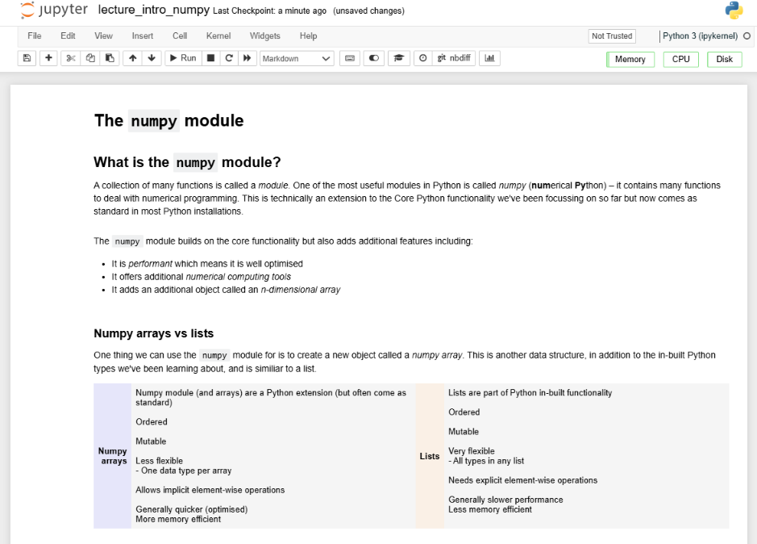
Practical
We now move over to Python
Slide 18/19

Slide 123
Practical
We now move over to Python
For the rest of today, you must do the following:
  First, read through:
  lecture_intro_numpy.ipynb
Slide 18/19

Slide 124
Practical
We now move over to Python
For the rest of today, you must do the following:
  First, read through:
  lecture_intro_numpy.ipynb
  Then, work through the exercises in:
  exercises_numpy.ipynb
Slide 18/19

Slide 125
Practical
We now move over to Python
For the rest of today, you must do the following:
  First, read through:
  lecture_intro_numpy.ipynb
  Then, work through the exercises in:
  exercises_numpy.ipynb
If you finish early, work through intermediate or advanced notebooks from weeks 1-5 that you haven’t yet tried!
Slide 18/19

Slide 126
Next Time
Lecture 6: The NumPy Module
  What is NumPy?
  Arrays vs Lists
  Operations on Arrays
  Practical
Lecture 7: Working with NumPy Arrays
  Array Indexing and Slicing
  Boolean Indexing
  Array Generating Functions
  Random Data Generation
  Practical
Slide 19/19

