Slide 1
Lecture 1:
Introduction & Data Types
SCIF10002 – Introduction to Coding and Data
James S. Martin
24th September 2026
Slide 0/19

Slide 2
Today’s Lecture
Lecture 1: Introduction and Data Types
  Course Structure
  Setting up Noteable
  Introduction to Coding
  Data Types
  Practical
Lecture 2: Booleans and Conditionals
  Recap: Accessing Noteable
  Recap: Booleans
  If statements
  Practical
Slide 1/19

Slide 3
Course Structure
This course will run for 20 weeks
Slide 2/19

Slide 4
Course Structure
This course will run for 20 weeks
We will cover:
  Data types, conditionals and loops
  Building functions
  Numpy arrays and linear algebra in python
  Pandas dataframes
  Plotting and visualisation
Slide 2/19

Slide 5

Course Structure
This course will run for 20 weeks
We will cover:
  Data types, conditionals and loops
  Building functions
  Numpy arrays and linear algebra in python
  Pandas dataframes
  Plotting and visualisation
Contact Details:
Email: james.martin@bristol.ac.uk
Office Hours: Thurs 11am-1pm, Fry Building
- book through jsmartinstats.github.io/teaching
Slide 2/19

Slide 6

Course Structure
This course will run for 20 weeks
We will cover:
  Data types, conditionals and loops
  Building functions
  Numpy arrays and linear algebra in python
  Pandas dataframes
  Plotting and visualisation
Contact Details:
Email: james.martin@bristol.ac.uk
Office Hours: Thurs 11am-1pm, Fry Building
- book through jsmartinstats.github.io/teaching
Contact Details:
Email: ft14968@Bristol.ac.uk
Slide 2/19

Slide 7
Course Structure
This course will run for 20 weeks
We will cover:
  Data types, conditionals and loops
  Building functions
  Numpy arrays and linear algebra in python
  Pandas dataframes
  Plotting and visualisation
Classes:
  1 lecture per week (Thursday)
  1 small-group tutorial per two weeks (date should be on calendar)
Contact Details:
Email: james.martin@bristol.ac.uk
Office Hours: Thurs 11am-1pm, Fry Building
- book through jsmartinstats.github.io/teaching
Contact Details:
Email: ft14968@Bristol.ac.uk
Slide 2/19

Slide 8

Lectures
Slide 3/19
Notes:
Structure – a mix of presentation and practical workshop-style session
Workshop style – the aim here is to give you hands on experience – crucial for coding!
You should try and get some hands-on practice throughout the week.
Don’t just do the exercises in class and leave it until the next week.
This is a 2h session – 10 min break on the hour
Bring a laptop or browser-compatible device
I’d recommend one with a keyboard (rather than a tablet) – but it’s up to you.
Make sure it’s charged before you get here – sockets are around the room, not v handy.
If someone is charging – keep an eye out for cables!
Introduce PhD demonstrators
you are encouraged to collaborate on the non-assessed work during the practical sessions
Obviously don’t collaborate on the assessed work
Any questions about the assessments should be asked of me individually –

Slide 9
Lectures
The weekly lecture will consist of
  ≈ 30-40 minutes presentation time covering:
    Key concepts
    Administrative points (e.g. homework submission etc)
    Code Demonstrations
Slide 3/19
Notes:
Structure – a mix of presentation and practical workshop-style session
Workshop style – the aim here is to give you hands on experience – crucial for coding!
You should try and get some hands-on practice throughout the week.
Don’t just do the exercises in class and leave it until the next week.
This is a 2h session – 10 min break on the hour
Bring a laptop or browser-compatible device
I’d recommend one with a keyboard (rather than a tablet) – but it’s up to you.
Make sure it’s charged before you get here – sockets are around the room, not v handy.
If someone is charging – keep an eye out for cables!
Introduce PhD demonstrators
you are encouraged to collaborate on the non-assessed work during the practical sessions
Obviously don’t collaborate on the assessed work
Any questions about the assessments should be asked of me individually –

Slide 10
Lectures
The weekly lecture will consist of
  ≈ 30-40 minutes presentation time covering:
    Key concepts
    Administrative points (e.g. homework submission etc)
    Code Demonstrations
  ≈ 1-1.5 hours practical
    Designed to provide hands on experience
Slide 3/19
Notes:
Structure – a mix of presentation and practical workshop-style session
Workshop style – the aim here is to give you hands on experience – crucial for coding!
You should try and get some hands-on practice throughout the week.
Don’t just do the exercises in class and leave it until the next week.
This is a 2h session – 10 min break on the hour
Bring a laptop or browser-compatible device
I’d recommend one with a keyboard (rather than a tablet) – but it’s up to you.
Make sure it’s charged before you get here – sockets are around the room, not v handy.
If someone is charging – keep an eye out for cables!
Introduce PhD demonstrators
you are encouraged to collaborate on the non-assessed work during the practical sessions
Obviously don’t collaborate on the assessed work
Any questions about the assessments should be asked of me individually –

Slide 11
Lectures
The weekly lecture will consist of
  ≈ 30-40 minutes presentation time covering:
    Key concepts
    Administrative points (e.g. homework submission etc)
    Code Demonstrations
  ≈ 1-1.5 hours practical
    Designed to provide hands on experience
CRUCIAL TO CODING!!
Slide 3/19
Notes:
Structure – a mix of presentation and practical workshop-style session
Workshop style – the aim here is to give you hands on experience – crucial for coding!
You should try and get some hands-on practice throughout the week.
Don’t just do the exercises in class and leave it until the next week.
This is a 2h session – 10 min break on the hour
Bring a laptop or browser-compatible device
I’d recommend one with a keyboard (rather than a tablet) – but it’s up to you.
Make sure it’s charged before you get here – sockets are around the room, not v handy.
If someone is charging – keep an eye out for cables!
Introduce PhD demonstrators
you are encouraged to collaborate on the non-assessed work during the practical sessions
Obviously don’t collaborate on the assessed work
Any questions about the assessments should be asked of me individually –

Slide 12
Lectures
The weekly lecture will consist of
  ≈ 30-40 minutes presentation time covering:
    Key concepts
    Administrative points (e.g. homework submission etc)
    Code Demonstrations
  ≈ 1-1.5 hours practical
    Designed to provide hands on experience
10 minute break on the hour
CRUCIAL TO CODING!!
Slide 3/19
Notes:
Structure – a mix of presentation and practical workshop-style session
Workshop style – the aim here is to give you hands on experience – crucial for coding!
You should try and get some hands-on practice throughout the week.
Don’t just do the exercises in class and leave it until the next week.
This is a 2h session – 10 min break on the hour
Bring a laptop or browser-compatible device
I’d recommend one with a keyboard (rather than a tablet) – but it’s up to you.
Make sure it’s charged before you get here – sockets are around the room, not v handy.
If someone is charging – keep an eye out for cables!
Introduce PhD demonstrators
you are encouraged to collaborate on the non-assessed work during the practical sessions
Obviously don’t collaborate on the assessed work
Any questions about the assessments should be asked of me individually –

Slide 13
Lectures
The weekly lecture will consist of
  ≈ 30-40 minutes presentation time covering:
    Key concepts
    Administrative points (e.g. homework submission etc)
    Code Demonstrations
  ≈ 1-1.5 hours practical
    Designed to provide hands on experience
10 minute break on the hour
CRUCIAL TO CODING!!
Don’t be this guy!
Please bring a laptop/device – must be able to type code and access the internet!
Slide 3/19
Notes:
Structure – a mix of presentation and practical workshop-style session
Workshop style – the aim here is to give you hands on experience – crucial for coding!
You should try and get some hands-on practice throughout the week.
Don’t just do the exercises in class and leave it until the next week.
This is a 2h session – 10 min break on the hour
Bring a laptop or browser-compatible device
I’d recommend one with a keyboard (rather than a tablet) – but it’s up to you.
Make sure it’s charged before you get here – sockets are around the room, not v handy.
If someone is charging – keep an eye out for cables!
Introduce PhD demonstrators
you are encouraged to collaborate on the non-assessed work during the practical sessions
Obviously don’t collaborate on the assessed work
Any questions about the assessments should be asked of me individually –

Slide 14
Lectures
The weekly lecture will consist of
  ≈ 30-40 minutes presentation time covering:
    Key concepts
    Administrative points (e.g. homework submission etc)
    Code Demonstrations
  ≈ 1-1.5 hours practical
    Designed to provide hands on experience
Opportunity to ask for help from
  Lecturer
  PhD helpers
  Each other!
10 minute break on the hour
CRUCIAL TO CODING!!
Don’t be this guy!
Please bring a laptop/device – must be able to type code and access the internet!
Slide 3/19
Notes:
Structure – a mix of presentation and practical workshop-style session
Workshop style – the aim here is to give you hands on experience – crucial for coding!
You should try and get some hands-on practice throughout the week.
Don’t just do the exercises in class and leave it until the next week.
This is a 2h session – 10 min break on the hour
Bring a laptop or browser-compatible device
I’d recommend one with a keyboard (rather than a tablet) – but it’s up to you.
Make sure it’s charged before you get here – sockets are around the room, not v handy.
If someone is charging – keep an eye out for cables!
Introduce PhD demonstrators
you are encouraged to collaborate on the non-assessed work during the practical sessions
Obviously don’t collaborate on the assessed work
Any questions about the assessments should be asked of me individually –

Slide 15
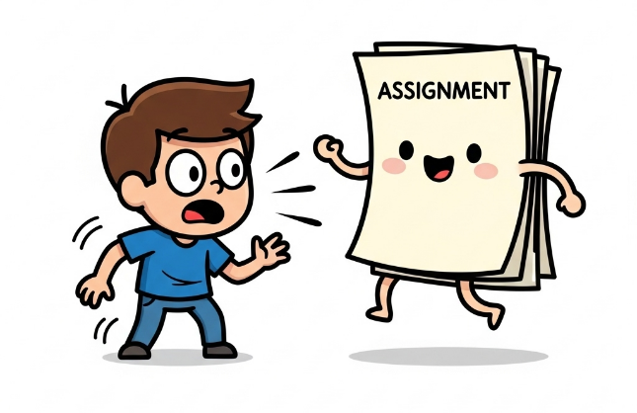
Assignments
Slide 4/19

Slide 16
Assignments
Formative:
  Weekly (optional) assignments available on quarto
Slide 4/19

Slide 17
Assignments
Formative:
  Weekly (optional) assignments available on quarto
Summative:
  This module is 100% coursework
  4 pieces of coursework
Slide 4/19

Slide 18
Assignments
Formative:
  Weekly (optional) assignments available on quarto
Summative:
  This module is 100% coursework
  4 pieces of coursework
    Assignment 1 (15%)
    Assignment 2 (30%)
    Assignment 3 (15%)
    Assignment 4 (40%)
Slide 4/19

Slide 19
Assignments
Formative:
  Weekly (optional) assignments available on quarto
Summative:
  This module is 100% coursework
  4 pieces of coursework
    Assignment 1 (15%)
    Assignment 2 (30%)
    Assignment 3 (15%)
    Assignment 4 (40%)
  Assignments 1-3 will be exercises
  Assignment 4 will be different
Slide 4/19

Slide 20
Assignments
Formative:
  Weekly (optional) assignments available on quarto
Summative:
  This module is 100% coursework
  4 pieces of coursework
    Assignment 1 (15%)
    Assignment 2 (30%)
    Assignment 3 (15%)
    Assignment 4 (40%)
  Assignments 1-3 will be exercises
  Assignment 4 will be different
    Project report analysing a dataset
Slide 4/19

Slide 21
Online Material
The course material is available online via:
Slide 5/19
Notes:
Quarto version – via BB > Topics > Link to the main material of the course

Slide 22

Online Material
The course material is available online via:
  Quarto – online searchable version
Slide 5/19
Notes:
Quarto version – via BB > Topics > Link to the main material of the course

Slide 23

Online Material
The course material is available online via:
  Quarto – online searchable version
  Noteable – interactive interface we shall work in during class
Slide 5/19
Notes:
Quarto version – via BB > Topics > Link to the main material of the course

Slide 24
Accessing Noteable
Slide 6/19
Notes:
Open Noteable through Blackboard
Open the Quarto pages → go to the slides for week 1 → down to the bottom for the link

Slide 25
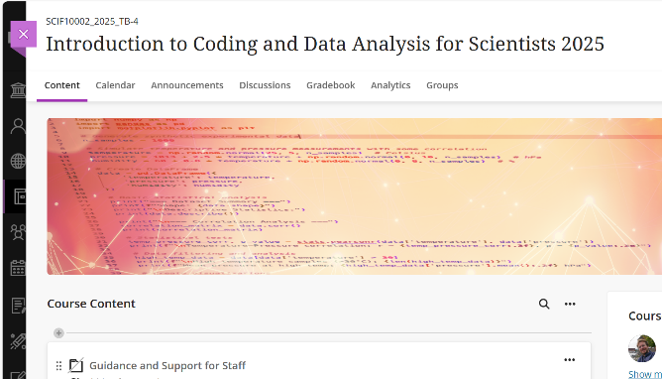
Accessing Noteable
Open Blackboard
  Go to “Introduction to Coding and Data Analysis for Scientists 2025”
  Click “Unit Information and Resources”
  Open Noteable
Slide 6/19
Notes:
Open Noteable through Blackboard
Open the Quarto pages → go to the slides for week 1 → down to the bottom for the link

Slide 26
Accessing Noteable
Open Blackboard
  Go to “Introduction to Coding and Data Analysis for Scientists 2025”
  Click “Unit Information and Resources”
  Open Noteable
    Make sure “Jupyter Classic (Legacy)” is selected.
    Click Start
Slide 6/19
Notes:
Open Noteable through Blackboard
Open the Quarto pages → go to the slides for week 1 → down to the bottom for the link

Slide 27
Accessing Noteable
Open Blackboard
  Go to “Introduction to Coding and Data Analysis for Scientists 2025”
  Click “Unit Information and Resources”
  Open Noteable
    Make sure “Jupyter Classic (Legacy)” is selected.
    Click Start
  Click “+GitRepo”
Slide 6/19
Notes:
Open Noteable through Blackboard
Open the Quarto pages → go to the slides for week 1 → down to the bottom for the link

Slide 28
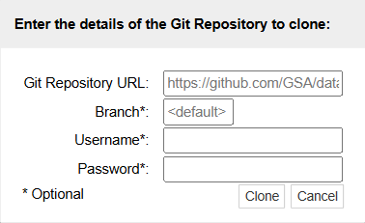
Accessing Noteable
Open Blackboard
  Go to “Introduction to Coding and Data Analysis for Scientists 2025”
  Click “Unit Information and Resources”
  Open Noteable
    Make sure “Jupyter Classic (Legacy)” is selected.
    Click Start
  Click “+GitRepo”
Slide 6/19
Notes:
Open Noteable through Blackboard
Open the Quarto pages → go to the slides for week 1 → down to the bottom for the link

Slide 29
Accessing Noteable
Open Blackboard
  Go to “Introduction to Coding and Data Analysis for Scientists 2025”
  Click “Unit Information and Resources”
  Open Noteable
    Make sure “Jupyter Classic (Legacy)” is selected.
    Click Start
  Click “+GitRepo”
  Paste into Git Repository URL:
  git@github.com:jsmartinstats/SCIF10002-2026.git
  https://github.com/jsmartinstats/SCIF10002-2026
Slide 6/19
Notes:
Open Noteable through Blackboard
Open the Quarto pages → go to the slides for week 1 → down to the bottom for the link
BB > Unit Information and Resources > Access Python

Slide 30
Accessing Noteable
Open Blackboard
  Go to “Introduction to Coding and Data Analysis for Scientists 2025”
  Click “Unit Information and Resources”
  Open Noteable
    Make sure “Jupyter Classic (Legacy)” is selected.
    Click Start
  Click “+GitRepo”
  Paste into Git Repository URL:
  git@github.com:jsmartinstats/SCIF10002-2026.git
  https://github.com/jsmartinstats/SCIF10002-2026
  Press clone
Slide 6/19
Notes:
Open Noteable through Blackboard
Open the Quarto pages → go to the slides for week 1 → down to the bottom for the link
BB > Unit Information and Resources > Access Python

Slide 31

Introduction to Coding
In this module, we shall be learning to code in Python
Slide 7/19

Slide 32
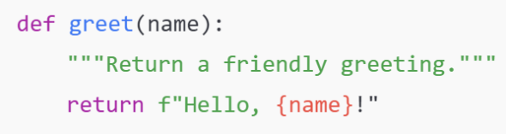
Introduction to Coding
In this module, we shall be learning to code in Python
Slide 7/19

Slide 33
Introduction to Coding
In this module, we shall be learning to code in Python
Python is a programming language
  In the same way humans communicate using different languages, there are many languages we can use to communicate with a computer
Slide 7/19

Slide 34
Introduction to Coding
In this module, we shall be learning to code in Python
Python is a programming language
  In the same way humans communicate using different languages, there are many languages we can use to communicate with a computer
Python is particularly useful for:
  Analysing data
  Making plots and visualisations
  Running simulations
  Machine learning and AI
Slide 7/19

Slide 35
Learning to Code
In fact, learning to code is a lot like learning a language
Slide 8/19

Slide 36
Learning to Code
In fact, learning to code is a lot like learning a language
When learning French, you might:
  Learn many phrases
  Practice writing sentences
  Speak to people who know the language
Slide 8/19

Slide 37
Learning to Code
In fact, learning to code is a lot like learning a language
When learning French, you might:
  Learn many phrases
  Practice writing sentences
  Speak to people who know the language
You can’t learn a language by listening to other people describe it…
Slide 8/19

Slide 38
Learning to Code
In fact, learning to code is a lot like learning a language
When learning French, you might:
  Learn many phrases
  Practice writing sentences
  Speak to people who know the language
You can’t learn a language by listening to other people describe it…
Hands-on experience and regular practice are crucial!
Slide 8/19

Slide 39
Learning to Code
In fact, learning to code is a lot like learning a language
When learning French, you might:
  Learn many phrases
  Practice writing sentences
  Speak to people who know the language
You can’t learn a language by listening to other people describe it…
Hands-on experience and regular practice are crucial!
Our goal is to give you as much practice as possible!
Slide 8/19

Slide 40
Getting Started
So… what actually is coding?
Slide 9/19

Slide 41
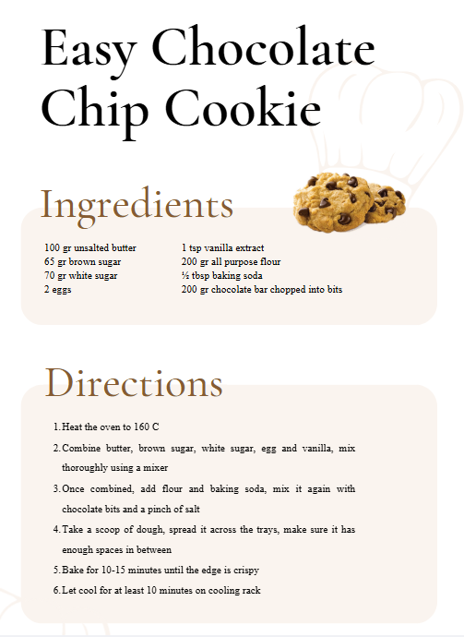
Getting Started
So… what actually is coding?
You can think of writing code as like writing a recipe…
Slide 9/19

Slide 42
Getting Started
So… what actually is coding?
You can think of writing code as like writing a recipe…
  You might start by specifying some ingredients…
  Then list some instructions…
  To get a desired output
Slide 9/19

Slide 43
Getting Started
So… what actually is coding?
You can think of writing code as like writing a recipe…
  You might start by specifying some ingredients…
  Then list some instructions…
  To get a desired output
Slide 9/19

Slide 44
Getting Started
So… what actually is coding?
You can think of writing code as like writing a recipe…
  You might start by specifying some ingredients…
  Then list some instructions…
  To get a desired output
Slide 9/19

Slide 45
Getting Started
So… what actually is coding?
You can think of writing code as like writing a recipe…
  You might start by specifying some ingredients…
  Then list some instructions…
  To get a desired output
Slide 9/19

Slide 46
Getting Started
So… what actually is coding?
You can think of writing code as like writing a recipe…
  You might start by specifying some ingredients…
  Then list some instructions…
  To get a desired output
Coding is pretty similar
Slide 9/19

Slide 47
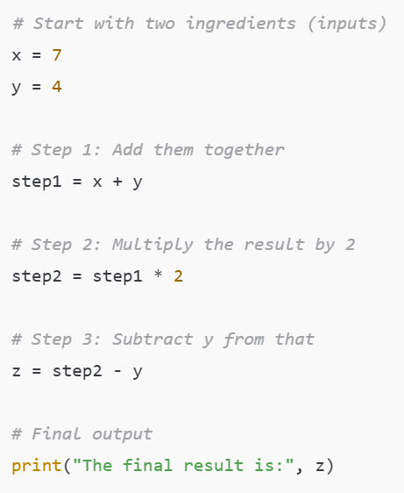
Getting Started
So… what actually is coding?
You can think of writing code as like writing a recipe…
  You might start by specifying some ingredients…
  Then list some instructions…
  To get a desired output
Coding is pretty similar
Slide 9/19

Slide 48
Getting Started
So… what actually is coding?
You can think of writing code as like writing a recipe…
  You might start by specifying some inputs…
  Then list some instructions…
  To get a desired output
Coding is pretty similar
Slide 10/19

Slide 49
Getting Started
So… what actually is coding?
You can think of writing code as like writing a recipe…
  You might start by specifying some inputs…
  Then list some instructions…
  To get a desired output
Coding is pretty similar
Slide 10/19

Slide 50
Getting Started
So… what actually is coding?
You can think of writing code as like writing a recipe…
  You might start by specifying some inputs…
  Then list some instructions…
  To get a desired output
Coding is pretty similar
Slide 10/19

Slide 51
Getting Started
So… what actually is coding?
You can think of writing code as like writing a recipe…
  You might start by specifying some inputs…
  Then list some instructions…
  To get a desired output
Coding is pretty similar
Slide 10/19

Slide 52
Getting Started
So… what actually is coding?
You can think of writing code as like writing a recipe…
  You might start by specifying some inputs…
  Then list some instructions…
  To get a desired output
Coding is pretty similar
Here we are producing some output that might be difficult to compute or evaluate by hand
Slide 10/19
Notes:
Next slide – at each of the first two steps, we progress through by saying one quantity is equal to a given value.
We are assigning values to variables, and it’s worth looking at this in detail

Slide 53
Assigning Variables
Slide 11/19

Slide 54
Assigning Variables
Slide 11/19

Slide 55
Assigning Variables
In this code, x and y are variables
Slide 11/19
Notes:
In regular written maths, “=” is a relational symbol -- we often use “=“ as a statement of fact describing the relationship between the left and right hand side
Here, we’re using it to give an instruction
It is not symmetric → writing 7 = x would give an error.

Slide 56
Assigning Variables
In this code, x and y are variables
These are named pieces of data which we can use for future computations
Slide 11/19
Notes:
In regular written maths, “=” is a relational symbol -- we often use “=“ as a statement of fact describing the relationship between the left and right hand side
Here, we’re using it to give an instruction
It is not symmetric → writing 7 = x would give an error.

Slide 57
Assigning Variables
In this code, x and y are variables
These are named pieces of data which we can use for future computations
The ‘=‘ symbol is the assignment operator.
Slide 11/19
Notes:
In regular written maths, “=” is a relational symbol -- we often use “=“ as a statement of fact describing the relationship between the left and right hand side
Here, we’re using it to give an instruction
It is not symmetric → writing 7 = x would give an error.

Slide 58
Assigning Variables
In this code, x and y are variables
These are named pieces of data which we can use for future computations
The ‘=‘ symbol is the assignment operator.
Assignment operator
Slide 11/19
Notes:
In regular written maths, “=” is a relational symbol -- we often use “=“ as a statement of fact describing the relationship between the left and right hand side
Here, we’re using it to give an instruction
It is not symmetric → writing 7 = x would give an error.

Slide 59
Assigning Variables
In this code, x and y are variables
These are named pieces of data which we can use for future computations
The ‘=‘ symbol is the assignment operator.
  Unlike in maths, this is an instruction
Assignment operator
Slide 11/19
Notes:
In regular written maths, “=” is a relational symbol -- we often use “=“ as a statement of fact describing the relationship between the left and right hand side
Here, we’re using it to give an instruction
It is not symmetric → writing 7 = x would give an error.

Slide 60
Assigning Variables
In this code, x and y are variables
These are named pieces of data which we can use for future computations
The ‘=‘ symbol is the assignment operator.
  Unlike in maths, this is an instruction
  E.g. “x=7” means “Save the integer 7 under the variable name x”
Assignment operator
Slide 11/19
Notes:
In regular written maths, “=” is a relational symbol -- we often use “=“ as a statement of fact describing the relationship between the left and right hand side
Here, we’re using it to give an instruction
It is not symmetric → writing 7 = x would give an error.

Slide 61
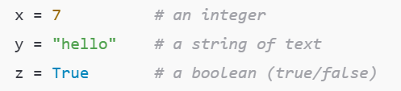
Data Types
When writing the recipe, some foods were of the “same type”
  E.g. we had 2 eggs
Slide 12/19

Slide 62
Data Types
When writing the recipe, some foods were of the “same type”
  E.g. we had 2 eggs
In the same way, in coding we have different types of data
Today, we shall look at some of these
Understanding data types is important, as we want to use different data types for different tasks
Slide 12/19

Slide 63
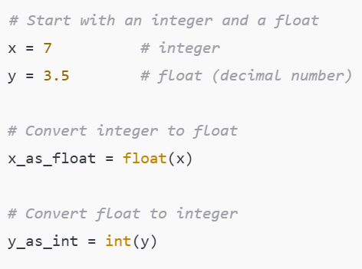

Numeric Data Types
The most ubiquitous data types are numeric
  Integers: Whole numbers/Integers
  ℤ = {…, -3, -2, -1, 0, 1, 2, 3,… }
Slide 13/19

Slide 64
Numeric Data Types
The most ubiquitous data types are numeric
  Integers: Whole numbers/Integers
  ℤ = {…, -3, -2, -1, 0, 1, 2, 3,… }
  Floats: Decimal numbers
  ℝ = Real numbers
Slide 13/19

Slide 65
Numeric Data Types
The most ubiquitous data types are numeric
  Integers: Whole numbers/Integers
  ℤ = {…, -3, -2, -1, 0, 1, 2, 3,… }
  Floats: Decimal numbers
  ℝ = Real numbers
We can convert between floats and integers using the float and int functions.
  What do you think might happen if we convert y to an integer?
Slide 13/19

Slide 66
Numeric Data Types
The most ubiquitous data types are numeric
  Integers: Whole numbers/Integers
  ℤ = {…, -3, -2, -1, 0, 1, 2, 3,… }
  Floats: Decimal numbers
  ℝ = Real numbers
We can convert between floats and integers using the float and int functions.
  What do you think might happen if we convert y to an integer?
Warning: A computer cannot actually describe arbitrarily small and large numbers – it approximates instead
Slide 13/19

Slide 67
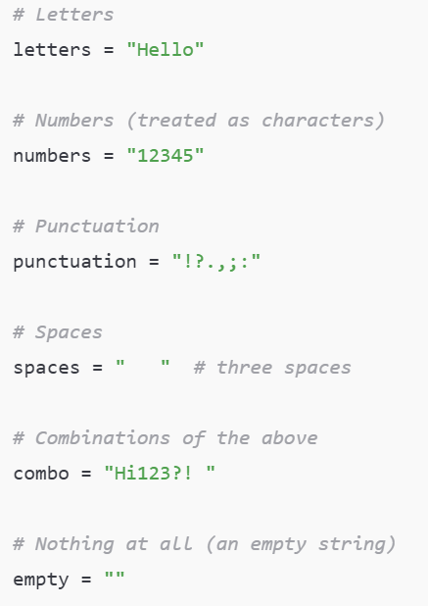
Strings
A string is a sequence of characters. Strings can contain:
Letters
Slide 14/19

Slide 68
Strings
A string is a sequence of characters. Strings can contain:
Letters
  Numbers (treated as characters)
Slide 14/19

Slide 69
Strings
A string is a sequence of characters. Strings can contain:
Letters
  Numbers (treated as characters)
  Punctuation
Slide 14/19

Slide 70
Strings
A string is a sequence of characters. Strings can contain:
Letters
  Numbers (treated as characters)
  Punctuation
  Spaces
Slide 14/19

Slide 71
Strings
A string is a sequence of characters. Strings can contain:
Letters
  Numbers (treated as characters)
  Punctuation
  Spaces
  Combinations of the above
Slide 14/19

Slide 72
Strings
A string is a sequence of characters. Strings can contain:
Letters
  Numbers (treated as characters)
  Punctuation
  Spaces
  Combinations of the above
  Nothing at all
Slide 14/19

Slide 73
Strings
A string is a sequence of characters. Strings can contain:
Letters
  Numbers (treated as characters)
  Punctuation
  Spaces
  Combinations of the above
  Nothing at all
Slide 14/19

Slide 74
Strings
A string is a sequence of characters. Strings can contain:
Letters
  Numbers (treated as characters)
  Punctuation
  Spaces
  Combinations of the above
  Nothing at all
In practice, there are many things we may want to do with text in Python
Split it into sentences
Search through it
Replace words
Slide 14/19

Slide 75
Strings
A string is a sequence of characters. Strings can contain:
Letters
  Numbers (treated as characters)
  Punctuation
  Spaces
  Combinations of the above
  Nothing at all
In practice, there are many things we may want to do with text in Python
Split it into sentences
Search through it
Replace words
After todays practical you will be able to perform some of these operations!
Slide 14/19

Slide 76
Booleans
A Boolean is variable that can be either True or False
Booleans represent logical statements.
Slide 15/19

Slide 77
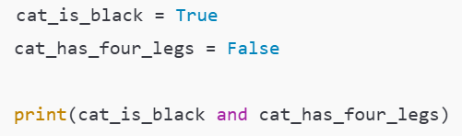
Booleans
A Boolean is variable that can be either True or False
Booleans represent logical statements.
Slide 15/19

Slide 78
Booleans
A Boolean is variable that can be either True or False
Booleans represent logical statements.
For instance, we might think of:
cat_is_black as representing the sentence “The cat is black”
Slide 15/19

Slide 79
Booleans
A Boolean is variable that can be either True or False
Booleans represent logical statements.
For instance, we might think of:
cat_is_black as representing the sentence “The cat is black”
cat_has_four_legs as representing the sentence “The cat has four legs”
Slide 15/19

Slide 80
Booleans
A Boolean is variable that can be either True or False
Booleans represent logical statements.
For instance, we might think of:
cat_is_black as representing the sentence “The cat is black”
cat_has_four_legs as representing the sentence “The cat has four legs”
We can use logical operators to combine Boolean statements
cat_is_black and cat_has_four_legs represents the sentence “The cat is black and has four legs”
Slide 15/19

Slide 81
Booleans
A Boolean is variable that can be either True or False
Booleans represent logical statements.
For instance, we might think of:
cat_is_black as representing the sentence “The cat is black”
cat_has_four_legs as representing the sentence “The cat has four legs”
We can use logical operators to combine Boolean statements
cat_is_black and cat_has_four_legs represents the sentence “The cat is black and has four legs”
Slide 15/19

Slide 82


Booleans
A Boolean is variable that can be either True or False
Booleans represent logical statements.
For instance, we might think of:
cat_is_black as representing the sentence “The cat is black”
cat_has_four_legs as representing the sentence “The cat has four legs”
We can use logical operators to combine Boolean statements
cat_is_black and cat_has_four_legs represents the sentence “The cat is black and has four legs”
Slide 15/19

Slide 83

Booleans
A Boolean is variable that can be either True or False
Booleans represent logical statements.
For instance, we might think of:
cat_is_black as representing the sentence “The cat is black”
cat_has_four_legs as representing the sentence “The cat has four legs”
We can use logical operators to combine Boolean statements
cat_is_black and cat_has_four_legs represents the sentence “The cat is black and has four legs”
Slide 15/19

Slide 84
Booleans
A Boolean is variable that can be either True or False
Booleans represent logical statements.
For instance, we might think of:
cat_is_black as representing the sentence “The cat is black”
cat_has_four_legs as representing the sentence “The cat has four legs”
We can use logical operators to combine Boolean statements
cat_is_black and cat_has_four_legs represents the sentence “The cat is black and has four legs”
Slide 15/19

Slide 85

Booleans
A Boolean is variable that can be either True or False
Booleans represent logical statements.
For instance, we might think of:
cat_is_black as representing the sentence “The cat is black”
cat_has_four_legs as representing the sentence “The cat has four legs”
We can use logical operators to combine Boolean statements
cat_is_black and cat_has_four_legs represents the sentence “The cat is black and has four legs”
Slide 15/19
Notes:
Take a few seconds with the person next to you. Introduce yourselves if you don’t already know them. What are the answers?
Then ask someone for all the answers.

Slide 86
Booleans
A Boolean is variable that can be either True or False
Booleans represent logical statements.
For instance, we might think of:
cat_is_black as representing the sentence “The cat is black”
cat_has_four_legs as representing the sentence “The cat has four legs”
We can use logical operators to combine Boolean statements
cat_is_black and cat_has_four_legs represents the sentence “The cat is black and has four legs”
Slide 15/19

Slide 87
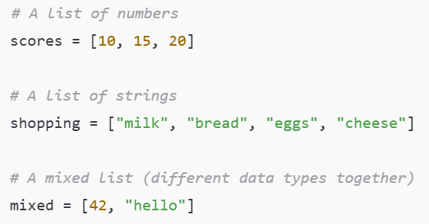
Collections
We’ve now seen some simple examples of datatypes:
  Numeric, strings, and booleans.
Slide 16/19

Slide 88
Collections
We’ve now seen some simple examples of datatypes:
  Numeric, strings, and booleans.
Data types don’t always have to be this simple!
  Sometimes we need data types that can hold more complex information.
A collection is any in-built data type that can group multiple objects together.
Slide 16/19

Slide 89
Collections
We’ve now seen some simple examples of datatypes:
  Numeric, strings, and booleans.
Data types don’t always have to be this simple!
  Sometimes we need data types that can hold more complex information.
A collection is any in-built data type that can group multiple objects together.
The most common collection is a list: an ordered group of items.
We’ll see more examples of collections throughout the course.
Slide 16/19

Slide 90
Collections
We’ve now seen some simple examples of datatypes:
  Numeric, strings, and booleans.
Data types don’t always have to be this simple!
  Sometimes we need data types that can hold more complex information.
A collection is any in-built data type that can group multiple objects together.
The most common collection is a list: an ordered group of items.
We’ll see more examples of collections throughout the course.
Slide 16/19

Slide 91
Collections
We’ve now seen some simple examples of datatypes:
  Numeric, strings, and booleans.
Data types don’t always have to be this simple!
  Sometimes we need data types that can hold more complex information.
A collection is any in-built data type that can group multiple objects together.
The most common collection is a list: an ordered group of items.
We’ll see more examples of collections throughout the course.
Slide 16/19

Slide 92
Collections
We’ve now seen some simple examples of datatypes:
  Numeric, strings, and booleans.
Data types don’t always have to be this simple!
  Sometimes we need data types that can hold more complex information.
A collection is any in-built data type that can group multiple objects together.
The most common collection is a list: an ordered group of items.
We’ll see more examples of collections throughout the course.
Slide 16/19

Slide 93
Collections
We’ve now seen some simple examples of datatypes:
  Numeric, strings, and booleans.
Data types don’t always have to be this simple!
  Sometimes we need data types that can hold more complex information.
A collection is any in-built data type that can group multiple objects together.
The most common collection is a list: an ordered group of items.
  Lists let you store, organize, and work with many values at once.
We’ll see more examples of collections throughout the course.
Slide 16/19
Notes:
Different types of collections – sets, dictionaries, tuples

Slide 94

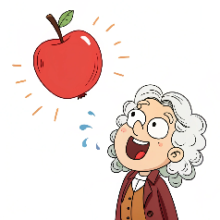

Practical
We have students from a range of courses and backgrounds in this class
  Chemistry
  Physics
  Data Science
Some people in the room will have less experience than others
For the first few weeks, we shall try to account for the differences in ability where possible
Slide 18/19
Notes:
The practical section – some explanatory remarks!

Slide 95
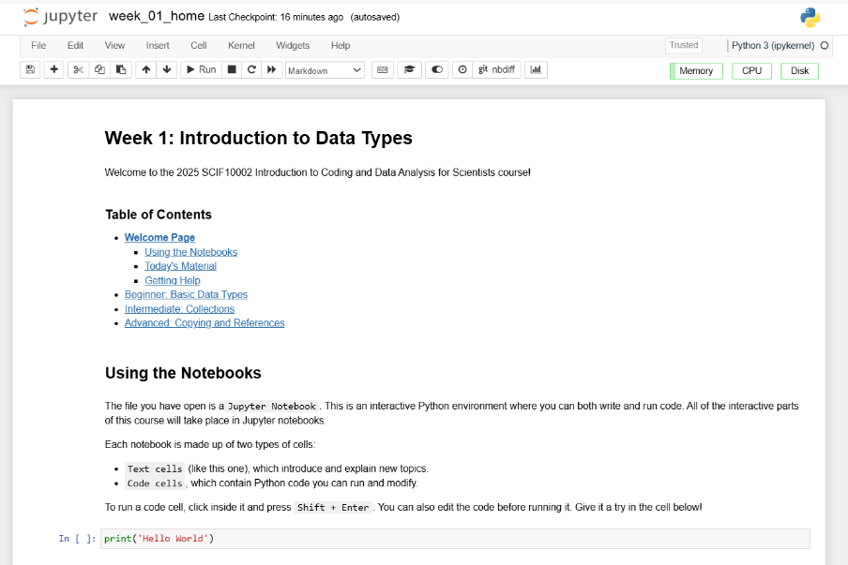
Practical
We now move over to Python
  Please open `week_01_home.ipynb`
For the rest of today, you’ll be working through a Python notebook
Slide 18/19

Slide 96
Practical
We now move over to Python
  Please open `week_01_home.ipynb`
For the rest of today, you’ll be working through a Python notebook
You have a choice of one of three options
  Option 1: Beginner - Basic Data Types
  Option 2: Intermediate - Collections
  Option 3: Advanced - Copying and References
Slide 18/19

Slide 97
Practical
We now move over to Python
  Please open `week_01_home.ipynb`
For the rest of today, you’ll be working through a Python notebook
You have a choice of one of three options
  Option 1: Beginner - Basic Data Types
  Option 2: Intermediate - Collections
  Option 3: Advanced - Copying and References
Choose this if you are new to the Python language or do not code regularly
Slide 18/19

Slide 98
Practical
We now move over to Python
  Please open `week_01_home.ipynb`
For the rest of today, you’ll be working through a Python notebook
You have a choice of one of three options
  Option 1: Beginner - Basic Data Types
  Option 2: Intermediate - Collections
  Option 3: Advanced - Copying and References
Slide 18/19

Slide 99
Practical
We now move over to Python
  Please open `week_01_home.ipynb`
For the rest of today, you’ll be working through a Python notebook
You have a choice of one of three options
  Option 1: Beginner - Basic Data Types
  Option 2: Intermediate - Collections
  Option 3: Advanced - Copying and References
Choose this if you have some experience with Python and are reasonably confident in your programming abilities
Slide 18/19

Slide 100
Practical
We now move over to Python
  Please open `week_01_home.ipynb`
For the rest of today, you’ll be working through a Python notebook
You have a choice of one of three options
  Option 1: Beginner - Basic Data Types
  Option 2: Intermediate - Collections
  Option 3: Advanced - Copying and References
Slide 18/19

Slide 101
Practical
We now move over to Python
  Please open `week_01_home.ipynb`
For the rest of today, you’ll be working through a Python notebook
You have a choice of one of three options
  Option 1: Beginner - Basic Data Types
  Option 2: Intermediate - Collections
  Option 3: Advanced - Copying and References
Choose this if you are a very strong Python programmer with a lot of experience
Slide 18/19

Slide 102
Practical
We now move over to Python
  Please open `week_01_home.ipynb`
For the rest of today, you’ll be working through a Python notebook
You have a choice of one of three options
  Option 1: Beginner - Basic Data Types
  Option 2: Intermediate - Collections
  Option 3: Advanced - Copying and References
Slide 18/19

Slide 103
Practical
We now move over to Python
  Please open `week_01_home.ipynb`
For the rest of today, you’ll be working through a Python notebook
You have a choice of one of three options
  Option 1: Beginner - Basic Data Types
  Option 2: Intermediate - Collections
  Option 3: Advanced - Copying and References
Important: If you choose the intermediate or advanced options, make sure you are comfortable with the material in Beginner first!!
Slide 18/19
Notes:
Common question – what is assessed?
The material in ‘beginner’ is fair game for assessment.
This split is just for the first few weeks
There might be some of today’s Intermediate material that is assessed – but we’ll come back to that material in more detail later in the course.
Reminder -- don’t just work on this today and leave it all until next week -- I would encourage you to take a look throughout the week – little and often is better than getting it all done in one go.
Before starting – mentimeter

Slide 104
Accessing Noteable
Open Blackboard
  Go to “Introduction to Coding and Data Analysis for Scientists 2025”
  Click “Unit Information and Resources”
  Open Noteable
    Make sure “Jupyter Classic (Legacy)” is selected.
    Click Start
  Click “+GitRepo”
  Paste into Git Repository URL:
  git@github.com:jsmartinstats/SCIF10002-2026.git
  https://github.com/jsmartinstats/SCIF10002-2026
  Press clone
Slide 6/19
Notes:
BB > Unit Information and Resources > Access Python
Before starting – mentimeter

Slide 105
Next Time
Lecture 1: Introduction and Data Types
  Course Structure
  Setting up Noteable
  Introduction to Coding
  Data Types
  Practical
Lecture 2: Booleans and Conditionals
  Recap: Accessing Noteable
  Recap: Booleans
  If statements
  Practical
Slide 19/19
Notes:
Before starting – mentimeter

