Slide 1
Lecture 5:
Consolidation
SCIF10002 – Introduction to Coding and Data
James S Martin
22nd October 2026
Slide 0/11

Slide 2
Today’s Lecture
Lecture 5: Consolidation
  Recap: The Course So Far
  Tackling Difficult Problems
  A Worked Example
  Practical
Lecture 6: Introduction to NumPy
  Recap: The Course So Far
  What is NumPy?
  NumPy Arrays
  Arrays vs Lists
  Practical
Slide 1/11

Slide 3
Recap: The Course So Far
Over the last 4 weeks, we’ve covered the basics of Python
We’ve looked at:
Slide 2/11

Slide 4
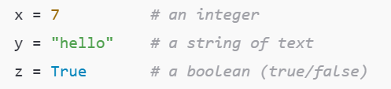

Recap: The Course So Far
Over the last 4 weeks, we’ve covered the basics of Python
We’ve looked at:
  Datatypes
Slide 2/11

Slide 5
Recap: The Course So Far
Over the last 4 weeks, we’ve covered the basics of Python
We’ve looked at:
  Datatypes
Slide 2/11

Slide 6
Recap: The Course So Far
Over the last 4 weeks, we’ve covered the basics of Python
We’ve looked at:
  Datatypes
Slide 2/11

Slide 7
Recap: The Course So Far
Over the last 4 weeks, we’ve covered the basics of Python
We’ve looked at:
  Datatypes
Slide 2/11

Slide 8
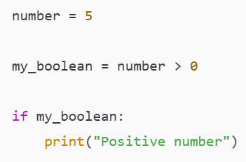
Recap: The Course So Far
Over the last 4 weeks, we’ve covered the basics of Python
We’ve looked at:
  Datatypes
  Conditional Logic
Slide 2/11

Slide 9
Recap: The Course So Far
Over the last 4 weeks, we’ve covered the basics of Python
We’ve looked at:
  Datatypes
  Conditional Logic
Slide 2/11

Slide 10
Recap: The Course So Far
Over the last 4 weeks, we’ve covered the basics of Python
We’ve looked at:
  Datatypes
  Conditional Logic
Slide 2/11

Slide 11
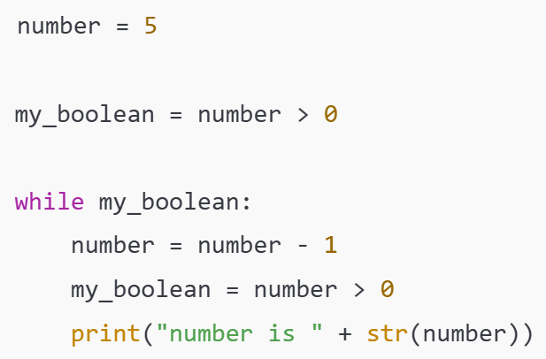
Recap: The Course So Far
Over the last 4 weeks, we’ve covered the basics of Python
We’ve looked at:
  Datatypes
  Conditional Logic
  Loops
Slide 2/11

Slide 12
Recap: The Course So Far
Over the last 4 weeks, we’ve covered the basics of Python
We’ve looked at:
  Datatypes
  Conditional Logic
  Loops
Slide 2/11

Slide 13
Recap: The Course So Far
Over the last 4 weeks, we’ve covered the basics of Python
We’ve looked at:
  Datatypes
  Conditional Logic
  Loops
Slide 2/11

Slide 14
Recap: The Course So Far
Over the last 4 weeks, we’ve covered the basics of Python
We’ve looked at:
  Datatypes
  Conditional Logic
  Loops
Slide 2/11

Slide 15
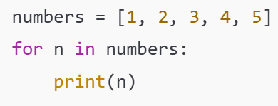
Recap: The Course So Far
Over the last 4 weeks, we’ve covered the basics of Python
We’ve looked at:
  Datatypes
  Conditional Logic
  Loops
Slide 2/11

Slide 16
Recap: The Course So Far
Over the last 4 weeks, we’ve covered the basics of Python
We’ve looked at:
  Datatypes
  Conditional Logic
  Loops
Slide 2/11

Slide 17
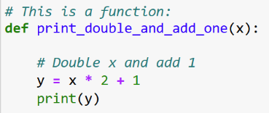
Recap: The Course So Far
Over the last 4 weeks, we’ve covered the basics of Python
We’ve looked at:
  Datatypes
  Conditional Logic
  Loops
  Functions
Slide 2/11

Slide 18
Recap: The Course So Far
Over the last 4 weeks, we’ve covered the basics of Python
We’ve looked at:
  Datatypes
  Conditional Logic
  Loops
  Functions
Slide 2/11

Slide 19
Recap: The Course So Far
Over the last 4 weeks, we’ve covered the basics of Python
We’ve looked at:
  Datatypes
  Conditional Logic
  Loops
  Functions
Before moving on to the next parts of the course…
  NumPy, Pandas and Matplotlib
Slide 2/11

Slide 20
Recap: The Course So Far
Over the last 4 weeks, we’ve covered the basics of Python
We’ve looked at:
  Datatypes
  Conditional Logic
  Loops
  Functions
Before moving on to the next parts of the course…
  NumPy, Pandas and Matplotlib
… this week we are going to do some “consolidation challenges”
  Using what we have learnt to tackle the kinds of tasks you might encounter in the real world
Slide 2/11

Slide 21
Aside: Dictionaries
Before we dive into today’s work, there is one concept we’d like to revisit in more detail
Slide 3/11

Slide 22
Aside: Dictionaries
Before we dive into today’s work, there is one concept we’d like to revisit in more detail
A dictionary, or “dict”, is a data type in Python
  It allows us to store values under keys
Slide 3/11

Slide 23
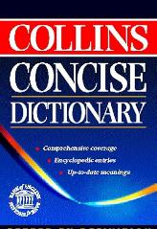
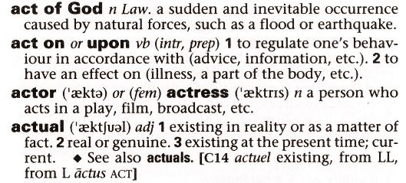
Aside: Dictionaries
Before we dive into today’s work, there is one concept we’d like to revisit in more detail
A dictionary, or “dict”, is a data type in Python
  It allows us to store values under keys
Think of a real-life dictionary
Slide 3/11

Slide 24
Aside: Dictionaries
Before we dive into today’s work, there is one concept we’d like to revisit in more detail
A dictionary, or “dict”, is a data type in Python
  It allows us to store values under keys
Think of a real-life dictionary
  You look up a word (the key)
Slide 3/11

Slide 25
Aside: Dictionaries
Before we dive into today’s work, there is one concept we’d like to revisit in more detail
A dictionary, or “dict”, is a data type in Python
  It allows us to store values under keys
Think of a real-life dictionary
  You look up a word (the key)
key
(the name you look up!)
Slide 3/11

Slide 26
Aside: Dictionaries
Before we dive into today’s work, there is one concept we’d like to revisit in more detail
A dictionary, or “dict”, is a data type in Python
  It allows us to store values under keys
Think of a real-life dictionary
  You look up a word (the key)
  You read its definition (the value)
Slide 3/11

Slide 27
Aside: Dictionaries
Before we dive into today’s work, there is one concept we’d like to revisit in more detail
A dictionary, or “dict”, is a data type in Python
  It allows us to store values under keys
Think of a real-life dictionary
  You look up a word (the key)
  You read its definition (the value)
Value
(the information you get back!)
Slide 3/11

Slide 28
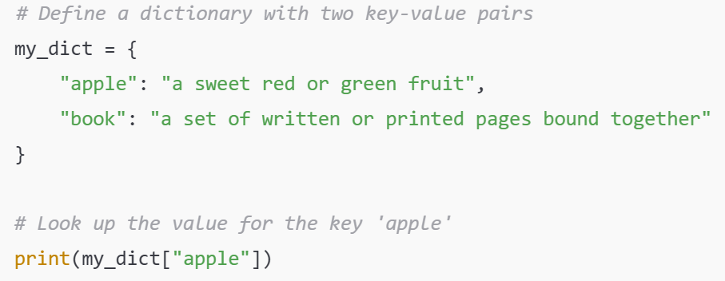
Aside: Dictionaries
Before we dive into today’s work, there is one concept we’d like to revisit in more detail
A dictionary, or “dict”, is a data type in Python
  It allows us to store values under keys
Think of a real-life dictionary
  You look up a word (the key)
  You read its definition (the value)
In the same way, a Python dict allows you to
  Look up a key
  Get back the value associated with it
Slide 3/11

Slide 29
Aside: Dictionaries
Before we dive into today’s work, there is one concept we’d like to revisit in more detail
A dictionary, or “dict”, is a data type in Python
  It allows us to store values under keys
Think of a real-life dictionary
  You look up a word (the key)
  You read its definition (the value)
In the same way, a Python dict allows you to
  Look up a key
  Get back the value associated with it
Slide 3/11

Slide 30
Aside: Dictionaries
Before we dive into today’s work, there is one concept we’d like to revisit in more detail
A dictionary, or “dict”, is a data type in Python
  It allows us to store values under keys
Think of a real-life dictionary
  You look up a word (the key)
  You read its definition (the value)
In the same way, a Python dict allows you to
  Look up a key
  Get back the value associated with it
Slide 3/11

Slide 31
Aside: Dictionaries
Before we dive into today’s work, there is one concept we’d like to revisit in more detail
A dictionary, or “dict”, is a data type in Python
  It allows us to store values under keys
Think of a real-life dictionary
  You look up a word (the key)
  You read its definition (the value)
In the same way, a Python dict allows you to
  Look up a key
  Get back the value associated with it
Name of the dictionary
Slide 3/11

Slide 32
Aside: Dictionaries
Before we dive into today’s work, there is one concept we’d like to revisit in more detail
A dictionary, or “dict”, is a data type in Python
  It allows us to store values under keys
Think of a real-life dictionary
  You look up a word (the key)
  You read its definition (the value)
In the same way, a Python dict allows you to
  Look up a key
  Get back the value associated with it
Assignment operator
Slide 3/11

Slide 33
Aside: Dictionaries
Before we dive into today’s work, there is one concept we’d like to revisit in more detail
A dictionary, or “dict”, is a data type in Python
  It allows us to store values under keys
Think of a real-life dictionary
  You look up a word (the key)
  You read its definition (the value)
In the same way, a Python dict allows you to
  Look up a key
  Get back the value associated with it
Slide 3/11

Slide 34
Aside: Dictionaries
Before we dive into today’s work, there is one concept we’d like to revisit in more detail
A dictionary, or “dict”, is a data type in Python
  It allows us to store values under keys
Think of a real-life dictionary
  You look up a word (the key)
  You read its definition (the value)
In the same way, a Python dict allows you to
  Look up a key
  Get back the value associated with it
Curly braces defining the dictionary
Slide 3/11

Slide 35
Aside: Dictionaries
Before we dive into today’s work, there is one concept we’d like to revisit in more detail
A dictionary, or “dict”, is a data type in Python
  It allows us to store values under keys
Think of a real-life dictionary
  You look up a word (the key)
  You read its definition (the value)
In the same way, a Python dict allows you to
  Look up a key
  Get back the value associated with it
key
(the name you look up!)
Slide 3/11

Slide 36
Aside: Dictionaries
Before we dive into today’s work, there is one concept we’d like to revisit in more detail
A dictionary, or “dict”, is a data type in Python
  It allows us to store values under keys
Think of a real-life dictionary
  You look up a word (the key)
  You read its definition (the value)
In the same way, a Python dict allows you to
  Look up a key
  Get back the value associated with it
colon – tells us this is a “key : value” pair
Slide 3/11

Slide 37
Aside: Dictionaries
Before we dive into today’s work, there is one concept we’d like to revisit in more detail
A dictionary, or “dict”, is a data type in Python
  It allows us to store values under keys
Think of a real-life dictionary
  You look up a word (the key)
  You read its definition (the value)
In the same way, a Python dict allows you to
  Look up a key
  Get back the value associated with it
Value (the information you get back!)
Slide 3/11

Slide 38
Aside: Dictionaries
Before we dive into today’s work, there is one concept we’d like to revisit in more detail
A dictionary, or “dict”, is a data type in Python
  It allows us to store values under keys
Think of a real-life dictionary
  You look up a word (the key)
  You read its definition (the value)
In the same way, a Python dict allows you to
  Look up a key
  Get back the value associated with it
This will print:
Slide 3/11

Slide 39
Aside: Dictionaries
Before we dive into today’s work, there is one concept we’d like to revisit in more detail
A dictionary, or “dict”, is a data type in Python
  It allows us to store values under keys
Think of a real-life dictionary
  You look up a word (the key)
  You read its definition (the value)
In the same way, a Python dict allows you to
  Look up a key
  Get back the value associated with it
This will print: a sweet red or green fruit
Slide 3/11

Slide 40
Aside: Dictionaries
New values can be added to the dictionary using the syntax
  my_dict[key] = value
Slide 4/11

Slide 41
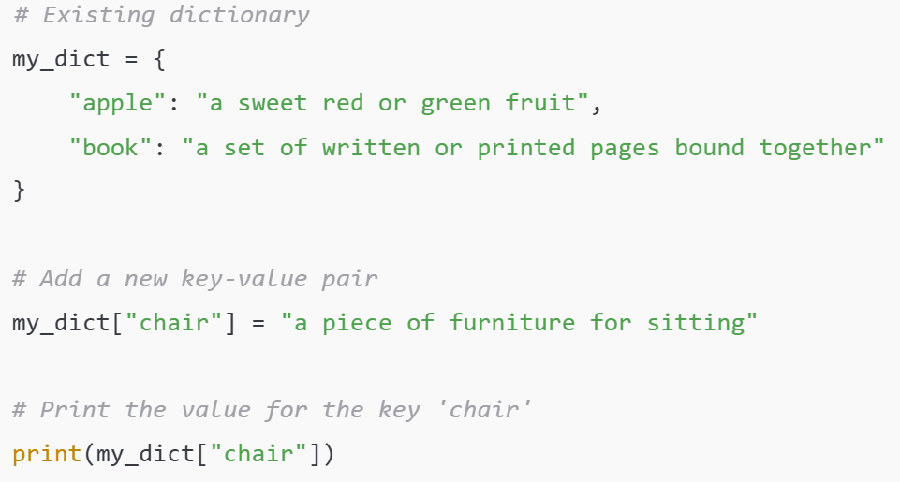
Aside: Dictionaries
New values can be added to the dictionary using the syntax
  my_dict[key] = value
Slide 4/11

Slide 42
Aside: Dictionaries
New values can be added to the dictionary using the syntax
  my_dict[key] = value
Slide 4/11

Slide 43
Aside: Dictionaries
New values can be added to the dictionary using the syntax
  my_dict[key] = value
Slide 4/11

Slide 44
Aside: Dictionaries
New values can be added to the dictionary using the syntax
  my_dict[key] = value
Prints:
a piece of furniture for sitting
Slide 4/11

Slide 45
Aside: Dictionaries
New values can be added to the dictionary using the syntax
  my_dict[key] = value
And keys and values can be any datatype you like
  They don’t have to be strings!
Slide 4/11

Slide 46
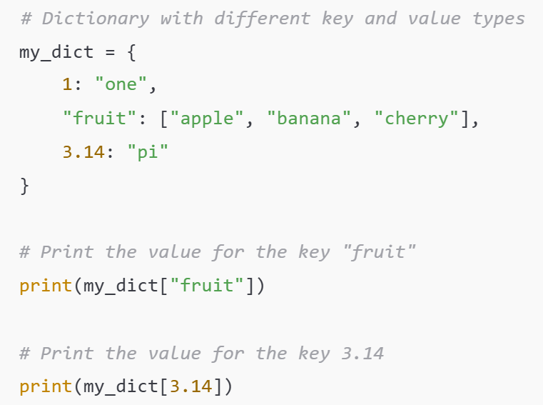
Aside: Dictionaries
New values can be added to the dictionary using the syntax
  my_dict[key] = value
And keys and values can be any datatype you like
  They don’t have to be strings!
Slide 4/11

Slide 47
Aside: Dictionaries
New values can be added to the dictionary using the syntax
  my_dict[key] = value
And keys and values can be any datatype you like
  They don’t have to be strings!
Slide 4/11

Slide 48
Aside: Dictionaries
New values can be added to the dictionary using the syntax
  my_dict[key] = value
And keys and values can be any datatype you like
  They don’t have to be strings!
Prints: [“apple”, “banana”, “cherry”]
Slide 4/11

Slide 49
Aside: Dictionaries
New values can be added to the dictionary using the syntax
  my_dict[key] = value
And keys and values can be any datatype you like
  They don’t have to be strings!
Slide 4/11

Slide 50
Aside: Dictionaries
New values can be added to the dictionary using the syntax
  my_dict[key] = value
And keys and values can be any datatype you like
  They don’t have to be strings!
Prints: “pi”
Slide 4/11

Slide 51
Aside: Dictionaries
New values can be added to the dictionary using the syntax
  my_dict[key] = value
And keys and values can be any datatype you like
  They don’t have to be strings!
Dictionaries will be crucial to some of today’s challenges as well as throughout the rest of this course
If you are unsure about these please take the time to read over:
  Week 1’s intermediate notebook
  Section: Sets and Dictionaries
You can do this either in today’s class or over the week 6 break
Slide 4/11

Slide 52
Tackling Difficult Problems
Slide 5/11

Slide 53

Tackling Difficult Problems
Today, we’re going to be looking at some challenge problems
Slide 5/11

Slide 54
Tackling Difficult Problems
Horrendous Assignment
Today, we’re going to be looking at some challenge problems
These problems may feel a little more open-ended than you are used to
  This can be a little daunting at first
  But do not worry…
Slide 5/11

Slide 55
Tackling Difficult Problems
Horrendous Assignment
Today, we’re going to be looking at some challenge problems
These problems may feel a little more open-ended than you are used to
  This can be a little daunting at first
  But do not worry…
  You already have all the skills necessary to complete the tasks!
Well-prepared SCIF10002 student
Slide 5/11

Slide 56
Tackling Difficult Problems
Today, we’re going to be looking at some challenge problems
These problems may feel a little more open-ended than you are used to
  This can be a little daunting at first
  But do not worry…
  You already have all the skills necessary to complete the tasks!
When faced with a difficult coding problem, here’s some general tips to help you get started out
Slide 5/11

Slide 57
Tackling Difficult Problems
Plan before you code
Clarify inputs and outputs
Look for structure and repetition
Slide 6/11

Slide 58
Tackling Difficult Problems
Plan before you code
Clarify inputs and outputs
Look for structure and repetition
Slide 6/11

Slide 59
Tackling Difficult Problems
Plan before you code
  Before you start coding, grab a pen and paper and try to solve the problem by hand!
Clarify inputs and outputs
Look for structure and repetition
Slide 6/11

Slide 60
Tackling Difficult Problems
Plan before you code
  Before you start coding, grab a pen and paper and try to solve the problem by hand!
Clarify inputs and outputs
Look for structure and repetition
Think about how you would do the computation first!
Slide 6/11

Slide 61
Tackling Difficult Problems
Plan before you code
  Before you start coding, grab a pen and paper and try to solve the problem by hand!
Clarify inputs and outputs
  When getting started think about what you have and what you need – these are probably your inputs and outputs
Look for structure and repetition
Slide 6/11

Slide 62
Tackling Difficult Problems
Plan before you code
  Before you start coding, grab a pen and paper and try to solve the problem by hand!
Clarify inputs and outputs
  When getting started think about what you have and what you need – these are probably your inputs and outputs
Look for structure and repetition
Ask yourself:
What information do I have before I start coding?
Slide 6/11

Slide 63
Tackling Difficult Problems
Plan before you code
  Before you start coding, grab a pen and paper and try to solve the problem by hand!
Clarify inputs and outputs
  When getting started think about what you have and what you need – these are probably your inputs and outputs
Look for structure and repetition
Ask yourself:
What information do I have before I start coding?
What do I want my code to produce?
Slide 6/11

Slide 64
Tackling Difficult Problems
Plan before you code
  Before you start coding, grab a pen and paper and try to solve the problem by hand!
Clarify inputs and outputs
  When getting started think about what you have and what you need – these are probably your inputs and outputs
Look for structure and repetition
  When you convert your thoughts to code, ask yourself which parts of the code are repetitive or self-contained
Slide 6/11

Slide 65
Tackling Difficult Problems
Plan before you code
  Before you start coding, grab a pen and paper and try to solve the problem by hand!
Clarify inputs and outputs
  When getting started think about what you have and what you need – these are probably your inputs and outputs
Look for structure and repetition
  When you convert your thoughts to code, ask yourself which parts of the code are repetitive or self-contained
Repetitive computation – think loops!
Self contained-computation – think functions!
Slide 6/11

Slide 66
Tackling Difficult Problems
Divide and Conquer
Talk things through
Use Resources
Trust your own process
Slide 7/11

Slide 67
Tackling Difficult Problems
Divide and Conquer
  Try to break the task down into smaller chunks where possible!
Talk things through
Use Resources
Trust your own process
Slide 7/11

Slide 68
Tackling Difficult Problems
Divide and Conquer
  Try to break the task down into smaller chunks where possible!
Talk things through
Use Resources
Trust your own process
How can we make the task simpler/more manageable?
Slide 7/11

Slide 69
Tackling Difficult Problems
Divide and Conquer
  Try to break the task down into smaller chunks where possible!
Talk things through
  If you are struggling to get started, talk through the problem with a friend or peer
Use Resources
Trust your own process
Slide 7/11

Slide 70
Tackling Difficult Problems
Divide and Conquer
  Try to break the task down into smaller chunks where possible!
Talk things through
  If you are struggling to get started, talk through the problem with a friend or peer
Use Resources
Trust your own process
Talking things through can help organise your thoughts!
Slide 7/11

Slide 71
Tackling Difficult Problems
Divide and Conquer
  Try to break the task down into smaller chunks where possible!
Talk things through
  If you are struggling to get started, talk through the problem with a friend or peer
Use Resources
  Googling and looking up documentation are key coding skills
Trust your own process
Slide 7/11

Slide 72
Tackling Difficult Problems
Divide and Conquer
  Try to break the task down into smaller chunks where possible!
Talk things through
  If you are struggling to get started, talk through the problem with a friend or peer
Use Resources
  Googling and looking up documentation are key coding skills
Trust your own process
Don’t be afraid to google!
Slide 7/11

Slide 73
Tackling Difficult Problems
Divide and Conquer
  Try to break the task down into smaller chunks where possible!
Talk things through
  If you are struggling to get started, talk through the problem with a friend or peer
Use Resources
  Googling and looking up documentation are key coding skills
Trust your own process
  Try to avoid using AI to make structural decisions about your code
Slide 7/11

Slide 74
Tackling Difficult Problems
Divide and Conquer
  Try to break the task down into smaller chunks where possible!
Talk things through
  If you are struggling to get started, talk through the problem with a friend or peer
Use Resources
  Googling and looking up documentation are key coding skills
Trust your own process
  Try to avoid using AI to make structural decisions about your code
It’s easier to understand and debug code if it comes from your own reasoning!
Slide 7/11

Slide 75
Tackling Difficult Problems
Above all, remember…
  Coding can be hard!
It can feel like you are running into the same problems over and over again sometimes
  This is a normal part of the process
If you keep trying you will get there
Slide 8/11

Slide 76
Tackling Difficult Problems
Above all, remember…
  Coding can be hard!
It can feel like you are running into the same problems over and over again sometimes
  This is a normal part of the process
If you keep trying you will get there
Slide 8/11

Slide 77

Tackling Difficult Problems
Above all, remember…
  Coding can be hard!
It can feel like you are running into the same problems over and over again sometimes
  This is a normal part of the process
If you keep trying you will get there
Slide 8/11

Slide 78
Tackling Difficult Problems
Above all, remember…
  Coding can be hard!
It can feel like you are running into the same problems over and over again sometimes
  This is a normal part of the process
If you keep trying you will get there
Slide 8/11

Slide 79
A Worked Example
Let’s go through an example together to see these principles in action:
Slide 9/11

Slide 80
A Worked Example
Let’s go through an example together to see these principles in action:
Slide 9/11

Slide 81
A Worked Example
Let’s go through an example together to see these principles in action:
Slide 9/11

Slide 82
A Worked Example
Let’s go through an example together to see these principles in action:
Slide 9/11

Slide 83
A Worked Example
Let’s go through an example together to see these principles in action:
Principles:
Slide 9/11

Slide 84
A Worked Example
Let’s go through an example together to see these principles in action:
Principles:
  Plan before you code
Slide 9/11

Slide 85
A Worked Example
Let’s go through an example together to see these principles in action:
Principles:
  Plan before you code
  Clarify inputs and outputs
Slide 9/11

Slide 86
A Worked Example
Let’s go through an example together to see these principles in action:
Principles:
  Plan before you code
  Clarify inputs and outputs
  Look for structure and repetition
Slide 9/11

Slide 87
A Worked Example
Let’s go through an example together to see these principles in action:
Principles:
  Plan before you code
  Clarify inputs and outputs
  Look for structure and repetition
  Divide and conquer
Slide 9/11

Slide 88
A Worked Example
Let’s go through an example together to see these principles in action:
Principles:
  Plan before you code
  Clarify inputs and outputs
  Look for structure and repetition
  Divide and conquer
  Talk things through
Slide 9/11

Slide 89
A Worked Example
Let’s go through an example together to see these principles in action:
Principles:
  Plan before you code
  Clarify inputs and outputs
  Look for structure and repetition
  Divide and conquer
  Talk things through
  Trust your own process
Slide 9/11

Slide 90
A Worked Example
Let’s go through an example together to see these principles in action:
Principles:
  Plan before you code
  Clarify inputs and outputs
  Look for structure and repetition
  Divide and conquer
  Talk things through
  Trust your own process
Let’s start out on paper
(…or in a Markdown cell!)
Slide 9/11

Slide 91
A Worked Example
Let’s go through an example together to see these principles in action:
Principles:
  Plan before you code
  Clarify inputs and outputs
  Look for structure and repetition
  Divide and conquer
  Talk things through
  Trust your own process
Slide 9/11

Slide 92
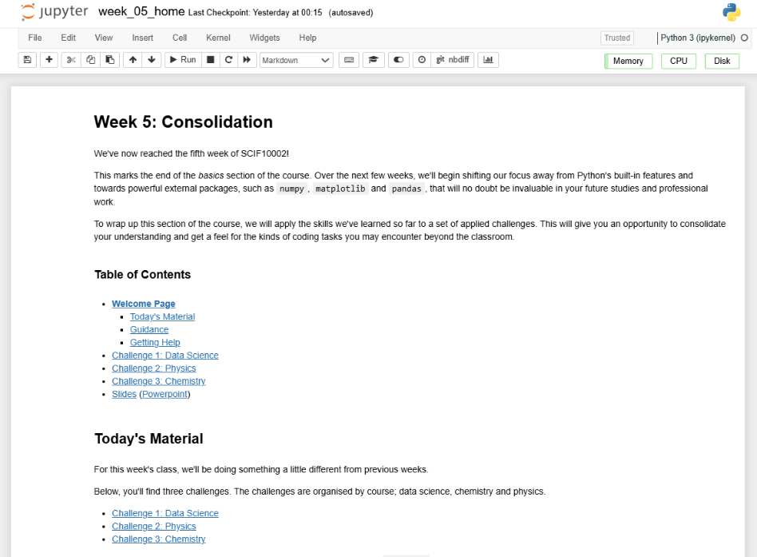
Practical
We now move over to Python
  Please open `week_05_home.ipynb`
Slide 10/11

Slide 93
Practical
We now move over to Python
  Please open `week_05_home.ipynb`
For the rest of today, you must work through a challenge
This week is a little different…
Please choose the challenge according to your course
Slide 10/11

Slide 94
Practical
We now move over to Python
  Please open `week_05_home.ipynb`
For the rest of today, you must work through a challenge
This week is a little different…
Please choose the challenge according to your course
Slide 10/11

Slide 95
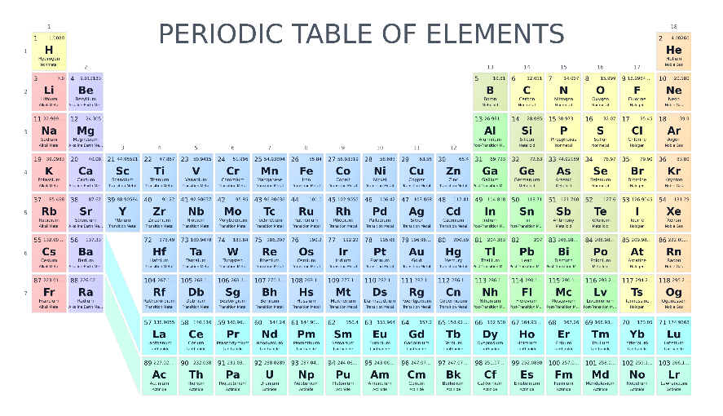
Practical
We now move over to Python
  Please open `week_05_home.ipynb`
For the rest of today, you must work through a challenge
This week is a little different…
Please choose the challenge according to your course
  Chemistry Challenge
Slide 10/11

Slide 96
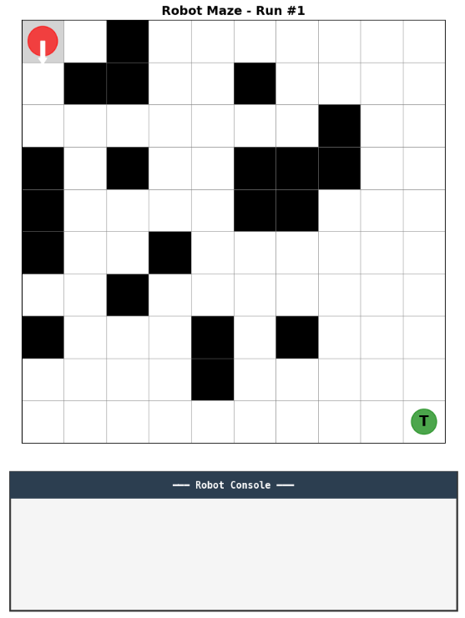
Practical
We now move over to Python
  Please open `week_05_home.ipynb`
For the rest of today, you must work through a challenge
This week is a little different…
Please choose the challenge according to your course
  Chemistry Challenge
  Data Science Challenge
Slide 10/11

Slide 97
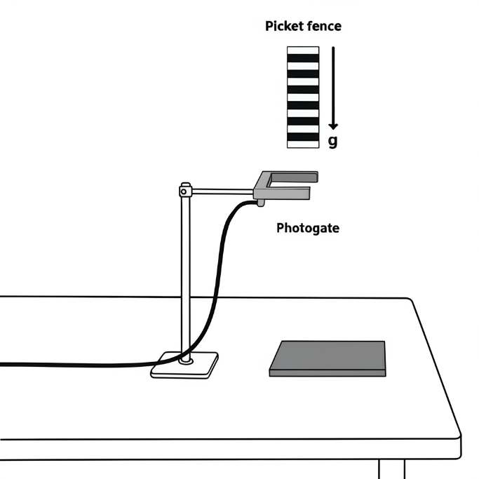
Practical
We now move over to Python
  Please open `week_05_home.ipynb`
For the rest of today, you must work through a challenge
This week is a little different…
Please choose the challenge according to your course
  Chemistry Challenge
  Data Science Challenge
  Physics Challenge
Slide 10/11

Slide 98
Practical
We now move over to Python
  Please open `week_05_home.ipynb`
For the rest of today, you must work through a challenge
This week is a little different…
Please choose the challenge according to your course
  Chemistry Challenge
  Data Science Challenge
  Physics Challenge
Slide 10/11

Slide 99
Practical
We now move over to Python
  Please open `week_05_home.ipynb`
For the rest of today, you must work through a challenge
This week is a little different…
Please choose the challenge according to your course
  Chemistry Challenge
  Data Science Challenge
  Physics Challenge
If you finish your course’s challenge, try one of the others!
Slide 10/11

Slide 100
Next Time
Lecture 5: Consolidation
  Recap: The Course So Far
  Tackling Difficult Problems
  A Worked Example
  Practical
Lecture 6: Introduction to NumPy
  Recap: The Course So Far
  What is NumPy?
  NumPy Arrays
  Arrays vs Lists
  Practical
Slide 11/11

