Slide 1


Green Pace
Security Policy Presentation
Developer: Jaden Mericle
CS 405 Project Two
Date: February 22, 2026
Notes:
Hello everyone. Today I’m presenting our Green Pace Security Policy for CS 405 Project Two. The purpose of this presentation is to make our secure coding and architecture expectations clear, repeatable, and easy to follow as our team grows.

Slide 2

OVERVIEW: DEFENSE IN DEPTH
Why it was needed: Best practices were happening informally—policy makes them consistent and repeatable.
Defense-in-depth: multiple layers across design, code, testing, and operations (not one control).
Assume vulnerability: plan for mistakes and limit impact when something goes wrong.
Focus areas: reduce attack surface, enforce secure defaults, and catch issues early with automation.
Notes:
This policy exists because security can’t depend on who is writing the code that day. We needed a standardized guide that supports defense-in-depth—multiple layers of protection across design, coding, testing, and operations. We also assume vulnerability: bugs happen, so we reduce attack surface and limit impact when something goes wrong.

Slide 3
THREATS MATRIX
High threat: CS-01 Input validation, CS-02 Memory safety, CS-03 Access control, CS-04 Error handling/info leaks, CS-05 Unsafe functions/UB.
Medium threat: CS-06 Logging/auditing gaps, CS-07 Concurrency/race conditions, CS-08 Misconfiguration/weak defaults, CS-09 Dependency risk.
Low threat: CS-10 Maintainability/style issues that increase future bug risk.
Placement logic: prioritize issues that enable crashes, data exposure, privilege escalation, or are commonly exploited.
This threats matrix summarizes the main coding risks we identified and how we rank them by likelihood and impact. High-priority items include input validation, memory safety, and access control because those issues tend to cause the most damage and are common targets. Medium items are still important, but they typically have either lower likelihood or lower impact. Low items are not ignored—they are scheduled and monitored so they don’t become future high-risk issues.
Notes:
This threats matrix summarizes the main coding risks we identified and how we rank them by likelihood and impact. High-priority items include input validation, memory safety, and access control because those issues tend to cause the most damage and are common targets. Medium items are still important, but they typically have either lower likelihood or lower impact. Low items are not ignored—they are scheduled and monitored so they don’t become future high-risk issues.

Slide 4
10 PRINCIPLES
1) Least privilege → CS-03, CS-06
2) Defense-in-depth → CS-01, CS-02, CS-09
3) Fail securely → CS-04, CS-08
4) Secure defaults → CS-08, CS-09
5) Validate all inputs → CS-01
6) Minimize attack surface → CS-08, CS-09
7) Separation of duties → CS-03, CS-06
8) Keep it simple → CS-10
9) Complete mediation → CS-03
10) Accountability → CS-06
Notes:
Here are the 10 coding standards listed in priority order. I prioritized them based on impact, likelihood, and the cost of fixing them late. The top items focus on validation, memory safety, and access control because they prevent major failures like crashes, data exposure, and privilege escalation. The examples on the left show how these standards apply to everyday coding tasks like handling user input, accessing arrays, and enforcing permissions.

Slide 5
CODING STANDARDS
Ranking method: (1) impact, (2) likelihood, (3) cost-to-fix if found late.
CS-01 Validate all input (Example: reject invalid length/range; sanitize/encode).
CS-02 Memory safety (Example: bounds checks; avoid unsafe copying; prefer safe APIs).
CS-03 Access control (Example: enforce role checks server-side for protected actions).
CS-04 Secure error handling (Example: generic user errors; detailed internal logs only).
CS-05 Avoid insecure/undefined behavior (Example: avoid deprecated/unsafe functions).
CS-06 Logging & auditing (Example: log admin changes and data exports—no secrets).
CS-07 Concurrency safety (Example: protect shared state; avoid race conditions).
CS-08 Secure configuration (Example: no debug in prod; strong TLS settings).
CS-09 Dependency hygiene (Example: pin versions; block known-vulnerable packages).
CS-10 Maintainable code (Example: simple, readable code to reduce security bugs).
Notes:
These 10 security principles are the ‘why’ behind the policy. The coding standards are the ‘how.’ For example, least privilege and complete mediation show up through consistent authorization checks. Defense-in-depth is supported by validation, memory safety controls, and automation. This mapping keeps our decisions consistent during implementation and code review.

Slide 6
ENCRYPTION POLICIES
In flight: Use TLS for client-to-service and service-to-service traffic; disable weak protocols/ciphers.
At rest: Encrypt sensitive stored data; protect and rotate keys; restrict key access.
In use: Avoid logging secrets; minimize plaintext exposure in memory; use secure secret storage.
Example: TLS for login/API calls; encrypt sensitive DB fields; store keys in a vault/KMS.
Notes:
Our encryption strategy covers data in flight, at rest, and in use. In flight, we use TLS for client and service communication and avoid weak protocols. At rest, we encrypt sensitive data and manage keys with rotation and restricted access. In use, we protect secrets in memory where possible and avoid logging sensitive values. The goal is to reduce exposure even if someone intercepts traffic or gains access to storage.

Slide 7
TRIPLE-A POLICIES
Authentication: strong password policy + MFA where possible; store credentials securely (hash + salt); never log secrets.
Authorization: least privilege; role-based access control; verify permissions on every protected action.
Accounting: log security events (login failures, role changes, data exports) with timestamps and user IDs; monitor and alert.
Example: admin features require elevated role + are always audited.
Notes:
The Triple-A framework means Authentication, Authorization, and Accounting. Authentication confirms identity, like passwords plus MFA. Authorization enforces what an identity can do using least privilege. Accounting means logging key events so actions can be traced during investigations. The main point is that all three work together: strong login without authorization checks still fails, and without accounting we can’t detect or respond effectively.

Slide 8
Unit Testing 1: Input validation (length/range)
Purpose: Prevent crashes and injection-style bugs by rejecting invalid input before processing.
What the test checks: rejects overly long strings; rejects negative/overflow values; confirms safe error handling.
Take it further: add boundary fuzz cases in CI; add encoding/normalization edge cases.
Screenshots to add: test code + test results (pass/fail).
Notes:
This unit test checks that input is validated for length and range before it is used. The goal is to prevent injection-style issues, crashes from invalid formats, or unsafe copying into buffers. To take it further, I would add more boundary tests, include random malformed inputs, and run the same tests as part of CI on every pull request.

Slide 9

AUTOMATION SUMMARY
Security automation happens at multiple stages so issues are caught early and repeatedly, not only at the end.
Use CI gates: fail builds on high-severity static analysis findings and failed unit tests.
Notes:
This diagram shows where security tools live in the DevSecOps flow. We run basic checks pre-commit, then compiler warnings and static analysis during build, unit tests during test, dependency gates during packaging, and monitoring after deployment. The point is that security is not one step—it’s repeated at multiple stages to catch issues as early as possible.

Slide 10
TOOLS
External tools used (examples):
• Static analysis: compiler warnings, linting, secure rule checks (fail build on high severity).
• Dynamic analysis: runtime checks (sanitizers) and behavior monitoring.
• Fuzzing: randomized inputs to trigger crashes and edge cases.
• Dependency checks: identify known-vulnerable libraries and block them before merge.
Pipeline fit: run automatically in CI on pull requests; results are visible to the team.
Notes:
This is how we use external testing methods and automation to detect vulnerabilities early. Static analysis helps us catch unsafe patterns before runtime. Dynamic testing and fuzzing help us find crashes and edge cases. Unit tests lock in secure behavior so regressions don’t come back. On this slide I’ll insert screenshots from my coding exercises—like a static analysis warning or a test run—showing how automation flags the problem.

Slide 11
RISKS AND BENEFITS
Method: prioritize by risk = likelihood × impact, then consider effort and blast radius.
Act now: cheaper fixes; lower incident likelihood; better long-term velocity.
Wait: higher chance issues reach production; incident response cost; reputational impact.
Address first: CS-02 memory safety, CS-03 access control, CS-01 validation (highest impact categories).
Notes:
On this slide I compare fixing issues now versus waiting. Fixing now reduces real risk and usually costs less because the context is fresh and the change is smaller. Waiting increases the chance that the vulnerability reaches production, and then the fix includes emergency work, incident response, and reputation impact.
Here are examples of what we address first and why. High-impact items like memory safety, validation, and access control get priority because they can cause the most damage. Lower-priority items are still scheduled, but we sequence the work so we reduce the biggest risks early and keep the project manageable.

Slide 12
RECOMMENDATIONS
Current gaps: inconsistent security checks; limited regression tests; uneven logging/auditing for high-risk actions.
Recommendations: standard CI gates; expand unit tests for known vulnerability classes; define minimum audit events + alerts; review policy each release.
Notes:
My gap analysis focuses on what still needs improvement moving forward. Common gaps include inconsistent enforcement, missing security checks in CI, weak logging, and unclear ownership of policy updates. My recommendations are to add measurable CI gates, improve documentation, and create a regular cadence for reviewing and updating the policy as threats evolve.

Slide 13
CONCLUSIONS
Standardized: threat matrix; 10 principles + 10 standards; automation + unit tests.
Next steps: adopt CI policy gates; add sanitizer/fuzz runs for high-risk areas; improve onboarding + documentation.
Notes:
To conclude, this policy standardizes what we already try to do in practice: build secure systems by default. The next steps are to keep the standards visible in code reviews, keep security checks automated, and treat policy updates as part of normal development—not a one-time document.

Slide 14
REFERENCES
National Institute of Standards and Technology. (2022). Secure Software Development Framework (SSDF) Version 1.1 (SP 800-218). https://csrc.nist.gov/pubs/sp/800/218/final
OWASP. (2021). OWASP Top 10: The Ten Most Critical Web Application Security Risks. https://owasp.org/Top10/
Microsoft. (n.d.). C++ Unit Testing in Visual Studio (Test Explorer). https://learn.microsoft.com/visualstudio/test/
Notes:
These are the sources I used to support the policy design and rationale. I’ll keep the references updated as the policy evolves.

Slide 15
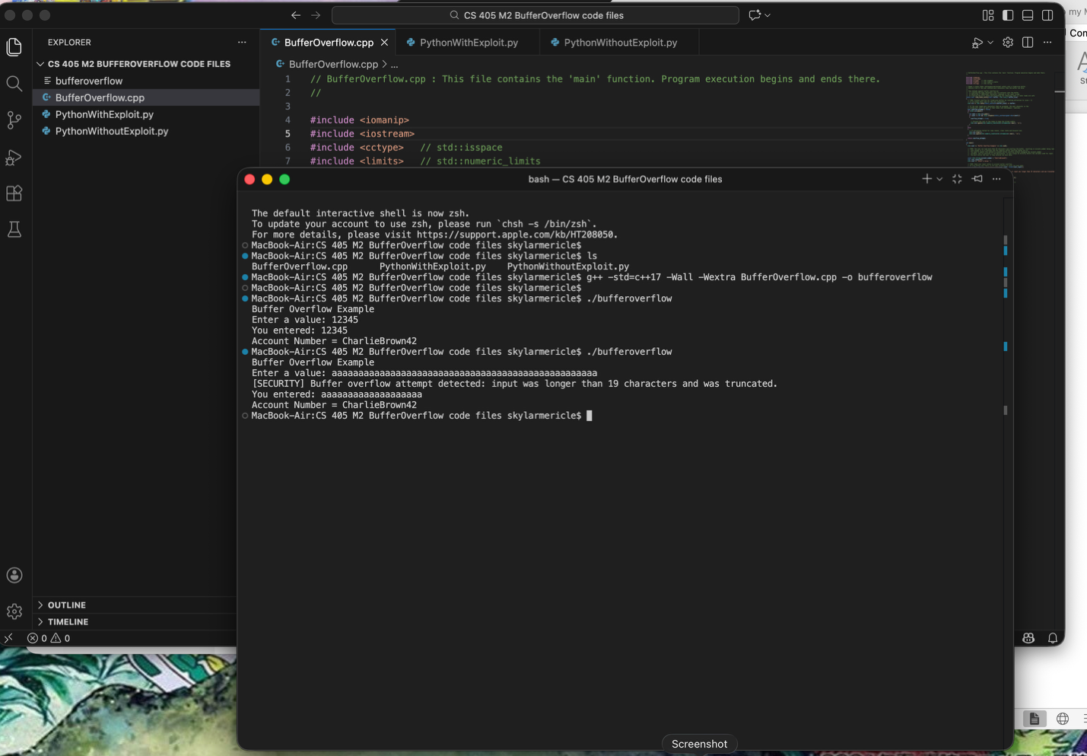
Unit Testing 2: Bounds checking / buffer safety
Purpose: Catch off-by-one and buffer overflow risks before they become exploitable.
What the test checks: asserts bounds checks; verifies safe copying/truncation behavior.
Take it further: run sanitizers in test builds; add property-based tests over many sizes/inputs.
Screenshots to add: test code + test results (pass/fail).
Notes:
This unit test focuses on bounds checking for arrays, strings, and buffers. The test should prove that the code refuses inputs that exceed buffer size and that it uses safe patterns when copying or indexing. To take it further, we can run sanitizers in test builds and expand test cases to include off-by-one boundaries and extreme sizes.

Slide 16
Unit Testing 3: Authentication / Authorization checks
Purpose: Prevent broken access control by verifying permissions for every protected action.
What the test checks: normal user blocked from admin-only functions; role changes require re-auth and are logged.
Take it further: add negative IDOR tests; add integration tests around API endpoints.
Notes:
This unit test verifies that sensitive actions require the correct permissions every time. It checks that unauthorized users are blocked and that privileged operations can’t be triggered just by manipulating inputs. To take it further, we can add tests for role changes, session expiration, and negative tests where the UI says no but the API must also enforce the rule.

Slide 17
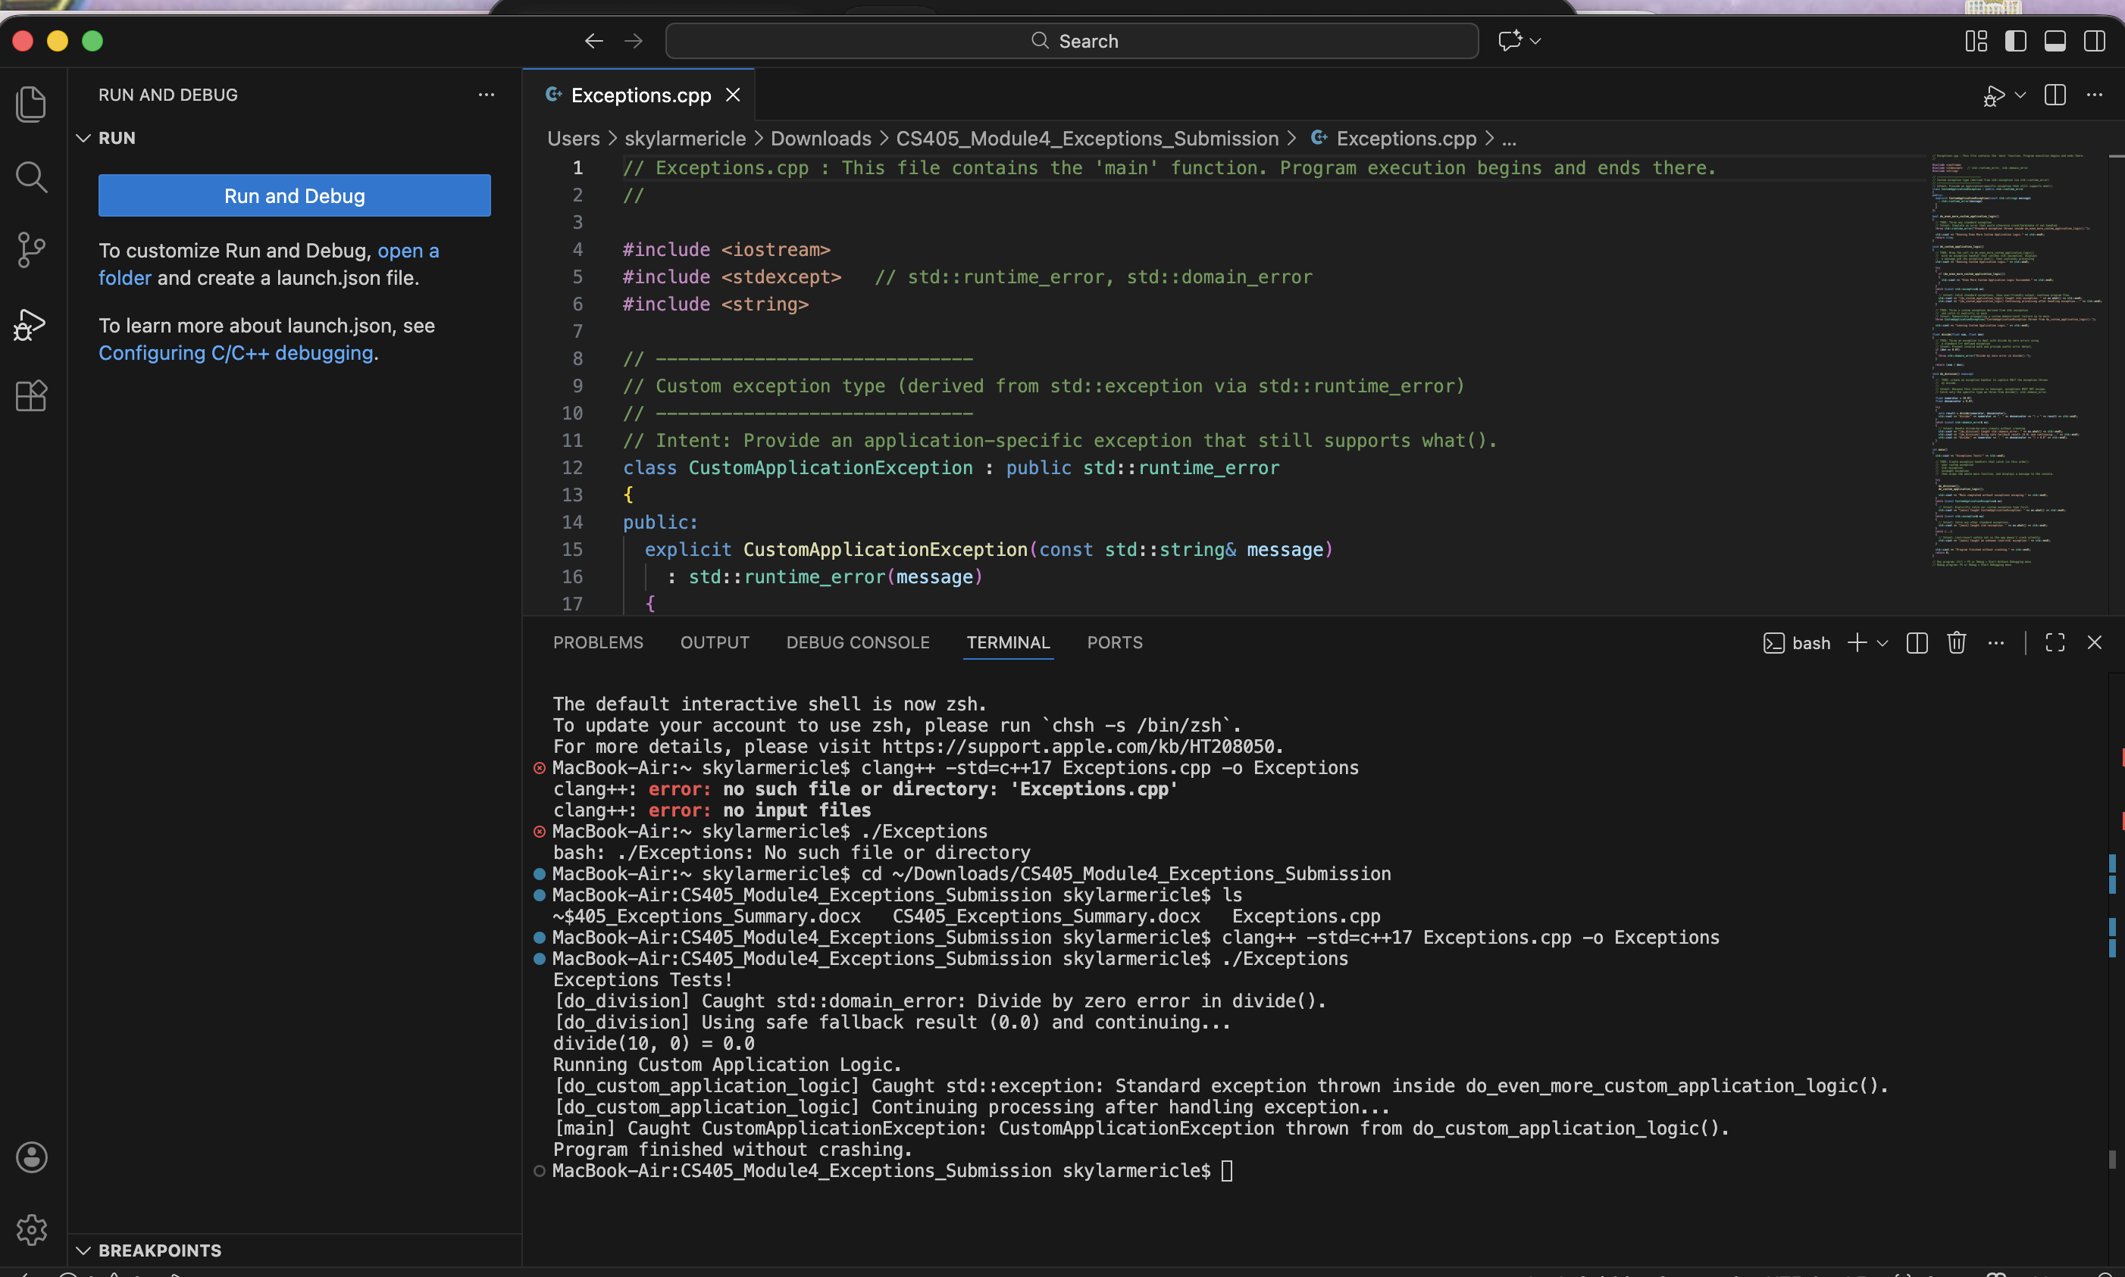
Unit Testing 4: Error handling & safe logging
Purpose: Ensure failures do not leak secrets and logs remain useful for investigations.
What the test checks: generic user-facing errors; logs record event without secrets/PII.
Take it further: validate log format; test redaction for PII/secrets.
Screenshots to add: test code + test results (pass/fail).
Notes:
This unit test checks that errors fail securely and don’t leak sensitive details. It also checks that logs are safe: they should contain what we need for troubleshooting and auditing, but not secrets, tokens, or personal data. To take it further, we can test log redaction and verify that the application returns generic error messages while keeping detailed info in internal logs.

Slide 18
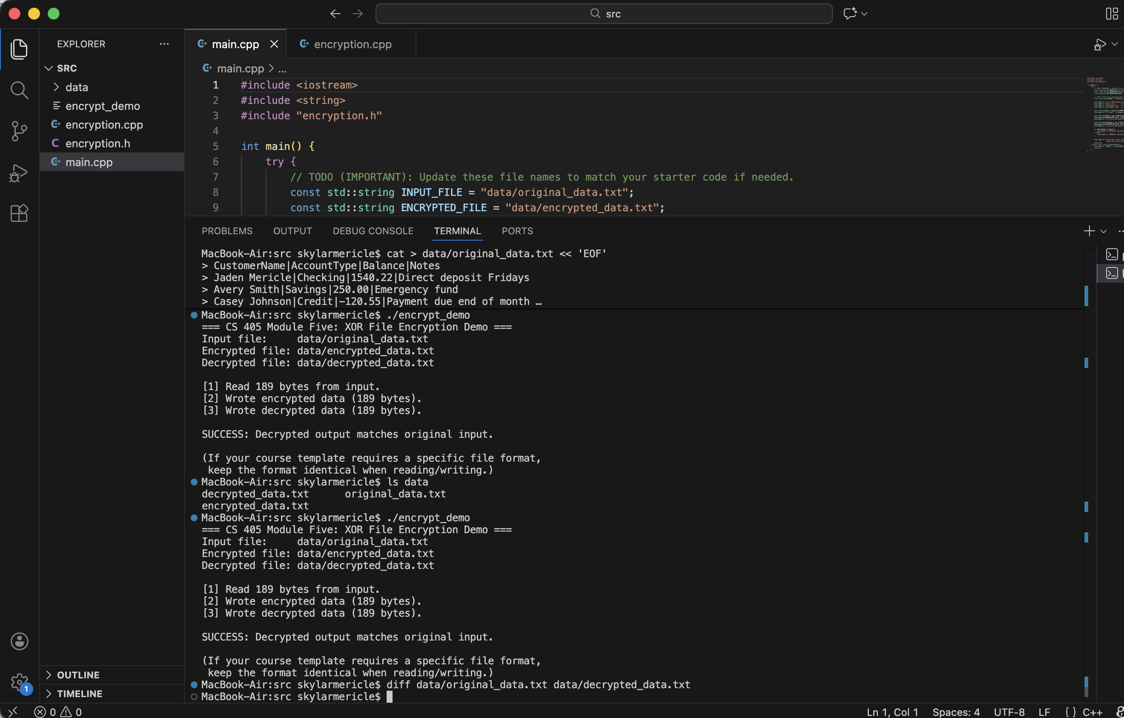
Unit Testing 5: Dependency/configuration guardrails
Purpose: Stop insecure defaults from shipping (debug flags, weak settings, vulnerable libs).
What the test checks: fails if DEBUG enabled in production; confirms required security settings are on.
Take it further: dependency policy test (allow list + pinned versions); SBOM checks and CI alerting.
Screenshots to add: test code + test results (pass/fail).
Notes:
This unit test and supporting checks ensure we don’t run with insecure defaults. Examples include disallowing debug mode in production builds, confirming TLS settings, or blocking known-bad dependency versions. To take it further, we can automate dependency checks and policy gates so insecure configurations fail the build.
Extra detail to mention while showing this slide: examples of external tools include compiler warnings (-Wall/-Wextra), static analyzers (cppcheck/clang-tidy), sanitizers (ASan/UBSan), dependency scanning, and a CI pipeline that blocks merges when tests or scans fail.

