Slide 1
ECE 4480/5480
Computer Architecture and Design
Interactive Branch Predictor Simulation App
Team J. Smith
Jeff Smith

Slide 2
Contents
Background and Motivation
Problem Statement
Main Ideas
Experimental Methodology
Results and Analysis
Conclusion
(Potential) Future work
2

Slide 3
Background and Motivation
Desire to have a flexible app to analyze branch prediction results
How can I speed up the process?
Main Ideas
Interact with the user to define memory allocations
Recommend changes to memory allocation based on results
Track improvement
Speed Up Process programmatically

Slide 4
Problem Statement
Current Branch Predictor
Needed to be rewritten to explore various memory allocations
No Historic Trending
No interactivity
No analysis of results
Too slow

Slide 5
Main Ideas
Describe main technical ideas and contributions
Prompt user for memory allocation
Track current and historical results
Analyze results and recommend changes to memory allocation for improved accuracy
Save analyzed data to .txt file
Use local variables to minimize dictionary use to improve speed
Parallelize functions to improve speed

Slide 6
Experimental Methodology
Which simulators, workloads, and metrics used?
Work Loads:
bzip2.tr, gzip.tr, twolf.tr, apsi.tr, crafty.tr, mcf.tr, vortex.tr, art.tr, gcc.tr, mesa.tr
Simulators:
Static Predictors, 1-Bit Predictor, Global 2-Bit Predictor, Local 2-Bit Predictor, Gshare Predictor, Gskewed Predictor,
Metrics
Accuray %, Avg Accuracy %, Global Avg Accuracy, Run Time, Accuracy Trend

Slide 7
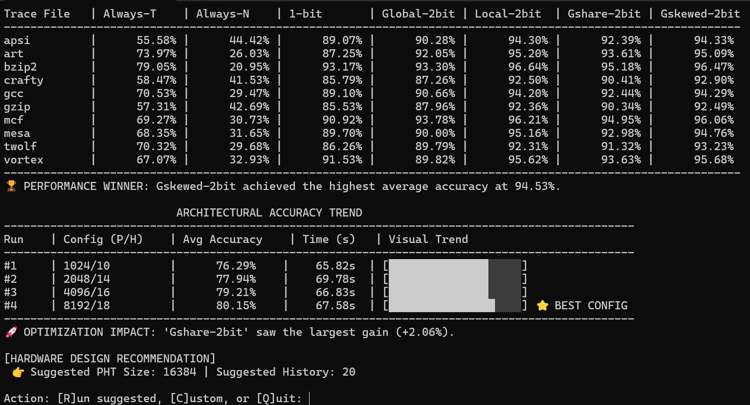
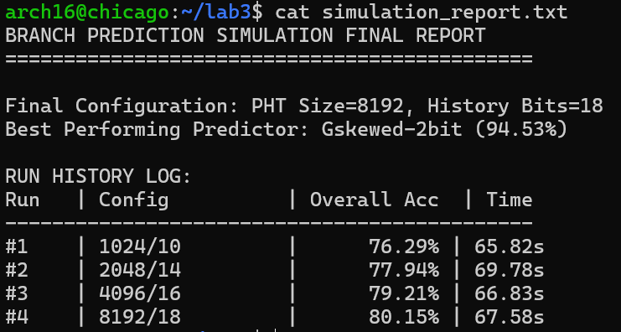
Results and Analysis
Describe experimental results
Overall Results: More interactive, significantly more efficient
Actual Run Results:

Slide 9
(Potential) Future work
Describe any future works
On local computer could add matlab plotting to improve graphics
Potentially have application scroll up through memory allocation automatically until global results begin to outperform local. That would allow best results with minimal memory allocation.
Expand data saved to text file to make it more comprehensive

Slide 10

Questions?

