Slide 1
Internet of Things
Simple concept of testing IoT applications

Slide 2
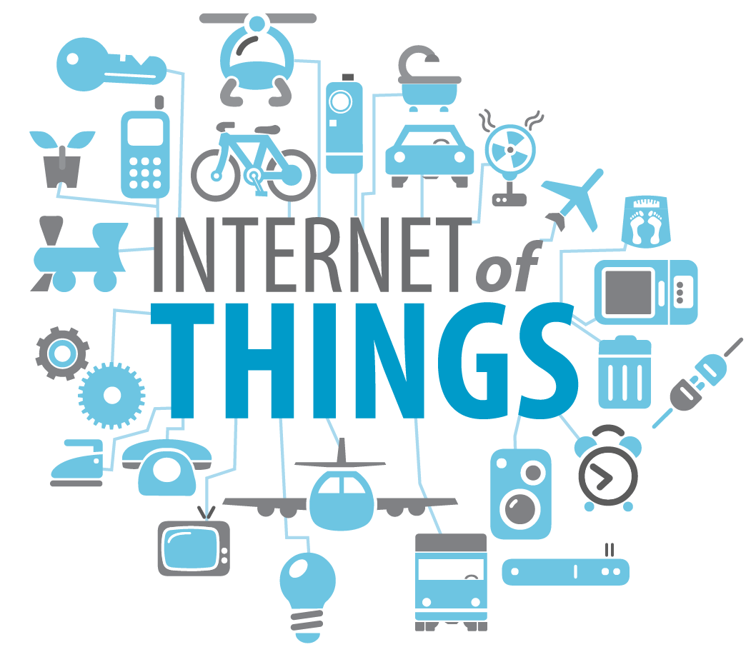

Slide 3
Why IoT applications needs to be tested
Required to point out defects and errors that were made
It’s essential since it makes sure of the Customer’s reliability and their satisfaction in the application
Testing is required for an effective performance of software application or product.
It’s important to ensure that the application should not result into any failures because it can be very expensive in the future or in the later stages of the development

Slide 4
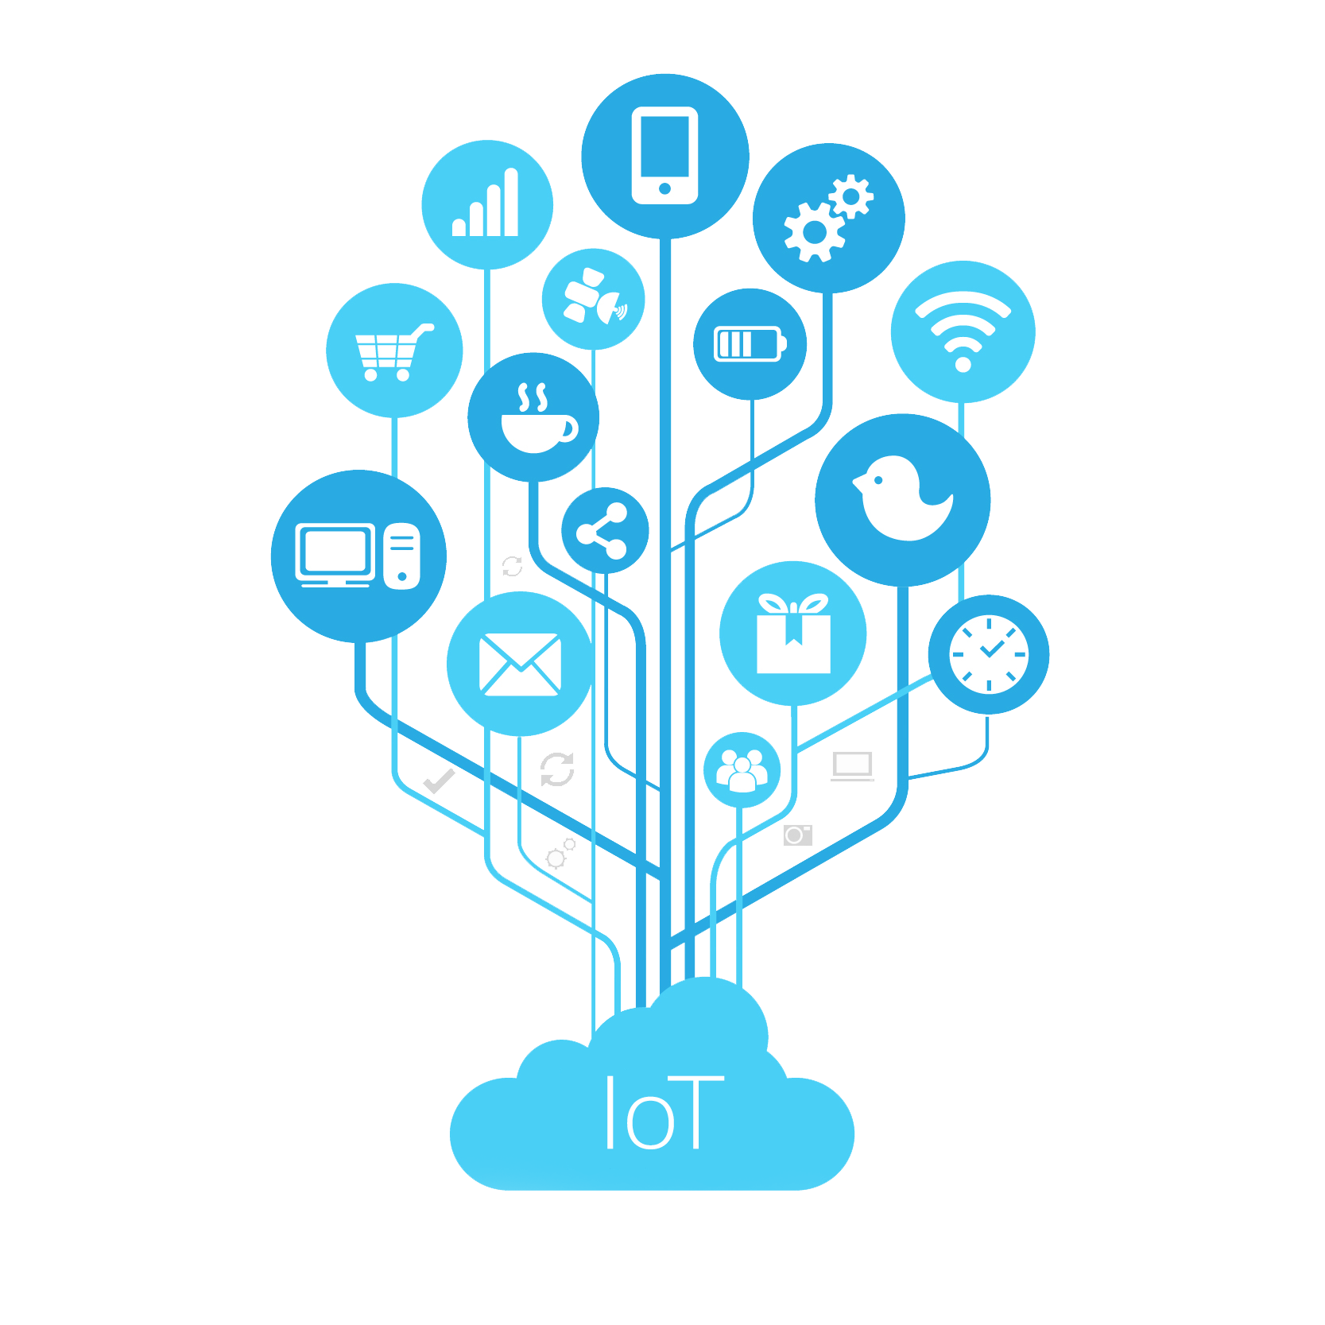
Thank you for your attention!

Slide 5
Sources
https://www.informationsecuritybuzz.com/study-research/organizations-cant-track-manage-iot-devices-networks/
http://www.interprit.com/integration/internet-of-things-iot
https://opensourceforu.com/2017/07/open-source-role-in-iot/
http://istqbexamcertification.com/why-is-testing-necessary/

