Slide 1

Movie Database
Noah Kramer, Jack Murray, Peter Willis and Braeden Hecht

Slide 2
Overview
A database containing movies and all their pertinent attributes
Users will be able to query the database to get information such as:
Movies with a particular actor or director
Movies released in certain years
Movies of a particular rating
And much more!

Slide 3
Business Rules and Restrictions
All movies must:
Have at least one director
Have a release year
Have at least one genre
Have a production studio
Have a rating between 0 and 10
Have birthdate for each actor and director

Slide 4
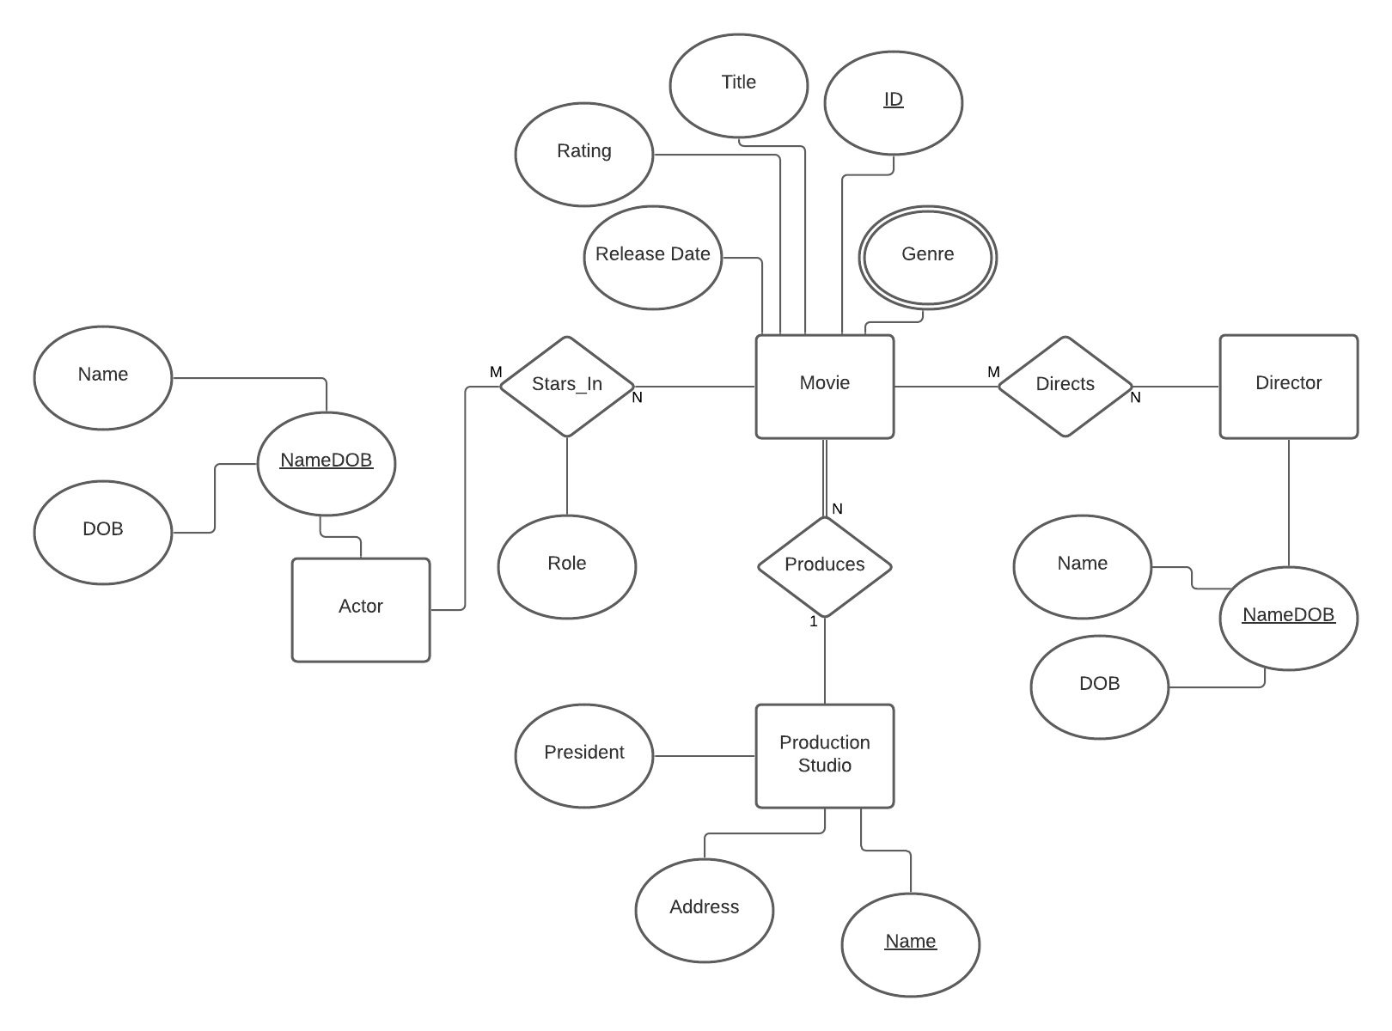
ER Diagram

Slide 5
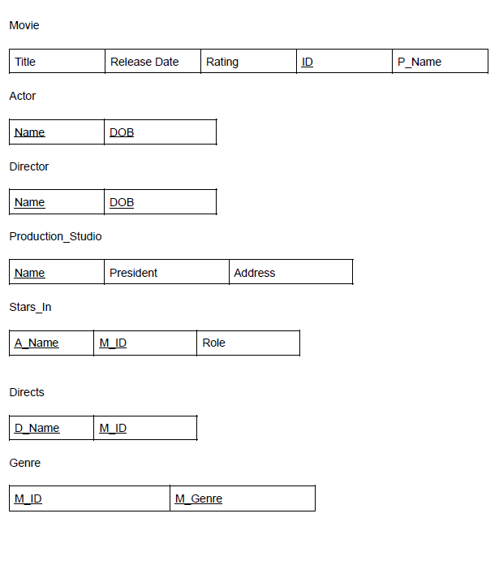
Schema

Slide 6
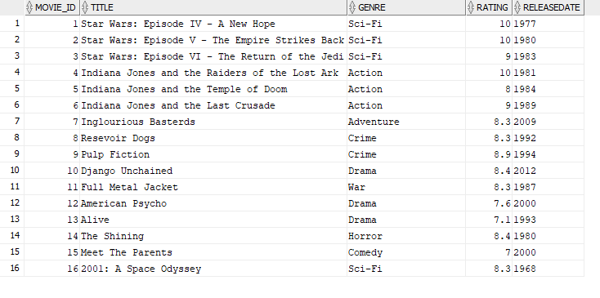
Movie Table

Slide 7
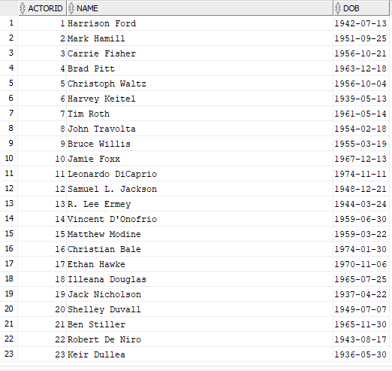
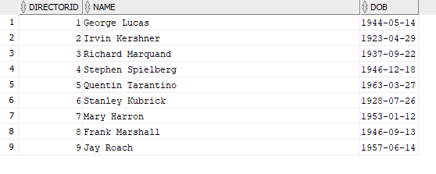
Actor & Director Tables

Slide 8
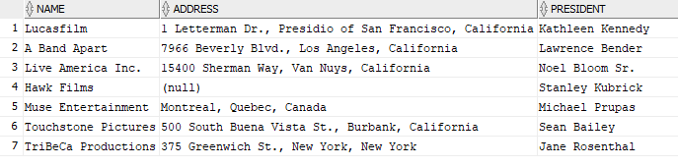
Production Studio Table

Slide 9


Simple Query
Finding all drama films released after the turn of the century

Slide 10
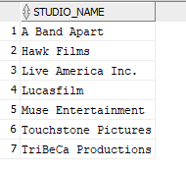

DISTINCT Operator Example
Lists all studio names in the database

Slide 11
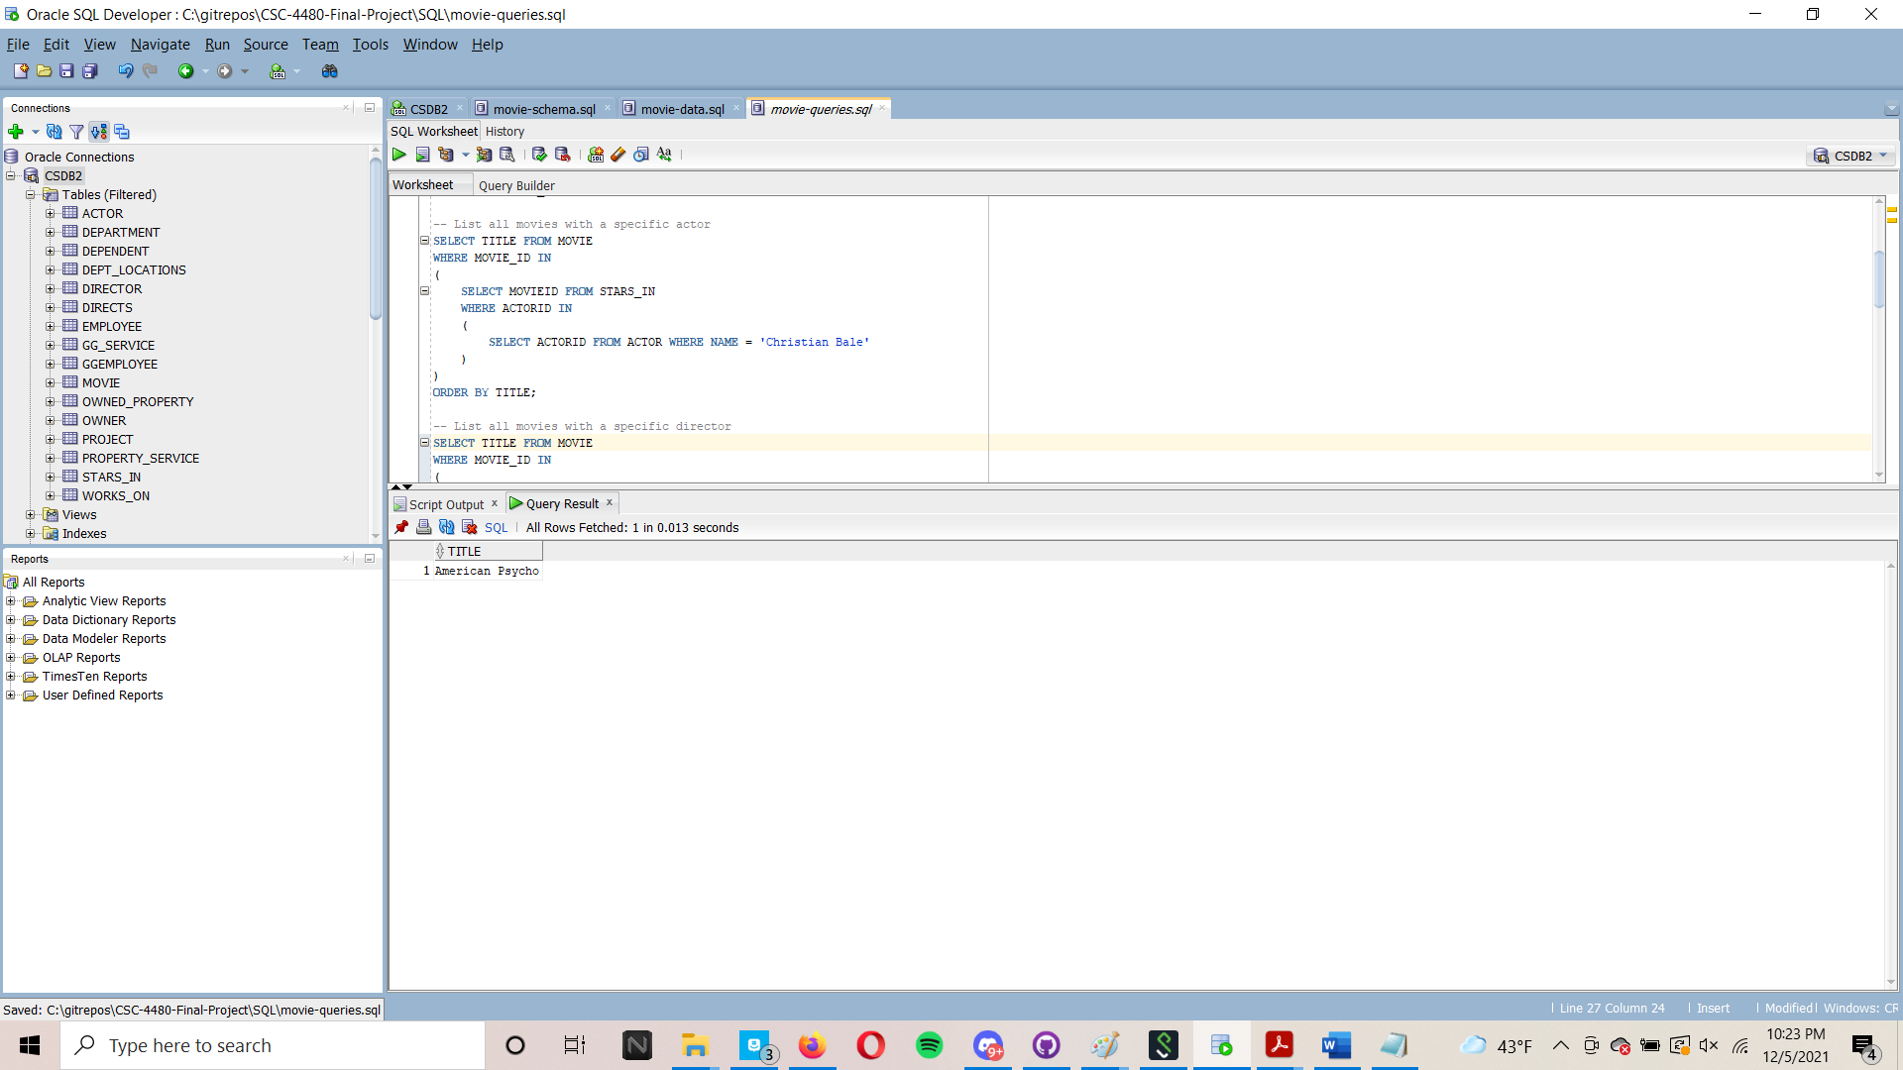
IN Statement Example
Lists all movies with a specific actor

Slide 12
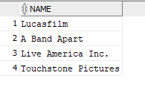

LIKE Operator Example
List all production studios located in California

Slide 13
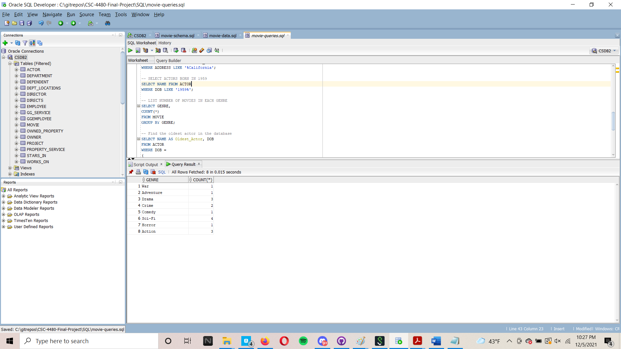
COUNT Operator Example
Lists number of movies in each genre

Slide 14
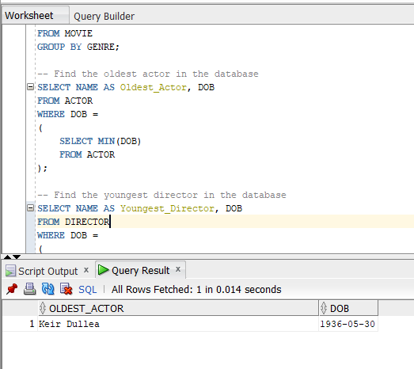
Min/Max Operator Example
Finds the oldest actor in the database

Slide 15
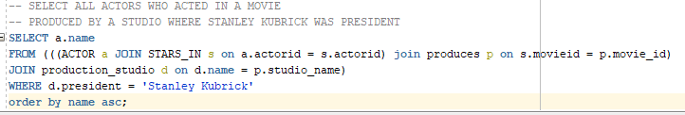
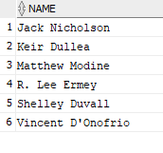
Advanced Query: JOIN Example
Find all actors that acted in a movie that was produced by a studio where Stanley Kubrick was president

