Slide 2
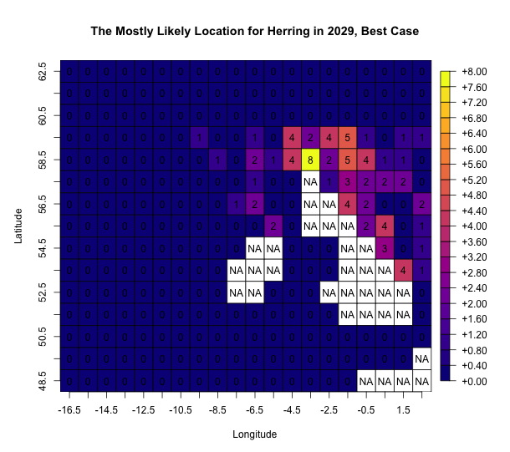
EEZ of Other Countries
Original Fishery

