Slide 2
Group xx Team Members
Sagar Mahajan
Ashwin Hole
Tifani O’Brien
Josh Snider
Patricia Zicht

Slide 3
Summary of Tasks
Problem definition; requirements analysis; and conceptual design
Data selection; and sampling
Cleaning and integration; and Preprocessing
Data transformation; and Data Reduction
Data Mining
Modeling; test & evaluation; and performance assessment
Knowledge discovery

Slide 4
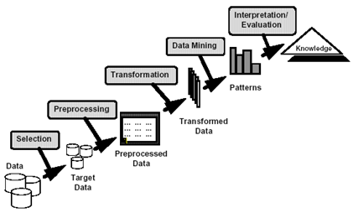
Summary of Tasks
Data selection
Target data preprocessing
Data transformation and redundancy
Data mining
Interpret/Evaluation
Knowledge discovery

Slide 5
Problem Definition

Slide 6
Data Source
The more examples the better…

Slide 7
Software Tools
WEKA

Slide 8
Data Selection

Slide 9
Data Preprocessing
Aggregation
Sampling
Dimensionality Reduction
Feature subset selection
Feature creation
Discretization and Binarization
Attribute Transformation

Slide 10
Preprocessing
Data Cleaning
Outliers
Eliminate attributes that do not contribute anything
Data Integration

Slide 11
Data Exploration and Visualization

Slide 12
Data Transformation and Reduction

Slide 13
Data Mining
Tools Used
Matlab
WEKA
Excel
Algorithms
Binary Decision Tree
RIPPER
K-Nearest Neighbors
AdaBoostM1

Slide 14
Data Mining Tasks (need to choose)
Predictive
Classification
Regression
Deviation Detection
Descriptive
Clustering
Association Rule Discovery
Sequential Pattern Discovery

Slide 15
Classification Definition
Given a collection of records, create a training set. Each record contains a set of attributes; one attribute is class. Training set used to build the model.
Find a model for class attribute as a function of the values of the other attributes.
Test set is used to determine accuracy of the model. Test set used to validate the model.

Slide 16
Association Rule Discovery
Given a set of records, each of which contain some number of items from a given collection.
Produce dependency rules which will predict occurrence of an ite3m based on occurrences of other items
Antecedent->Consequent {Bagels}->{Potato Chips} shows what product should be sold with bagels to promote sale of potato chips.

Slide 17
Clustering Definition
Given a set of data points, each having a set of attributes, and a similarity among them, find clusters such that:
Data points in one cluster are more similar to one another.
Data points in separate clusters are less similar to one another.
Similarity Measures:
Euclidean Distance if attributes are continuous
Other problem-specific measures

Slide 18
Sequential Pattern Discovery
Given a set of objects, with each object associated with its own timeline of events, find rules that predict strong sequential dependencies among different events.
In point-of-sale transaction sequences of book store:
(Intro_to_visual_c) (c++_primer)→(perl_for_dummies)

Slide 19
Regression
Predict a value of a given continuous valued variable based on the values of other variables, assuming a linear or nonlinear model of dependency.
Widely studied in statistics, neural network fields.
Examples – predicting new product sales amounts based on advertising expenditure, etc.

Slide 20
Deviation/Anomaly Detection
Detect significant deviations from normal behavior
Applications
Credit card fraud detection
Network Intrusion Detection

Slide 21
Data Mining: Training Results

Slide 22
Data Mining: Test Results

Slide 23
Binary Decision Tree

Slide 24
Rule-Based Classifer: RIPPER

Slide 25
K-Nearest Neighbor

Slide 26
AdaBoostM1 (using WEKA)

Slide 27
Summary

Slide 28
Demonstration

Slide 29
Next Steps

Slide 30
Any Questions?

