Slide 1


A Machine Learning Approach to Myers-Briggs Personality Classification
Jason Snouffer

Slide 2
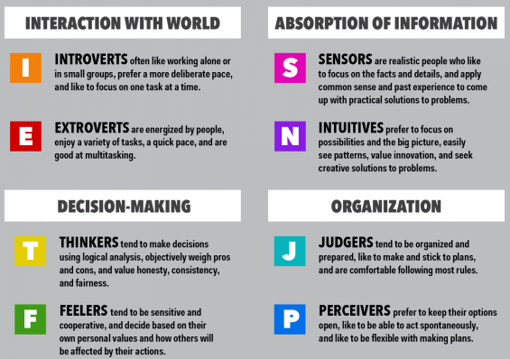
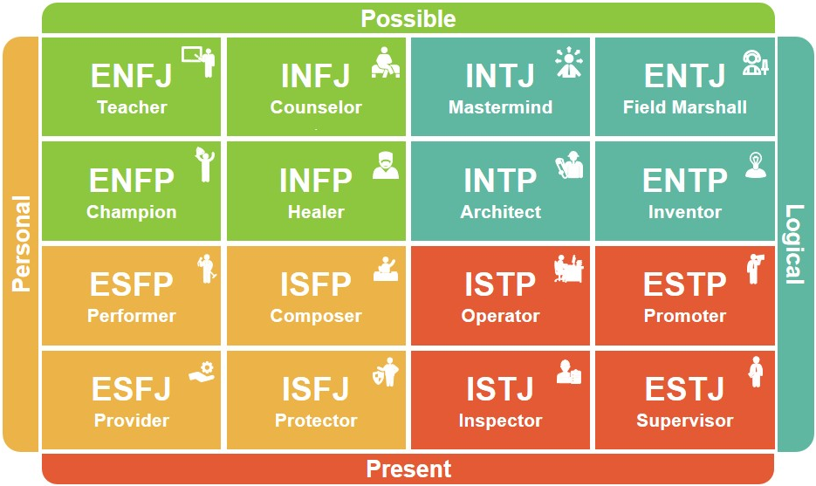
Myers-Briggs Personality Types
Notes:
Myers Briggs is a personality classification framework based on a theory by Carl Jung where a person is assigned 1 of 2 opposing values in 4 categories to classify a person in 1 of the 16 possible personality types.

Slide 3
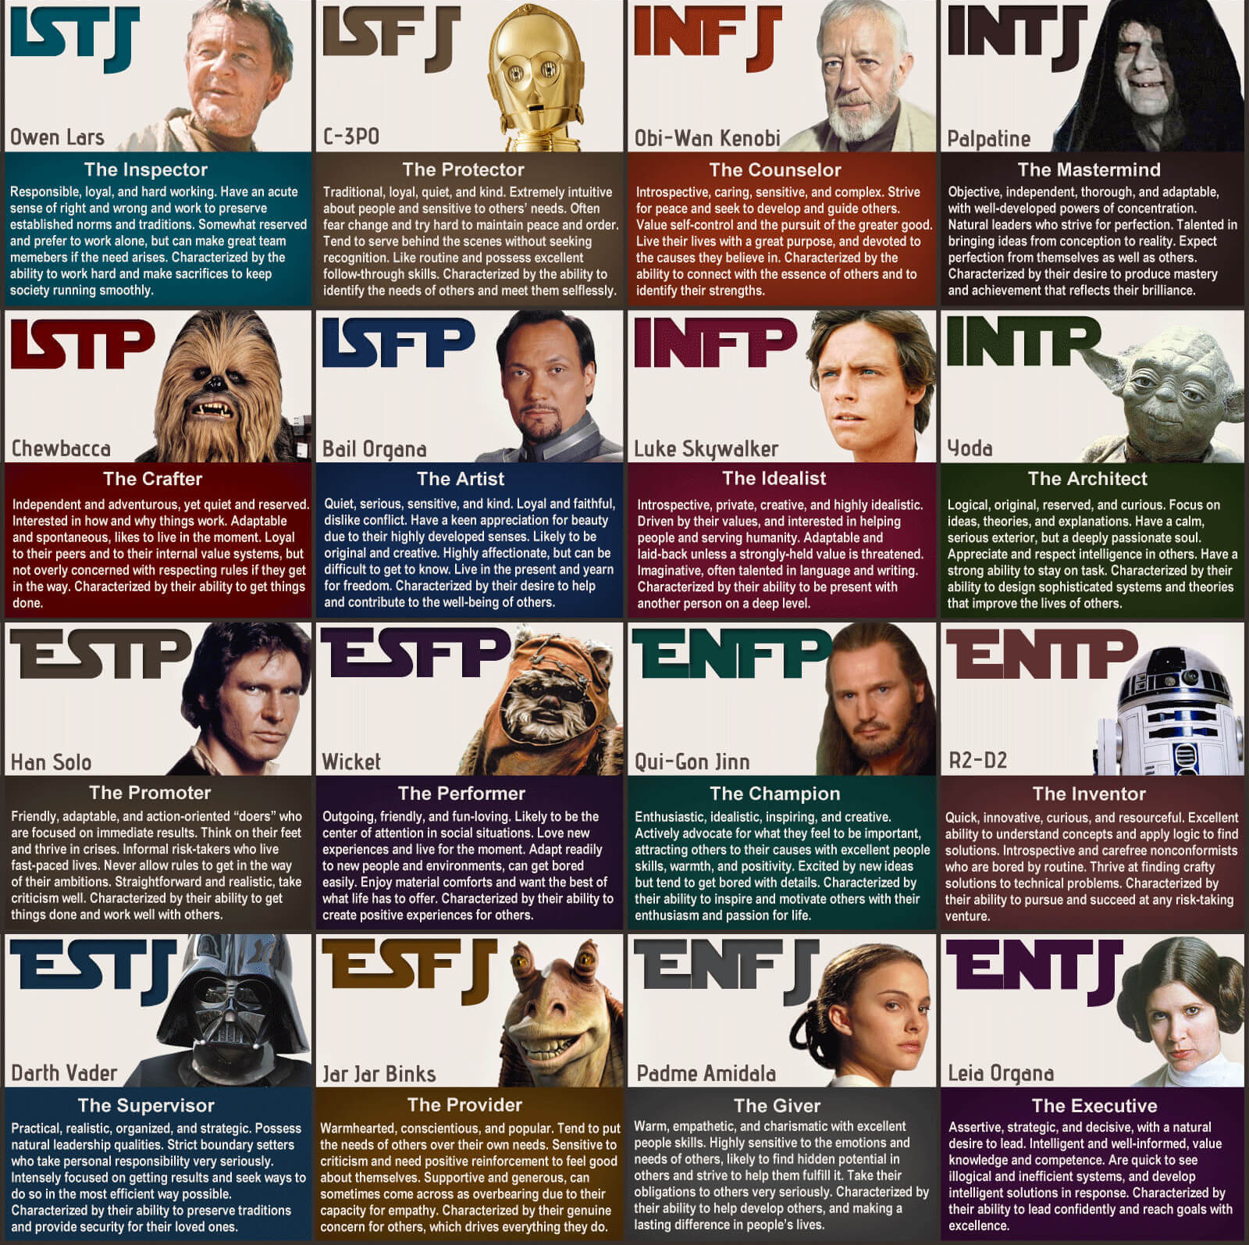
MBTI Types as Star Wars characters

Slide 4
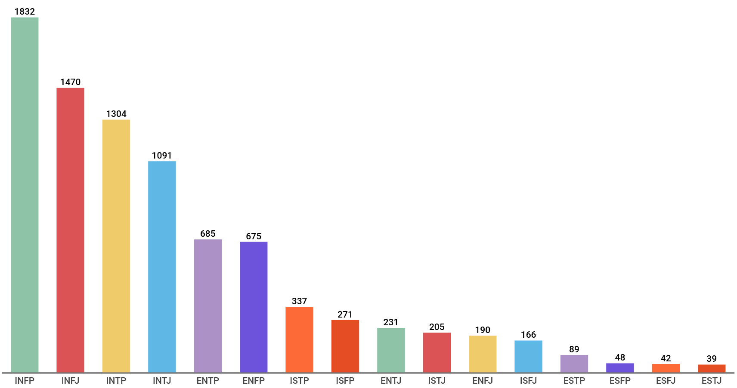









Type Distribution in Training Data
Notes:
- To build a model – I used a dataset available on Kaggle of 8000 people from a forum called PersonalityCafe. The dataset consisted the MBTI and 50 sentences that they posted to the forum.
- The dataset has a large bias toward Introverted Intuitives

Slide 5
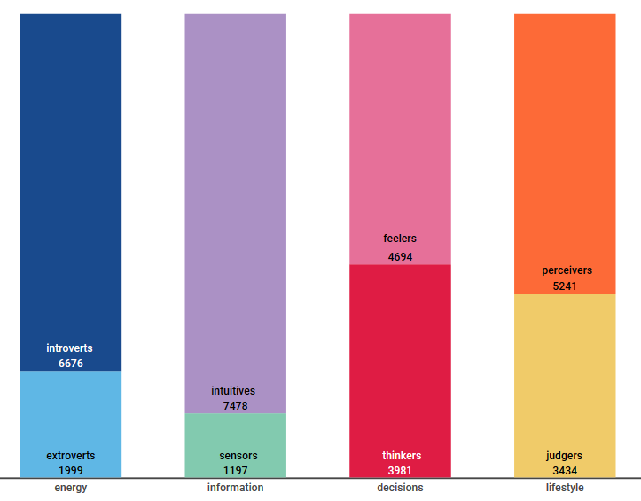
Group Distribution in Training Data
Notes:
The distribution per category is a little better, but is still not evenly distributed
So instead of building 1 model to predict 1 out 16 types – I did 4 models each predicting 1 out of 2 opposing values.

Slide 6
Training a classifier
Training data was transformed into TF-IDF feature vector
Dimensionality reduction
Latent semantic analysis
Chi-squared score computed and K-highest scores selected as features (k = 100)
Z-score normalization
Tree-Based Pipeline Optimization (TPOT) used to find optimum classification algorithm
4 Logistic Regression models trained
Extravert vs Introvert
Sensing vs Intuition
Thinking vs Feeling
Judging vs Perceiving
During prediction, each sentence needs to be classified 4x to determine MBTI
Notes:
TPOT is a really neat genetic algorithm for intelligently searching a tree for an optimum model, instead of a brute-force grid search.

Slide 7
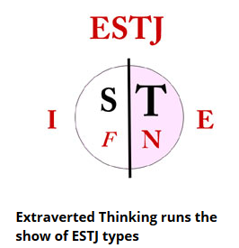

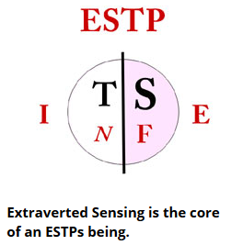

Classifier Test Drive: Donald J Trump
Personality Pathways Journal predicts somewhere between ESTJ and ESTP
My classifier prediction:
Extravert (99.91%)
iNtuitive (71.78%)
Thinking (64.55%)
Judging (75.98%)

Slide 8
Scraping Reddit Data
Used PRAW, a Python library that wraps the Reddit REST API.
From the top 25 most active subreddits, I downloaded 25K users (redditors) and a 100 of their comments.
Data was persisted and indexed into ElasticSearch
Classification took about 70 hours when scaled across a 40 core HPCC
Classified 100 followers for a random sample of 1000 redditors
Notes:
So I decided to use model on Reddit data.

Slide 9
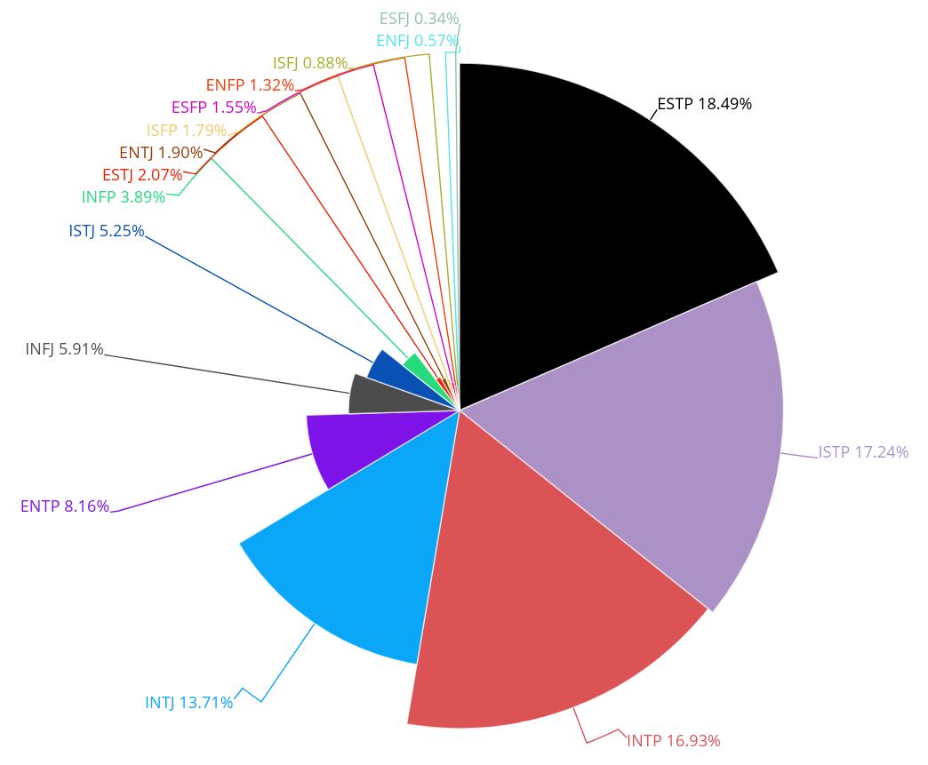

Type Distribution in Reddit Data
Notes:
Majority of sample population is ESTP – kinda amazining – since only 1% of training data was ESTP
I expected a large bias toward INFP, INFJ, and INTP – while that is only true of Yoda

Slide 10
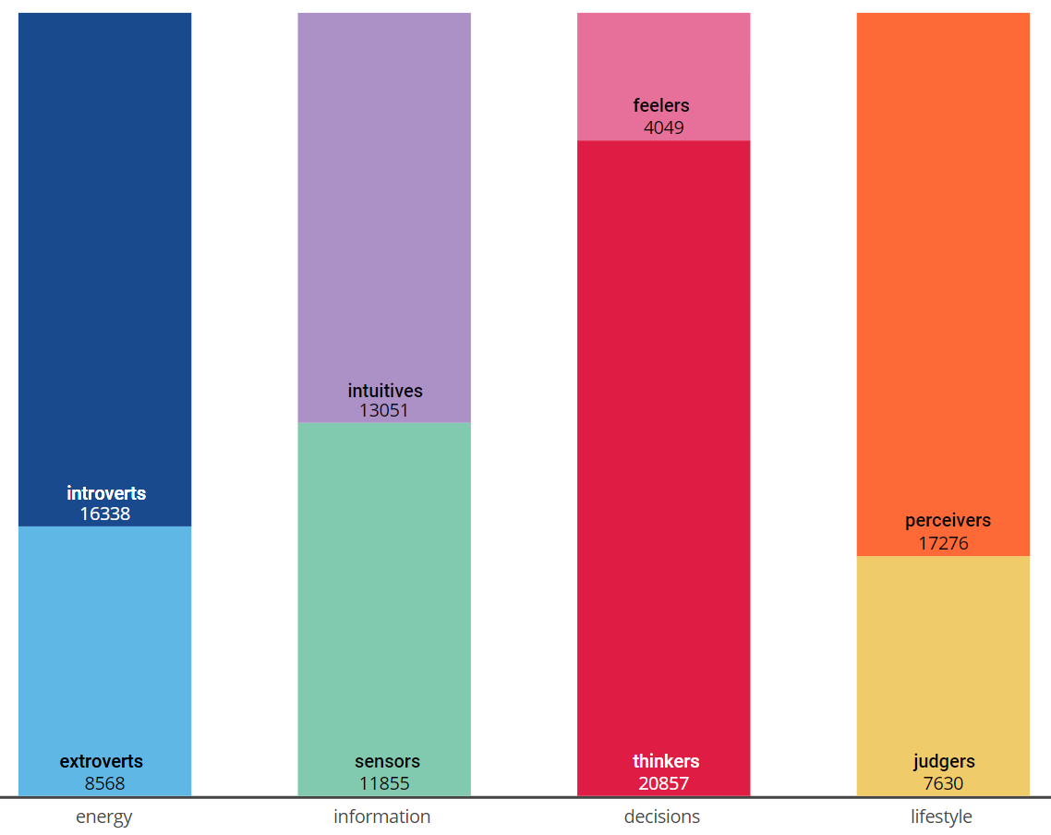
Group Distribution in Reddit Data
Notes:
Group distribution has a lot of similarities with distribution of training set.
Distribution of Feelers verged greatly from training set.

Slide 11
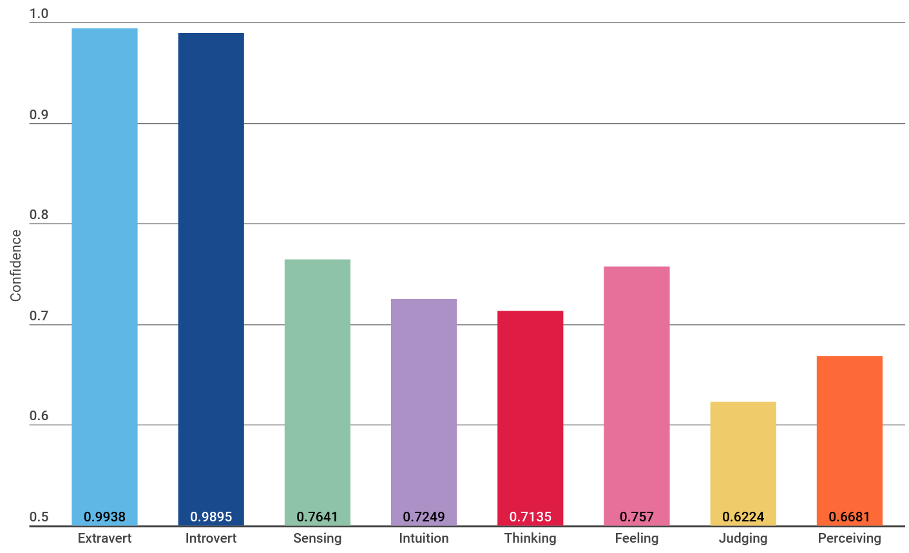
Average model confidence per group
Notes:
Logistic Regression model outputs a score on how confident it is on a prediction. 50% is basically a coin toss, either way
E vs I model was almost always highly confident on its prediction, while J vs P sucked big time.

Slide 12
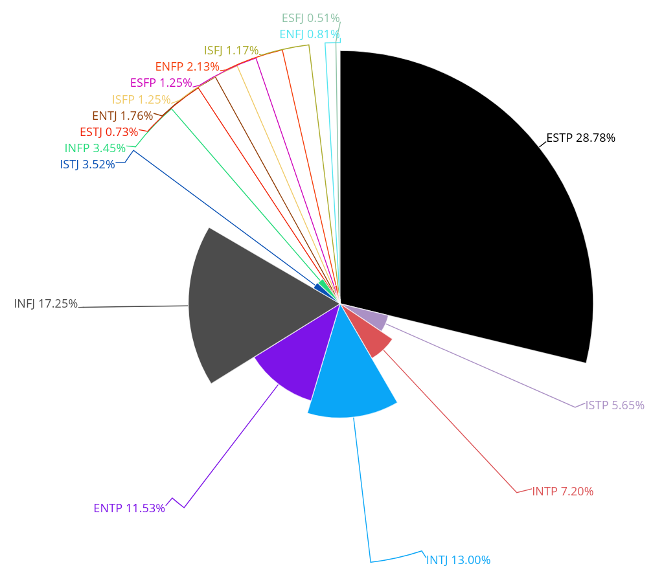
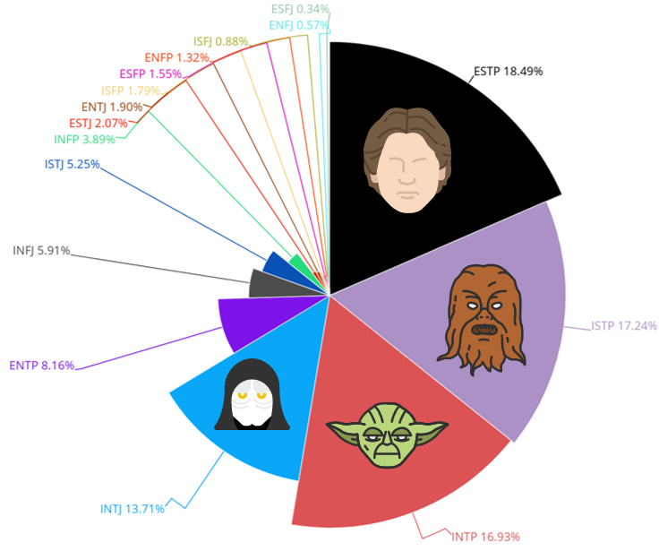
Adjusted Type Distribution in Reddit Data
Notes:
Let’s take out weak predictions
If a user has a confidence value below 70% on any of its 4 predictions, I threw the user out.

Slide 13
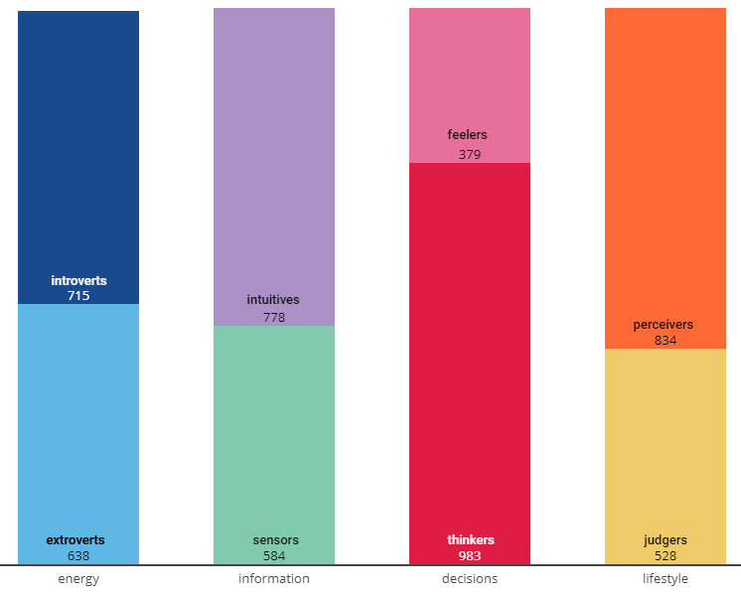
Adjusted Group Distribution in Reddit Data

Slide 14
Follower Makeup
Notes:
I was hoping to find some interesting patterns when looking at a redditor’s followers.
Regardless of a Redditor’s predicted personality, the makeup of their followers largely stayed the same.
For the most part, follower makeup has the same distribution as the entire 25K user group.

Slide 15


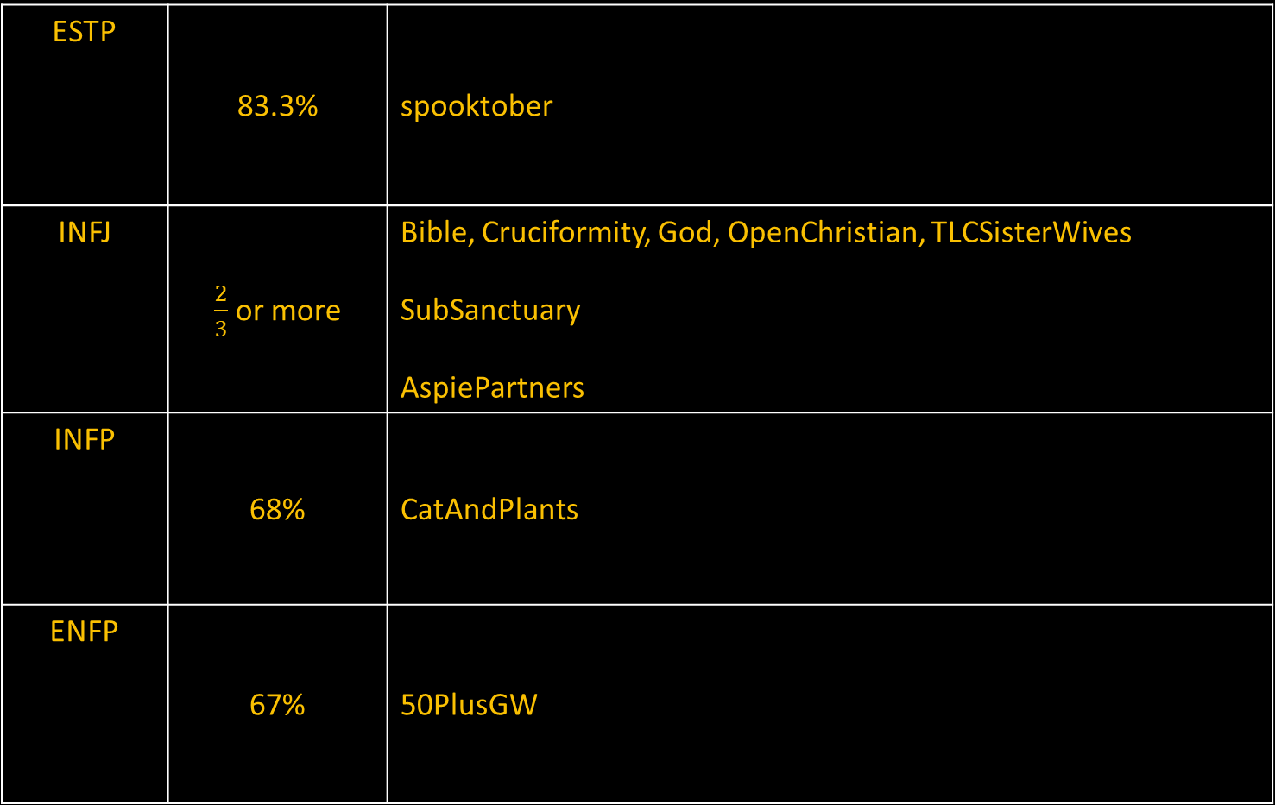
Highlighted Subreddit Patterns
ESTP | 83.3% | spooktober
INFJ | $\frac{2}{3}$ or more | Bible, Cruciformity, God, OpenChristian, TLCSisterWives SubSanctuary AspiePartners
INFP | 68% | CatAndPlants
ENFP | 67% | 50PlusGW

Slide 16


Highlighted Subreddit Patterns
INTP | 72% | NorthKoreaPics
ENTP | 63% | AmatuerFights
ISTP / ESTP | A lot | Video game related sub-reddits

Slide 17
What is next?
Address the confidence variance
For simplicity’s sake, I stuck with Logistic Regression (global optimum) for all 4 models.
TPOT arrived at different local optimums for each of the 4 groups.
E vs I: Ensemble of Extreme Random Forest & KNN
S vs N: Ensemble of Extreme Random Forest & Linear Support Vector Machine
T vs F: Logistic Regression (why is confidence so low in this group, when global optimum == local optimum)
J vs P: Linear Support Vector Machine
Ensemble approach should reduce variance.
Can an exhaustive TPOT search arrive at a global optimum?
Are RNNs, CNNs, or LSTMs the inevitable solution to this problem space?

