Slide 1


OCSS(GWU) 2024
Climate Case Study
October 2024
Derived From: The George Washington University
Data Bootcamp Project 1
Team Members: Will Davis, Mohamed Mursal, Thaimu Sesay, Jessica Snowden (Team 4!)

Slide 2
Project Outline
The OCSS was tasked to conduct a Climate Study to understand the changes in temperature and precipitation in several large cities and if there is a relationship between the observed changes. This study seeks to inform an analytical climate model for scientists to forecast future climate change.
Questions we considered
Temperature: How much has the average high temperature changed for the largest five cities in the United States from 2010-2019
Precipitation: How much has the average annual precipitation changed for the largest five cities in the United States from 2010 - 2019
Correlation: What is the relationship between average high temperature and average annual precipitation
Office of Climate Support Services
One Mission One team

Slide 3
Data Exploration
We utilized data from two APIs to answer the questions posed by this project.
City API: api-ninjas.com/api/city
Geographic data include city name, latitude and longitude coordinates, and population data
VisualCrossingAPI: www.visualcrossing.com/weather-api
Historical weather data including daily high temperatures and precipitation
Office of Climate Support Services
One Mission One team

Slide 4
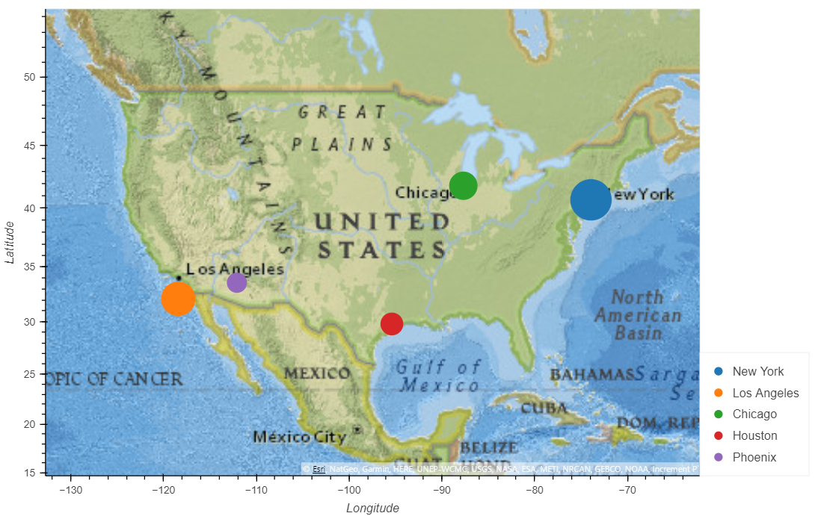
Identifying the Five Largest Cities
The team utilized city population data to show that the five largest cities are New York, Los Angeles, Chicago, Houston and Phoenix
Rank | City | Population
1 | New York City | 18,713,220
2 | Los Angeles | 12,750,807
3 | Chicago | 8,604,203
4 | Houston | 5,464,251
5 | Phoenix | 4,219,697
Office of Climate Support Services
One Mission One team

Slide 5
Determining the Historical Weather Values
The team utilized daily historical weather data (2010-2019) for the five largest cities
To answer temperature question
For high temperature, the maximum value observed in each calendar year was captured as that city’s datapoint year
To answer precipitation question
For total precipitation, the daily precipitation values were added together and captured as a city’s datapoint for the year
Office of Climate Support Services
One Mission One team

Slide 6
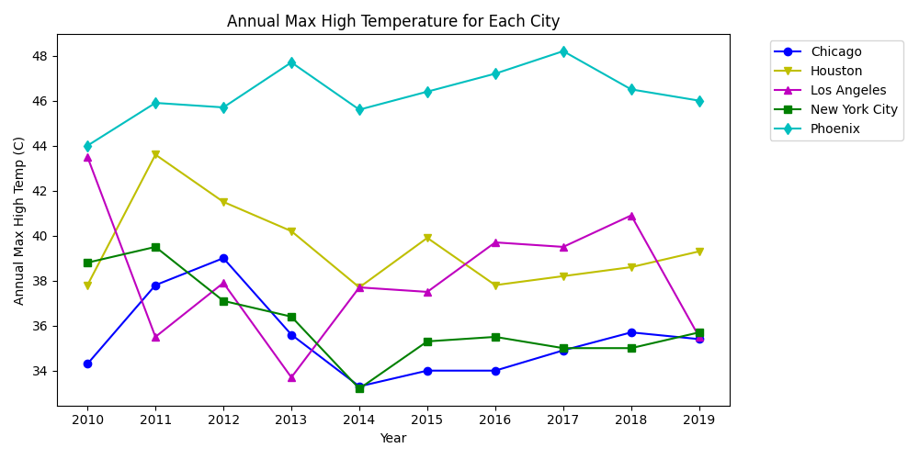
Maximum High Temperature for Each City by Year
Office of Climate Support Services
One Mission One team

Slide 7
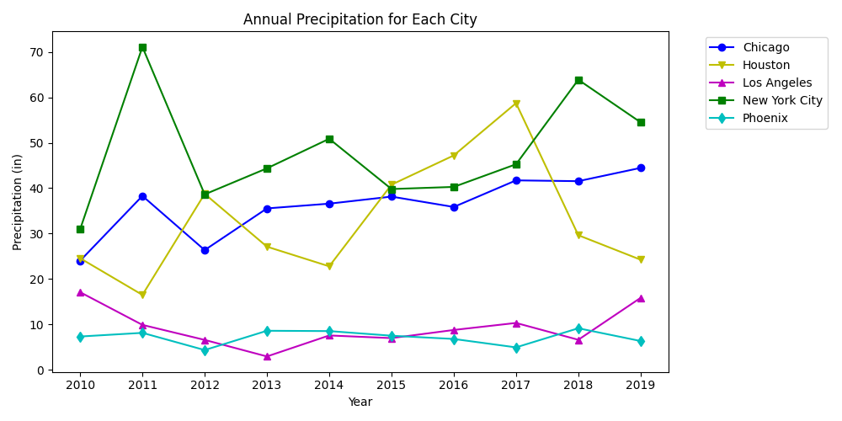
Annual Precipitation for Each City by Year
Office of Climate Support Services
One Mission One team

Slide 8
Assessing for Relationship in Weather Values
The team utilized summary historical weather data (2010-2019) for the five largest cities
To answer relationship question
A scatter plot for high temperature vs total precipitation was plotted
A correlation calculation was made to assess whether a relationship existed
A linear regression equation was modeled to support climate forecasting
Office of Climate Support Services
One Mission One team

Slide 9
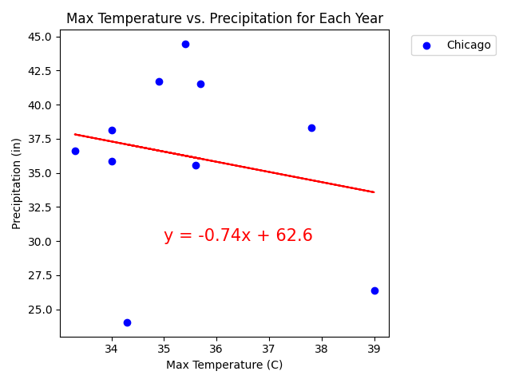
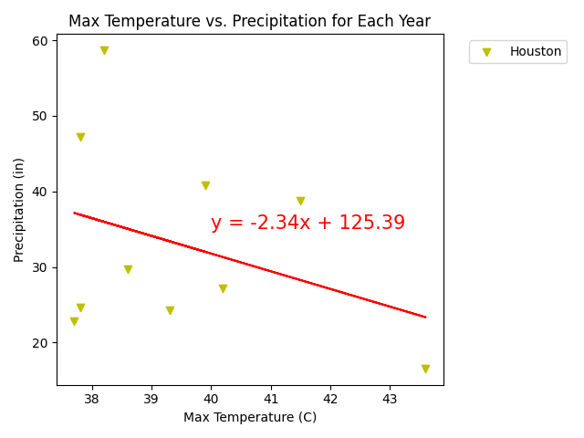
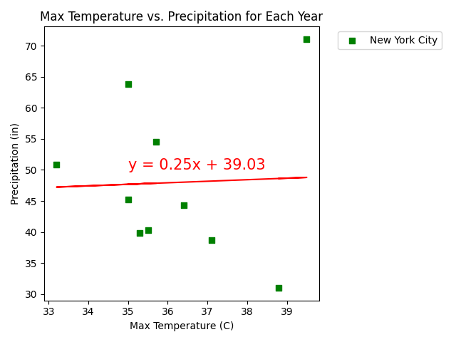
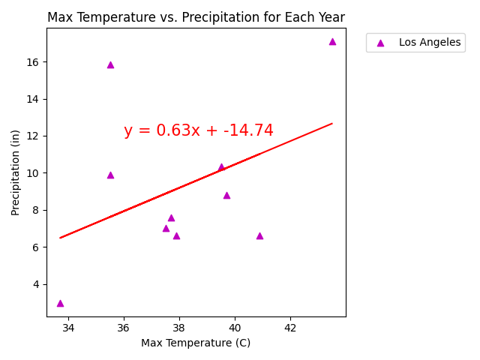
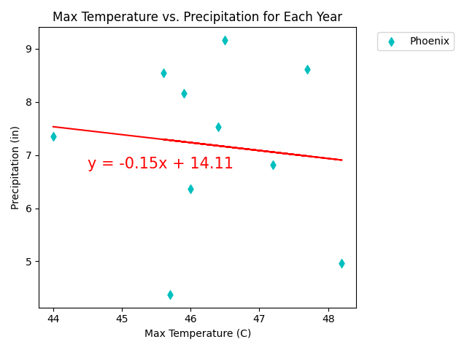
Scatter Plots for Each City
The correlation between both factors is -0.34
The correlation between both factors is 0.04
The correlation between both factors is -0.2
Office of Climate Support Services
One Mission One team
The correlation between both factors is 0.42
The correlation between both factors is -0.11

Slide 10
Observations
The high temperature or total precipitation for each city did not show much variation from year to year in any city, except for when certain cities were subject to noteworthy natural weather disasters or droughts.
New York City showed high precipitation in 2011 due to Hurricane Irene and TS Lee (outlier)
Houston showed high precipitation in 2017 due to Hurricane Harvey (outlier)
Western US was under a prolonged drought from 2011 - 2017
Comparing the values for each showed there was no correlation between high temperature vs. total precipitation.
Office of Climate Support Services
One Mission One team

Slide 11
Conclusion
There does not appear to be a relationship between maximum high temperature and annual precipitation. The OCSS team recommends other factors should be explored to identify alternate approaches for developing a more reliable modeling approach.
Office of Climate Support Services
One Mission One team

Slide 12
THANK YOU

