Slide 1
50W Ku GaN Cascade Results
John Sochacki

Slide 2
Outline
Hardware
Test Results
No Linearizer
With Linearizer
Single Setting
Comparison of No Linearizer Vs. With Linearizer
Improvement of With Linearizer Over No Linearizer
Power Optimized Settings
Comparison of No Linearizer Vs. With Linearizer
Improvement of With Linearizer Over No Linearizer
Comparison of With Linearizer Type 1 Vs. With Linearizer Type 2
Single Setting Linearizer Vs. Power Optimized Setting Linearizer
Power Optimized Settings and Standard Pulse Shaping Filter Vs. Power Optimized Settings and POPAPR Pulse Shaping Filter
Conclusion

Slide 3
Outline
Hardware
Test Results
No Linearizer
With Linearizer
Single Setting
Comparison of No Linearizer Vs. With Linearizer
Improvement of With Linearizer Over No Linearizer
Power Optimized Settings
Comparison of No Linearizer Vs. With Linearizer
Improvement of With Linearizer Over No Linearizer
Comparison of With Linearizer Type 1 Vs. With Linearizer Type 2
Single Setting Linearizer Vs. Power Optimized Setting Linearizer
Power Optimized Settings and Standard Pulse Shaping Filter Vs. Power Optimized Settings and POPAPR Pulse Shaping Filter
Conclusion

Slide 4
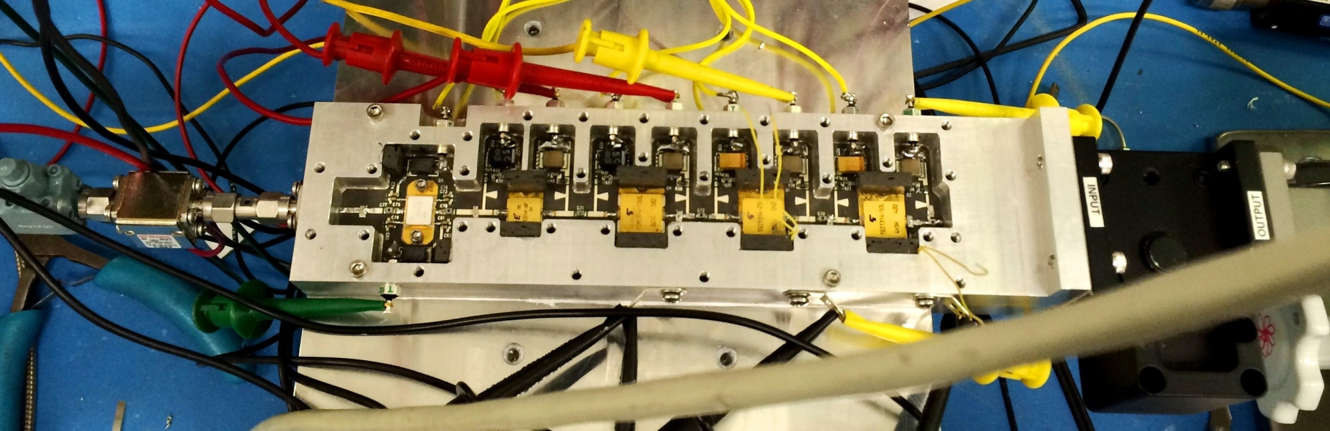
50W Ku Band GaN Cascade Without Linearizer
TIM-1314-15UL
TIM-1314-7
FMM-5054VF
TGI-1314-25L
TGI-1314-50L

Slide 5
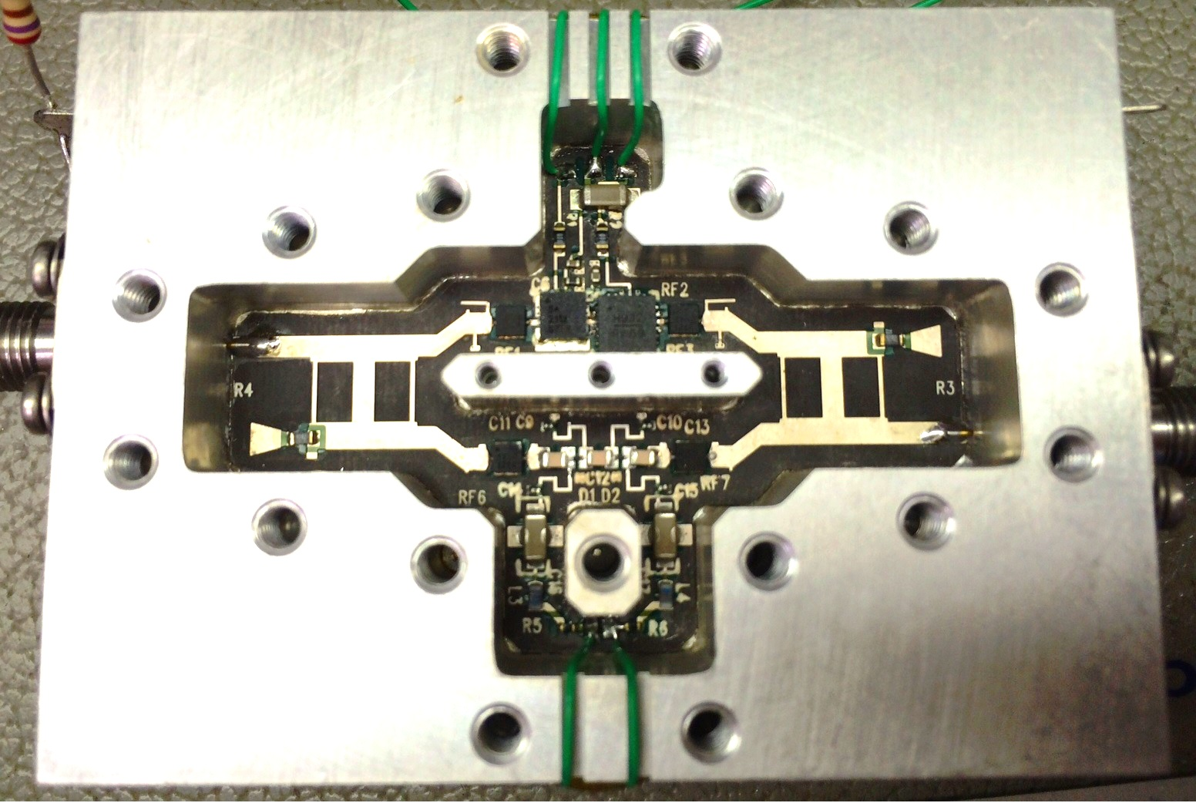
Ku Band GaN Linearizer

Slide 6
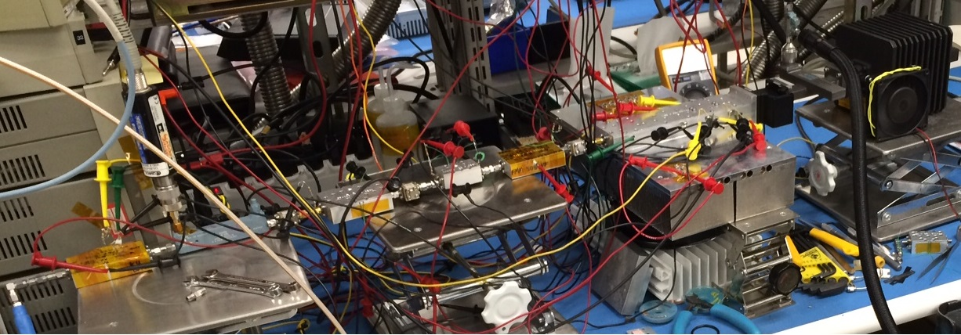
50W Ku Band GaN Cascade With Linearizer
50W Ku Band GaN Cascade
Gain Block
Voltage Variable Attenuator
Gain Block
Ku Band GaN Linearizer

Slide 7
Outline
Hardware
Test Results
No Linearizer
With Linearizer
Single Setting
Comparison of No Linearizer Vs. With Linearizer
Improvement of With Linearizer Over No Linearizer
Power Optimized Settings
Comparison of No Linearizer Vs. With Linearizer
Improvement of With Linearizer Over No Linearizer
Comparison of With Linearizer Type 1 Vs. With Linearizer Type 2
Single Setting Linearizer Vs. Power Optimized Setting Linearizer
Power Optimized Settings and Standard Pulse Shaping Filter Vs. Power Optimized Settings and POPAPR Pulse Shaping Filter
Conclusion

Slide 8
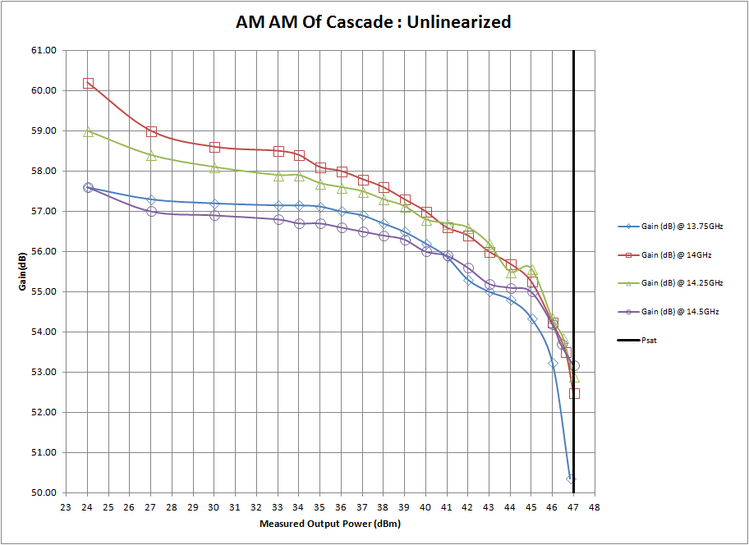
50W Cascade No Linearizer Results
CW
AM - AM results.

Slide 9
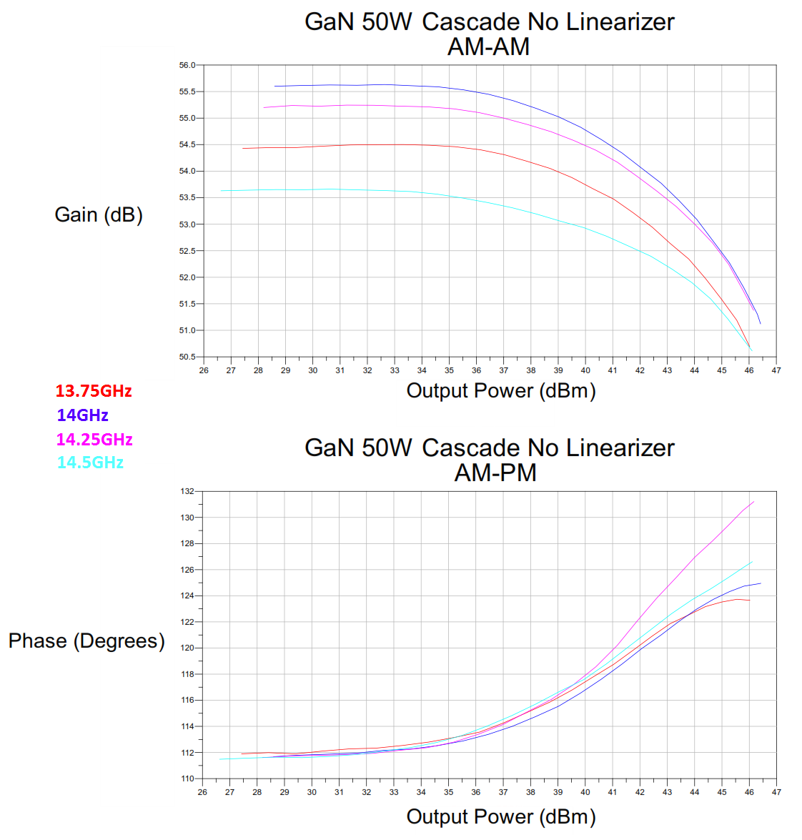
50W Cascade No Linearizer Results
Swept
AM - AM and AM - PM results.

Slide 10
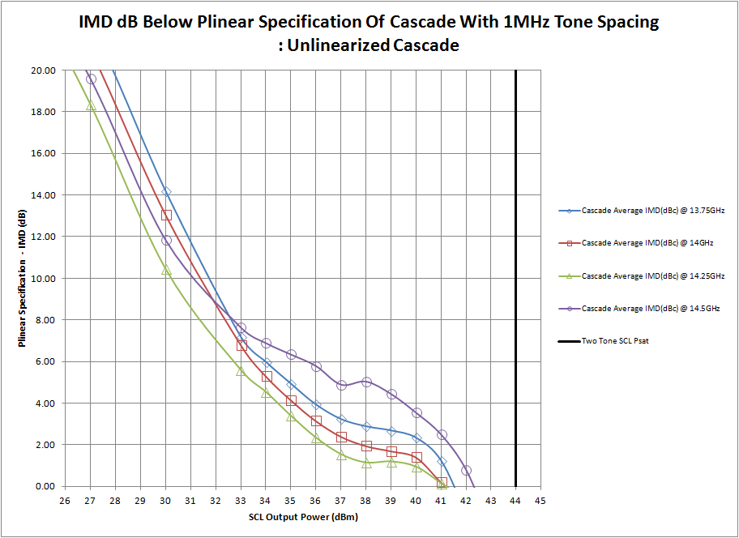
50W Cascade No Linearizer Results
Difference Between Third Order Intermodulation Products Of Unlinearized 50W GaN Cascade And Plinear Specification For Third Order Intermodullation Products..

Slide 11
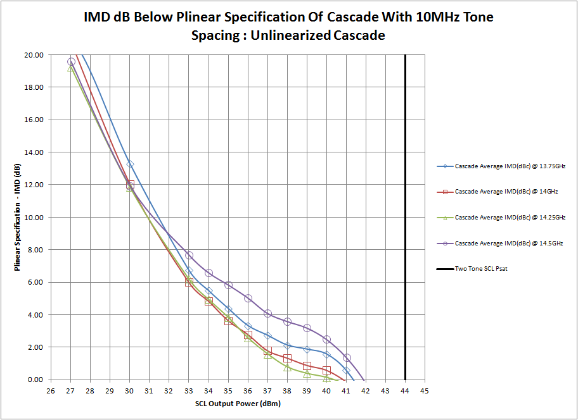
50W Cascade No Linearizer Results
Difference Between Third Order Intermodulation Products Of Unlinearized 50W GaN Cascade And Plinear Specification For Third Order Intermodullation Products..

Slide 12
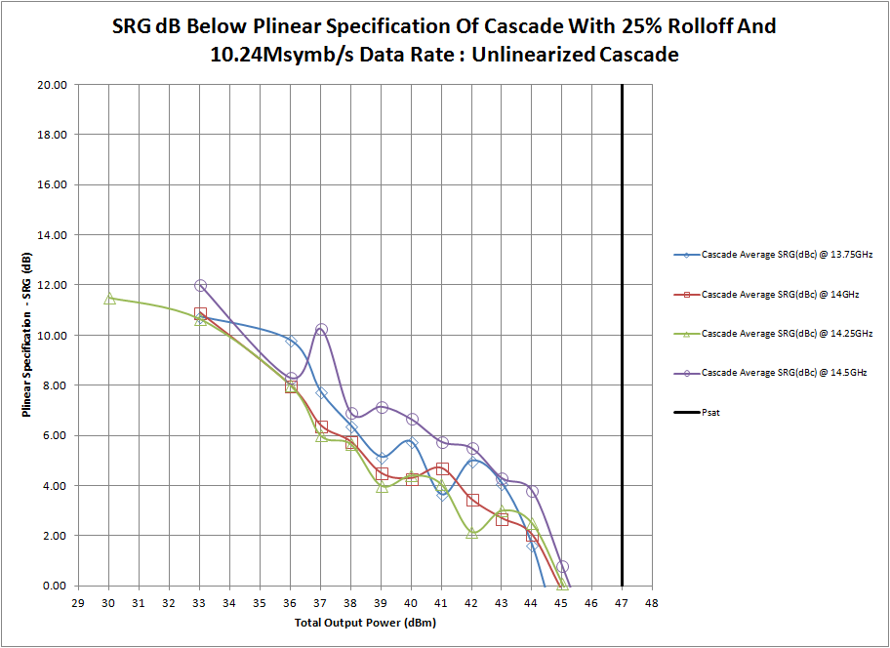
50W Cascade No Linearizer Results
Difference Between Spectral Regrowth at 1.0x Symbol Rate From The Center Of The Channel Of Unlinearized 50W GaN Cascade And Plinear Specification For Spectral Regrowth at 1.0x Symbol Rate From The Center Of The Channel .

Slide 13
Outline
Hardware
Test Results
No Linearizer
With Linearizer
Single Setting
Comparison of No Linearizer Vs. With Linearizer
Improvement of With Linearizer Over No Linearizer
Power Optimized Settings
Comparison of No Linearizer Vs. With Linearizer
Improvement of With Linearizer Over No Linearizer
Comparison of With Linearizer Type 1 Vs. With Linearizer Type 2
Single Setting Linearizer Vs. Power Optimized Setting Linearizer
Power Optimized Settings and Standard Pulse Shaping Filter Vs. Power Optimized Settings and POPAPR Pulse Shaping Filter
Conclusion

Slide 14
Definition of Single Setting and Power Optimized Setting
Single Setting
All of the different linearizer control voltages were set for the setting that gave the lowest IMD3 at 3dB and 9dB backoff simultaneously at all 4 measurement frequencies
Power Optimized Setting
All of the different linearizer control voltages were set for three distinct output power ranges
The first is from 3 dB output back off to Psat
The second was from 10 dB output back off to 3 dB back off
The third was for output powers below 10 dB back off

Slide 15
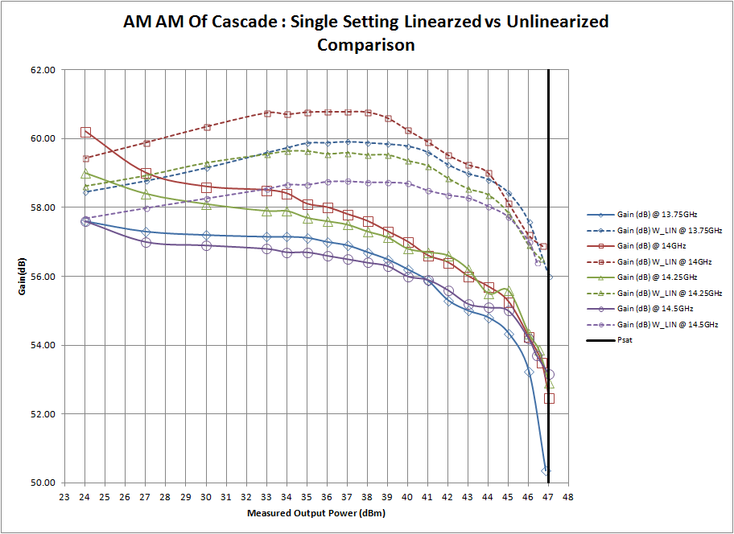
Comparison of No Linearizer Vs. With Linearizer: Single Setting
CW
AM - AM results.

Slide 16
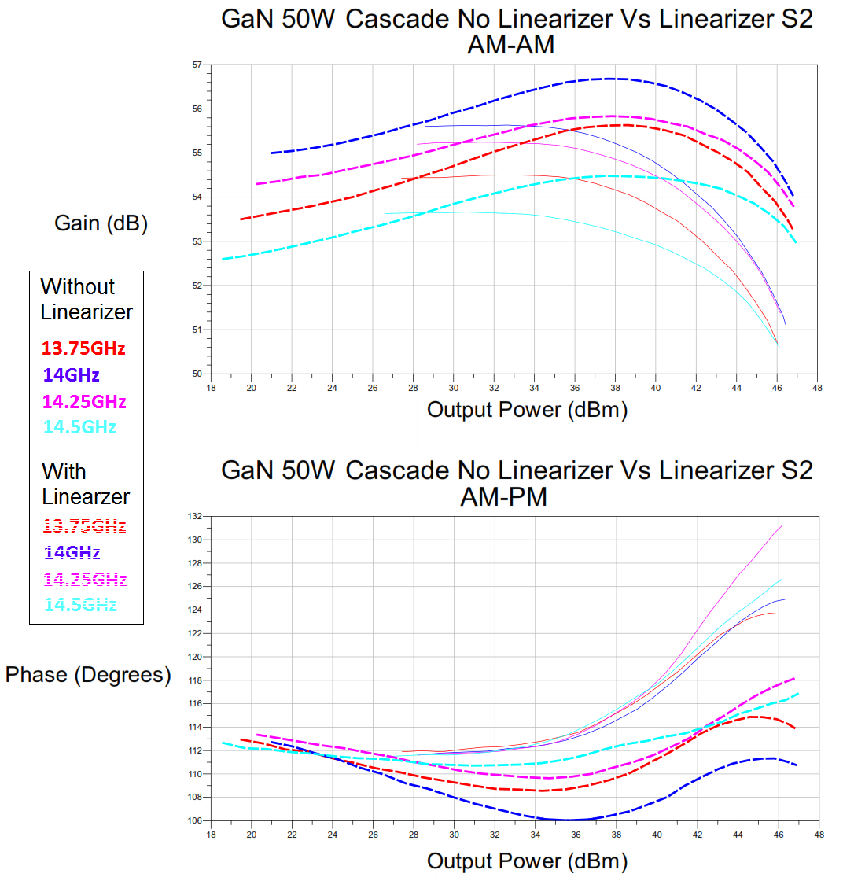
Comparison of No Linearizer Vs. With Linearizer: Single Setting
Swept
AM - AM and AM - PM results.

Slide 17
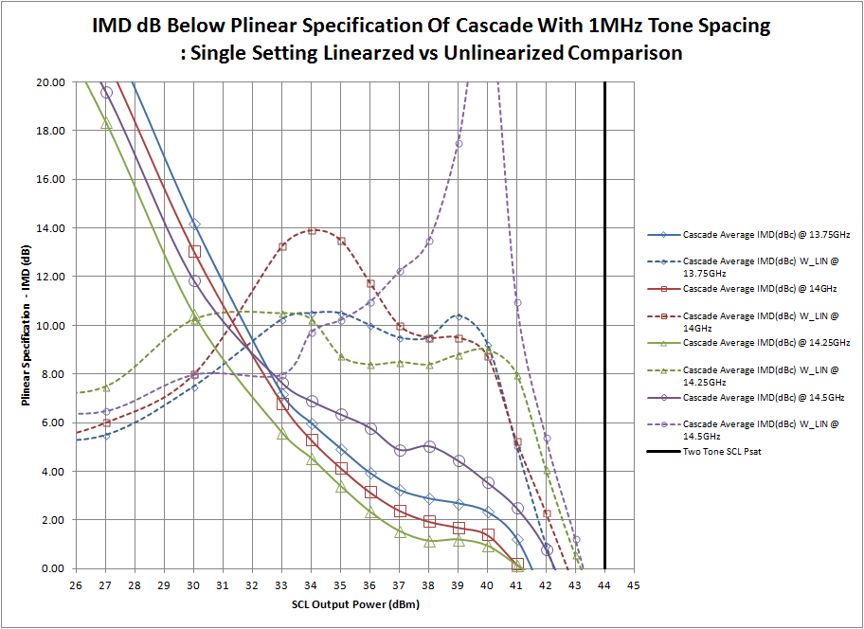
Comparison of No Linearizer Vs. With Linearizer: Single Setting
Difference Between Third Order Intermodulation Products Of The Single Setting Linearized And Unlinearized 50W GaN Cascade And Plinear Specification For Third Order Intermodullation Products.

Slide 18
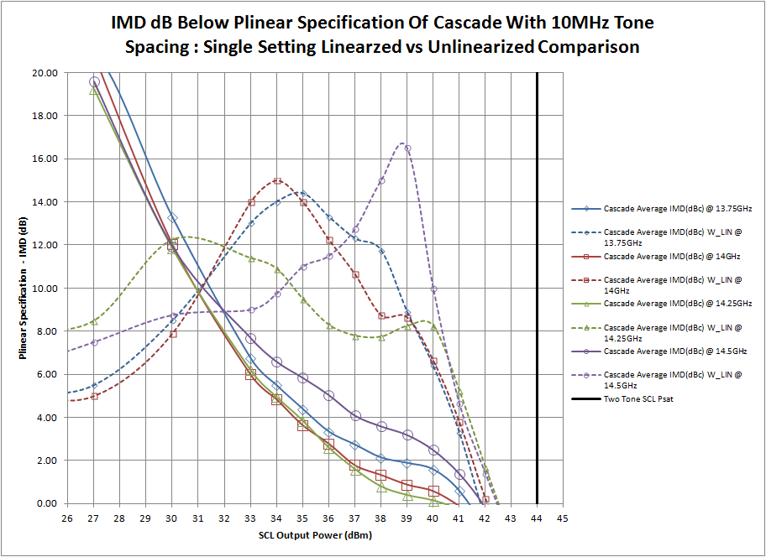
Comparison of No Linearizer Vs. With Linearizer: Single Setting
Difference Between Third Order Intermodulation Products Of The Single Setting Linearized And Unlinearized 50W GaN Cascade And Plinear Specification For Third Order Intermodullation Products.

Slide 19
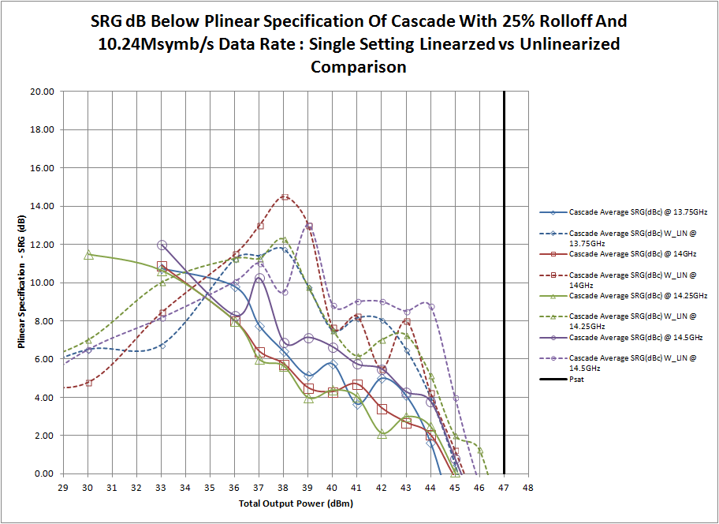
Comparison of No Linearizer Vs. With Linearizer: Single Setting
Difference Between Spectral Regrowth at 1.0x Symbol Rate From The Center Of The Channel Of The Single Setting Linearized And Unlinearized 50W GaN Cascade And Plinear Specification For Spectral Regrowth at 1.0x Symbol Rate From The Center Of The Channel .

Slide 20
Outline
Hardware
Test Results
No Linearizer
With Linearizer
Single Setting
Comparison of No Linearizer Vs. With Linearizer
Improvement of With Linearizer Over No Linearizer
Power Optimized Settings
Comparison of No Linearizer Vs. With Linearizer
Improvement of With Linearizer Over No Linearizer
Comparison of With Linearizer Type 1 Vs. With Linearizer Type 2
Single Setting Linearizer Vs. Power Optimized Setting Linearizer
Power Optimized Settings and Standard Pulse Shaping Filter Vs. Power Optimized Settings and POPAPR Pulse Shaping Filter
Conclusion

Slide 21
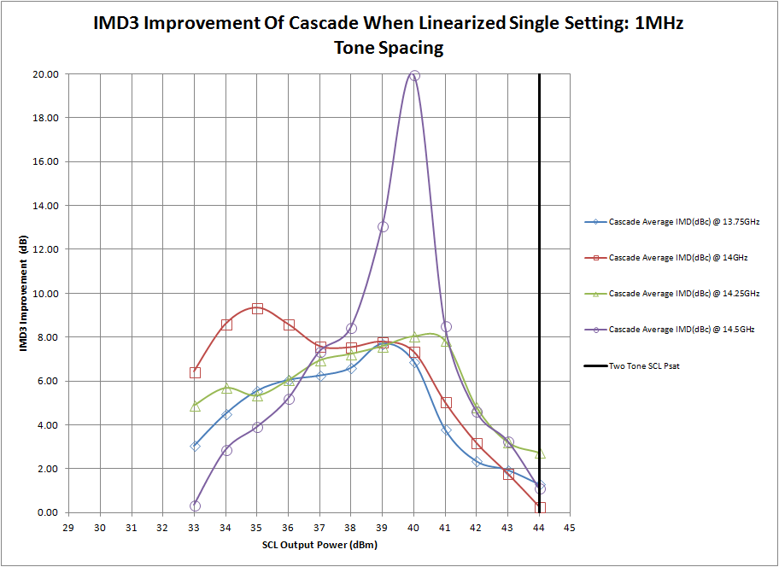
Improvement With Linearizer Over No Linearizer: Single Setting
Difference Between Third Order Intermodulation Products Of The Single Setting Linearized 50W GaN Cascade And Unlinearized 50W GaN Cascade Third Order Intermodullation Products.

Slide 22
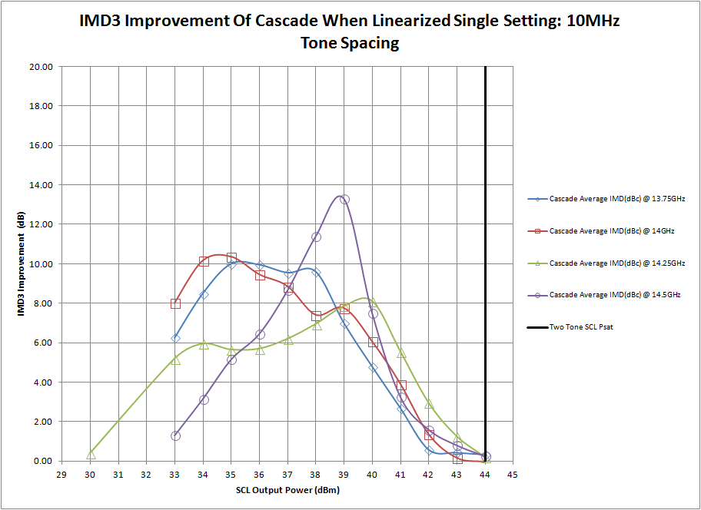
Improvement With Linearizer Over No Linearizer: Single Setting
Difference Between Third Order Intermodulation Products Of The Single Setting Linearized 50W GaN Cascade And Unlinearized 50W GaN Cascade Third Order Intermodullation Products.

Slide 23
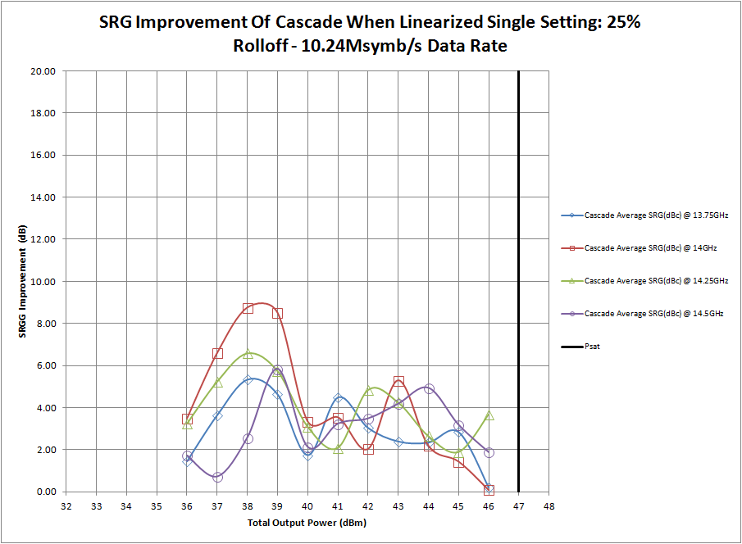
Improvement With Linearizer Over No Linearizer: Single Setting
Difference Between Spectral Regrowth at 1.0x Symbol Rate From The Center Of The Channel Of The Single Setting Linearized 50W GaN Cascade And Unlinearized 50W GaN Cascade Spectral Regrowth at 1.0x Symbol Rate From The Center Of The Channel .

Slide 24
Outline
Hardware
Test Results
No Linearizer
With Linearizer
Single Setting
Comparison of No Linearizer Vs. With Linearizer
Improvement of With Linearizer Over No Linearizer
Power Optimized Settings
Comparison of No Linearizer Vs. With Linearizer
Improvement of With Linearizer Over No Linearizer
Comparison of With Linearizer Type 1 Vs. With Linearizer Type 2
Single Setting Linearizer Vs. Power Optimized Setting Linearizer
Power Optimized Settings and Standard Pulse Shaping Filter Vs. Power Optimized Settings and POPAPR Pulse Shaping Filter
Conclusion

Slide 25
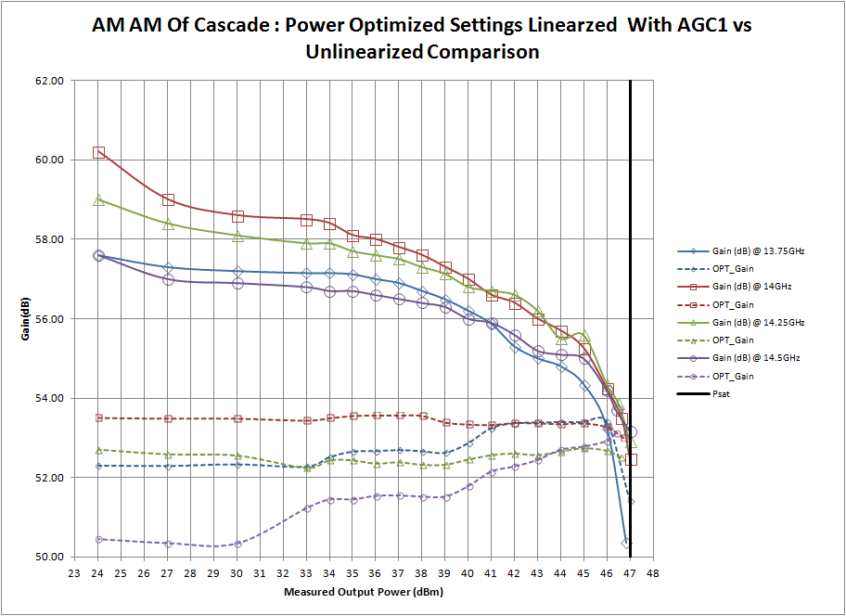
Comparison of No Linearizer Vs. With Linearizer: Power Optimized Settings
CW
AM - AM results. AGC 1 is set to maintain flat gain for the mid band frequencies and live with what happens at the band edges.

Slide 26
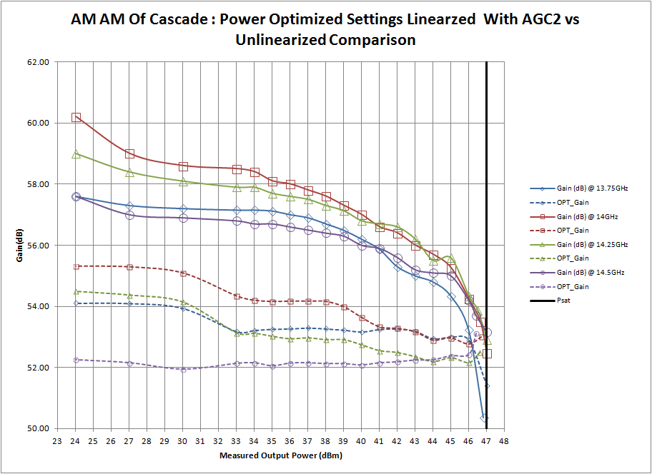
Comparison of No Linearizer Vs. With Linearizer: Power Optimized Settings
CW
AM - AM results. AGC 2 is set to maintain flat gain for the band edge frequencies and live with what happens at the mid band.

Slide 27
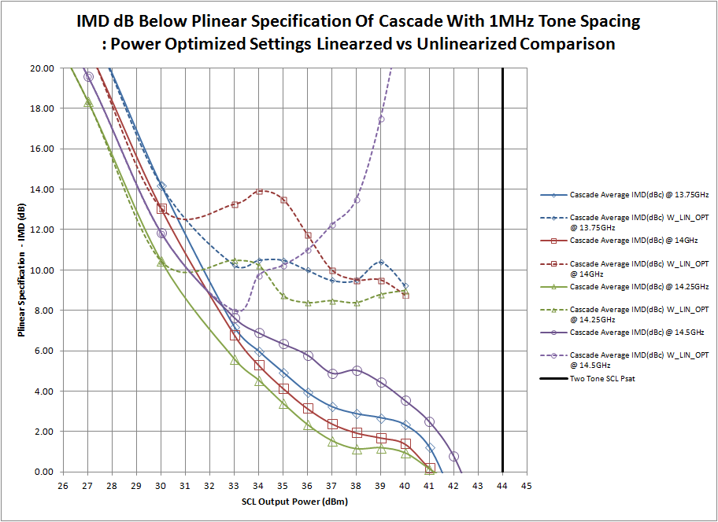
Comparison of No Linearizer Vs. With Linearizer: Power Optimized Settings
Difference Between Third Order Intermodulation Products Of The Power Optimized Settings Linearized And Unlinearized 50W GaN Cascade And Plinear Specification For Third Order Intermodullation Products. This is independent of AGC settings.

Slide 28
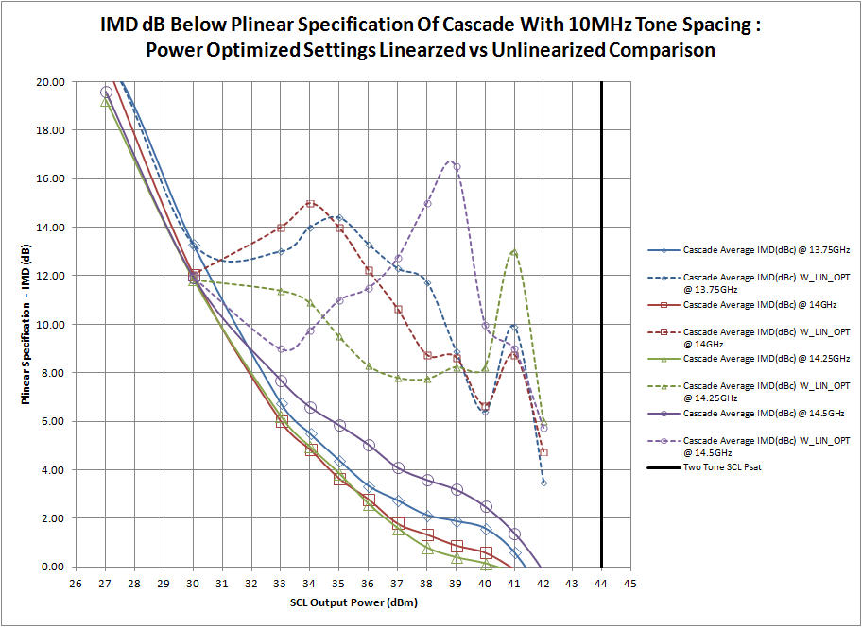
Comparison of No Linearizer Vs. With Linearizer: Power Optimized Settings
Difference Between Third Order Intermodulation Products Of The Power Optimized Settings Linearized And Unlinearized 50W GaN Cascade And Plinear Specification For Third Order Intermodullation Products. This is independent of AGC settings.

Slide 29
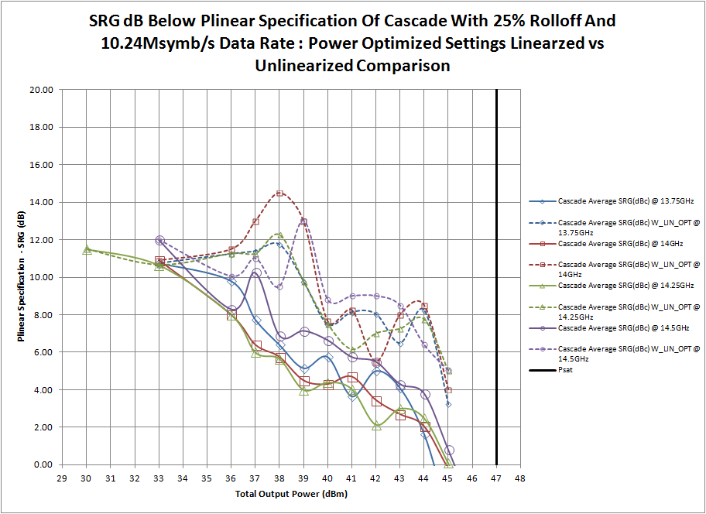
Comparison of No Linearizer Vs. With Linearizer: Power Optimized Settings
Difference Between Spectral Regrowth at 1.0x Symbol Rate From The Center Of The Channel Of The Power Optimized Settings Linearized And Unlinearized 50W GaN Cascade And Plinear Specification For Spectral Regrowth at 1.0x Symbol Rate From The Center Of The Channel . This is independent of AGC settings.

Slide 30
Outline
Hardware
Test Results
No Linearizer
With Linearizer
Single Setting
Comparison of No Linearizer Vs. With Linearizer
Improvement of With Linearizer Over No Linearizer
Power Optimized Settings
Comparison of No Linearizer Vs. With Linearizer
Improvement of With Linearizer Over No Linearizer
Comparison of With Linearizer Type 1 Vs. With Linearizer Type 2
Single Setting Linearizer Vs. Power Optimized Setting Linearizer
Power Optimized Settings and Standard Pulse Shaping Filter Vs. Power Optimized Settings and POPAPR Pulse Shaping Filter
Conclusion

Slide 31
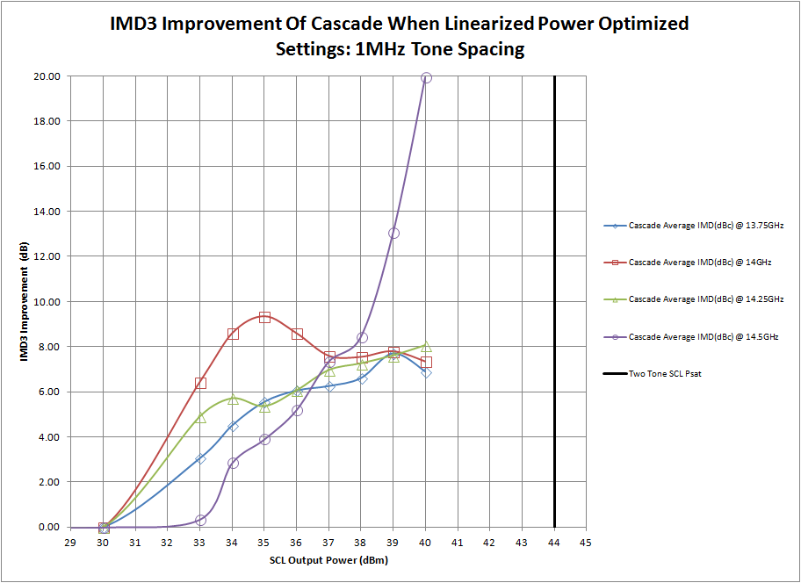
Improvement With Linearizer Over No Linearizer: Power Optimized Settings
Difference Between Third Order Intermodulation Products Of The Power Optimized Settings Linearized 50W GaN Cascade And Unlinearized 50W GaN Cascade Third Order Intermodullation Products.

Slide 32
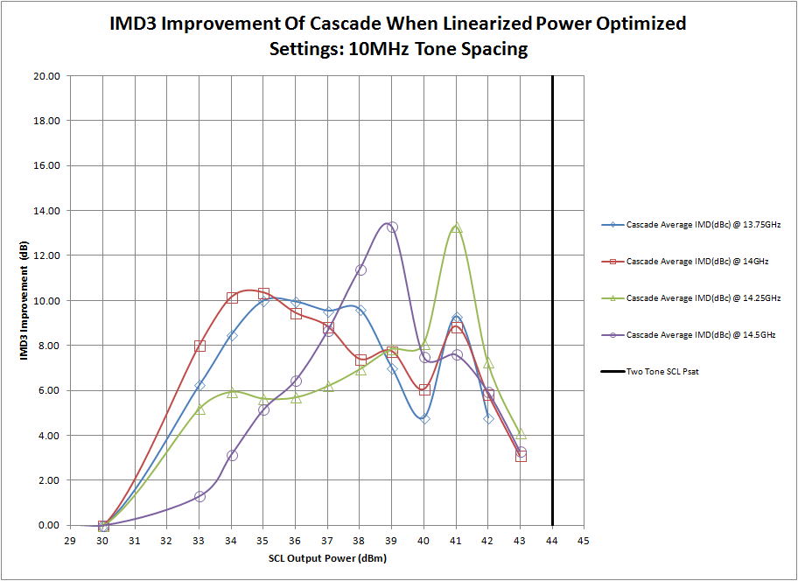
Improvement With Linearizer Over No Linearizer: Power Optimized Settings
Difference Between Third Order Intermodulation Products Of The Power Optimized Settings Linearized 50W GaN Cascade And Unlinearized 50W GaN Cascade Third Order Intermodullation Products.

Slide 33
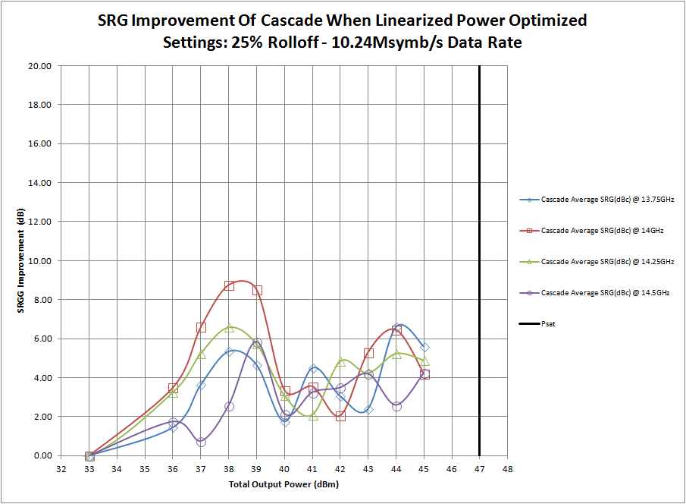
Improvement With Linearizer Over No Linearizer: Power Optimized Settings
Difference Between Spectral Regrowth at 1.0x Symbol Rate From The Center Of The Channel Of The Power Optimized Settings Linearized 50W GaN Cascade And Unlinearized 50W GaN Cascade Spectral Regrowth at 1.0x Symbol Rate From The Center Of The Channel .

Slide 34
Outline
Hardware
Test Results
No Linearizer
With Linearizer
Single Setting
Comparison of No Linearizer Vs. With Linearizer
Improvement of With Linearizer Over No Linearizer
Power Optimized Settings
Comparison of No Linearizer Vs. With Linearizer
Improvement of With Linearizer Over No Linearizer
Comparison of With Linearizer Type 1 Vs. With Linearizer Type 2
Single Setting Linearizer Vs. Power Optimized Setting Linearizer
Power Optimized Settings and Standard Pulse Shaping Filter Vs. Power Optimized Settings and POPAPR Pulse Shaping Filter
Conclusion

Slide 35
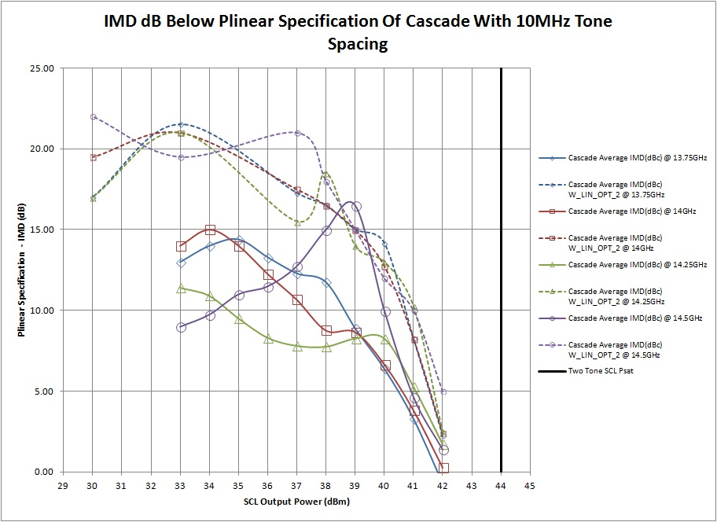
Comparison of With Linearizer: Single Setting Vs. Power Optimized Settings
Difference Between Third Order Intermodulation Products Of The Power Optimized Settings Linearized And Single Setting Linearized 50W GaN Cascade And Plinear Specification For Third Order Intermodullation Products.

Slide 36
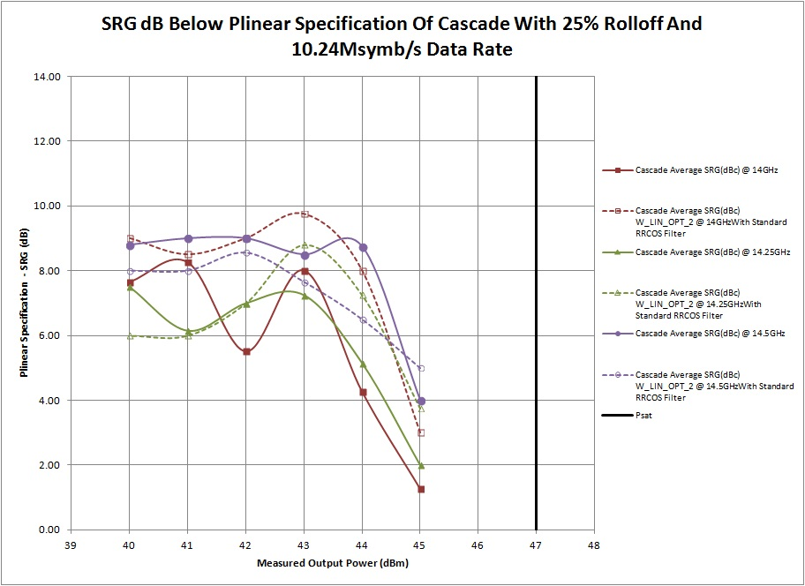
Comparison of With Linearizer: Single Setting Vs. Power Optimized Settings
Difference Between Spectral Regrowth at 1.0x Symbol Rate From The Center Of The Channel Of The Power Optimized Settings Linearized And Single Setting Linearized 50W GaN Cascade And Plinear Specification For Spectral Regrowth at 1.0x Symbol Rate From The Center Of The Channel .

Slide 37
Outline
Hardware
Test Results
No Linearizer
With Linearizer
Single Setting
Comparison of No Linearizer Vs. With Linearizer
Improvement of With Linearizer Over No Linearizer
Power Optimized Settings
Comparison of No Linearizer Vs. With Linearizer
Improvement of With Linearizer Over No Linearizer
Comparison of With Linearizer Type 1 Vs. With Linearizer Type 2
Single Setting Linearizer Vs. Power Optimized Setting Linearizer
Power Optimized Settings and Standard Pulse Shaping Filter Vs. Power Optimized Settings and POPAPR Pulse Shaping Filter
Conclusion

Slide 38
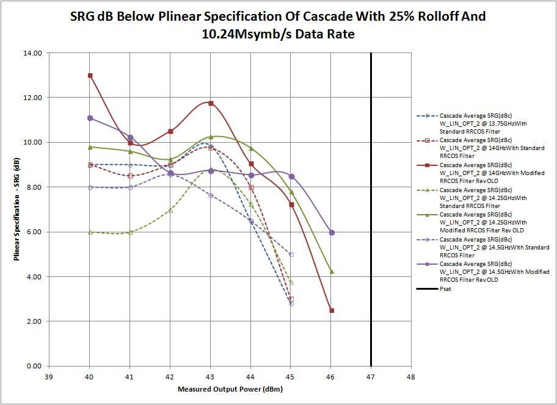
Comparison of With Linearizer Power Optimized Settings: Standard RRCOS PSF and POPAPR PSF
Difference Between Spectral Regrowth at 1.0x Symbol Rate From The Center Of The Channel Of The Power Optimized Settings Linearized 50W GaN Cascade With The Standard RRCOS Pulse Shaping Filters And The Pre-Optimized PAPR Pulse Shaping Filters And Plinear Specification For Spectral Regrowth at 1.0x Symbol Rate From The Center Of The Channel .

Slide 39
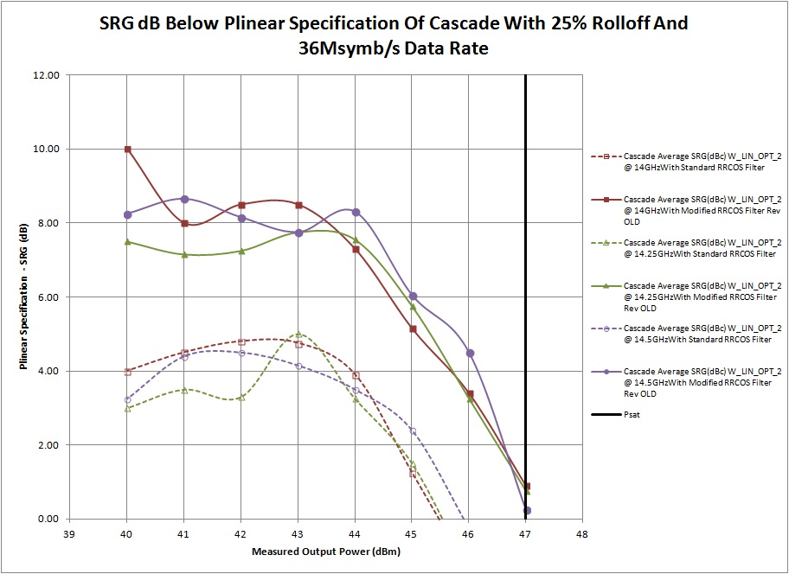
Comparison of With Linearizer Power Optimized Settings: Standard RRCOS PSF and POPAPR PSF
Difference Between Spectral Regrowth at 1.0x Symbol Rate From The Center Of The Channel Of The Power Optimized Settings Linearized 50W GaN Cascade With The Standard RRCOS Pulse Shaping Filters And The Pre-Optimized PAPR Pulse Shaping Filters And Plinear Specification For Spectral Regrowth at 1.0x Symbol Rate From The Center Of The Channel .

Slide 40
Outline
Hardware
Test Results
No Linearizer
With Linearizer
Single Setting
Comparison of No Linearizer Vs. With Linearizer
Improvement of With Linearizer Over No Linearizer
Power Optimized Settings
Comparison of No Linearizer Vs. With Linearizer
Improvement of With Linearizer Over No Linearizer
Comparison of With Linearizer Type 1 Vs. With Linearizer Type 2
Single Setting Linearizer Vs. Power Optimized Setting Linearizer
Power Optimized Settings and Standard Pulse Shaping Filter Vs. Power Optimized Settings and POPAPR Pulse Shaping Filter
Conclusion

Slide 41
Conclusion
50 Watt Ku Band GaN Cascade Worst Case Over Frequency Results At Room Temperature (25C)
Pout @ Plinear | Without Linearizer | With Single Setting Linearizer | With Power Optimized Linearizer (250MHz instantaneous bandwidth limit) | With Power Optimized Linearizer and modified RRCOS (250MHz instantaneous bandwidth limit)
Single Channel SRG Spec 10.24Mbps QPSK 25% Rolloff | 25.12 Watts (44 dBm) | 31.62 Watts (45 dBm) | 31.62 Watts (45 dBm) | 39.81 Watts (46 dBm)
Single Channel SRG Spec 36Mbps QPSK 25% Rolloff | NA | NA | 31.62 Watts (45 dBm) | 39.81 Watts (46 dBm)
Multiple Channel IMD Spec 10MHz Tone Spacing | 19.95 Watts (43 dBm) | 25.12 Watts (44 dBm) | 31.62 Watts (45 dBm) | NA
Multiple Channel IMD Spec 1 MHz Tone Spacing | 25.12 Watts (44 dBm) | 31.62 Watts (45 dBm) | 31.62 Watts (45 dBm) | NA
Legend
Out of Spec
Meets Spec With Little Margin
Exceeds Spec With Margin For 60C Operation
Exceeds Spec With Guaranteed Margin For 60C Operation

Slide 42
Conclusion
50 Watt Ku Band GaN Cascade Worst Case Over Frequency Results At Room Temperature (25C)
Output Back Off From 50 Watts (47 dBm) @ Plinear | Without Linearizer | With Single Setting Linearizer | With Power Optimized Linearizer (250MHz instantaneous bandwidth limit) | With Power Optimized Linearizer and modified RRCOS (250MHz instantaneous bandwidth limit)
Single Channel SRG Spec 10.24Mbps QPSK 25% Rolloff | 3 dB | 2 dB | 2 dB | 1 dB
Multiple Channel IMD Spec 10MHz Tone Spacing | 4 dB | 3 dB | 2 dB | NA
Multiple Channel IMD Spec 1 MHz Tone Spacing | 3 dB | 2 dB | 2 dB | NA
Legend
Out of Spec
Meets Spec With Little Margin
Exceeds Spec With Margin For 60C Operation
Exceeds Spec With Guaranteed Margin For 60C Operation

Slide 43
Conclusion
50 Watt Ku Band GaN Cascade Worst Case Over Frequency Results At Room Temperature (25C)
Gain Deviation and Phase Deviation | Without Linearizer | With Single Setting Linearizer | With Power Optimized Linearizer (250MHz instantaneous bandwidth limit) | With Power Optimized Linearizer and modified RRCOS (250MHz instantaneous bandwidth limit)
Maximum Deviation in Gain At 50 Watts (47 dBm) SCL Output Power From Gain @ 20dB Output Backoff | 7.72 dB | 2.5 dB | 2.7 dB (full bandwidth) / 0.5 dB (250 MHz Bandwidth) | NA
Deviation in Gain At 39.81 Watts (46 dBm) SCL Output Power From Gain @ 20dB Output Backoff | 5.96 dB | 2.1 dB | 2.7 dB (full bandwidth) / 0.5 dB (250 MHz Bandwidth) | NA
Maximum Deviation in Phase From Phase At 50 Watts (47 dBm) SCL Output Power From Gain @ 20dB Output Backoff | 20 degrees | 7 degrees | NA | NA
Deviation in Phase At 39.81 Watts (46 dBm) SCL Output Power From Phase @ 20dB Output Backoff | 20 degrees | 4 degrees | NA | NA

Slide 44
Thank You
Be sure to review the “SOTA_GaN_APD_Appendix.pptx” presentation for a full review of the most state of the art linearizers at the time of this presentation.

