Slide 1
Board Material Thermal Characteristics Comparison
John Sochacki

Slide 2
Outline
Test Set Up
46.45W At Input Of Board In Housing
Taconics TLY-5 20 Mils Thick
40W At Input Of Test Board Outside Of Housing
Physical vs. Thermal
Comparison
RO5880 vs. RF35TC/TSM-DS3
With Cap
No Cap
Material With Cap vs. No Cap
RF35TC
RO5880
TSM-DS3
TSM-DS3 vs. RF35TC
With Cap
No Cap
Conclusion

Slide 3
Outline
Test Set Up
46.45W At Input Of Board In Housing
Taconics TLY-5 20 Mils Thick
40W At Input Of Test Board Outside Of Housing
Physical vs. Thermal
Comparison
RO5880 vs. RF35TC/TSM-DS3
With Cap
No Cap
Material With Cap vs. No Cap
RF35TC
RO5880
TSM-DS3
TSM-DS3 vs. RF35TC
With Cap
No Cap
Conclusion

Slide 4
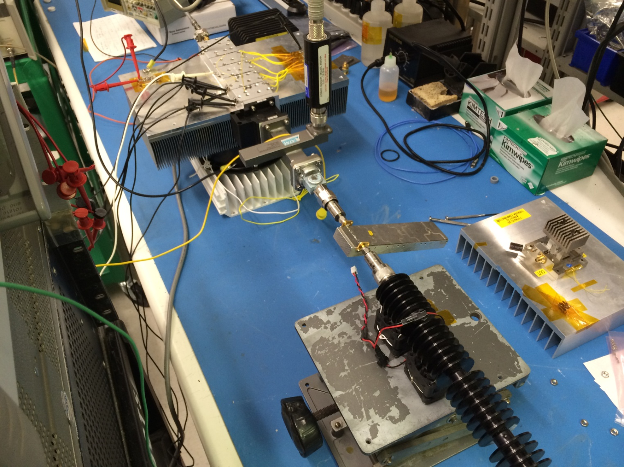
Test Set Up

Slide 5
Outline
Test Set Up
46.45W At Input Of Board In Housing
Taconics TLY-5 20 Mils Thick
40W At Input Of Test Board Outside Of Housing
Physical vs. Thermal
Comparison
RO5880 vs. RF35TC/TSM-DS3
With Cap
No Cap
Material With Cap vs. No Cap
RF35TC
RO5880
TSM-DS3
TSM-DS3 vs. RF35TC
With Cap
No Cap
Conclusion

Slide 6
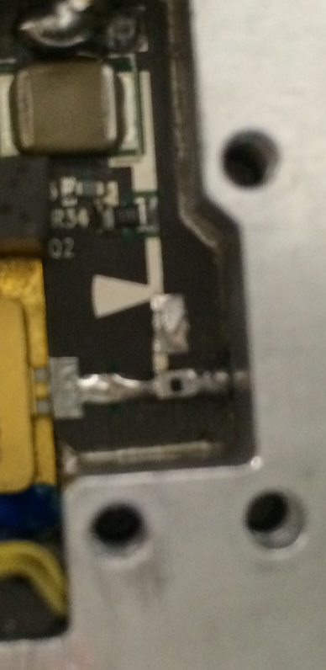
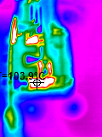
TLY-5 20 mils Thick Performance
Physical
Thermal

Slide 7
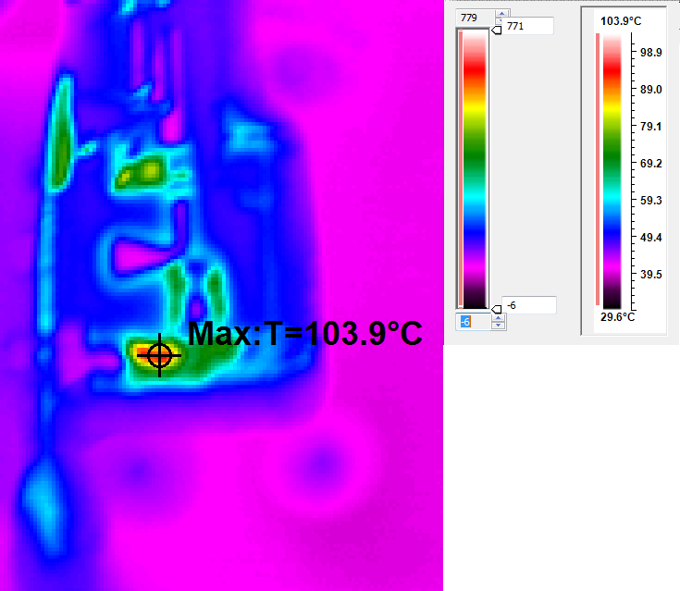
TLY-5 20 mils Thick Performance

Slide 8
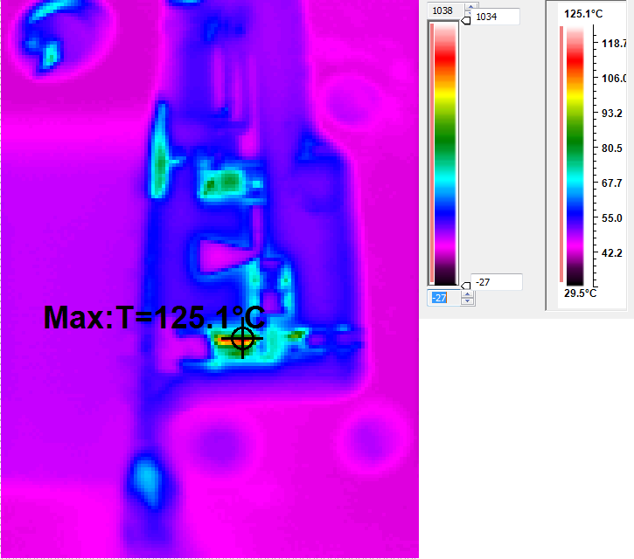
TLY-5 20 mils Thick Performance

Slide 9
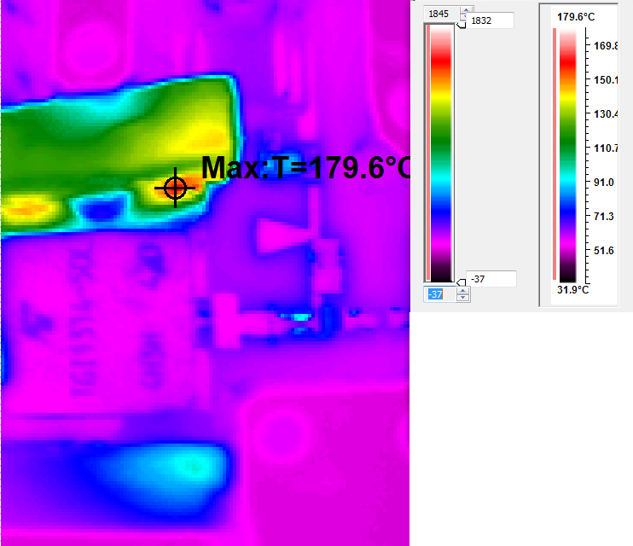
TLY-5 20 mils Thick Performance

Slide 10
Outline
Test Set Up
46.45W At Input Of Board In Housing
Taconics TLY-5 20 Mils Thick
40W At Input Of Test Board Outside Of Housing
Physical vs. Thermal
Comparison
RO5880 vs. RF35TC/TSM-DS3
With Cap
No Cap
Material With Cap vs. No Cap
RF35TC
RO5880
TSM-DS3
TSM-DS3 vs. RF35TC
With Cap
No Cap
Conclusion

Slide 11
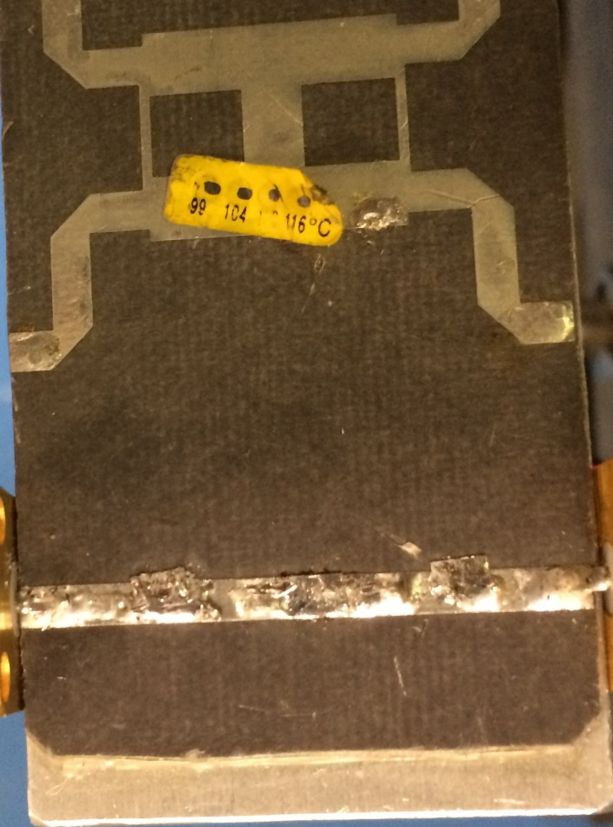
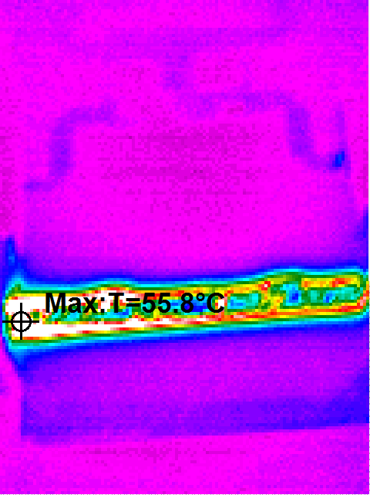
RO5880 30 mils Thick
Physical
Thermal

Slide 12
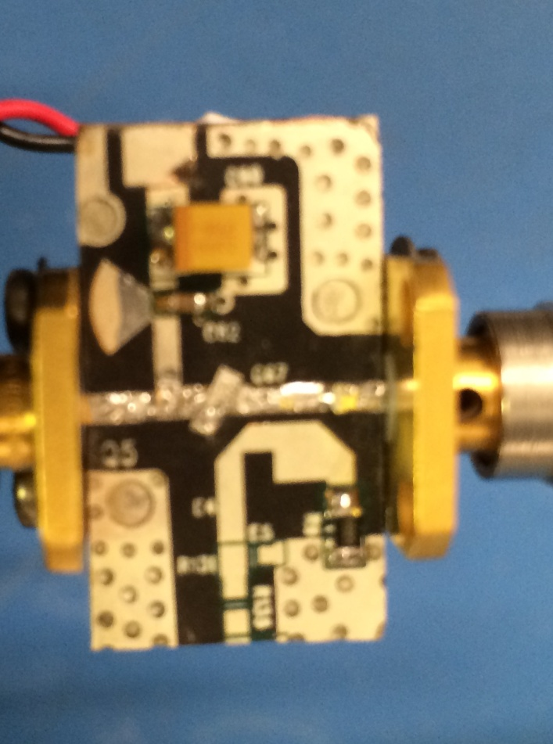
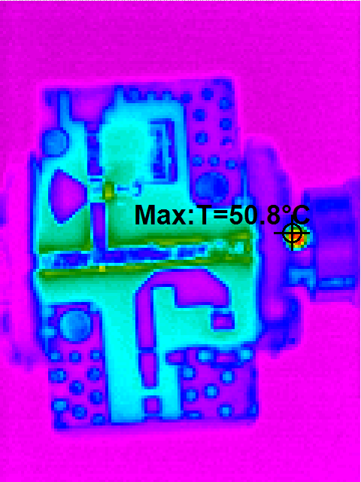
TSM-DS3 20 mils Thick
Physical
Thermal

Slide 13
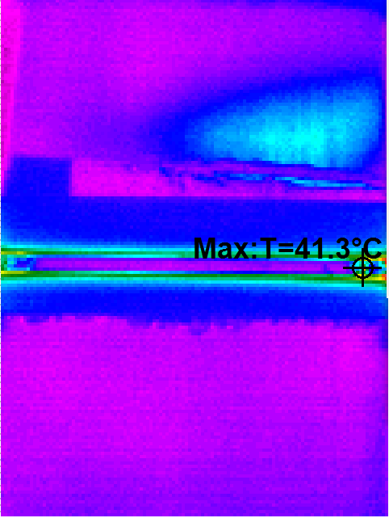
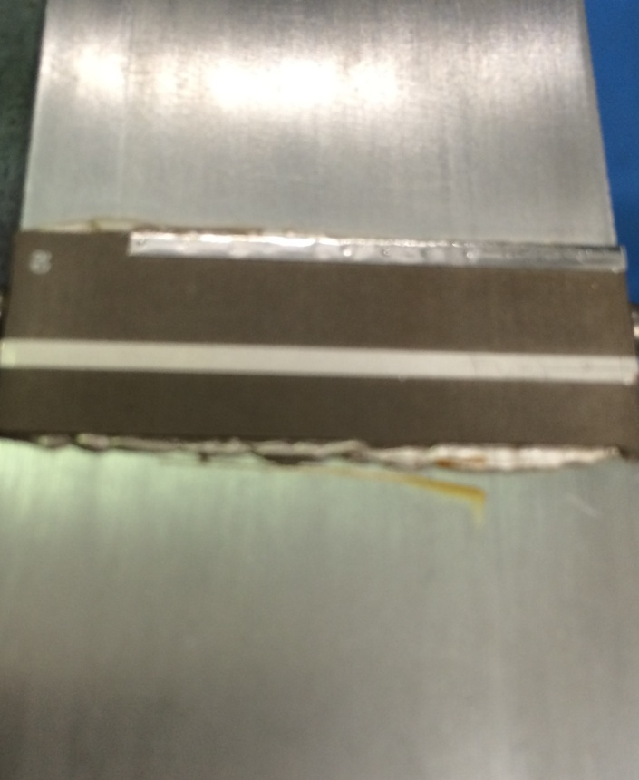
RF35TC 30 mils Thick
Physical
Thermal

Slide 14
Outline
Test Set Up
46.45W At Input Of Board In Housing
Taconics TLY-5 20 Mils Thick
40W At Input Of Test Board Outside Of Housing
Physical vs. Thermal
Comparison
RO5880 vs. RF35TC/TSM-DS3
With Cap
No Cap
Material With Cap vs. No Cap
RF35TC
RO5880
TSM-DS3
TSM-DS3 vs. RF35TC
With Cap
No Cap
Conclusion

Slide 15
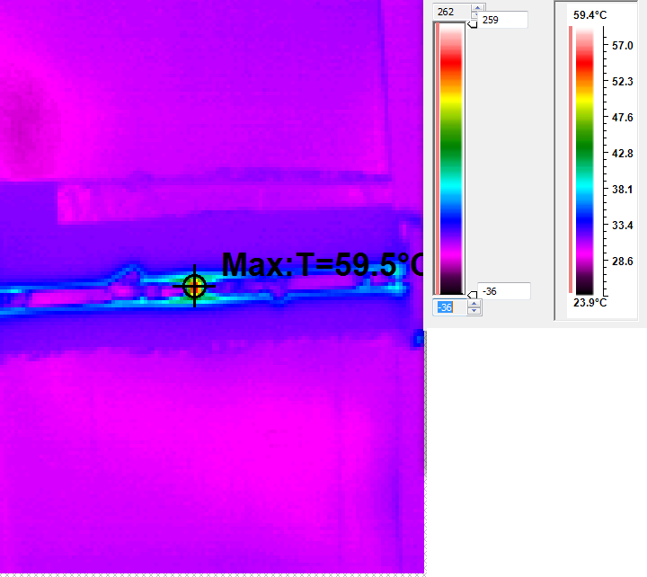
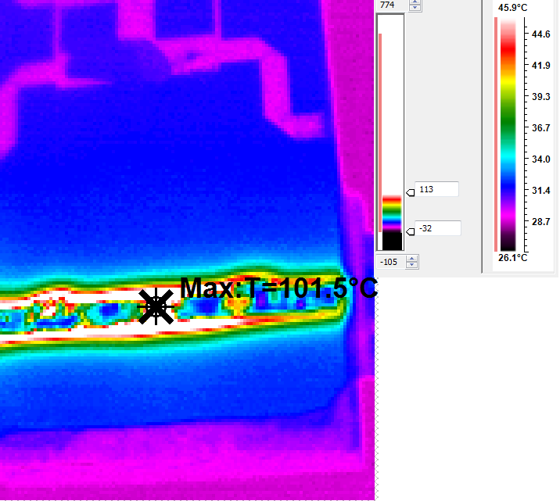
Comparison: RO5880 VS. RF35TC/TSM-DS3 – With Cap
RF35TC 30 Mils Thick
RO5880 30 Mils Thick
Notes:
Note improper scale for clors on 5880 results but max temp accurate

Slide 16
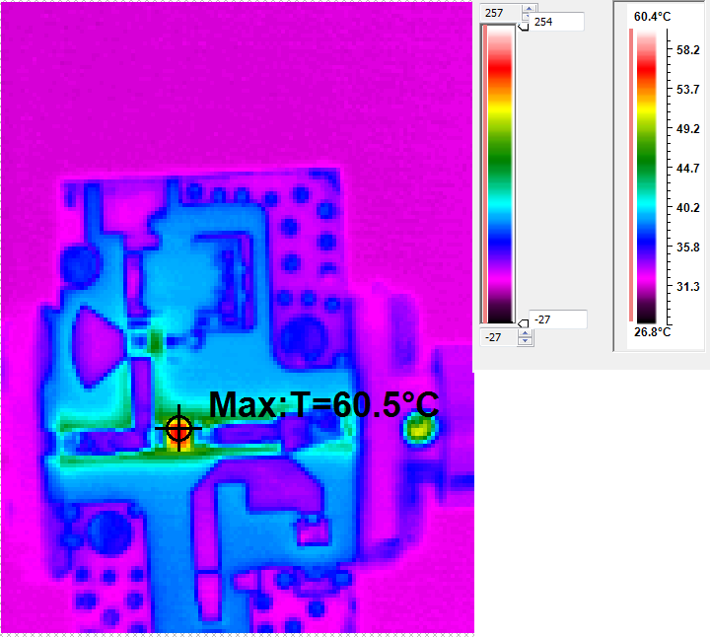
Comparison: RO5880 VS. RF35TC/TSM-DS3 – With Cap
TSM-DS3 20 Mils Thick
RO5880 30 Mils Thick
Notes:
Note improper scale for clors on 5880 results but max temp accurate

Slide 17
Outline
Test Set Up
46.45W At Input Of Board In Housing
Taconics TLY-5 20 Mils Thick
40W At Input Of Test Board Outside Of Housing
Physical vs. Thermal
Comparison
RO5880 vs. RF35TC/TSM-DS3
With Cap
No Cap
Material With Cap vs. No Cap
RF35TC
RO5880
TSM-DS3
TSM-DS3 vs. RF35TC
With Cap
No Cap
Conclusion

Slide 18
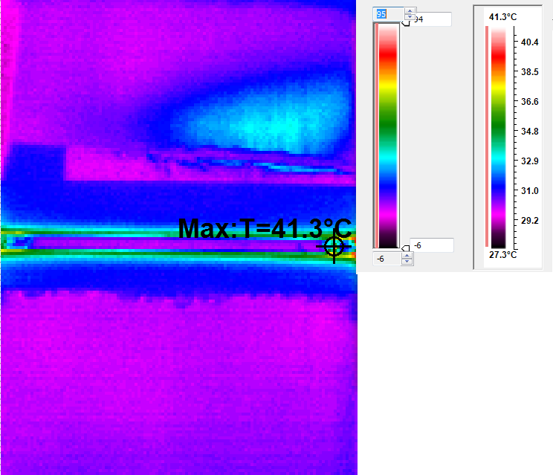
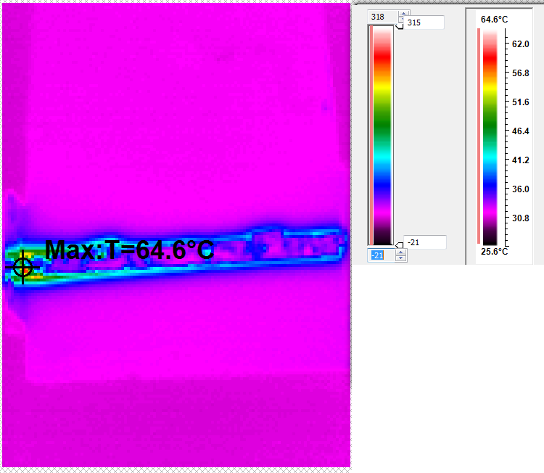
Comparison: RO5880 VS. RF35TC/TSM-DS3 – No Cap
RF35TC 30 Mils Thick
RO5880 30 Mils Thick

Slide 19
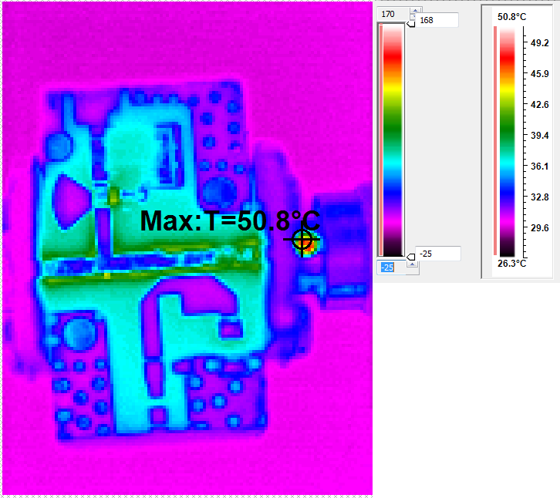
Comparison: RO5880 VS. RF35TC/TSM-DS3 – No Cap
TSM-DS3 20 Mils Thick
RO5880 30 Mils Thick

Slide 20
Outline
Test Set Up
46.45W At Input Of Board In Housing
Taconics TLY-5 20 Mils Thick
40W At Input Of Test Board Outside Of Housing
Physical vs. Thermal
Comparison
RO5880 vs. RF35TC/TSM-DS3
With Cap
No Cap
Material With Cap vs. No Cap
RF35TC
RO5880
TSM-DS3
TSM-DS3 vs. RF35TC
With Cap
No Cap
Conclusion

Slide 21
Comparison: Cap VS. No Cap
RF35TC 30 Mils Thick No Capacitor
RF35TC 30 Mils Thick With Capacitor

Slide 22
Comparison: Cap VS. No Cap
RO5880 30 Mils Thick No Capacitor
RO5880 30 Mils Thick With Capacitor

Slide 23
Comparison: Cap VS. No Cap
TSM-DS3 20 Mils Thick No Capacitor
TSM-DS3 20 Mils Thick With Capacitor

Slide 24
Outline
Test Set Up
46.45W At Input Of Board In Housing
Taconics TLY-5 20 Mils Thick
40W At Input Of Test Board Outside Of Housing
Physical vs. Thermal
Comparison
RO5880 vs. RF35TC/TSM-DS3
With Cap
No Cap
Material With Cap vs. No Cap
RF35TC
RO5880
TSM-DS3
TSM-DS3 vs. RF35TC
With Cap
No Cap
Conclusion

Slide 25
Comparison: TSM-DS3 VS. RF35TC – With Cap
TSM-DS3 20 Mils Thick
RF35TC 30 Mils Thick
Notes:
Note improper scale for clors on 5880 results but max temp accurate

Slide 26
Comparison: TSM-DS3 VS. RF35TC – No Cap
TSM-DS3 20 Mils Thick
RF35TC 30 Mils Thick

Slide 27
Outline
Test Set Up
46.45W At Input Of Board In Housing
Taconics TLY-5 20 Mils Thick
40W At Input Of Test Board Outside Of Housing
Physical vs. Thermal
Comparison
RO5880 vs. RF35TC/TSM-DS3
With Cap
No Cap
Material With Cap vs. No Cap
RF35TC
RO5880
TSM-DS3
TSM-DS3 vs. RF35TC
With Cap
No Cap
Conclusion

Slide 28
Conclusion
The maximum temperature of the TSM-DS3 is 14 degrees cooler than the RO5880/TLY-5 when there is no capacitor and 40 degrees cooler than the RO5880/TLY-5 when there is a capacitor.
The maximum temperature of the RF35TC is 23 degrees cooler than the RO5880/TLY-5 when there is no capacitor and 40 degrees cooler than the RO5880/TLY-5 when there is a capacitor.
The maximum temperature of the TSM-DS3 rises 10 degrees when a capacitor is added to the trace.
The maximum temperature of the RF35TC rises 18 degrees when a capacitor is added to the trace.
When there is no capacitor added to the trace the temperature of the RF35TC is 13 degrees cooler than that of the TSM-DS3.
When there is a capacitor added to the trace the temperature of the RF35TC is 1 degrees cooler than that of the TSM-DS3.

Slide 29
Result
Use TSM-DS3

Slide 30
Notes and Action Items
Good measurements with good IR camera and Emissivity Dots
Maybe do some measurements with “thermal tape-measure”
Note not fair comparison between TSM-DS3 and RF35TC

Slide 31
Extra Slides

Slide 32
RO5880 30 mils Thick
Physical
Thermal

Slide 33
RO5880 30 mils Thick Performance With Capacitor

Slide 34
RO5880 30 mils Thick Performance Without Capacitor

Slide 35
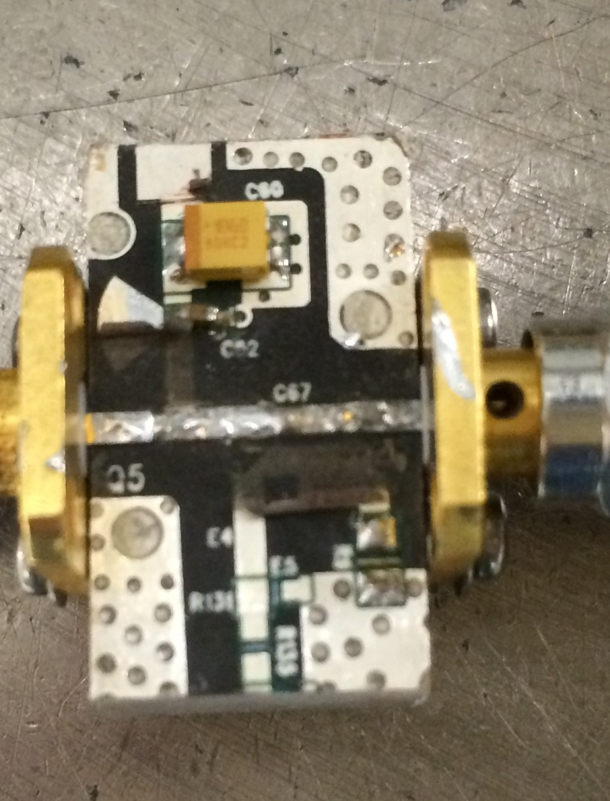
TSM-DS3 20 mils Thick
Physical
Thermal

Slide 36
TSM-DS3 20 mils Thick Performance With Capacitor

Slide 37
TSM-DS3 20 mils Thick Performance Without Capacitor

Slide 38
RF35TC 30 mils Thick
Physical
Thermal

Slide 39
RF35TC 30 mils Thick Performance With Capacitor

Slide 40
RF35TC 30 mils Thick Performance Without Capacitor

