Slide 1
Link Nonlinearity Detector and Equalizer
John Sochacki

Slide 2
Outline
Theory Of Operation
  Block Diagram
Results
  Matlab Simulation Results Comparison
    Hard Decision Decoding vs Soft Decision Decoding Accuracy
    Correction With Receiver Side DPD
Implementation
  How To Implement At Minimal Hardware Cost
Uses
  Non-Linear Equalization
  Link Trouble Shooting For Customer Service
  CnC Link Linearity Maintenance
  Suggestions

Slide 3
Outline
Theory Of Operation
  Block Diagram
Results
  Matlab Simulation Results Comparison
    Hard Decision Decoding vs Soft Decision Decoding Accuracy
    Correction With Receiver Side DPD
Implementation
  How To Implement At Minimal Hardware Cost
Uses
  Non-Linear Equalization
  Link Trouble Shooting For Customer Service
  CnC Link Linearity Maintenance
  Suggestions

Slide 4

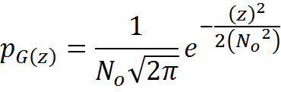
Theory Of Operation
Since Channel Is Assumed To Be Additive White Gaussian Noise (AWGN), The Probability Density Function (PDF) Of AWGN Is Gaussian Of The Form
By Definition AWGN Is Of Zero Mean And ‘No’ Variance (For Complex Signals). Therefore The PDF Will Be Equal To
This Means That A Time Averaged Signal Of A AWGN Noise Has Mean Noise Power Distribution Of
Which Is Equal To Zero

Slide 5
Theory Of Operation
So, That Was A Long Way Of Saying That The Mean Noise Power Of AWGN Noise Is 0
This means sufficient averaging of complex constellation points that are corrupted by AWGN will remove the AWGN so long as the constellation points correspond to the same word.

Slide 6
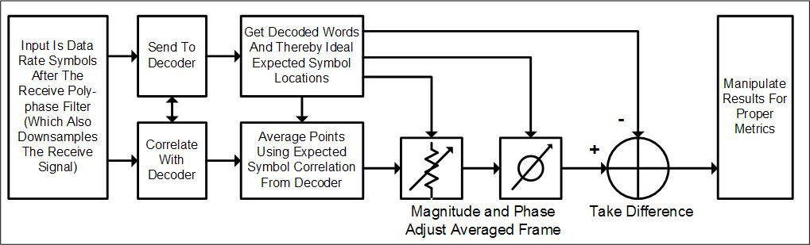
Theory Of Operation
Algorithm

Slide 7
Outline
Theory Of Operation
  Block Diagram
Results
  Matlab Simulation Results Comparison
    Hard Decision Decoding vs Soft Decision Decoding Accuracy
    Correction With Receiver Side DPD
Implementation
  How To Implement At Minimal Hardware Cost
Uses
  Non-Linear Equalization
  Link Trouble Shooting For Customer Service
  CnC Link Linearity Maintenance
  Suggestions

Slide 8
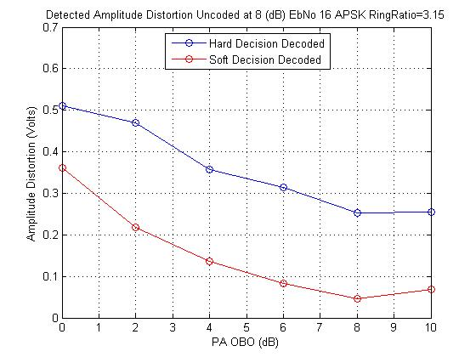
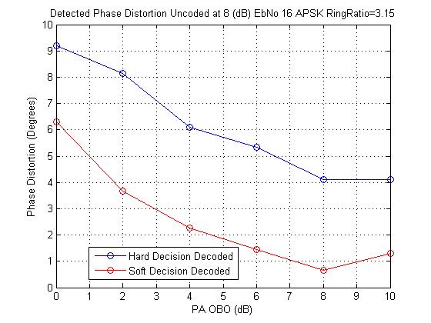
Results
Comparison Of Point Correlated Averaging Based On Hard Decision Decoding Vs Soft Decision Decoding At 8 dB EbNo 16APSK 2/3
Detected Magnitude Distortion
Detected Phase Distortion

Slide 9
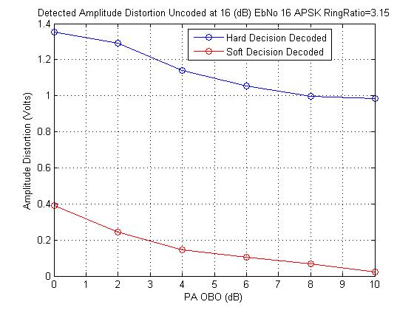
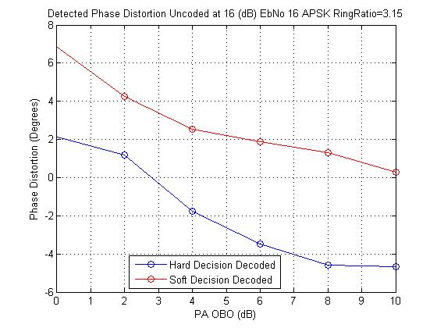
Results
Comparison Of Point Correlated Averaging Based On Hard Decision Decoding Vs Soft Decision Decoding At 16 dB EbNo 16APSK 2/3
Detected Magnitude Distortion
Detected Phase Distortion

Slide 10
Results
It Is Clear From The Simulation Results That Proper Constellation Point Correlation Is Crucial For An Accurate Measure Of Link Non-linearity As The Detected Link Non-linearity Is Virtually The Same For The Soft Decision Case At 8 dB EbNo And 16 dB EbNo.
Therefore In Order For This Technique To Be Implemented In An Effective Manner It Must Be Used With Soft Decision Decoding

Slide 11
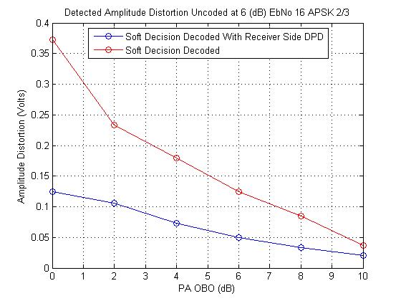
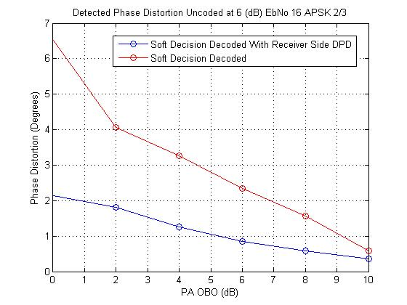
Results
Comparison Distortion Of Soft Decision Decoding No DPD Vs Soft Decision Decoding With Receiver Side DPD At 16 dB EbNo 16APSK 2/3
Detected Magnitude Distortion
Detected Phase Distortion

Slide 12
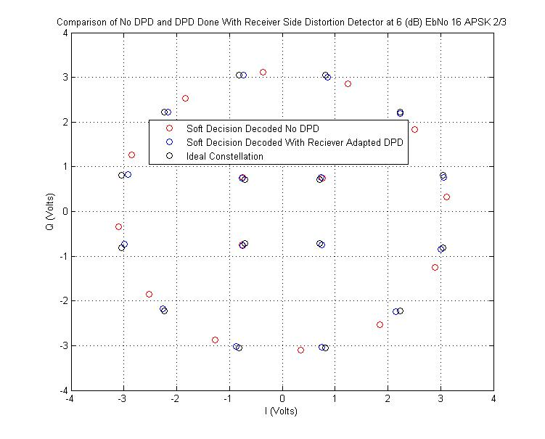
Results
Comparison Distortion Of Soft Decision Decoding No DPD Vs Soft Decision Decoding With Receiver Side DPD At 16 dB EbNo 16APSK 2/3

Slide 13
Outline
Theory Of Operation
  Block Diagram
Results
  Matlab Simulation Results Comparison
    Hard Decision Decoding vs Soft Decision Decoding Accuracy
    Correction With Receiver Side DPD
Implementation
  How To Implement At Minimal Hardware Cost
Uses
  Non-Linear Equalization
  Link Trouble Shooting For Customer Service
  CnC Link Linearity Maintenance
  Suggestions

Slide 14
Implementation
Issues Faced When Implementing This Algorithm
  Correlation Of Received Complex Symbols And Decoded Words
  Magnitude And Phase Alignment Of Constellations
  DPD Algorithm Implementation At Receiver
    Transmit Side Polynomial Pre-Distorter
    Non-Linear Equalizer On Receive Side

Slide 15
Implementation
Correlation Of Received Complex Symbols And Decoded Words
  All That Must Be Done In The Receiver Is Maintain Tracking Between A Complex Symbol And The Word That Is Output From The Decoder That Is Associated With It
  This Can Be Done By Simply Storing A Copy Of The Noisy Received Complex Data Points As They Are Stored In The Decoder
    Resources
      There Must Be An Amount Of Ram That Is Equal To The Amount Of Ram In The Decoder That Is Used To Store The Encoded Fecframe (Number Of Complex Symbols (Based On Modcod) Corresponding To 64800 Bits)
    Method
      The Complex Data Must Be Written Into This Ram In The Same Exact Way That It Is Written Into The Decoder I.E. In A De-interleaving Manner
      Any Data Shifting Operations That Occur In The Decoder Must Be Mimicked On The Complex Data Ram
        One I Can Think Of Is The Removal Of All The FEC Words From The Beginning/End Of The Frame After De-Interleaving And Prior To Decoding

Slide 16
Implementation
Magnitude And Phase Alignment Of Constellations
  The LMS Algorithm Can Be Used To Align The Magnitude And Angle Of The Received Averaged Data At Little Hardware Cost In The Form Of A Simple One Tap Filter

Slide 17
Implementation
DPD Algorithm Implementation At Receiver
  Transmit Side Polynomial Pre-Distorter
    Coefficients Can Be Sent To The Transmitter Over The “Back Channel” If It Is Desired That The Non-linear Equalization Be Done At The Transmit Side
    The Coefficients Are A Very Small Amount Of Data (Approximately A Few Data Words Depending On Precision) And Therefore Do Not Measurable Cut Into Data Rate On Large Frames
    The Coefficients Can Be Solved For With The Direct Learning Architecture LMS Algorithm By Using The Ideal Complex Constellation As The Actual Input Signal And The Averaged Receive Constellation As The Desired Input Signal To The LMS Block. This Forms The System Model. Then The Inverse System Model Can Be Formed By Applying The Direct Learning Architecture LMS Algorithm To The Cascade Of The System Model And The Pre-distorter Where The Ideal Complex Constellation Is The Desired Input Signal And The Averaged Receive Constellation Is The Actual Input Signal To The LMS Block
  However, This Requires That The Transmitter Is Able To Receive These Coefficients And Knows What To Do With Them

Slide 18
Implementation
DPD Algorithm Implementation At Receiver
  Non-Linear Equalizer On Receive Side
    No Knowledge Of The Transmitter Or Link Is Assumed In This Method And There Is No Requirement Of Interoperability In Order For This Method To Function
    The Non-linear Correction Takes The Form Of A Non-linear Equalizer On The Receiver Front End
    The Coefficients Can Be Solved For With The Direct Learning Architecture LMS Algorithm By Using The Ideal Complex Constellation As The Desired Input Signal And The Averaged Receive Constellation As The Actual Input Signal To The LMS Block. This Forms The Inverse System Model For The Non-Linear Equalizer

Slide 19
Outline
Theory Of Operation
  Block Diagram
Results
  Matlab Simulation Results Comparison
    Hard Decision Decoding vs Soft Decision Decoding Accuracy
    Correction With Receiver Side DPD
Implementation
  How To Implement At Minimal Hardware Cost
Uses
  Non-Linear Equalization
  Link Trouble Shooting For Customer Service
  CnC Link Linearity Maintenance
  Suggestions

Slide 20
Uses
Non-Linear Equalization
  As Discussed In The Implementation Section
Link Troubleshooting For Customer Service
  Distortion Information Could Be Logged And Sent To Customer Service To Aid In Troubleshooting With Customers Who Are Experiencing Problems
CnC Linearity Maintenance
  In Order For Cnc To Work Properly The Link Must Be Kept Linear
  This Feature Could Help AUPC Auto Adapt And Make Sure That The Link Is Kept In The Linear Region For Cnc Users

Slide 21
Suggestions?

