Slide 1
Clojure on Android
hank@123mail.org

Slide 2
Why Mobile?
It’s not a phone
Honey, I Shrunk the PC
specs ≈ 2004 desktop PC
e.g. Galaxy Nexus: 1.2 GHz RISC dual core, 1 GB RAM, 16 GB storage
Honey, I Shrunk the server
always on, always connected
≈ ADSL 1 bandwidth

Slide 3
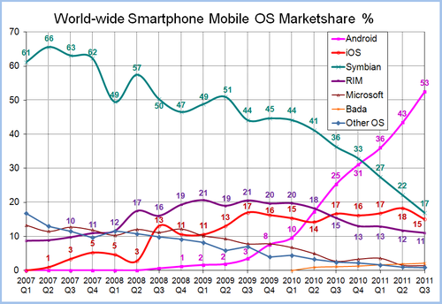
Why Android?

Slide 4
Why Android?
Broad device spectrum
Developer favourites: Linux, Open source
Familiar tools: Eclipse, Java, Ant, …
Runs Clojure

Slide 5
Why not Clojure?
Low complexity on small apps
Can’t help with native, 3D
Some hoops to jump through
Shooting at a moving target

Slide 6
Why Clojure?
Organizational aspects
Familiarity with Clojure & ecosystem
Coming from a non-java background
Interactive development using REPL
One language for mobile, backend, browser
no context switching
code reuse: lower dev time, reduced bug count
move code between tiers

Slide 7
Why Clojure?
Technical aspects:
Clojure’s simplicity dominating factor even for smallish projects
Concurrency a key issue for mobile apps
inputs from UI, network & hardware (e.g. GPS)
mobile UX demands instant responses
Ad-hoc, online updates
push code to device at runtime

Slide 8
Live Updates
Update deployed apps while in use
Easier updates
Fine-grained customization
IP protection
Staged rollouts
Goal: Blank bootstrap app + all code online

Slide 9
How
Android based on Java + libraries in jars
Clojure just another jar!
drop jar + AOT code into libs
Start with Java: clojure.lang.RT
Start with Clojure: gen-class

Slide 10
Concerns
watch Conj 2011: “Clojure on Android”
blip.tv/clojure
eval: scripts, REPL, explicit eval (macros!)
dex + APK trick → github.com/sattvik
startup time ≈ 4 secs
use boot time service
default stack size 8kB (Andoid) vs. 256kB (PC)
no Java beans

Slide 11
Friction
Build systems: Android/ant vs. leiningen
Apache Harmony vs. Sun/OpenJDK
Apache HTTP Client & Commons Codec
project.clj duplication in libraries
user.clj presence in libraries
→ custom versions of libraries
→ private maven repo

Slide 12
nREPL live coding

Slide 13
Outlook
lean Clojure (Conj 2011 Keynote)
UI library
reactive programming
UI
REPL
event-based applications

