Slide 1
Approximate Bayesian Computation
“Basic Concepts”
Joao Sollari Lopes
March 2010

Slide 2
Basic Concepts
Logic and Probability

Slide 3
Basic Concepts
Axioms of probability:
P(A) ≥ 0 for any event A
P(U) = 1
If A and B are mutually exclusive events, then P(A U B) = P(A) + P(B)

Slide 4
Basic Concepts
Axioms of probability:
P(A) ≥ 0 for any event A
P(U) = 1
If A and B are mutually exclusive events, then P(A U B) = P(A) + P(B)
Rules of probability:
P(ɸ) = 0
P(Ā) = 1 – P(A)
P(A U B) = P(A) + P(B) – P(A ∩ B)

Slide 5
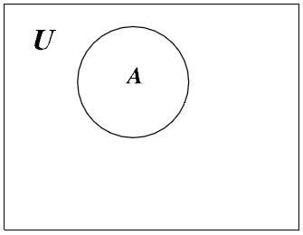
Basic Concepts
Probability of A, (Venn diagram):
Universe of events U
Event A

Slide 6
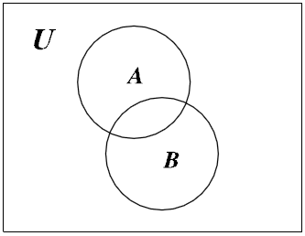
Basic Concepts

Slide 7
Basic Concepts
Joint probability:
- The joint probability of events A and B is the probability that both events occur simultaneously, i.e. P(A ∩ B)

Slide 8
Basic Concepts
Marginal probability:
The probability of event A, in the joint event setting, is called the marginal probability. It is found by summing its disjoint parts:
P(A) = P(A ∩ B) + P(A ∩ B)
ˉ

Slide 9
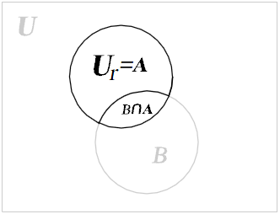
Basic Concepts

Slide 10
Basic Concepts
Conditional probability:
- Event A has occurred. The only part of event B that is now relevant is that part which is also in A, i.e. B ∩ A.
- The total probability in the reduced universe, U_{r} = A, must equal 1. It has to be multiplied by the scale factor 1/P(A):
P(B|A) = P(B ∩ A) / P(A)

Slide 11
Basic Concepts
Multiplication rule:
- Event A can occur either with event B or with its complement B. The chance of event A may depend on which one B or B occurred.
- By reversing the roles of the two events A and B we get:
P(A|B) = P(A ∩ B) / P(B) ↔ P(A ∩ B) = P(A|B) x P(B)
ˉ
ˉ

Slide 12
Basic Concepts
Multiplication rule:
- Event A can occur either with event B or with its complement B. The chance of event A may depend on which one B or B occurred.
- By reversing the roles of the two events A and B we get:
P(A|B) = P(A ∩ B) / P(B) ↔ P(A ∩ B) = P(A|B) x P(B)
ˉ
ˉ
Bayes’ Theorem:
From the definition of conditional probability:
P(B|A) = P(A ∩ B) / P(A)
Using the multiplication rule to find the join probability:
P(B|A) = P(A|B) x P(B)
P(A)
___________

Slide 13
Basic Concepts
Multiplication rule:
- Event A can occur either with event B or with its complement B. The chance of event A may depend on which one B or B occurred.
- By reversing the roles of the two events A and B we get:
P(A|B) = P(A ∩ B) / P(B) ↔ P(A ∩ B) = P(A|B) x P(B)
ˉ
ˉ
Bayes’ Theorem:
From the definition of conditional probability:
P(B|A) = P(A ∩ B) / P(A)
Using the multiplication rule to find the join probability:
P(B|A) = P(A|B) x P(B)
P(A)
___________

Slide 14
Basic Concepts
Random variables

Slide 15
Basic Concepts
Random variables:
- A number that is determined by the outcome of a random experiment is called a
random variable.

Slide 16
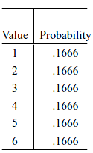
Basic Concepts
Random variables:
- A number that is determined by the outcome of a random experiment is called a
random variable.
E.g.
Y = rolling of a fair dice

Slide 17
Basic Concepts
Probability distribution:
- The probability of any possible event can be found from the probability distribution of the random variable using the rules of probability.
- The probability distribution is a numerical function.

Slide 18
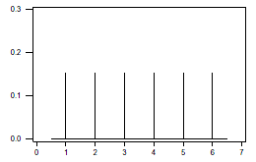
Basic Concepts
Probability distribution:
- The probability of any possible event can be found from the probability distribution of the random variable using the rules of probability.
- The probability distribution is a numerical function.
E.g.
Y = rolling of a fair dice
f(y_{k}) = Probability distribution of Y
P(Y = y_{k}) = 0.1666, for k = 1, 2, …, 6
P(Y )
Y

Slide 19
Basic Concepts
Joint random variables:
- When at least two numbers are determined from the outcome of a random experiment, we call them joint random variables.
- The joint probability function of two discrete joint random variables is defined at
each point in the universe as:
f(x_{i}, y_{j}) = P(X = x_{i}, Y = y_{j})

Slide 20
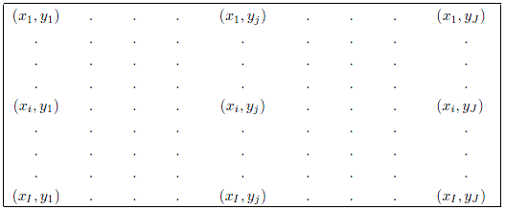
Basic Concepts
Joint random variables:
- When at least two numbers are determined from the outcome of a random experiment, we call them joint random variables.
- The joint probability function of two discrete joint random variables is defined at
each point in the universe as:
f(x_{i}, y_{j}) = P(X = x_{i}, Y = y_{j})

Slide 21
Basic Concepts
Conditional probability for joint random variables:
- Given that Y = y_{j}, the reduced universe is the set of ordered pairs where the second element is y_{j}.
- The conditional probability that random variable X = x_{i} , given Y = y_{j} is:
f(x_{i} | y_{j}) = P(X = x_{i} | Y = y_{j})

Slide 22
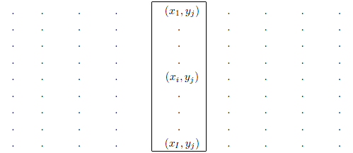
Basic Concepts
Conditional probability for joint random variables:
- Given that Y = y_{j}, the reduced universe is the set of ordered pairs where the second element is y_{j}.
- The conditional probability that random variable X = x_{i} , given Y = y_{j} is:
f(x_{i} | y_{j}) = P(X = x_{i} | Y = y_{j})

Slide 23
Basic Concepts
- The conditional probability that X = x_{i} , given Y = y_{j} is the probability of the intersection of the events X = x_{i} and Y = y_{j} divided by the probability that Y = y_{j}.
- Dividing the joint probability by the marginal probability scales it up so the probability of the reduced universe equals 1:
P(X = x_{i} | Y = y_{j}) = P(X = x_{i}, Y = y_{j}) or f(x_{i} | y_{j}) = f(x_{i}, y_{j})
P(Y = y_{j}) f(y_{j})
_____________
_____

Slide 24
Basic Concepts
- The conditional probability that X = x_{i} , given Y = y_{j} is the probability of the intersection of the events X = x_{i} and Y = y_{j} divided by the probability that Y = y_{j}.
- Dividing the joint probability by the marginal probability scales it up so the probability of the reduced universe equals 1:
P(X = x_{i} | Y = y_{j}) = P(X = x_{i}, Y = y_{j}) or f(x_{i} | y_{j}) = f(x_{i}, y_{j})
P(Y = y_{j}) f(y_{j})
_____________
_____
Conditional probability as multiplication rule:
Again, by reversing the roles of the 2 events, X = x_{i} and Y = y_{j}, we get:
f(y_{j} | x_{i}) = f(x_{i}, y_{j}) ↔ f(x_{i}, y_{j}) = f(x_{i}) × f(y_{j} | x_{i})
f(x_{i})
thus
f(x_{i} | y_{j}) = f(x_{i}) × f(y_{j} | x_{i})
f(y_{j})
_____
___________

Slide 25
Basic Concepts
- The conditional probability that X = x_{i} , given Y = y_{j} is the probability of the intersection of the events X = x_{i} and Y = y_{j} divided by the probability that Y = y_{j}.
- Dividing the joint probability by the marginal probability scales it up so the probability of the reduced universe equals 1:
P(X = x_{i} | Y = y_{j}) = P(X = x_{i}, Y = y_{j}) or f(x_{i} | y_{j}) = f(x_{i}, y_{j})
P(Y = y_{j}) f(y_{j})
_____________
_____
Conditional probability as multiplication rule:
Again, by reversing the roles of the 2 events, X = x_{i} and Y = y_{j}, we get:
f(x_{i} | y_{j}) = f(x_{i}, y_{j}) ↔ f(x_{i}, y_{j}) = f(x_{i}) × f(y_{j} | x_{i})
f(y_{j})
thus
f(x_{i} | y_{j}) = f(x_{i}) × f(y_{j} | x_{i})
f(y_{j})
_____
___________

Slide 26
Basic Concepts
Final remarks:
No need to fully understand Logic and Probability to use Bayesian statistics tools. But it is helpful to understand where the Bayesian theory comes from.
Our knowledge (or uncertainty) can be represented by Random Variables.
When we consider two Random Variables we can define joint probabilities, conditional probabilities and marginal probabilities.
Bibliography:
Bolstad (2004) Introduction to Bayesian statistics. Wiley.

