Slide 1
Approximate Bayesian Computation
“Bayesian Statistics”
Joao Sollari Lopes
March 2010

Slide 2
Bayesian Statistics
Statistical Inference

Slide 3
Bayesian Statistics
Frequentist and Bayesian methods:
According to frequentist theory, only repeatable events have probabilities. In the Bayesian framework, probability simply describes uncertainty.
An event can be uncertain due to:
  being intrinsically unpredictable, i.e. subject to random variability;
  simple from us having an imperfect knowledge about it.

Slide 4
Bayesian Statistics
Frequentist and Bayesian methods:
According to frequentist theory, only repeatable events have probabilities. In the Bayesian framework, probability simply describes uncertainty.
An event can be uncertain due to:
  being intrinsically unpredictable, i.e. subject to random variability;
  simple because of having imperfect knowledge about it.
Statistical methods:
statistical methods make inferences about unknown parameters. These can be thought of as properties of the population from which the data arises.
Parameters are specific to the problem, and are not generally subject to random variability. Frequentist statistics does not regard probability statements about them as meaningful. Bayesian statistics, in contrast, can make probability statements about parameters, simply because they are unknown.

Slide 5
Bayesian Statistics
Frequentist
Bayesian
Probability is a limiting, long-run frequency;
Probability measures a personal degree of belief;

Slide 6
Bayesian Statistics
Frequentist
Bayesian
Probability is a limiting, long-run frequency;
It only applies to events that are (at least in principle) repeatable;
Probability measures a personal degree of belief;
It applies to any event or proposition about which we are uncertain;

Slide 7
Bayesian Statistics
Frequentist
Bayesian
Probability is a limiting, long-run frequency;
It only applies to events that are (at least in principle) repeatable;
Parameters are not repeatable or random, they are fixed (unknown) quantities.
Probability measures a personal degree of belief;
It applies to any event or proposition about which we are uncertain;
Parameters are unknown, therefore they are random variables;

Slide 8
Bayesian Statistics
Frequentist
Bayesian
Probability is a limiting, long-run frequency;
It only applies to events that are (at least in principle) repeatable;
Parameters are not repeatable or random, they are fixed (unknown) quantities.
Cannot (although it appears to) make statements about parameters;
Probability measures a personal degree of belief;
It applies to any event or proposition about which we are uncertain;
Parameters are unknown, therefore they are random variables;
Makes direct probability statements about parameters;

Slide 9
Bayesian Statistics
Frequentist
Bayesian
Probability is a limiting, long-run frequency;
It only applies to events that are (at least in principle) repeatable;
Parameters are not repeatable or random, they are fixed (unknown) quantities.
Cannot (although it appears to) make statements about parameters;
Inferences are interpreted in terms of long-run repetitions.
Probability measures a personal degree of belief;
It applies to any event or proposition about which we are uncertain;
Parameters are unknown, therefore they are random variables;
Makes direct probability statements about parameters;
Inferences in terms of evidence from the observed data.

Slide 10
Bayesian Statistics
Frequentist
Bayesian
Probability is a limiting, long-run frequency;
It only applies to events that are (at least in principle) repeatable;
Parameters are not repeatable or random, they are fixed (unknown) quantities.
Cannot (although it appears to) make statements about parameters;
Inferences are interpreted in terms of long-run repetitions.
E.g. “We reject the hypothesis at the 5% level of significance.”, that is, in 5% of samples where the hypothesis is true it will be rejected (nothing stated about this sample).
Probability measures a personal degree of belief;
It applies to any event or proposition about which we are uncertain;
Parameters are unknown, therefore they are random variables;
Makes direct probability statements about parameters;
Inferences in terms of evidence from the observed data.
E.g. “The probability that this hypothesis is true is 0.05.”, statement applies on the basis of this sample (as a degree of belief)

Slide 11
Bayesian Statistics
Advantages of Bayesian statistics:
can accommodate unobserved data and latent variables;
provide an explicit mechanism for incorporating previous information;
results are intuitively interpreted in contrast to the ones from classic statistics;
allow for analyses of complex data sets while assuming complicated models.

Slide 12
Bayesian Statistics
Advantages of Bayesian statistics:
can accommodate unobserved data and latent variables;
provide an explicit mechanism for incorporating previous information;
results are intuitively interpreted in contrast to the ones from classic statistics;
allow for analyses of complex data sets while assuming complicated models.
Disadvantages of Bayesian statistics:
involve an element of subjectivity, not explicit in frequentist methods;
methods are complex and there is a lack of software to apply them.

Slide 13
Bayesian Statistics
Bayesian method

Slide 14
Bayesian Statistics
Revise our beliefs about the parameters, given the data that occurred.
parameters
Model
data
RANDOM VARIABLES with a JOINT PROBABILITY DISTRIBUTION specified by a probabilistic model:
Φ – parameters (UNOBSERVED variables)
D – data set (OBSERVED variables)

Slide 15
Bayesian Statistics
Obtain the probability distribution of the parameters (Φ) of a model given some observed data set (D=d’).
p(Φ | D) = p(D, Φ)
p(D)
_______

Slide 16
Bayesian Statistics
Obtain the probability distribution of the parameters (Φ) of a model given some observed data set (D=d’).
p(Φ | D) = p(D, Φ)
p(D)
_______
p(Φ |D) – “posterior distribution” – probability of the parameters given we observed a particular data set.
p(D,Φ) – “joint distribution” – joint probability of the data and the parameters.
p(D) – “marginal distribution of the data” – Characteristic of the data set.

Slide 17
Bayesian Statistics
Given that
p(D,Φ) = p(D|Φ) x p(Φ)
p(D|Φ) – “likelihood” – conditional distribution that specifies the probability of the observed data given any particular parameter set. Obtained from the assumed model.
p(Φ) – “prior distribution” – Assumed distribution of the parameters that is obtained from previous knowledge.
Then,
p(Φ | D) = p(D|Φ) x p(Φ)
p(D)
_____________

Slide 18
Bayesian Statistics
Given that
p(D,Φ) = p(D|Φ) x p(Φ)
p(D|Φ) – “likelihood” – conditional distribution that specifies the probability of the observed data given any particular parameter set. Obtained from the assumed model.
p(Φ) – “prior distribution” – Assumed distribution of the parameters that is obtained from previous knowledge.
Then,
p(Φ | D) = p(D|Φ) x p(Φ)
p(D)
_____________

Slide 19
Bayesian Statistics
E.g.
Φ = number of red ball in the urn
5 balls: ? reds
D = 1 if draw ball is red and D = 0 if draw ball is not red

Slide 20
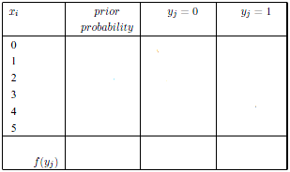
Bayesian Statistics
E.g.
Φ = number of red ball in the urn
5 balls: ? reds
D = 1 if draw ball is red and D = 0 if draw ball is not red
p(D = y_{j} , Φ = x_{i})

Slide 21
Bayesian Statistics
E.g.
Φ = number of red ball in the urn
5 balls: ? reds
D = 1 if draw ball is red and D = 0 if draw ball is not red
p(Φ = x_{i}) = 1/6, for i = 0, …, 5
p(D = 1 | Φ = x_{i}) = i / 5
p(D = 0 | Φ = x_{i}) = (5 – i) / 5
p(D = y_{j} , Φ = x_{i})

Slide 22
Bayesian Statistics
E.g.
Φ = number of red ball in the urn
5 balls: ? reds
D = 1 if draw ball is red and D = 0 if draw ball is not red
p(Φ = x_{i}) = 1/6, for i = 0, …, 5
p(D = 1 | Φ = x_{i}) = i / 5
p(D = 0 | Φ = x_{i}) = (5 – i) / 5
p(D = y_{j} , Φ = x_{i}) = p(D = y_{j} | Φ = x_{i}) . p(Φ = x_{i})

Slide 23
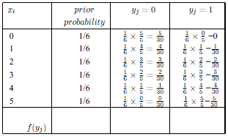
Bayesian Statistics
E.g.
Φ = number of red ball in the urn
5 balls: ? reds
D = 1 if draw ball is red and D = 0 if draw ball is not red
p(Φ = x_{i}) = 1/6, for i = 0, …, 5
p(D = 1 | Φ = x_{i}) = i / 5
p(D = 0 | Φ = x_{i}) = (5 – i) / 5
p(D = y_{j} , Φ = x_{i}) = p(D = y_{j} | Φ = x_{i}) . p(Φ = x_{i})

Slide 24
Bayesian Statistics
E.g.
Φ = number of red ball in the urn
5 balls: ? reds
D = 1 if draw ball is red and D = 0 if draw ball is not red
p(Φ = x_{i}) = 1/6, for i = 0, …, 5
p(D = 1 | Φ = x_{i}) = i / 5
p(D = 0 | Φ = x_{i}) = (5 – i) / 5
p(D = y_{j} ) = f(y_{j})

Slide 25
Bayesian Statistics
E.g.
Φ = number of red ball in the urn
5 balls: ? reds
D = 1 if draw ball is red and D = 0 if draw ball is not red
p(Φ = x_{i}) = 1/6, for i = 0, …, 5
p(D = 1 | Φ = x_{i}) = i / 5
p(D = 0 | Φ = x_{i}) = (5 – i) / 5
p(D = y_{j} ) = Σ p(D = y_{j} , Φ = x_{i}) , for i = 0, …, 5

Slide 26
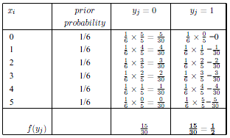
Bayesian Statistics
E.g.
Φ = number of red ball in the urn
5 balls: ? reds
D = 1 if draw ball is red and D = 0 if draw ball is not red
p(Φ = x_{i}) = 1/6, for i = 0, …, 5
p(D = 1 | Φ = x_{i}) = i / 5
p(D = 0 | Φ = x_{i}) = (5 – i) / 5
p(D = y_{j} ) = Σ p(D = y_{j} , Φ = x_{i}) , for i = 0, …, 5

Slide 27
Bayesian Statistics
E.g.
Drawing a red ball:
5 balls: ? reds
D = 1

Slide 28
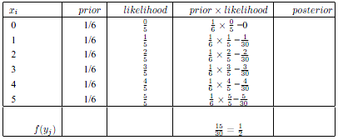
Bayesian Statistics
E.g.
Drawing a red ball:
5 balls: ? reds
D = 1

Slide 29
Bayesian Statistics
E.g.
Drawing a red ball:
5 balls: ? reds
D = 1
p(Φ = x_{i} | D = 1) = p(D = 1| Φ = x_{i}) . p(Φ = x_{i}) , for i = 0, …, 5
p(D = 1)
________________________

Slide 30
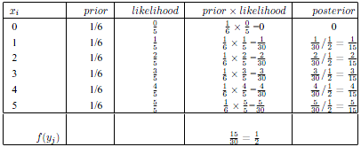
Bayesian Statistics
E.g.
Drawing a red ball:
5 balls: ? reds
D = 1
p(Φ = x_{i} | D = 1) = p(D = 1| Φ = x_{i}) . p(Φ = x_{i}) , for i = 0, …, 5
p(D = 1)

Slide 31
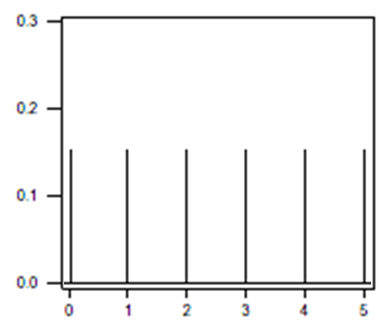
Bayesian Statistics
E.g.
Drawing a red ball:
5 balls: ? reds
D = 1

Slide 32
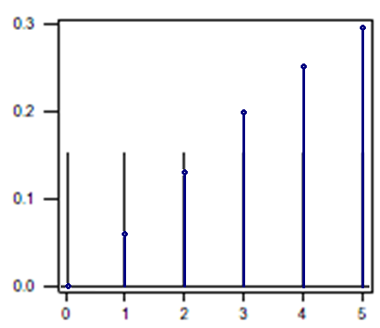
Bayesian Statistics
E.g.
Drawing a red ball:
5 balls: ? reds
D = 1

Slide 33
Bayesian Statistics
E.g.
Drawing a non-red ball in a second try:
5 balls: ? reds
D = 1; D = 0.

Slide 34
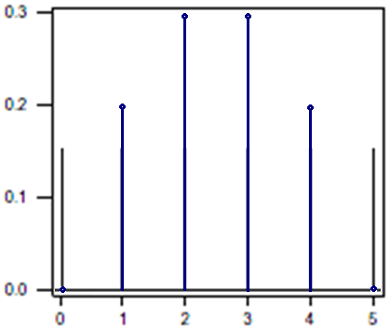
Bayesian Statistics
E.g.
Drawing a non-red ball in a second try:
5 balls: ? reds
D = 1; D = 0.

Slide 35
Basic Concepts
Final remarks:
In Bayesian statistics, probability just represents uncertainty.
No need to fully understand Bayesian statistics to perform ABC tools. But we need to understand enough to know what we are doing.
Bayesian statistics provide the tools to revise our knowledge by considering new information/data.
Bibliography:
O’Hagan A, Luce BR (2003) A primer on Bayesian statistics in health economics and outcomes research. Medtap International Inc.

