Slide 1
Approximate Bayesian Computation
“ABC methods – regression step”
Joao Sollari Lopes
March 2010

Slide 2
ABC methods – regression step
ABC algorithm:
(1) Sample (vector valued) parameter, Φ, from the prior: Φ_{i} ~ p(Φ);
(2) Simulate data, D, given Φ_{i}: D_{i} ~ p(D| Φ_{i});
(3) Summarize D_{i} with a set of chosen summary statistics to obtain S_{i}; go to (1) until N sample points from the joint distribution p(S, Φ) have been created;
(4) Accept the points whose S_{i} is within a distance δ from s’, the real data
summarized by the same set of summary statistics, |S − s'| < δ.

Slide 3
ABC methods – regression step
ABC algorithm:
(1) Sample (vector valued) parameter, Φ, from the prior: Φ_{i} ~ p(Φ);
(2) Simulate data, D, given Φ_{i}: D_{i} ~ p(D| Φ_{i});
(3) Summarize D_{i} with a set of chosen summary statistics to obtain S_{i}; go to (1) until N sample points from the joint distribution p(S, Φ) have been created;
(4) Apply a weighting scheme to the points according to their distance to the s' . And then perform a weighted linear multiple regression with points assigned nonzero weight. Adjust them according to Φ_{i}* = Φ_{i} + R_{i} , where R_{i} is the residual of the i^{th} point.

Slide 4
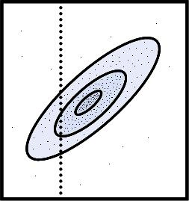
ABC methods – regression step
Graphical representation:
δ − tolerance
Rejection method (Pritchard et al, 1999):
Parameter, Φ
SummStats, S
s’ - “real” data
Posterior distribution – p(Φ | S=s’)

Slide 5
ABC methods – regression step
Graphical representation:
Local Linear Multiple Regression adjustment and Weighting (Beaumont et al, 2002):
Parameter, Φ
SummStats, S
s’ - “real” data
Weighting

Slide 6
ABC methods – regression step
Graphical representation:
Local Linear Multiple Regression adjustment and Weighting (Beaumont et al, 2002):
Parameter, Φ
SummStats, S
s’ - “real” data
Weighting

Slide 7
ABC methods – regression step
Graphical representation:
Local Linear Multiple Regression adjustment and Weighting (Beaumont et al, 2002):
Parameter, Φ
Regression
SummStats, S
s’ - “real” data
Weighting

Slide 8
ABC methods – regression step
Graphical representation:
Local Linear Multiple Regression adjustment and Weighting (Beaumont et al, 2002):
Parameter, Φ
Regression
SummStats, S
s’ - “real” data
Weighting

Slide 9
ABC methods – regression step
Graphical representation:
Local Linear Multiple Regression adjustment and Weighting (Beaumont et al, 2002):
Parameter, Φ
Regression
SummStats, S
s’ - “real” data
Posterior distribution – p(Φ | S=s’)
Weighting

Slide 10
ABC methods – regression step
Graphical representation:
Regression
Parameter, Φ
SummStats, S
S’ - “real” data

Slide 11
ABC methods – regression step
Graphical representation:
Regression
Parameter, Φ
SummStats, S
S’ - “real” data

Slide 12
ABC methods – regression step
Advantages:
Reduces the needed number of iterations to characterize the joint distribution.

Slide 13
ABC methods – regression step
Advantages:
Reduces the needed number of iterations to characterize the joint distribution.
Disadvantages:
Brings a new layer of approximation
Can induce a wrong sample of the posterior distribution
Implies the need to consider the problems inherent to regressions (correlation of predictors, lack of data to establish a relation between the variables, …)

Slide 14
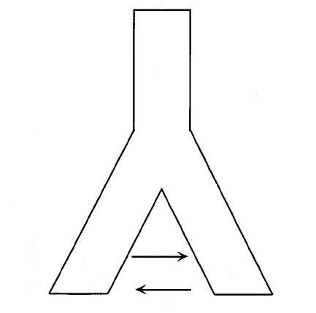
ABC methods – regression step
Example:
1000 individuals
Pop_{anc}
100 years
DNA sequence data (1 locus)
Pop1: 50 samples
Pop2: 50 samples
μ = 0.01 mut/locus/years
t
No mig
Pop₁
Pop₂
100 individuals

Slide 15
ABC methods – regression step
Example:
1000 individuals
Pop_{anc}
100 years
DNA sequence data (1 locus)
Pop1: 50 samples
Pop2: 50 samples
μ = 0.01 mut/locus/years
t
No mig
Ne = ?
Pop₁
Pop₂
100 individuals

Slide 16

ABC methods – regression step
Example:
Relative Mean Integrated Square Error (RMISE):

Slide 17

ABC methods – regression step
Example:
Relative Mean Integrated Square Error (RMISE):
Results:

Slide 18
ABC methods – regression step
Final remarks:
The regression step improves highly the efficiency of ABC.
This gain, however, does come with a price.
Bibliography:
Beaumont MA, Zhang W, Balding DJ (2002) Approximate Bayesian computation in population genetics. Genetics 162:2025-35
Lopes J, Beaumont M (2009) ABC: a useful Bayesian tool for the analysis of population data. Infect. Genet. Evol.:doi: 10.1016/j.meegid.2009.10.010
Pritchard JK et al (1999) Population growth of human Y chromosomes: a study of Y chromosome microsatellites. Mol. Biol. Evol. 16:1791-8

