Slide 1
Approximate Bayesian Computation
“ABC methods – model choice”
Joao Sollari Lopes
March 2010

Slide 2
ABC methods – model choice
ABC algorithm:
(1) Sample (vector valued) parameter, Φ, from the prior: Φ_{i} ~ p(Φ);
(2) Simulate data, D, given Φ_{i}: D_{i} ~ p(D| Φ_{i});
(3) Summarize D_{i} with a set of chosen summary statistics to obtain S_{i}; go to (1) until N sample points from the joint distribution p(S, Φ) have been created;
(4) Accept the points whose S_{i} is within a distance δ from s’, the real data
summarized by the same set of summary statistics, |S − s'| < δ.

Slide 3
ABC methods – model choice
ABC algorithm:
(1) Sample parameter, M, from the models’ prior: M_{j} ~ {m₁, m₂, …, m_{n}}
(2) Sample (vector valued) parameter, Φ, from the prior conditional on the model, M, chosen: Φ_{i} ~ p(Φ | M_{j});
(3) Simulate data, D, given Φ_{i}: D_{i} ~ p(D| Φ_{i});
(4) Summarize D_{i} with a set of chosen summary statistics to obtain S_{i}; go to (1) until N sample points from the joint distribution p(S, Φ) have been created;
(5) Accept the points whose S_{i} is within a distance δ from s’, the real data
summarized by the same set of summary statistics, |S − s'| < δ.

Slide 4
ABC methods – model choice
ABC algorithm:
(1) Sample parameter, M, from the models’ prior: M_{j} ~ {m₁, m₂, …, m_{n}}
(2) Sample (vector valued) parameter, Φ, from the prior conditional on the model, M, chosen: Φ_{i} ~ p(Φ | M_{j});
(3) Simulate data, D, given Φ_{i}: D_{i} ~ p(D| Φ_{i});
(4) Summarize D_{i} with a set of chosen summary statistics to obtain S_{i}; go to (1) until N sample points from the joint distribution p(S, Φ) have been created;
(5) Apply a weighting scheme to the points according to their distance to the s' . And then perform a logistic regression with points assigned nonzero weight. Adjust them according to Φ_{i}* = Φ_{i} + R_{i} , where R_{i} is the residual of the i^{th} point.

Slide 5
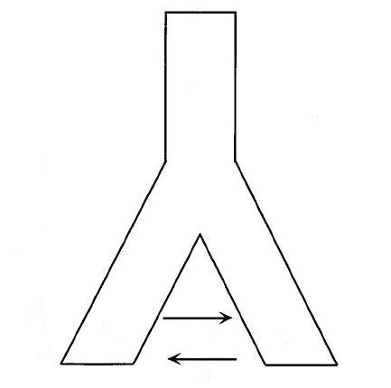
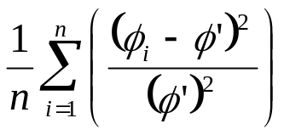
ABC methods – model choice
Example:
Φ = {Ne₁, Ne₂, Ne_{A}, m₁, m₂, t}
DNA sequence data (1 locus)
Pop1: 45 samples
Pop2: 55 samples
10 data sets
Ne_{A}
Pop_{anc}
t
RMISE:
m₂
Ne₁
m₁
Ne₂
Pop₁
Pop₂
The population model

Slide 6
ABC methods – model choice
Example:
10000
20000
5000
0
0
5000
0 12500
0 40000
0 10000
0 0.0005
0 0.0005
0 10000
Ne₁
Ne₂
Ne_{A}
m₁
m₂
t
ABC
“real” data
MCMC
prior distribution

Slide 7
ABC methods – model choice
Example:
Population model 1 (M = M₁)
Population model 2 (M = M₂)
Pop_{anc}
Pop_{anc}
or
x
Pop₁
Pop₂
Pop₁
Pop₂

Slide 8
ABC methods – model choice
Example:
Population model 1 (M = M₁)
Population model 2 (M = M₂)
Pop_{anc}
Pop_{anc}
or
x
Pop₁
Pop₂
Pop₁
Pop₂
π_{M1} = 2%
π_{M2} = 98%

Slide 9
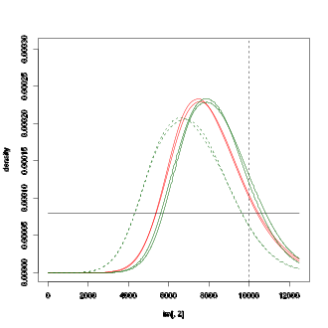
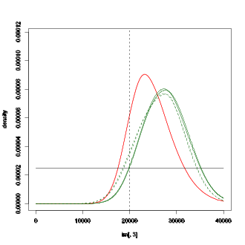
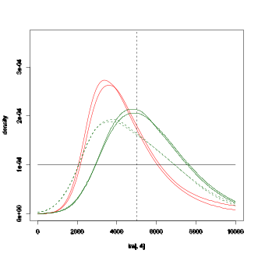
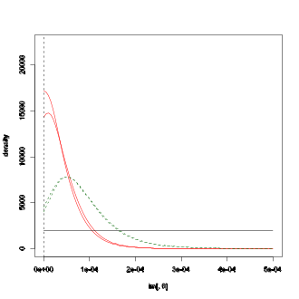
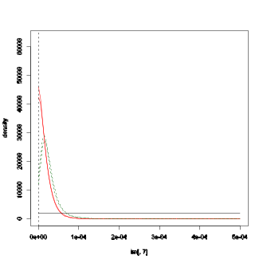
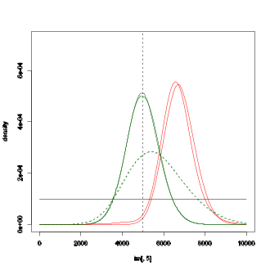
ABC methods – model choice
Example:
Simulation 8:
Ne₁
Ne₂
Ne_{A}
m₁
m₂
t
average RMISE: (10 data sets)
 | Ne₁ |  | Ne₂ |  | Ne_{A} |  | m₁ |  | m₂ |  | t
ABC | 0.05 | 0.003 | 0.11 | 0.005 | 0.23 | 0.006 | 6.21E-09 | 0.26E-09 | 1.87E-09 | 0.08E-09 | 0.15 | 0.005
ABC | 0.03 | 0.001 | 0.12 | 0.007 | 0.19 | 0.005 | - | - | - | - | 0.07 | 0.007
MCMC | 0.04 | 0.007 | 0.11 | 0.029 | 0.16 | 0.015 | 1.28E-09 | 2.53E-10 | 6.03E-10 | 1.84E-10 | 0.05 | 0.013
Priors | 0.27 | - | 0.33 | - | 0.33 | - | 8.33E-08 | - | 8.33E-08 | - | 0.33 | -
Notes:
Shanons index = heterozygosity based on hapotypes

Slide 10
ABC methods – model choice
Final remarks:
Model choice techniques are used to infer which model better explains the data.
However, such methods can also help to partition the parameters space to better explore it.
Bibliography:
Lopes J (2010) Software development in population genetics. University of Reading.

