Slide 1
Approximate Bayesian Computation
“ABC methods in practice”
Joao Sollari Lopes
March 2010

Slide 2
ABC methods in practice
Chimpanzees’ data

Slide 3

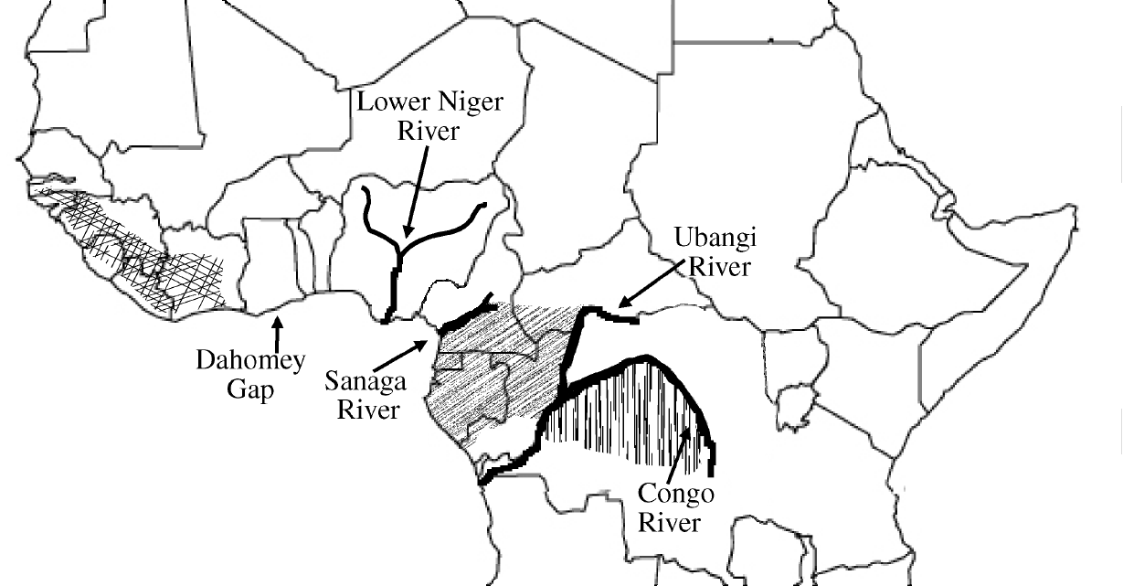
ABC methods in practice
Bonobo
www.wwf.org.uk
Data from:
(Won and Hey, 2005)
Pan trog verus Pan trog trog Pan paniscus

Slide 4

ABC methods in practice
Ne_{A}
Ne_{A}
Ne_{A}
Pop_{A}
Pop_{A}
Pop_{A}
t_{split}
t_{split}
t_{split}
Data from:
(Won and Hey, 2005)
m₁
m₂
m₁
m₃
m₂
m₃
Using IM [software performing MCMC based analysis, (Hey and Nielsen, 2004)]
Pop₁
Pop₂
Pop₁
Pop₃
Pop₂
Pop₃
Ne₁
Ne₂
Ne₁
Ne₃
Ne₂
Ne₃
Pan trog verus Pan trog trog Pan paniscus

Slide 5
ABC methods in practice
Ne_{A2}
Pop_{A2}
t_{split2}
m_{A1}
Ne_{A1}
Data from:
(Won and Hey, 2005)
Pop_{A1}
t_{split1}
Using PopABC:
  better fit of the model
  no incompatible results
  increase amount of data for single study
m₂
m₃
m₁
Pop₂
Pop₃
Pop₁
Ne₂
Ne₃
Ne₁
Pan trog verus Pan trog trog Pan paniscus

Slide 6
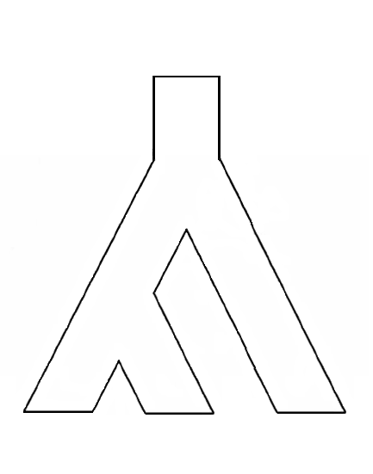
ABC methods in practice
Ne_{anc2}
Pop_{anc2}
t_{split2}
m_{A}
Ne_{anc1}
m₁
Bonobo
www.wwf.org.uk
t_{split1}
Pop_{anc1}
m₂
m₃
Ne₂
Ne₃
Ne₁
Pop₂
Pop₃
Pop₁

Slide 7
ABC methods in practice
Population model 1 (M = M₁)
Population model 2 (M = M₂)
Pop_{anc2}
Pop_{anc2}
or
Pop_{anc1}
Pop_{anc1}
Pop₂
Pop₃
Pop₁
Pop₂
Pop₃
Pop₁

Slide 8
ABC methods in practice
Population model 1 (M = M₁)
Population model 2 (M = M₂)
Pop_{anc2}
Pop_{anc2}
or
Pop_{anc1}
Pop_{anc1}
Pop₂
Pop₃
Pop₁
Pop₂
Pop₃
Pop₁
π_{M1} = 3%
π_{M2} = 97%

Slide 9
ABC methods in practice
Posterior distribution
Prior distribution
Pop_{anc2}
density
Pop_{anc1}
Pop₂
Pop₃
Pop₁
values for φ_{i}

Slide 10
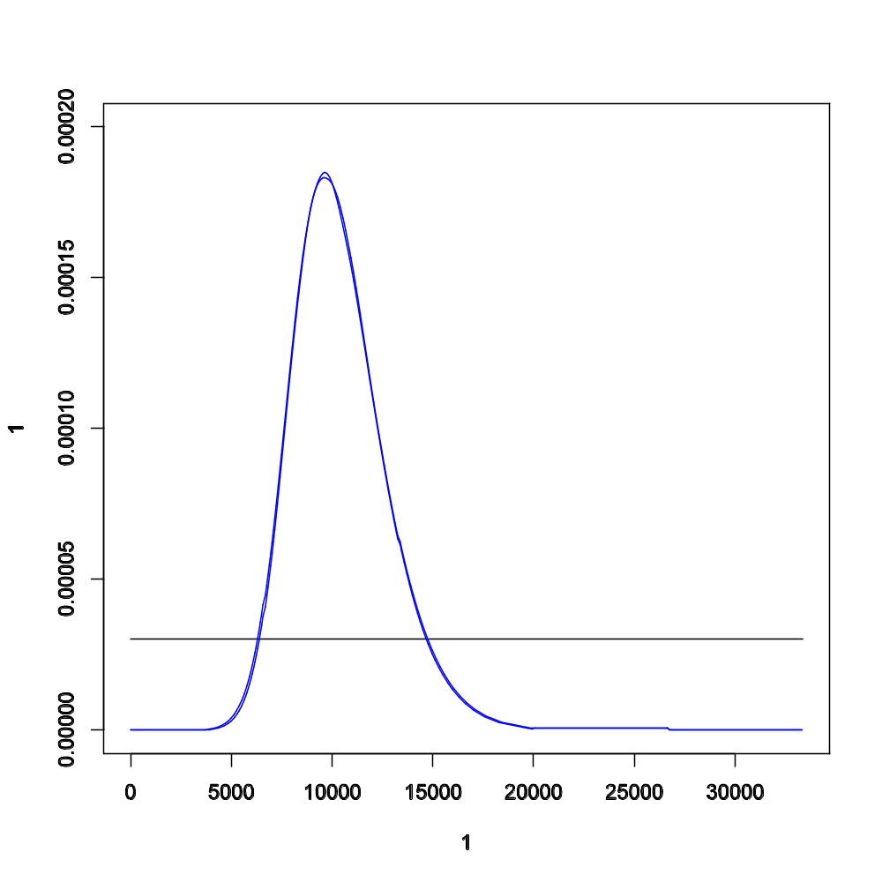
ABC methods in practice
Ne₁ = 10k ind
Pop_{anc2}
Pop_{anc1}
Pop₂
Pop₃
Pop₁
Ne₁

Slide 11
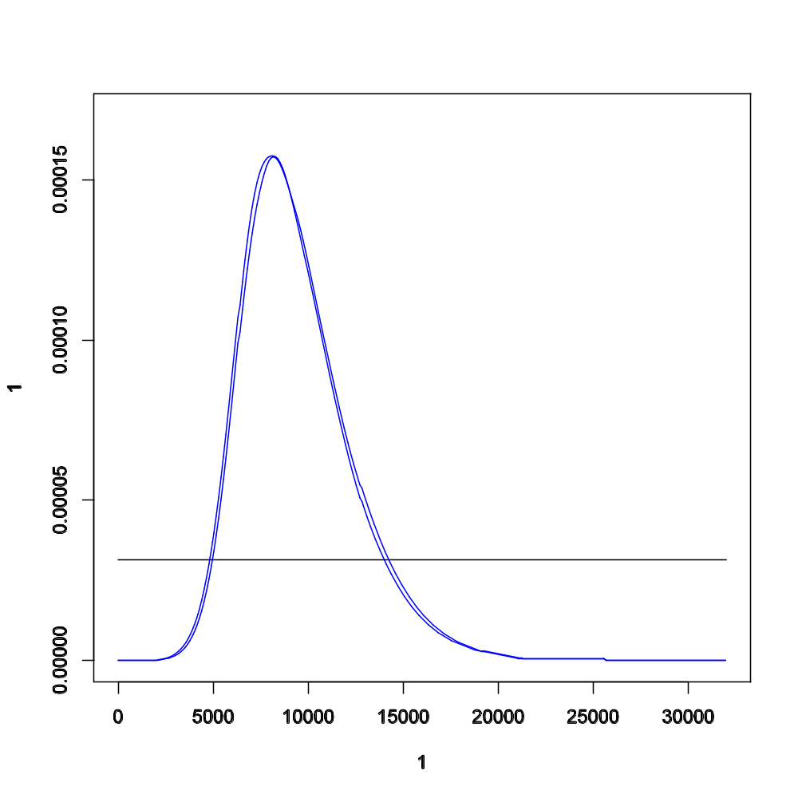
ABC methods in practice
Ne₂ = 8k ind
Pop_{anc2}
Pop_{anc1}
Pop₂
Pop₃
Pop₁
Ne₂

Slide 12
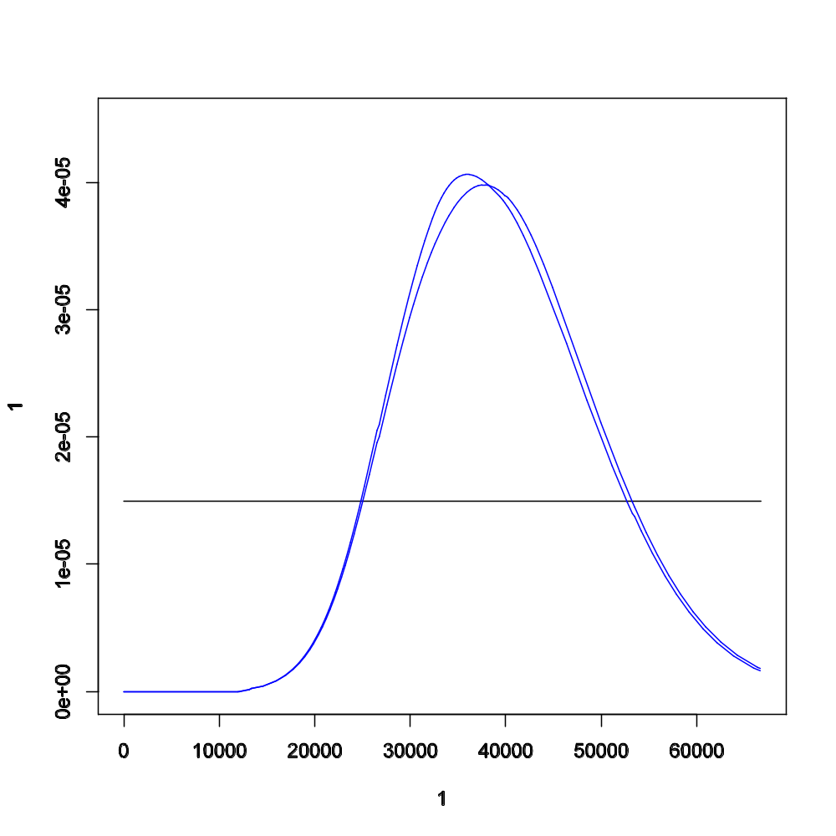
ABC methods in practice
Ne₃ = 37k ind
Pop_{anc2}
Pop_{anc1}
Pop₂
Pop₃
Pop₁
Ne₃

Slide 13
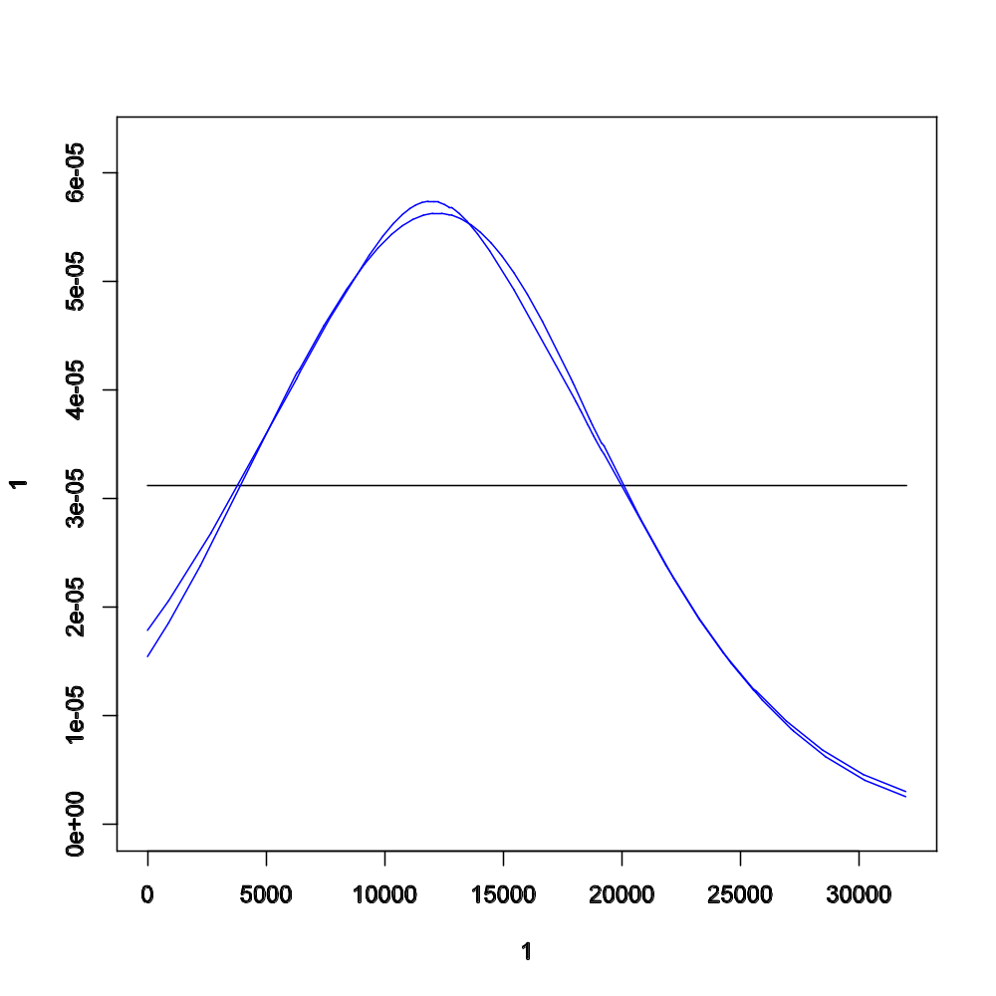
ABC methods in practice
Ne_{A1} = 12k ind
Pop_{anc2}
Ne_{A1}
Pop_{anc1}
Pop₂
Pop₃
Pop₁

Slide 14
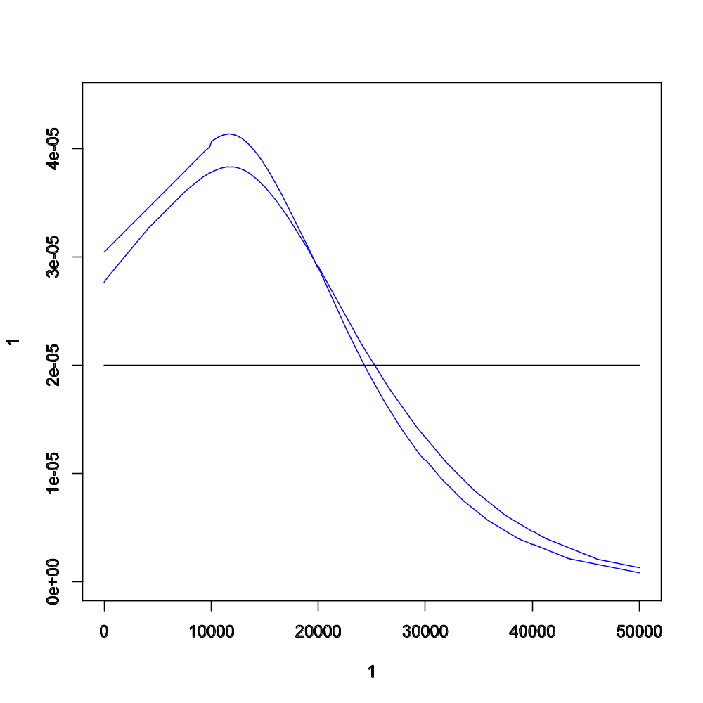
ABC methods in practice
Ne_{A2} = 12k ind
Ne_{A2}
Pop_{anc2}
Pop_{anc1}
Pop₂
Pop₃
Pop₁

Slide 15
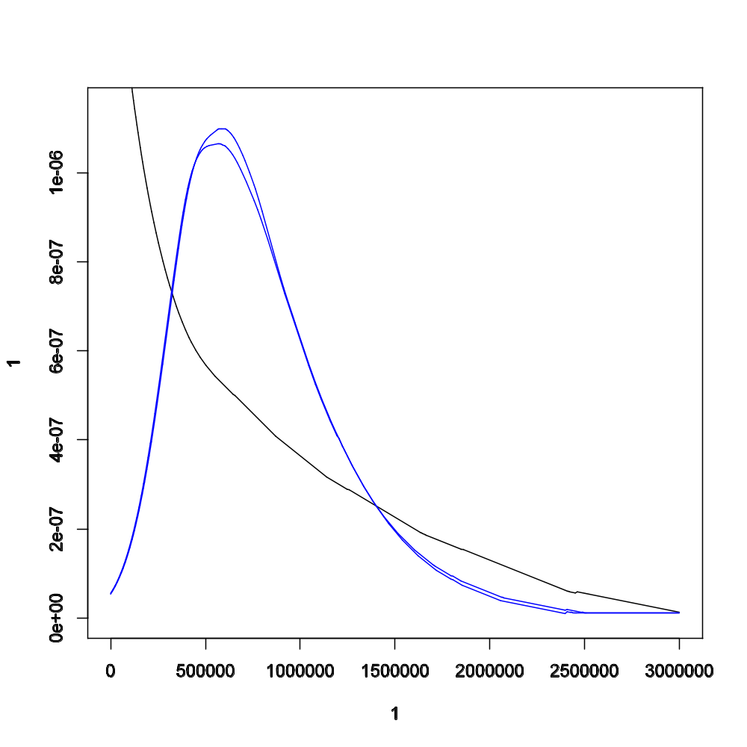
ABC methods in practice
t₁ = 0.6M years
Pop_{anc2}
t_{split1}
Pop_{anc1}
Pop₂
Pop₃
Pop₁

Slide 16
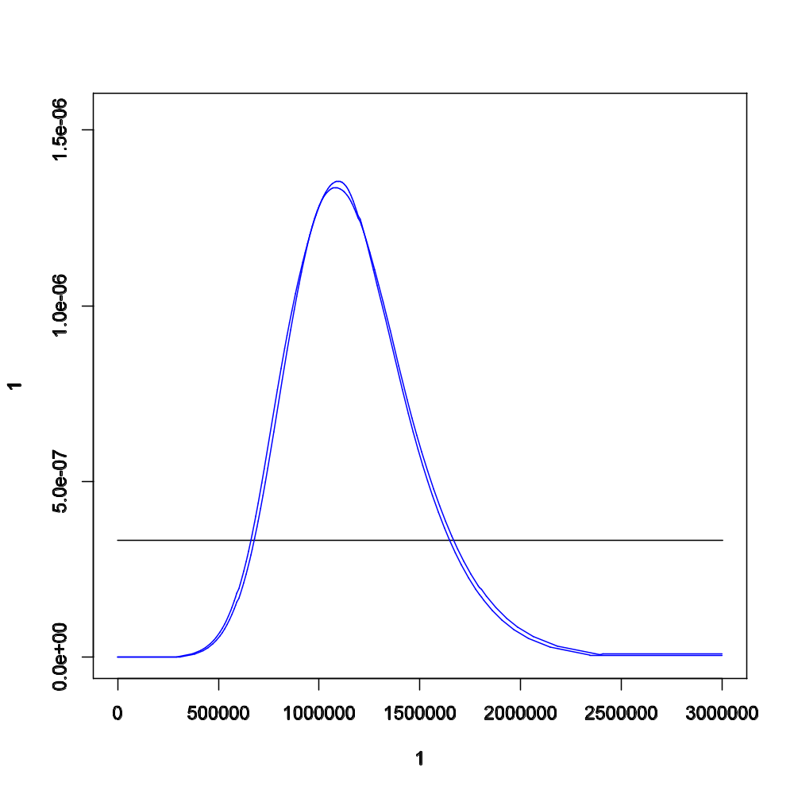
ABC methods in practice
t₂ = 1.0M years
Pop_{anc2}
t_{split2}
Pop_{anc1}
Pop₂
Pop₃
Pop₁

Slide 17
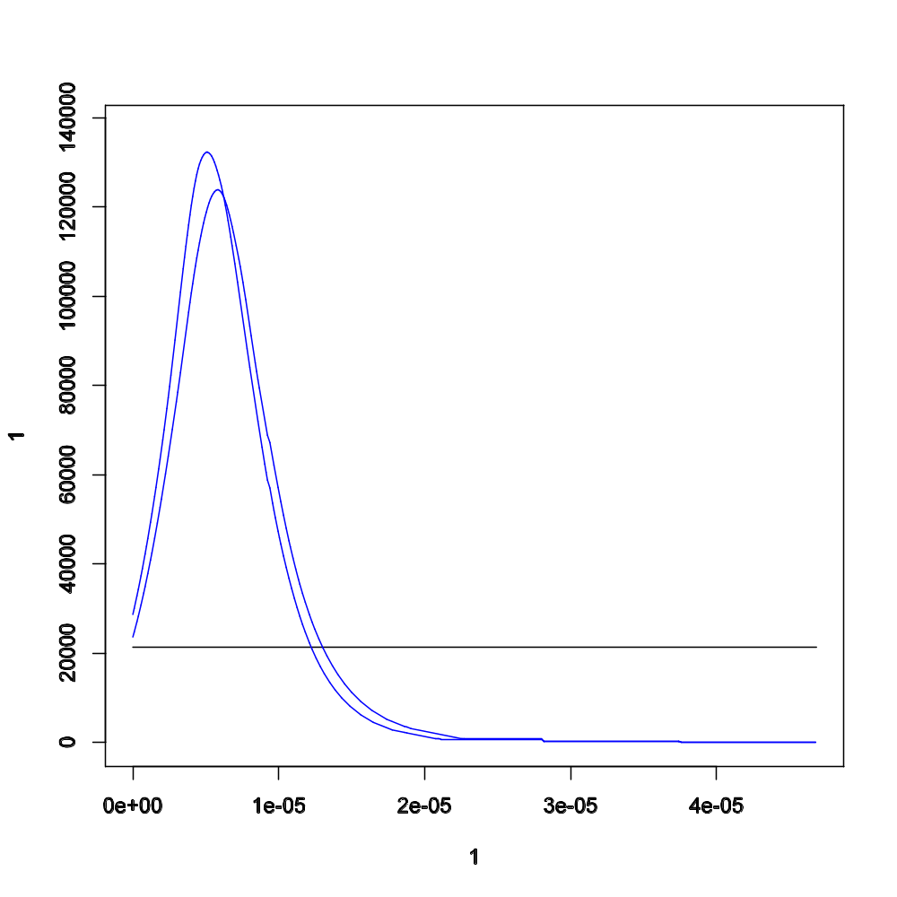
ABC methods in practice
m₂ = 0.000005
2.N₂.m₂ = 0.1 ind/gen
Pop_{anc2}
Pop_{anc1}
m₂
Pop₂
Pop₃
Pop₁

Slide 18
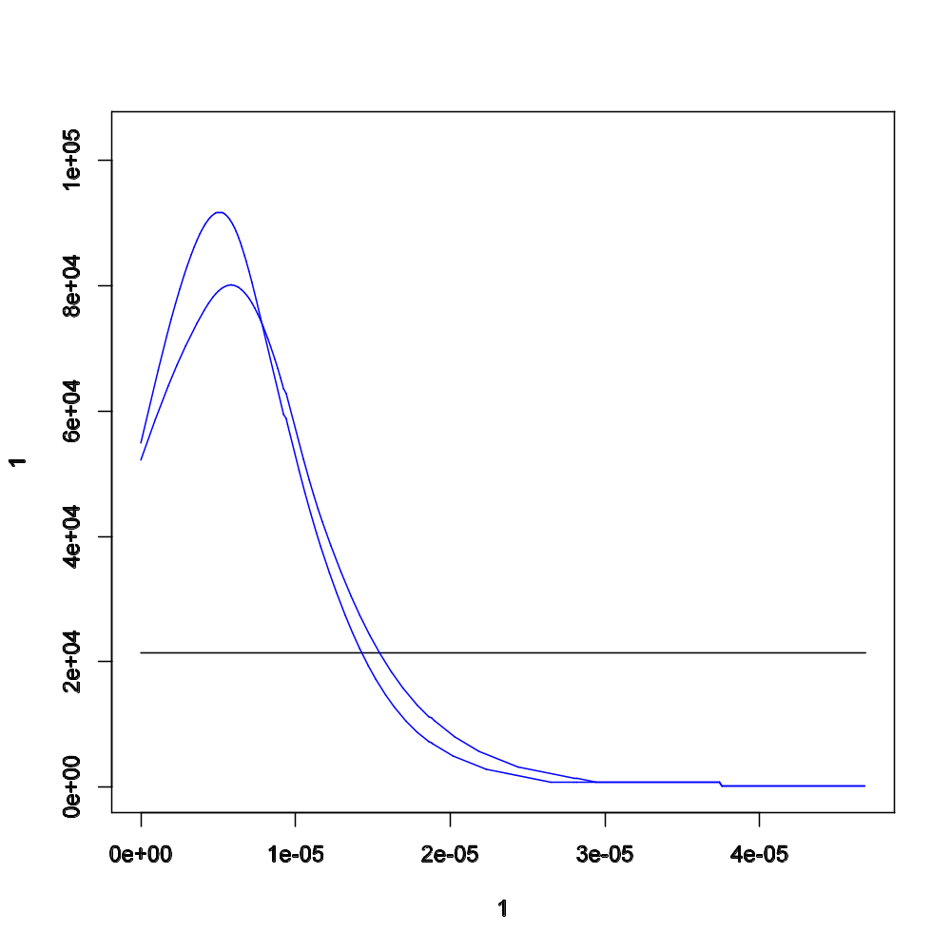
ABC methods in practice
m₃ = 0.000006
2.N₃.m₃ = 0.4 ind/gen
Pop_{anc2}
Pop_{anc1}
m₃
Pop₂
Pop₃
Pop₁

Slide 19
ABC methods in practice
 |  | MCMC |  |  | ABC (2 populations)
 |  | mode | credible interval (α = 0.05) |  | mode | credible interval (α = 0.05)
Ne₁ | Pan paniscus | 9,100 | 7,000 | 11,900 | 8,600 | 5,700 | 13,000
 |  | 9,400 | 7,000 | 12,200 | 9,300 | 6,100 | 13,900
Ne₂ | Pan trog. verus | 8,200 | 6,100 | 11,000 | 9,100 | 6,000 | 14,000
 |  | 7,900 | 5,500 | 11,100 | 8,400 | 5,000 | 13,900
Ne₃ | Pan trog. trog. | 22,300 | 16,900 | 29,000 | 21,800 | 14,600 | 33,900
 |  | 28,900 | 20,300 | 42,200 | 34,700 | 21,800 | 56,100
Ne_{A1} | Ancestor1 | 5,400 | 200 | 11,700 | 6,300 | 0 | 13,000
Ne_{A2} | Ancestor2 | 15,200 | 1,900 | 26,000 | 1,800 | 0 | 11,300
 |  | 15,900 | 0 | 28,900 | 1,800 | 0 | 18,300
m₁ | Mig(pop2 -> pop1) | 0.0 E-06 | 0.0 E-06 | 1.9 E-06 | 0.6 E-06 | 0.0 E-06 | 2.1 E-06
 | Mig(pop3 -> pop1) | 0.0 E-06 | 0.0 E-06 | 1.1 E-06 | 0.3 E-06 | 0.0 E-06 | 0.8 E-06
m₂ | Mig(pop1 -> pop2) | 0.0 E-00 | 0.0 E-06 | 0.9 E-06 | 0.3 E-06 | 0.0 E-06 | 0.8 E-06
 | Mig(pop3 -> pop2) | 8.9 E-06 | 2.4 E-06 | 19.0 E-06 | 3.2 E-06 | 0.0 E-06 | 8.0 E-06
m₃ | Mig(pop1 -> pop3) | 0.0 E-00 | 0.0 E-06 | 1.1 E-06 | 0.5 E-06 | 0.0 E-06 | 1.3 E-06
 | Mig(pop2 -> pop3) | 0.0 E-06 | 0.0 E-06 | 9.3 E-06 | 2.8 E-06 | 0.0 E-06 | 14.0 E-06
t₁ | Splitting time1 | 437,000 | 264,000 | 652,000 | 665,000 | 234,000 | 1,439,000
t₂ | Splitting time2 | 882,000 | 634,000 | 1,321,000 | 1,140,000 | 597,000 | 1,974,000
 |  | 836,000 | 574,000 | 1,273,000 | 839,000 | 377,000 | 1,621,000

Slide 20
ABC methods in practice
 |  | MCMC |  |  | ABC (2 populations)
 |  | mode | credible interval (α = 0.05) |  | mode | credible interval (α = 0.05)
Ne₁ | Pan paniscus | 9,100 | 7,000 | 11,900 | 8,600 | 5,700 | 13,000
 |  | 9,400 | 7,000 | 12,200 | 9,300 | 6,100 | 13,900
Ne₂ | Pan trog. verus | 8,200 | 6,100 | 11,000 | 9,100 | 6,000 | 14,000
 |  | 7,900 | 5,500 | 11,100 | 8,400 | 5,000 | 13,900
Ne₃ | Pan trog. trog. | 22,300 | 16,900 | 29,000 | 21,800 | 14,600 | 33,900
 |  | 28,900 | 20,300 | 42,200 | 34,700 | 21,800 | 56,100
Ne_{A1} | Ancestor1 | 5,400 | 200 | 11,700 | 6,300 | 0 | 13,000
Ne_{A2} | Ancestor2 | 15,200 | 1,900 | 26,000 | 1,800 | 0 | 11,300
 |  | 15,900 | 0 | 28,900 | 1,800 | 0 | 18,300
m₁ | Mig(pop2 -> pop1) | 0.0 E-06 | 0.0 E-06 | 1.9 E-06 | 0.6 E-06 | 0.0 E-06 | 2.1 E-06
 | Mig(pop3 -> pop1) | 0.0 E-06 | 0.0 E-06 | 1.1 E-06 | 0.3 E-06 | 0.0 E-06 | 0.8 E-06
m₂ | Mig(pop1 -> pop2) | 0.0 E-00 | 0.0 E-06 | 0.9 E-06 | 0.3 E-06 | 0.0 E-06 | 0.8 E-06
 | Mig(pop3 -> pop2) | 8.9 E-06 | 2.4 E-06 | 19.0 E-06 | 3.2 E-06 | 0.0 E-06 | 8.0 E-06
m₃ | Mig(pop1 -> pop3) | 0.0 E-00 | 0.0 E-06 | 1.1 E-06 | 0.5 E-06 | 0.0 E-06 | 1.3 E-06
 | Mig(pop2 -> pop3) | 0.0 E-06 | 0.0 E-06 | 9.3 E-06 | 2.8 E-06 | 0.0 E-06 | 14.0 E-06
t₁ | Splitting time1 | 437,000 | 264,000 | 652,000 | 665,000 | 234,000 | 1,439,000
t₂ | Splitting time2 | 882,000 | 634,000 | 1,321,000 | 1,140,000 | 597,000 | 1,974,000
 |  | 836,000 | 574,000 | 1,273,000 | 839,000 | 377,000 | 1,621,000

Slide 21
ABC methods in practice
 |  | MCMC |  |  | ABC (3 populations)
 |  | mode | credible interval (α = 0.05) |  | mode | credible interval (α = 0.05)
Ne₁ | Pan paniscus | 9,100 | 7,000 | 11,900 | 9,600 | 6,700 | 14,100
 |  | 9,400 | 7,000 | 12,200
Ne₂ | Pan trog. verus | 8,200 | 6,100 | 11,000 | 8,100 | 5,000 | 14,000
 |  | 7,900 | 5,500 | 11,100
Ne₃ | Pan trog. trog. | 22,300 | 16,900 | 29,000 | 36,900 | 23,700 | 55,000
 |  | 28,900 | 20,300 | 42,200
Ne_{A1} | Ancestor1 | 5,400 | 200 | 11,700 | 12,000 | 900 | 23,000
Ne_{A2} | Ancestor2 | 15,200 | 1,900 | 26,000 | 11,700 | 0 | 29,800
 |  | 15,900 | 0 | 28,900
m₁ | Mig(pop2 -> pop1) | 0.0 E-06 | 0.0 E-06 | 1.9 E-06 | - | - | -
 | Mig(pop3 -> pop1) | 0.0 E-06 | 0.0 E-06 | 1.1 E-06 | - | - | -
m₂ | Mig(pop1 -> pop2) | 0.0 E-06 | 0.0 E-06 | 0.9 E-06 | - | - | -
 | Mig(pop3 -> pop2) | 8.9 E-06 | 2.4 E-06 | 19.0 E-06 | 5.5 E-06 | 0.0 E-06 | 15.0 E-06
m₃ | Mig(pop1 -> pop3) | 0.0 E-06 | 0.0 E-00 | 1.1 E-06 | - | - | -
 | Mig(pop2 -> pop3) | 0.0 E-06 | 0.0 E-06 | 9.3 E-06 | 5.49E-06 | 0.3 E-06 | 11.6 E-06
t₁ | Splitting time1 | 437,000 | 264,000 | 652,000 | 580,000 | 138,000 | 1,458,000
t₂ | Splitting time2 | 882,000 | 634,000 | 1,321,000 | 1,091,000 | 664,000 | 1,672,000
 |  | 836,000 | 574,000 | 1,273,000

Slide 22
ABC methods in practice
Final remarks:
ABC modes are similar to MCMC (full likelihood method)
ABC can easily incorporate more complex population models
Using a model-framework comes just naturally from the ABC approach
Bibliography:
Hey J, Nielsen R (2004) Multilocus methods for estimating population sizes, migration rates and divergence time, with applications to the divergence of Drosophila pseudoobscura and D. persimilis. Genetics 167:747-60
Lopes J, Balding D, Beaumont M (2009) PopABC: a program to infer historical demographic parameters. Bioinformatics 25:2747 – 2749
Won YJ, Hey J (2005) Divergence population genetics of chimpanzees. Mol. Biol. Evol. 22:297-307

Slide 23
ABC methods in practice
Spiny lobsters’ data

Slide 24
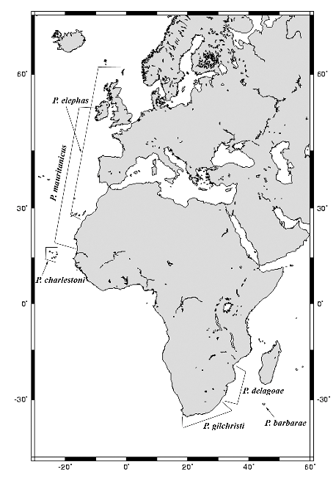
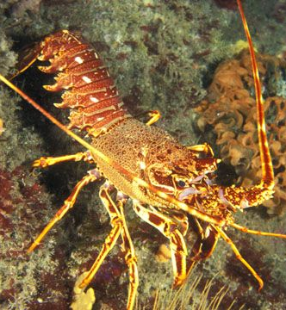
ABC methods in practice
Expansion of Spiny Lobsters
Spiny Lobster (Palinurus)
6 defined populations:
Palinurus elephas (Atlantic, Mediterranean);
Palinurus mauritanicus (Atlantic, Mediterranean);
Palinurus charlestoni (Cape Verde);
Palinurus gilchristi (South Africa);
Palinurus delagoae (South Africa, Mozambique);
Palinururs barbarae (Madagascar ridge).
[Groeneveld et al., 2007]

Slide 25
ABC methods in practice
Model 1
~ 15 Mya
Spiny Lobster (Palinurus)
Miocene event (11.2 - 23 Mya):
[Based on parsimony and maximum likelihood]
[mtDNA sequence data]
explains the obtained results of a South-African colonization of the Cape Verde islands.
- congruent with the pre-Plistocene North-to-South water currents;
requires a slow rates of evolution;
[Groeneveld et al., 2007]

Slide 26
ABC methods in practice
Model 2
Spiny Lobster (Palinurus)
Pleistocene event (< 2.6 Mya):
[Based on approximate Bayesian computation]
[mtDNA sequence and 10 microsatellite data]
- congruent with the Plistocene South-to-North water currents;
assumes a standard decapod taxa rate of evolution.
< 2 Mya
[Palero, Lopes et al. (2009), BMC]

Slide 27
ABC methods in practice
Model-choice on mutation rate:
Considered scenario | Mutation rate | Posterior probability
Model 1 (Groeneveld et al., 2007) | Slow (0.54x10⁻⁵) | 11%
 | Standard (2.34x10⁻⁵) | 89%
Model 2 (North-to-South) | Slow (0.54x10⁻⁵) | 10%
 | Standard (2.34x10⁻⁵) | 90%
Spiny Lobster (Palinurus)
Model-choice on the expansion model:
Considered scenario | Expansion scenario | Posterior probability
Standard mutation rate (2.34x10⁻⁵) | Model 1 | 12%
 | Model 2 | 88%

Slide 28
ABC methods in practice
Posterior distribution
Prior distribution
density
Palinurus
values for φ_{i}

Slide 29
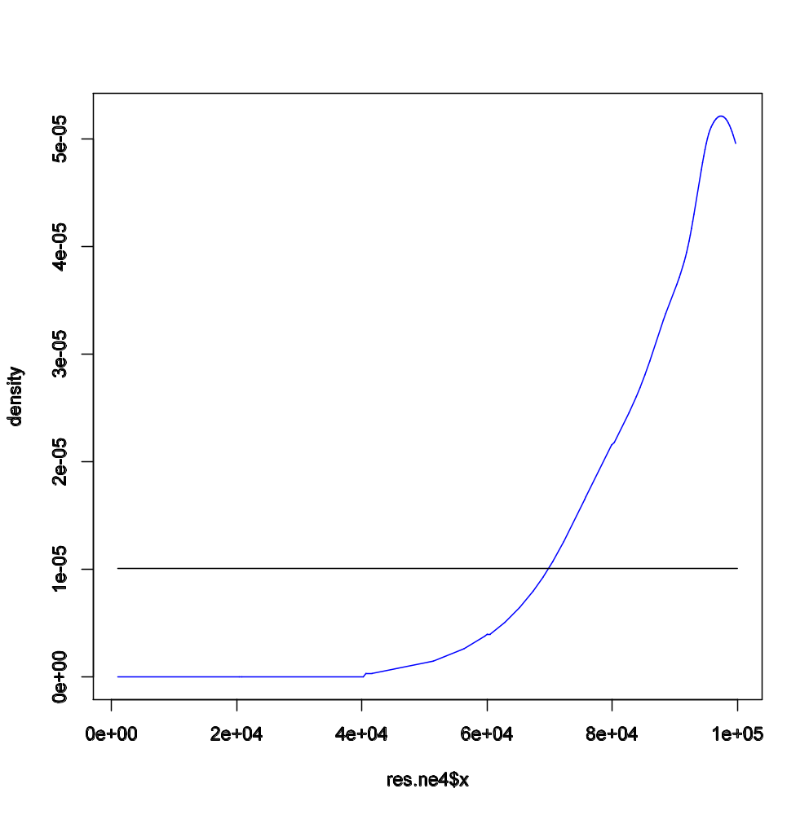
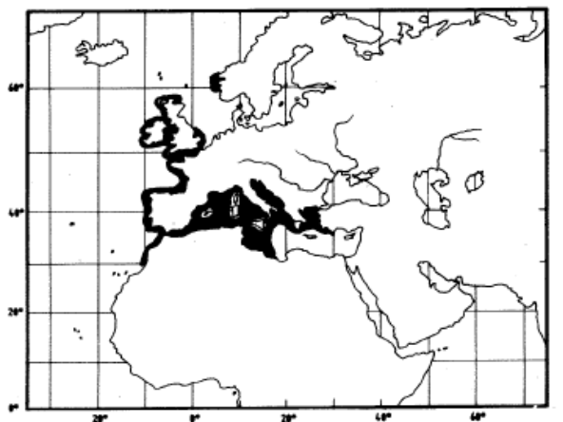
ABC methods in practice
Ne₆ = 98k ind
P. elephas

Slide 30
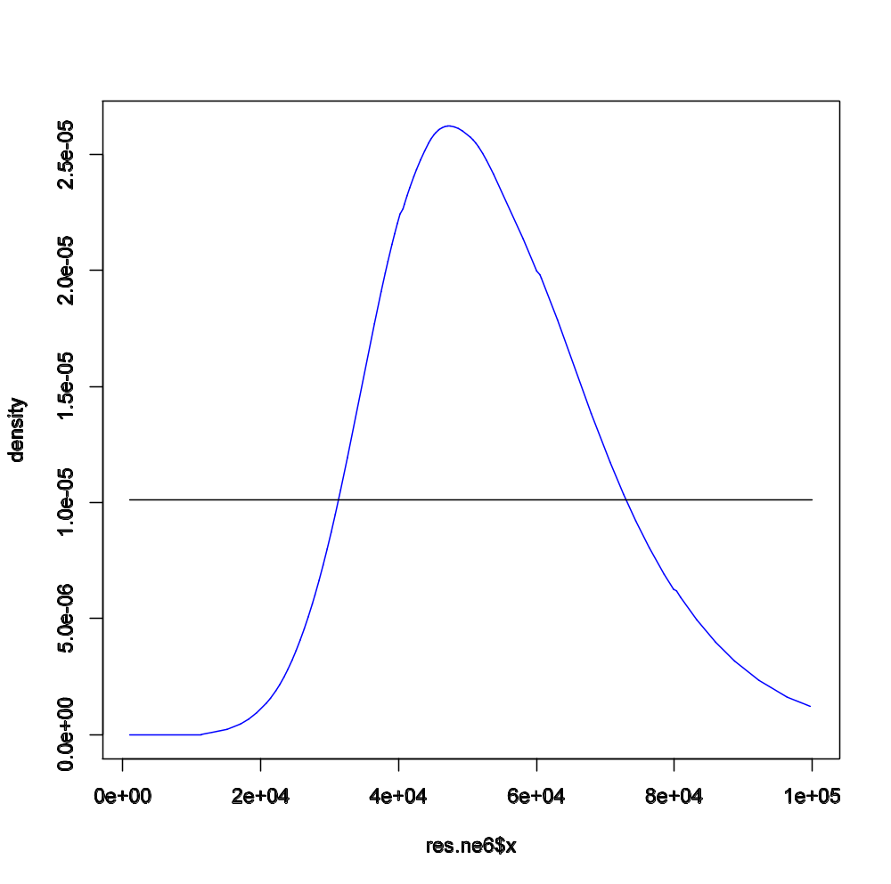
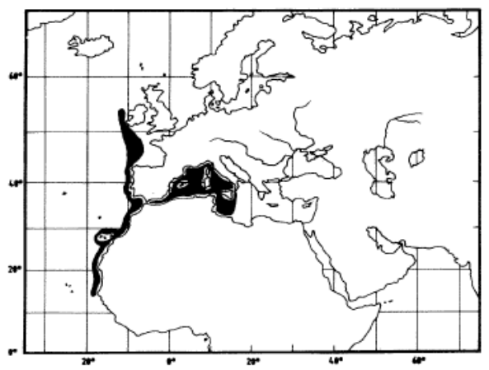
ABC methods in practice
Ne₅ = 47k ind
P. mauritanicus

Slide 31
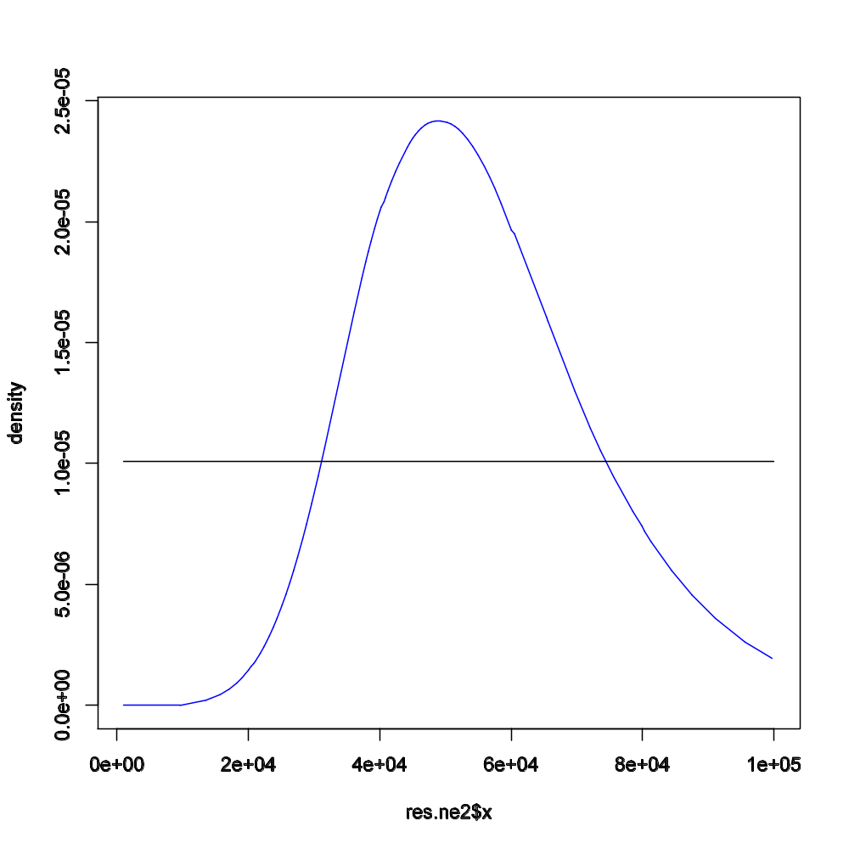
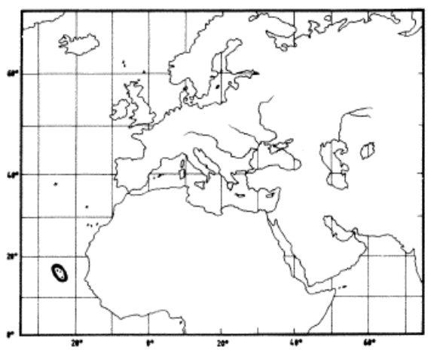
ABC methods in practice
Ne₃ = 49k ind
P. charlestoni

Slide 32
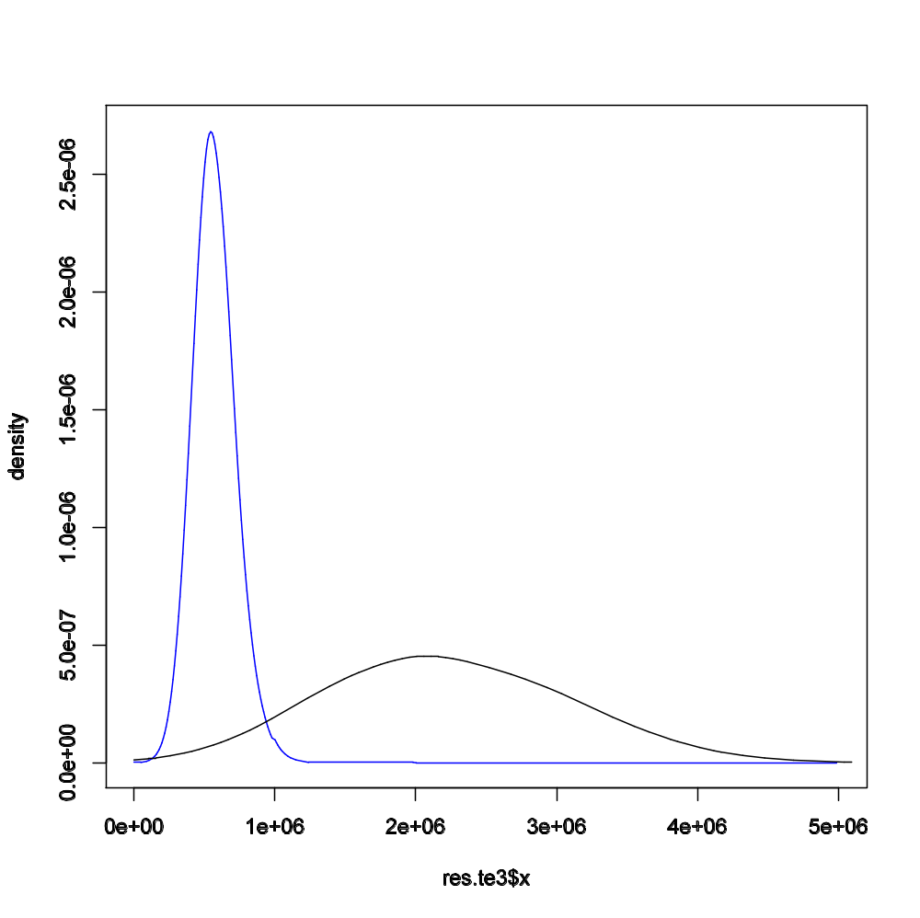
ABC methods in practice
tev₃ = 0.5 Mya

Slide 33
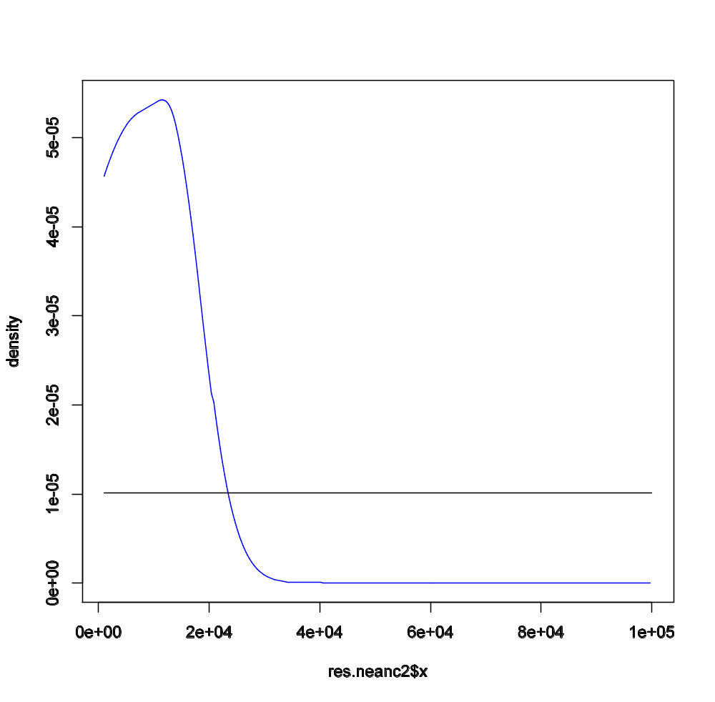
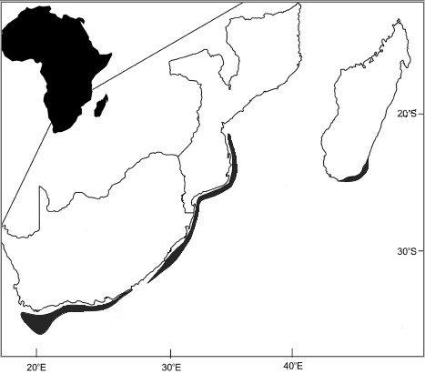
ABC methods in practice
Ne_{A2} = 12k ind
Ancestor population

Slide 34
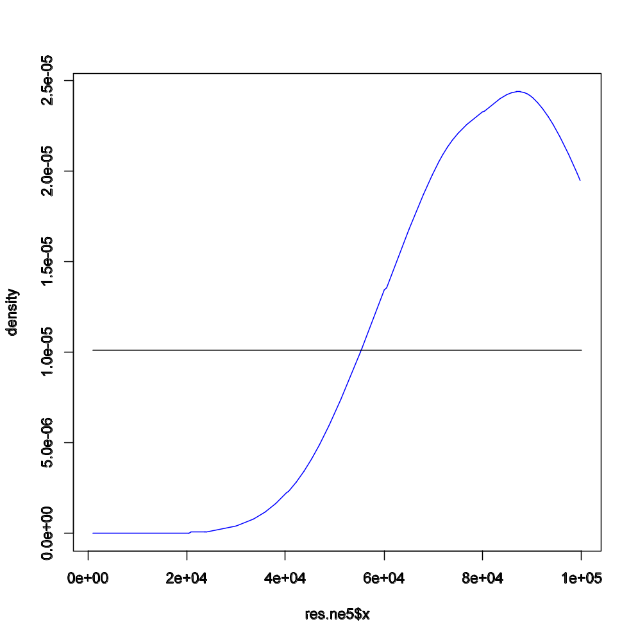
ABC methods in practice
Ne₄ = 87k ind
P. guilchristi

Slide 35
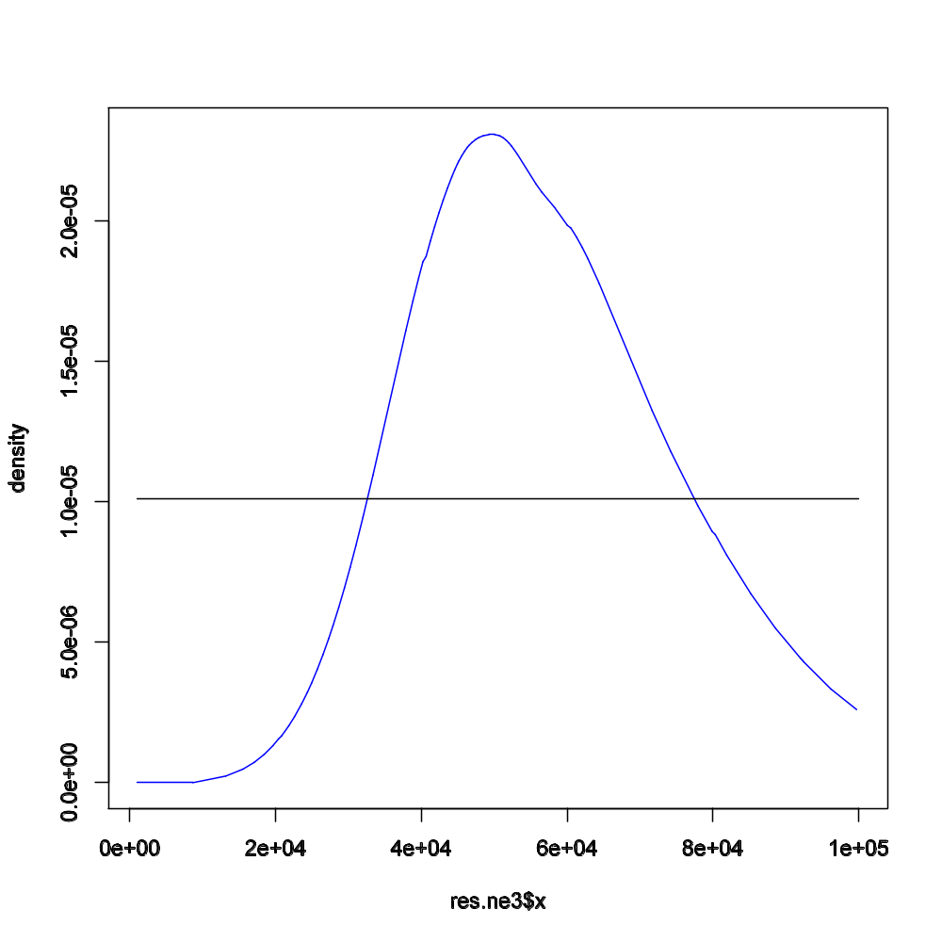
ABC methods in practice
Ne₂ = 50k ind
P. delagoae

Slide 36
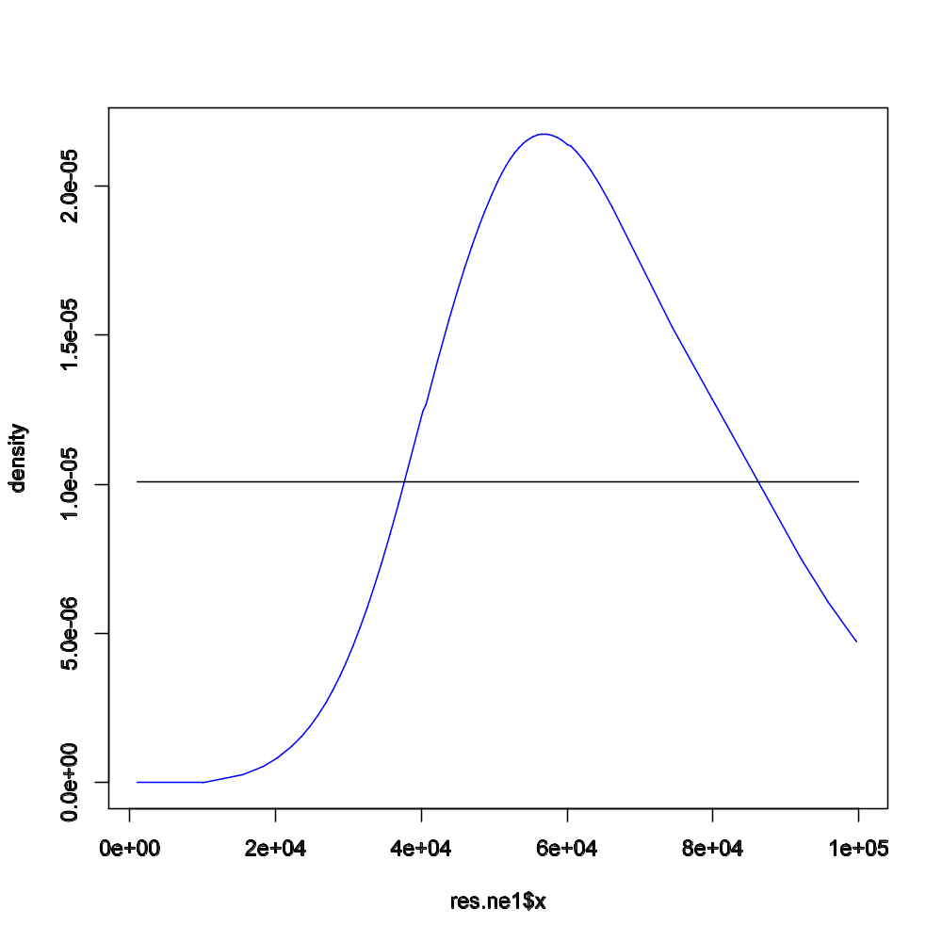
ABC methods in practice
Ne₁ = 57k ind
P. barbarae

Slide 37
ABC methods in practice
Final remarks:
The closure of the Thethyan Seaway (middle-Miocene) does not seem to be related to the expansion of the Spiny Lobsters;
Recent (Pleistocene) climate change-related oceanographic processes (e.g. Western Africa upwellings) might have influenced Palinurus phylogeny.
Bibliography:
Groeneveld J et al (2007) Molecular phylogeny of the spiny lobster genus Palinurus (Decapoda: Palinuridae) with hypotheses on speciation in the NE Atlantic/Mediterranean and SW Indian Ocean. Molecular Phylogenetics and Evolution 45:102 - 110
Lopes J, Balding D, Beaumont M (2009) PopABC: a program to infer historical demographic parameters. Bioinformatics 25:2747 – 2749
Palero F et al. (2009) Rapid radiation in spiny lobsters (Palinurus spp) as revealed by classic and ABC methods using mtDNA and microsatellite data. BMC Evol. Biol. 9:263

