Slide 1
Approximate Bayesian Computation
“Choosing the summary statistics”
Joao Sollari Lopes
March 2010

Slide 2
Choosing the summary statistics
Effect of adding a summary statistic:
Interaction with other summary statistics:
Less weight to the previously chosen summary statistics
Can be highly correlated with other summary statistics (double weighting)
Can increase the efficiency of other summary statistics
Interactions with the parameter values:
Can have different effects on each parameter depending on their correlation
Will have two level of effects:
  within the rejection step, all the parameters are considered together (Φ)
  within the regression step, the parameters are considered separately (θ₁, θ₂, …, θ_{n})
Effect on the space problem:
Increase the dimensionality of the problem
Can add a considerable variance to the space of results depending on the variance of the summary statistic values along the parameter ranges.

Slide 3
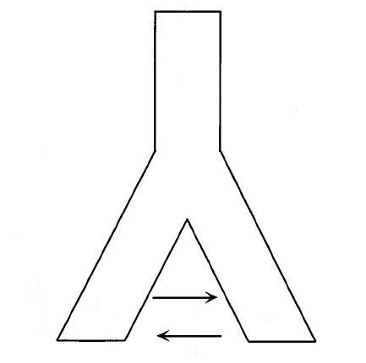
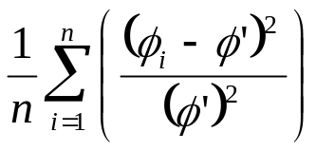
Choosing the summary statistics
Example:
Φ = {Ne₁, Ne₂, Ne_{A}, m₁, m₂, t}
DNA sequence data (1 locus)
Pop1: 45 samples
Pop2: 55 samples
10 data sets
Ne_{A}
Pop_{anc}
t
RMISE:
m₂
Ne₁
m₁
Ne₂
Pop₁
Pop₂
The population model

Slide 4
Choosing the summary statistics
Example:
10000
20000
5000
0
0
5000
0 12500
0 40000
0 10000
0 0.0005
0 0.0005
0 10000
Ne₁
Ne₂
Ne_{A}
m₁
m₂
t
ABC
“real” data
MCMC
prior distribution

Slide 5
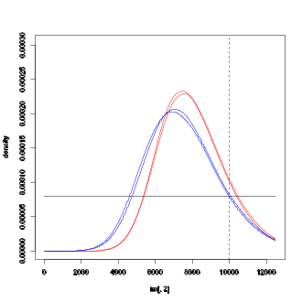
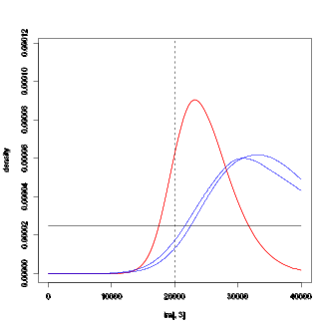
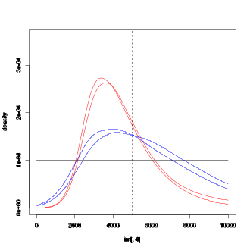
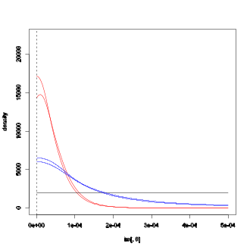
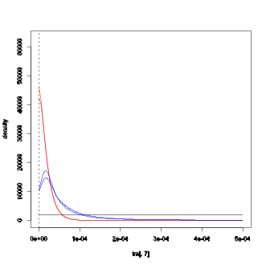
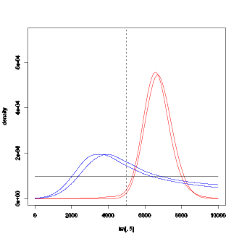
Choosing the summary statistics
Example:
(500 000 iter, tol=0.02, logit transf, sstats=9 )
Simulation 8:
Ne₁
Ne₂
Ne_{A}
m₁
m₂
t
average relMISE: (10 data sets)
 | Ne₁ |  | Ne₂ |  | Ne_{A} |  | m₁ |  | m₂ |  | t
ABC | 0.05 | 0.011 | 0.22 | 0.035 | 0.27 | 0.034 | 23.00E-09 | 3.28E-09 | 8.74E-09 | 1.62E-09 | 0.24 | 0.020
MCMC | 0.04 | 0.007 | 0.11 | 0.029 | 0.16 | 0.015 | 1.28E-09 | 0.25E-09 | 0.60E-09 | 0.18E-09 | 0.05 | 0.013
Priors | 0.27 | - | 0.33 | - | 0.33 | - | 83.33E-09 | - | 83.33E-09 | - | 0.33 | -

Slide 6
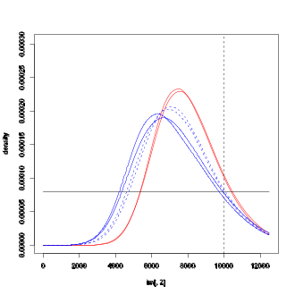
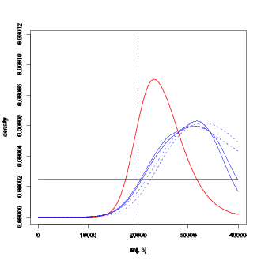
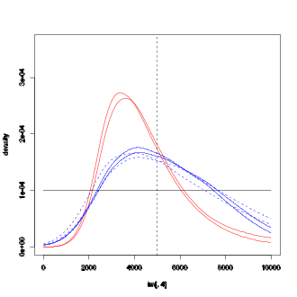
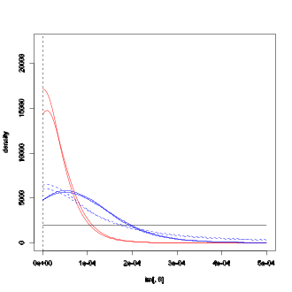
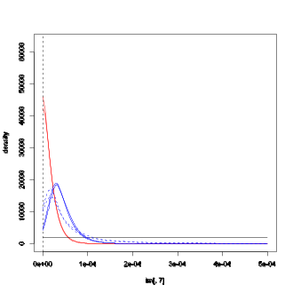
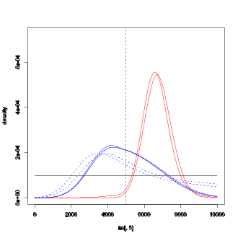
Choosing the summary statistics
Example:
(2500 000 iter, tol=0.004, log transf, sstats=9)
Simulation 8:
Ne₁
Ne₂
Ne_{A}
m₁
m₂
t
average relMISE: (10 data sets)
 | Ne₁ |  | Ne₂ |  | Ne_{A} |  | m₁ |  | m₂ |  | t
ABC | 0.05 | 0.011 | 0.22 | 0.035 | 0.27 | 0.034 | 23.00E-09 | 3.28E-09 | 8.74E-09 | 1.62E-09 | 0.24 | 0.020
ABC* | 0.06 | 0.012 | 0.18 | 0.033 | 0.24 | 0.035 | 10.10E-09 | 2.11E-09 | 3.07E-09 | 0.92E-09 | 0.18 | 0.019
MCMC | 0.04 | 0.007 | 0.11 | 0.029 | 0.16 | 0.015 | 1.28E-09 | 0.25E-09 | 0.63E-09 | 0.18E-09 | 0.05 | 0.013
Priors | 0.27 | - | 0.33 | - | 0.33 | - | 83.33E-09 | - | 83.33E-09 | - | 0.33 | -
Notes:
Shanons index = heterozygosity based on hapotypes

Slide 7
Choosing the summary statistics
Example:
mean of pairwise differences
  in each population
  both populations joined together
number of segregating sites
  in each population
  both populations joined together
number of haplotypes
  in each population
  both populations joined together
variance of pairwise difference
  in each population
  both populations joined together
Shanon’s index
  in each population
  both populations joined together
number of singletons
  in each population
  both populations joined together
Tajima’s D
  in each population
  both populations joined together
heterozygosity
  in each population
  both populations joined together
Notes:
Shanons index = heterozygosity based on hapotypes

Slide 8
Choosing the summary statistics
number of private haplotypes
  in each population
Slatkin’s Nm
  in each population
mean of Mutation Frequency Spectrum
  in each population
st. dev. of Mutation Frequency Spectrum
  in each population
mean Segregating sites Frequency Density
  in each population
st. dev. Segregating sites Frequency Density
  in each population
“Nm”_S
  in each population
<Nm>_H
  in each population
“Nm”_π
  in each population
private segregating sites
  in each population
frequency of private segregating sites
  in each population
Wakeley’s Ψ (Wakeley, 1996)
  both populations joined together
Notes:
Shanons index = heterozygosity based on hapotypes

Slide 9
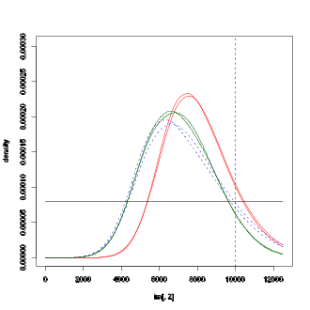
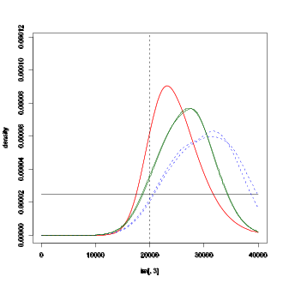
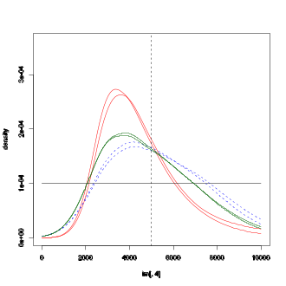
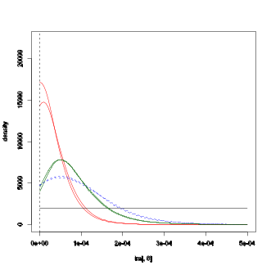
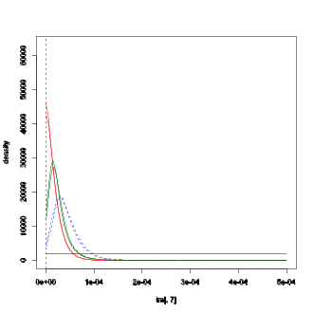
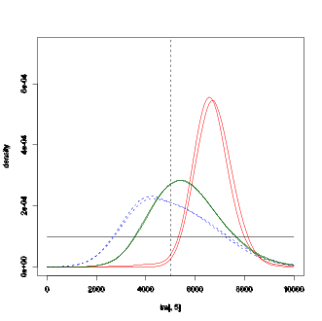
Choosing the summary statistics
Example:
(2500 000 iter, tol=0.004, log transf, sstats=21)
Simulation 8:
Ne₁
Ne₂
Ne_{A}
m₁
m₂
t
average relMISE: (10 data sets)
 | Ne₁ |  | Ne₂ |  | Ne_{A} |  | m₁ |  | m₂ |  | t
ABC | 0.05 | 0.011 | 0.22 | 0.035 | 0.27 | 0.034 | 23.00E-09 | 3.28E-09 | 8.74E-09 | 1.62E-09 | 0.24 | 0.020
ABC* | 0.06 | 0.012 | 0.18 | 0.033 | 0.24 | 0.035 | 10.10E-09 | 2.11E-09 | 3.07E-09 | 0.92E-09 | 0.18 | 0.019
ABC** | 0.05 | 0.003 | 0.11 | 0.005 | 0.23 | 0.006 | 6.21E-09 | 0.26E-09 | 1.87E-09 | 0.08E-09 | 0.15 | 0.005
MCMC | 0.04 | 0.007 | 0.11 | 0.029 | 0.16 | 0.015 | 1.28E-09 | 0.25E-09 | 0.60E-09 | 0.18E-09 | 0.05 | 0.013
Priors | 0.27 | - | 0.33 | - | 0.33 | - | 83.3E-09 | - | 83.33E-09 | - | 0.33 | -
Notes:
Shanons index = heterozygosity based on hapotypes

Slide 10
Choosing the summary statistics
Final remarks:
Adding an informative summary statistics can highly increase the efficiency of ABC.
However, the effect of adding a summary statistic is hard to understand
Choosing the summary statistics set is a complex problem.
Bibliography:
Lopes J (2010) Software development in population genetics. University of Reading.

