Slide 1
Approximate Bayesian Computation
“Non-linear regression methods”
Joao Sollari Lopes
March 2010

Slide 2
Non-linear regression methods
ABC-regression characteristics:
A typical ABC run produces hundreds of thousands or even millions of simulations.
However only around 1 to 2% are retained.
The ABC-regression method allows to make use of a larger tolerance interval.
Francois and Blum propose non-linear regression improving the regression step correction.

Slide 3
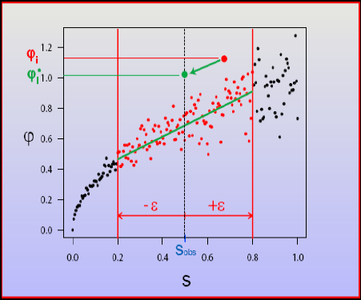
Non-linear regression methods
Michael Blum & Olivier Francois (2009) “Non-linear regression
Models for ABC” - ABC in Paris, Paris:
φ – model parameter
s – summary statistic
ε – tolerance

Slide 4
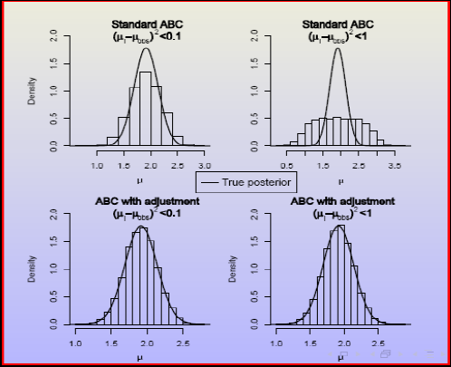
Non-linear regression methods
Michael Blum & Olivier Francois (2009) “Non-linear regression
Models for ABC” - ABC in Paris, Paris:

Slide 5
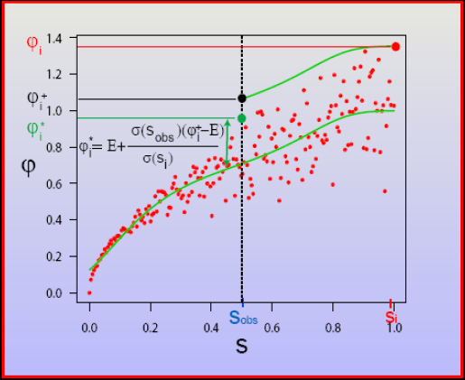
Non-linear regression methods
Michael Blum & Olivier Francois (2009) “Non-linear regression
Models for ABC” - ABC in Paris, Paris:
non-linear conditional heteroscedastic regression models
φ – model parameter
s – summary statistic
ε – tolerance

Slide 6
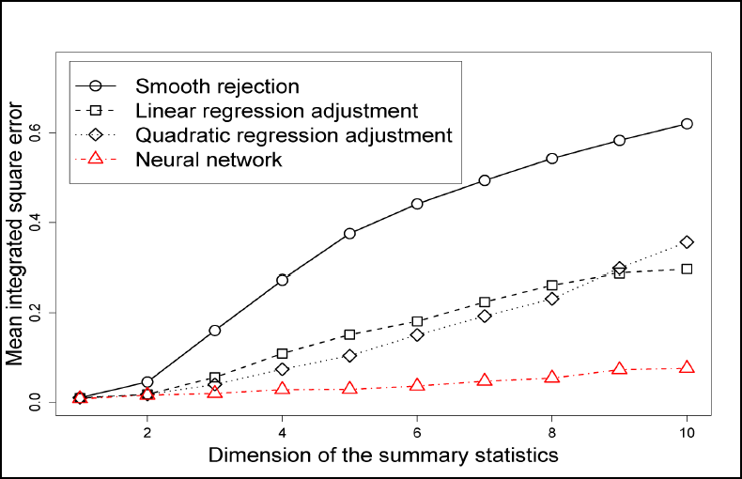
Non-linear regression methods
Michael Blum & Olivier Francois (2009) “Non-linear regression
Models for ABC” - ABC in Paris, Paris:
Adding useless summary statistics:

Slide 7
Non-linear regression methods
Final remarks:
Non-linear regression extends the advantage of the linear regression method.
Easy to implement R function.
(available in http://membres-timc.imag.fr/Michael.Blum/my_publications.html)
Also extends the multinomial logistic regression approach for model-choice.
Bibliography:
Blum M, François O (2009) Non-linear regression models for Approximate Bayesian Computation. Stat. Comput.

