Slide 1
Approximate Bayesian Computation
“Sequential ABC”
Joao Sollari Lopes
March 2010

Slide 2
Sequential ABC
ABC algorithm:
Run the standard ABC algorithm once:
(1.1) Sample parameters, Φ, from the prior: Φ ~ p(Φ )₁;
(1.2) Obtain the first posterior, through rejection-based ABC procedures:
p(Φ | D = d‘)₁
(2) Run the ABC method n times ( i = 1, 2, 3, … n), using a rough estimate of
the i^{th} posterior as the i + 1th prior, but with a weight that corrects for not using the true prior:
(2.1) Sample parameters, Φ, from the i + 1th prior: Φ ~ p(Φ)_{i +1}
(2.2) Weight the sampled value Φ with: p(Φ)₁ / p(Φ)_{i + 1}
(2.3) Obtain samples from the i + 1th posterior, through standard ABC
procedures: p(Φ | D = d’)_{i}

Slide 3
Sequential ABC
ABC algorithm:
Using posterior distribution information in priors distributions:
p
Prior distribution – p(Φ₁)

Slide 4
Sequential ABC
ABC algorithm:
Using posterior distribution information in priors distributions:
p
Prior distribution – p(Φ₁)

Slide 5
Sequential ABC
ABC algorithm:
Using posterior distribution information in priors distributions:
p
Prior distribution – p(Φ₁)

Slide 6
Sequential ABC
ABC algorithm:
Using posterior distribution information in priors distributions:
p
Prior distribution – p(Φ₁)

Slide 7
Sequential ABC
ABC algorithm:
Using posterior distribution information in priors distributions:
p
Prior distribution – p(Φ₁)

Slide 8
Sequential ABC
ABC algorithm:
Using posterior distribution information in priors distributions:
p
Randomly chose points from the posterior distribution (pseudo-prior)
Φ₁’
Prior distribution – p(Φ₁)

Slide 9
Sequential ABC
ABC algorithm:
Using posterior distribution information in priors distributions:
p
Randomly chose points from the posterior distribution (pseudo-prior)
weight
Prior (Φ₁=Φ₁’)
Pseudo-prior (Φ₁=Φ₁’)
Simulation parameter
Φ₁’
Prior distribution – p(Φ₁)

Slide 10
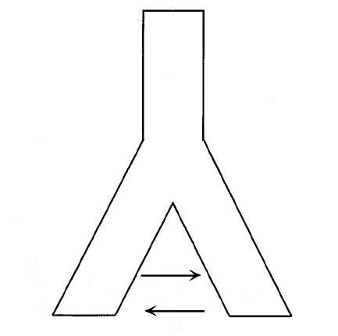
Sequential ABC
Example:
1000 individuals
Pop_{anc}
100 years
DNA sequence data (1 locus)
Pop1: 50 samples
Pop2: 50 samples
μ = 0.01 mut/locus/years
t
No mig
Ne = ?
Pop₁
Pop₂
100 individuals

Slide 11
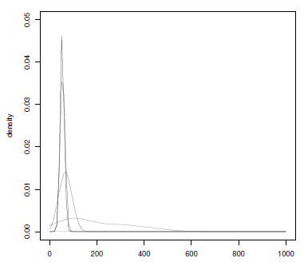
Sequential ABC
Example:

Slide 12
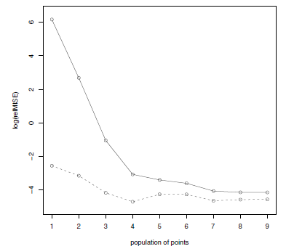

Sequential ABC
Example:
RMISE:

Slide 13
Sequential ABC
Final remarks:
The sequential approach allows for a more elegant and efficient way to explore the prior distribution.
Bibliography:
Lopes J (2010) Software development in population genetics. University of Reading.

