Slide 1
AsDroid: Detecting Stealthy Behaviors in Android Applications by User Interface and Program Behavior Contradiction
Cited 161 times ICSE
Jianjun Huang Xiangyu Zhang Purdue University Department of Computer Science Purdue University, USA
Lin Tana Electrical and Computer Engineering University of Waterloo, Canada
Peng Wang Bin Liang
School of Information Renmin University of China, China
Presented by: Jeremy Solmonson
Class Project: CS 5371
26 Feb 19

Slide 2
Overview
1. Introduction
1.0. Motivation
1.1. Problem Statement
1.2. Contributions
1.3. Terminology
2. Related work
3. Methods
4. Results and Discussion
5. Future work

Slide 3
1.0 Motivation
Imagine
You download a flashlight app to only provide light by turning on camera LED

Slide 4
1.0 Motivation
Imagine
You download a flashlight app to only provide light by turning on camera LED
Instead it collects information on YOU

Slide 5
1.0 Motivation
Imagine
You download a flashlight app to only provide light by turning on camera LED
Instead it collects information on YOU
Now imagine
A program that can detect the “intent” of an app (turn on a LED), and the “behavior” of the program (collect information).
Alert the user of the mismatch

Slide 6
1.0 Motivation
Imagine
You download a flashlight app to only provide light by turning on camera LED
Instead it collects information on YOU
Now imagine
A program that can detect the “intent” of a program (turn on a LED), and the behavior of the program (collect information).
Alert the user of the mismatch
This Paper

Slide 7
1.0 Motivation
ACTUALLY HAPPENED (2014)
Imagine
You download a flashlight app to only provide light by turning on camera LED
Instead it collects information on YOU
Now imagine
A program that can detect the “intent” of a program (turn on a LED), and the behavior of the program (collect information).
Alert the user of the mismatch
This Paper

Slide 8
1.1. Problem Statement
Android malware performs stealthy operations: phone calls, texts, http requests
Estimated total loss of $8 million
App market place exists to share apps
Almost 2 million adpps are available
Hard to control quality of 3rd party apps

Slide 9
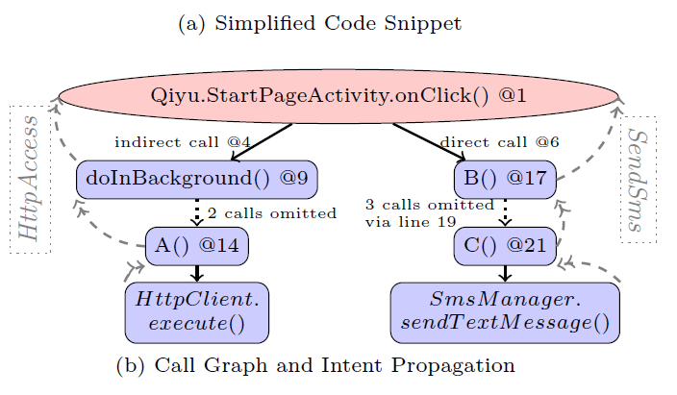
1.2. Contributions
Analyze the underlying “behavior” of the application
Analyze the “intent” of the program through the user interface (UI)
Compare the above to ensure a match
Continue until a top-level function is reached

Slide 10
1.3. Terminology
Intent: Refers to the actual behavior of the program (I will call this “app behavior”)
Phone Call, HTTPAccess, Install, SMS Notify,
UI Operation (also an intent): The actual information that is seen by the user (I will call this “app intent”).
Intent Propagation: Assigning lower intents to higher level functions
Top Level function: The summation of all the lower level functions

Slide 11
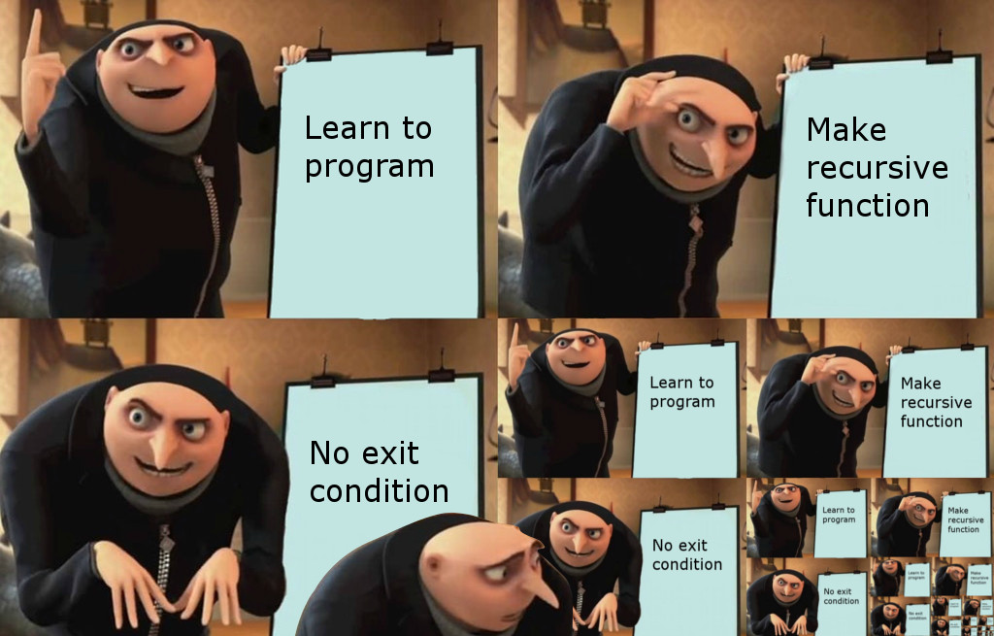
EVIL PLAN – no top level function?

Slide 12
2. Related Work
Taint Droid tracking variables for mem leaks
Hardcoded phone numbers for SMS texts
Droid Ranger signature based to find phone calls and SMS texts
Search based testing to improve UI
Whyper to analyze app text descriptions

Slide 13
3. Methods
Datalog Rules
Rules (example)
correlatedIntent(F,T1,L1,T2,L2) :- hasIntent(F, T1, L1) & hasIntent(F, T2, L2) & correlated(L1,L2)
hasIntent(F,T,L) :- invoke(F,A,L) & apiIntent(L,T)
invoke(F1,F2,L) :- directInvoke(F1,F2,L)
correlated(L1,L2) :- controlDep(L1,L2)
controlDep(L1,L2) :- immediateCD(L1,L2)
Atoms
immediateCD(L1,L2) : program point L2 is immediately control dependent on L1 in the same function.
apiIntent(L,T) : API call at program point L has intent type T.
directInvoke(F1,F2,L) : F1 invokes F2 at program point L

Slide 14
3. Methods (cont.)
Text Analysis
Stanford Parser to parse the text to keywords
picks the most frequently occurring keyword k at a time and adds it to the keyword set
Removes all the keywords that appear in the top level functions in which k occurs (covered by k)
Repeats until the set of functions are covered
Machine
Intel core i7 3.4 Ghz, 12 GB memory, Ubuntu 12.04

Slide 15
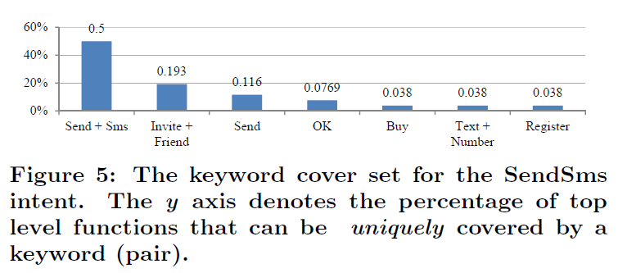
4. Results and Discussion

Slide 16
4. Results and Discussion (cont.)
AsDroid Results:
Correctly ID with stealth behavior 85 (TP)
Wrongly ID with stealth behavior 28 (FP)
No ID, and had stealth behavior 11 (FN)
No ID, and no stealth behavior + 58 (TN)
Total tested apps: 182
Correctly ID app 78.5 % of the time

Slide 17
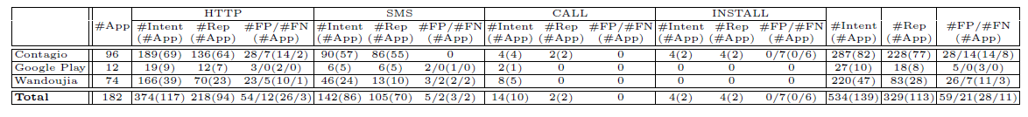
4. Results and Discussion (cont.)
#App in the second column denotes the number of tested apps from a specific source.
#Intent is the number of API invocations with one of the four kinds of potential stealthy intents.
#Rep is the number of intent points reported by AsDroid as stealthy.
#FP is the number of false positives and
#FN is the number of false negatives

Slide 18
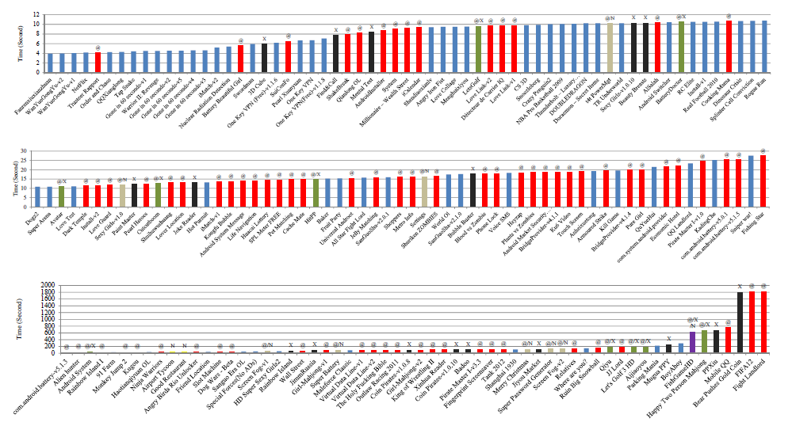
4. Results and Discussion (cont.)

Slide 19
4. Results and Discussion (cont.)
Key idea: identify contradiction between program behavior and user interface text
By checking the compatibility between the intents and the text of the UI artifacts, stealthy operations can be detected
Good start at matching intents to program behavior

Slide 20
5. Future Work
My Recommendations:
Identify more intents to find stealthy features
Expand datalog rules for more intents
Integrate into IDS and Anti-Virus

Slide 21
Questions or Comments ?? || //
“Wisdom is not a product of schooling but of the lifelong attempt to acquire it.” - Albert Einstein

