Slide 1
Imaging

Slide 2
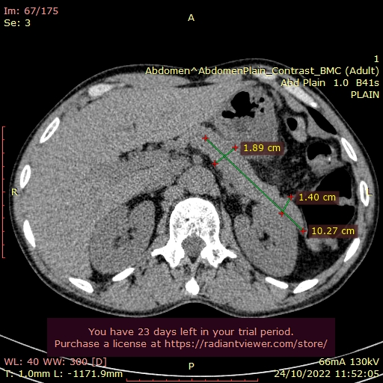
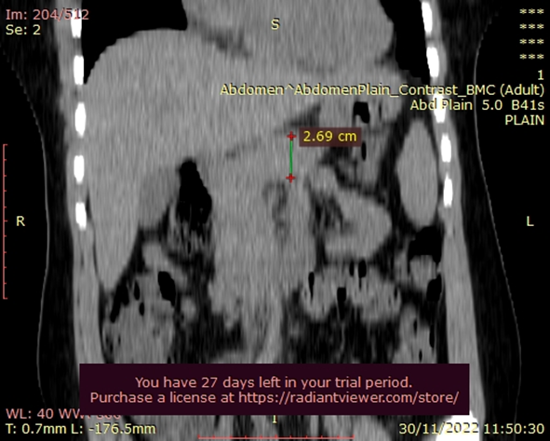
Body_Anterior Posterior diameter = 1.89cm
Body&Tail_Length = 10.27cm
Tail_AP diameter = 1.40cm
Head_Craniocaudal diameter = 2.69cm

Slide 3
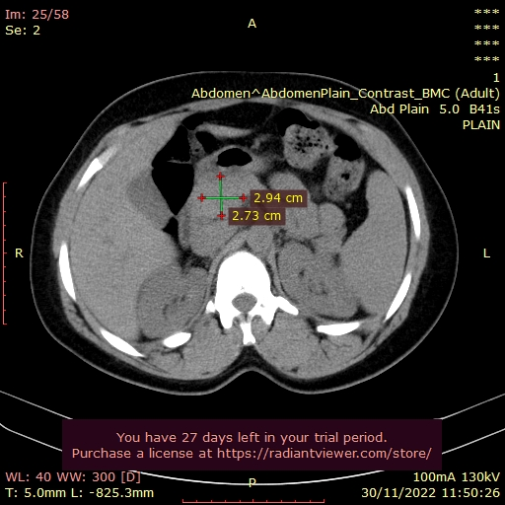
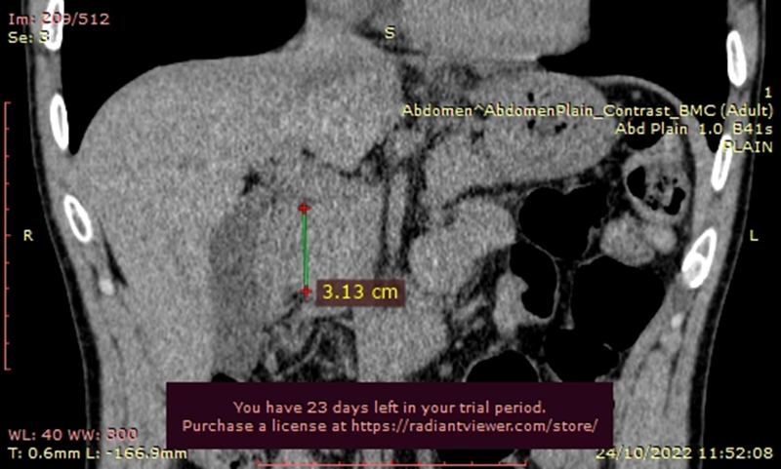
Head_Craniocaudal diam
Head_AP_Trans

Slide 4
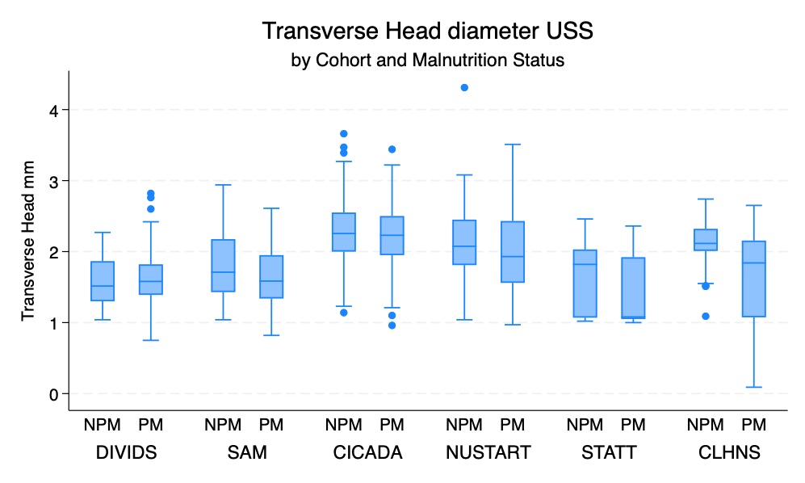

Slide 5
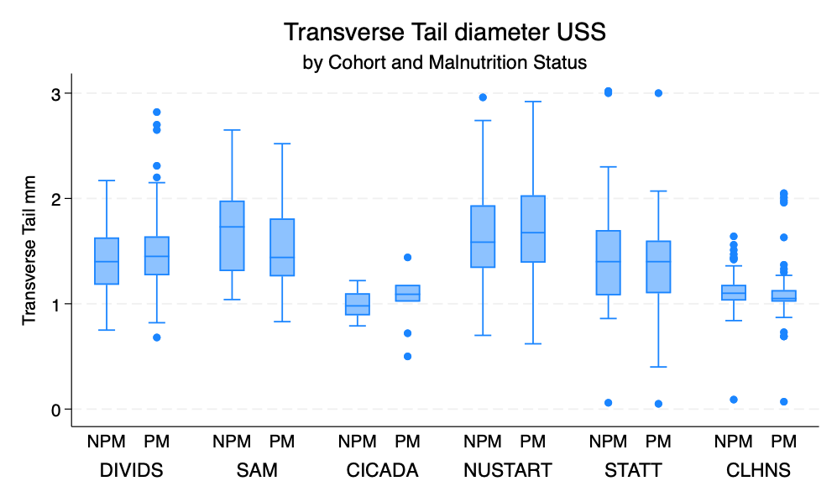

Slide 6
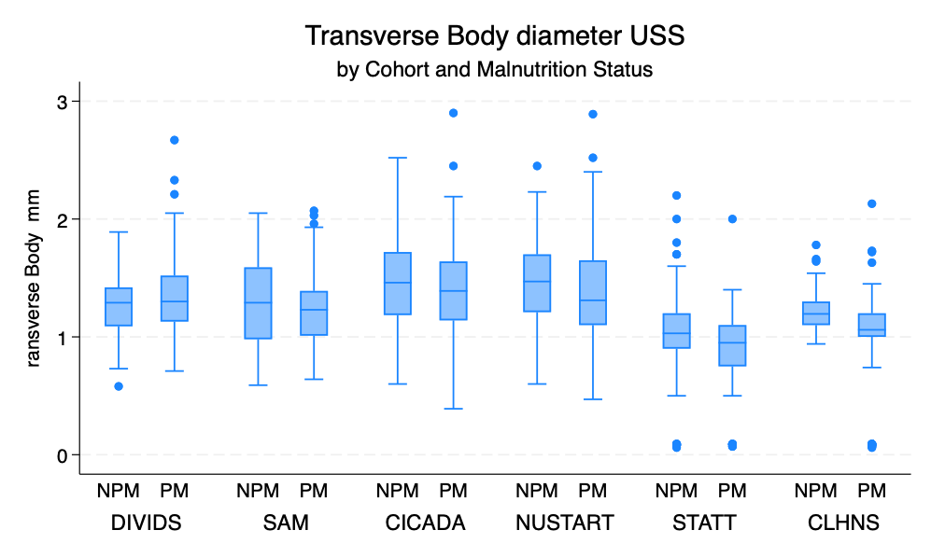

Slide 7
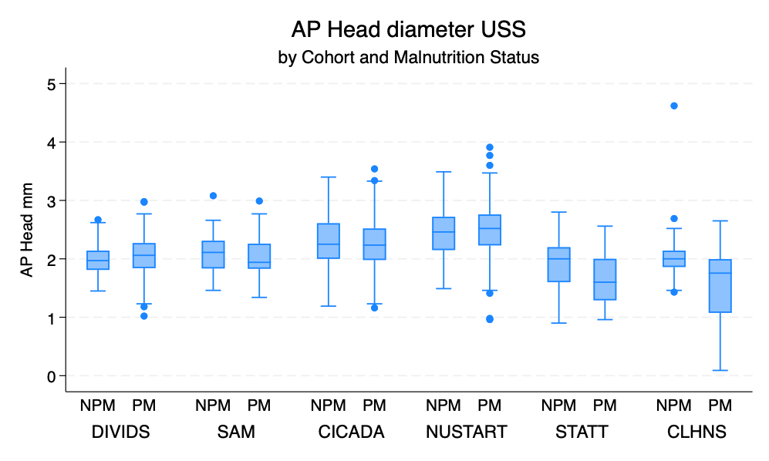

Slide 8
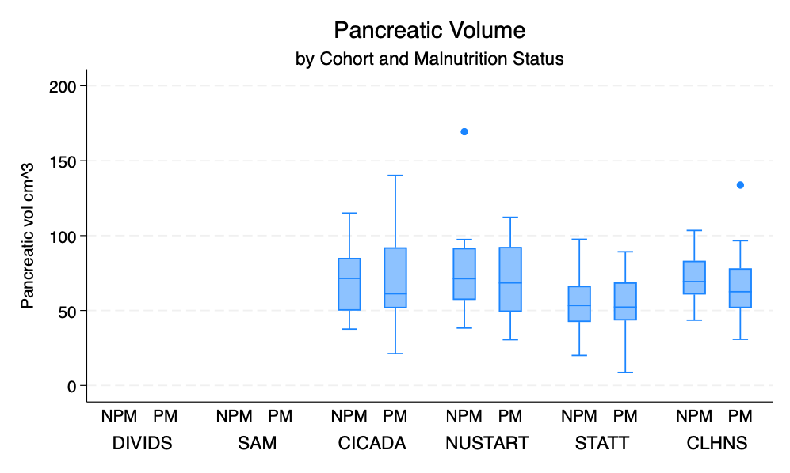

Slide 9
