Slide 1
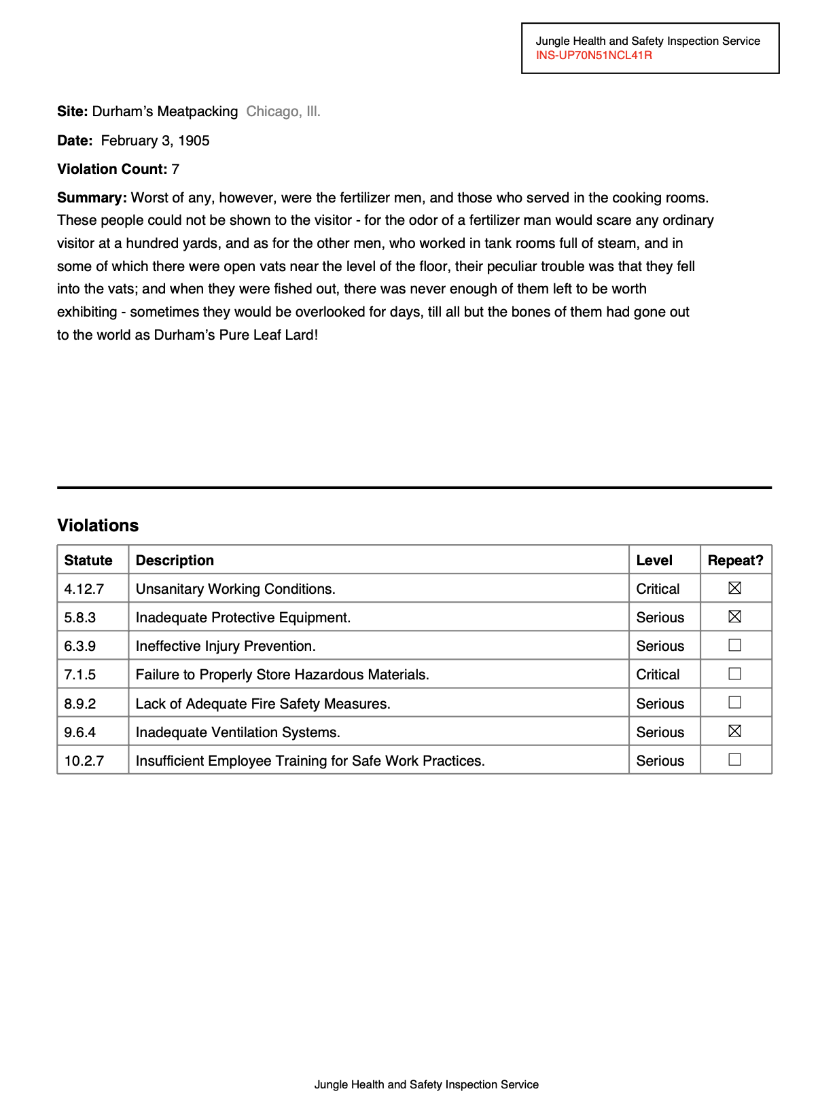
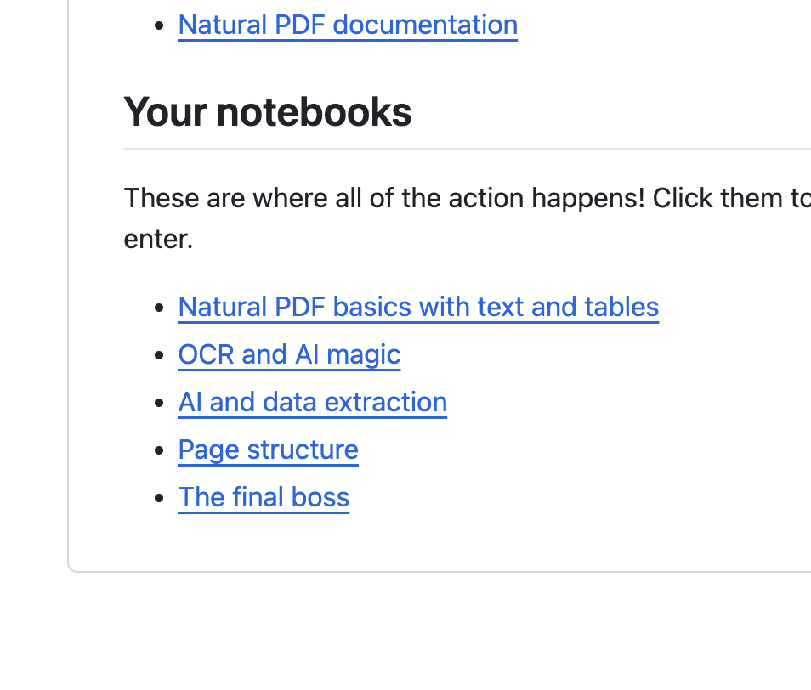
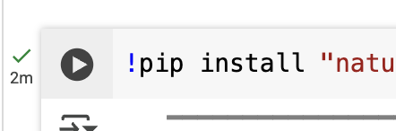


Visit https://bit.ly/ire25-pdfs, scroll down down down down down
Scraping PDFs with Python + Natural PDF
click
Jonathan Soma
Knight Chair in Data Journalism
Columbia University
js4571@columbia.edu / @dangerscarf

Slide 2


Visit https://bit.ly/ire25-pdfs, scroll down down down down down

Slide 3
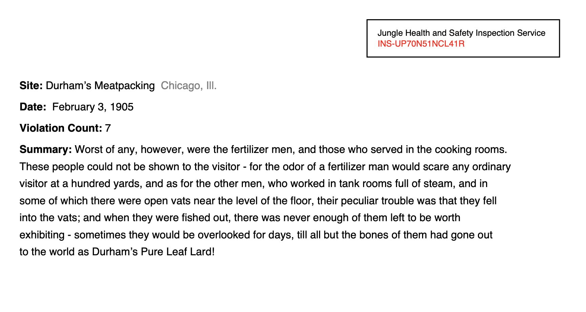

Visit https://bit.ly/ire25-pdfs, scroll down down down down down

Slide 4

Visit https://bit.ly/ire25-pdfs, scroll down down down down down

Slide 5

Visit https://bit.ly/ire25-pdfs, scroll down down down down down

Slide 6

Visit https://bit.ly/ire25-pdfs, scroll down down down down down

Slide 7

Visit https://bit.ly/ire25-pdfs, scroll down down down down down

Slide 8
Visit https://bit.ly/ire25-pdfs, scroll down down down down down
Scraping PDFs with Python + Natural PDF
Jonathan Soma
Knight Chair in Data Journalism
Columbia University
js4571@columbia.edu / @dangerscarf

