Slide 1
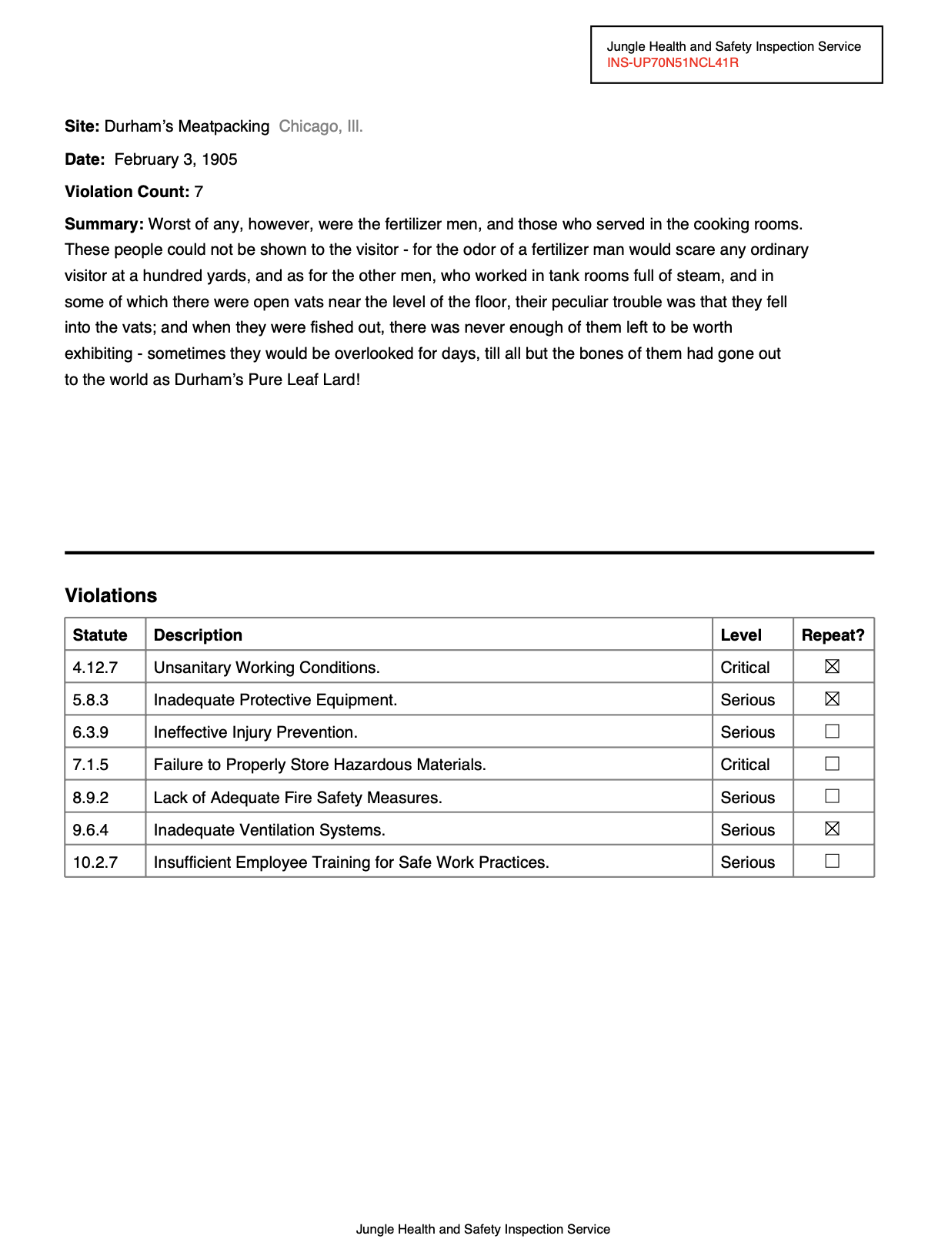
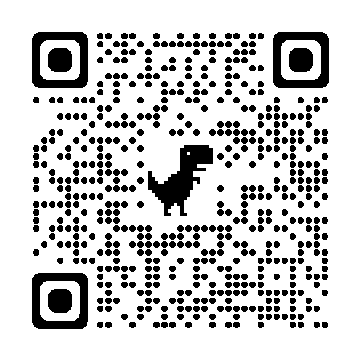
Workshop materials are at https://bit.ly/natural-pdf
Magical, modern PDF processing with Natural PDF
Jonathan Soma
Knight Chair in Data Journalism
Columbia University
js4571@columbia.edu / @dangerscarf

Slide 2
bit.ly/natural-pdf

Slide 3
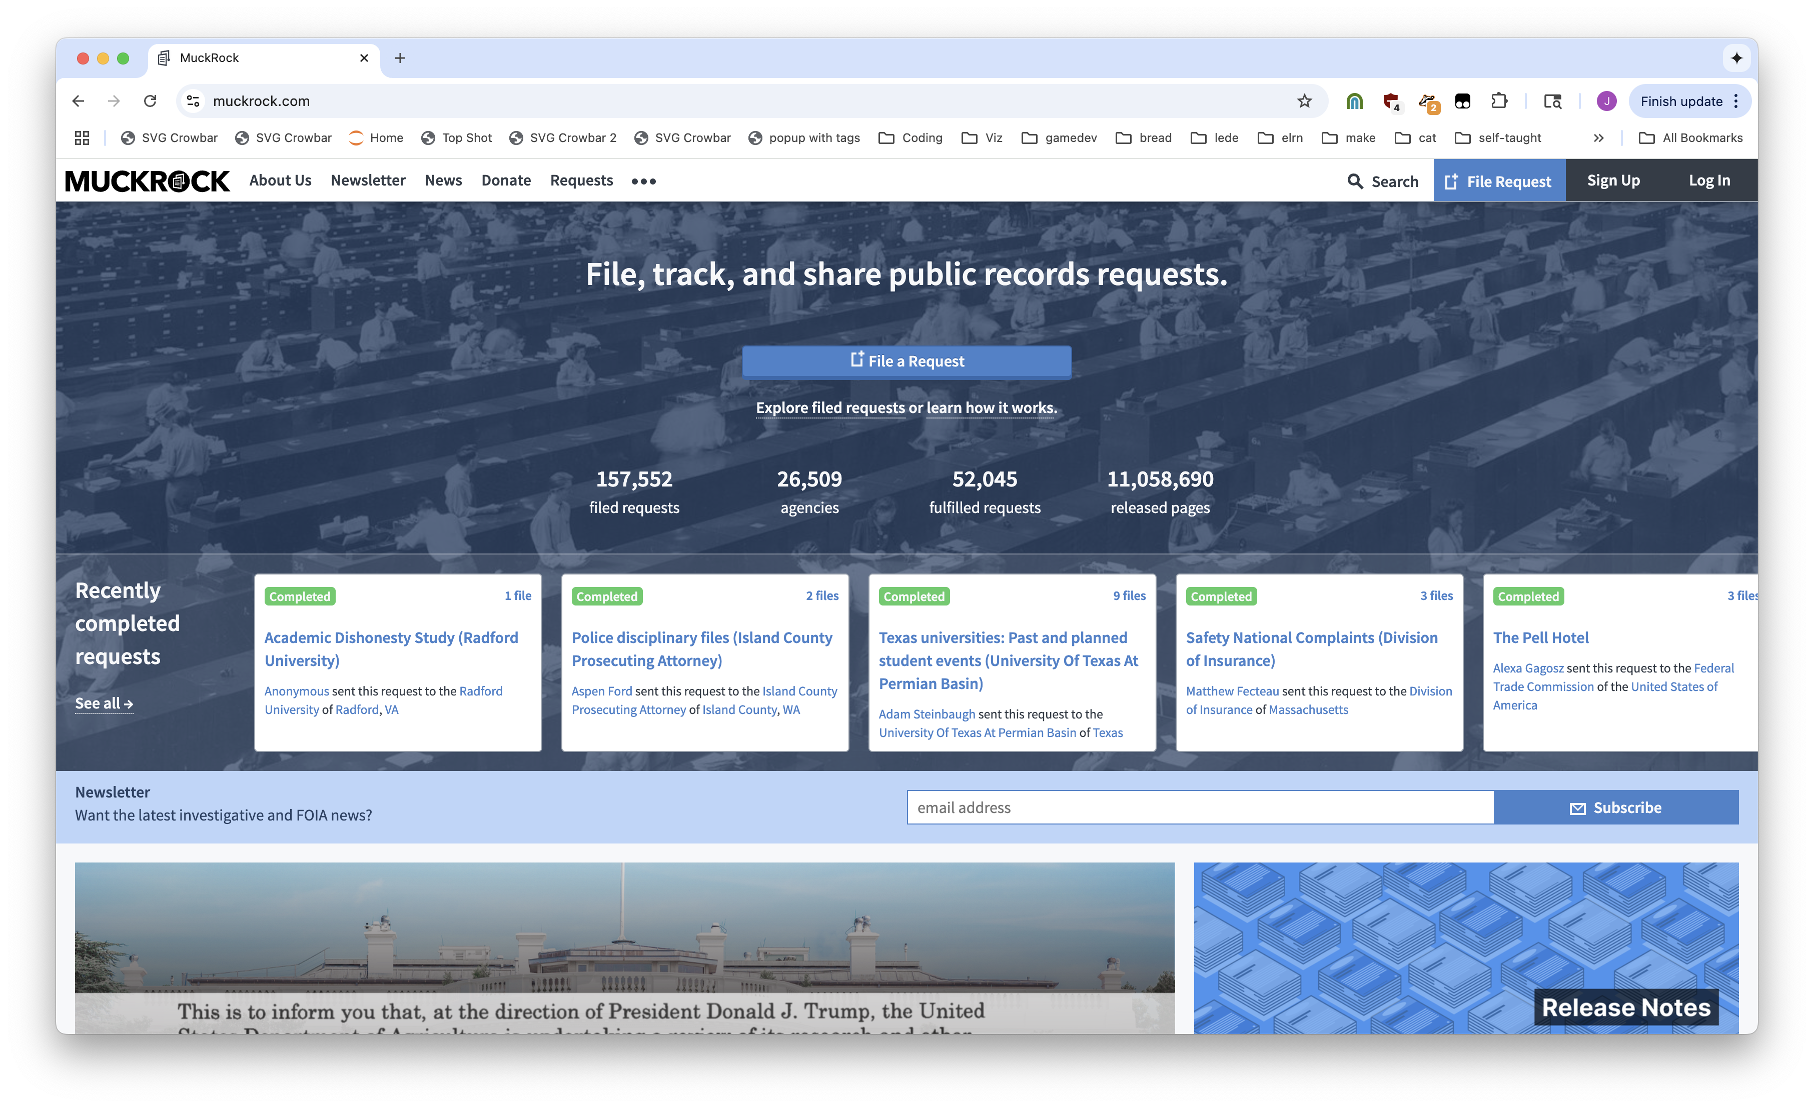
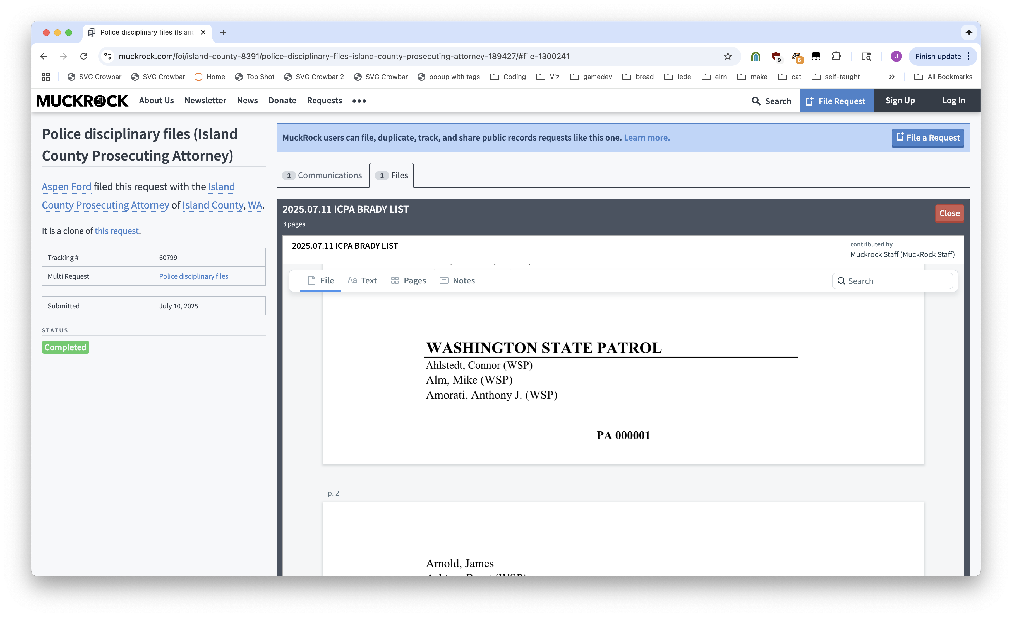
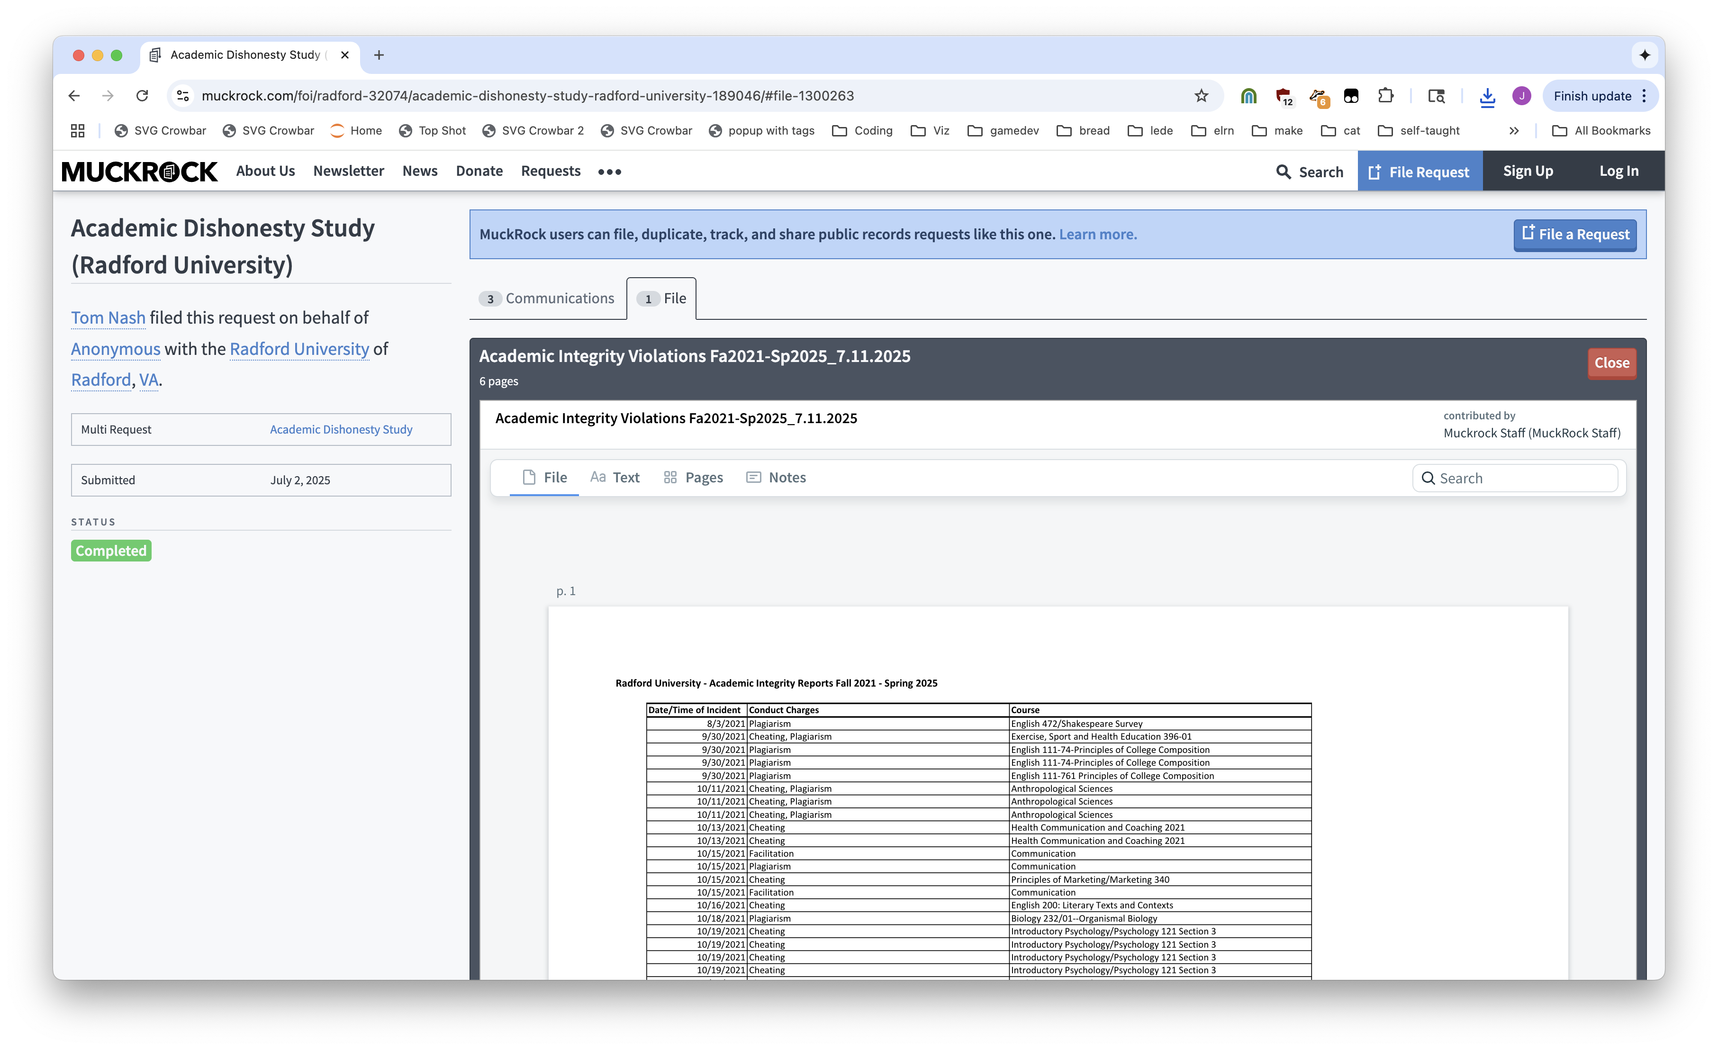
Notes:
Muckrock: a place for FOIA requests

Slide 4
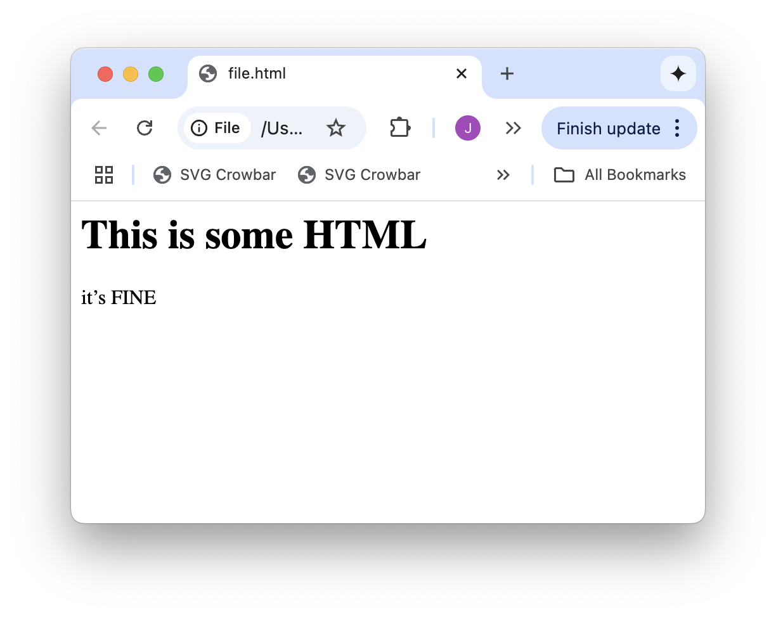
<h1>This is some HTML</h1>
<p>it’s FINE</p>

Slide 5
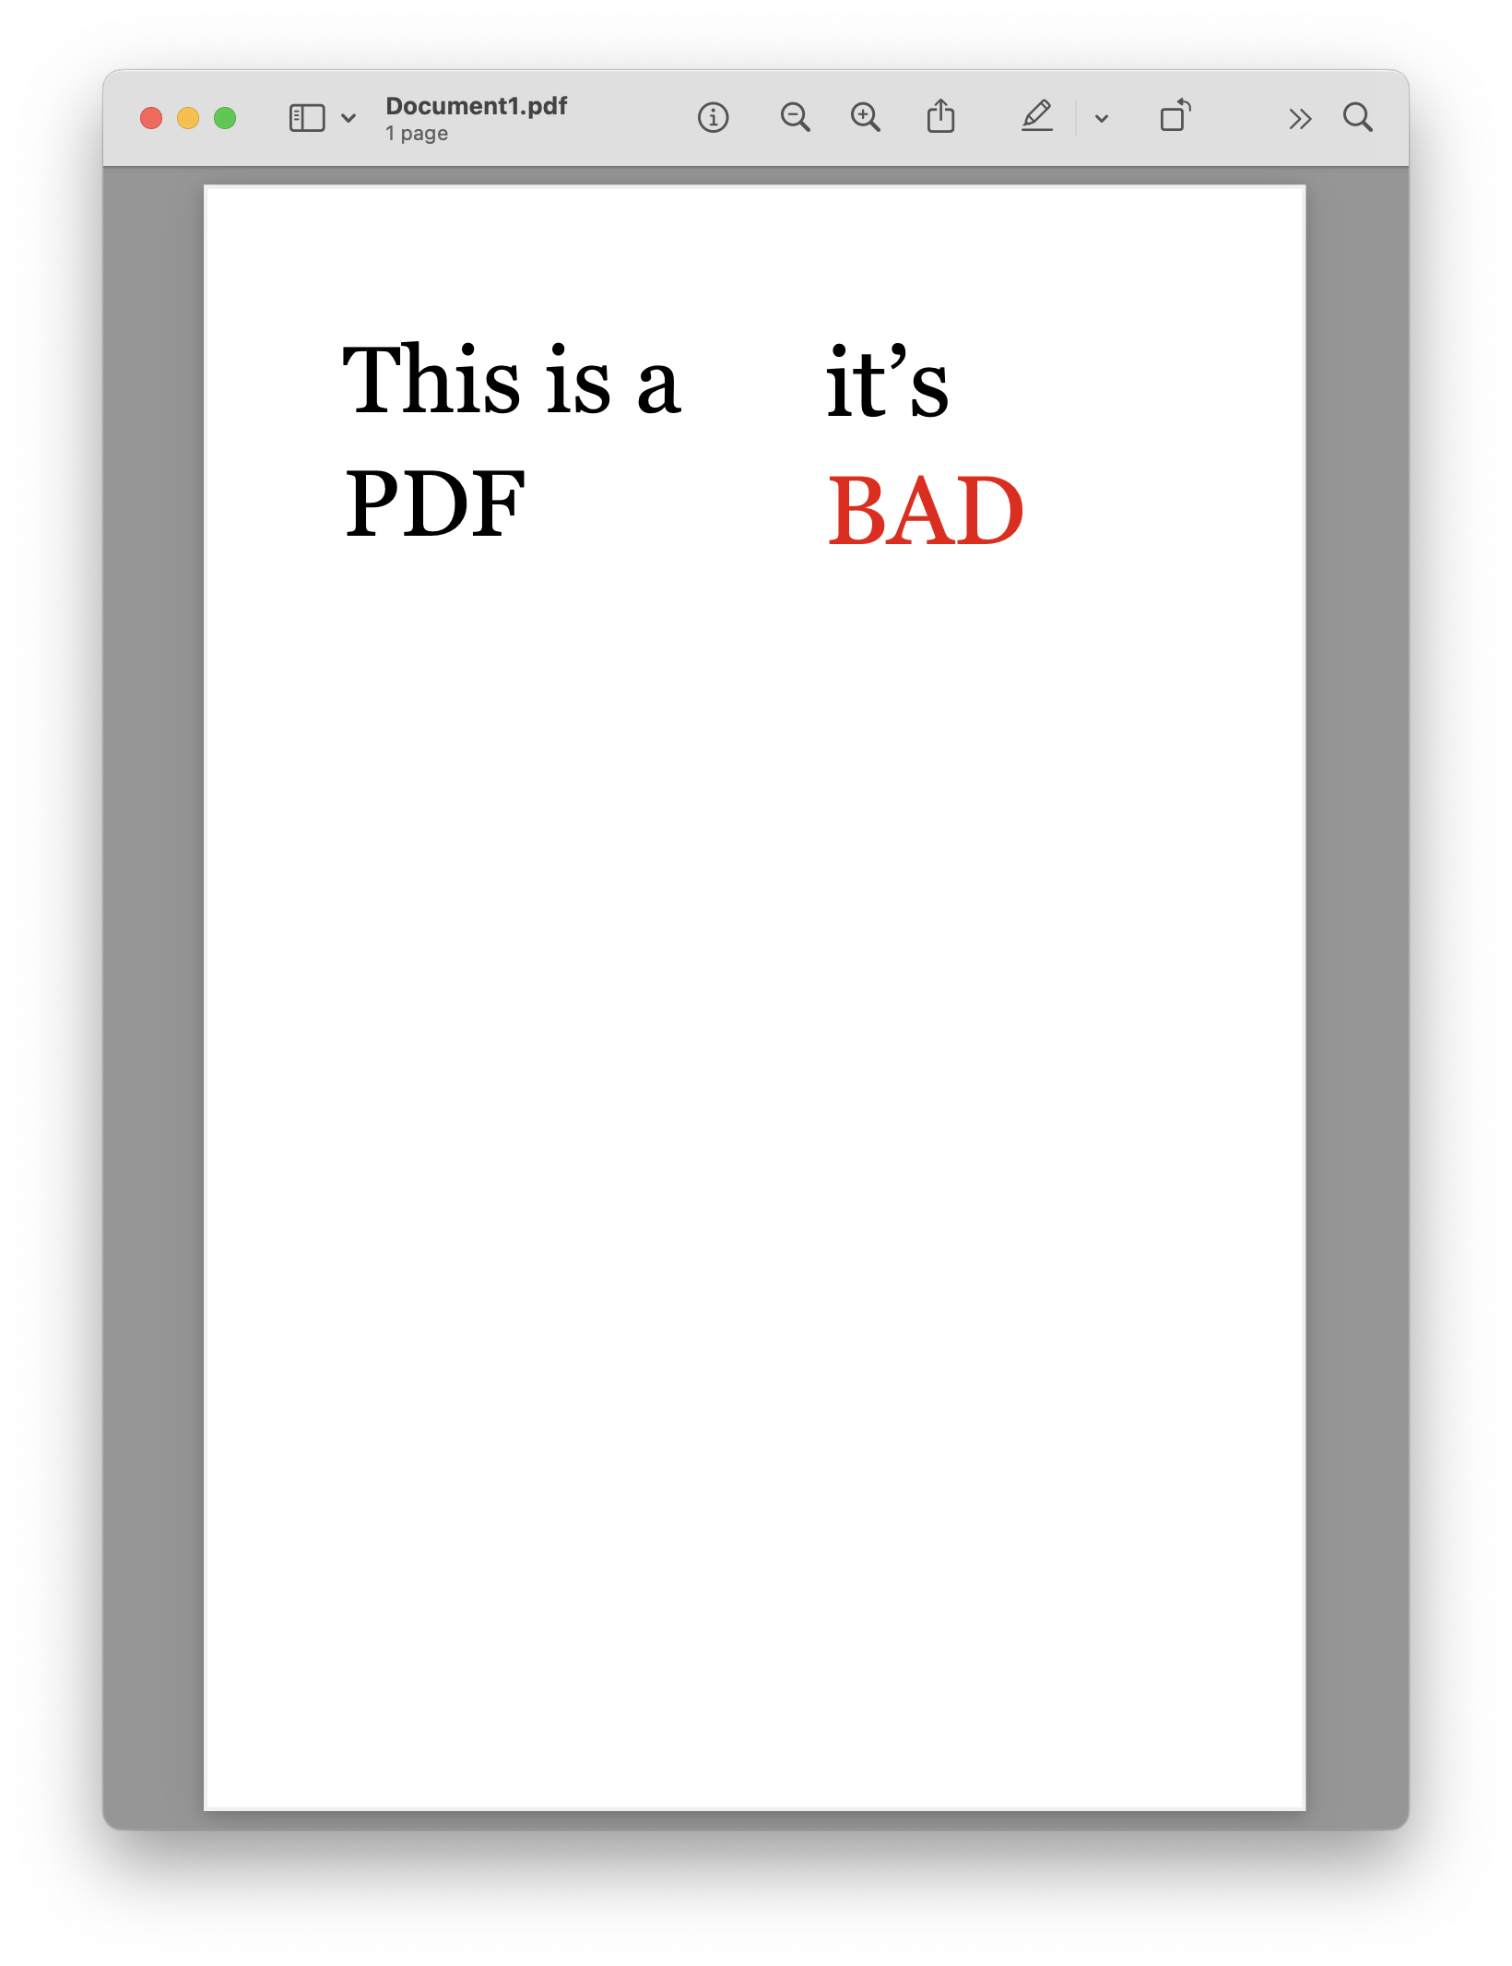

Slide 6
T
h
i
s
i
s
a
i
t
’
s
P
D
F
B
A
D

Slide 7

T
h
i
s
i
s
a
i
t
’
s
P
D
F
B
A
D
Notes:
PDFs are good for printing, but nothing else

Slide 8



matrix: (24.96, 0.0, 0.0, 24.96, 160.080072, 359.47999999999996)
fontname: AAAAAC+Georgia
adv: 0.293
upright: True
x0: 160.080072
y0: 354.01375999999993
x1: 167.393352
y1: 378.97375999999997
width: 7.313279999999992
height: 24.960000000000036
size: 24.960000000000036
mcid: None
tag: None
object_type: char
ncs: ICCBased
text: i
stroking_color: None
stroking_pattern: None
non_stroking_color: (0, 0, 0)
non_stroking_pattern: None
i
t
’
s
B
A
D
object_type: rect
width: 500
height: 1
Notes:
PDFs are good for printing, but nothing else

Slide 9
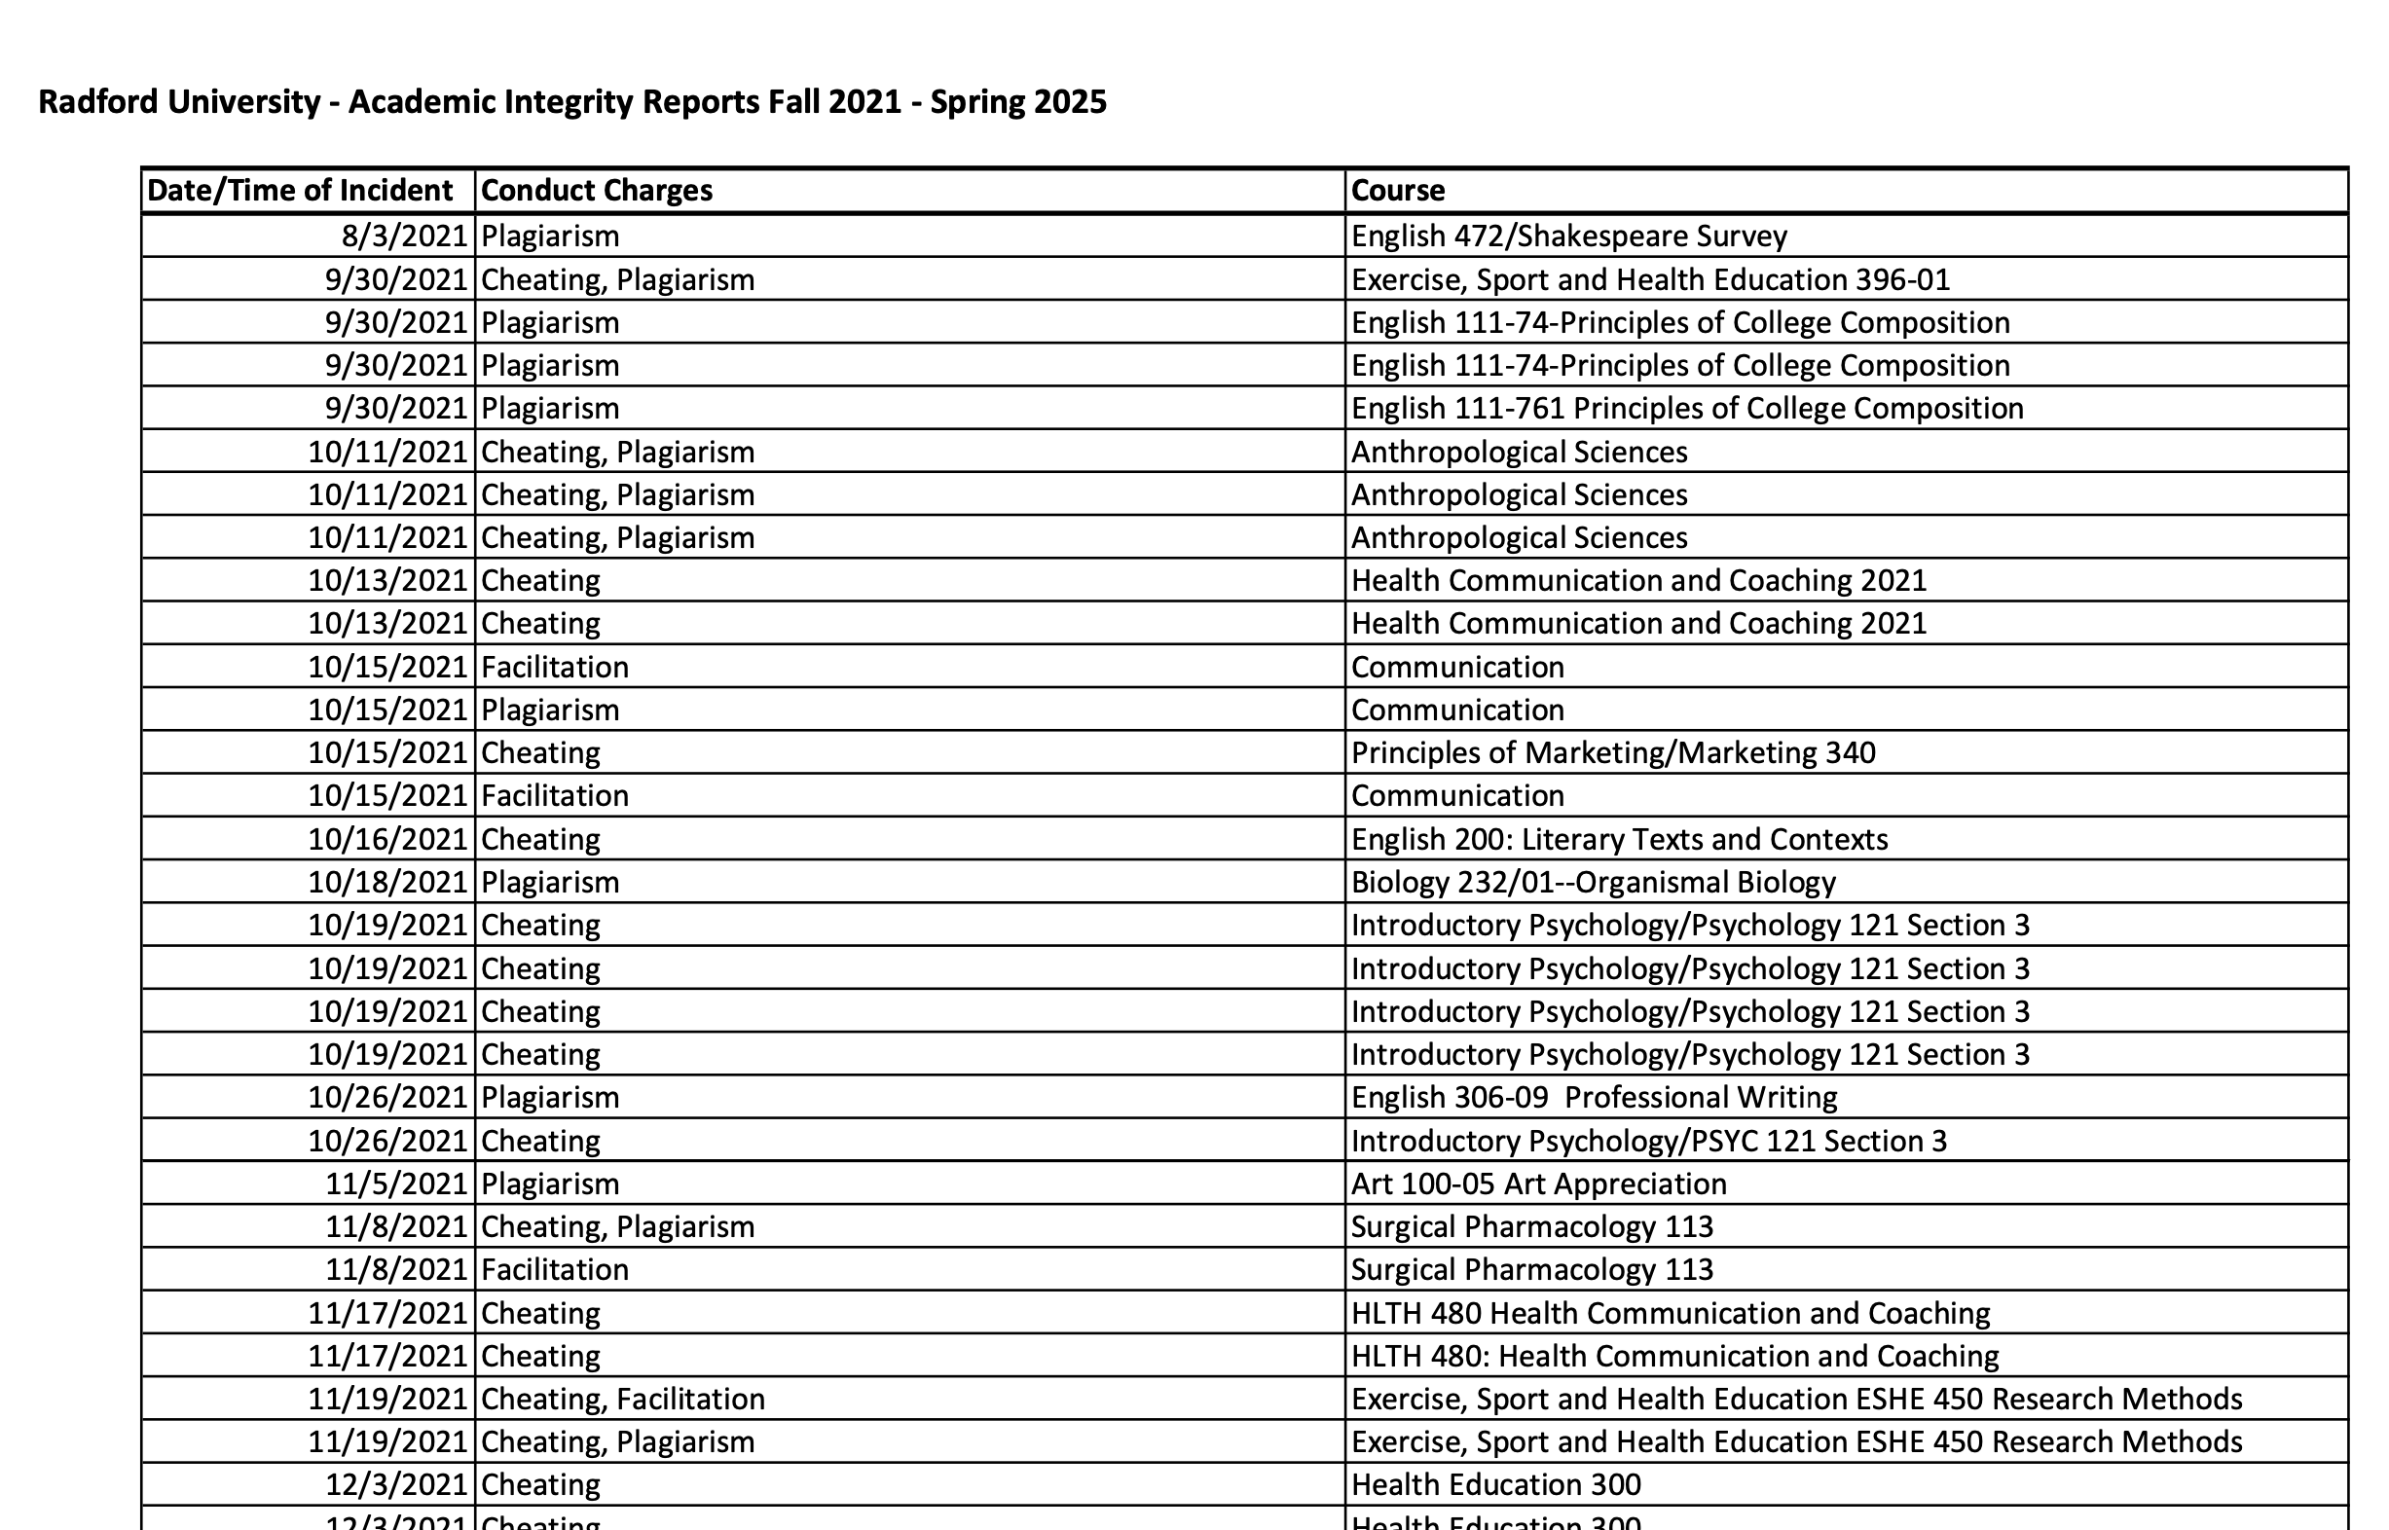
T
h
i
s
i
s
a
i
t
’
s
P
D
F
B
A
D

Slide 10



Slide 11
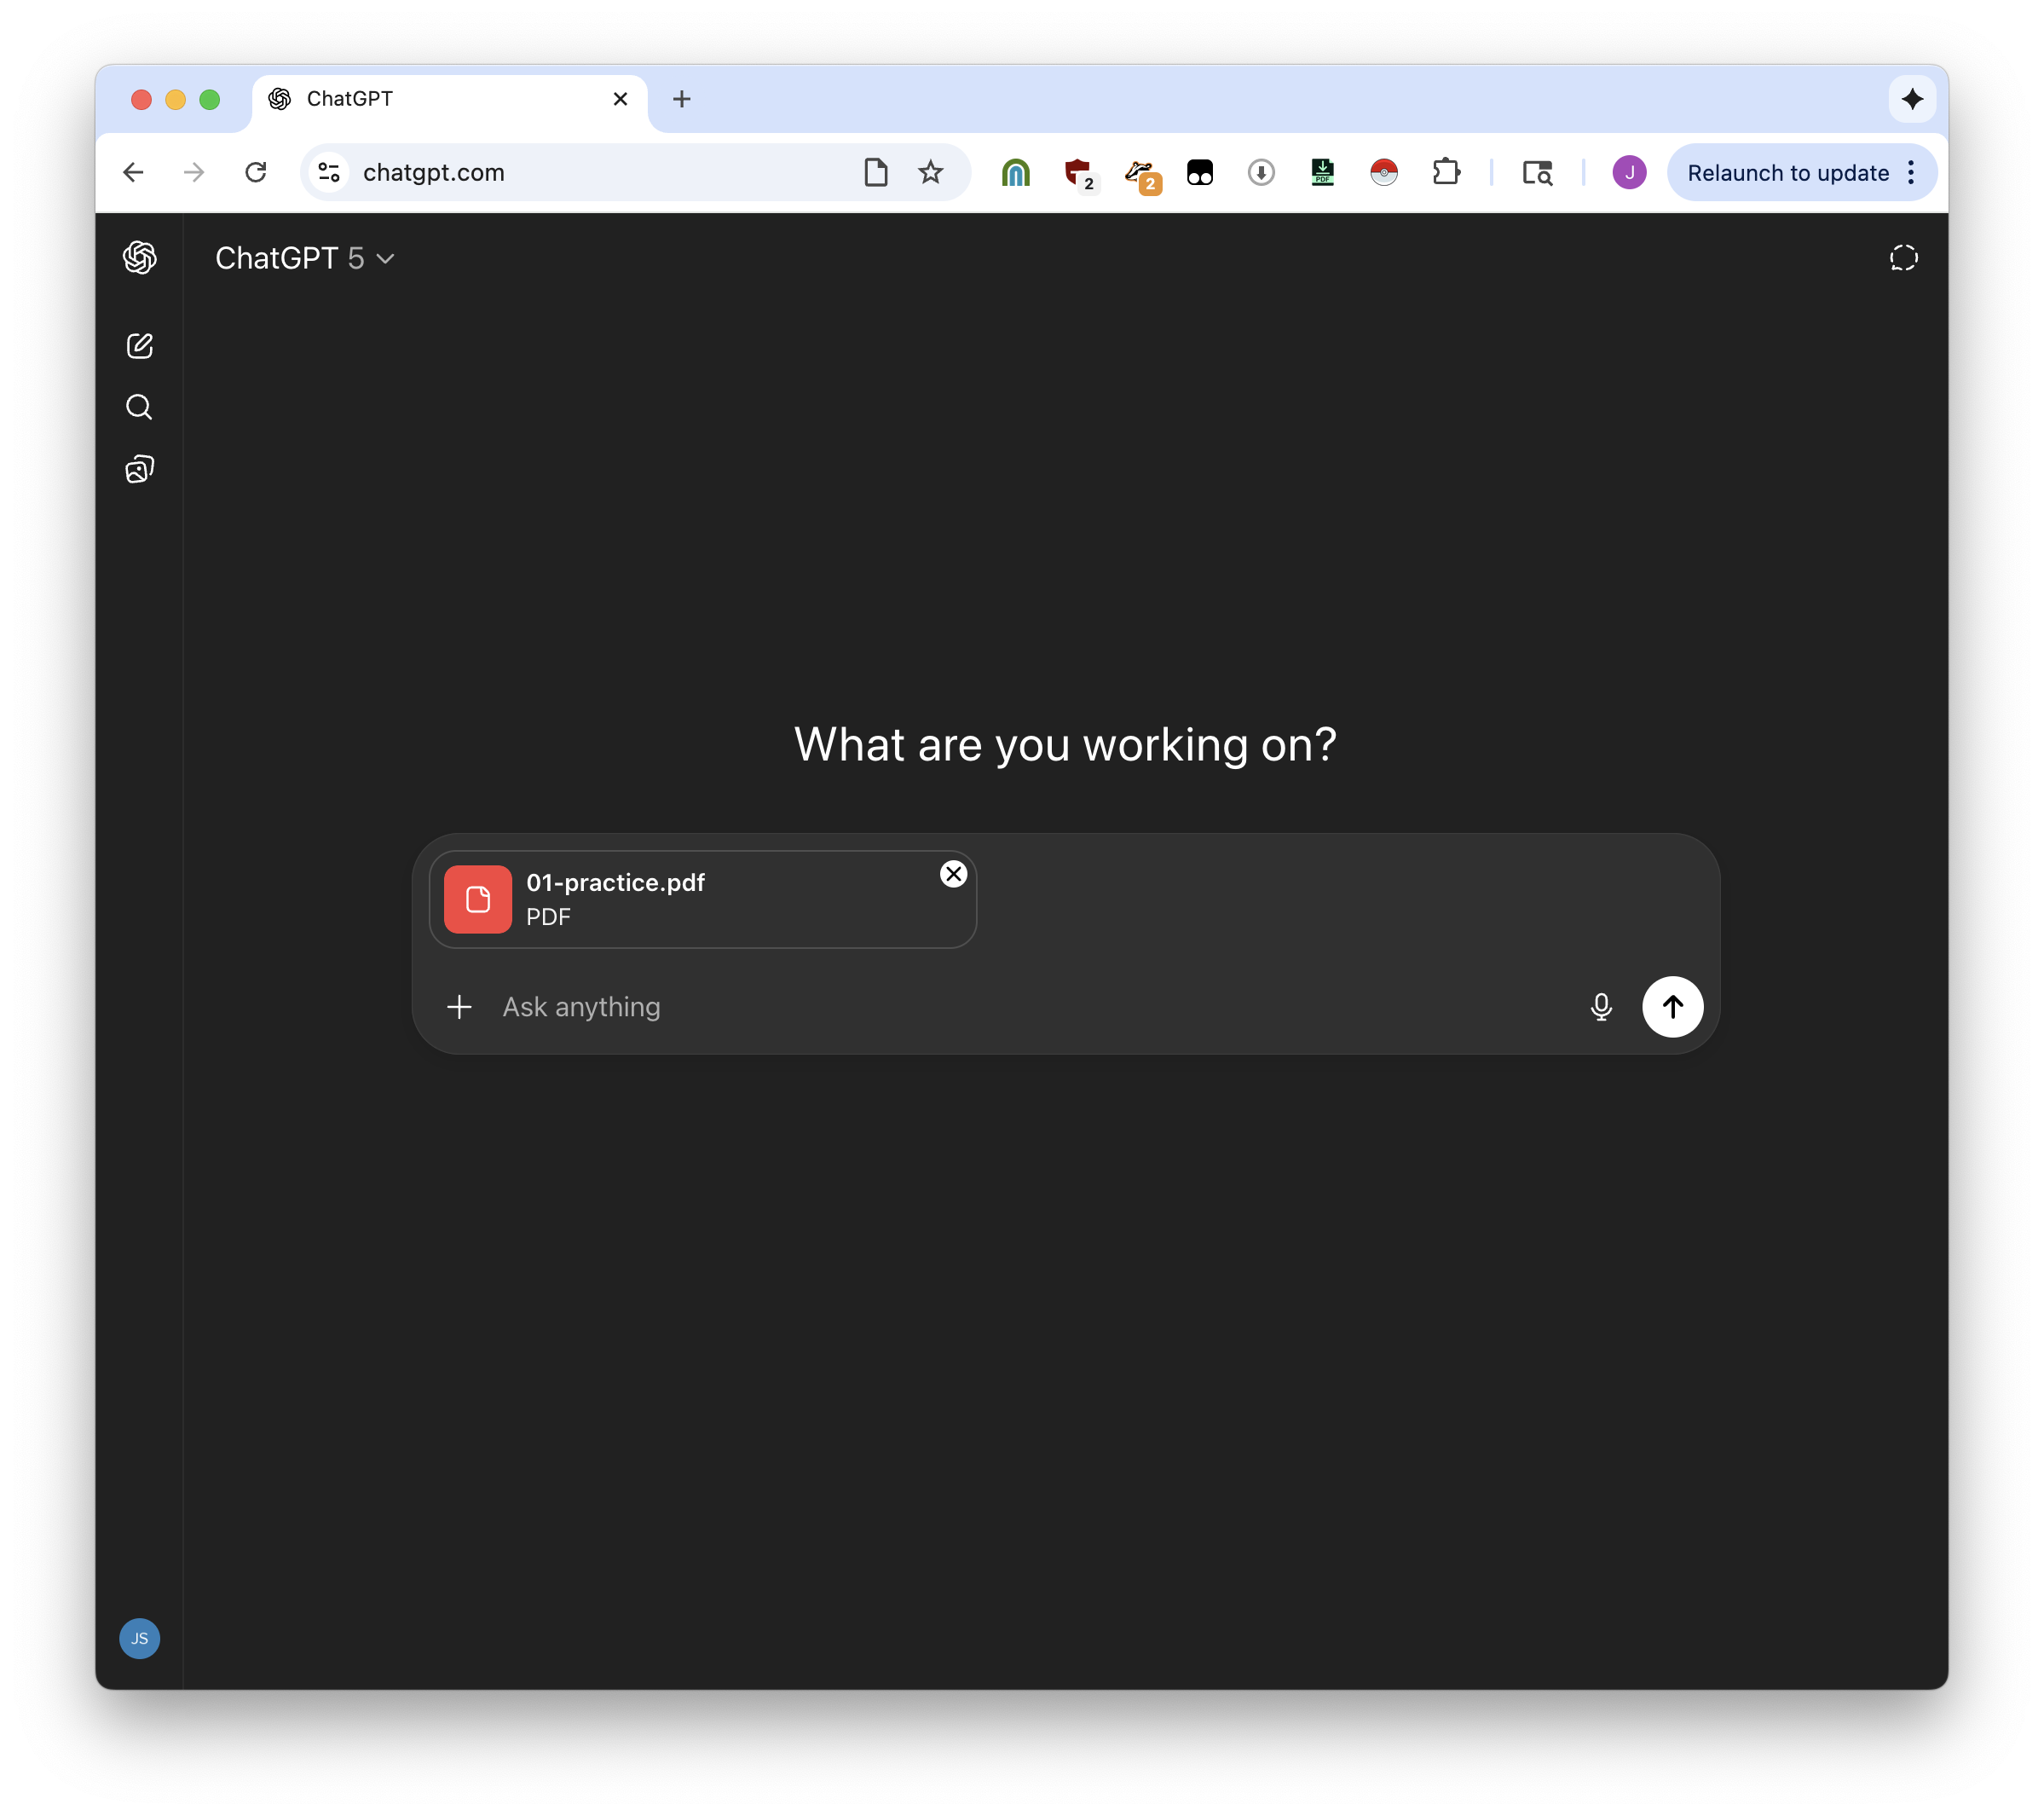


Slide 12
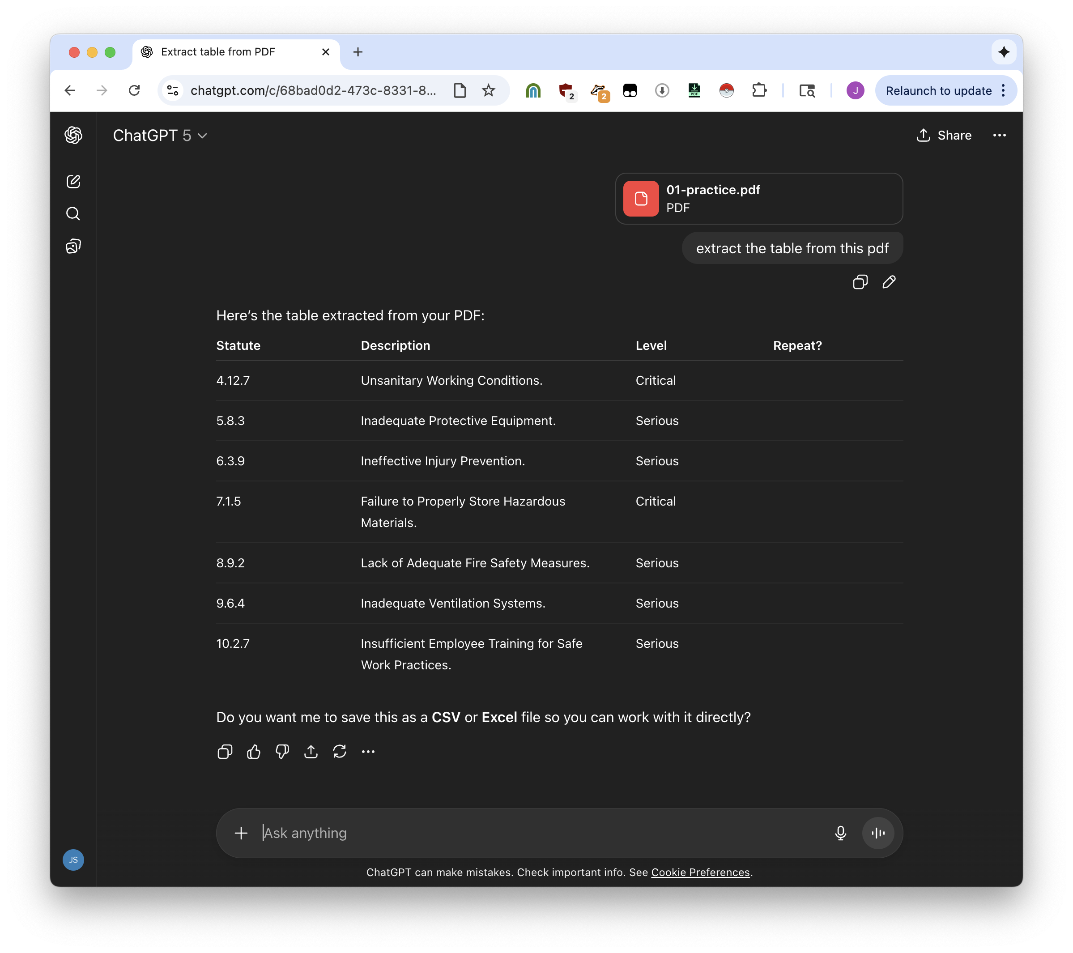


unfortunately: doing this should land you in prison, forever

Slide 13

LLMs are not built for exactly copying things. The probability is high that they’ll copy correctly, but not 100%.

Slide 14
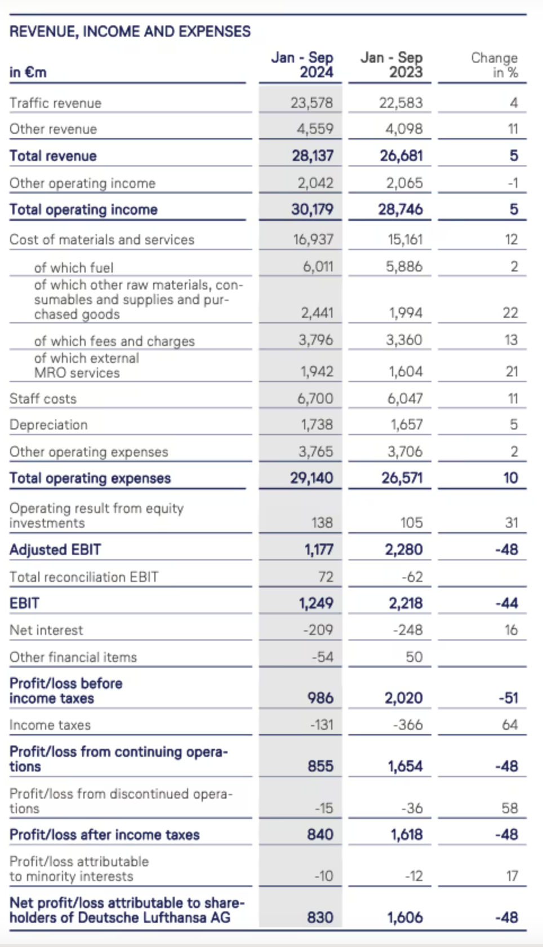
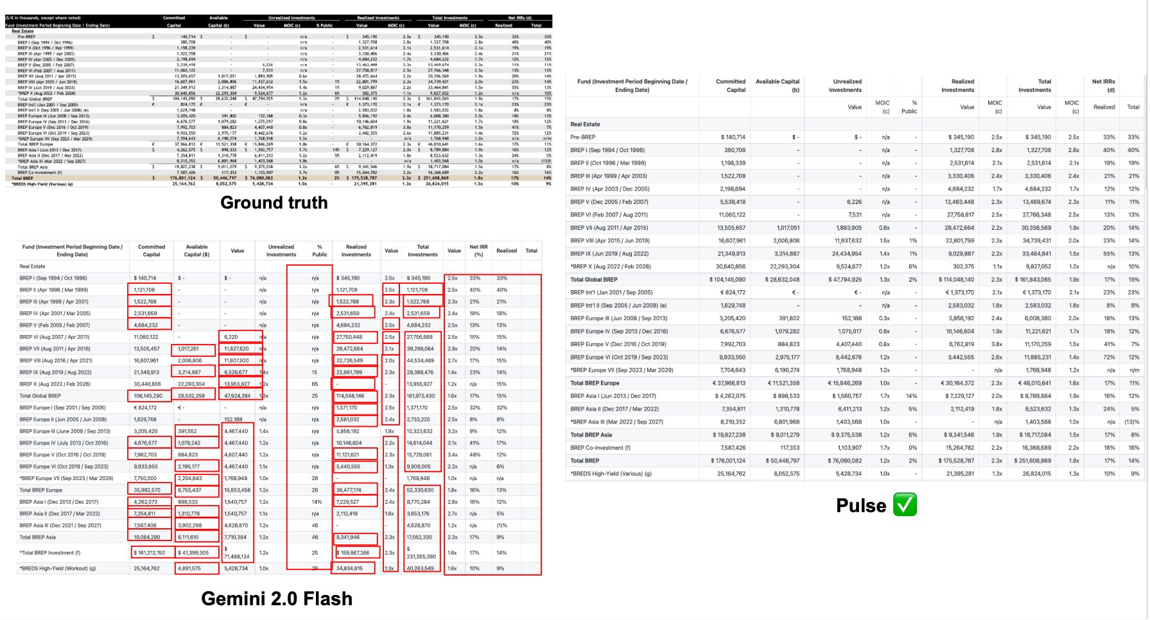
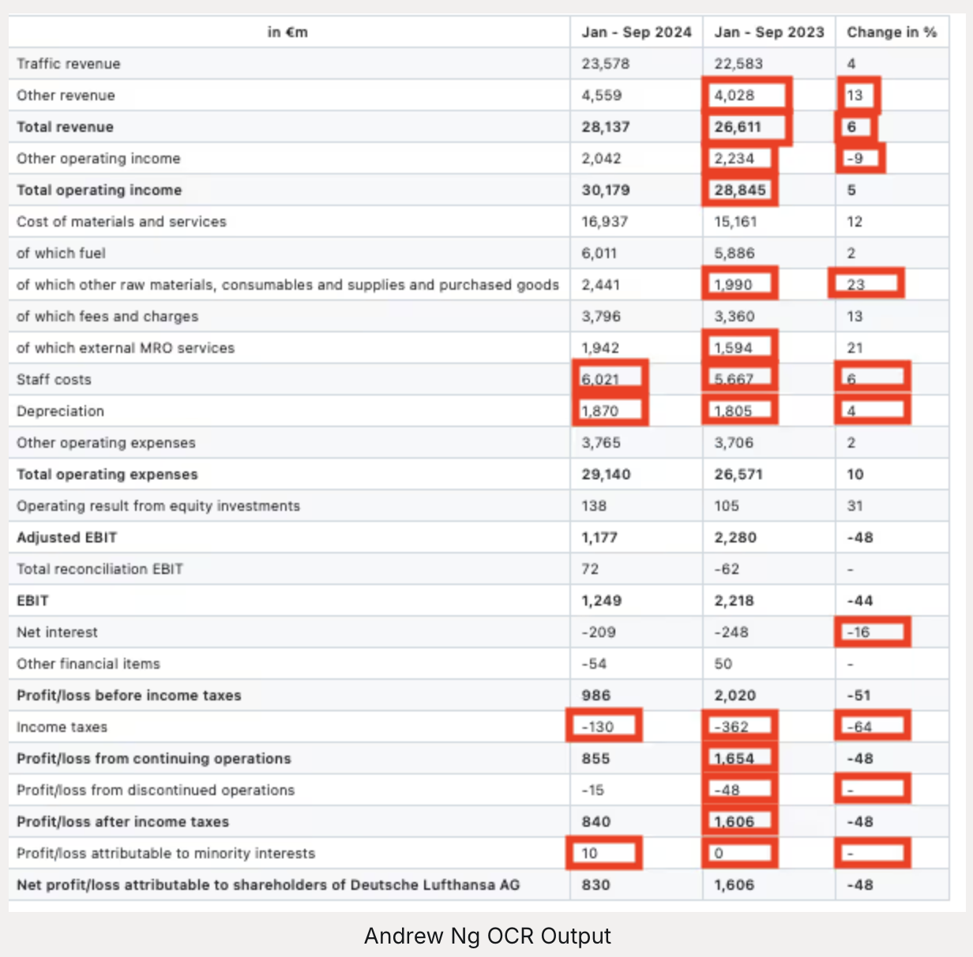
numbers + structured data require accuracy
you get a table but probably not the table
www.runpulse.com/blog

Slide 15
Workshop materials are at https://bit.ly/natural-pdf
sometimes, you really do need to do it manually

Slide 16
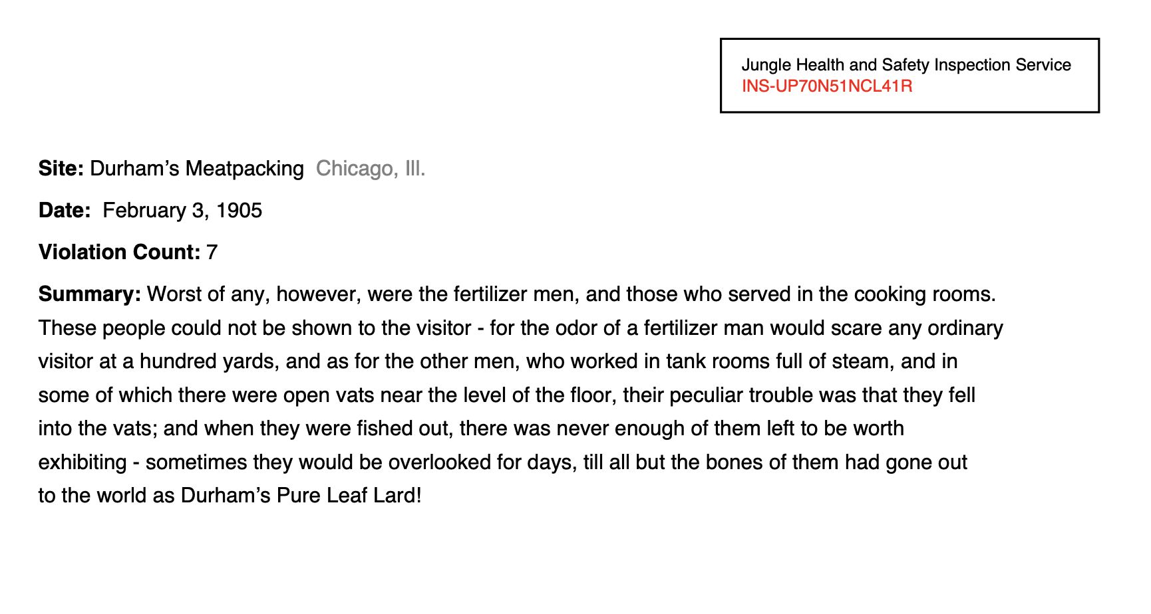

Workshop materials are at https://bit.ly/natural-pdf

Slide 17

Workshop materials are at https://bit.ly/natural-pdf

Slide 18

Workshop materials are at https://bit.ly/natural-pdf

Slide 19

Workshop materials are at https://bit.ly/natural-pdf

Slide 20

Workshop materials are at https://bit.ly/natural-pdf

Slide 21


Workshop materials are at https://bit.ly/natural-pdf
01: Spatial awareness

Slide 22

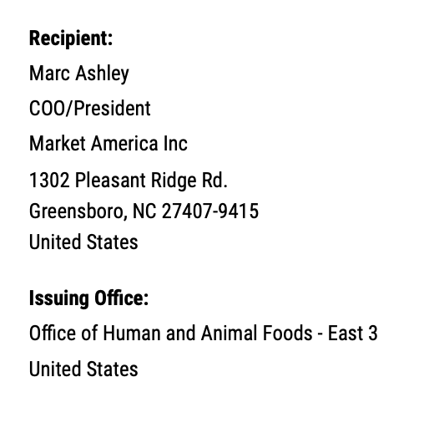

(
page
.find(“Recipient”)
.below(until=”text:bold”)
.extract_text()
)
PDF text, so zero risk of hallucinations
Marc Ashley
COO/President
Market America Inc
1302 Pleasant Ridge Rd.
Greensboro, NC 27407-9415
United States

Slide 23
02: OCR: when text isn’t text

Slide 24
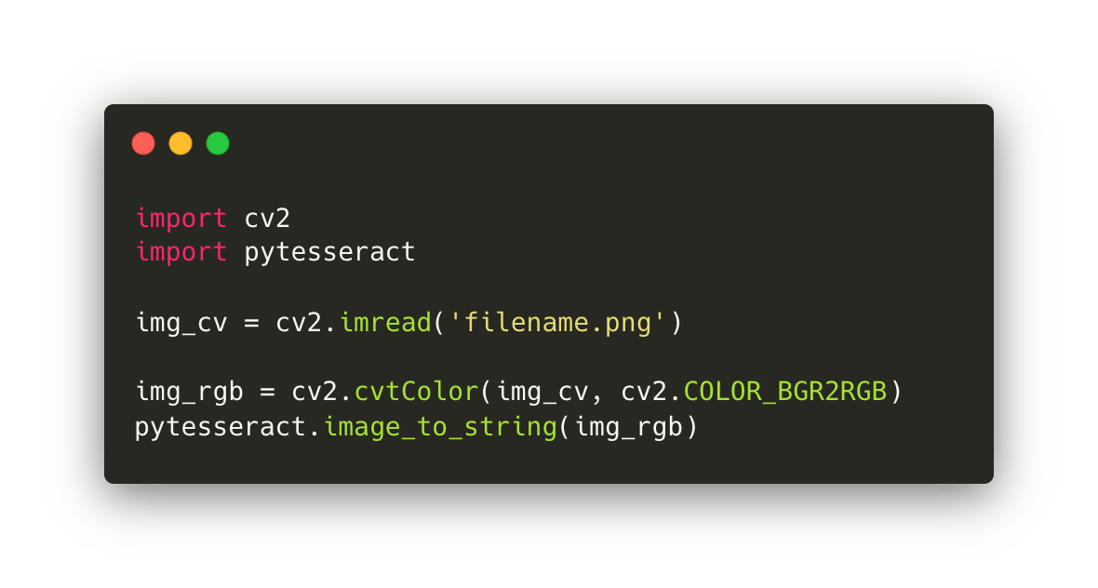
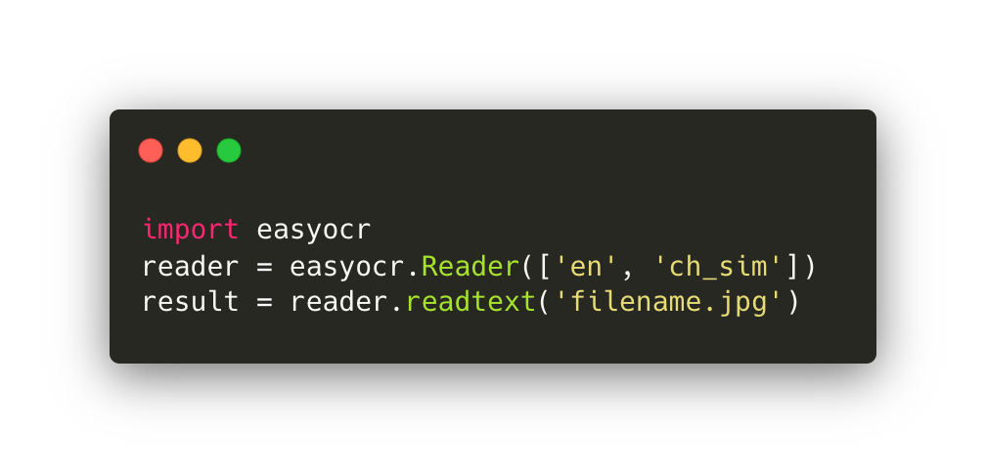
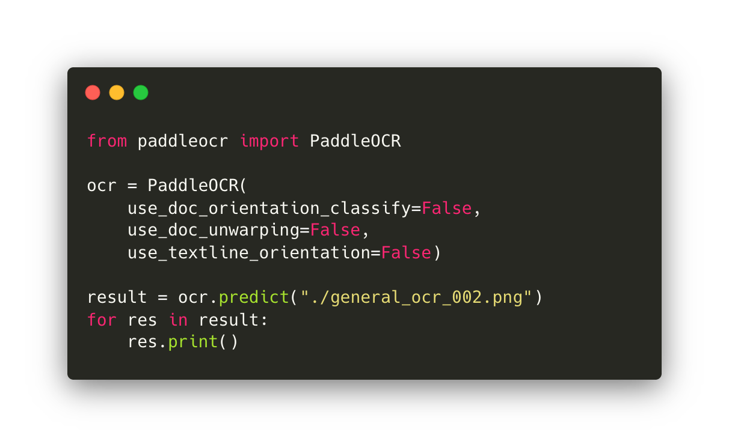
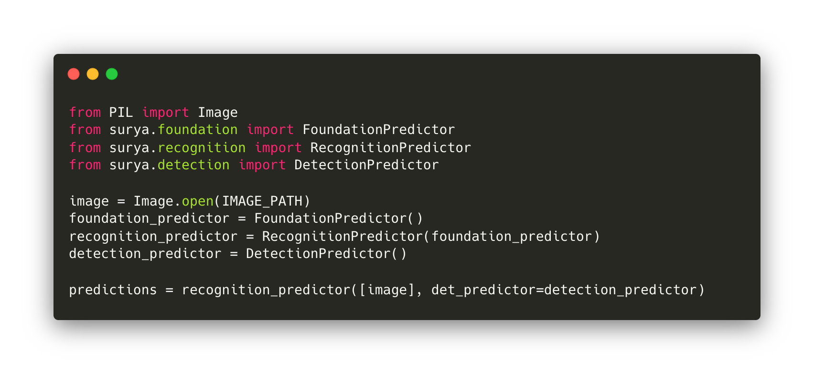
02: OCR: when text isn’t text

Slide 25
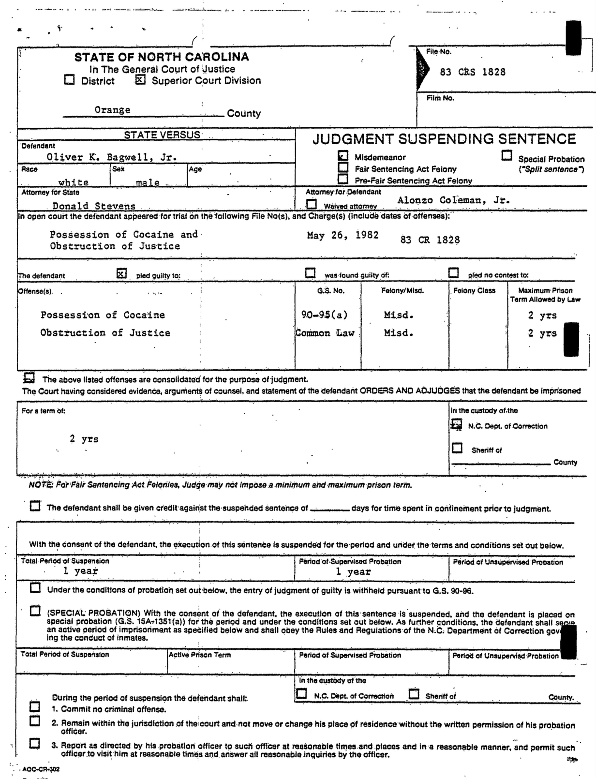
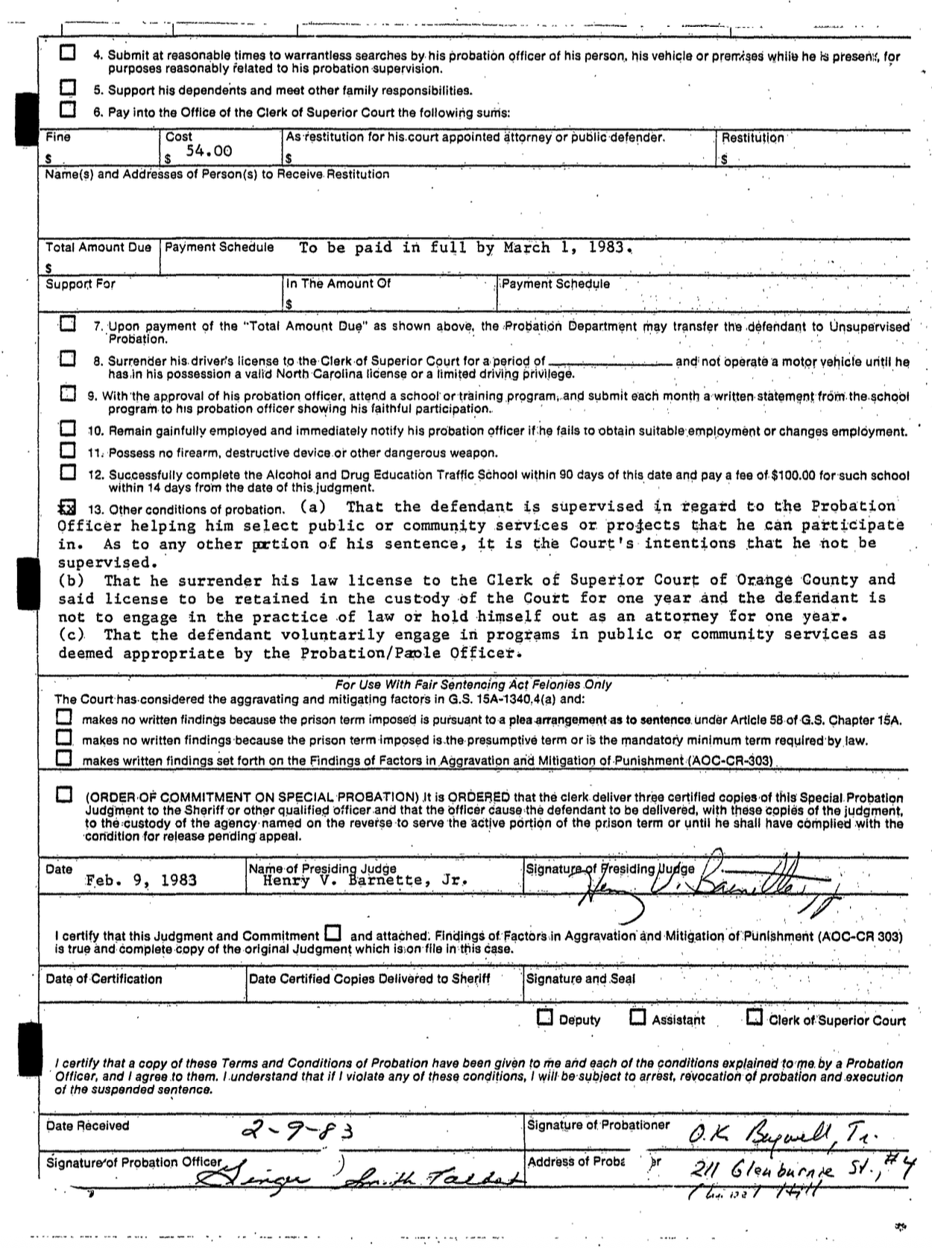
pdf.apply_ocr(‘surya’)
pdf.apply_ocr(‘easyocr’)
pdf.apply_ocr(model=’Qwen/Qwen3-VL-2B-Instruct’)
pdf.apply_ocr()
pdf.apply_ocr(‘rapidocr’)
pdf.apply_ocr(client=client, model=’gemini-2.5-flash’)

Slide 26
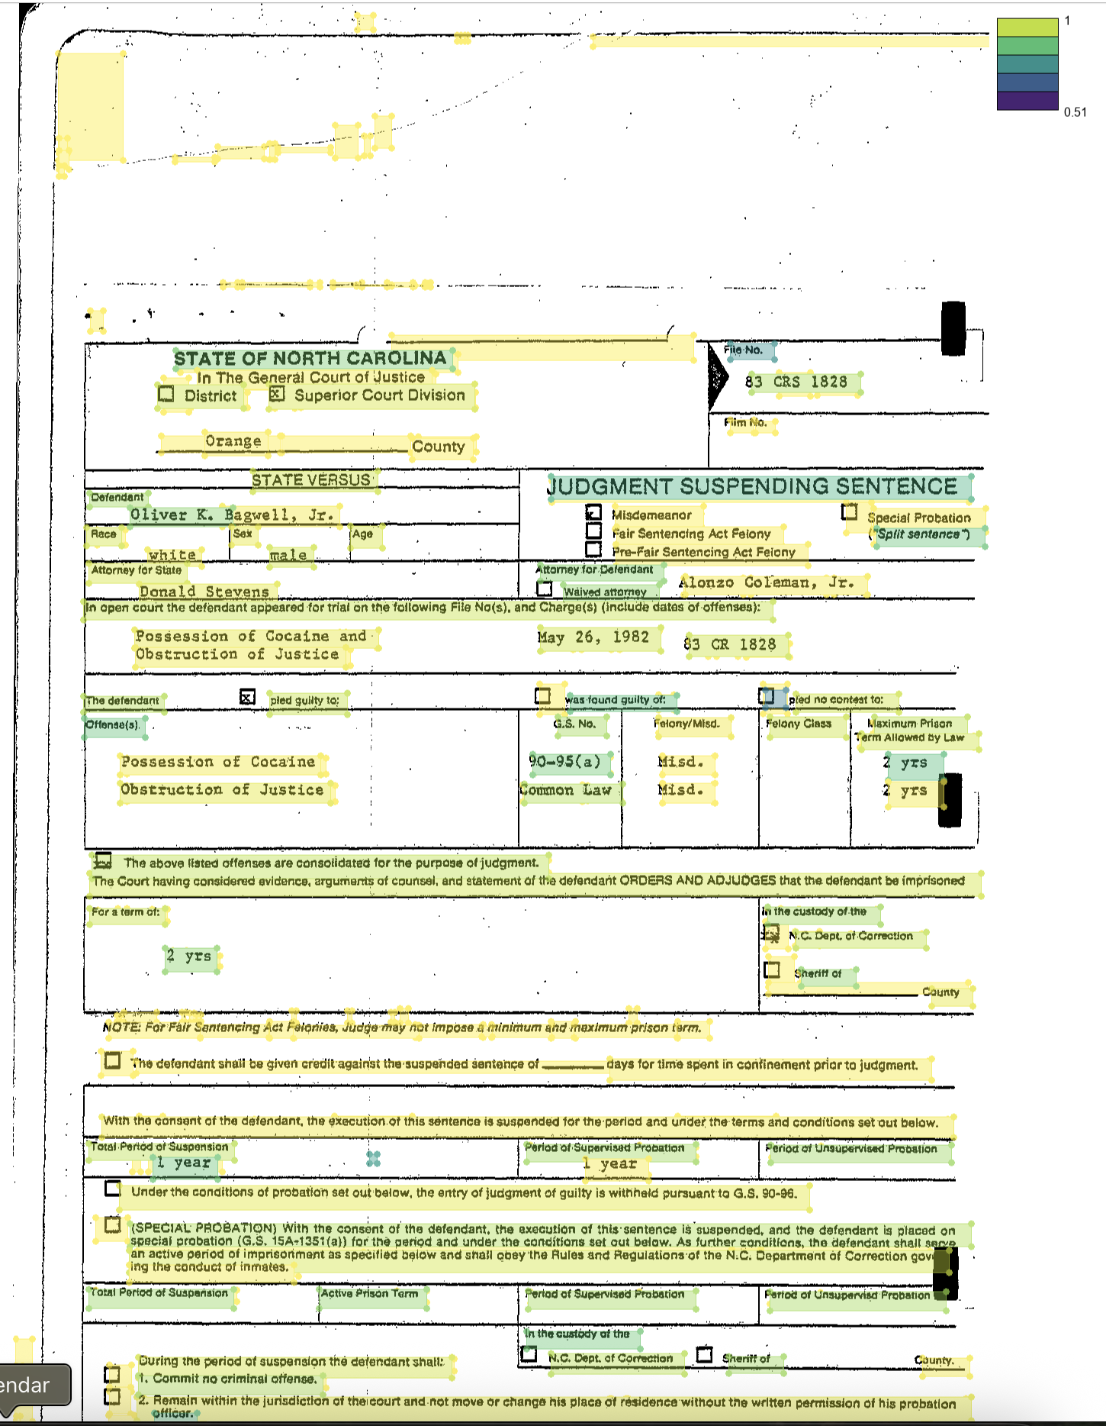
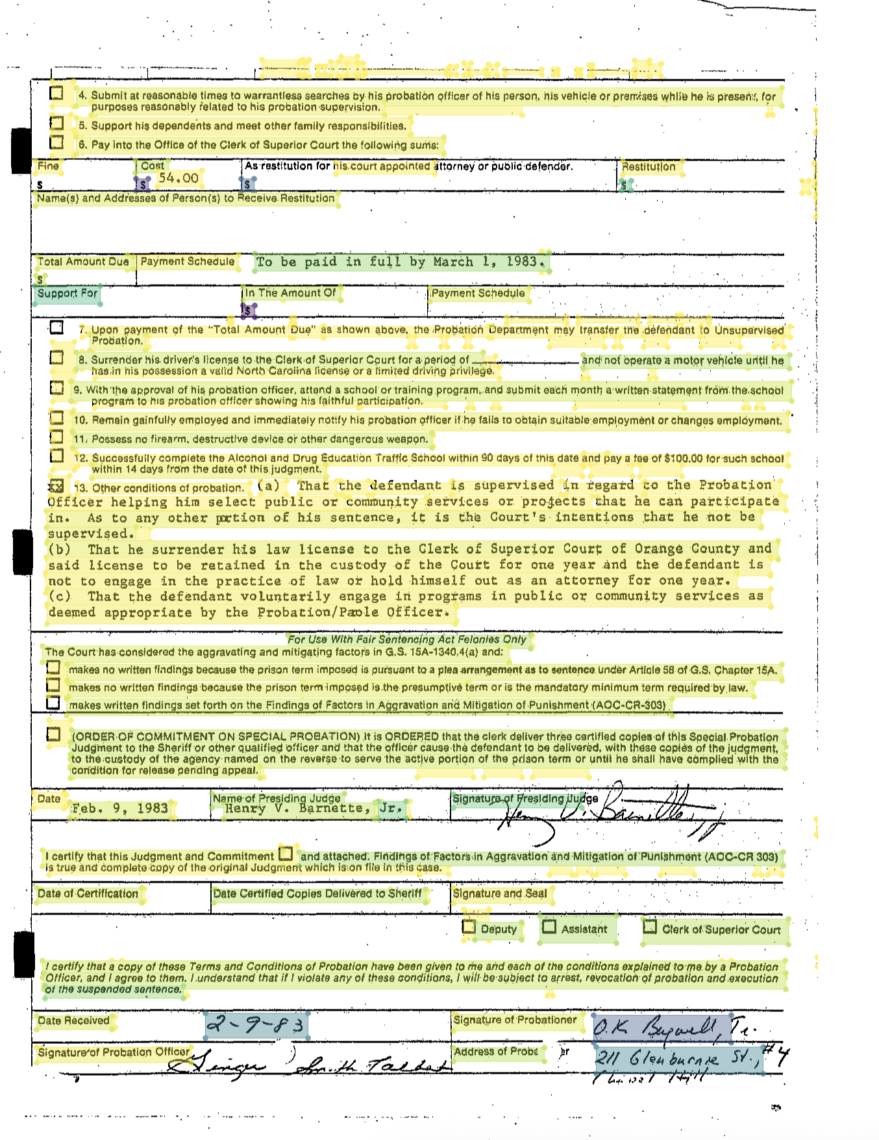
pdf
.find_all('text')
.show(group_by='confidence', cols=2)

Slide 27
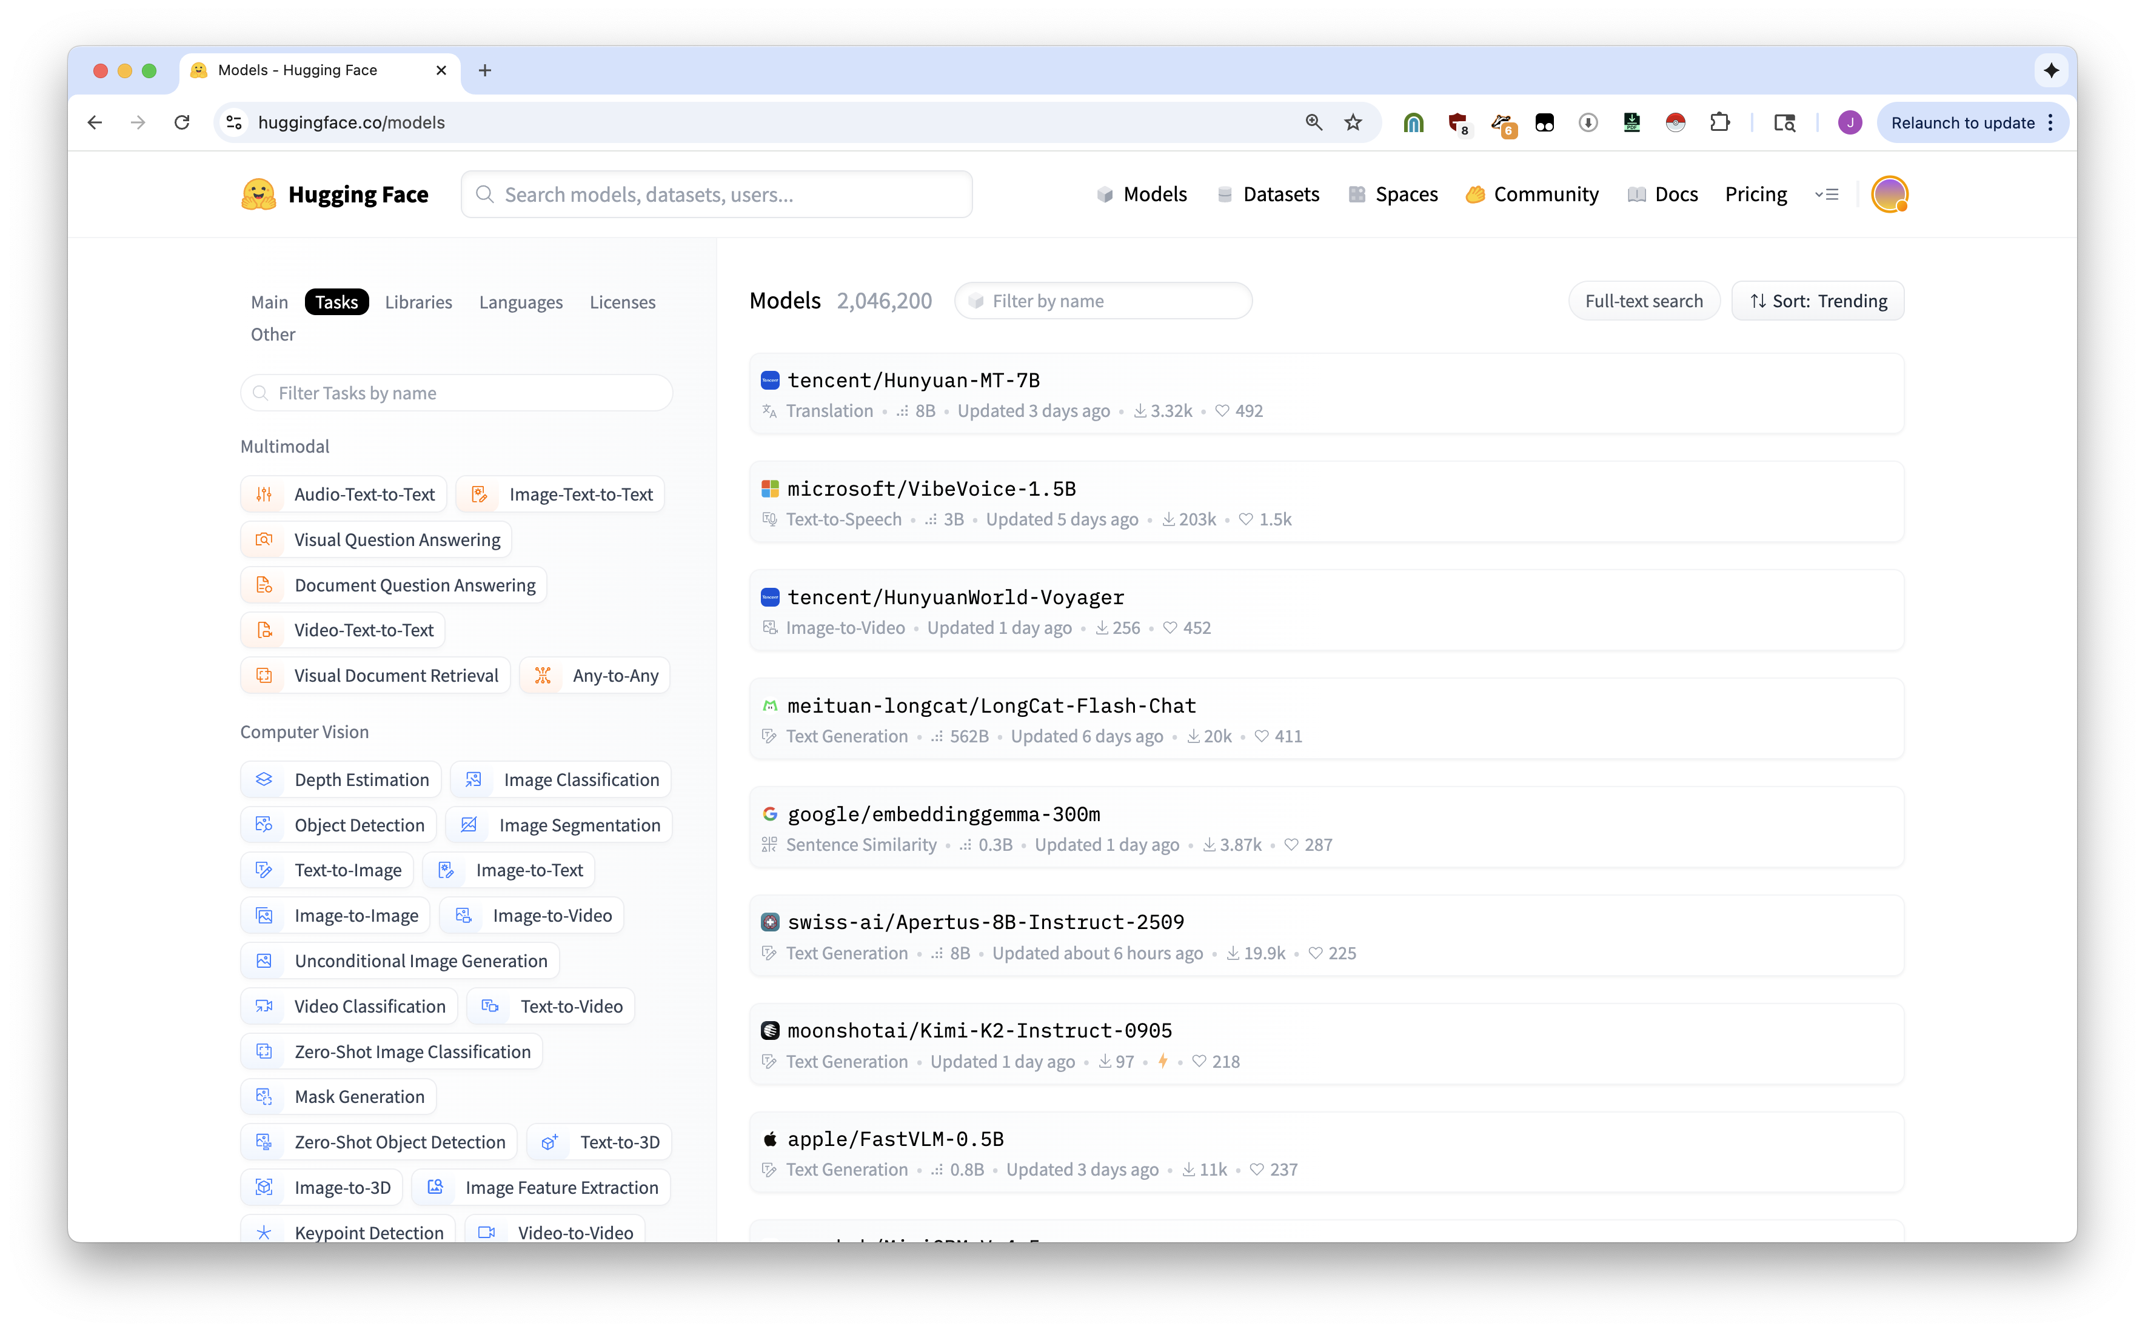

Workshop materials are at https://bit.ly/natural-pdf
Workshop materials are at https://bit.ly/natural-pdf
every battery included

Slide 28
Workshop materials are at https://bit.ly/natural-pdf
.extract LLM q&a
.classify text or vision classification
.apply_ocr various flavors of image-to-text
.judge custom region classifiers
.correct_ocr traditional LLMs
.analyze_layout document layout analysis

Slide 29
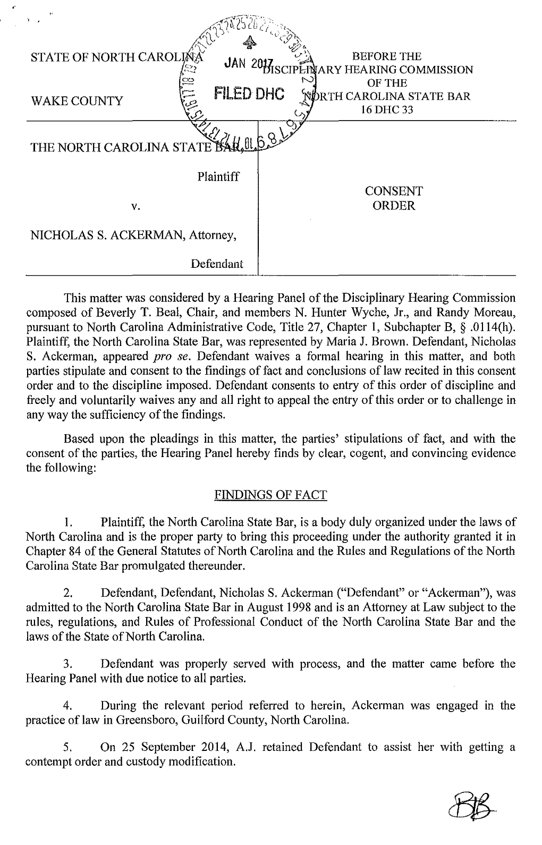
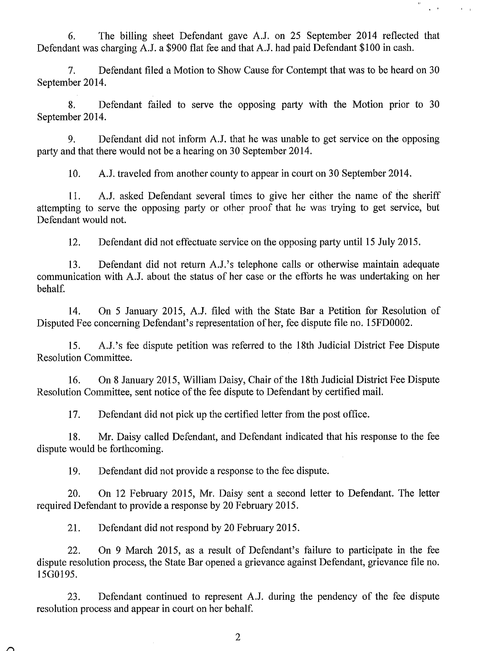
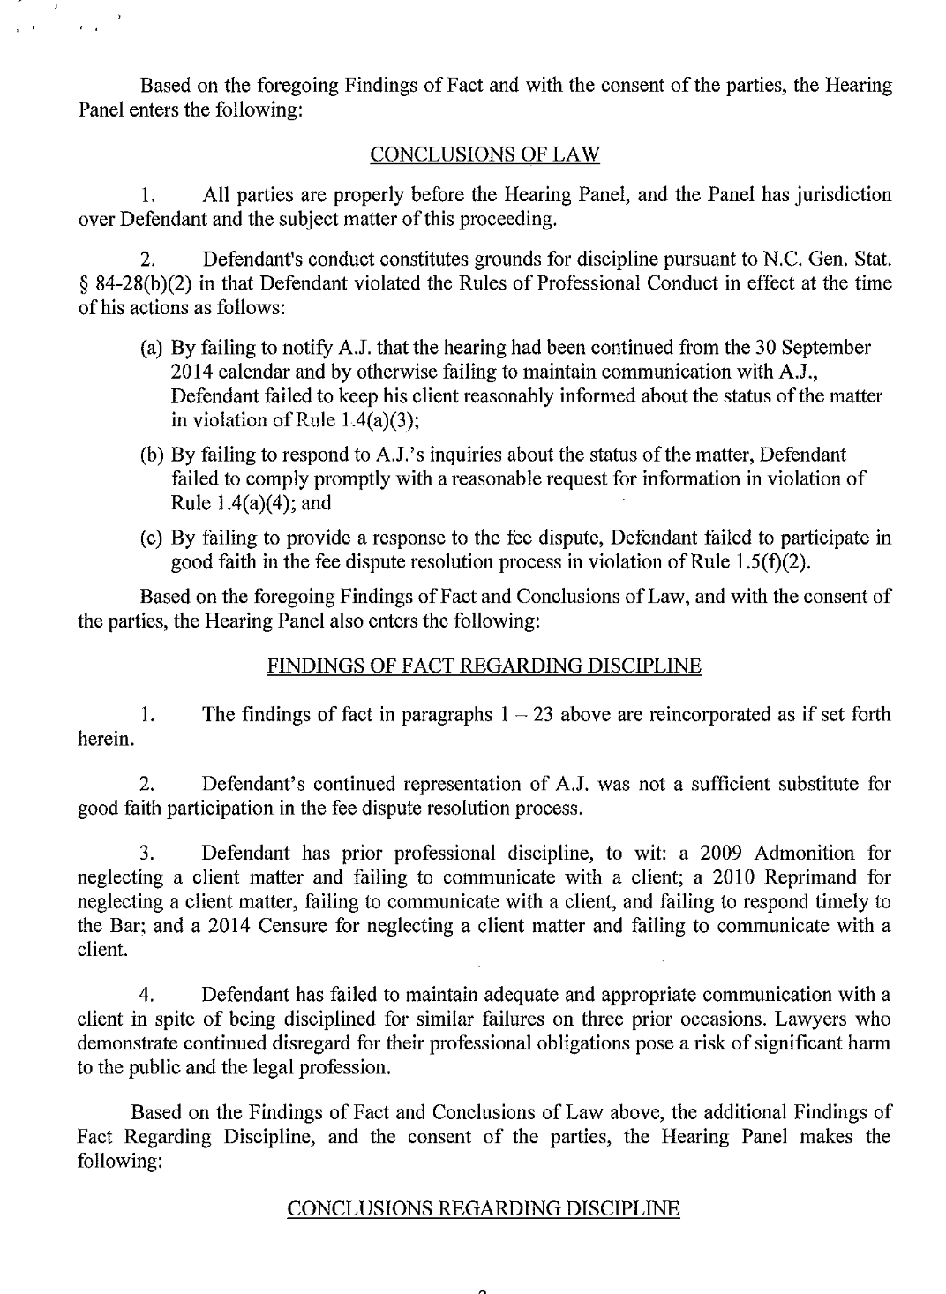
Plaintiff?
Defendant?
Charges?
Penalty?

Slide 30
pdf.extract(
["Plaintiff", "Defendant", “Charges”,
"City of practice", "Penalty"],
client=client,
model="gemini-2.5-flash-lite",
citations=True
)
{
'Plaintiff': 'The North Carolina State Bar',
'Defendant': 'Nicholas S. Ackerman',
'Charges': 'Failure to keep client reasonably informed about the status of the matter; Failure to comply promptly with a reasonable request for information; Failure to participate in good faith in the fee dispute resolution process',
'City_of_practice': 'Greensboro',
'Penalty': 'Suspension of license for one (1) year, stayed for two (2) years as long as Defendant complies with specified conditions.'
}

Slide 31
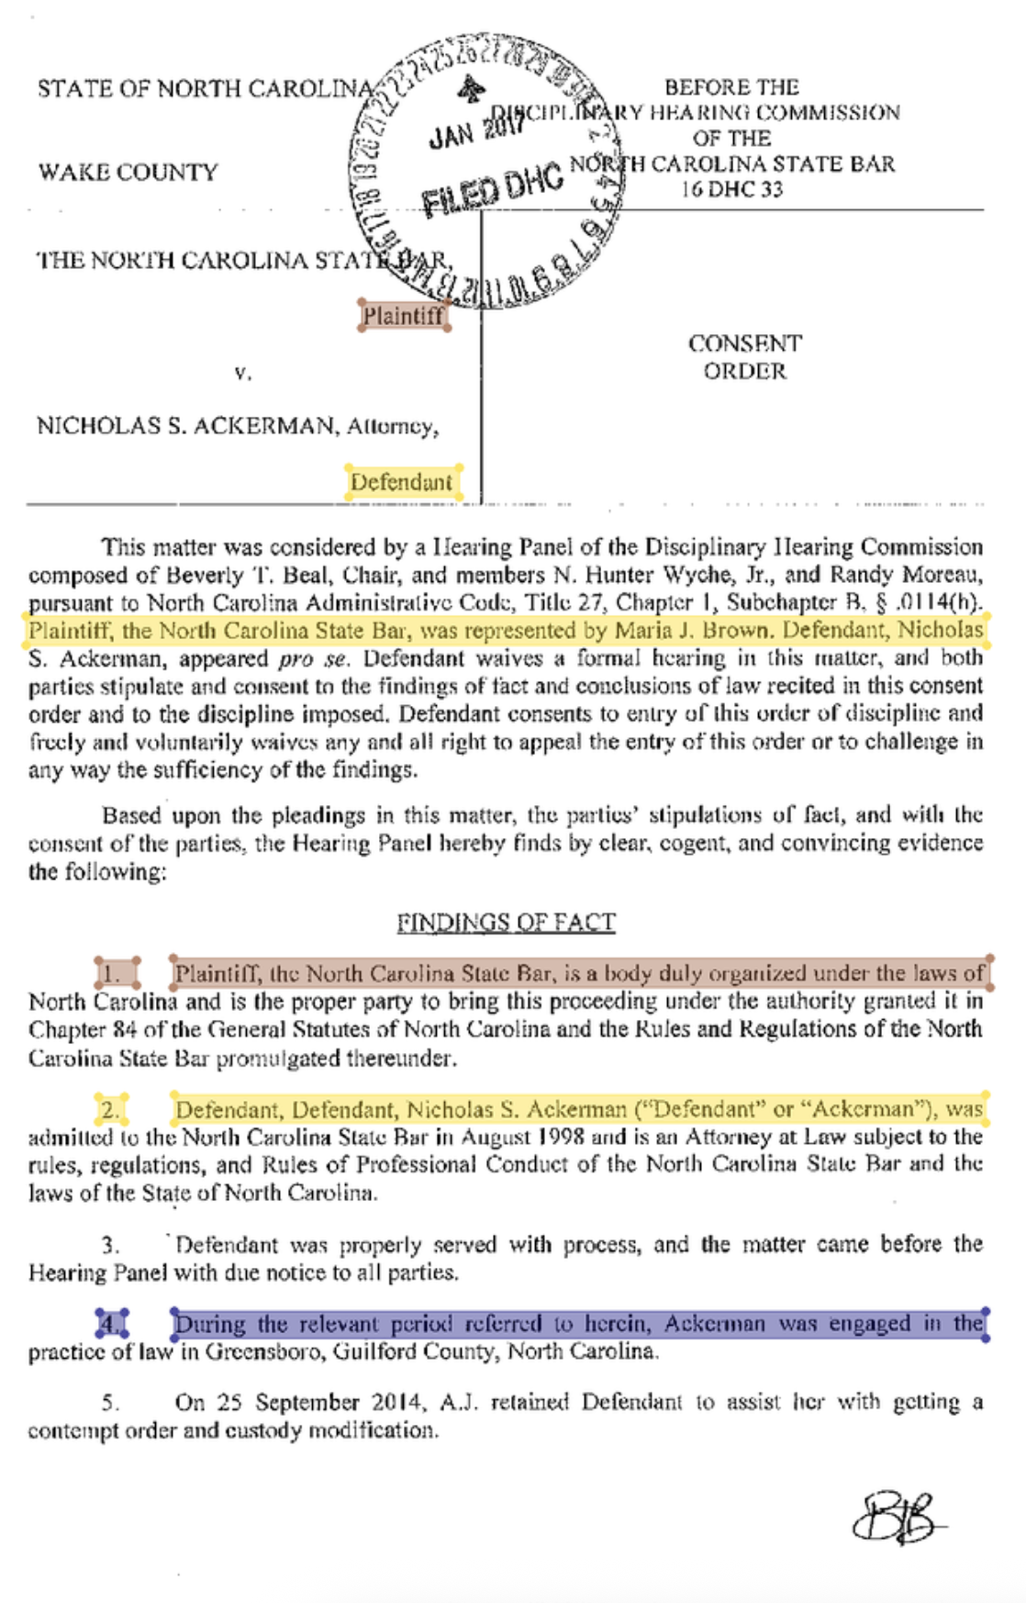
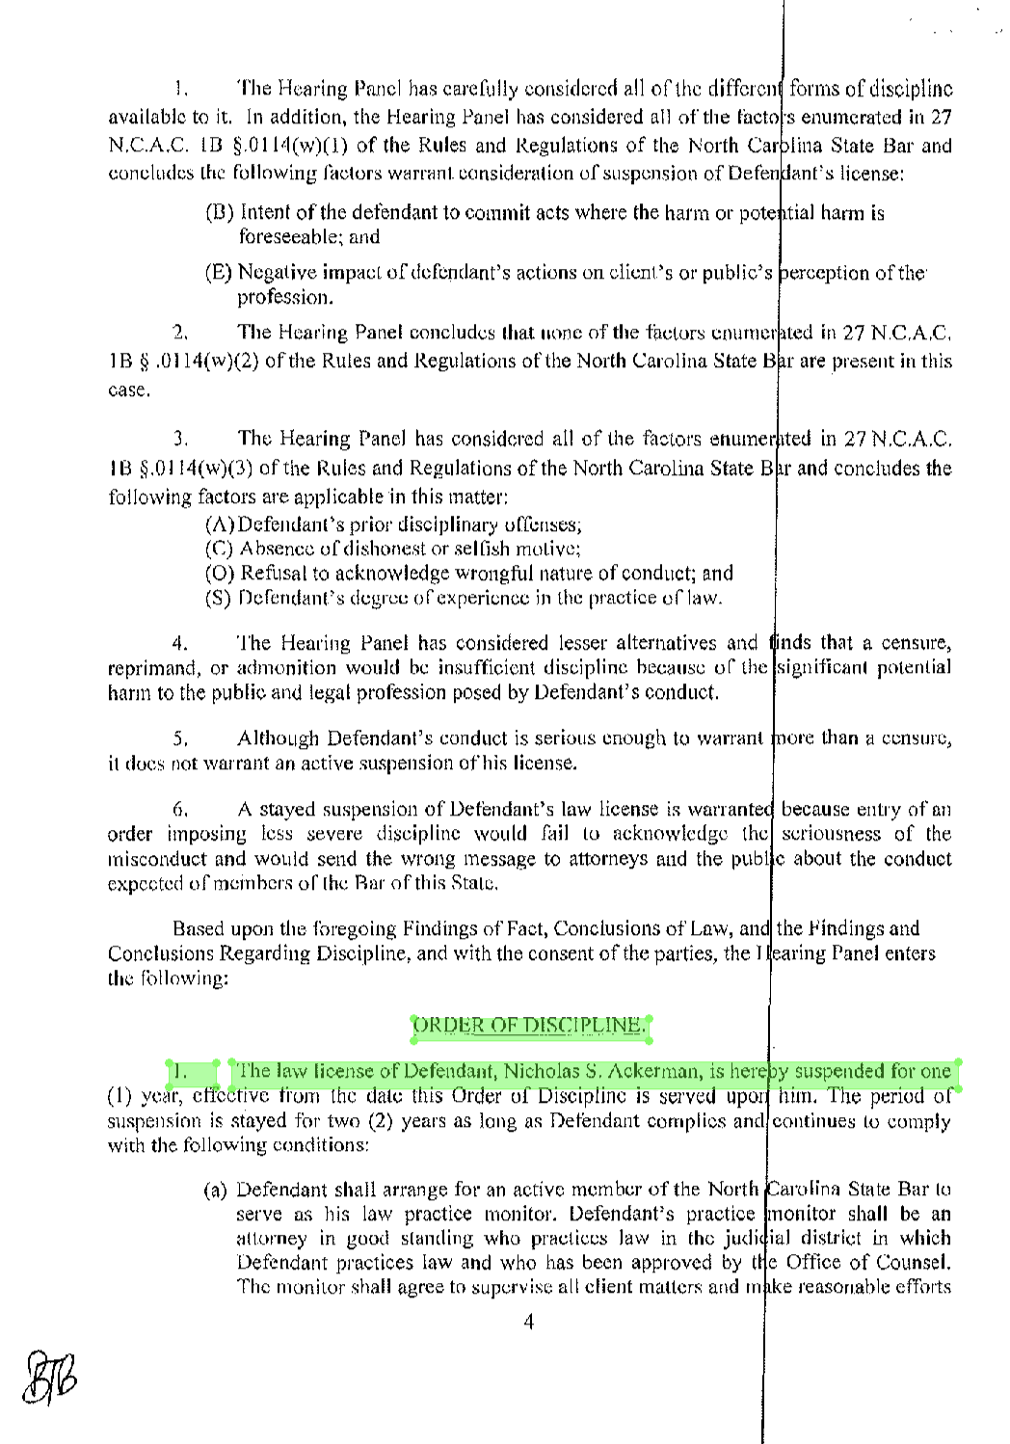
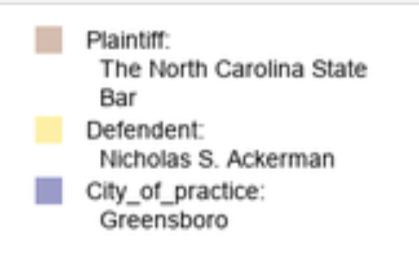
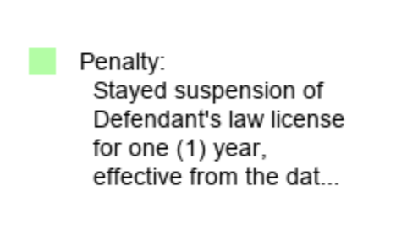
results.show()
results.save_pdf(“output.pdf”)

Slide 32
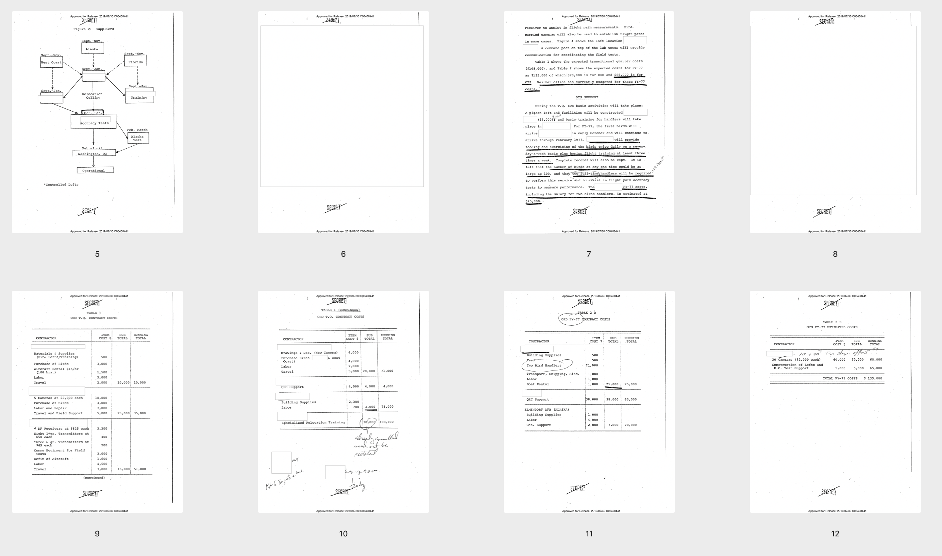
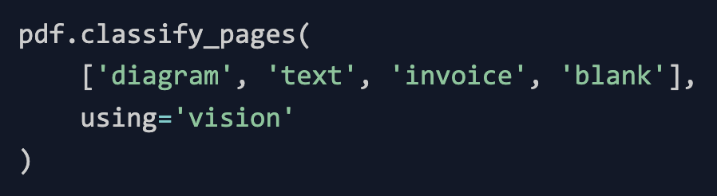
diagram
blank
text
blank
invoice
invoice
invoice
invoice

Slide 33
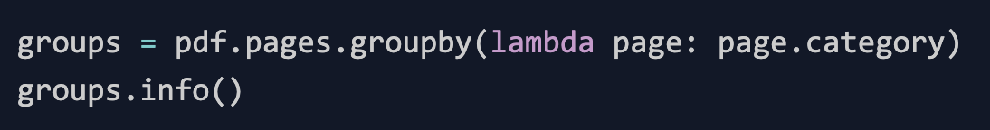
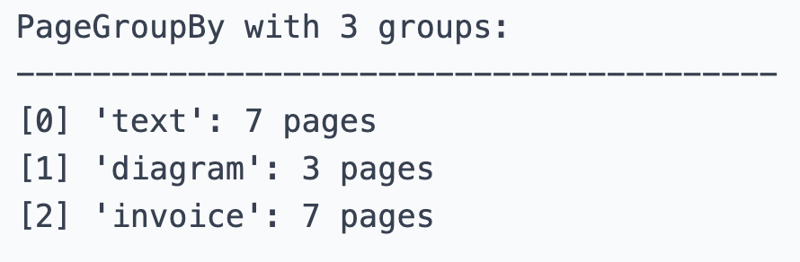
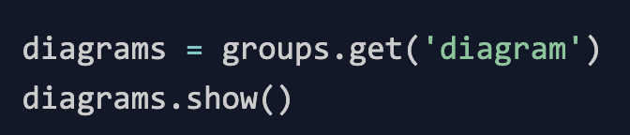
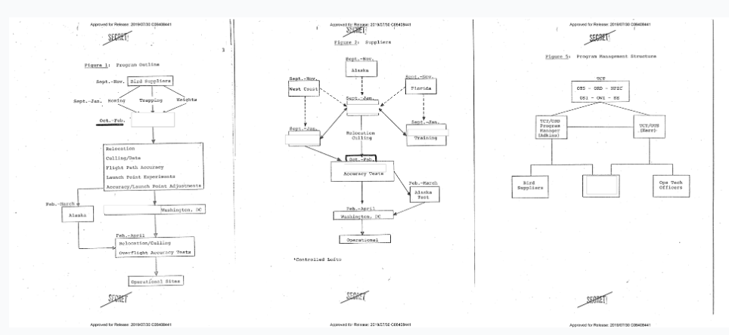



Slide 34
Workshop materials are at https://bit.ly/natural-pdf
Magical, modern PDF processing with Natural PDF
Jonathan Soma
Knight Chair in Data Journalism
Columbia University
js4571@columbia.edu / @dangerscarf

