Slide 1
Stress-Testing AI:
How to Evaluate Whether Your AI Tools Are Working
Jonathan Soma
js4571@columbia.edu @dangerscarf
Columbia University

Slide 2
Two definitions of “working”
Serving a true user need vs the tech is working
Example:
  “We made an AI chatbot to answer questions about elections”
  Does the reader want to engage with it? Not for today!
  Does it give accurate responses? This is our session!

Slide 3
Fear not, failure is normal
Every failure just becomes one more thing to test for
Don’t cry because it failed, smile because it happened :/
The stakes are lower than you think, I swear, every newsroom has screwed up
But you do have an obligation to not screw up!

Slide 4
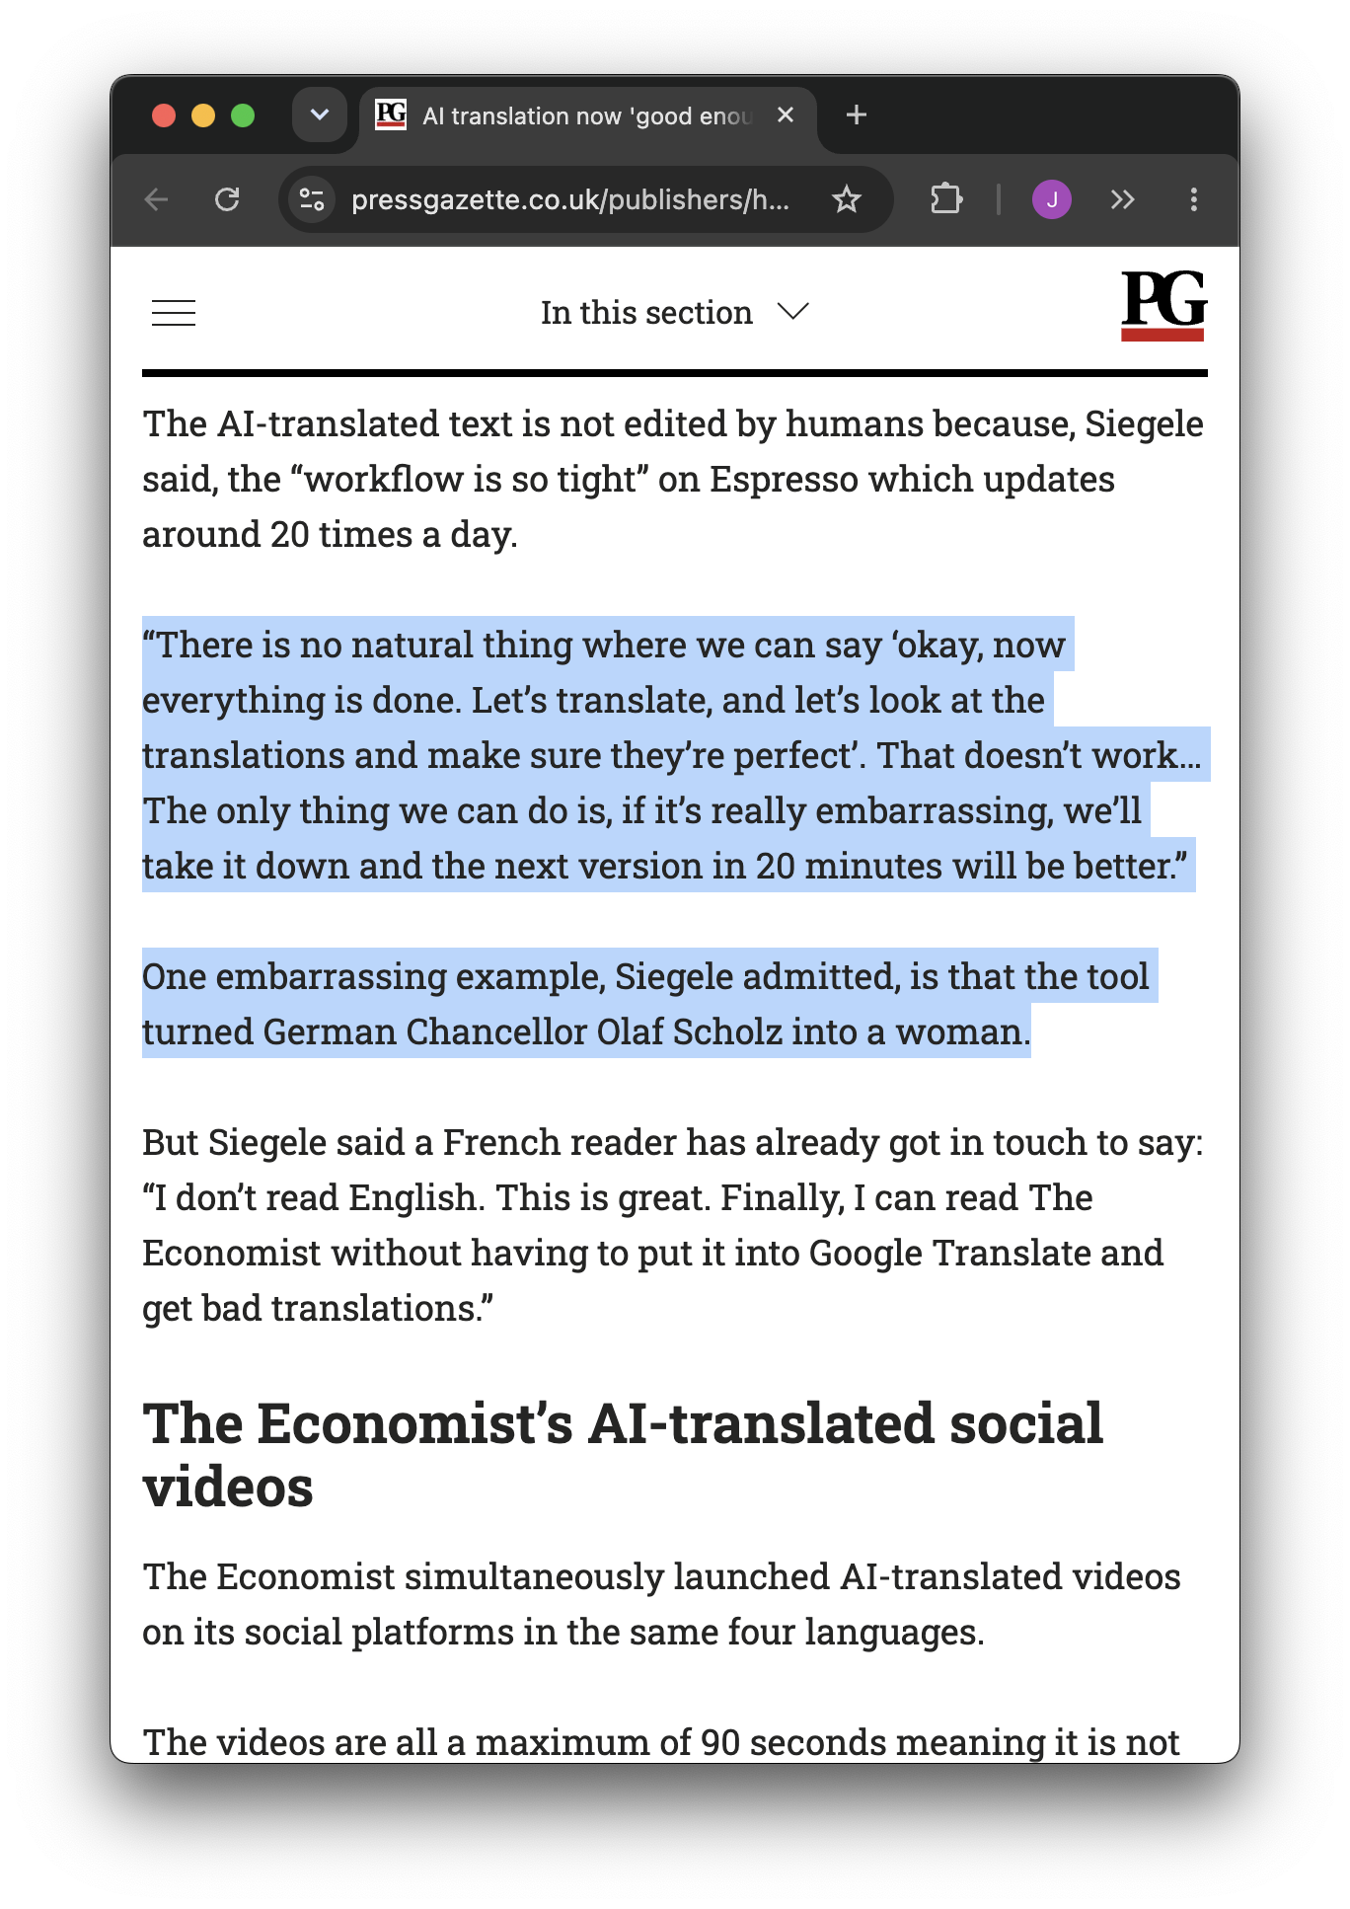

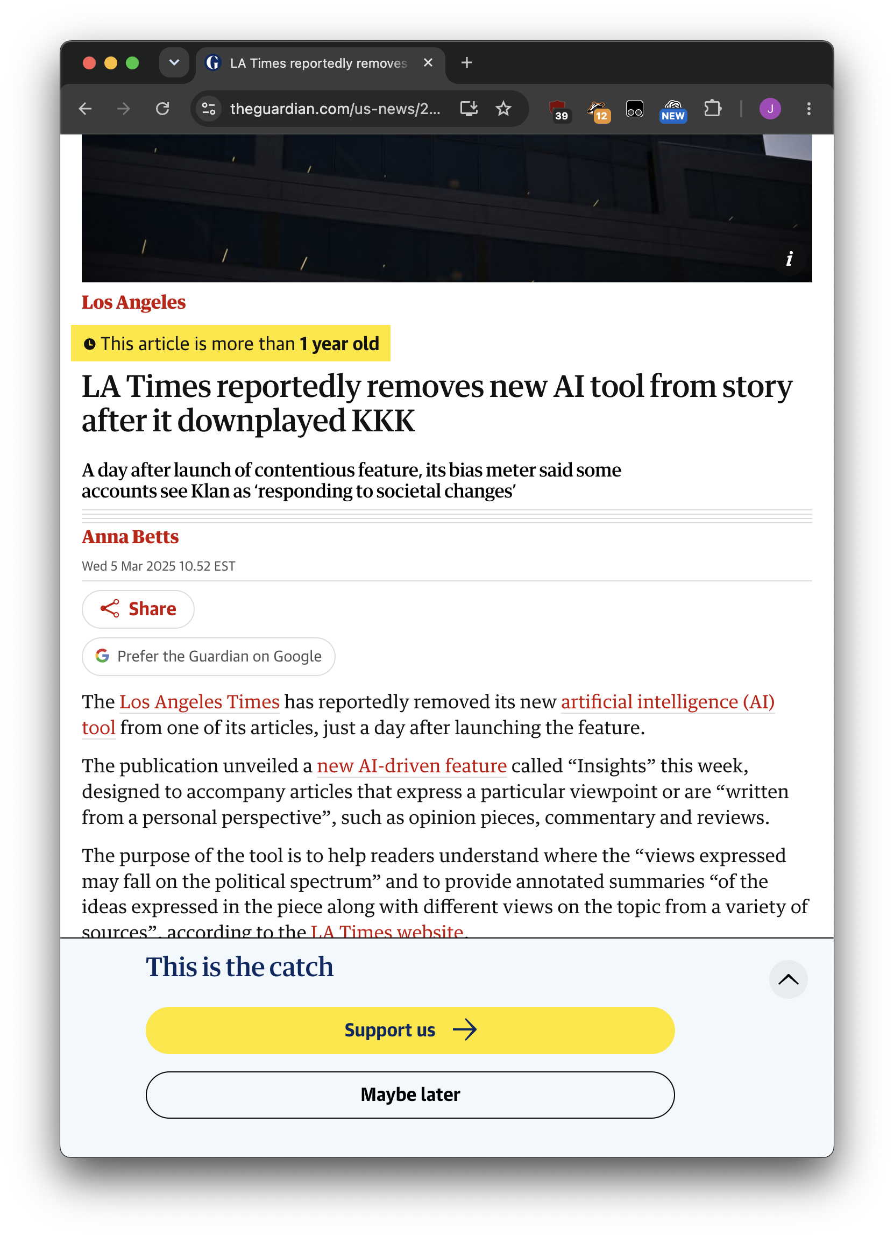
they all still exist!!!!!

Slide 5
What we are doing today
Getting to the point of evals
Checking the outputs of your AI
Checking the process inside of your AI
What the tools look like, existing and bespoke
Minimizing cost while maximizing performance
And finally: a couple case studies

Slide 6
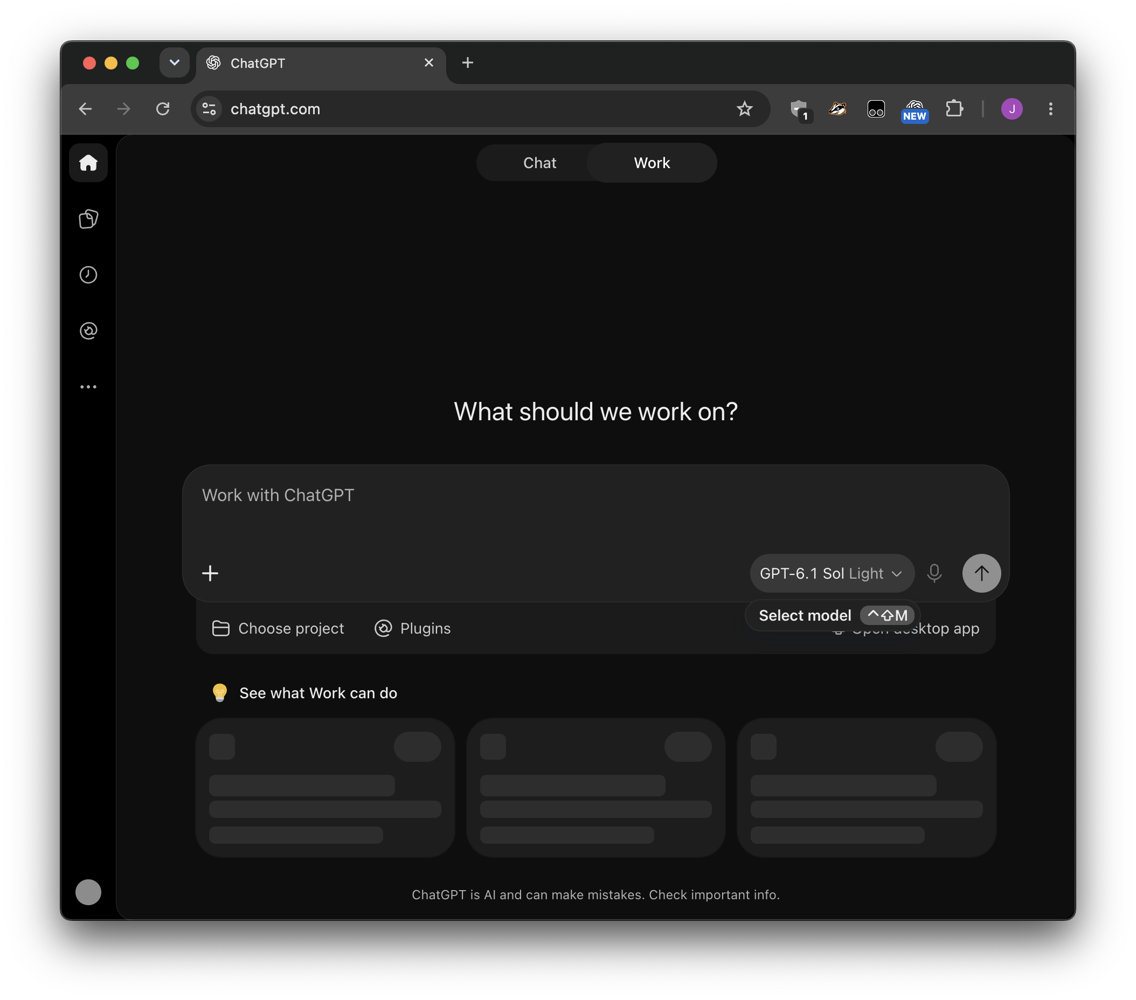
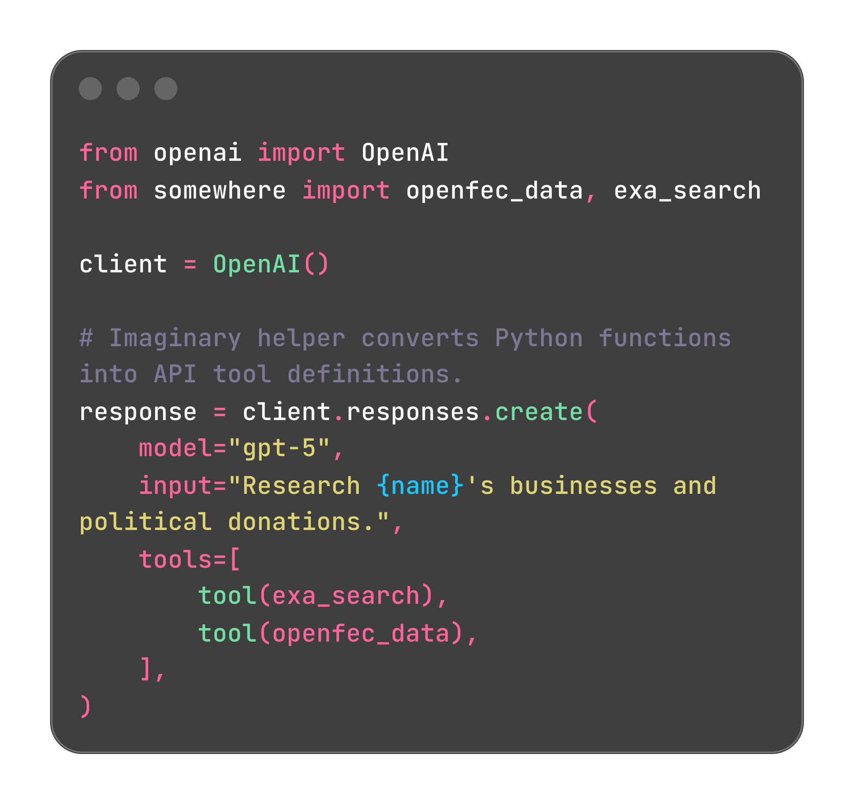

Notes:
Who here does ChatGPT vs who codes (even vibe codes)
Web vs code: you can see more of what happens ‘inside’ with code
We’ll address both, same concepts, they just live in different places

Slide 7
Our example use case
We’ll look at each step through the lens of a simple research agent that delivers a report.
  Web research
  Tool use
  Presentation
At the end we’ll look at a simpler newsletter summarizer and an “ask our archives” chatbot

Slide 8
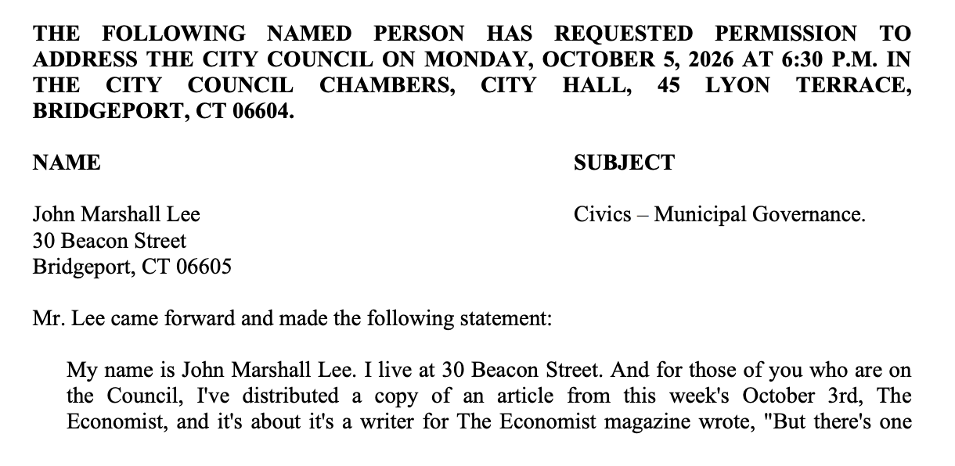
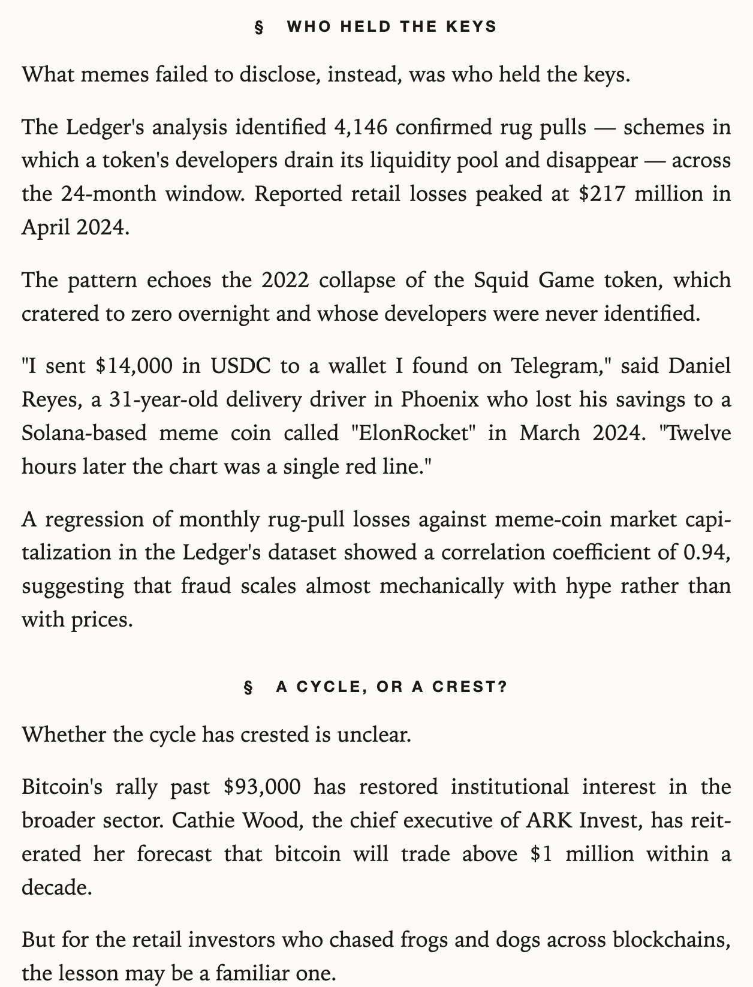
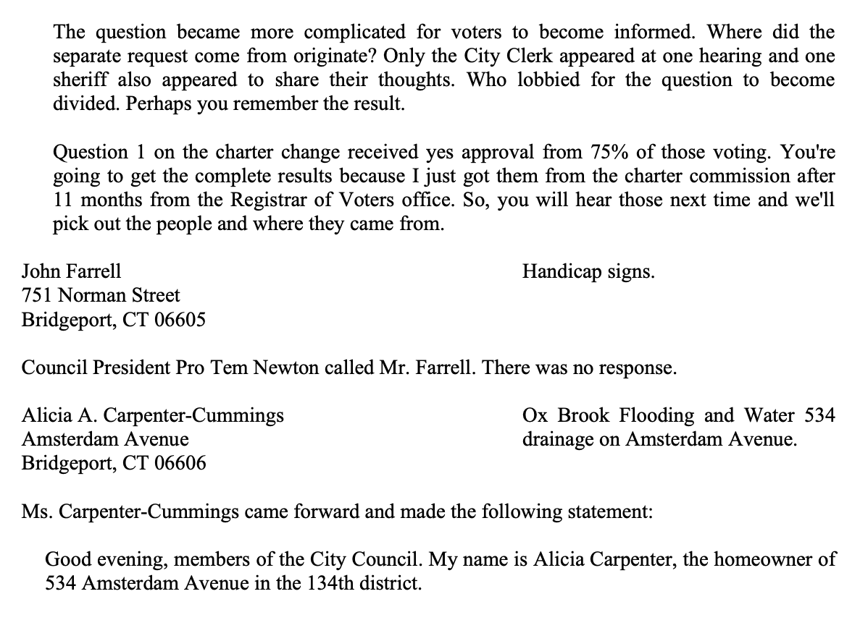





Slide 9
STEP ONE:
Get to a good place

Slide 10









prompt
agent
tools/skills
FEC data
Google Sheets
web search

Slide 11
“Look this person up and find a little summary about them and grab their LinkedIn and details on any campaign contributions: {name}”

Slide 12
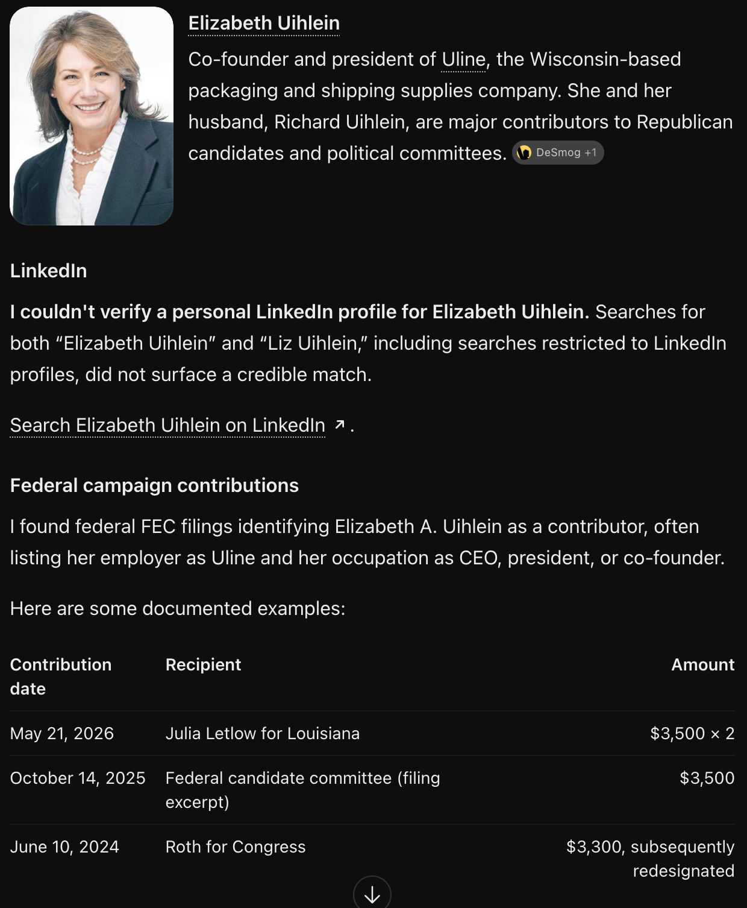
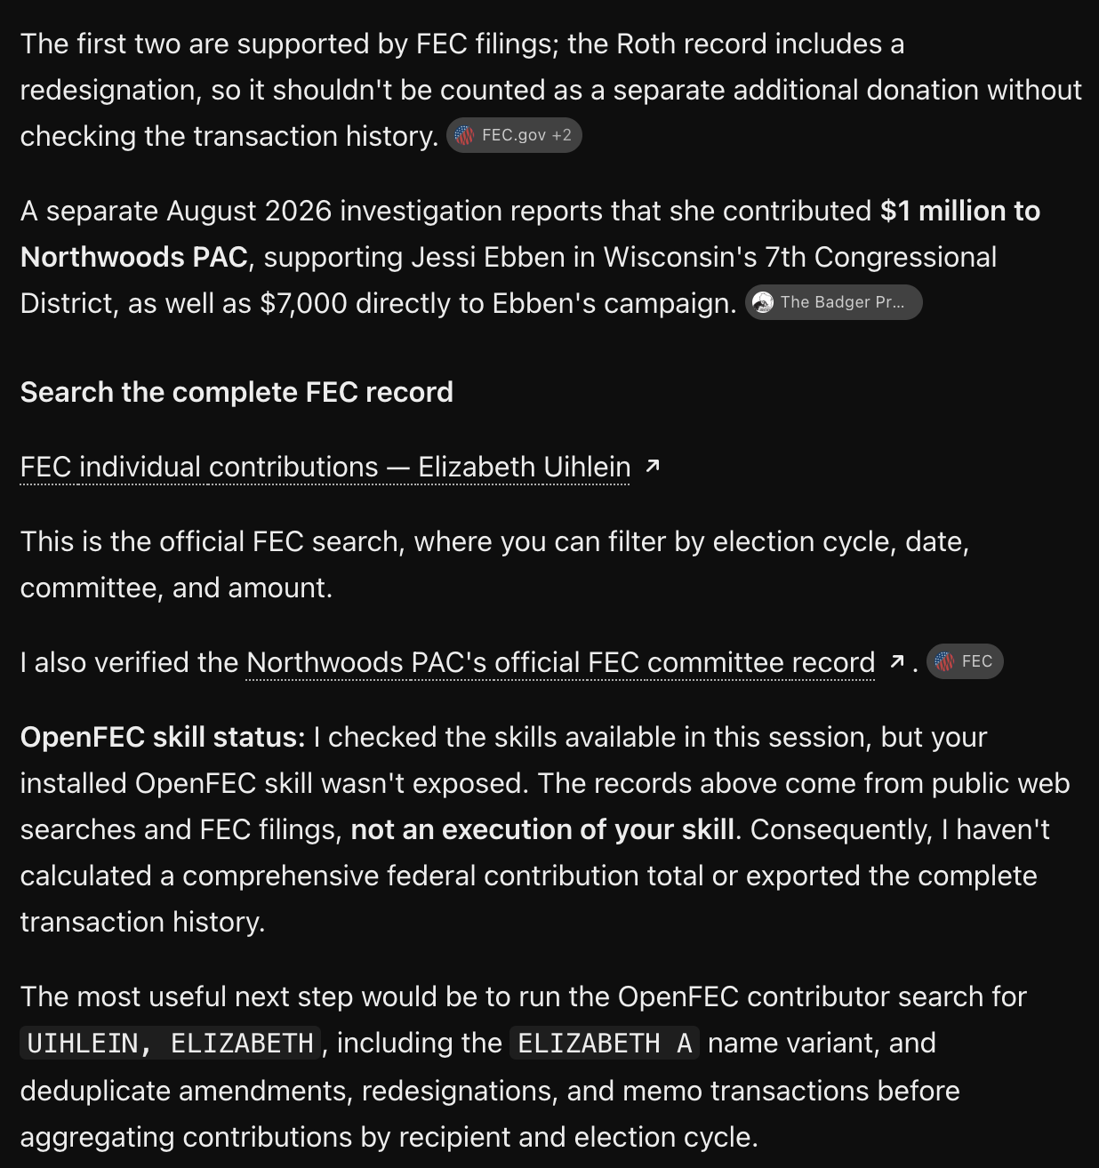



Slide 13
No!!!! Anecdotes are not data
We’re done! Great job, everyone!

Slide 14
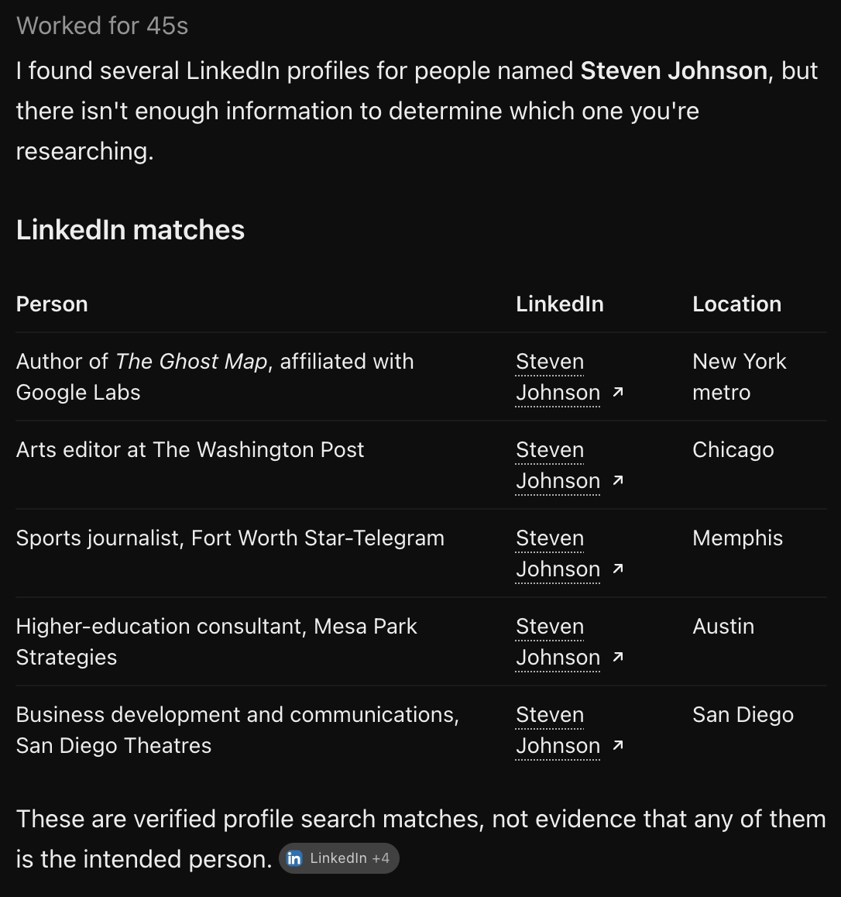
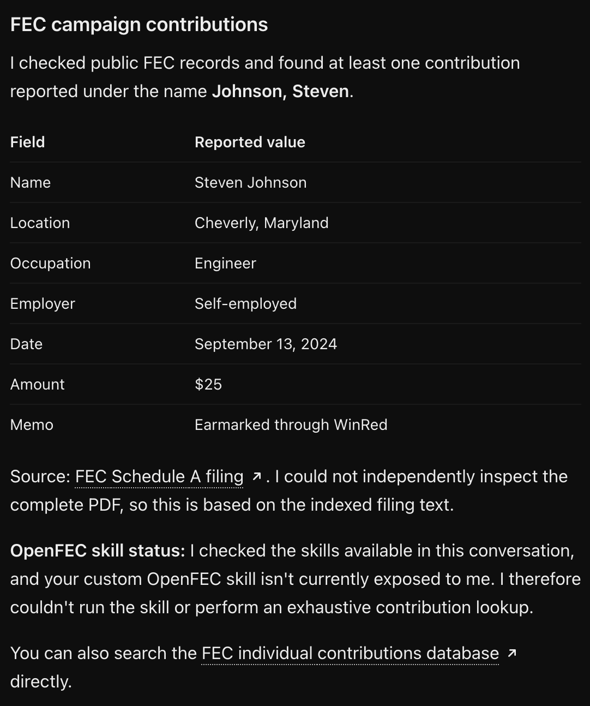
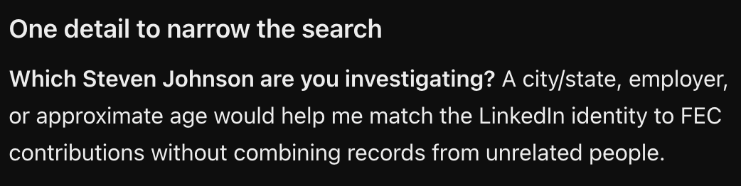



Slide 15

“With this name and partial address, look this person up and find a little summary about them and grab their LinkedIn and details on any campaign contributions: {name} {address}”

Slide 16
STEP TWO:
Make it structured

Slide 17
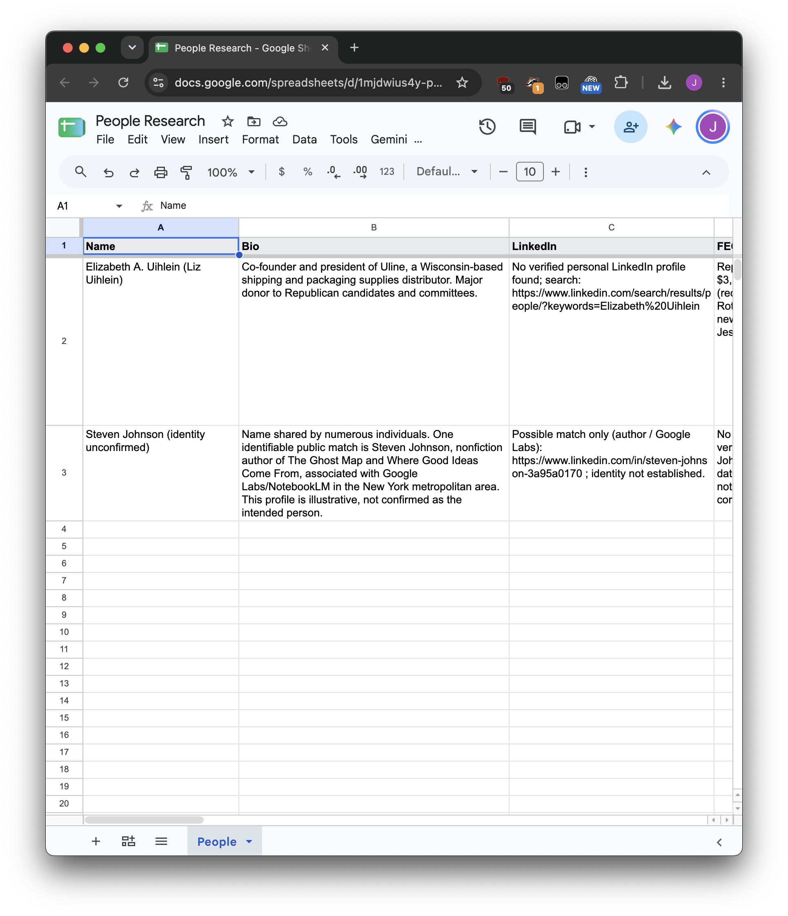




Slide 18

prompt
agent
tools/skills
FEC data
Google Sheets
web search

Slide 19
Structured places data can live
Spreadsheets, obviously
Emails! One email = one data point
Slack messages! One post = one data point
GitHub! One issue = one data point
Google Docs! One file = one data point

Slide 20
STEP THREE:
Designing your eval

Slide 22
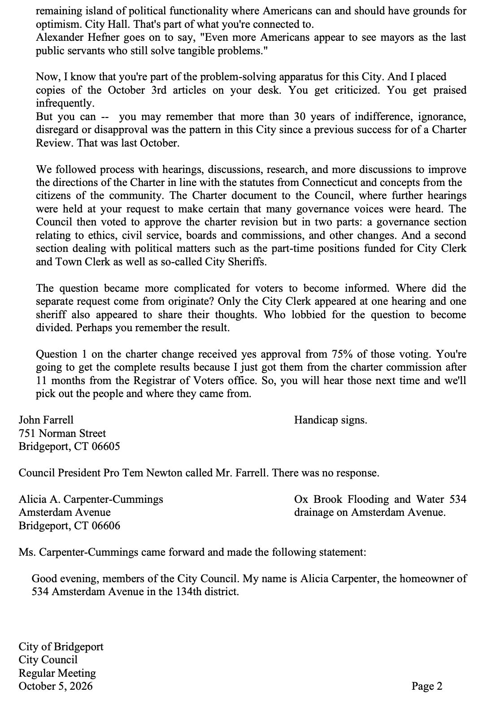
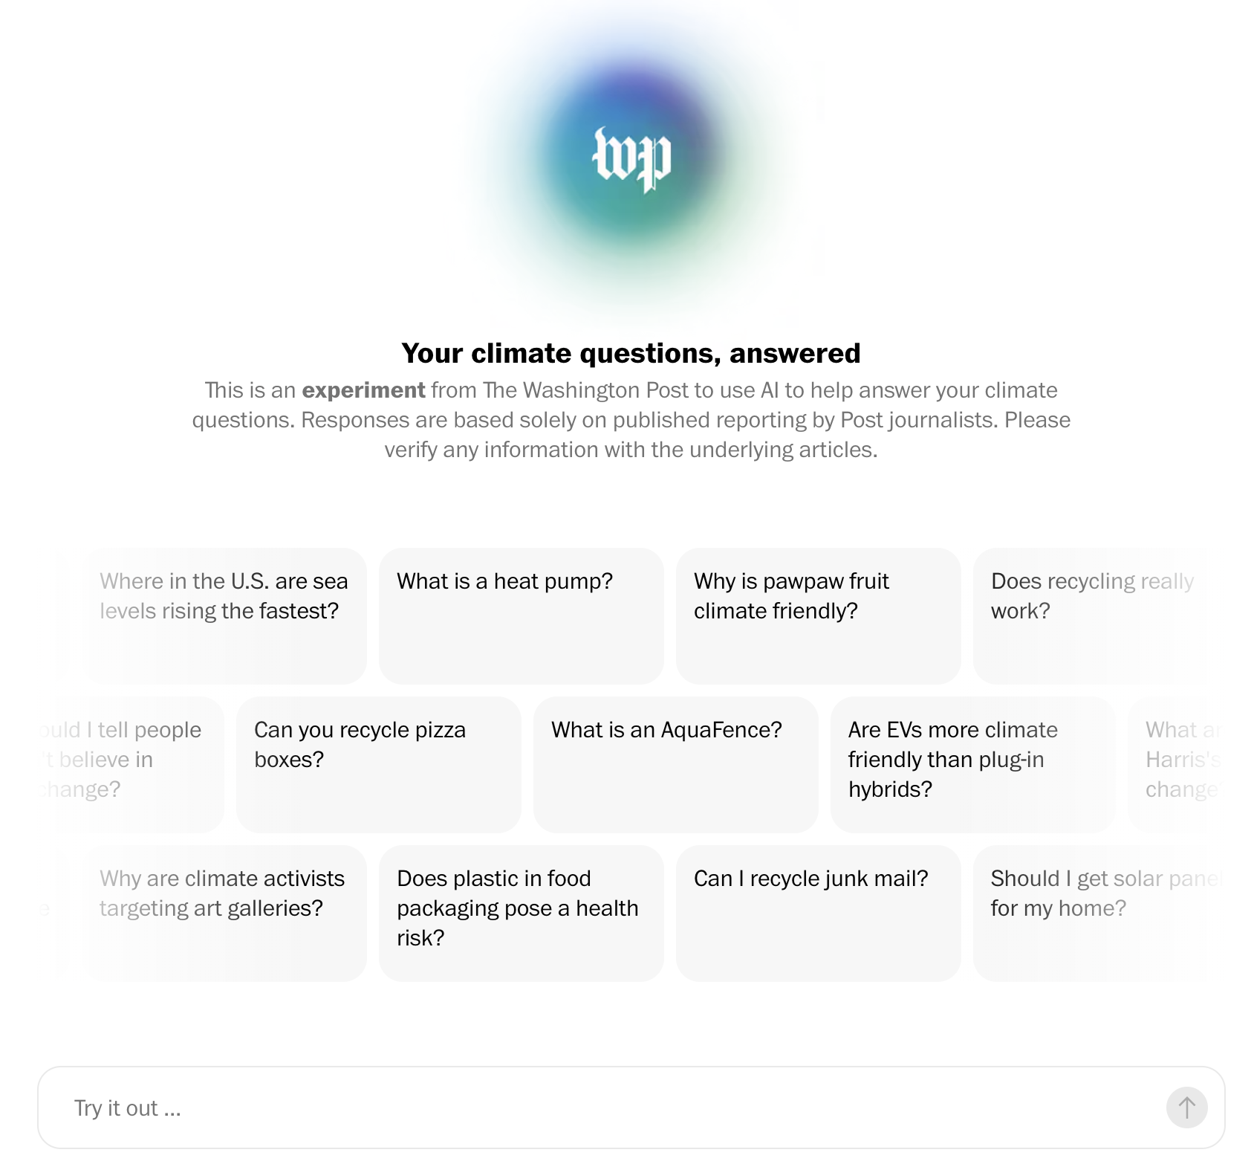
Real data is best!
…but isn’t always possible
I love synthetic data

Slide 23
❌ “Hey ChatGPT, give me 100 sample data points”
How could each person be different easier or more difficult to do research on, or somehow affect the results?
Dimensions of difference: Which aspects have the most variance?
Some options for doing research on people:
  Rarity of name
  Abbreviated name (Elizabeth vs Liz vs Beth)
  Not online vs very online, has LinkedIn vs doesn’t
  Full address vs partial address vs no address
We’re researching real people so synthetic data is much much harder to make because it has to be real people. It’s simpler to fake documents to analyze or reader questions to answer!

Slide 24
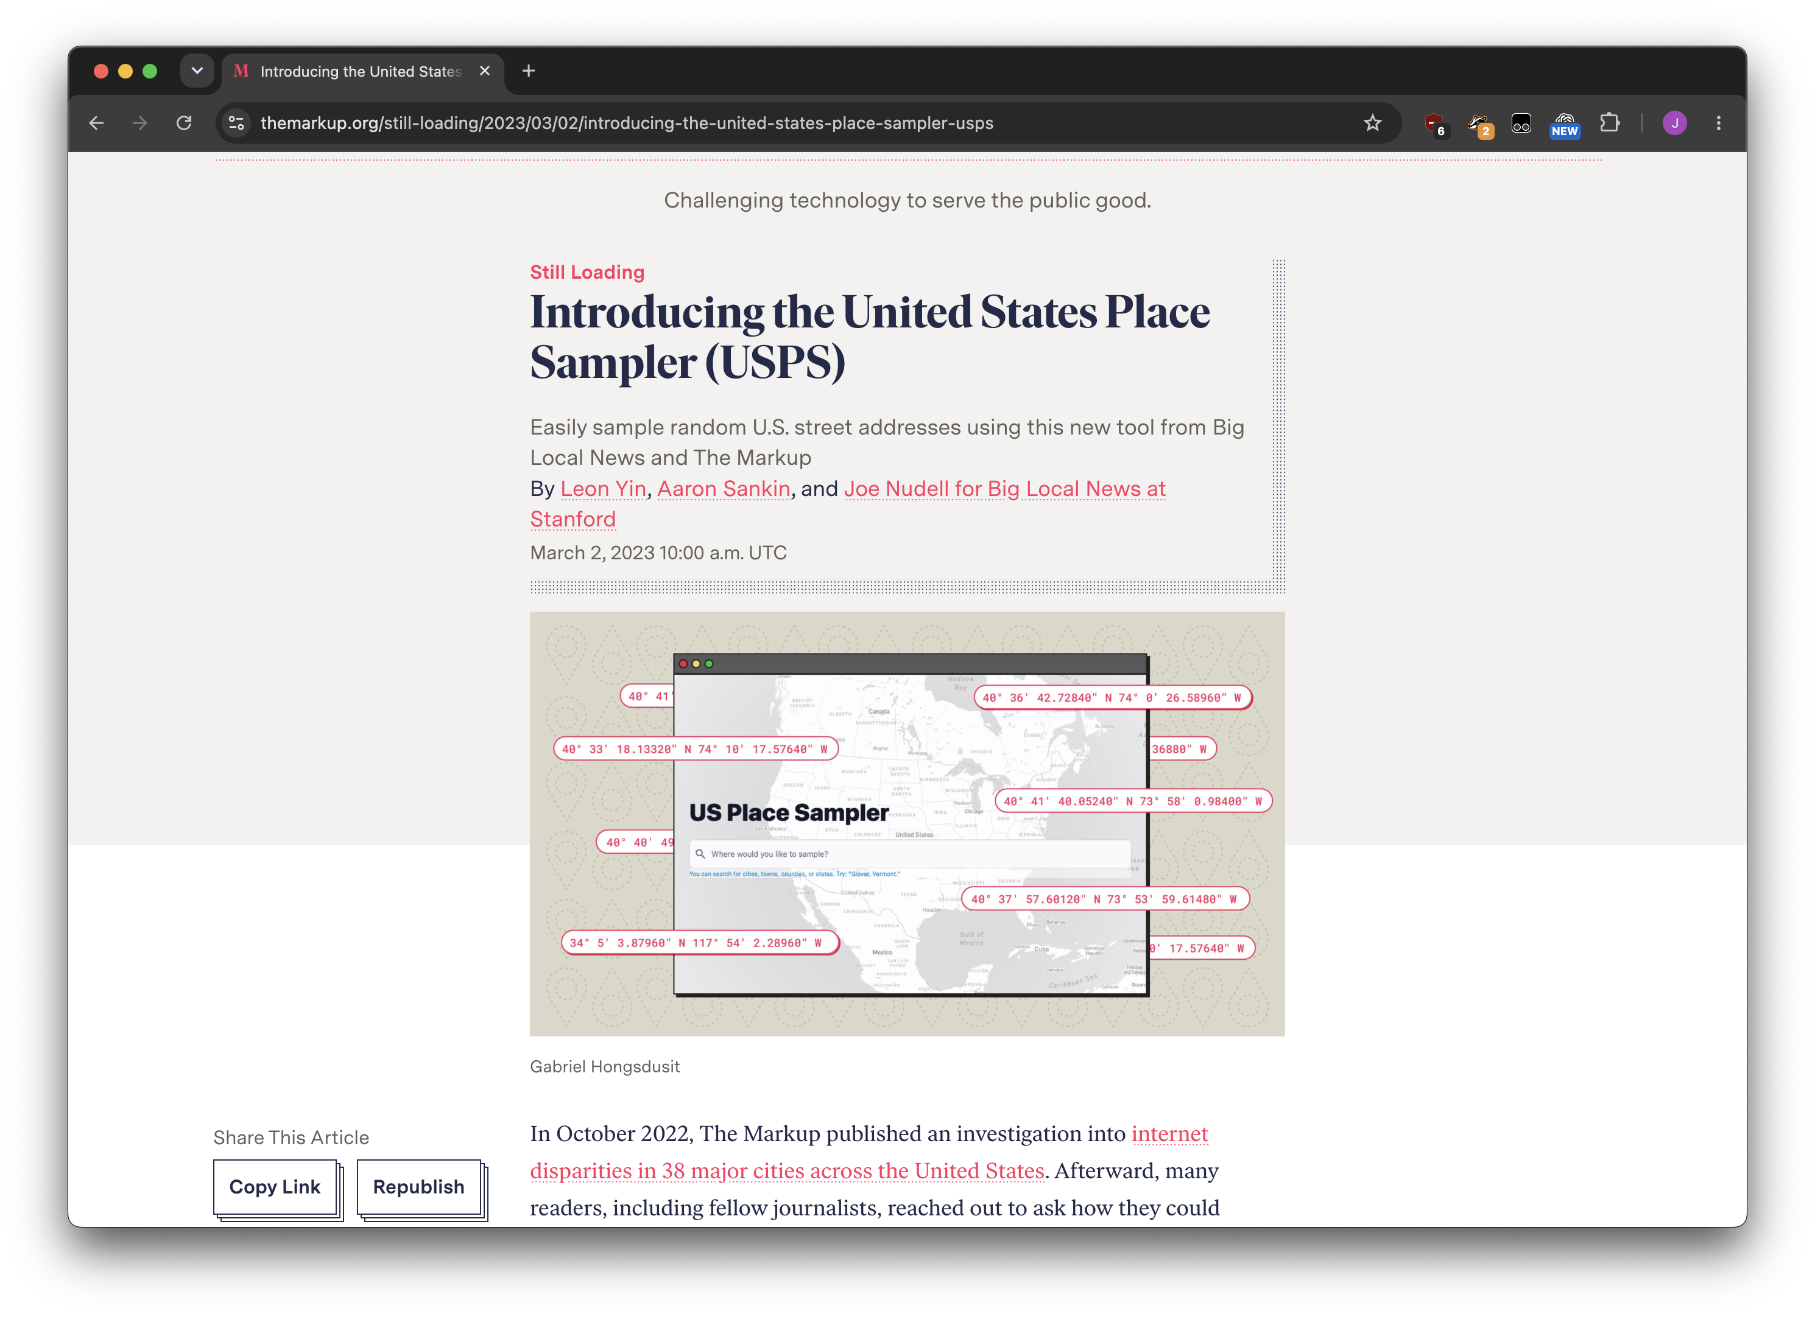
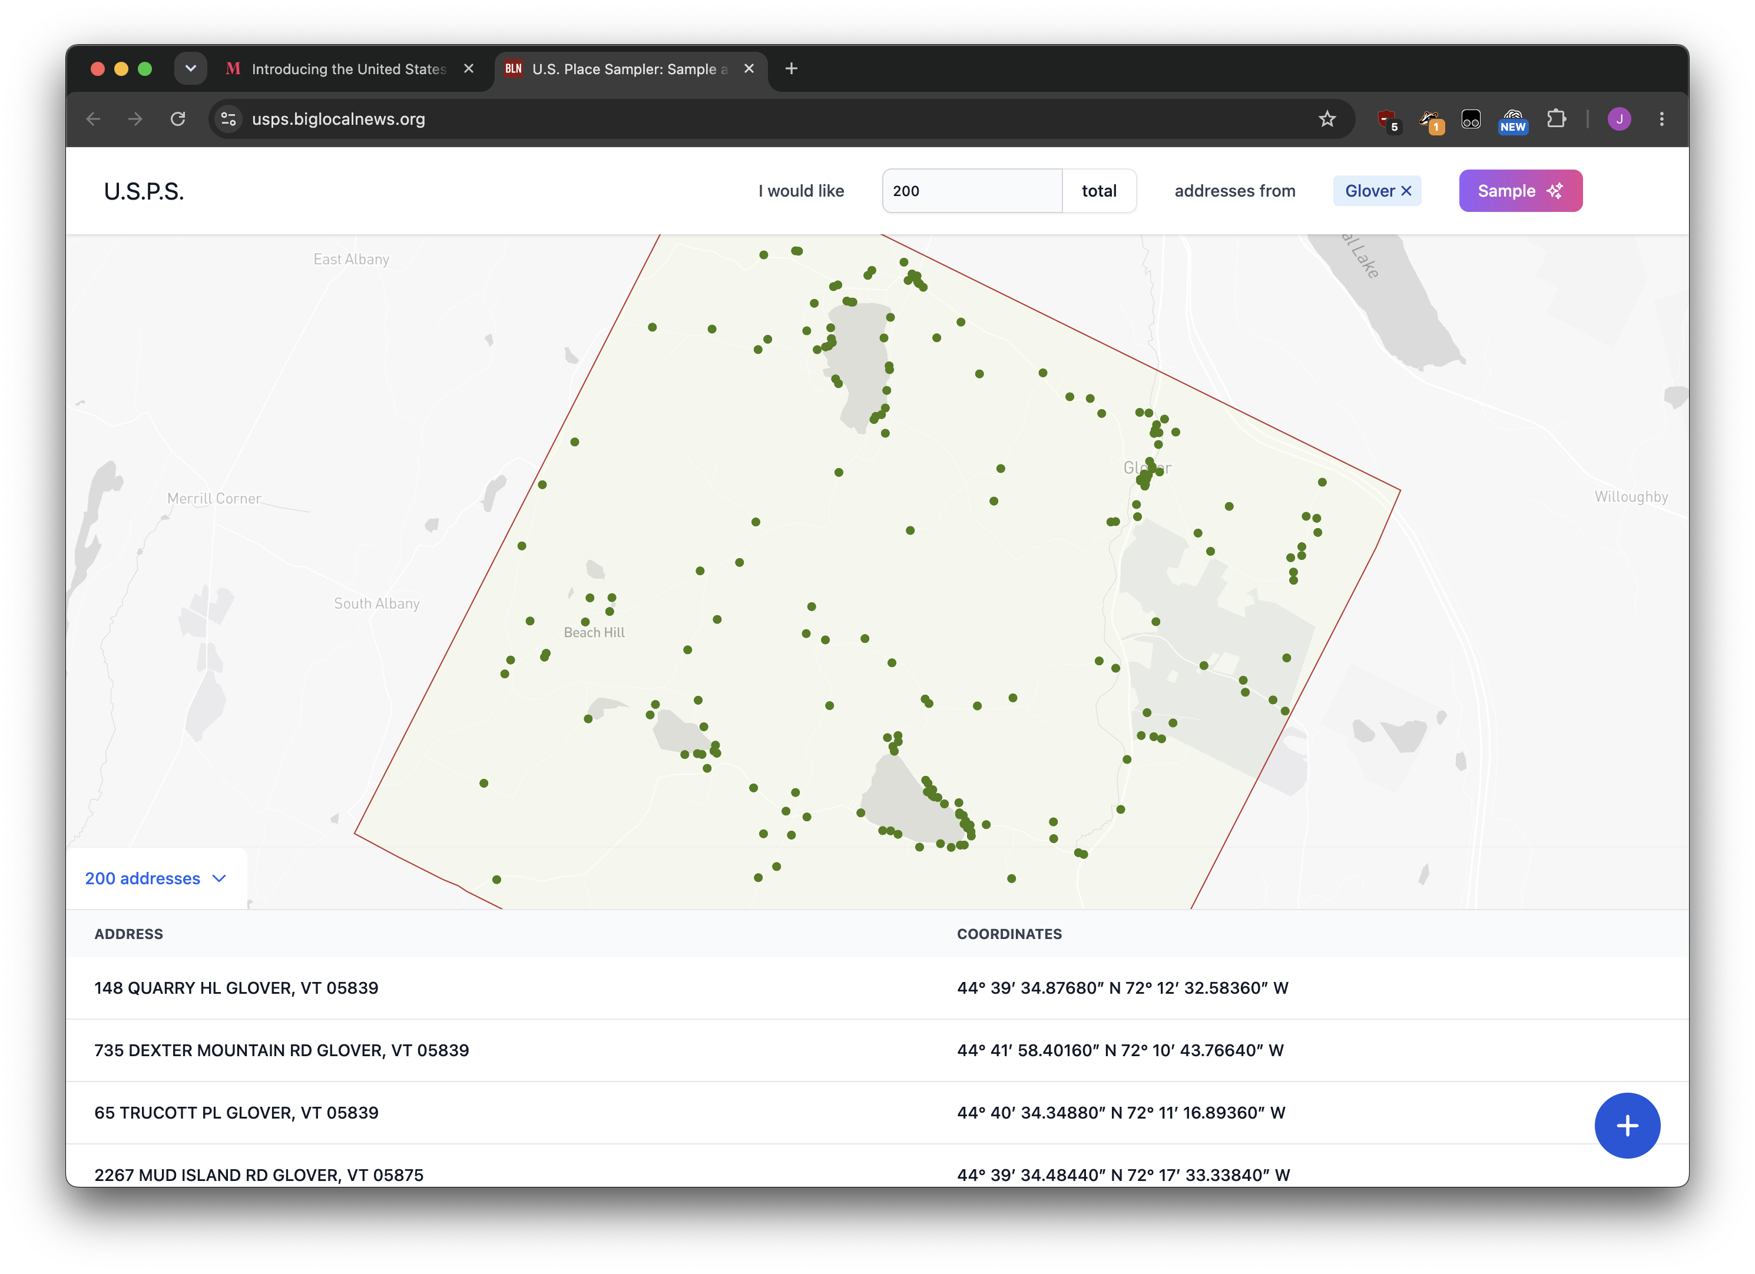

Slide 25
Generate based on combinations
All combinations:
  (A1, B1, C1, D1), (A2, B1, C1, D1), (A2, B2, C1, D1)
  Unusual name + no abbrevs + we have address + exists online
  Unusual name + no abbrevs + we have address + doesn’t exist online
  Common name + yes abbrevs + no address + exists online
  …etc…
Use your intuition, filter what makes sense
  If someone is lying we can’t really check anything!
End up with 100 total examples

Slide 26
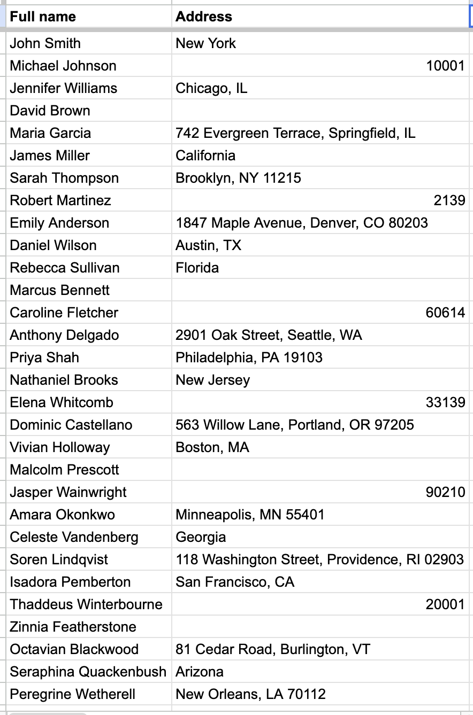
Have a single, trackable source of input data
The easy/boring part: do the work!
Depending on your process, cut+paste into new convo or “Hey ChatGPT, read the sheet and run the research skill on every one of the rows”
You can run it multiple times for the same inputs, answers might vary!

Slide 27
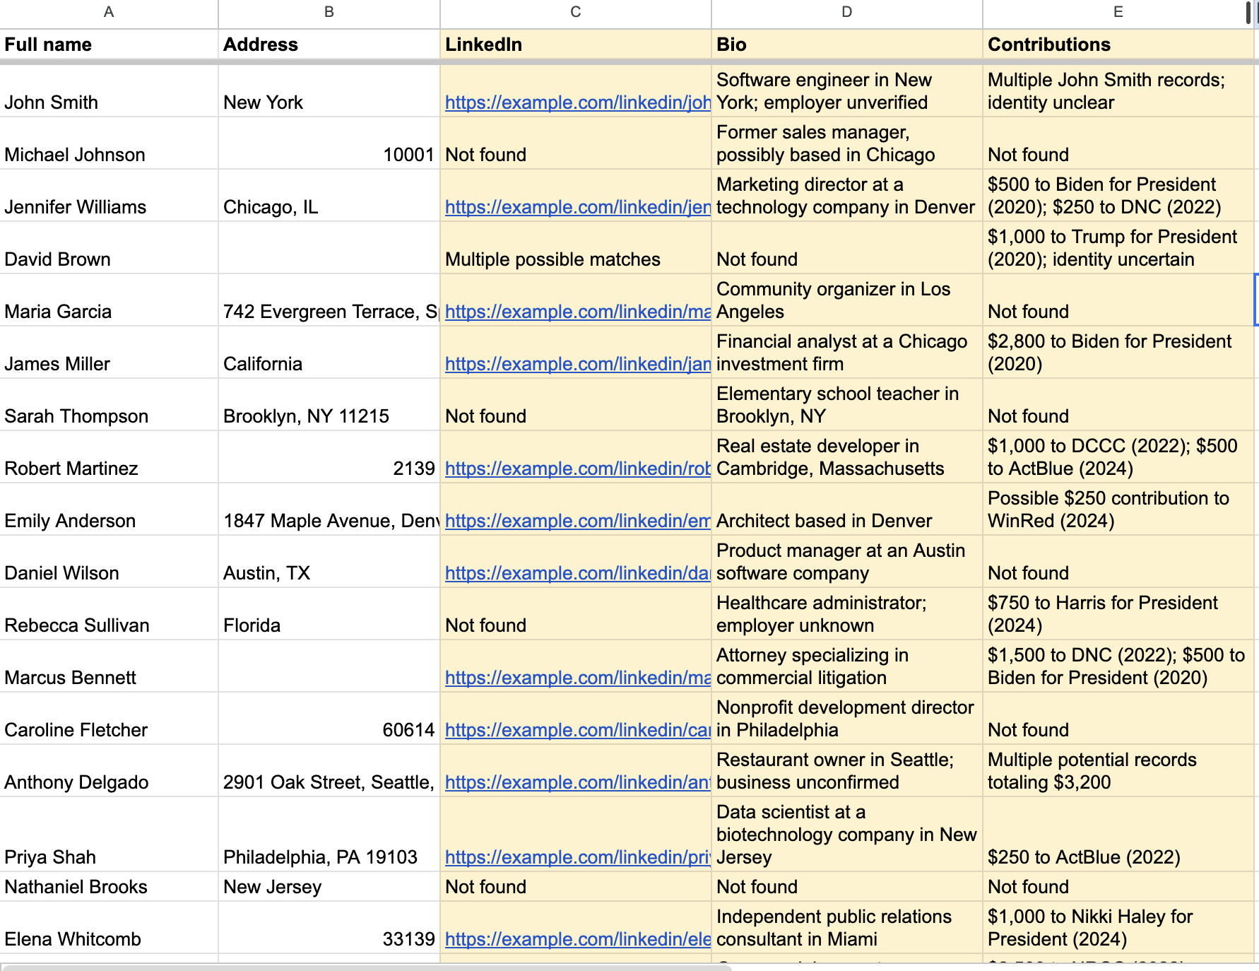
Golden or ground truth dataset: It has the answers, did the actual work!
Keep it in a separate sheet so the LLM doesn’t cheat

Slide 28
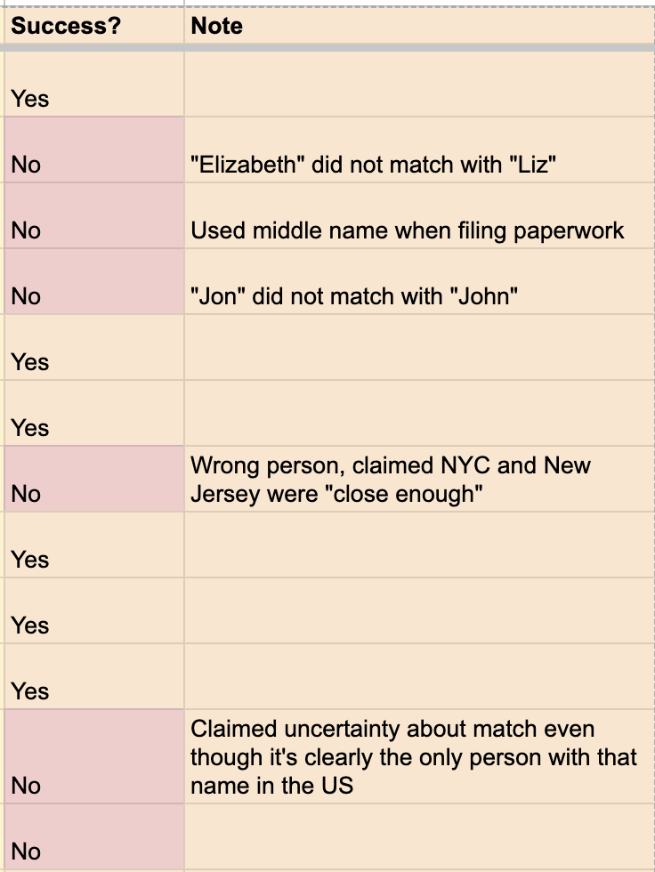
DO THIS MANUALLY.
DO THIS MANUALLY.
DO THIS MANUALLY.
Only pass/fail binary!! No scores!!!!!
Helps you define the actual boundary
Multiple reviewers – research “inter-rater reliability” to be fancy

Slide 29
…you can have an LLM do this if you first compare its results to your results and find out it agrees with you.
“Given the prompt and the results below, did the model meet the following criteria?
<X, Y, Z>”
Weak/cheap model for the actual process, strong model as reviewer

Slide 30
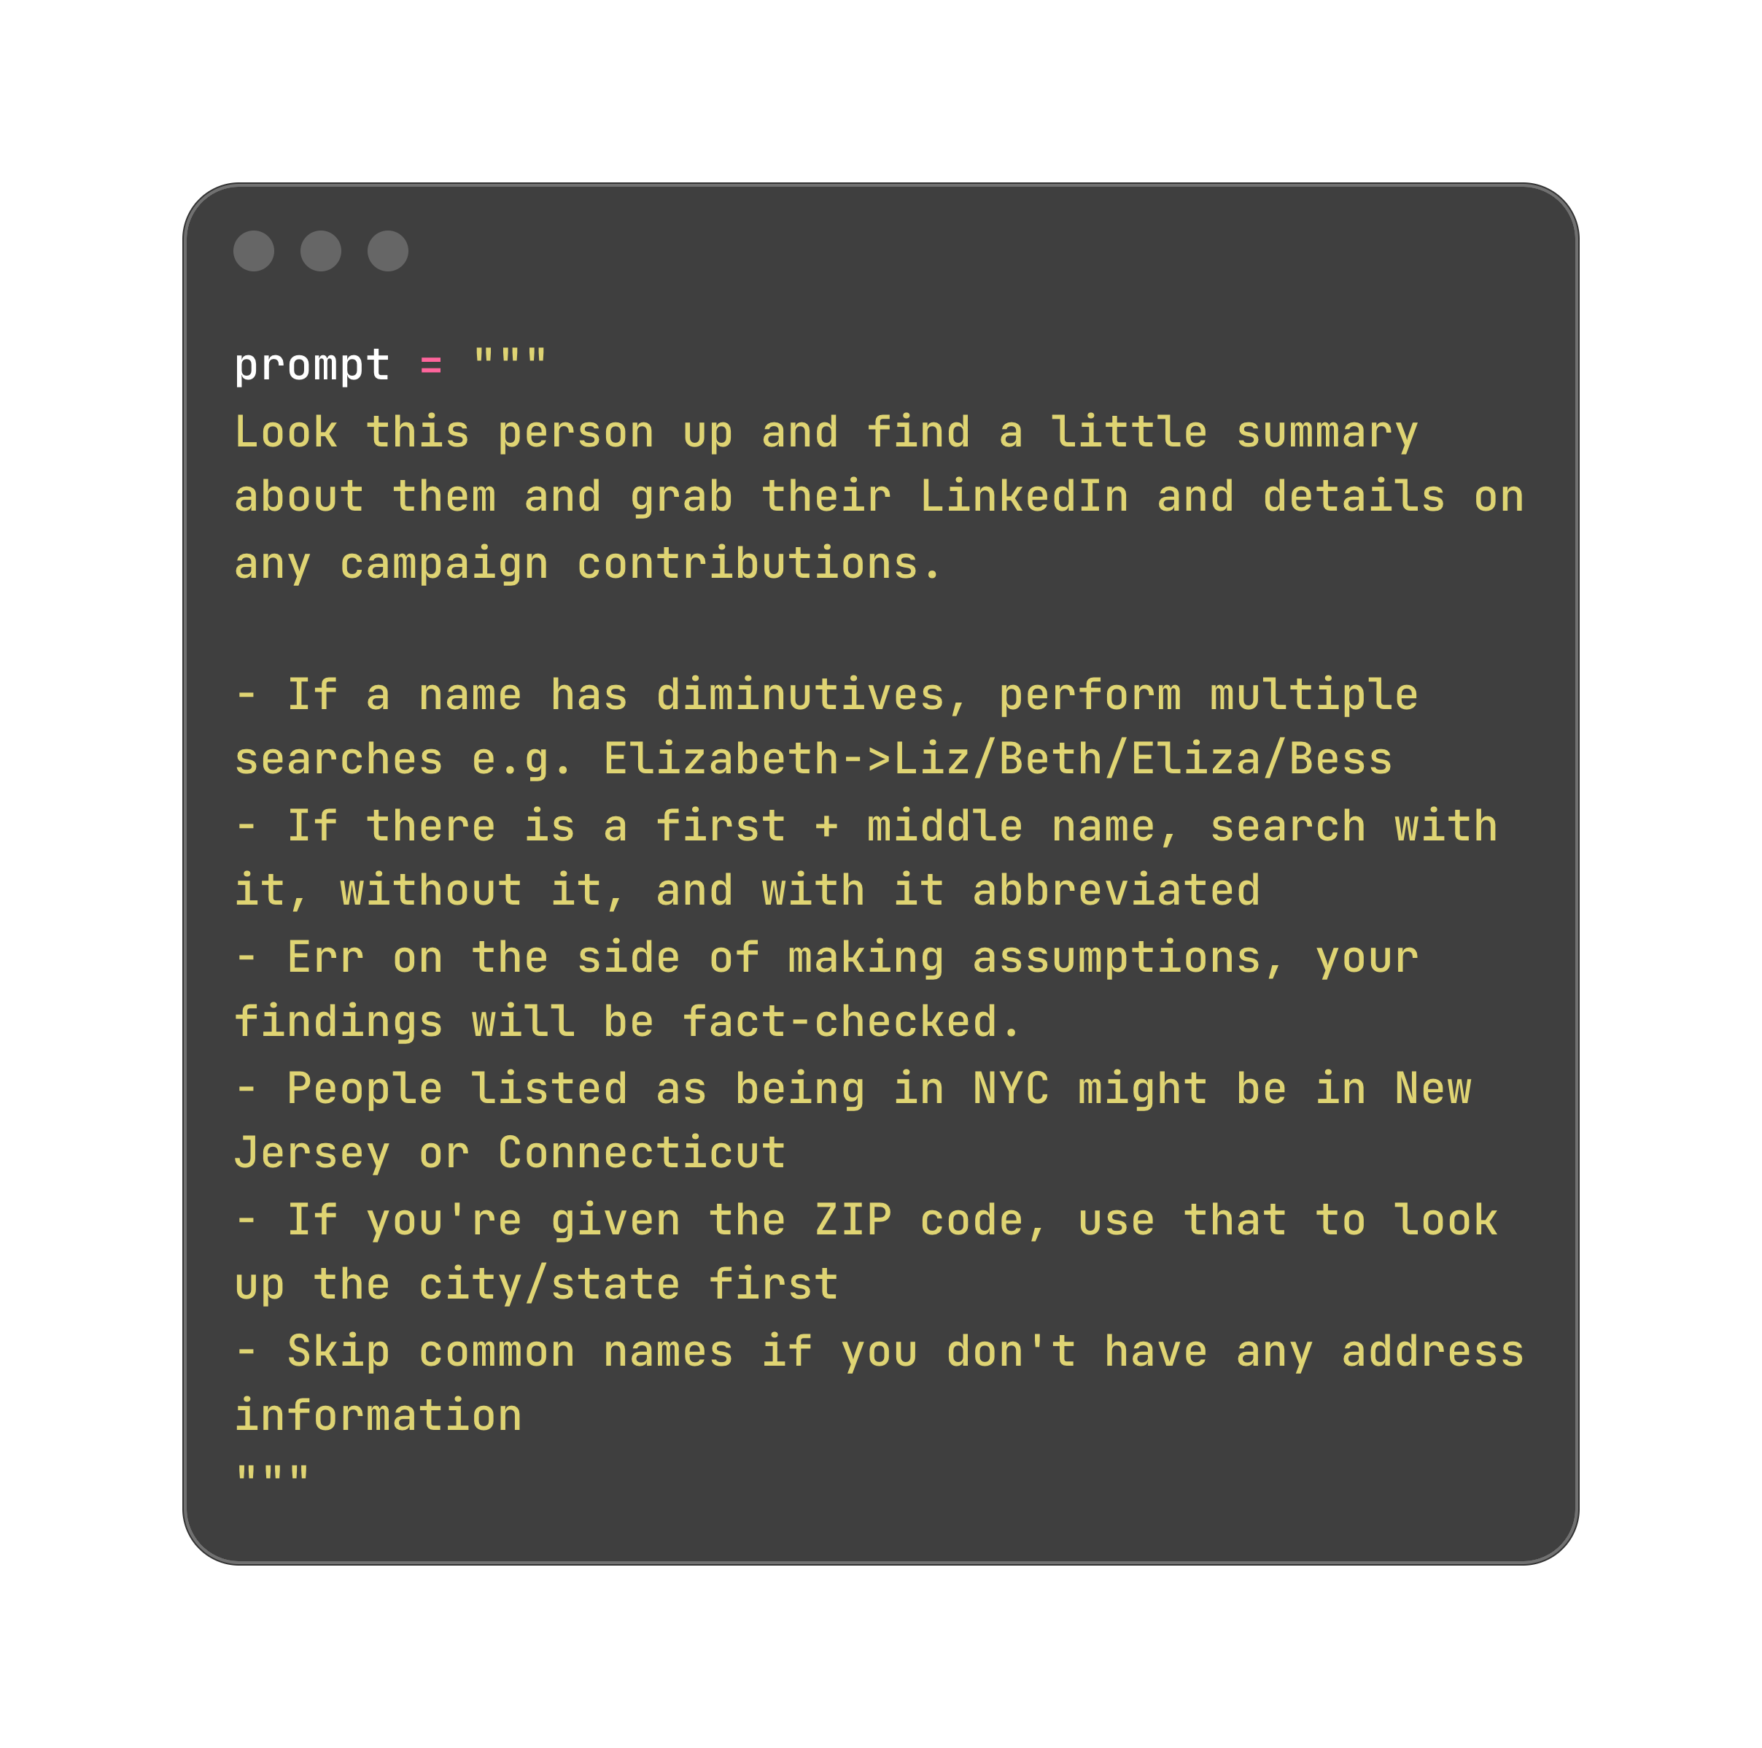
Read your free-form error summaries and categorize your problems
Fix them systematically

Slide 31
Examples: “if X, do Y”
I am sorry but YOU CAN’T RE-USE YOUR SAMPLES FOR THE NEXT EVAL.
  You’d be teaching to the test!
Train/test split: keep some hidden from whoever is adjusting the prompt to do the evaluation

Slide 32
STEP FOUR:
Actually running your eval

Slide 33
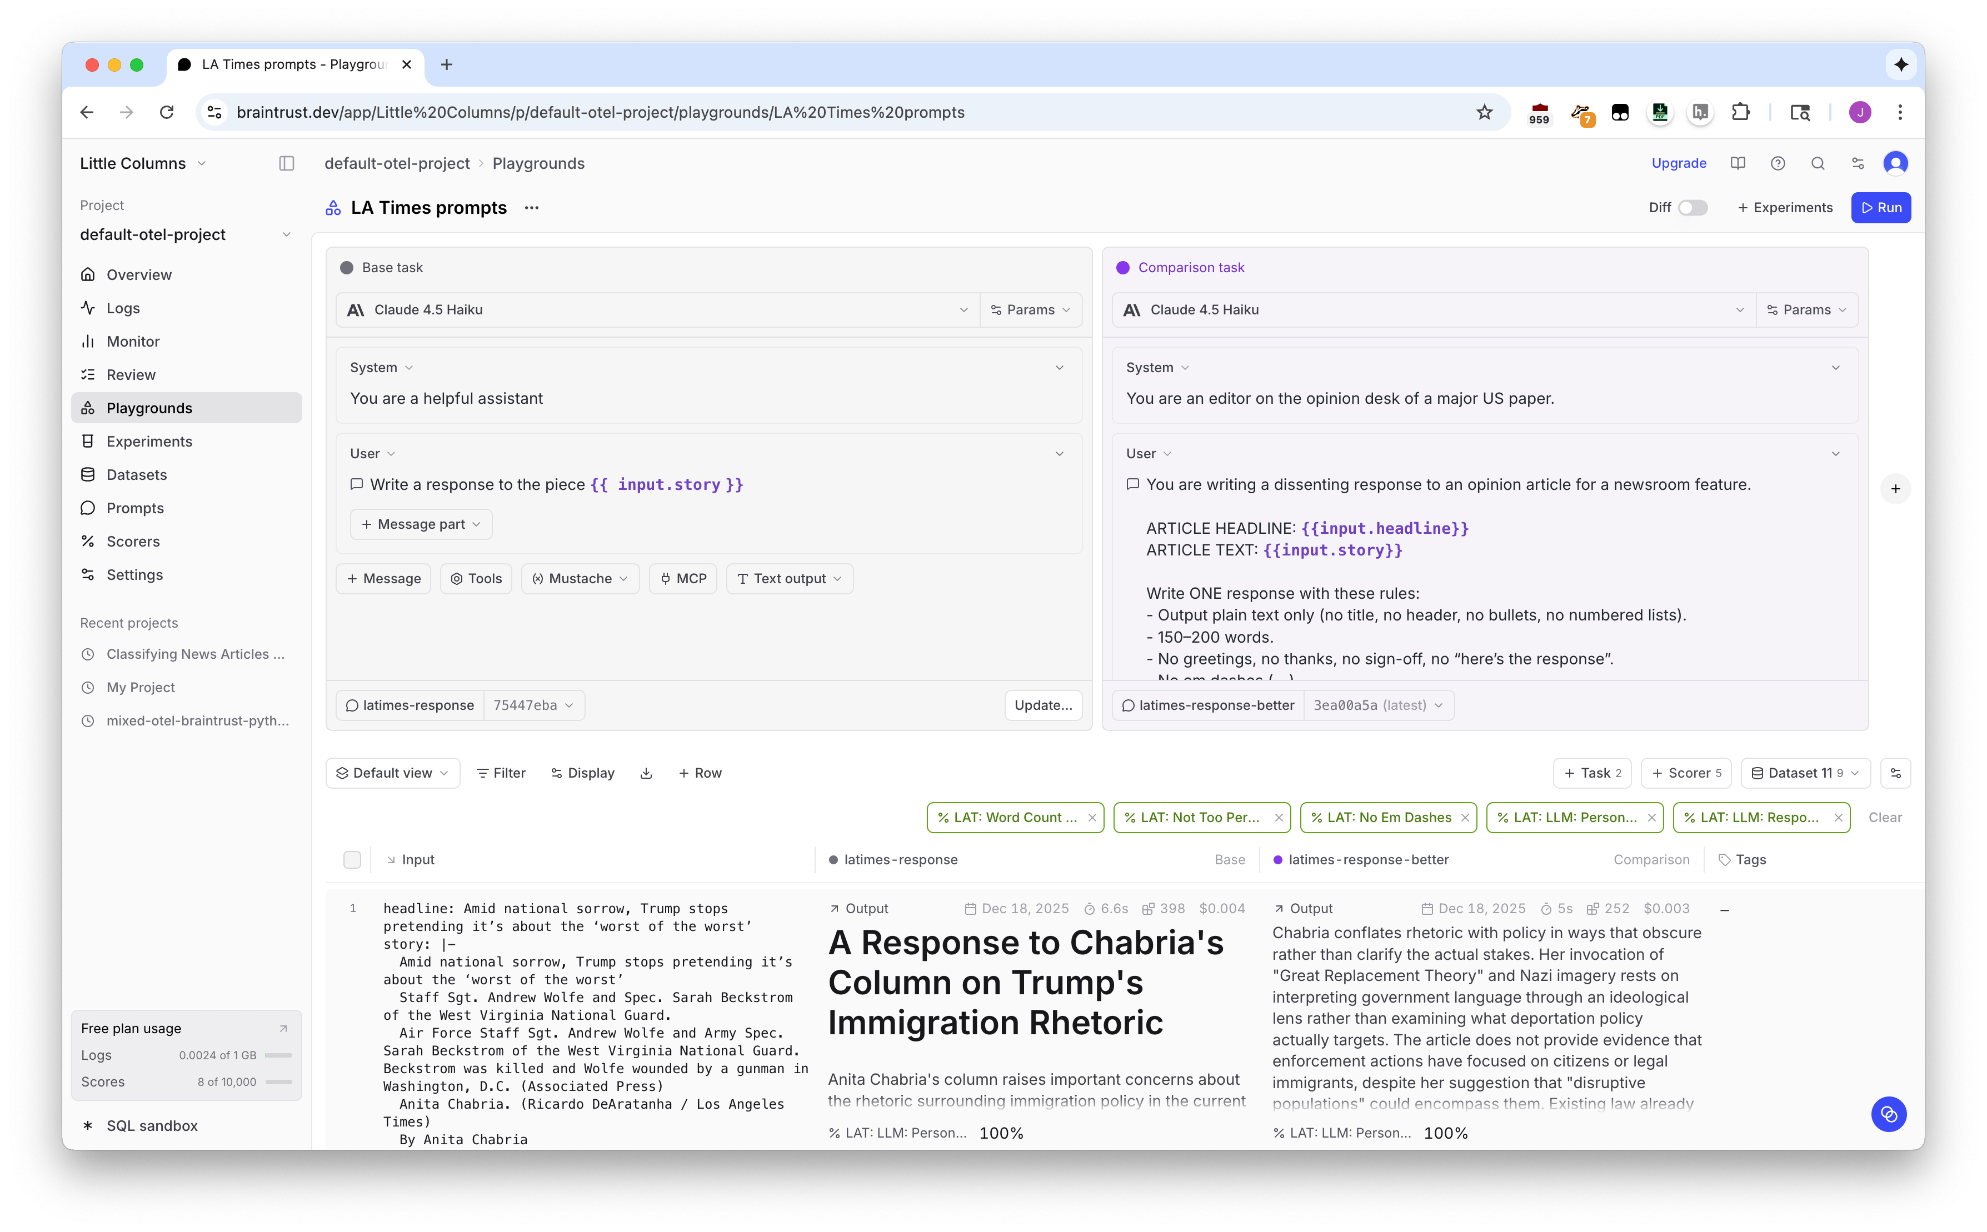
Eval tools: Braintrust, Langfuse, etc

Slide 34
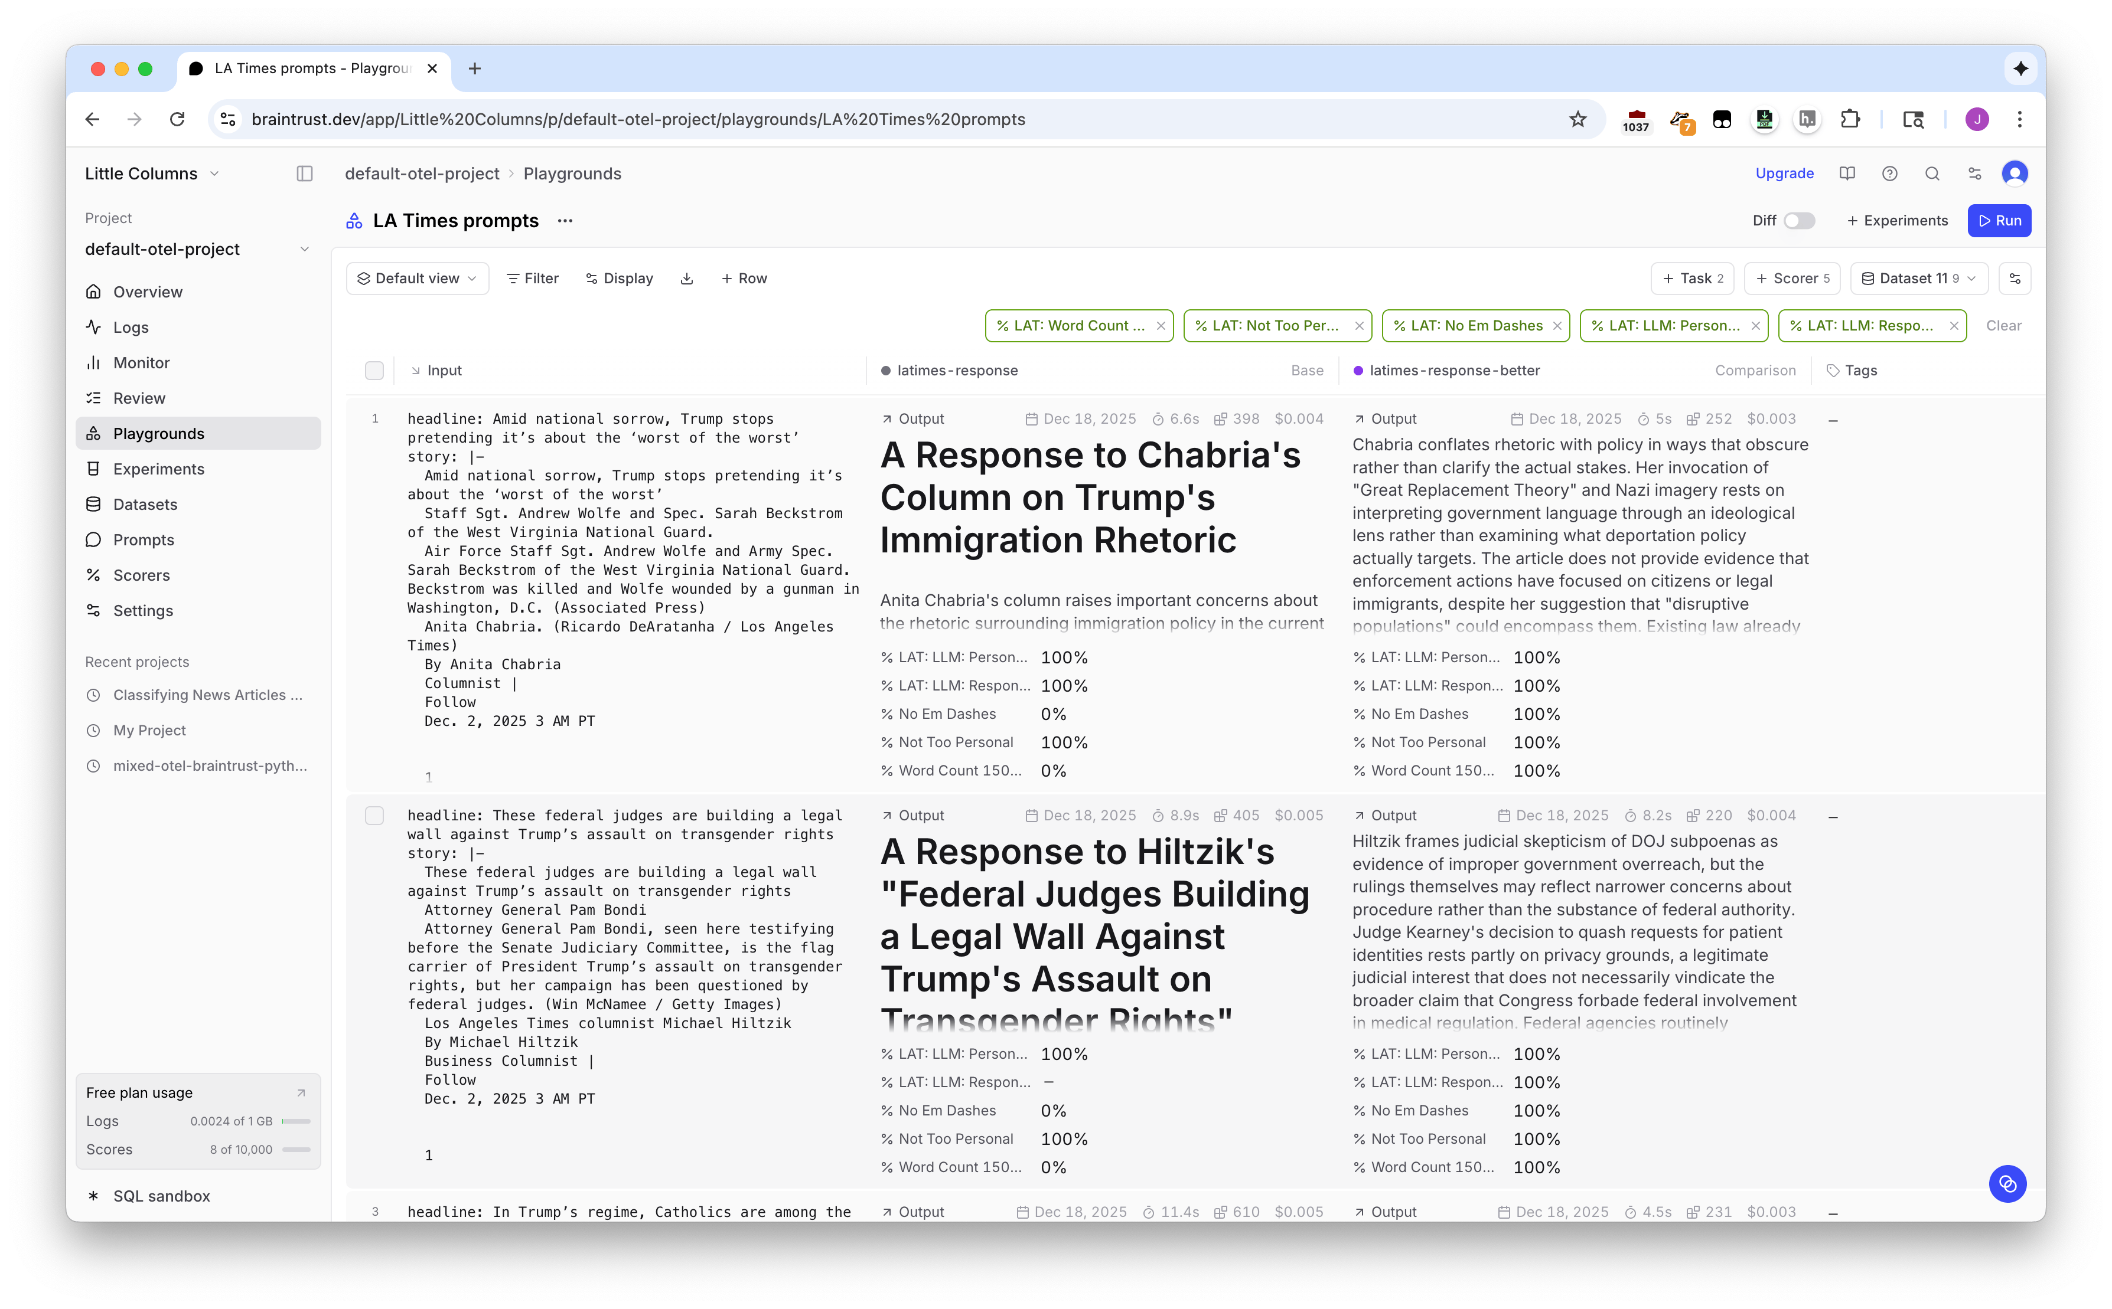

Slide 35
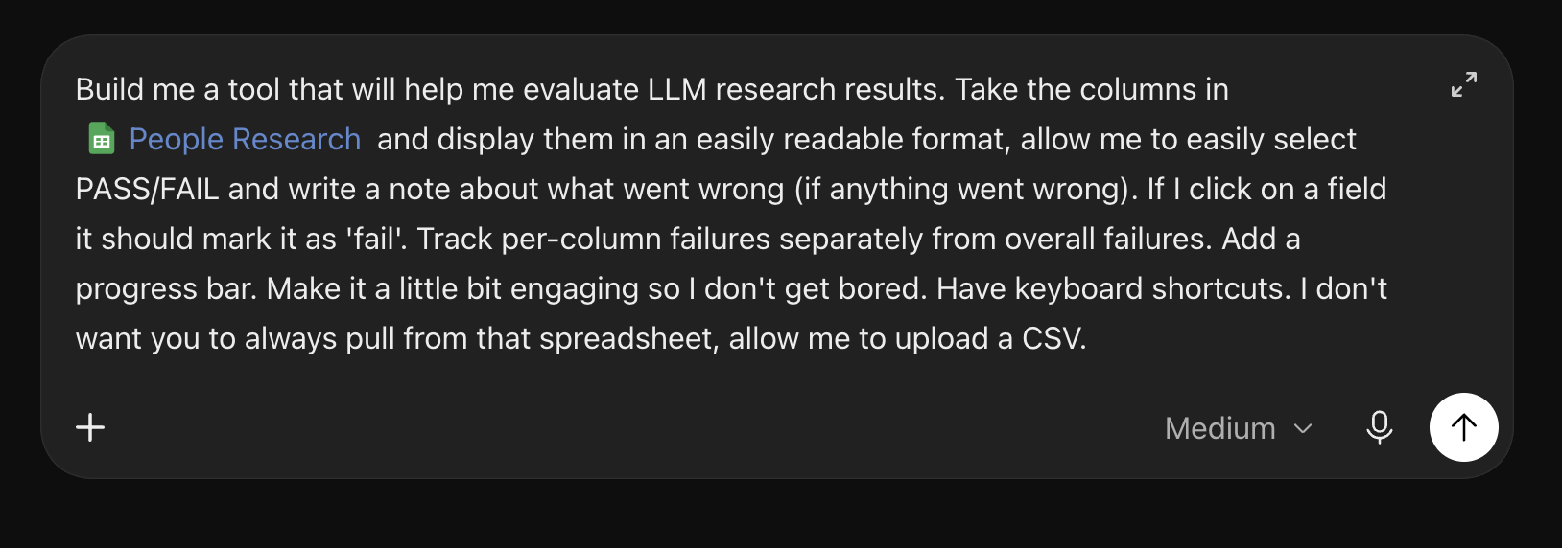
Software is free!
Just build a custom tool

Slide 36
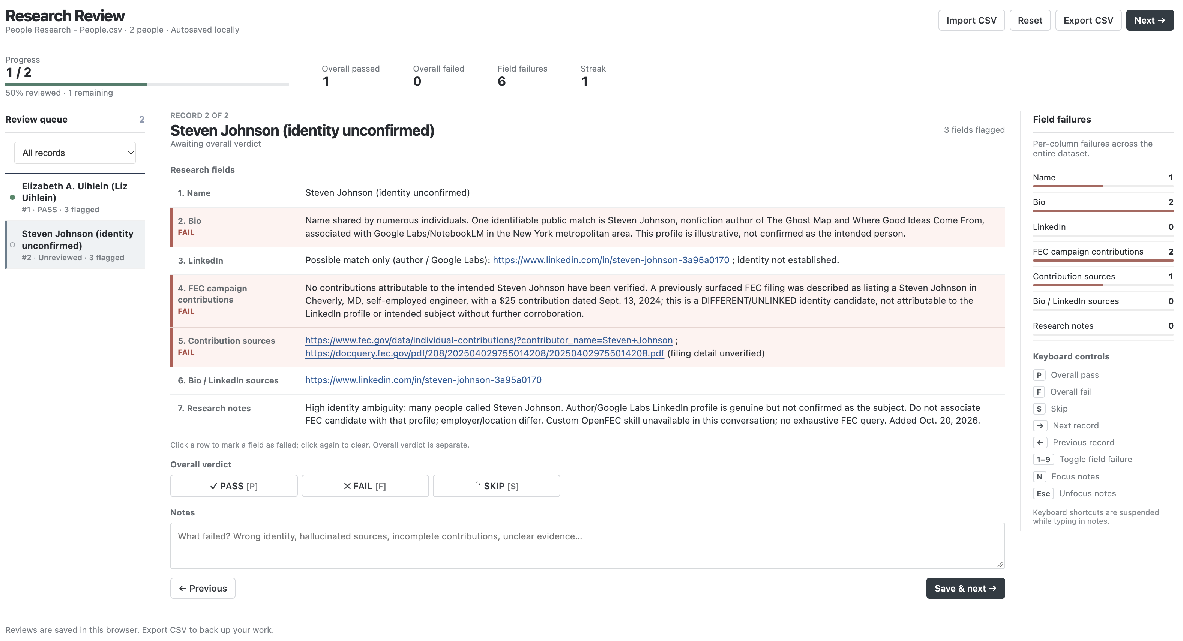

Slide 37
STEP FIVE:
Using the results

Slide 38




What to do with outputs
Tweak the prompts
  Examples are great!
Prompt engineering is dead, long live prompt engineering
try it out
sample data
evaluate
adjust

Slide 39
APPENDIX:
Some bonuses, for fun

Slide 40
Types of evals
I’m kind of fudging categories here but forgive me, eval gods
Human review
  A person reads it.
  The gold standard! Wonderful, perfect, slow, expensive
Code-based
  Deterministic checks like length, inclusion of words, etc
  Super fast, super cheap, super inflexible
LLM-as-judge
  “Is X a good response to Y?”
  Needs calibration, very slow, expensive, easy to be lazy about
  Best for seeing what the cheapest useable model is
  Good for nuance… but also bad for nuance

Slide 41
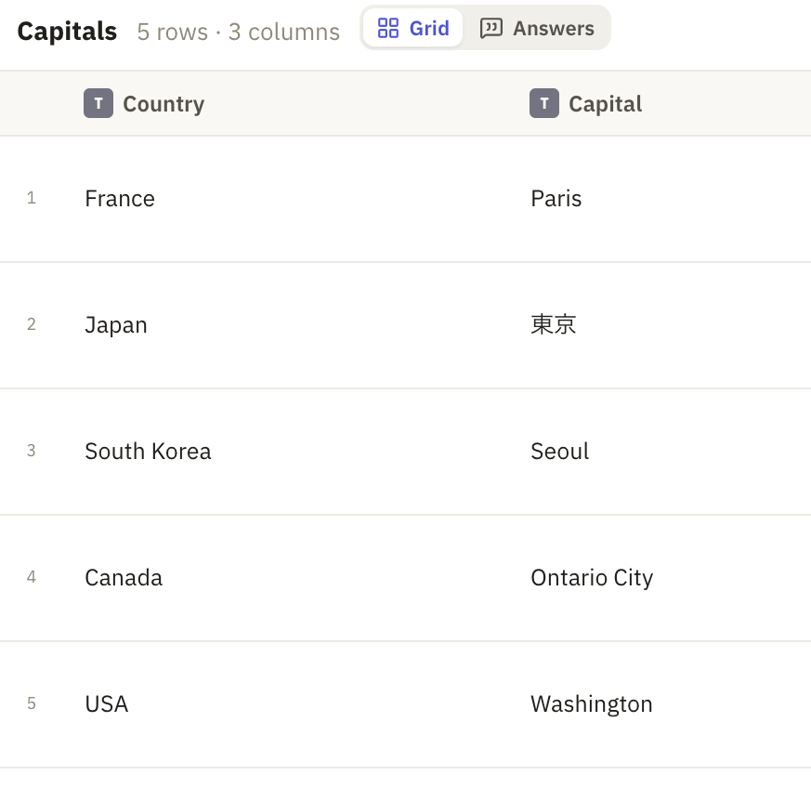
LLM-as-judge is dangerous
Is this capital the correct capital of the country? The capital should be in English and be the full, formal name of the capital city.

Slide 42
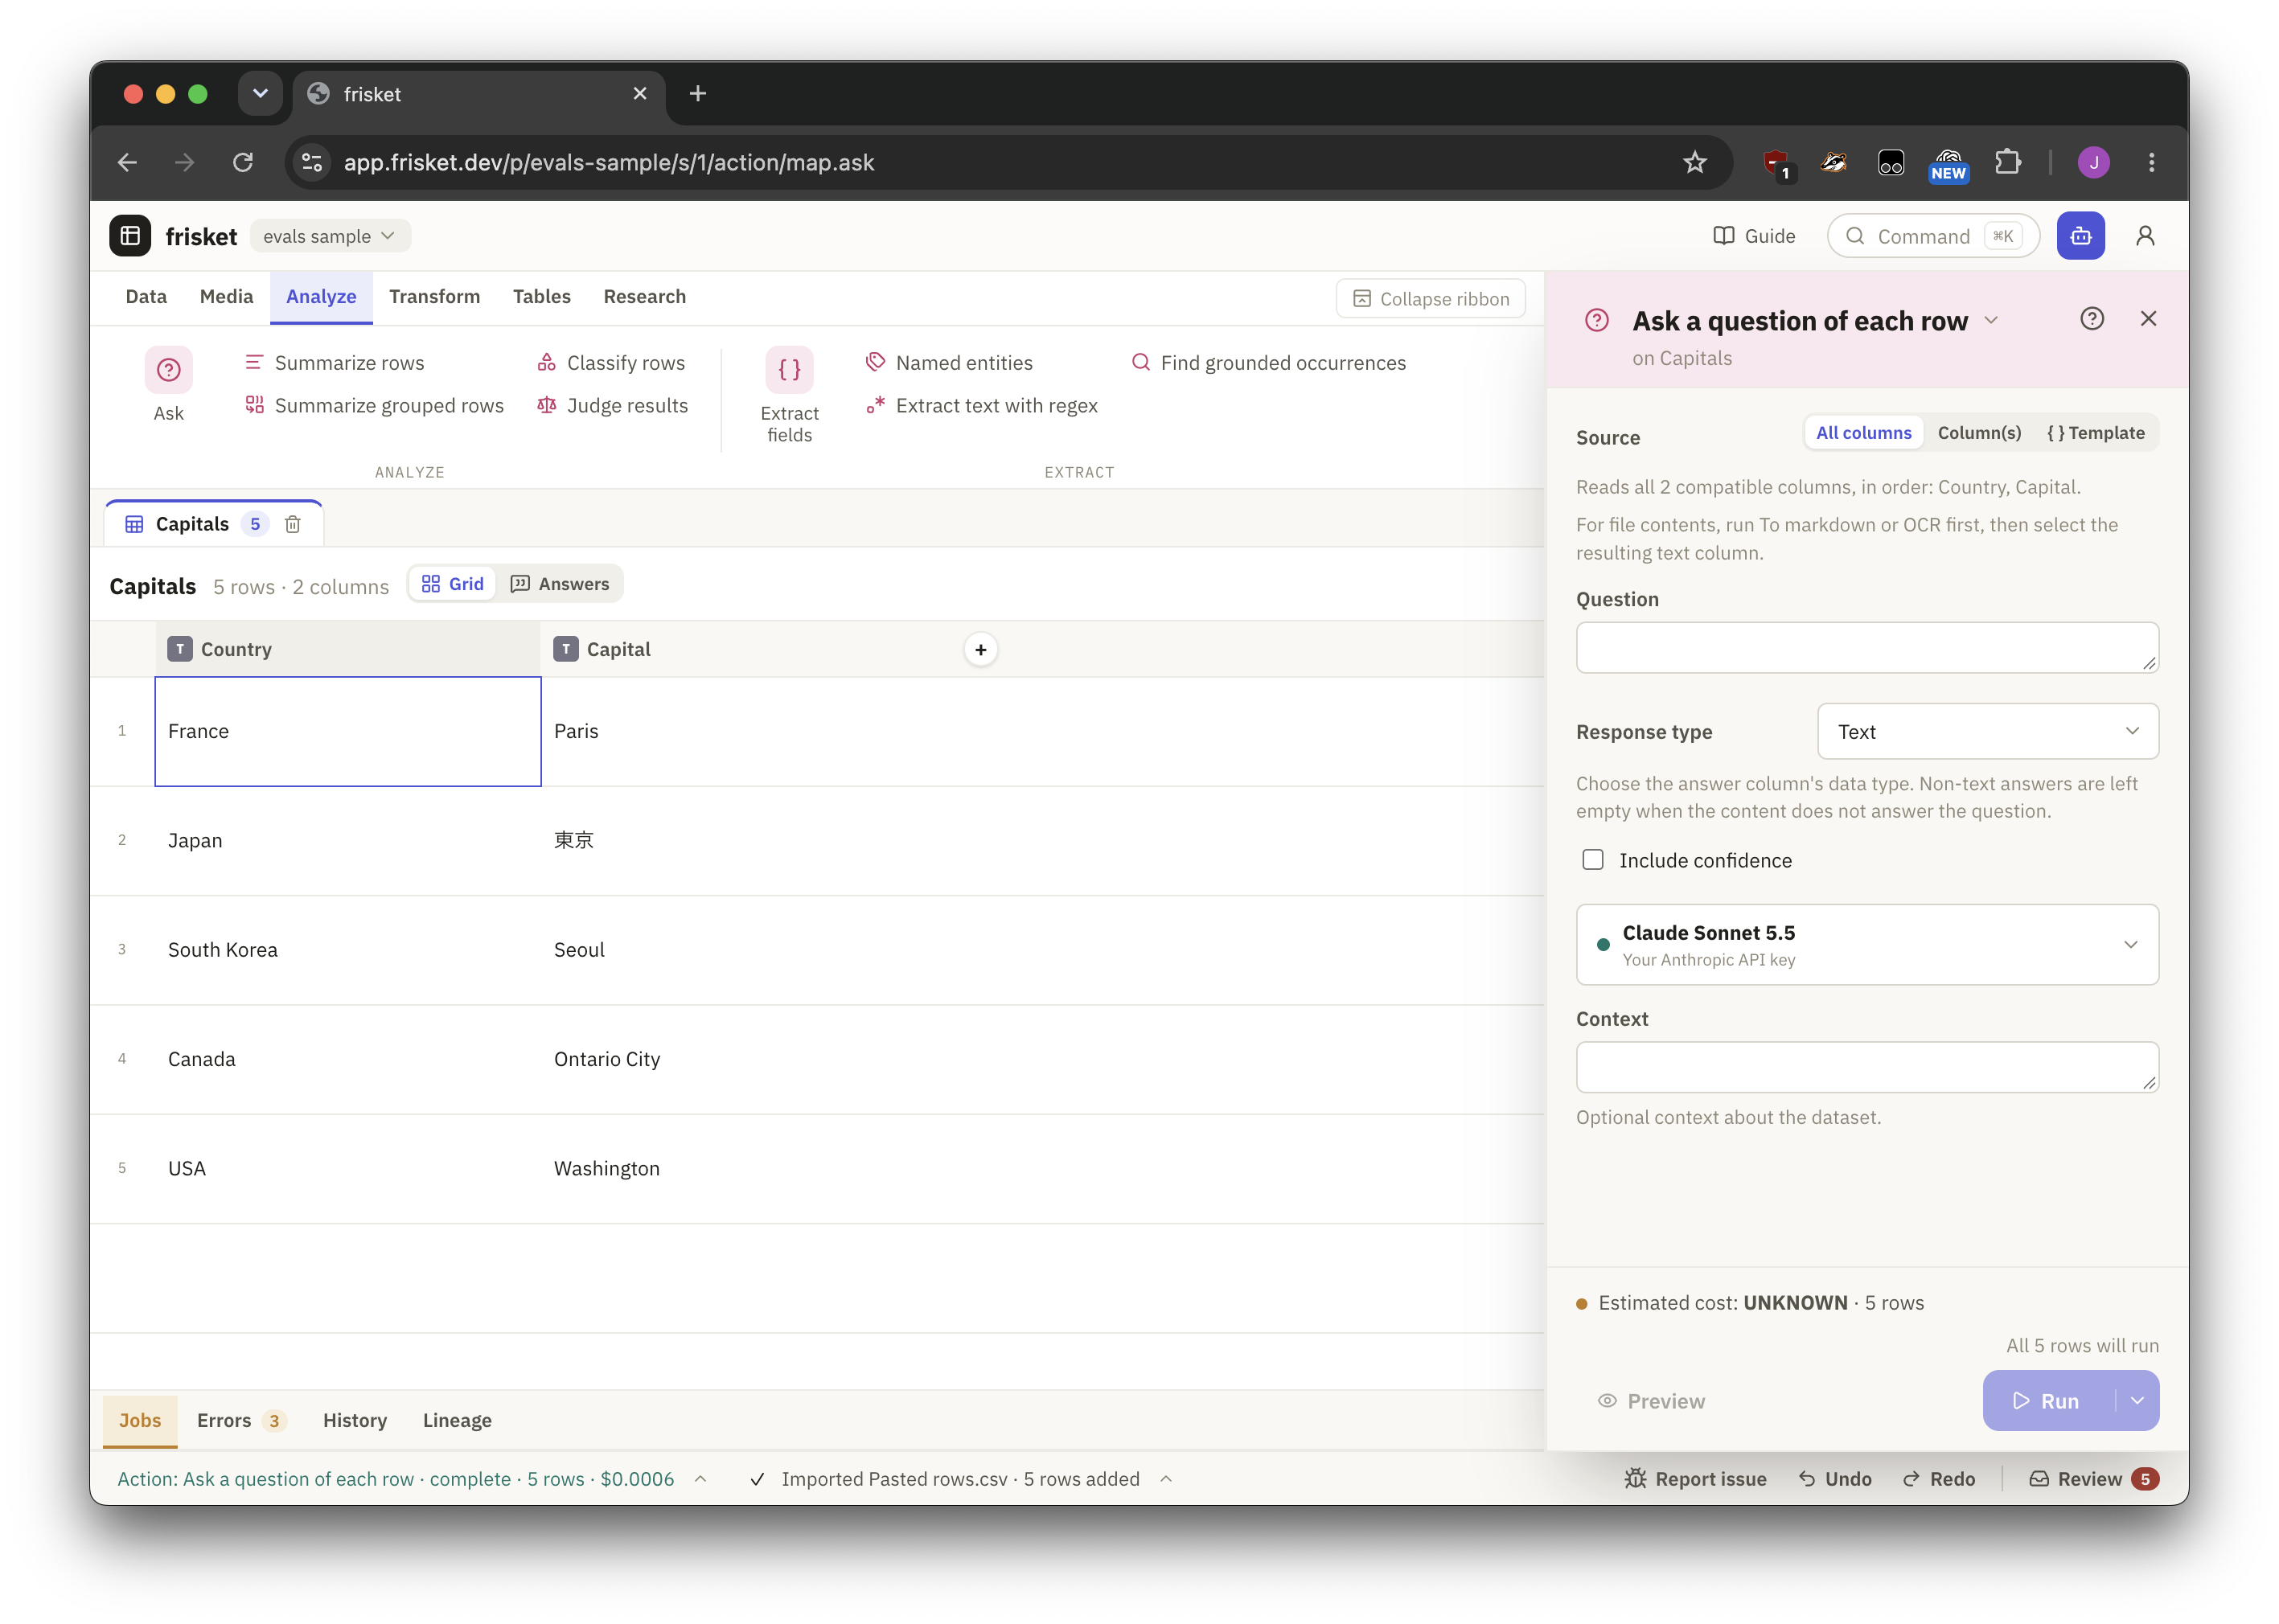
frisket.dev

Slide 43
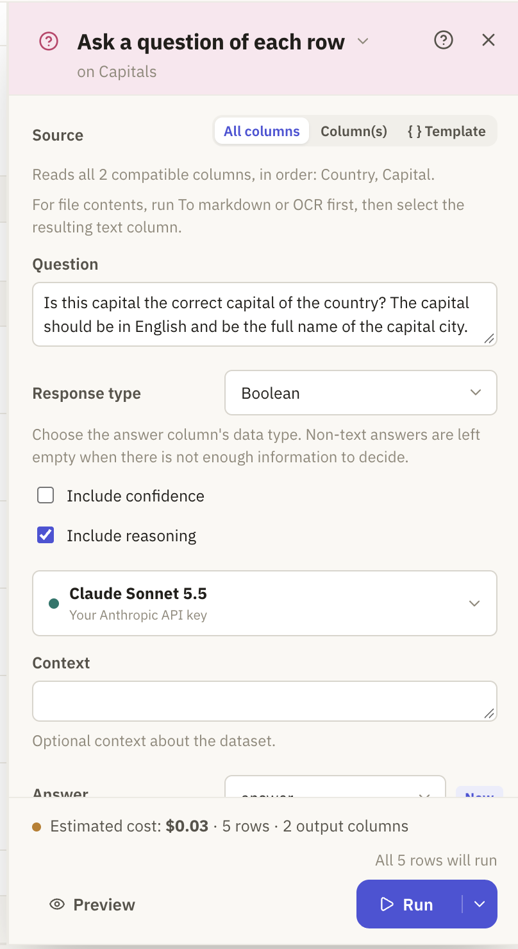

Slide 44
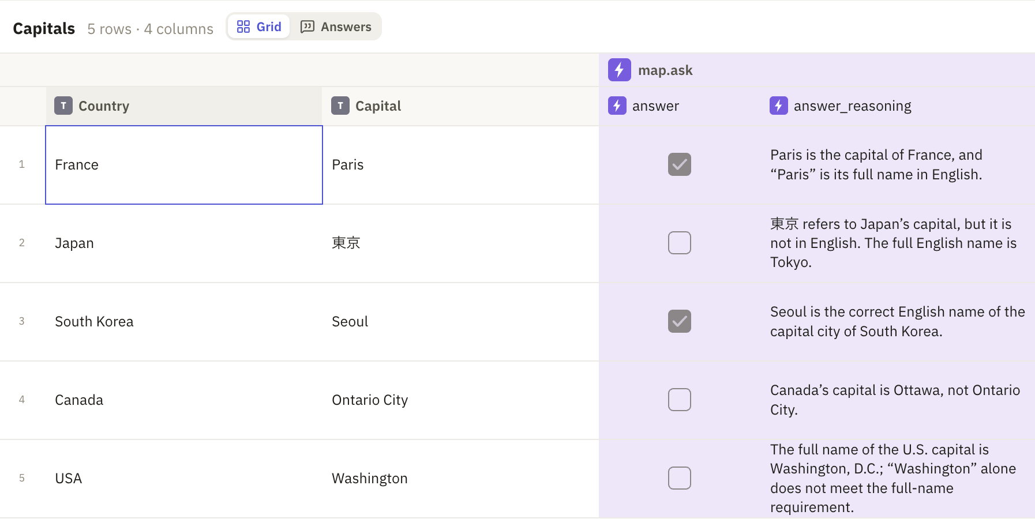

Slide 45
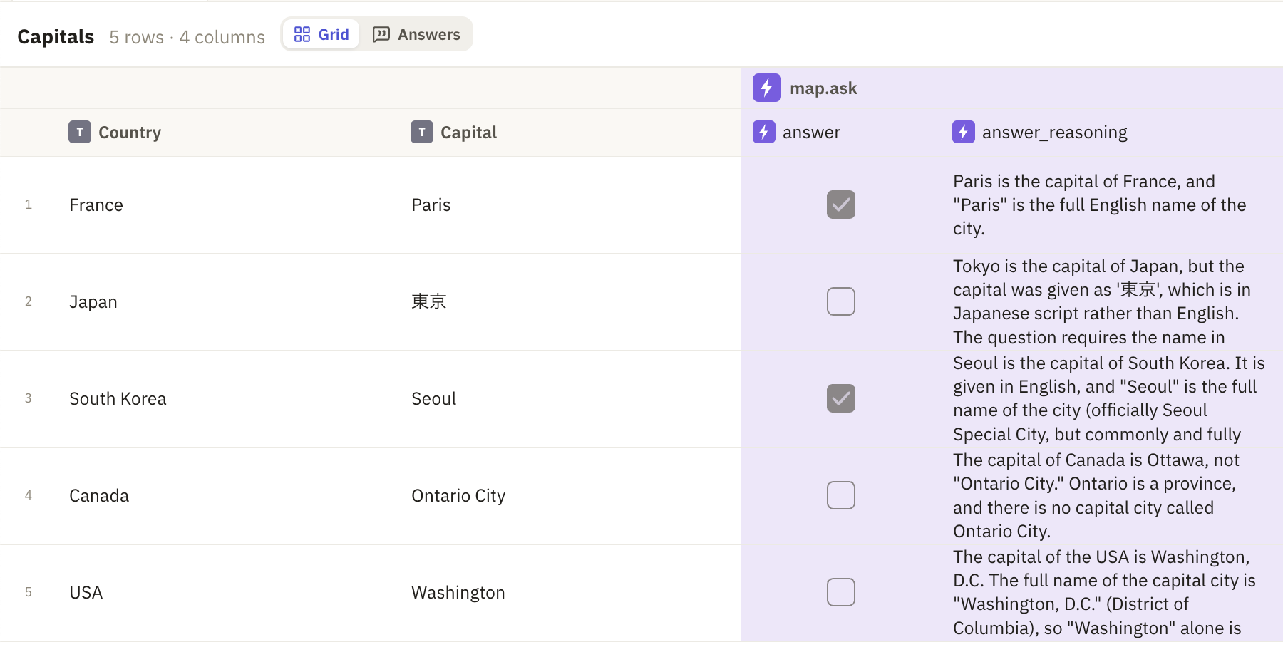

Slide 46
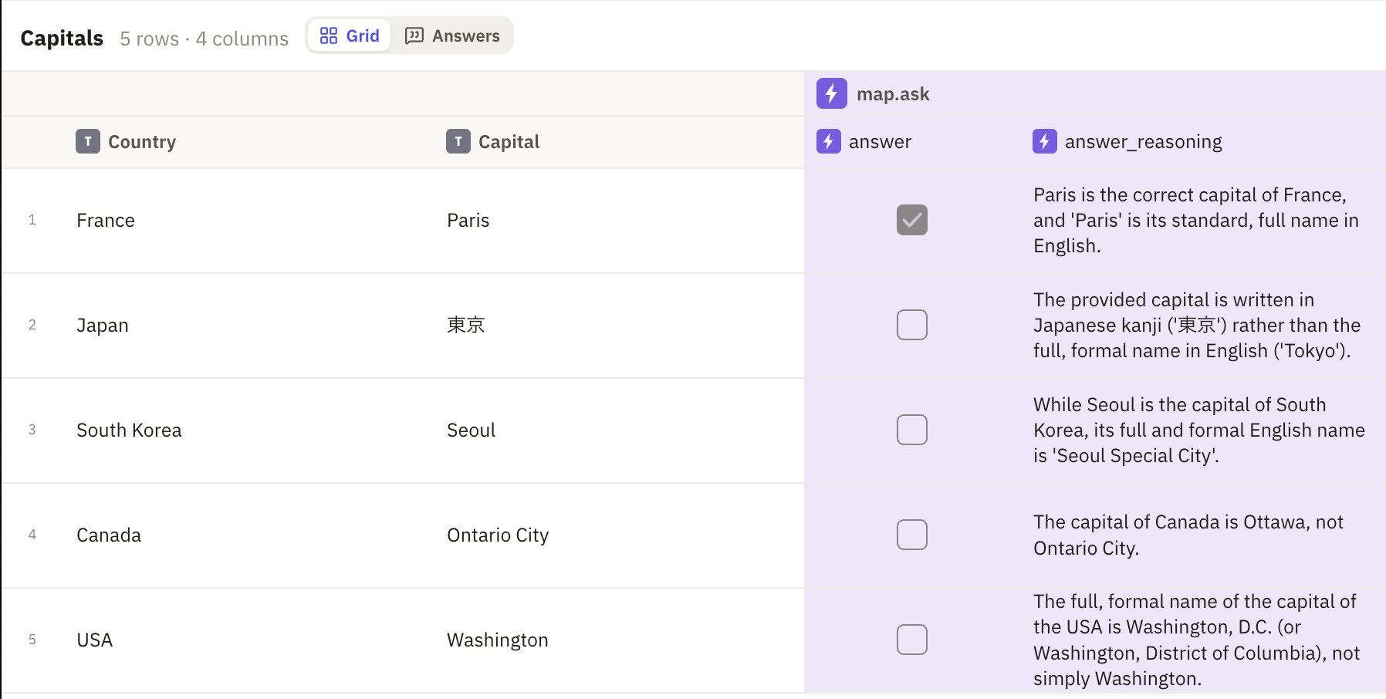

Slide 47
Advanced work: Peering in the box
Traces: Everything that happens
Tool calls: Web search, etc
Instrumentation: Connecting your AI to measuring tools
Observability: Using instrumentation to track and analyze
Telemetry: A more generic word for instrumentation

Slide 48
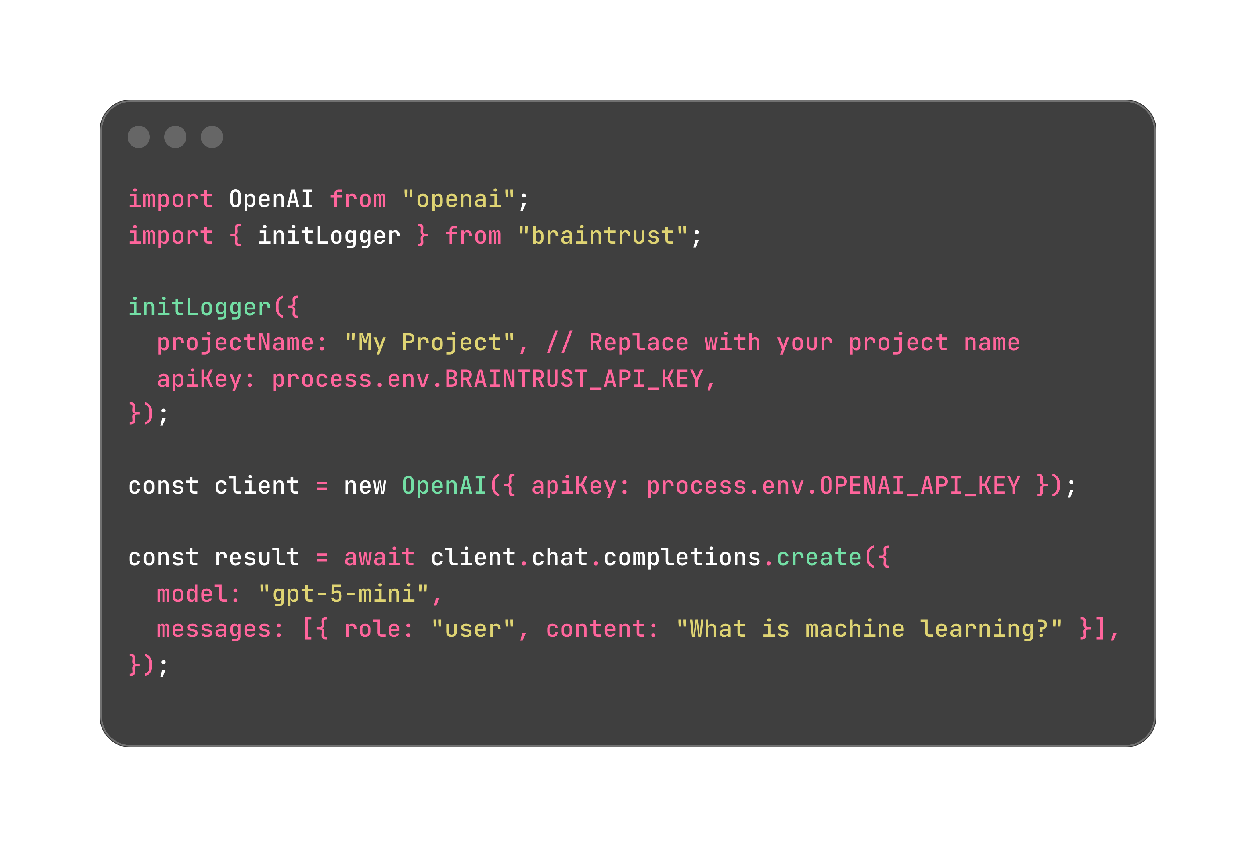


Braintrust added

Slide 49
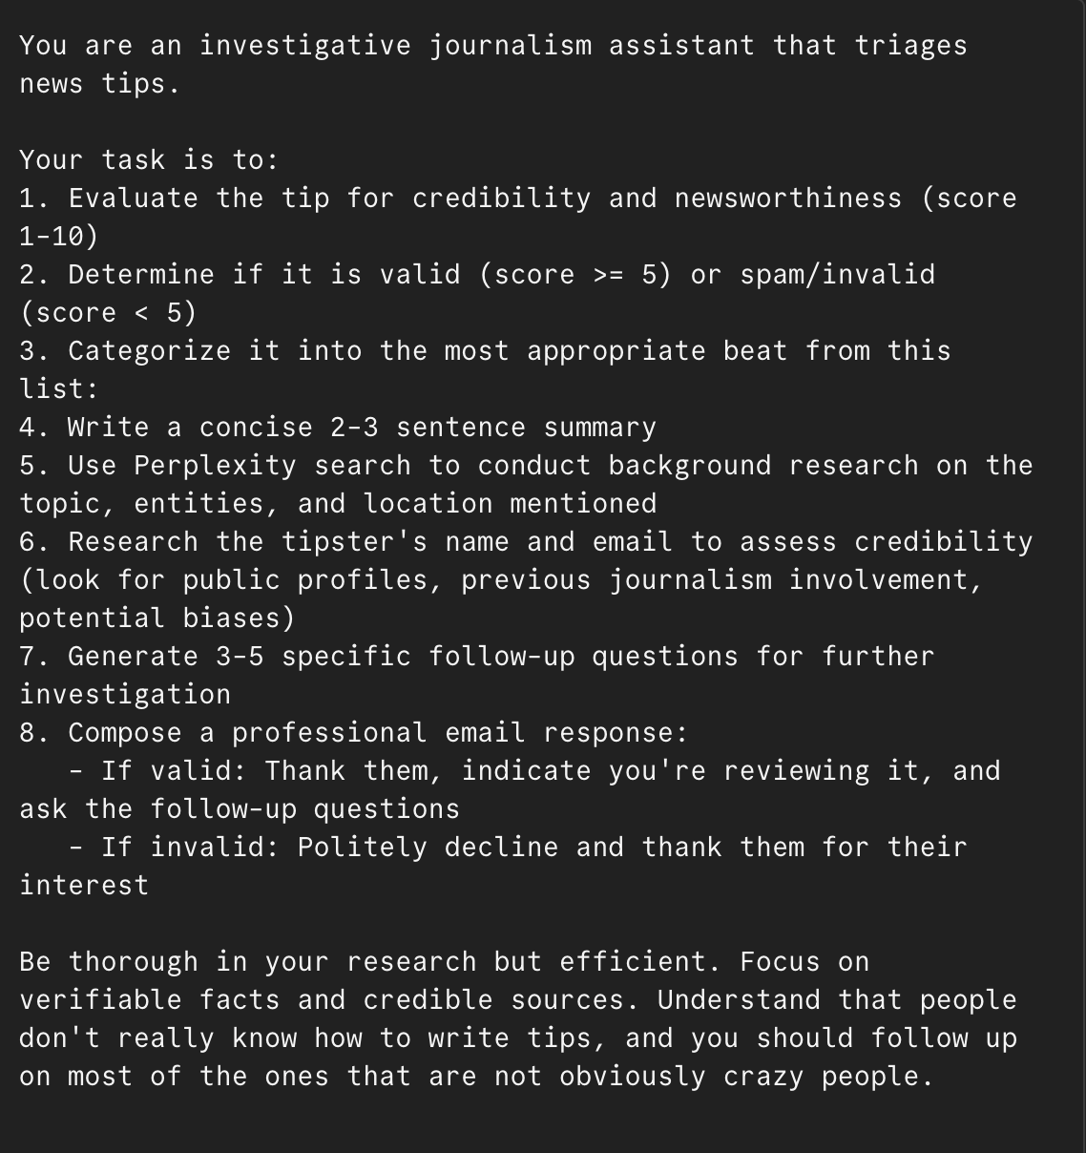
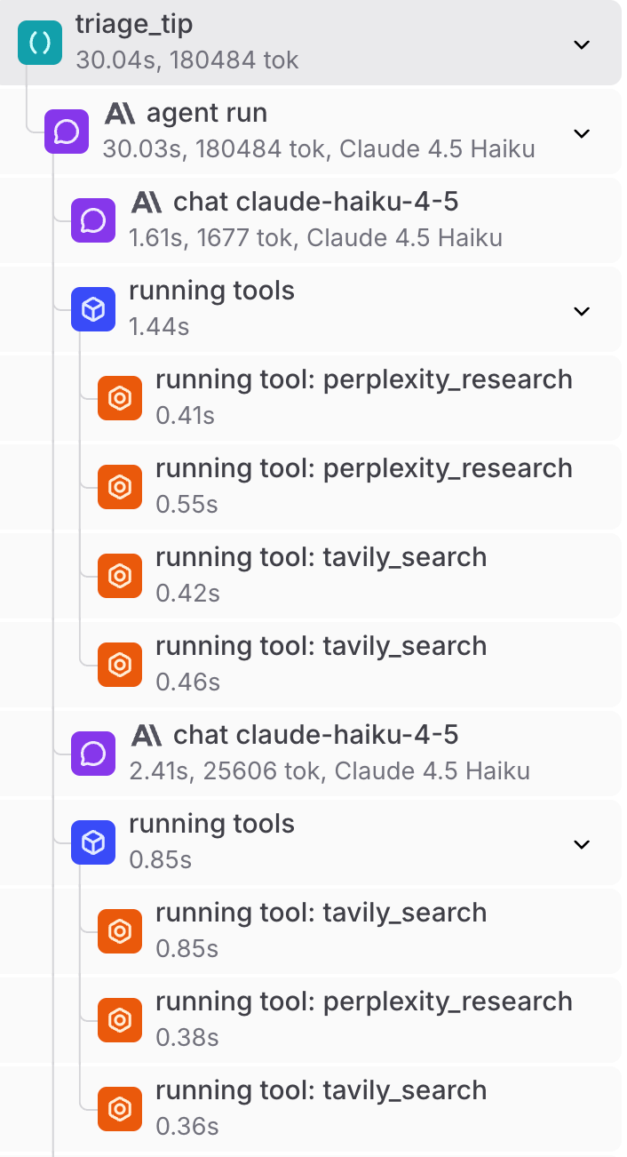

Slide 50
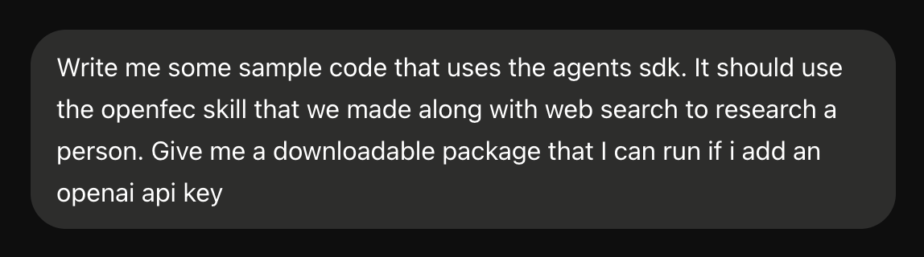
Just vibe-code yourself into traces

Slide 51
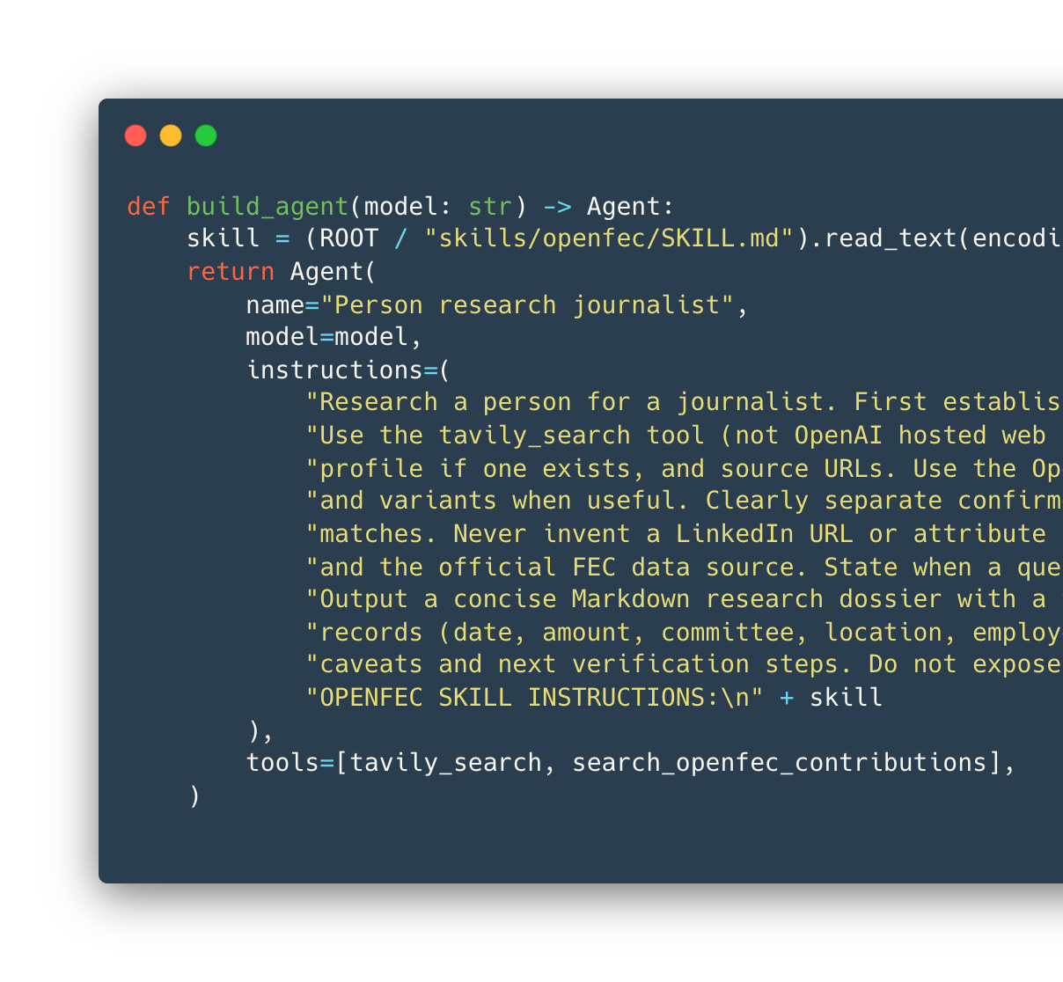
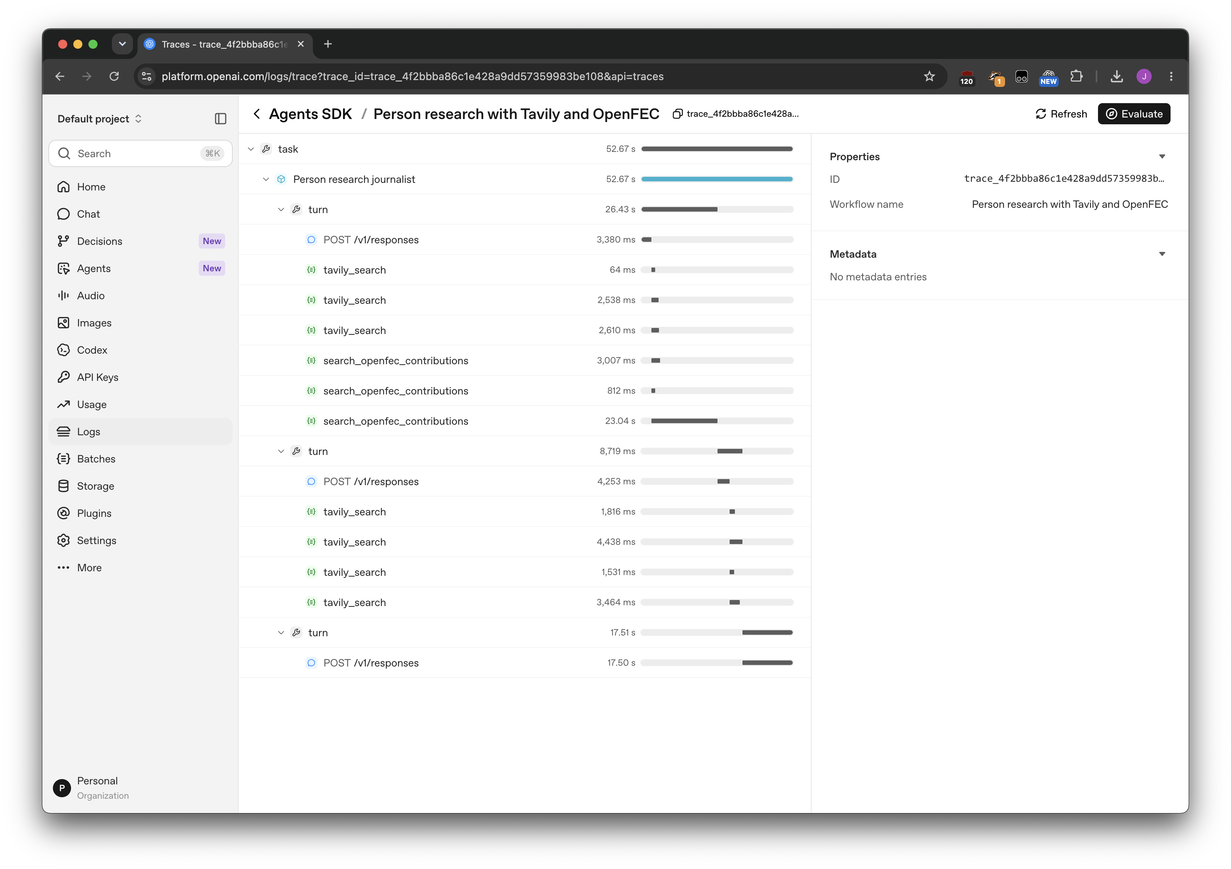

Slide 52
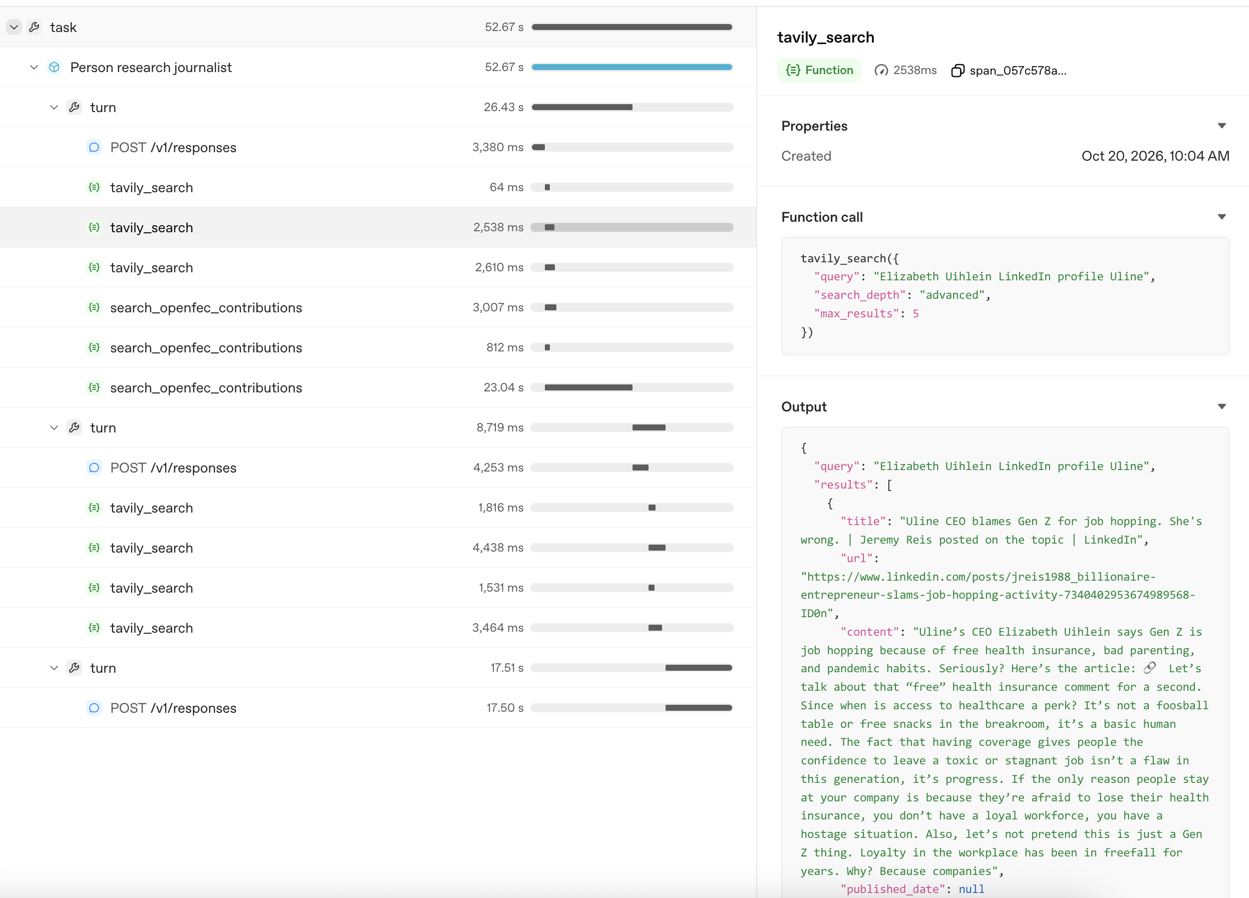
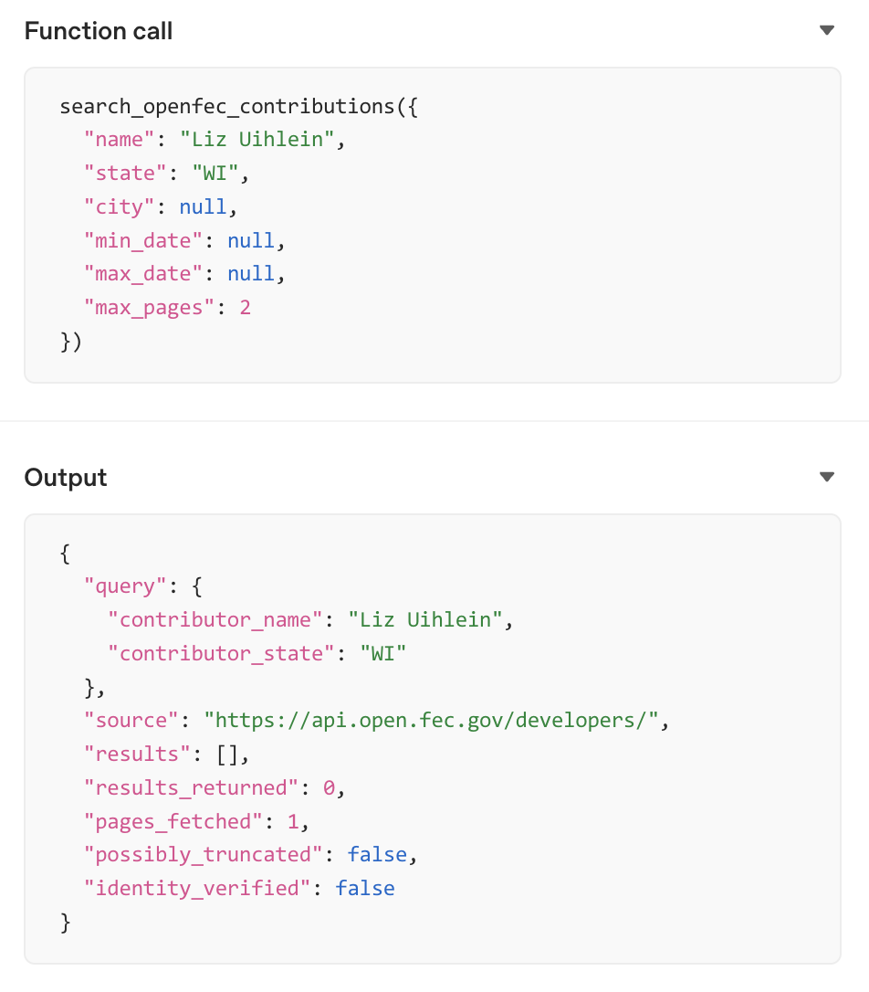
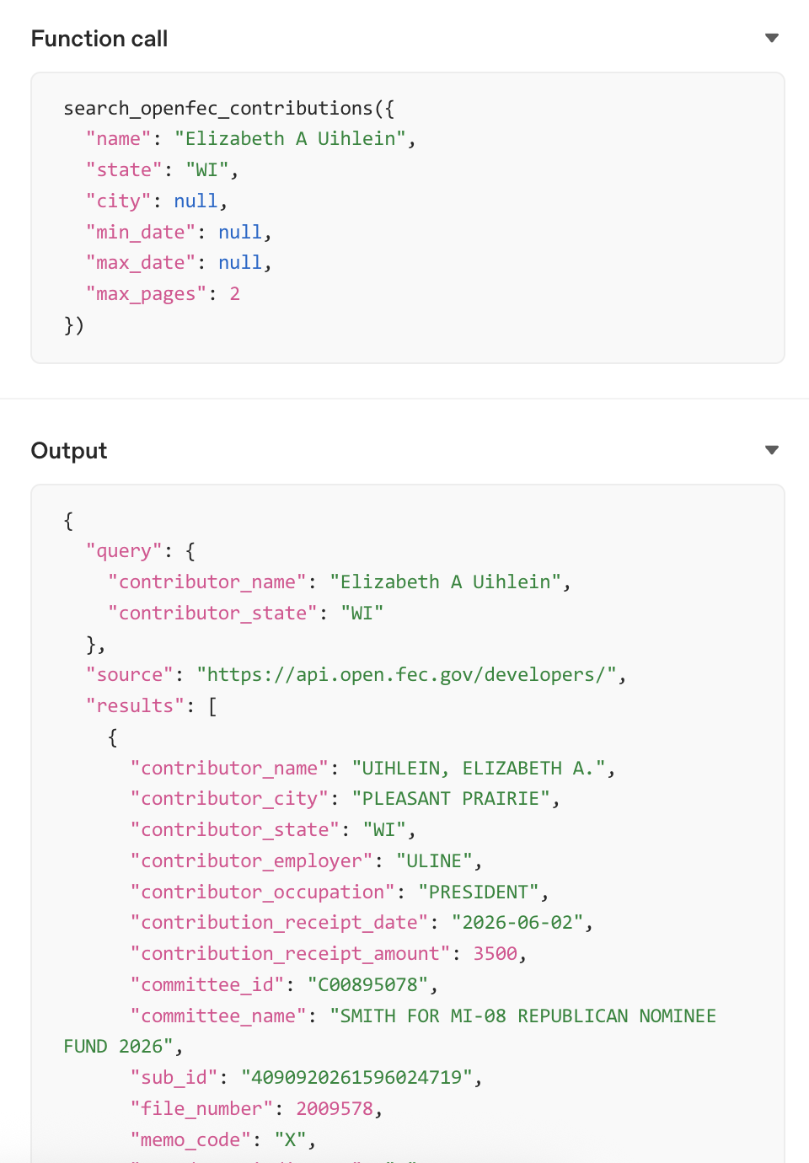
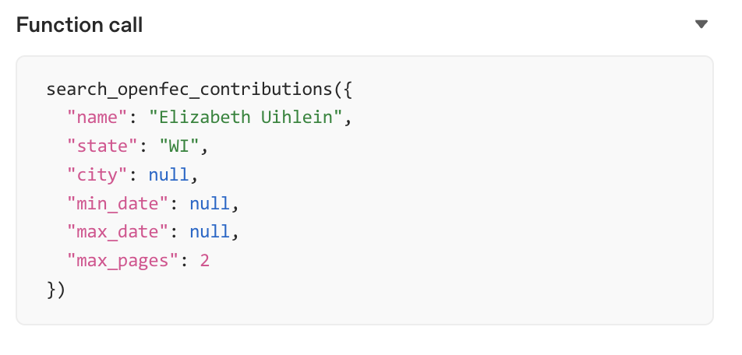

Slide 53
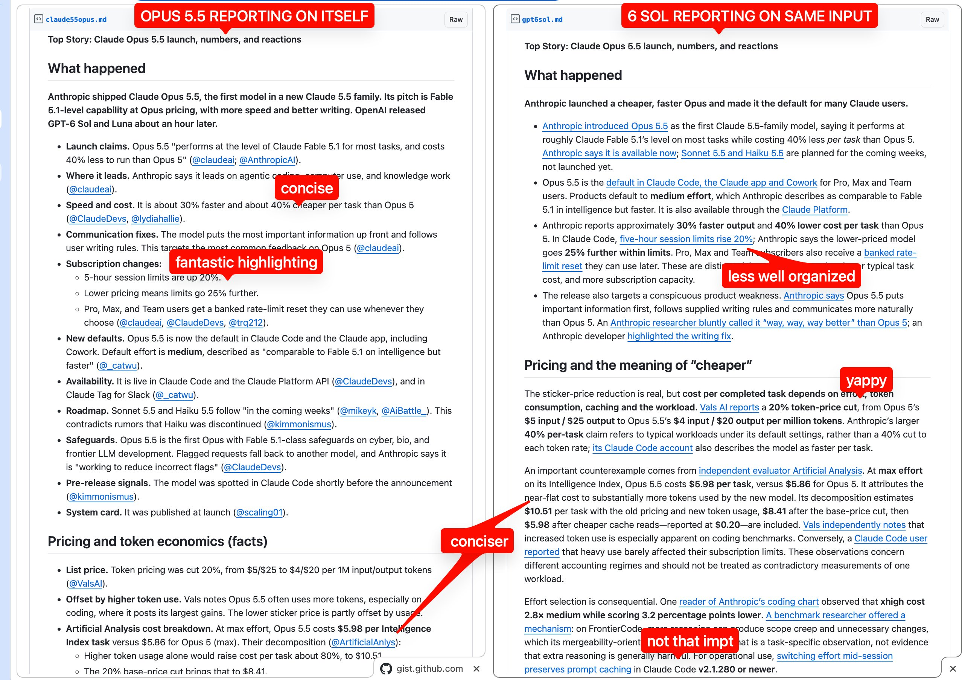
Experimentation opens doors!
https://x.com/swyx/status/2102650014552182920

Slide 54
A gotcha: things change

Slide 55
A gotcha: the bitter lesson
A better model is just about to solve the problem without any extra prompting work!

Slide 56
Evaluate: Story-to-blurb summarizer
We are designing something to make it easy for our reporters to write blurbs for newsletters and/or social media. It takes a story, outputs a blurb.
What is our evaluation criteria?
  Honestly, we probably won’t know what’s good/bad until we iterate a bunch!!
What are our dimensions of difference?
  Beat/topic
  Which social media channel it is going to/target newsletter audience
  Level of seriousness
  Probably 1,000 things we can’t think of, this is how everyone gets bitten
How do we generate synthetic examples of entire stories?
  We don’t! Just take the past year of examples
What does our spreadsheet look like?
  Do we need a gold set? If yes, how do we build it?
Do we need tracing?

Slide 57
Evaluate: “Ask our archives” bot
We’re designing a chatbot to answer questions about local development.
What is our evaluation criteria?
  Accurate: answer reflects reporting
  Evidence-backed: citations support claims
  More recent information supercedes older information
  Acknowledges gaps
What are our dimensions of difference?
  Unrelated topic, red teaming, biased question, about old data, etc
What does our spreadsheet look like?
  Do we need a gold set? If yes, how do we build it?
Do we need tracing?
  Most likely! It will be important to dig into how it’s actually searching.

Slide 58
Stress-Testing AI:
How to Evaluate Whether Your AI Tools Are Working
Jonathan Soma
js4571@columbia.edu @dangerscarf
Columbia University

