Slide 1
Many-core Architectures
Sathish Vadhiyar
Introduction to Scalable Systems

Slide 2
Introduction
Graphical Processing Unit
A single CPU can consist of 2, 4, 8 or 12 cores
GPUs consist of a large number of light-weight cores
Primarily proposed for graphics applications
  Consists of stages with each stage consisting of independent computations

Slide 3
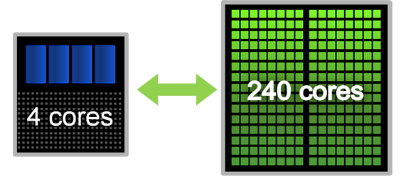
GPU and CPU, CUDA
Typically GPU and CPU coexist in a heterogeneous setting
“Less” computationally intensive part runs on CPU (coarse-grained parallelism), and more intensive parts run on GPU (fine-grained parallelism)
NVIDIA’s GPU architecture is called CUDA (Compute Unified Device Architecture) architecture, accompanied by CUDA programming model, and CUDA C language

Slide 4
SPs and SMX
GPU cores are called streaming processors (SPs)
SP cores grouped into streaming multiprocessors (SMX)
Promotes coarse and fine-level parallelism
Kepler K40 – 15 SMXs consisting of 192 SP cores each for a total of 2880 SP cores
Light-weight – 745 MHz
SIMD execution (actually SIMT)

Slide 5
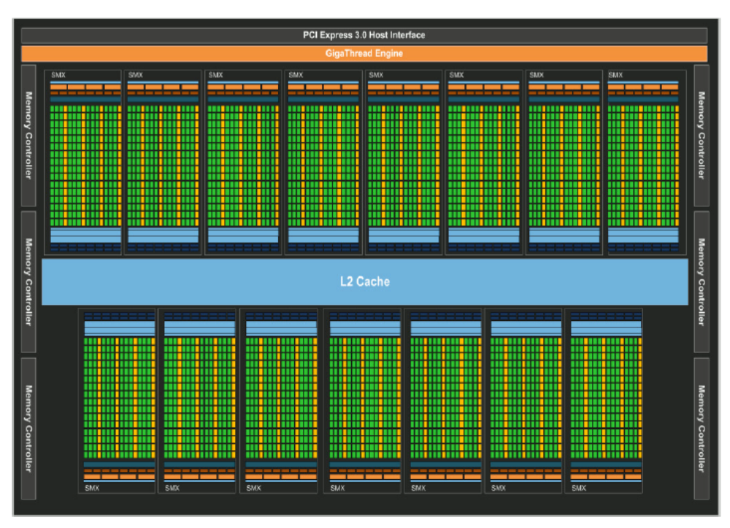


Slide 6
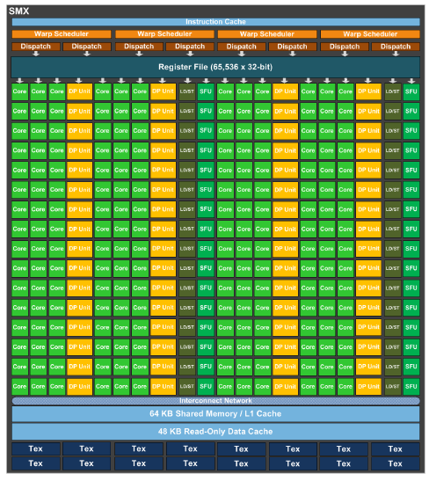
Streaming Multiprocessor (SMX) Architecture
65536 registers
192 SP cores
64 DP cores
32 Special functional units (SFUs)
32 load/store units
16 texture filtering units
Shared memory size = 16/32/48 K

Slide 7
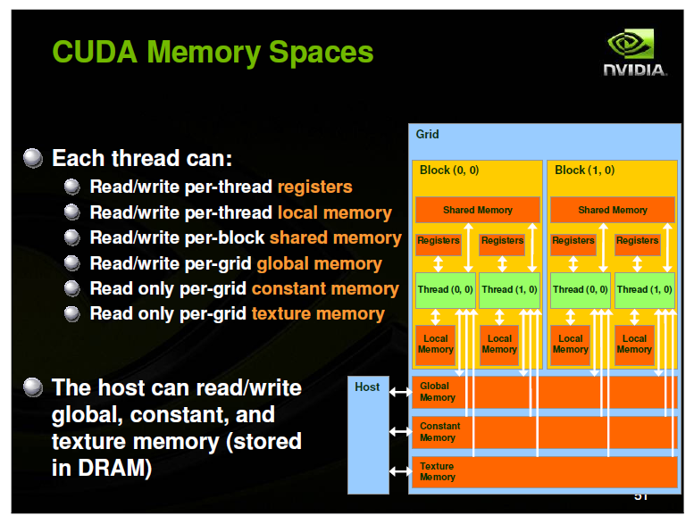

Slide 8
Memory Hierarchy
Global or Device memory:
  Can be accessed by all the threads executing in all the SMXs
  Can be accessed by the CPU host
  Kepler K40: 12 GB
Shared memory:
  In each SMX
  Shared by all the threads of a thread block executing in a SMX
  Kepler K40: 64 KB can be configured as 16/32/48KB for shared memory, with the rest for L1 cache

Slide 9
Memory Hierarchy
Registers
  In each SMX
  Used for storing the local data of the threads
  Kepler k40: 64K registers in each SMX
Constant and texture memory
  Accessed by all the threads
  Texture memory: used to improve performance of reads that exhibit spatial locality among the threads
Latency of data access
  Device memory: 200-400 clock cycles (about 300 ns)
  Shared memory: 20-30 clock cycles (about 5 ns)

Slide 10
Differences with the CPU threads
Context switching fast: The state of a thread (thread block) stored in shared memory and registers stay till execution completion
Cache explicitly managed: User’s program will have to explicitly bring the frequently accessed data from the device to the shared memory

Slide 11
Intel Xeon Phi Coprocessors and Vectorization
The previous generation Intel Xeon Phi coprocessors (Knights Corner) has 61 cores, with each core (1.05 GHz) supporting 4 hardware threads
Each core has L1 and L2 caches

Slide 12
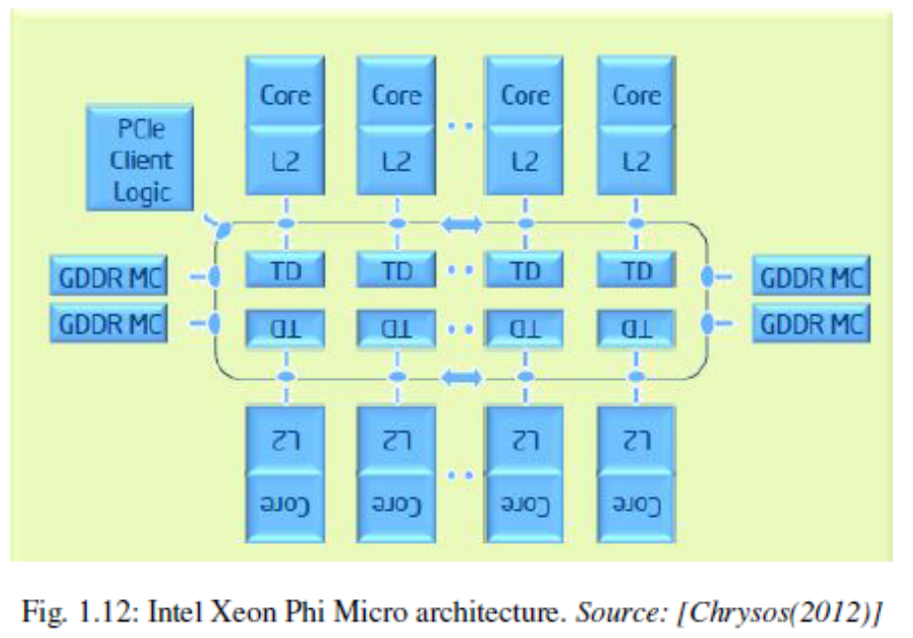
Intel Xeon Phi
L2 caches of cores connected by bidirectional rings
Cache coherence of L2 caches achieved using distributed tagged directory (DTD) scheme
L1 cache miss -> lookup of local L2 cache -> if miss, lookup of remote L2 cache using DTD

Slide 13
Vectorization
Each core has a 512-bit wide vector processing unit (VPU)
A VPU can process 8 double precision instructions per cycle

