Slide 1
Parallel Architecture
Sathish Vadhiyar
Notes:
L1

Slide 2
Motivations of Parallel Computing
Faster execution times
  From days or months to hours or seconds
  E.g., climate modelling, bioinformatics
Large amount of data dictate parallelism
Parallelism more natural for certain kinds of problems, e.g., climate modelling
Due to computer architecture trends
  CPU speeds have saturated
  Slow memory bandwidths
Notes:
Lec22

Slide 3
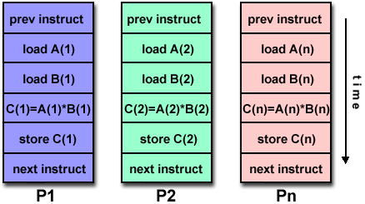
Classification of Architectures – Flynn’s classification
In terms of parallelism in instruction and data stream
Single Instruction Single Data (SISD): Serial Computers
Single Instruction Multiple Data (SIMD)
- Vector processors and processor arrays
- Examples: CM-2, Cray-90, Cray YMP, Hitachi 3600
Courtesy: http://www.llnl.gov/computing/tutorials/parallel_comp/

Slide 4
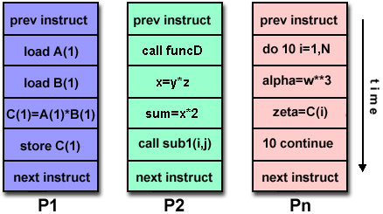
Classification of Architectures – Flynn’s classification
Multiple Instruction Single Data (MISD): Not popular
Multiple Instruction Multiple Data (MIMD)
- Most popular
- IBM SP and most other supercomputers,
clusters, computational Grids etc.
Courtesy: http://www.llnl.gov/computing/tutorials/parallel_comp/

Slide 5
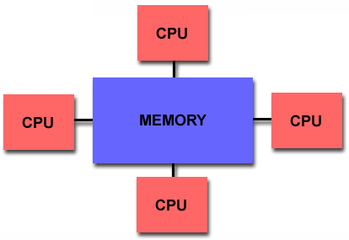
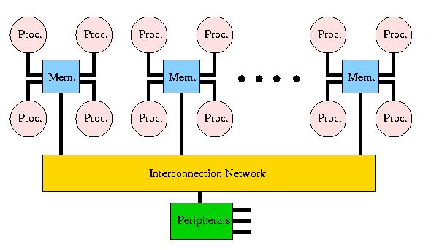
Classification of Architectures – Based on Memory
Shared memory
2 types – UMA and NUMA
NUMA
Examples: HP-Exemplar, SGI Origin, Sequent NUMA-Q
UMA
Courtesy: http://www.llnl.gov/computing/tutorials/parallel_comp/

Slide 6
Classification 2:
Shared Memory vs Message Passing
Shared memory machine: The n processors share physical address space
  Communication can be done through this shared memory
The alternative is sometimes referred to as a message passing machine or a distributed memory machine
P
P
P
P
P
P
P
M
M
M
M
M
M
M
P
P
P
P
P
Interconnect
P
P
Interconnect
Main Memory
Notes:
Lec22

Slide 7
Shared Memory Machines
The shared memory could itself be distributed among the processor nodes
  Each processor might have some portion of the shared physical address space that is physically close to it and therefore accessible in less time
  Terms: NUMA vs UMA architecture
    Non-Uniform Memory Access
    Uniform Memory Access
Notes:
Lec22

Slide 8
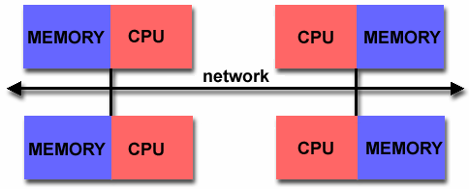
Classification of Architectures – Based on Memory
Distributed memory
Courtesy: http://www.llnl.gov/computing/tutorials/parallel_comp/
Recently multi-cores
Yet another classification – MPPs, NOW (Berkeley), COW, Computational Grids

Slide 9
SHARED MEMORY AND CACHES

Slide 10
Shared Memory Architecture: Caches
P1
P2
Read X
Read X
Write X=1
Read X
Cache hit: Wrong data!!
X: 1
X: 0
X: 0
X: 0
X: 1
Notes:
Lec24

Slide 11
Cache Coherence Problem
If each processor in a shared memory multiple processor machine has a data cache
  Potential data consistency problem: the cache coherence problem
  Shared variable modification, private cache
Objective: processes shouldn’t read `stale’ data
Solutions
  Hardware: cache coherence mechanisms
Notes:
Lec24

Slide 12
Cache Coherence Protocols
Write update – propagate cache line to other processors on every write to a processor
Write invalidate – each processor gets the updated cache line whenever it reads stale data
Which is better?
Notes:
Lec24

Slide 13
Invalidation Based Cache Coherence
P1
P2
Read X
Read X
Write X=1
Read X
X: 1
X: 1
X: 0
X: 0
Invalidate
X: 1
X: 0
Notes:
Lec24

Slide 14
Cache Coherence using invalidate protocols
3 states associated with data items
  Shared – a variable shared by 2 caches
  Invalid – another processor (say P0) has updated the data item
  Dirty – state of the data item in P0

Slide 15
Implementations of cache coherence protocols
Snoopy
    for bus based architectures
    shared bus interconnect where all cache controllers monitor all bus activity
    There is only one operation through bus at a time; cache controllers can be built to take corrective action and enforce coherence in caches
    Memory operations are propagated over the bus and snooped

Slide 16
Implementations of cache coherence protocols
Directory-based
    Instead of broadcasting memory operations to all processors, propagate coherence operations to relevant processors
    A central directory maintains states of cache blocks, associated processors

Slide 17
Implementation of Directory Based Protocols
Using presence bits for the owner processors
Two schemes:
Full bit vector scheme – O(MxP) storage for P processors and M cache lines
But not necessary
Modern day processors use sparse or tagged directory scheme
Limited cache lines and limited presence bits

Slide 18
False Sharing
Cache coherence occurs at the granularity of cache lines – an entire cache line is invalidated
Modern day cache lines are 64 bytes in size
Consider a Fortran program dealing with a matrix
Assume each thread or process accessing a row of a matrix
Leads to false sharing

Slide 19
False sharing: Solutions
Reorganize the code so that each processor access a set of rows
Can still lead to overlapping of cache lines if matrix size not divisible by processors
In such cases, employ padding
Padding: dummy elements added to make the matrix size divisible

Slide 20
Parallel Architecture: Interconnection Networks
An interconnection network defined by switches, links and interfaces
  Switches – provide mapping between input and output ports, buffering, routing etc.
  Interfaces – connects nodes with network

Slide 21
Parallel Architecture: Interconnections
Indirect interconnects: nodes are connected to interconnection medium, not directly to each other
  Shared bus, multiple bus, crossbar, MIN
Direct interconnects: nodes are connected directly to each other
  Topology: linear, ring, star, mesh, torus, hypercube
  Routing techniques: how the route taken by the message from source to destination is decided
Network topologies
  Static – point-to-point communication links among processing nodes
  Dynamic – Communication links are formed dynamically by switches
Notes:
Lec22

Slide 22
Interconnection Networks
Static
  Bus
  Completely connected
  Star
  Linear array, Ring (1-D torus)
  Mesh
  k-d mesh: d dimensions with k nodes in each dimension
  Hypercubes – 2-logp mesh
  Trees – our campus network
Dynamic – Communication links are formed dynamically by switches
  Crossbar
  Multistage
For more details, and evaluation of topologies, refer to book by Grama et al.

Slide 23
Indirect Interconnects
Shared bus
Multiple bus
2x2 crossbar
Crossbar switch
Multistage Interconnection Network
Notes:
Lec22

Slide 24
Direct Interconnect Topologies
Star
Ring
Linear
2D
Mesh
Hypercube
(binary n-cube)
n=2
n=3
Torus
Notes:
Lec22

Slide 25
Evaluating Interconnection topologies
Diameter – maximum distance between any two processing nodes
  Full-connected –
  Star –
  Ring –
  Hypercube -
Connectivity – multiplicity of paths between 2 nodes. Miniimum number of arcs to be removed from network to break it into two disconnected networks
  Linear-array –
  Ring –
  2-d mesh –
  2-d mesh with wraparound –
  D-dimension hypercubes –
1
2
p/2
logP
1
2
2
4
d

Slide 26
Evaluating Interconnection topologies
bisection width – minimum number of links to be removed from network to partition it into 2 equal halves
  Ring –
  P-node 2-D mesh -
  Tree –
  Star –
  Completely connected –
  Hypercubes -
2
Root(P)
1
1
P²/4
P/2

Slide 27
Evaluating Interconnection topologies
channel width – number of bits that can be simultaneously communicated over a link, i.e. number of physical wires between 2 nodes
channel rate – performance of a single physical wire
channel bandwidth – channel rate times channel width
bisection bandwidth – maximum volume of communication between two halves of network, i.e. bisection width times channel bandwidth

