Slide 1
Parallelization Principles
Sathish Vadhiyar
Notes:
L1

Slide 2
Parallel Programming and Challenges
Recall the advantages and motivation of parallelism
But parallel programs incur overheads not seen in sequential programs
  Communication delay
  Idling
  Synchronization

Slide 3
Challenges
P0
P1
Idle time
Computation
Communication
Synchronization

Slide 4
How do we evaluate a parallel program?
Execution time, T_{p}
Speedup, S
  S(p, n) = T(1, n) / T(p, n)
  Usually, S(p, n) < p
  Sometimes S(p, n) > p (superlinear speedup)
Efficiency, E
  E(p, n) = S(p, n)/p
  Usually, E(p, n) < 1
  Sometimes, greater than 1
Scalability – Limitations in parallel computing, relation to n and p.

Slide 5
Speedups and efficiency
S
E
p
p
Ideal
Practical

Slide 6
Limitations on speedup – Amdahl’s law
Amdahl's law states that the performance improvement to be gained from using some faster mode of execution is limited by the fraction of the time the faster mode can be used.
Overall speedup in terms of fractions of computation time with and without enhancement, % increase in enhancement.
Places a limit on the speedup due to parallelism.
Speedup = 1
(f_{s} + (f_{p}/P))

Slide 7
Gustafson’s Law
Increase problem size proportionally so as to keep the overall time constant
The scaling keeping the problem size constant (Amdahl’s law) is called strong scaling
The scaling due to increasing problem size is called weak scaling

Slide 8
Scalability and Isoefficiency
Efficiency decreases with increasing P; increases with increasing N
How effectively the parallel algorithm can use an increasing number of processors
How the amount of computations performed must scale with P to keep E constant
This function of computation in terms of P is called isoefficiency function.

Slide 9
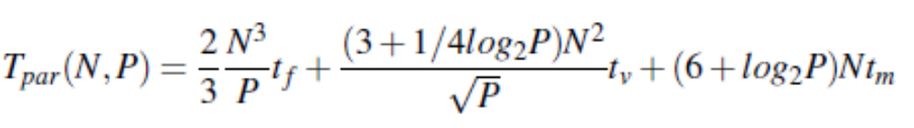
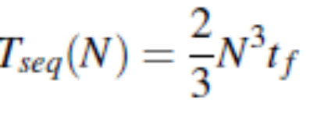
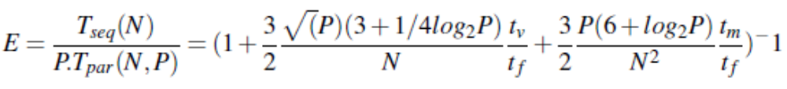



Example: ScaLAPACK PDGESV
As P is increased, N should be increased by approx.
As amount of computations is , the isoefficiency function is

Slide 10
Isoefficiency
Smaller isoefficiency functions imply higher scalability
Consider two parallel algorithms with isoefficiency functions W1=O(P) and W2=O(root-P)
The second algorithm is considered to be more scalable since only small amount of work needs to be added
Similarly, an algorithm with an isoefficiency function of O(P) is highly scalable while an algorithm with quadratic or exponential isoefficiency function is poorly scalable

Slide 11
PARALLEL PROGRAMMING CLASSIFICATION AND STEPS

Slide 12
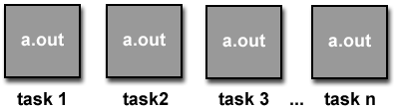
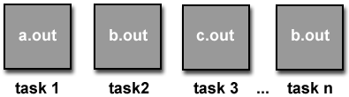
Parallel Program Models
Single Program Multiple Data (SPMD)
Multiple Program Multiple Data (MPMD)
Courtesy: http://www.llnl.gov/computing/tutorials/parallel_comp/

Slide 13
Programming Paradigms
Shared memory model – Threads, OpenMP, CUDA
Message passing model – MPI

Slide 14
Parallelizing a Program
Given a sequential program/algorithm, how to go about producing a parallel version
Four steps in program parallelization
  Decomposition
    Identifying parallel tasks with large extent of possible concurrent activity; splitting the problem into tasks
  Assignment
    Grouping the tasks into processes with best load balancing
  Orchestration
    Reducing synchronization and communication costs
  Mapping
    Mapping of processes to processors (if possible)
Notes:
L27

Slide 15
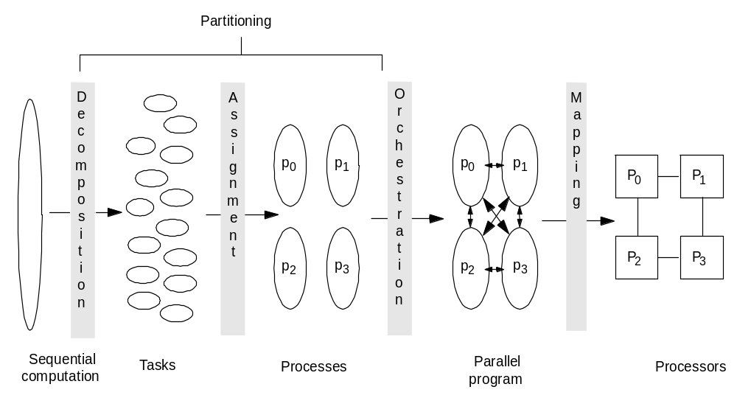
Steps in Creating a Parallel Program

Slide 16
Decomposition and Assignment
Specifies how to group tasks together for a process
  Balance workload, reduce communication and management cost
Structured approaches usually work well
  Code inspection (parallel loops) or understanding of application
  Static versus dynamic assignment
Both decomposition and assignment are usually independent of architecture or prog model
  But cost and complexity of using primitives may affect decisions
In practical cases, both steps combined into one step, trying to answer the question “What is the role of each parallel processing entity?”

Slide 17
Data Parallelism and Domain Decomposition
Given data divided across the processing entitites
Each process owns and computes a portion of the data – owner-computes rule
Multi-dimensional domain in simulations divided into subdomains equal to processing entities
This is called domain decomposition

Slide 18
Domain decomposition and Process Grids
The given P processes arranged in multi-dimensions forming a process grid
The domain of the problem divided into process grid
For dividing the data in a dimension using the processes in a dimension, data distribution schemes are followed
Common data distributions:
  Block: for regular computations
  Block-cyclic: when there is load imbalance across space

Slide 19
Task parallelism
Independent tasks identified
The task may or may not process different data
The tasks are grouped by a process called mapping
Two objectives:
  Balance the groups
  Minimize inter-group dependencies
Represented as task graph
Mapping problem is NP-hard

Slide 20
Orchestration
Goals
  Structuring communication
  Synchronization
Challenges
  Organizing data structures – packing
  Small or large messages?
  How to organize communication and synchronization ?

Slide 21
Orchestration
Maximizing data locality
  Minimizing volume of data exchange
    Not communicating intermediate results – e.g. dot product
  Minimizing frequency of interactions - packing
Minimizing contention and hot spots
  Do not use the same communication pattern with the other processes in all the processes
Overlapping computations with interactions
  Split computations into phases: those that depend on communicated data (type 1) and those that do not (type 2)
  Initiate communication for type 1; During communication, perform type 2
Replicating data or computations
  Balancing the extra computation or storage cost with the gain due to less communication

Slide 22
Mapping
Which process runs on which particular processor?
  Can depend on network topology, communication pattern of processes
  On processor speeds in case of heterogeneous systems

Slide 23
Mapping
Static mapping
  Mapping based on Data partitioning
    Applicable to dense matrix computations
    Block distribution
    Block-cyclic distribution
  Graph partitioning based mapping
    Applicable for sparse matrix computations
  Mapping based on task partitioning
0
0
0
1
1
1
2
2
2
0
1
2
0
1
2
0
1
2

Slide 24
Based on Task Partitioning
Based on task dependency graph
In general the problem is NP complete
0
0
4
0
2
4
6
0
1
2
3
4
5
6
7

Slide 25
Mapping
Dynamic Mapping
  A process/global memory can hold a set of tasks
  Distribute some tasks to all processes
  Once a process completes its tasks, it asks the coordinator process for more tasks
  Referred to as self-scheduling, work-stealing

Slide 26
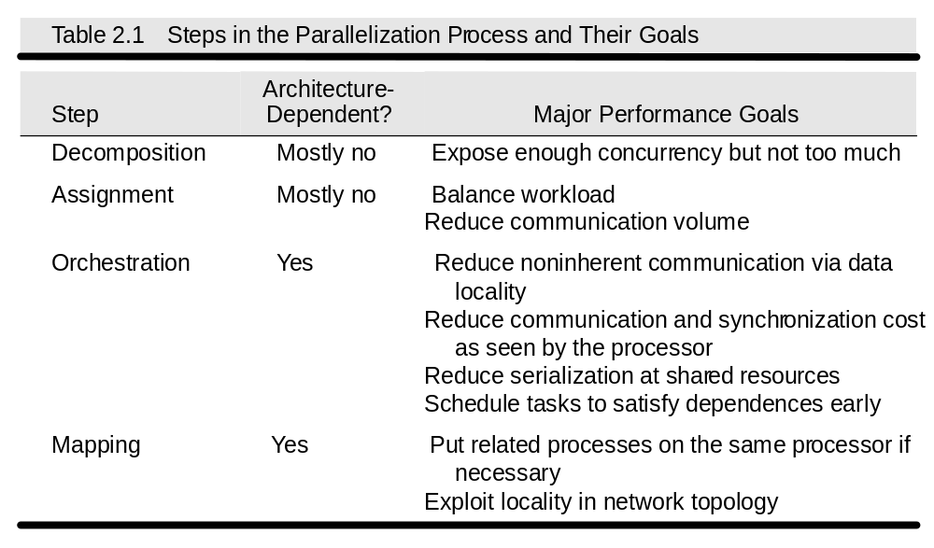
High-level Goals

Slide 27
Example
Given a 2-d array of float values, repeatedly average each elements with immediate neighbours until the difference between two iterations is less than some tolerance value
do {
diff = 0.0
for (i=0; i < n; i++)
  for (j=0; j < n, j++){
  temp = A[i] [j];
  A[i][j] = average (neighbours);
  diff += abs (A[i][j] – temp);
  }
  while (diff > tolerance) ;
A[i-1][j]
A[i][j-1]
A[i][j]
A[i][j+1]
A[i+1][j]
Notes:
L27

Slide 28
Assignment Options
A concurrent task for each element update
  Max concurrency: n**2
  Synch: wait for left & top values
  High synchronization cost
Concurrent tasks for elements in anti-diagonal
  No dependence among elements in a diagonal
  Max concurrency: ~ n
  Synch: must wait for previous anti-diagonal values; less cost than for previous scheme
Notes:
L27

Slide 29
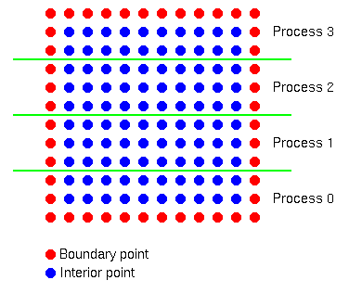
Option 2 - Anti-diagonals
Notes:
L27

Slide 30
Assignment Options
A concurrent task for each element update
  Max concurrency: n**2
  Synch: wait for left & top values
  High synchronization cost
A concurrent task for each anti-diagonal
  No dependence among elements in task
  Max concurrency: ~ n
  Synch: must wait for previous anti-diagonal values; less cost than for previous scheme
A concurrent task for each block of rows
Notes:
L27

Slide 31
Assignment -- Option 3
P
0
P
1
P
2
P
4

Slide 32
Orchestration
Different for different programming models/architectures
  Shared address space
    Naming: global addr. Space
    Synch. through barriers and locks
  Distributed Memory /Message passing
    Non-shared address space
    Send-receive messages + barrier for synch.

Slide 33
SAS Version – Generating Processes
1. int n, nprocs; /* matrix: (n + 2-by-n + 2) elts.*/
2. float **A, diff = 0;
2a. LockDec (lock_diff);
2b. BarrierDec (barrier1);
3. main()
4. begin
5. read(n) ; /*read input parameter: matrix size*/
5a. Read (nprocs);
6. A ← g_malloc (a 2-d array of (n+2) x (n+2) doubles);
6a. Create (nprocs -1, Solve, A);
7. initialize(A); /*initialize the matrix A somehow*/
8. Solve (A); /*call the routine to solve equation*/
8a. Wait_for_End (nprocs-1);
9. end main

Slide 34
SAS Version -- Solve
10. procedure Solve (A) /*solve the equation system*/
11. float **A; /*A is an (n + 2)-by-(n + 2) array*/
12. begin
13. int i, j, pid, done = 0;
14. float temp;
14a. mybegin = 1 + (n/nprocs)*pid;
14b. myend = mybegin + (n/nprocs);
15. while (!done) do /*outermost loop over sweeps*/
diff = 0; /*initialize difference to 0*/
16a. Barriers (barrier1, nprocs);
17. for i ← mybeg to myend do/*sweep for all points of grid*/
18. for j ← 1 to n do
19. temp = A[i,j]; /*save old value of element*/
20. A[i,j] ← 0.2 * (A[i,j] + A[i,j-1] + A[i-1,j] +
21. A[i,j+1] + A[i+1,j]); /*compute average*/
22. diff += abs(A[i,j] - temp);
23. end for
24. end for
25. if (diff/(n*n) < TOL) then done = 1;
26. end while
27. end procedure

Slide 35
SAS Version -- Issues
SPMD program
Wait_for_end – all to one communication
How is diff accessed among processes?
  Mutex to ensure diff is updated correctly.
  Single lock ⇒ too much synchronization!
  Need not synchronize for every grid point. Can do only once.
What about access to A[i][j], especially the boundary rows between processes?
Can loop termination be determined without any synch. among processes?
  Do we need any statement for the termination condition statement

Slide 36
SAS Version -- Solve
10. procedure Solve (A) /*solve the equation system*/
11. float **A; /*A is an (n + 2)-by-(n + 2) array*/
12. begin
13. int i, j, pid, done = 0;
14. float mydiff, temp;
14a. mybegin = 1 + (n/nprocs)*pid;
14b. myend = mybegin + (n/nprocs);
15. while (!done) do /*outermost loop over sweeps*/
mydiff = diff = 0; /*initialize local difference to 0*/
16a. Barriers (barrier1, nprocs);
17. for i ← mybeg to myend do/*sweep for all points of grid*/
18. for j ← 1 to n do
19. temp = A[i,j]; /*save old value of element*/
20. A[i,j] ← 0.2 * (A[i,j] + A[i,j-1] + A[i-1,j] +
21. A[i,j+1] + A[i+1,j]); /*compute average*/
22. mydiff += abs(A[i,j] - temp);
23. end for
24. end for
24a lock (diff-lock);
24b. diff += mydiff;
24c unlock (diff-lock)
24d. barrier (barrier1, nprocs);
25. if (diff/(n*n) < TOL) then done = 1;
25a. Barrier (barrier1, nprocs);
26. end while
27. end procedure

Slide 37
SAS Program
done condition evaluated redundantly by all
Code that does the update identical to sequential program
  each process has private mydiff variable
Most interesting special operations are for synchronization
  accumulations into shared diff have to be mutually exclusive
  why the need for all the barriers?
Good global reduction?
  Utility of this parallel accumulate??

Slide 38
Message Passing Version
Cannot declare A to be global shared array
  compose it from per-process private arrays
  usually allocated in accordance with the assignment of work -- owner-compute rule
    process assigned a set of rows allocates them locally
Structurally similar to SPMD SAS
Orchestration different
  data structures and data access/naming
  communication
  synchronization
Ghost rows

Slide 39
Data Layout and Orchestration
P
0
P
0
P
1
P
1
P
2
P
4
P
2
Data partition allocated per processor
Add ghost rows to hold boundary data
Send edges to neighbors
P
4
Receive into ghost rows
Compute as in sequential program

Slide 40
Message Passing Version – Generating Processes
1. int n, nprocs; /* matrix: (n + 2-by-n + 2) elts.*/
2. float **myA;
3. main()
4. begin
5. read(n) ; /*read input parameter: matrix size*/
5a. read (nprocs);
/* 6. A ← g_malloc (a 2-d array of (n+2) x (n+2) doubles); */
6a. Create (nprocs -1, Solve, A);
/* 7. initialize(A); */ /*initialize the matrix A somehow*/
8. Solve (A); /*call the routine to solve equation*/
8a. Wait_for_End (nprocs-1);
9. end main

Slide 41
Message Passing Version – Array allocation and Ghost-row Copying
10. procedure Solve (A) /*solve the equation system*/
11. float **A; /*A is an (n + 2)-by-(n + 2) array*/
12. begin
13. int i, j, pid, done = 0;
14. float mydiff, temp;
14a. myend = (n/nprocs) ;
6. myA = malloc (array of (n/nprocs) x n floats );
7. initialize (myA); /* initialize myA LOCALLY */
15. while (!done) do /*outermost loop over sweeps*/
16. mydiff = 0; /*initialize local difference to 0*/
16a. if (pid != 0) then
SEND (&myA[1,0] , n*sizeof(float), (pid-1), row);
16b. if (pid != nprocs-1) then
SEND (&myA[myend,0], n*sizeof(float), (pid+1), row);
16c. if (pid != 0) then
RECEIVE (&myA[0,0], n*sizeof(float), (pid -1), row);
16d. if (pid != nprocs-1) then
RECEIVE (&myA[myend+1,0], n*sizeof(float), (pid -1), row);

Slide 42
Message Passing Version – Solver
12. begin
… … …
15. while (!done) do /*outermost loop over sweeps*/
… … …
17. for i ← 1 to myend do/*sweep for all points of grid*/
18. for j ← 1 to n do
19. temp = myA[i,j]; /*save old value of element*/
20. myA[i,j] ← 0.2 * (myA[i,j] + myA[i,j-1] +myA[i-1,j] +
21. myA[i,j+1] + myA[i+1,j]); /*compute average*/
22. mydiff += abs(myA[i,j] - temp);
23. end for
24. end for
24a if (pid != 0) then
24b. SEND (mydiff, sizeof (float), 0, DIFF);
24c. RECEIVE (done, sizeof(int), 0, DONE);
24d. else
24e. for k ← 1 to nprocs-1 do
24f. RECEIVE (tempdiff, sizeof(float), k , DIFF);
24g. mydiff += tempdiff;
24h. endfor
24i. If(mydiff/(n*n) < TOL) then done = 1;
24j. for k ← 1 to nprocs-1 do
24k. SEND (done, sizeof(float), k , DONE);
24l. endfor
25. end while
26. end procedure

Slide 43
Notes on Message Passing Version
Receive does not transfer data, send does
  unlike SAS which is usually receiver-initiated (load fetches data)
Can there be deadlock situation due to sends?
Communication done at once in whole rows at beginning of iteration, not grid-point by grid-point
Core similar, but indices/bounds in local rather than global space
Synchronization through sends and receives
  Update of global diff and event synch for done condition – mutual exclusion occurs naturally
Can use REDUCE and BROADCAST library calls to simplify code

Slide 44
Notes on Message Passing Version
/*communicate local diff values and determine if done, using reduction and broadcast*/
25b. REDUCE(0,mydiff,sizeof(float),ADD);
25c. if (pid == 0) then
25i. if (mydiff/(n*n) < TOL) then
25j. done = 1;
25k. endif
25m. BROADCAST(0,done,sizeof(int),DONE

Slide 45
Send and Receive Alternatives
  Semantic flavors: based on when control is returned
  Affect when data structures or buffers can be reused at either end
  Synchronous messages provide built-in synch. through match
  Separate event synchronization needed with asynch. Messages
  Now, deadlock can be avoided in our code.
Send/Receive
Synchronous
Asynchronous
Blocking asynch.
Nonblocking asynch.

Slide 46
Orchestration: Summary
Shared address space
  Shared and private data explicitly separate
  Communication implicit in access patterns
  Synchronization via atomic operations on shared data
  Synchronization explicit and distinct from data communication

Slide 47
Orchestration: Summary
Message passing
  Data distribution among local address spaces needed
  No explicit shared structures (implicit in comm. patterns)
  Communication is explicit
  Synchronization implicit in communication (at least in synch. case)

Slide 48
Grid Solver Program: Summary
Decomposition and Assignment similar in SAS and message-passing
Orchestration is different
  Data structures, data access/naming, communication, synchronization
  Performance?

Slide 49
Grid Solver Program: Summary
SAS
Msg-Passing
Explicit global data structure?
Yes
No
Communication
Implicit
Explicit
Synchronization
Explicit
Implicit
Explicit replication of border rows?
No
Yes

