Slide 1
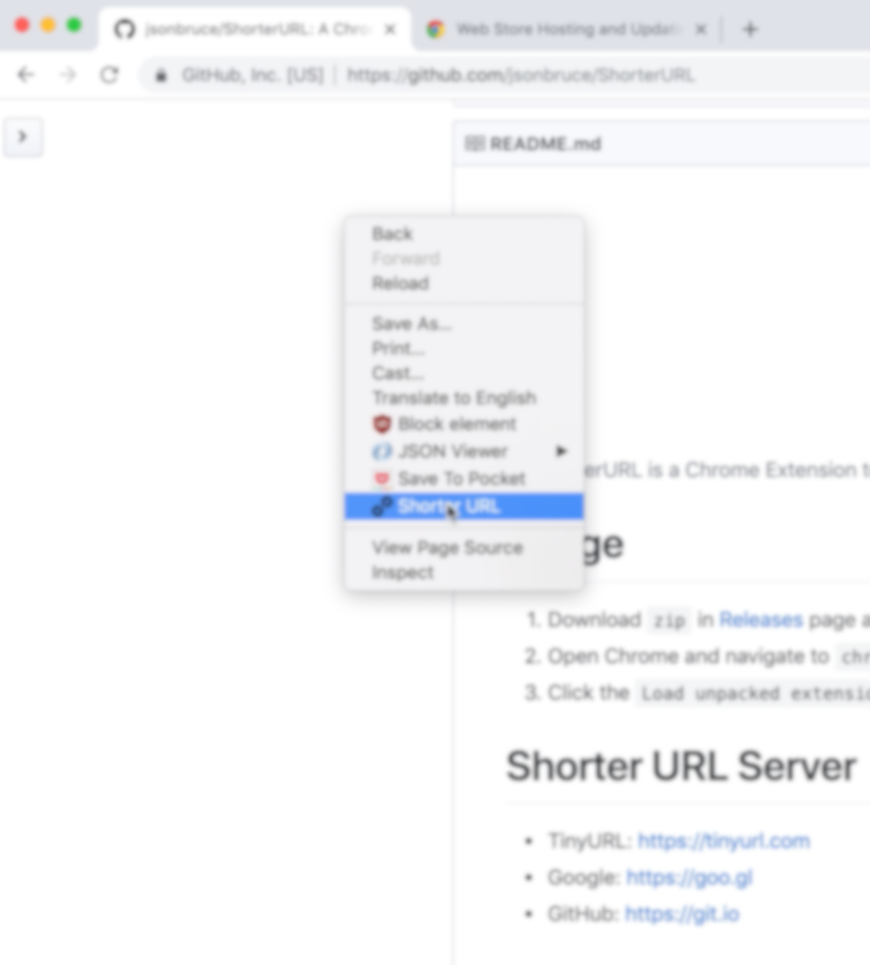
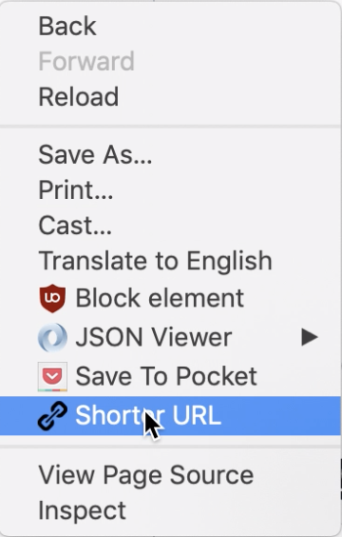
Just right click

Slide 2
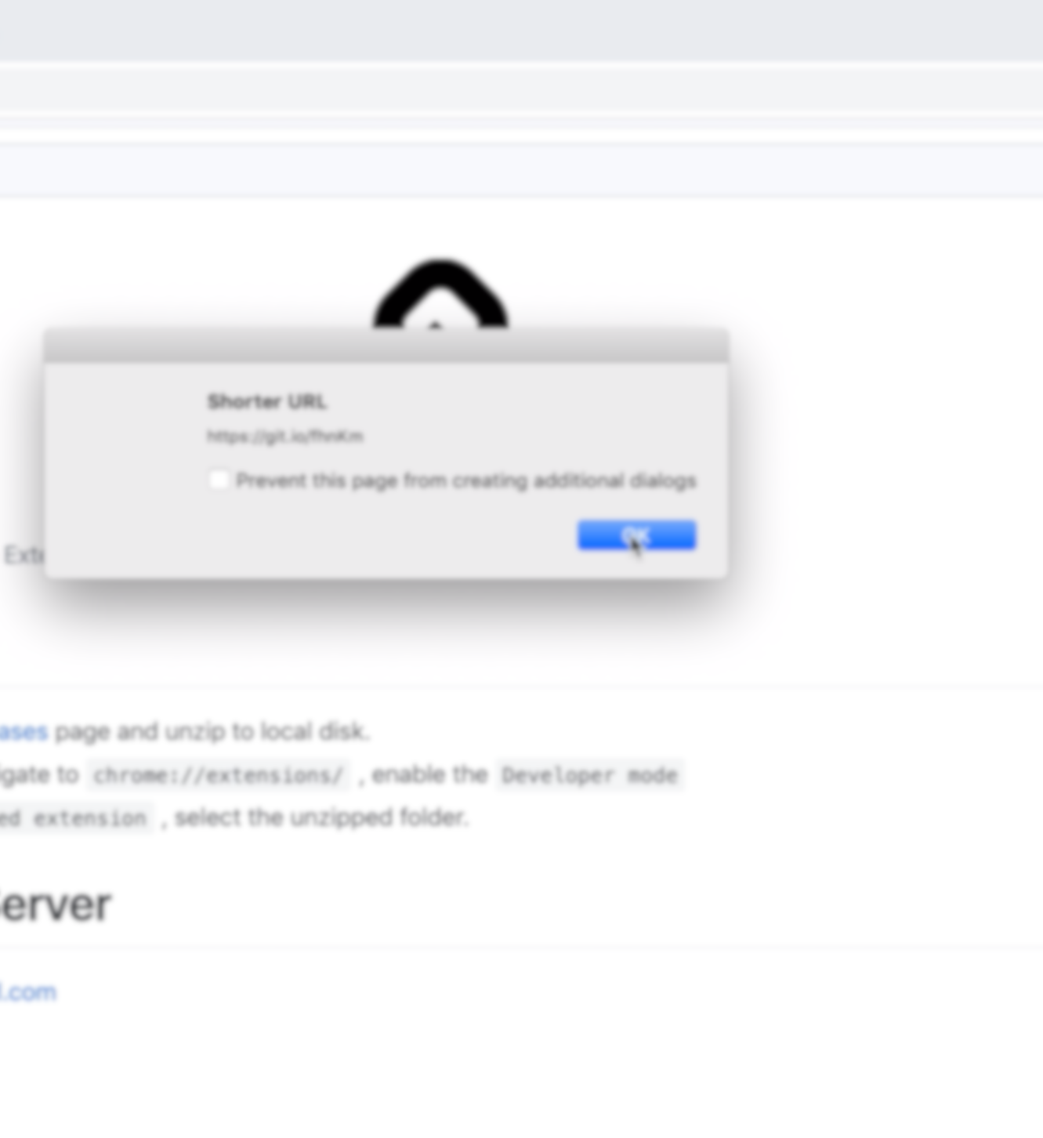
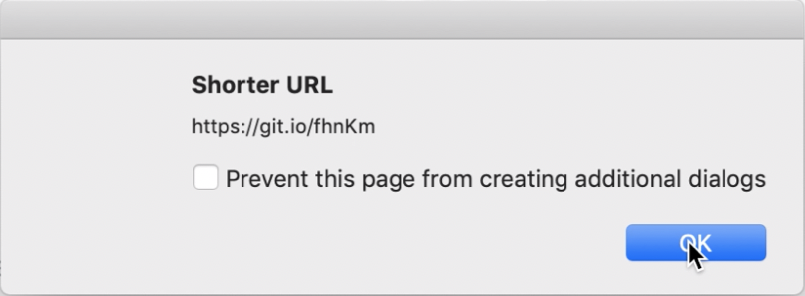
Auto copy to clipboard

Slide 4
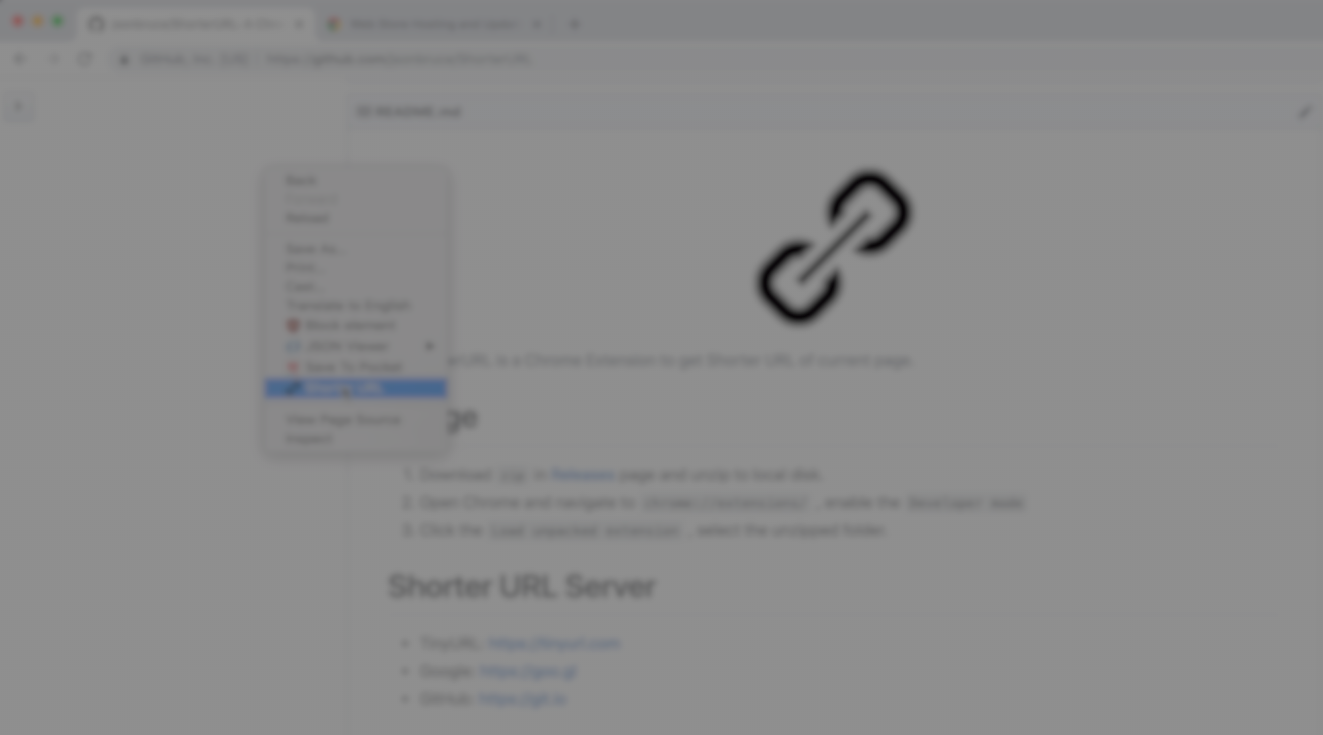
Just right click

Slide 5
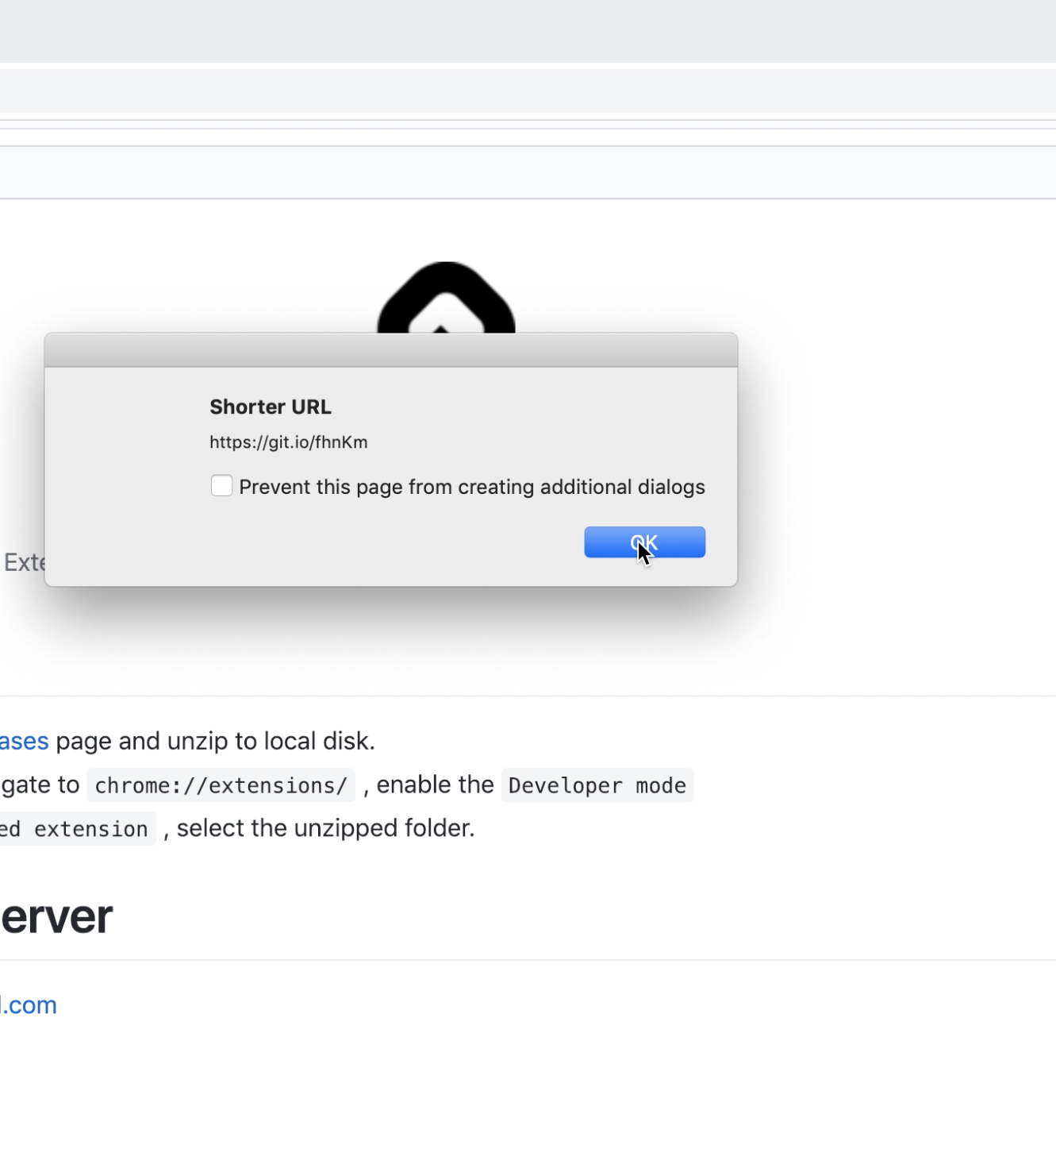
Auto copy to clipboard

Slide 6


Slide 7


Shorter URL

Slide 8

Shorter URL
Get a shorter URL for any website

Slide 9

Shorter URL
Get a shorter URL for any website

