Slide 1
Designing And Implementing A Protocol for Peer-to-Peer RTS Games in Unreal Engine
By Jason Crandall

Slide 2
Roadmap
Problem Overview
Challenges
Protocol Design
Security considerations
Real-world examples

Slide 3
Problem Overview

Slide 4
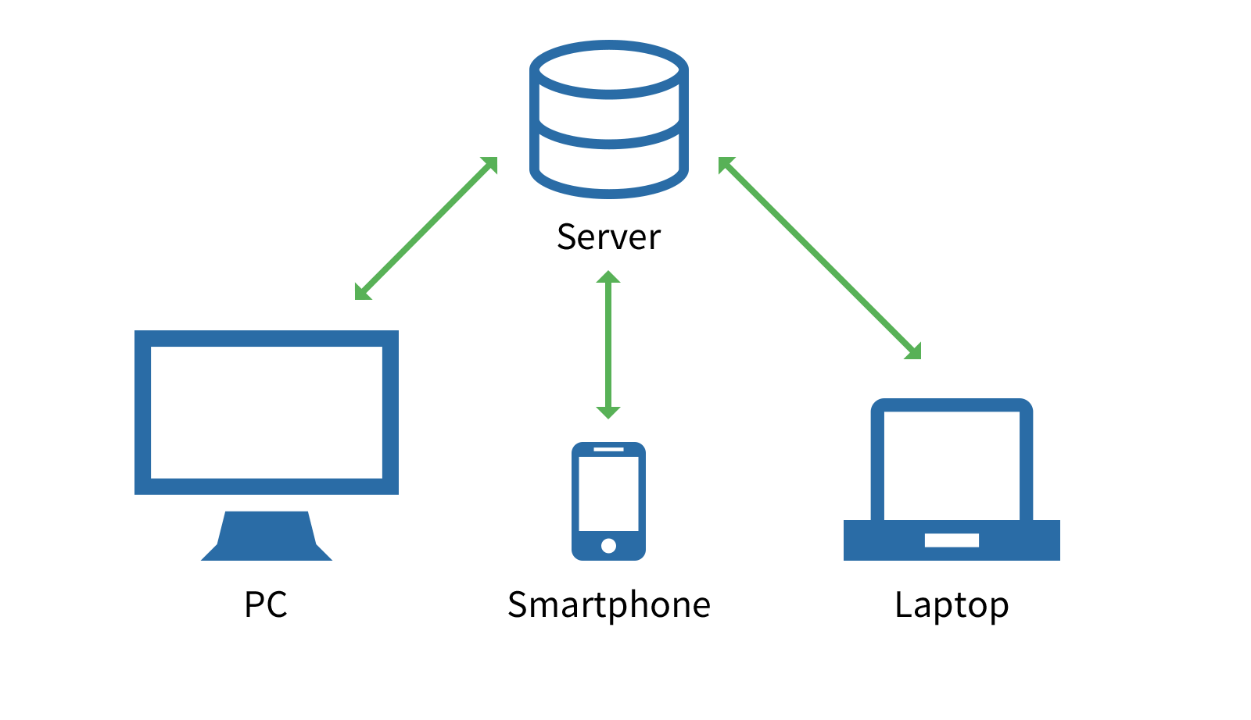
Multiplayer Game Architectures
Server-Authoritative
Clients all connect to an authoritative server, which replicates data to all other clients
One client may be assigned to be the “host” or “super-peer”, where they act as both a client and server
High latency from server RTT
Modern games use a combination of client-side prediction and entity interpolation to hide latency. Everyone sees something slightly different

Slide 5
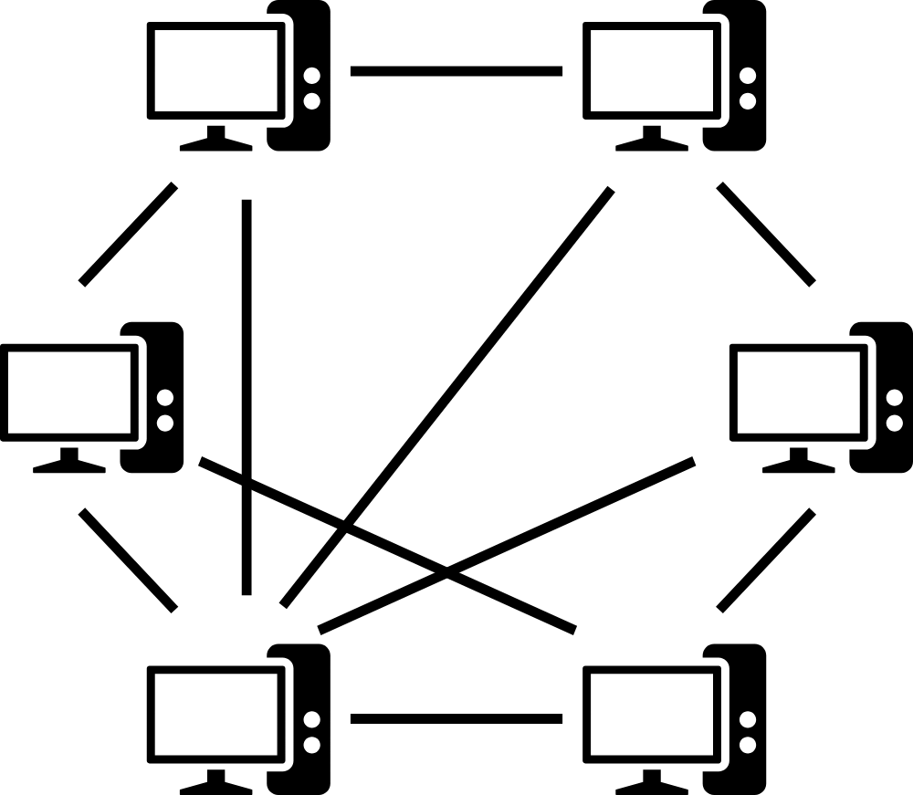
Multiplayer Game Architectures
Peer-to-Peer (P2P)
Clients all connect to directly to each other
No one client has authority
Each client runs their own simulation using the information from other peers
Lockstep P2P
Inputs are sent between clients, then the game is updated for each player
Requires less bandwidth
Every player sees the exact same game

Slide 6
P2P and RTS Games
While most modern games choose to use dedicated servers, P2P is still common in the real-time strategy (RTS) genre for a few reasons:
Replicating hundreds of units between several players has high bandwidth costs.
In highly competitive games, it is important that everyone sees the exact same game.

Slide 7
Project Goal
Due to the complexity of programming P2P games and lack of engine support, the RTS genre has been less accessible to indie developers
Goal: Design and implement a lockstep P2P framework in Unreal Engine for creating RTS games

Slide 8
Challenges

Slide 9
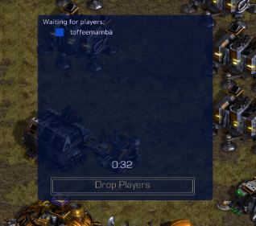
Avoiding Desyncs
Since each client is running their own version of the simulation, any deviation can break the whole game
The game simulation must be 100% deterministic
Random numbers need a shared seed
If cross platform, floating-point rounding differences can cause desyncs
If a peer gets disconnected, rejoining is extremely difficult
You can pause the simulation to wait for a slow or disconnected peer.

Slide 10
Unreal Engine Architecture
Unreal Engine is designed completely around a client-server architecture.
The protocol cannot use any built-in networking replication code
The implementation should support different socket subsystems for better compatibility
Ex. Steam Sockets
I had a lot of trouble determining if there was a higher-level abstraction for connection over UDP that supports P2P connection, so I resorted to using the low-level socket API

Slide 11
Protocol Design

Slide 12
Protocol Design - Glossary
Action – A single input instruction such as moving a unit, attacking an enemy, or building a structure.
Turn – A single simulation step.
Packet – A message sent over the network. Could be a keep-alive packet, ACK, turn done message, or action.

Slide 13
Protocol Design – Turn Overview
Broadcast all buffered actions
Receive any actions from other clients sent last turn
Simulate a game step, using actions sent two turns earlier
Send a turn done message
Wait until turn time is up
If any clients are not done, wait and potentially drop them out if they take too long

Slide 14
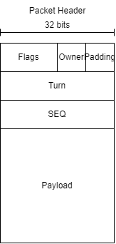
Packet Format
Each packet has a 12-byte header
Flags – Flags indicating the contents of the packet
Owner - The index of the sending player. For ACK this is the player whose packet is being ACKed
Turn – The turn the packet was sent
SEQ – The sequence number of the sent bytes. Used to detect out of order, dropped, or duplicate packets.

Slide 15
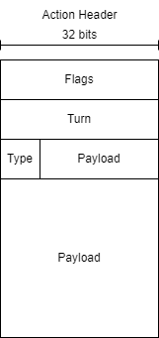
Action Format
Each action consists of a header and data
Flags – Indicate what data has been sent
Turn - The turn which the action is scheduled to run on
Type – The type of action, such as move, attack, or build
Payload – The action data. These are essentially parameters to be used in a method determined by the type.

Slide 16
Protocol Design – Reliability
To ensure that every peer has the simulation, only actions that everyone has received can be used.
Each time a peer receives a message, they broadcast an ACK to the network
Actions can only be used if the peer receives an ACK from every client
If an ACK is not received in the expected amount of time:
If the original sender, resend the packet
If waiting for one peer to send an ACK, request a new ACK

Slide 17
Protocol Design – Unreal Engine
The implementation takes a multi-threaded approach:
Client-only thread– Uses standard Unreal code for UI, input, and rendering.
Generates and buffers actions, and interpolates object positions based on the interpolation
Simulation thread – Handles network communications and game simulation. Runs at a slower fixed framerate

Slide 18
Security

Slide 19
Security
The main security issue is that players in a P2P connection can see each other’s IP addresses.
If you’re only playing with friends, this isn’t a big deal
Consoles make it (slightly) harder to find IP addresses
A broker server can be used to hide IP addresses from other players
Case Study – Hackers in Red Dead Online and Grand Theft Auto Online were able to DDoS people who reported them since their IP addresses were exposed.

Slide 20
Real-World Examples
Game | Who can play | Exposes IP Address
N64 Online (Switch) | Friends only | Yes
Super Smash Bros. Ultimate | Anyone | Yes
StarCraft II | Anyone | No (Broker Server)

