Slide 1
Multiplayer in Unity
UTP and NGO

Slide 2
UTP (Unity Transport)
An abstraction over both UDP and WebSockets
Adds some simple networking functionality:
Connections over UDP
Message fragmentation
Packet reliability
Packet encryption

Slide 3
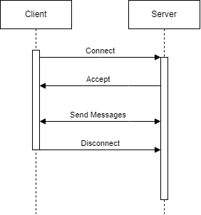
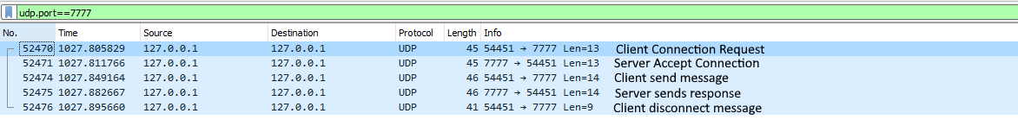
Connection Protocol
Client sends connect message
Server sends accept message
Client can send disconnect message when done

Slide 5
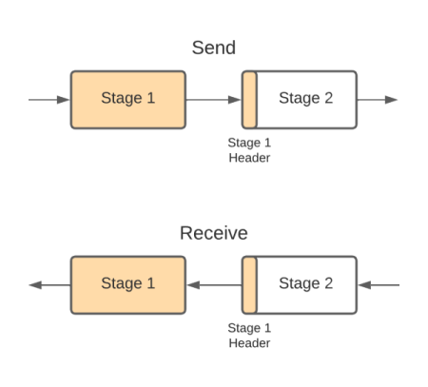
Message Pipeline
Application layer processing stages before packets are sent
Fragmentation Stage
Reliability Stage
Simulation Stage
Pipeline can be changed for different types of messages

Slide 6
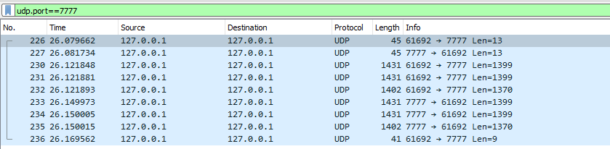
Fragmentation Stage
Used to break up large packets into smaller packets
The maximum without fragmentation is ~1400 bytes
With fragmentation the maximum is ~20MB, optimized for 4096 bytes
Does not enforce the order

Slide 7
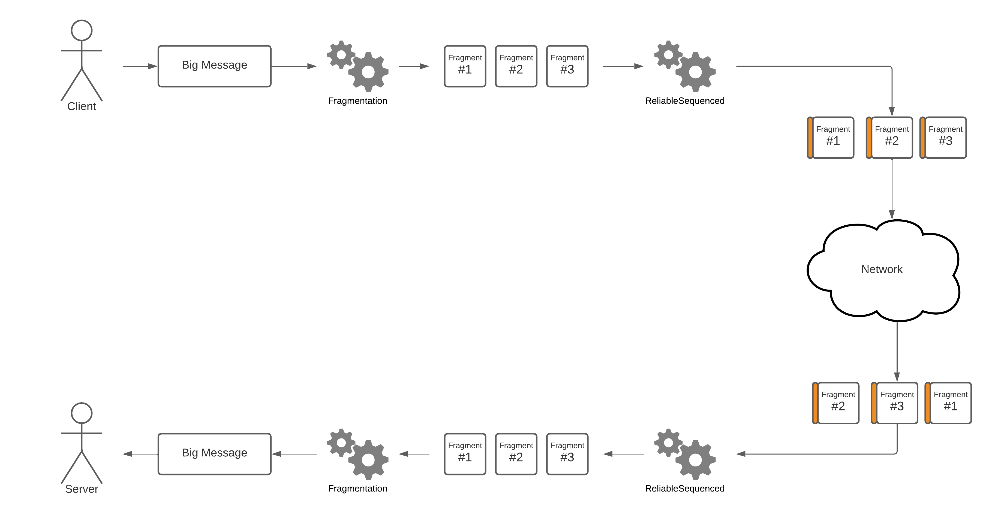
Reliable Stage
Buffers packets in sent order until all arrive
Packets not received will be resent

Slide 8
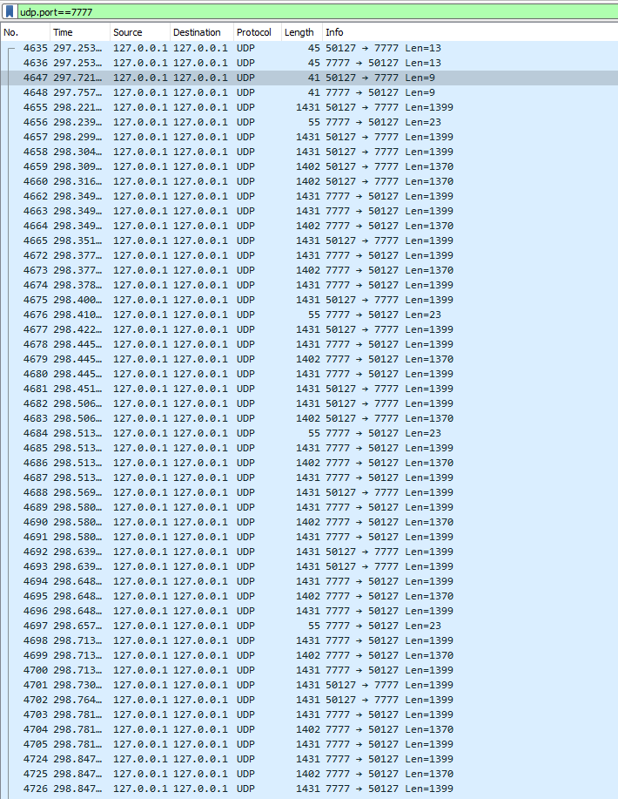
Simulation Stage
Used to simulate various network conditions
Varying packet delay
Dropped packets

Slide 9
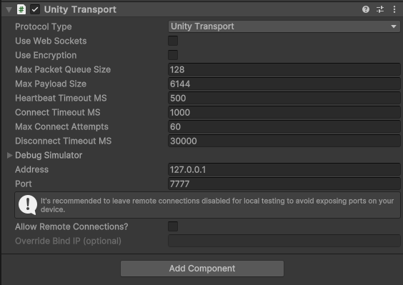
NGO (Netcode for GameObjects)
A high-level API for client-server game architecture built on UTP
Useful features:
Remote Procedure Calls (RPCs)
Object ownership
Scene management
Client replication:
Synced network variables
Synced Components:
NetworkTransform
NetworkRigidbody
NetworkAnimator

Slide 10
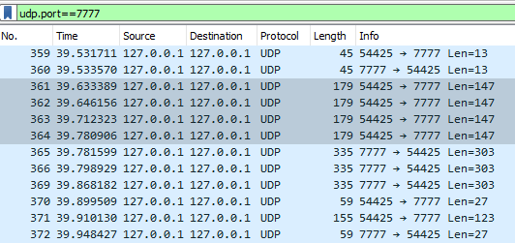

Connection Protocol
Starts with same 13 byte UTP connection
9 byte keep-alive messages are sent

Slide 11
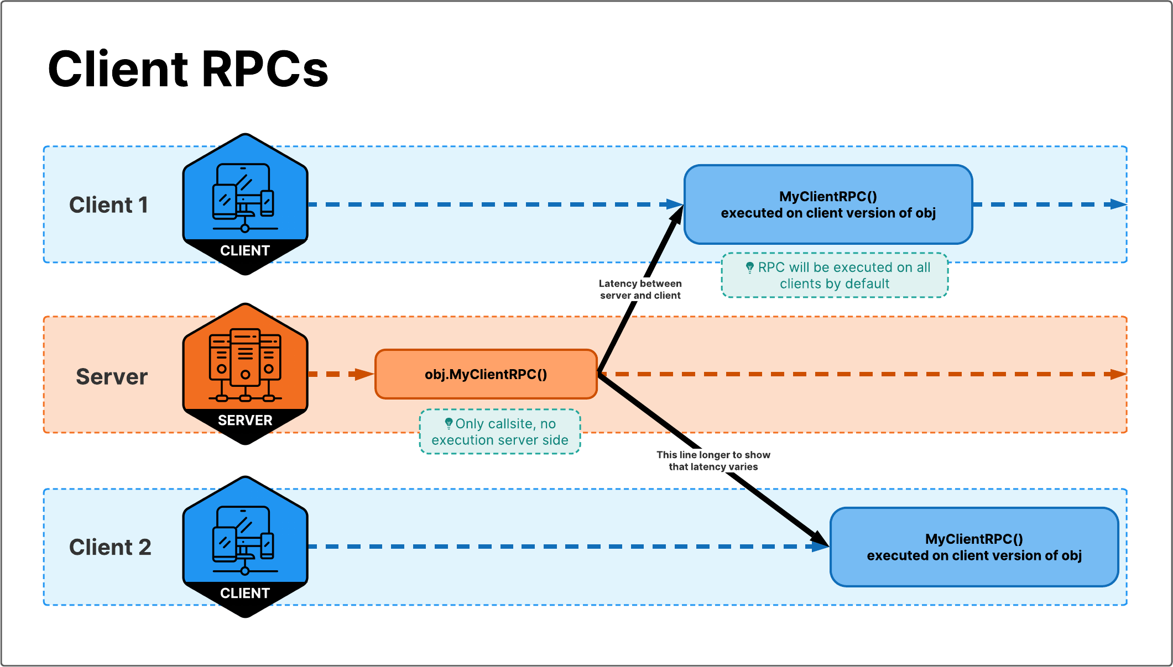
Remote Procedure Calls (RPC)
Abstraction to run a method on another process
ClientRpc
The server instructs one or more clients to run the method
ServerRpc
A client instructs the server to run the method
Should always be validated on the server
Uses the ReliablePipelineStage

Slide 12
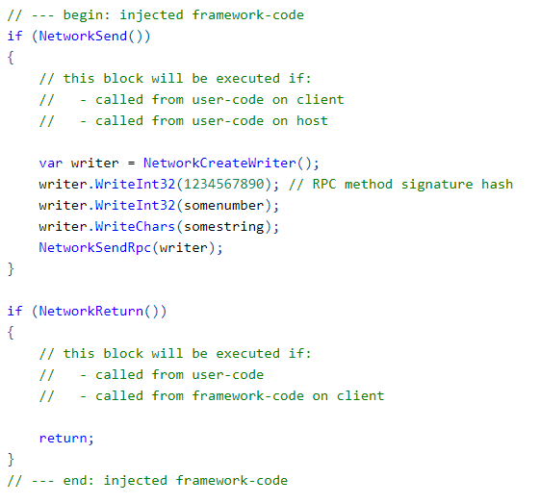
Remote Procedure Calls (RPC)
RPCs work by injecting code into the start of the method
A message is sent to receivers with a signature hash and parameters
The called method returns if it does not need to run in this process

Slide 13
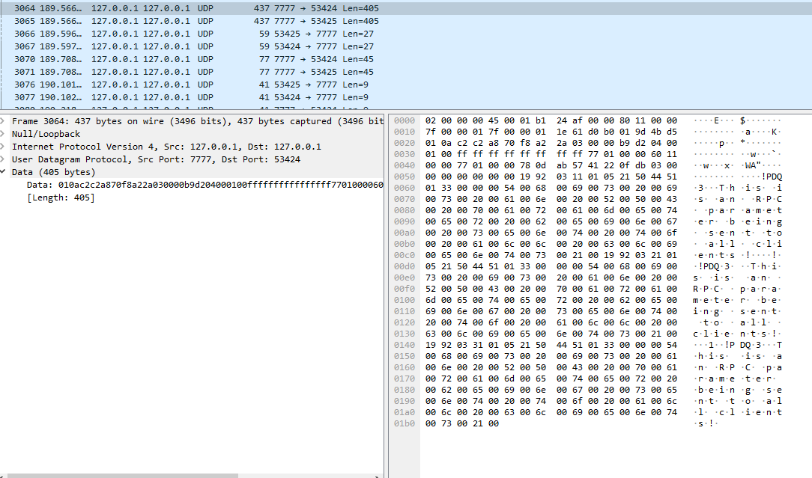
RPC Protocol
A packet is sent, followed by an ACK

