Slide 1
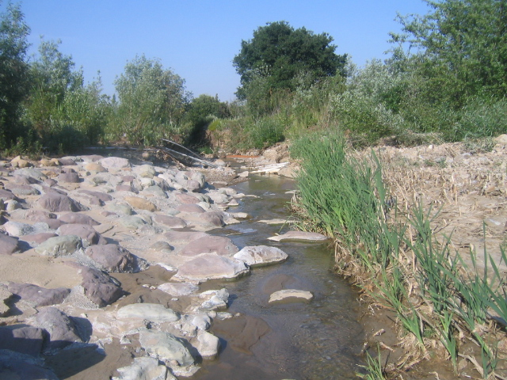
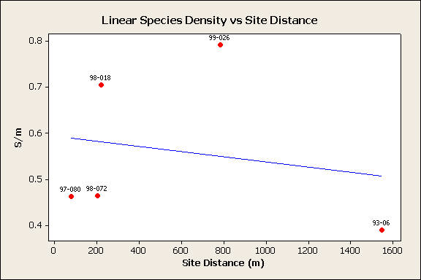
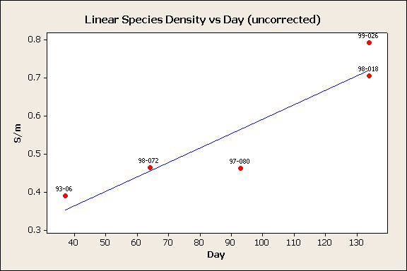
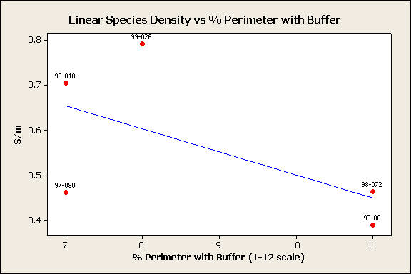
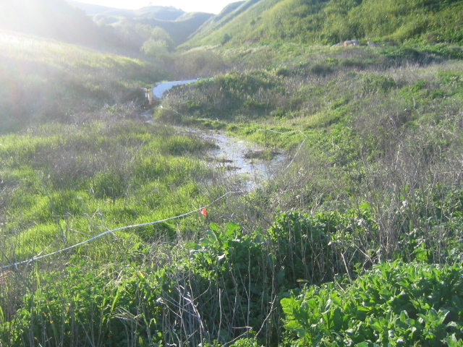
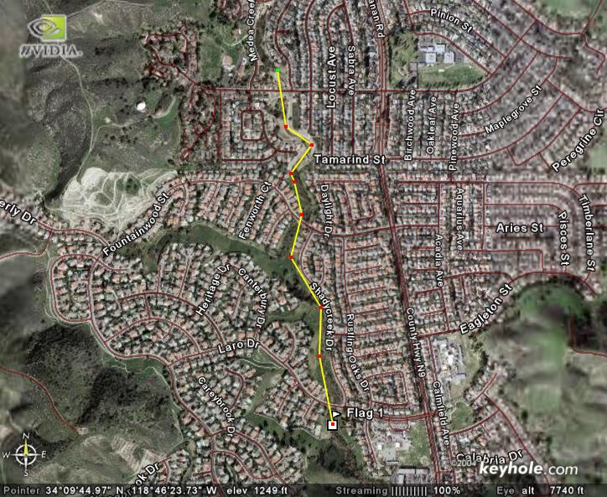
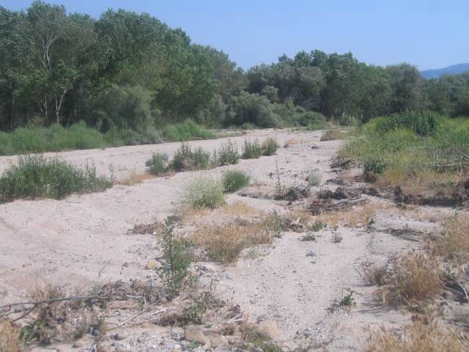
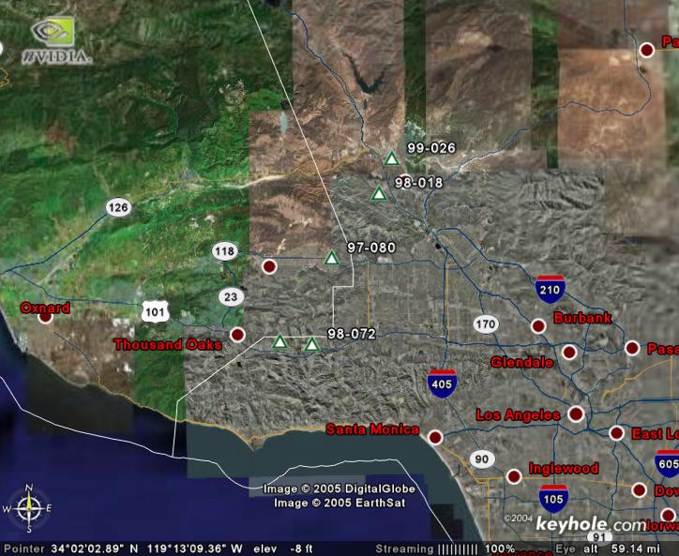
An Application of Island Biogeography Theory to Riparian Restoration
JANE SHEVTSOV¹; Richard F. Ambrose²
¹Department of Ecology and Evolutionary Biology, ²Department of Environmental Health Sciences
ABSTRACT
The theory of island biogeography says that species diversity on an island is controlled by its size and distance from the mainland. If a degraded landscape can be thought of as an “ocean” inhospitable to many species, restored and natural areas provide “islands” of habitat. If Island Biogeography Theory applies to habitat restoration, there should be a relationship between species diversity at a restored site and its distance from the nearest established site. At five southern California riparian restoration sites, transects were used to measure plant species richness. The closest upstream established site to the restoration was located using a combination of fieldwork and aerial photographs. Distance between this site and the restoration (“site distance”) was measured and a regression analysis of species richness per meter transect length (S/m) vs. site distance was performed. This regression yielded a significant negative relationship (p=0.04) once seasonality and landscape factors were taken into account. These findings are tentative due to small sample size but, if confirmed, will have implications for restoration planning.
Results
When seasonality and buffer presence are controlled for, there is a significant negative relationship (p=0.04) between distance from an established site and species richness at a restored site.
Discussion
Correlation is not causation. Even though there are good empirical and theoretical reasons to think that the distance effect found here results from variation in numbers of available propagules, it could be a simple indicator of landscape integrity. (The presence of a buffer is most likely both a direct cause of increased diversity and an indicator of landscape health.) Only a larger study could examine enough variables to untangle this question.
The distance-species richness effect has clear implications for restoration planning.
  All things being equal, placing a restoration close to an established site increases its chances of success.
  A regression equation such as the one here can allow planners to assess the relative impact of site distance and other factors on restoration success and make predictions.
Without intensive previous assessments, the effect of site distance on species richness apparent in this study could not have been found. This could well be a problem for attempts to detect distance effects elsewhere, as well as much other work in ecology.
The Regression Equation
S/m=0.268-0.000131D+0.0059T+0.0418A, where
S/m = linear species density
D = site distance, in meters
T = sampling day, adjusted for correlation with site distance
A = percent of site perimeter having a buffer, on a 1-12 scale
p=0.025, r²>0.999
Introduction
Spatial configuration of habitat patches plays an important role in determining the species richness and composition of an area. Thus, metapopulation theory and island biogeography are prominent tools for conservation planning and the design of reserves. However, they are rarely used in planning habitat restoration projects. Even spatial decision-making models for restoration rarely incorporate them. When distance is a consideration, it tends to be looked at less than systematically. Even less frequently are long-term “stepping stone” effects considered.
The theory of island biogeography predicts that proximity to the mainland (or established habitat) increases species number on an island (or newly restored habitat patch). While more complex ways of looking at this issue, such as analysis of landscape connectivity, exist and are somewhat more commonly discussed, simple Euclidean distance has important effects on community composition, as shown by tests of island biogeography theory. This study examines the effects of proximity to a natural site on species richness, measured as “linear species density” or species per meter transect length.
Predictor | Coef | SE Coef | T | P
Constant | 0.26829 | 0.02574 | 10.42 | 0.061
Distance | -0.00013106 | 0.00000816 | -16.06 | 0.040
Day (adjusted) | 0.0058960 | 0.0001495 | 39.44 | 0.016
% with Buffer | 0.041843 | 0.003255 | 12.86 | 0.049
Figure 2
Measuring distance in an aerial photograph
Methods
Site Selection
Five restoration sites, at least five years old at the time of selection, were surveyed. All chosen sites had good to moderate abiotic structure, as determined by a study looking at the success of wetland mitigation in southern California.
Field Methods
At each site, a 100-meter transect was laid out adjacent to the stream. Five or, at one site, six transects were laid perpendicular to the stream, running from it to the edge of the riparian zone. Along each transect, the number of morphospecies was counted and linear species density was calculated.
Analysis
The closest upstream established site to the restoration was located using a combination of fieldwork and aerial photographs. Distance between this site and the restoration (“site distance”) was measured using a combination of fieldwork and aerial photographs.
A stepwise regression was performed in Minitab 14. The independent variables were
  site distance,
  a measure of percent site area with a buffer using the California Rapid Assessment Method, and
  the residuals of sampling day regressed against site distance.
Acknowledgements
Jane Shevtsov would like to thank field volunteers Brian Alfaro, Amy Kwan and Kristin McCully for giving up their weekends; UCLA URSP, the Wasserman family and Dr. Audrey Cramer for financial support; Vladimir and Tatyana Shevtsov for driving the team and putting up with the project; Dr. Tom Gillespie for advice and Dr. Richard Ambrose for taking a chance.
Figure 1
Study site locations

