Slide 1
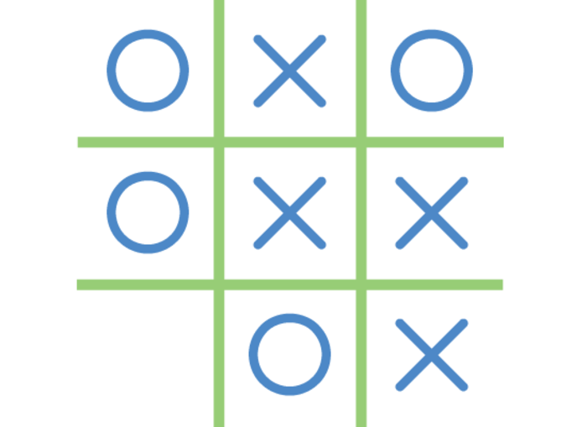
Tic Tac Toe
Introduction
Architecture & Technical Stack
Demonstration
Next steps
Conclusion

Slide 2
1. Introduction - Hypothesis
Game hypothesis :
- One user after another
- Win : Horizontal, vertical or diagonal
- Millions of users

Slide 3
1. Introduction – Development methodology
Development done in 4 steps :
- definition of api (api first)
- server : TDD
- UI
- E2E tests

Slide 4
2. Architecture
Pull architecture
Push architecture
Browser-1
5 seconds
TicTacToe Server
Simpler implementation ☺
Server overloading ☹
Browser-2
5 seconds
Browser-1
TicTacToe Server
Simpler implementation ☹
No server overloading ☺
Browser-2

Slide 5
2. Technical stack
Front end
React/redux (facebook framework)
Api
&
Backend
Server tools : nodejs with ecma6/websocket
Build tools : gulp saas
Database
Relational db : postgres
(for high dimensionality mongodb is a better option)

Slide 6
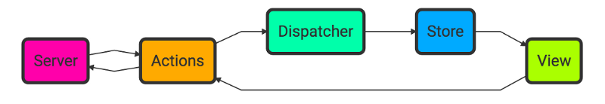
2. Technical stack – Front end – Redux concept
Goals
Deterministic View Renders
Deterministic State Reproduction

Slide 7
2. Technical stack – Front end
Games
{
Games :[{
id : 1,
game : game_1,
arcade : false,
status: even,
size: 4,
winner : null
},{
id : 2,
game : game_2,
arcade : false,
status: even,
size: 3,
winner : null
}]
}
GameDetails
{
Game_details :{
game : {
id : 1,
game : game_1,
arcade : false,
status: even,
winner :
},
details : [
{
row_id : 1,
column_id : 3,
game_id : 1,
user_id : 1,
}
]
}

Slide 8
2. Technical stack – Api (Websocket)
play_game
request : {
token: 44454212,
game_id; 54,
row_id : 1,
column_id : 3
}
response : {
game_details: {
game :{
id : 1,
game : game_1,
arcade : false,
status: even,
size: 4,
winner : null
},
details:[{
row_id : 1,
column_id : 3,
game_id : 1,
user_id : 1
}]
}}
login
request : {
login: jsoto,
password: hash(pwd)
}
response : {
token: 4454212
}
Game_details
request : {
token: 44454212,
game_id; 54
}
response : {
game_details: {
game :{
id : 1,
game : game_1,
arcade : false,
status: even,
size: 4,
winner : null
},
details:[{
row_id : 1,
column_id : 3,
game_id : 1,
user_id : 1
}]
}}
games
request : {
token: 44454212
}
response : {
games :[{
id : 1,
game : game_1,
arcade : false,
status: even,
size: 4,
winner : null
}]
}

Slide 9
2. Technical stack – Backend
jsoto | game1 | game_details1
game3
play_game
game1 & jsoto
Server
jsoto : w1
rparent : w2
jeremy : w3
rparent | game2 | game_details3
game3
jeremy | game1 | game_details2
game2

Slide 10
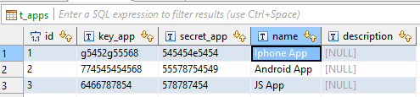
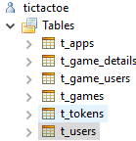
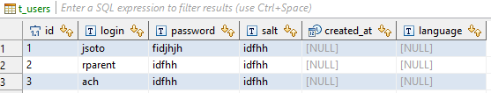

2. Technical stack – Database
Supports
- multi app
- multi user
- high security
password = hash(hash(pwd).salt)

Slide 11
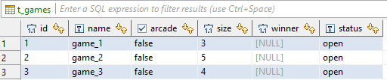
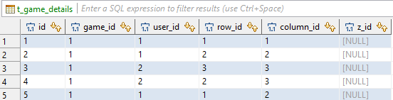
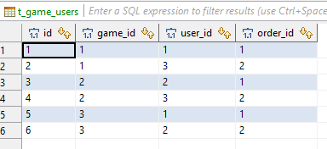
2. Technical stack – Database
Supports
- many users by game
- 3D tictactoe
- any size
- arcade mode

Slide 12
3. Demonstration

Slide 13
4. Next steps – Distributed Service
Modify api
select_streaming_node
request: {
token : 6455454
}
response: {
url : tictactoe-1.tictactoe.com
}
Maintain in redis
server_id : [games]
Problem
Where does browser 3 goes ?
Browser-1
TicTacToe Server 1
g1 & g2
Browser-2
TicTacToe Server 2
HaProxy
g3 & g4
tictactoe.com
Browser-3
TicTacToe Server 3
g1 & g3
Beware of deployment
Reconnect protocol client side

Slide 14
4. Next steps – Distributed Cache
game 1
TicTacToe Server 1
Distributed Cache
Local cache on each server
Invalidation mechanism with kafka
TicTacToe Server 2
game 1
Kafka
game 3
TicTacToe Server 3

Slide 15
4. Next steps – AI - Idea
It is a tree with n2 possibilities :
Calculate them all or do machine learning
At each node store the winning percentage
9 possibilities
user1
X
 | X | O
O |  | X
8 possibilities
user2
7 possibilities
user1
6 possibilities
user2

Slide 16
4. Next steps – AI – Fill up
@ each end of game : when user 1 puts an X on position 1
1 | 2 | 3
4 | 5 | 6
7 | 8 | 9
id | size | parent_id | position | user_order_id | nb_games | winning | percent
11 | 3 | null | 5 | 1 | 10 + 1 | 5 + 1 | 6/11
12 | 3 | 11 | 7 | 2 | 5+1 | 3+1 | 4/6
13 | 3 | 12 | 9 | 1 | 2+1 | 1+1 | 2/3
14 | 3 | 13 | 6 | 2 | 1 | 1 | 1/1
15 | 3 | 14 | 1 | 1 | 1 | 1 | 1/1
X
 | X | O
O |  | X
Benefits :
- unique table for all size
- unique table for any number of users in the game

Slide 17
4. Next steps – AI – Arcade mode
The procedure is the following :
- Search in the tree the current node for game size
- List all possible children
- Take the one with highest probabilty to win
1 | 2 | 3
4 | 5 | 6
7 | 8 | 9
id | size | parent_id | position | user_order_id | nb_games | winning | percent
11 | 3 | 5 | 9 | 1 | 10 + 1 | 5 + 1 | 6/11
12 | 3 | 11 | 7 | 2 | 5+1 | 3+1 | 4/6
13 | 3 | 5 | 6 | 1 | 2+1 | 1+1 | 2/3
14 | 3 | 13 | 6 | 2 | 1 | 1 | 1/1
15 | 3 | 5 | 7 | 1 | 1 | 1 | 1/1
 | X

Slide 18
4. Next steps – Docker
Images
Services
Stack
Dockerfile
FROM alpine
USER root
RUN apt-get install -y git npm gulp
git clone https://github.com/jsotogaviard/tictactoe
cd tictactoe
npm install
ENTRYPOINT ["gulp"]
docker-compose.yml
version: '3'
services:
tictactoe
postgresql
elk
game
Using docker 1.13 stack

Slide 19
5. Conclusion
Interesting assignment
Even though the problem is simple : lots of underlying complexity
Concepts are similar in any case

