Slide 1
Assignment 1
Robotic challenge solver using the CiberRato simulation environment

Slide 2
Contents of this template
You can delete this slide when you’re done editing the presentation
Fonts | To view this template correctly in PowerPoint, download and install the fonts we used
Used and alternative resources | An assortment of graphic resources that are suitable for use in this presentation
Thanks slide | You must keep it so that proper credits for our design are given
Colors | All the colors used in this presentation
Icons and infographic resources | These can be used in the template, and their size and color can be edited
Editable presentation theme | You can edit the master slides easily. For more info, click here
For more info: SLIDESGO | BLOG | FAQs
You can visit our sister projects: FREEPIK | FLATICON | STORYSET | WEPIK | VIDEVO

Slide 3
Table of contents
01
02
03
04
Theory lesson
You can describe the topic of the section here
Features of the topic
You can describe the topic of the section here
Tips
You can describe the topic of the section here
Practical exercise
You can describe the topic of the section here

Slide 4
01
Theory lesson
You can enter a subtitle here if you need it

Slide 5
9h 55m 23s
333,000
386,000 km
Jupiter’s rotation period
The Sun’s mass compared to Earth’s
Distance between the Earth and the Moon

Slide 6
Introduction
Mercury is the closest planet to the Sun and the smallest one in the entire Solar System. This planet’s name has nothing to do with the liquid metal, since Mercury was named after the Roman messenger god. Mercury’s surface is filled with craters
Mercury takes a little more than 58 days to complete its rotation, so try to imagine how long days must be there! Since the temperatures are so extreme, albeit not as extreme as on Venus, Mercury has been deemed to be non-habitable for humans

Slide 7
—Someone Famous
“This is a quote, words full of wisdom that someone important said and can make the reader get inspired”

Slide 8
Introduction to AI
Definition
Advantages
Mercury is the closest planet to the Sun and the smallest in the Solar System—it’s a bit larger than the Moon
Venus has a beautiful name and is the second planet from the Sun. It’s hot and has a poisonous atmosphere

Slide 9
AI and ethics
Transparency
Privacy
Legal
Mercury is the closest planet to the Sun and the smallest one of them all
Venus has a beautiful name and is the second planet from the Sun
Despite being red, Mars is actually a cold place. It’s full of iron oxide dust

Slide 10
AI and society
Impact
Healthcare
Despite being red, Mars is very cold
Neptune is the smallest planet
Education
Government
Jupiter is the biggest planet of them all
Saturn is a gas giant and has several rings

Slide 11
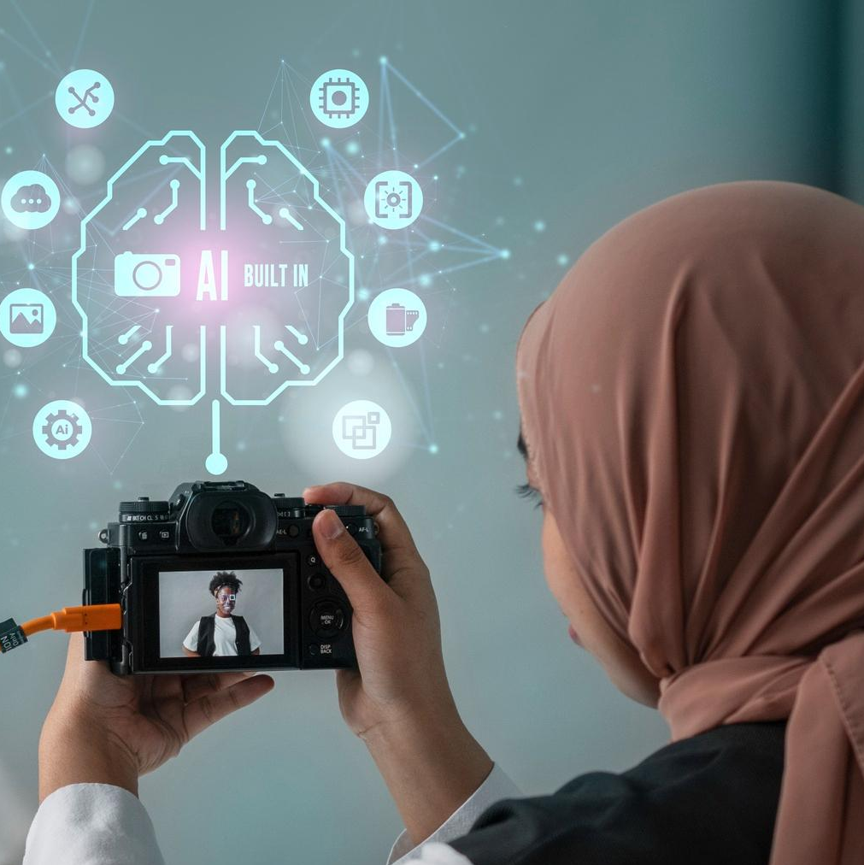
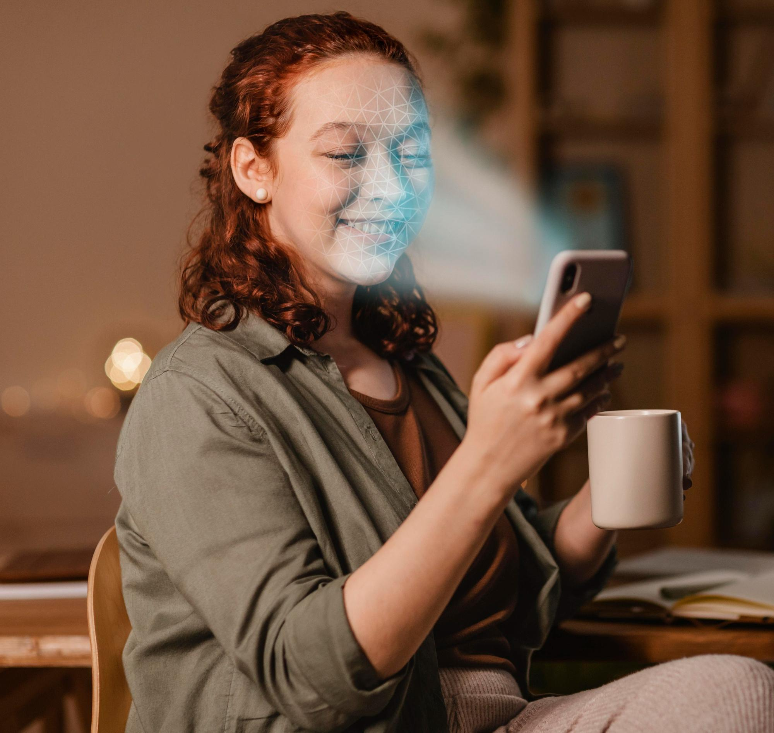
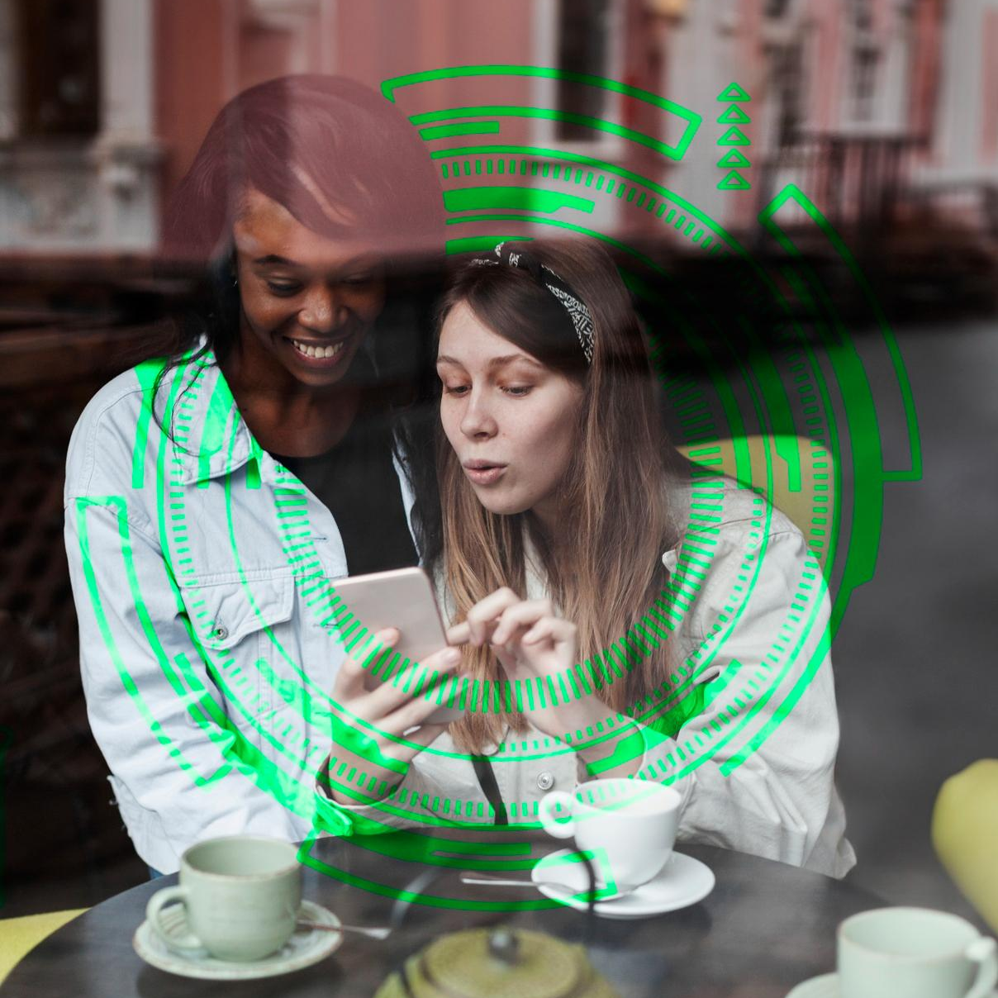
Examples
Business
Entertainment
Social
Mercury is the closest planet to the Sun and the smallest one of them all
Venus has a beautiful name and is the second planet from the Sun
Despite being red, Mars is actually a cold place. It’s full of iron oxide dust

Slide 12
AI and business
Applications
Models
Role of data
Despite being red, Mars is very cold
Venus is the second planet from the Sun
Neptune is the farthest planet from the Sun
Ethics
Customer
Future
Mercury is the closest planet to the Sun
Saturn is a gas giant and has several rings
Jupiter is the biggest planet of them all

Slide 13
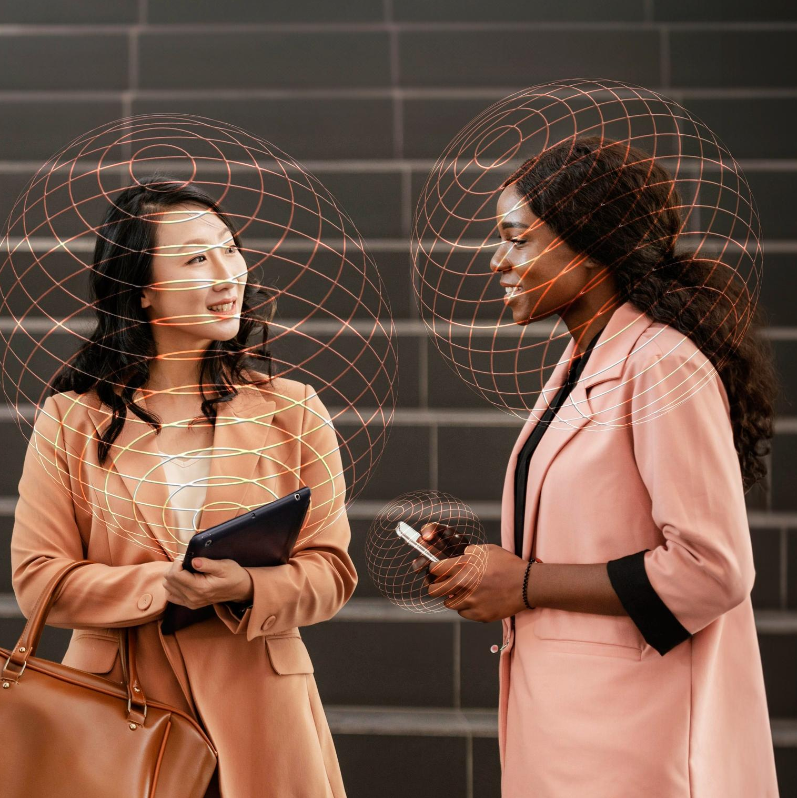
A picture always reinforces
the concept
You can give a brief description of the topic you want to talk about here. For example, if you want to talk about Mercury, you can say that it’s the smallest planet in the entire Solar System

Slide 14
4,498,300,000
Big numbers catch your audience’s attention

Slide 15
Awesome words

Slide 16
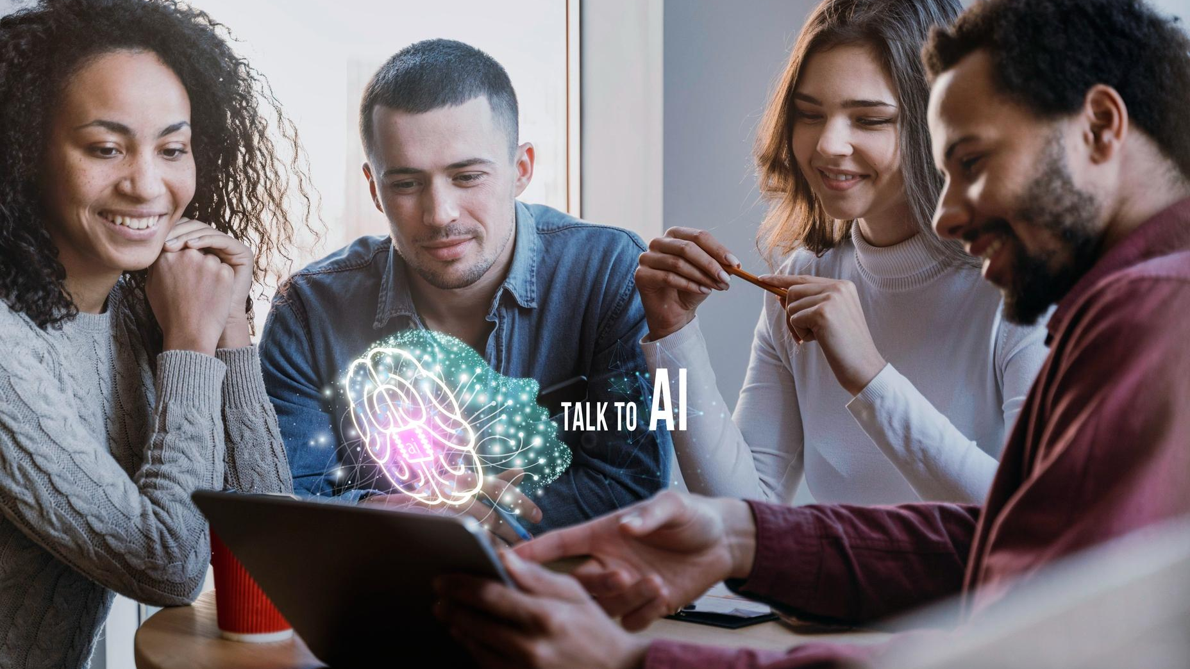
A picture is worth a thousand words

Slide 17
Improve your cybersecurity for AI
Mercury is the closest planet
Mercury is very small
Mercury has a thin atmosphere
Mercury takes 59 Earth days

Slide 18
KWL (brainstorming)
What I know | Mercury is the closest planet to the Sun
 | Despite being red, Mars is a very cold planet
What I want to know | Venus is the second planet from the Sun
 | Jupiter is the biggest planet of them all
What I learned | Saturn is composed of hydrogen and helium
 | Neptune is the farthest planet from the Sun

Slide 19
Advanced threat detection
Risk
Mercury is the closest planet to the Sun and the smallest one in the Solar System
Threat detection
Anomaly
Despite being red, Mars is actually a cold place. It’s full of iron oxide dust
Troubles
Venus has a very beautiful name and is the second planet from the Sun

Slide 20
AI and transportation
Monitoring
Predictive
Despite being red, Mars is actually a very cold place
Neptune is the farthest planet from the Sun
Reduce waste
Advantages
Future
Mercury is the closest planet to the Sun
Saturn is a gas giant and has several rings
Jupiter is the biggest planet of them all

Slide 21
Steps to apply AI in schools
Identify
Collect data
Choose AI tool
Mercury is the closest planet to the Sun
Venus is the second planet from the Sun
Despite being red, Mars is actually a cold place
Train the tool
Evaluate
Refine
Jupiter is the biggest planet of them all
Saturn is composed of hydrogen and helium
Neptune is the farthest planet from the Sun

Slide 22
Classification of AI
Reactive machines | Limited memory | Theory of mind | Self-aware conscious
Small Red Cold Rocky | Small Hot Dry Volcanic | Small Hot Rocky Cratered | Large Cold Gassy Striped
Despite being red, Mars is actually a cold place | Venus is extremely hot, even more than Mercury | Mercury is the smallest planet of them all | Jupiter is the biggest planet of them all

Slide 23
Cause and effect
Environment
People
Measurement
Mercury is the closest planet to the Sun
Mars is actually a very cold place
Saturn is a gas giant and has several rings
Problem or goal
Venus is the second planet from the Sun
Jupiter is the biggest planet of them all
Neptune is the farthest planet from the Sun
Materials
Methods
Machines

Slide 24
Theory of mind
Why is important the theory of mind?
Is Mercury the closest planet to the Sun and the smallest one in the Solar System? Note that it’s a bit larger than the Moon
Understand the mind of humans
Venus has a beautiful name and is the second planet from the Sun. It’s hot and has a poisonous atmosphere

Slide 25
Evolution of AI
20XX
20XX
20XX
20XX
Venus is the second planet from the Sun
Mercury is the closest planet to the Sun
Despite being red, Mars is a very cold
Jupiter is the biggest planet of them all

Slide 26
Parts and whole
The whole object
Parts of the object
What happens if the parts are missing?
Mercury is the closest planet to the Sun and the smallest one in the entire Solar System. This planet’s name has nothing to do with the liquid metal
Mercury
Venus has a beautiful name and is the second planet from the Sun
Mars
Saturn
What’s the function of the parts?
Venus
Saturn is a gas giant and has several rings. It’s composed of hydrogen and helium
Jupiter

Slide 27
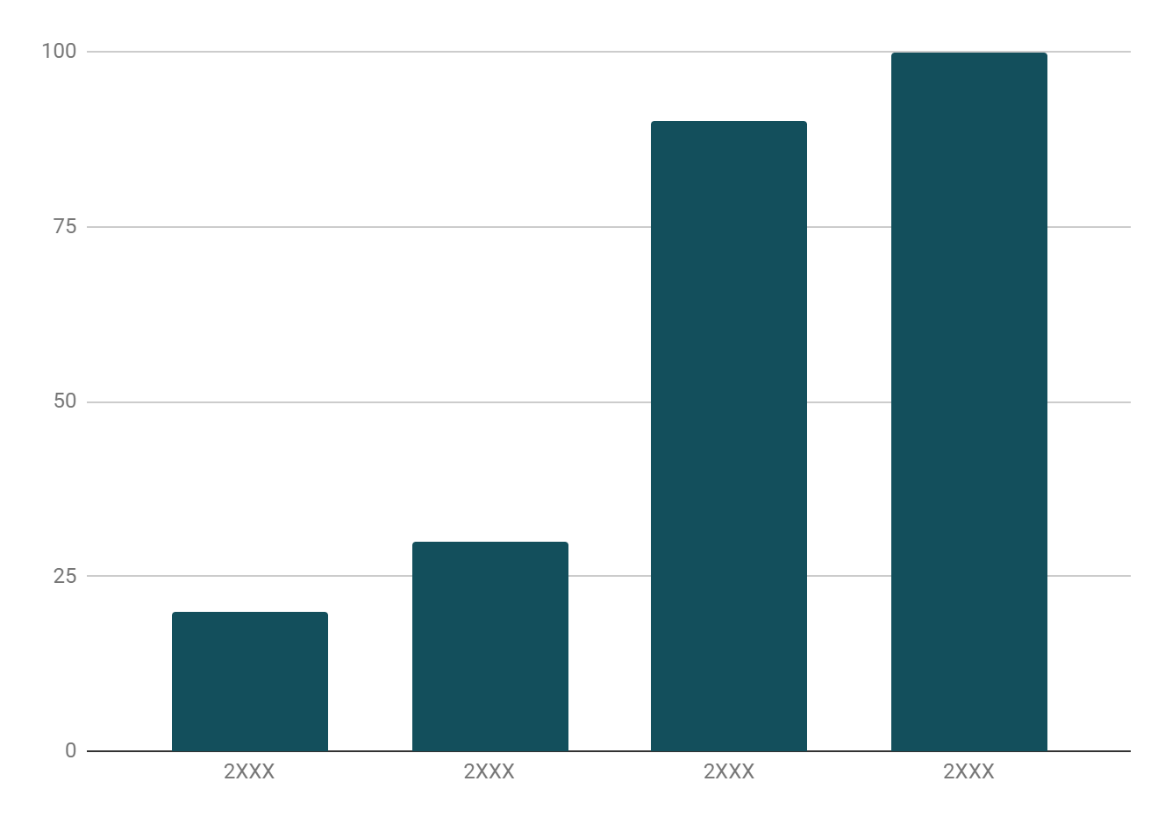
Evolution of domestic AI
Evolution
Mercury is the closest planet to the Sun and the smallest one in the entire Solar System. This planet’s name has nothing to do with the liquid metal
Follow the link in the graph to modify its data and then paste the new one here. For more info, click here

Slide 28
Where is AI being studied
Universities
Venus is the second planet from the Sun
Institutions
Mercury is the first planet from the Sun

Slide 29
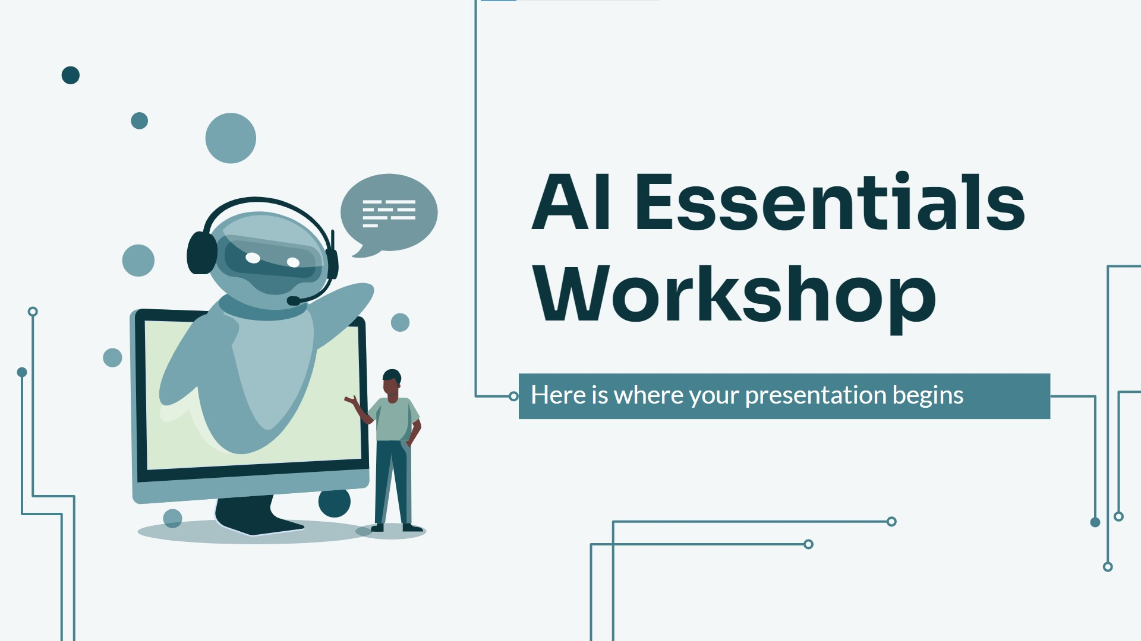
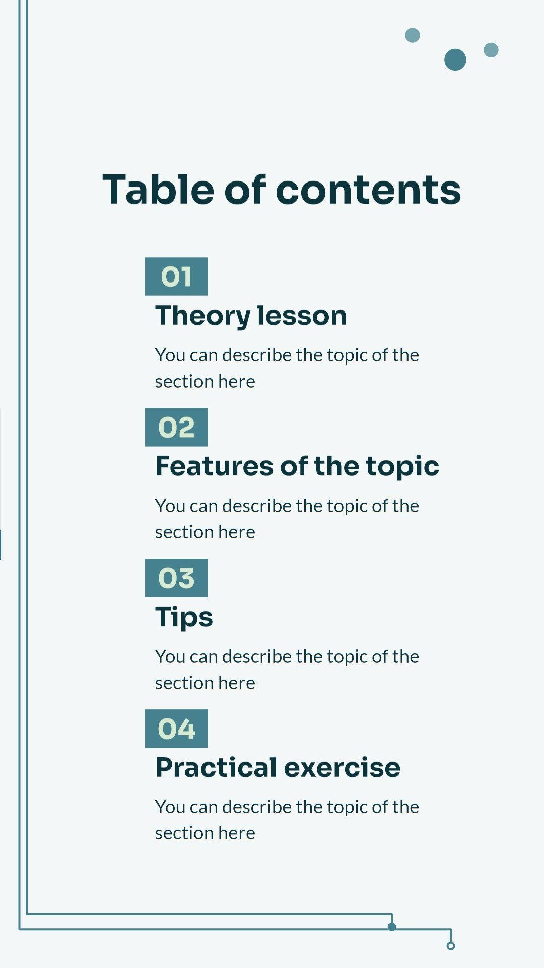
Mockups
You can replace the images on the screen with your own work. Just right-click on them and select “Replace image”

Slide 30
Thanks!
Do you have any questions?
youremail@freepik.com
+34 654 321 432
yourwebsite.com
Please keep this slide for attribution

Slide 31
Icon pack

Slide 32
Alternative resources
Here’s an assortment of alternative resources whose style fits the one of this template:
Gradient quantum illustration
Landing page artificial intelligence template
Template artificial intelligence landing page

Slide 33
Resources
Did you like the resources in this template? Get them at these websites:
Vector
Gradient npl illustration
Gradient quantum illustration
Gradient quantum illustration I
Gradient ssl illustration
Gradient sql illustration
Gradient sql illustration I
Gradient npl illustration
Photos
Woman with phone doing face scan
Person using ai tool at job
Automatic recognition software analyzing everyday subjects
Automatic recognition software analyzing everyday subjects I
Person using ai tool at job
Icons
Icon Pack: Artificial intelligence | Filled

Slide 34
Instructions for use
If you have a free account, in order to use this template, you must credit Slidesgo by keeping the Thanks slide. Please refer to the next slide to read the instructions for premium users.
As a Free user, you are allowed to:
Modify this template.
Use it for both personal and commercial projects.
You are not allowed to:
Sublicense, sell or rent any of Slidesgo Content (or a modified version of Slidesgo Content).
Distribute Slidesgo Content unless it has been expressly authorized by Slidesgo.
Include Slidesgo Content in an online or offline database or file.
Offer Slidesgo templates (or modified versions of Slidesgo templates) for download.
Acquire the copyright of Slidesgo Content.
For more information about editing slides, please read our FAQs or visit our blog:
https://slidesgo.com/faqs and https://slidesgo.com/slidesgo-school

Slide 35
Instructions for use (premium users)
As a Premium user, you can use this template without attributing Slidesgo or keeping the "Thanks" slide.
You are allowed to:
Modify this template.
Use it for both personal and commercial purposes.
Hide or delete the “Thanks” slide and the mention to Slidesgo in the credits.
Share this template in an editable format with people who are not part of your team.
You are not allowed to:
Sublicense, sell or rent this Slidesgo Template (or a modified version of this Slidesgo Template).
Distribute this Slidesgo Template (or a modified version of this Slidesgo Template) or include it in a database or in any other product or service that offers downloadable images, icons or presentations that may be subject to distribution or resale.
Use any of the elements that are part of this Slidesgo Template in an isolated and separated way from this Template.
Register any of the elements that are part of this template as a trademark or logo, or register it as a work in an intellectual property registry or similar.
For more information about editing slides, please read our FAQs or visit our blog:
https://slidesgo.com/faqs and https://slidesgo.com/slidesgo-school

Slide 36
Fonts & colors used
This presentation has been made using the following fonts:
Sora
(https://fonts.google.com/specimen/Sora)
Lato
(https://fonts.google.com/specimen/Lato)
#0c343d
#f3f7f8
#134f5c
#45818e
#76a5af
#d9ead3
#88ada5
#f3f3f3
#ffffff

Slide 37



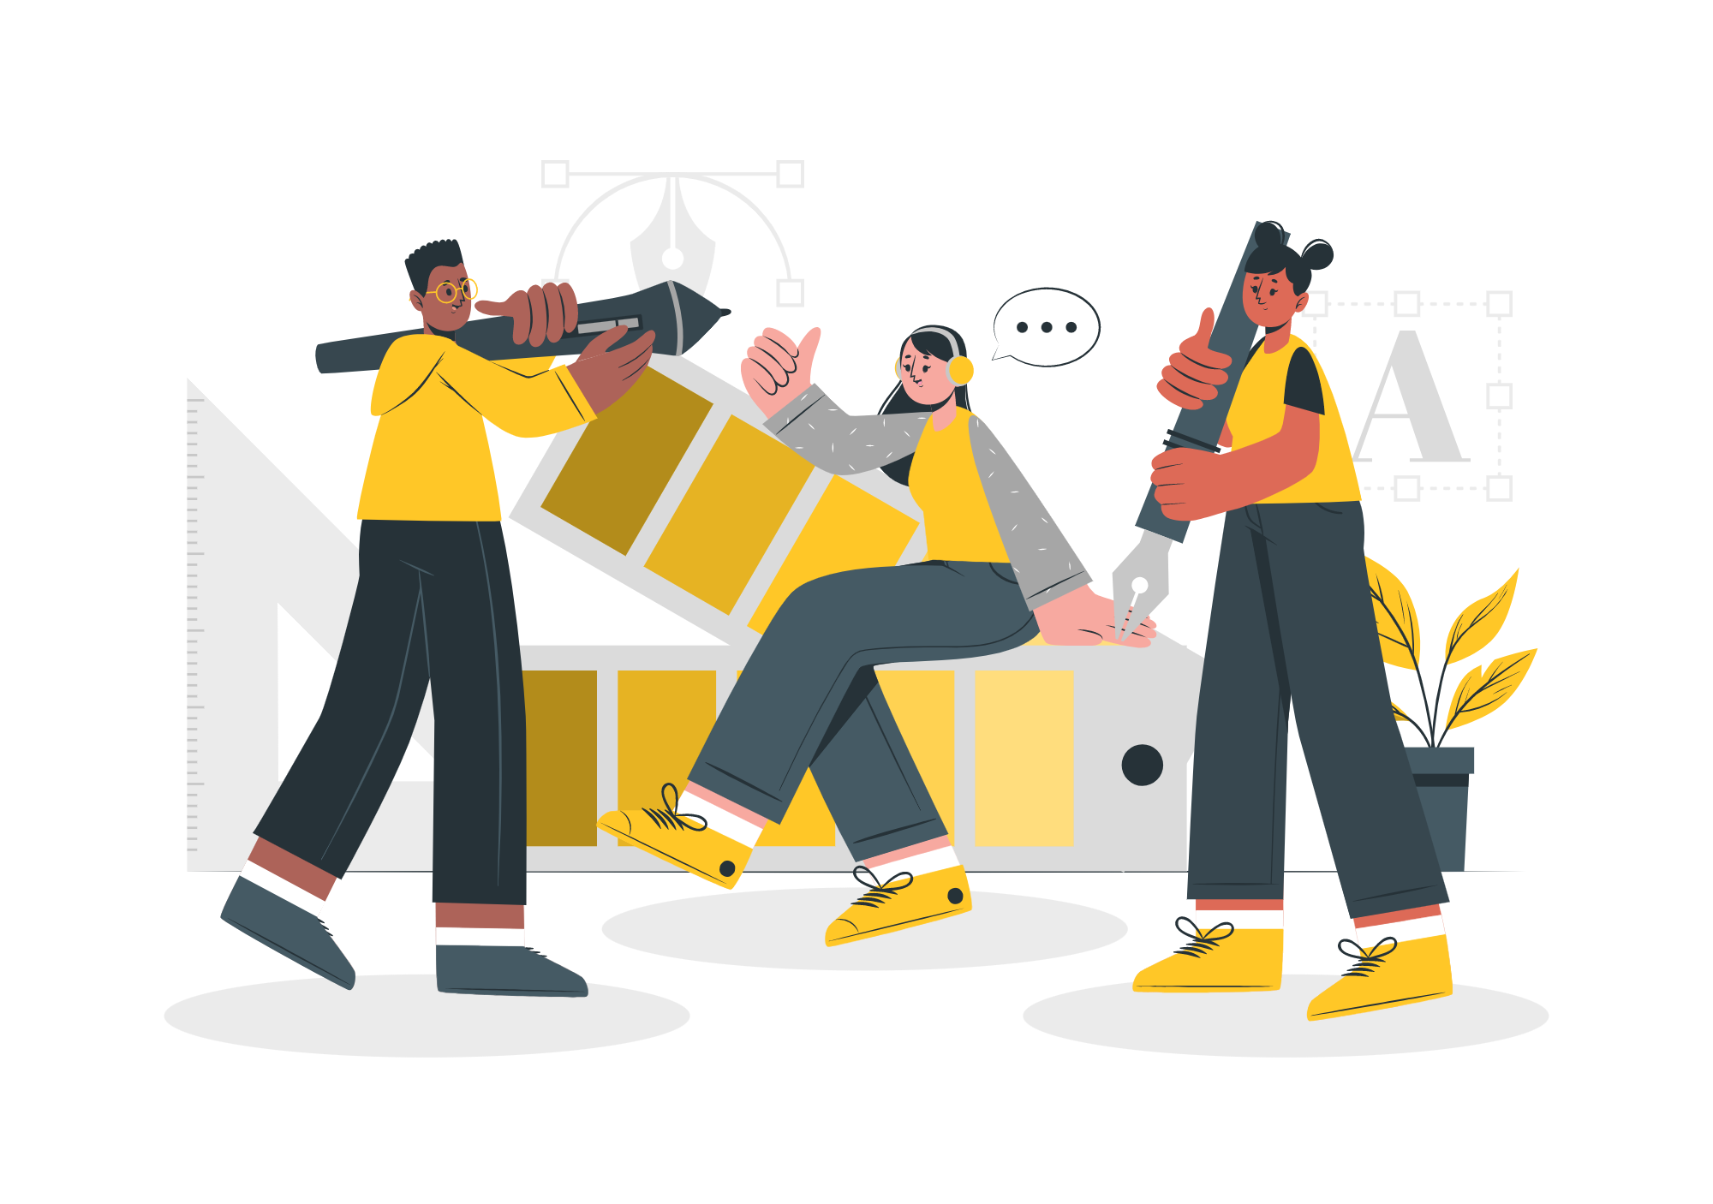

Storyset
Create your Story with our illustrated concepts. Choose the style you like the most, edit its colors, pick the background and layers you want to show and bring them to life with the animator panel! It will boost your presentation. Check out how it works.
Pana
Amico
Bro
Rafiki
Cuate

Slide 38
Use our editable graphic resources...
You can easily resize these resources without losing quality. To change the color, just ungroup the resource and click on the object you want to change. Then, click on the paint bucket and select the color you want. Group the resource again when you’re done. You can also look for more infographics on Slidesgo.

Slide 41
JANUARY
FEBRUARY
MARCH
APRIL
MAY
JUNE
PHASE 1
Task 1
Task 2
PHASE 2
Task 1
Task 2
JANUARY
FEBRUARY
MARCH
APRIL
PHASE 1
Task 1
Task 2

Slide 44
...and our sets of editable icons
You can resize these icons without losing quality.
You can change the stroke and fill color; just select the icon and click on the paint bucket/pen.
In Google Slides, you can also use Flaticon’s extension, allowing you to customize and add even more icons.

Slide 45
Educational Icons
Medical Icons

Slide 46
Business Icons
Teamwork Icons

Slide 47
Help & Support Icons
Avatar Icons

Slide 48
Creative Process Icons
Performing Arts Icons

Slide 49
Nature Icons

Slide 50
SEO & Marketing Icons

Slide 51


