Slide 1

Differential Evolution
Jurriaan H. Spaaks
Netherlands eScience Center

Slide 2
local search methods
efficient?
effective?
what does the response surface look like?
smoothness
local minima

Slide 3
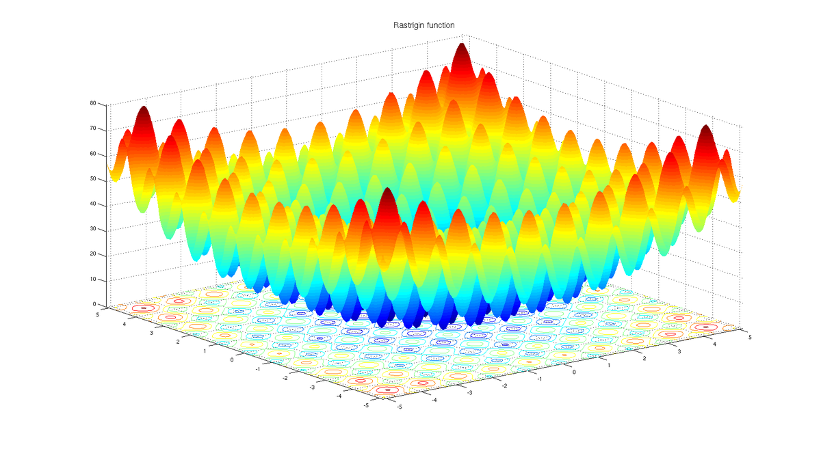
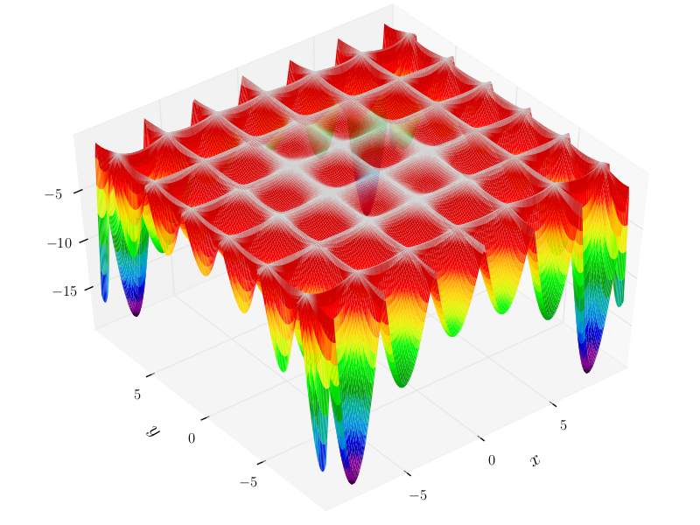
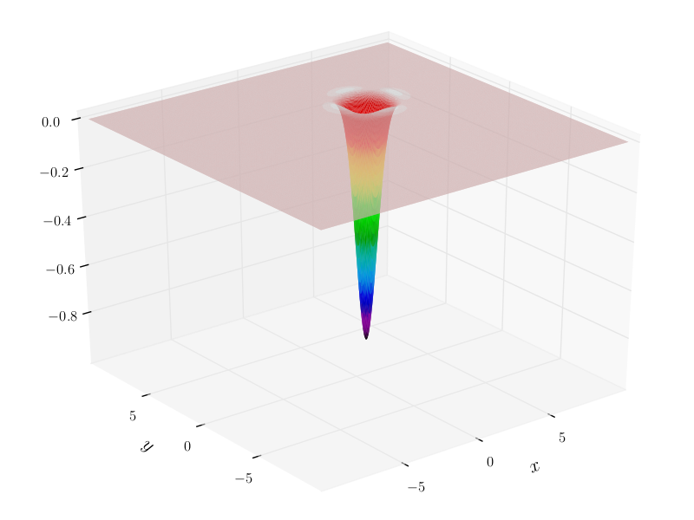
Differential Evolution
how to deal with difficult 'landscapes'
Rastrigin function
(local optima)
Hölder table function
(distant, multiple global optima )
Easom function
(insensitivity)

Slide 4

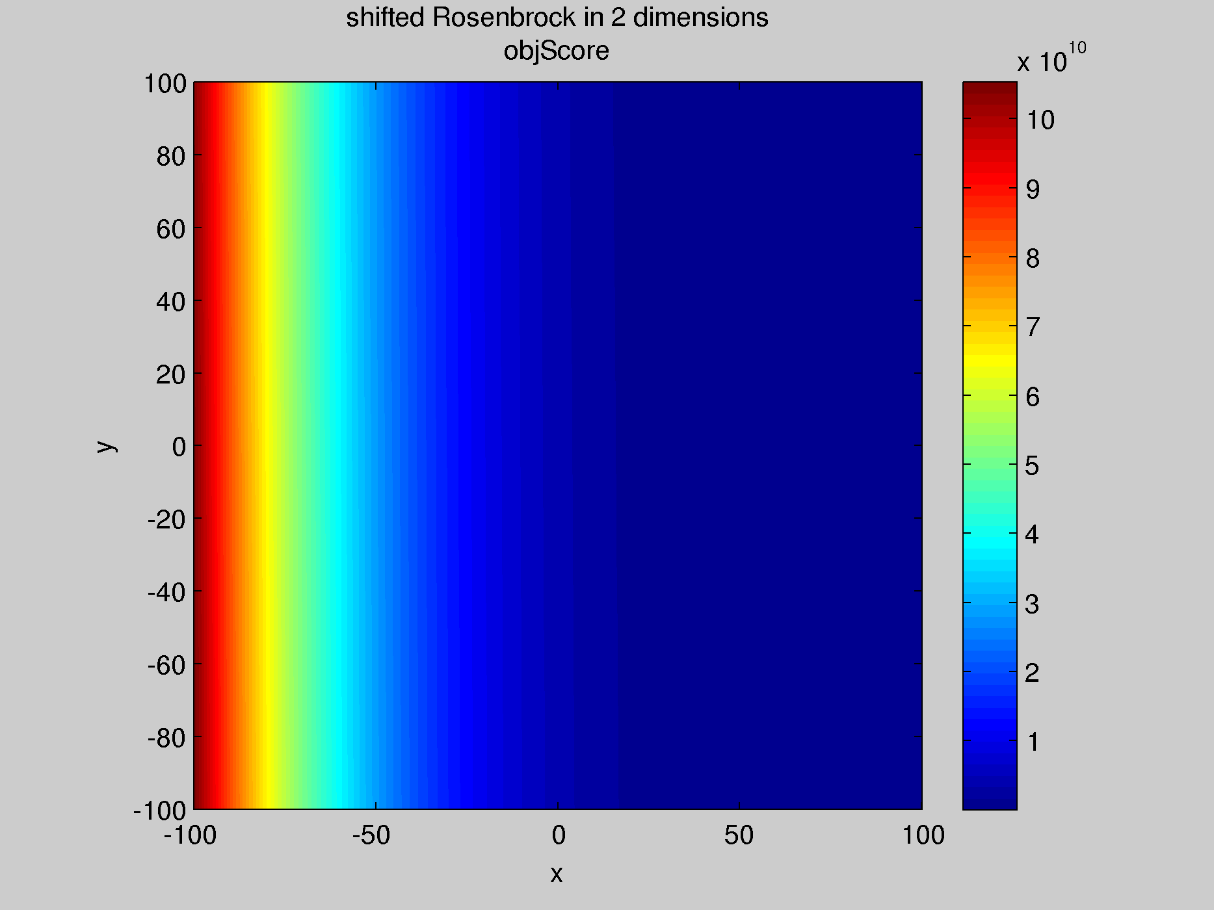
Differential Evolution
shifted Rosenbrock function
2-D
constrained parameter space: [-100, 100]
response surface (4 million points)
can't see much detail, so let's apply log10 transform on the objective score

Slide 5
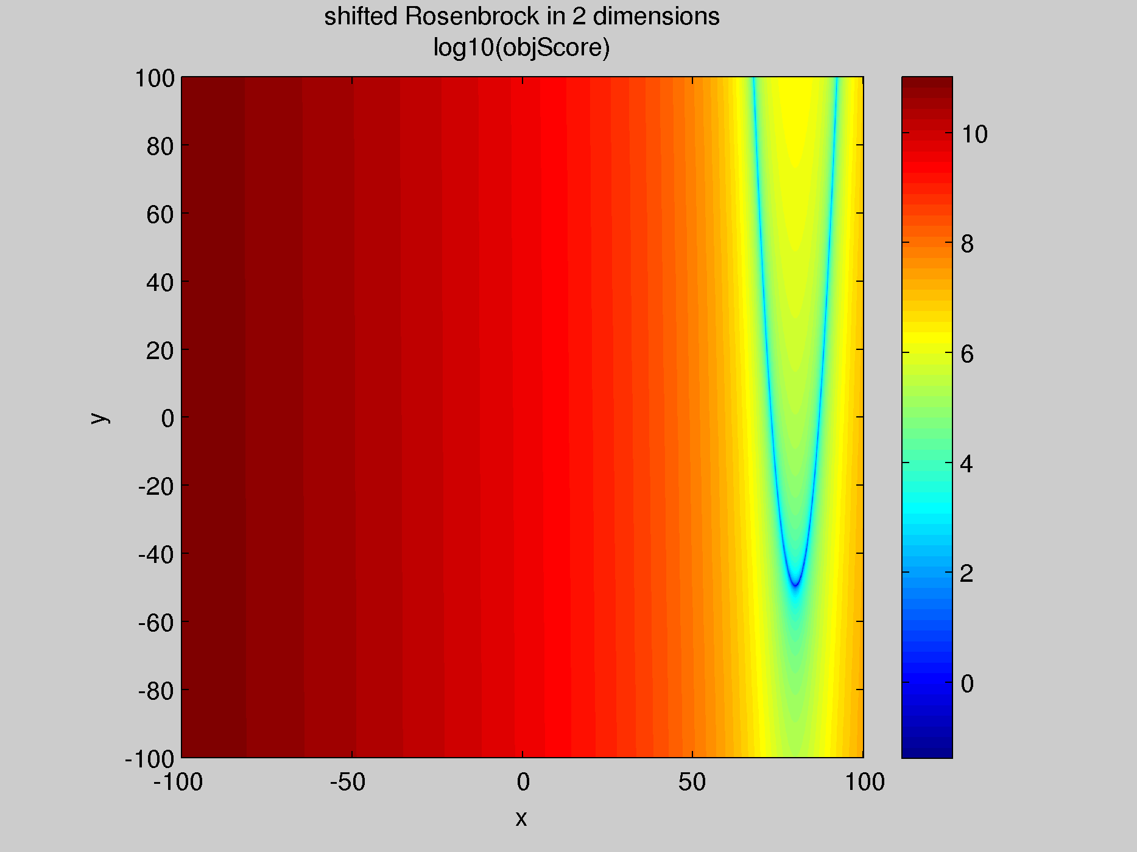
Differential Evolution
shifted Rosenbrock
2-D
constrained parameter space: [-100, 100]
response surface (4 million points)
only interested in blue areas -- let's limit color scale to [-1,1]

Slide 6
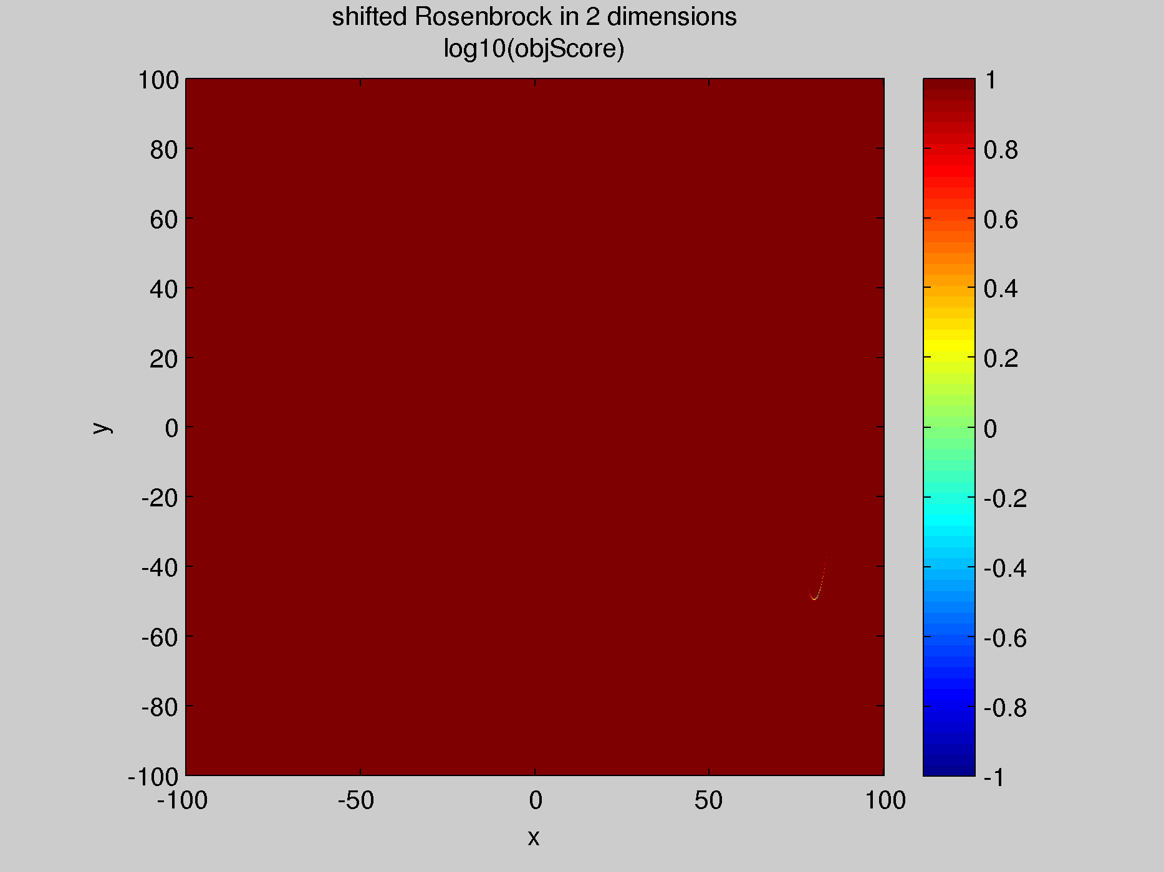
Differential Evolution
shifted Rosenbrock
2-D
constrained parameter space: [-100, 100]
response surface (4 million points)
only interested in dashed area
let's zoom in

Slide 7
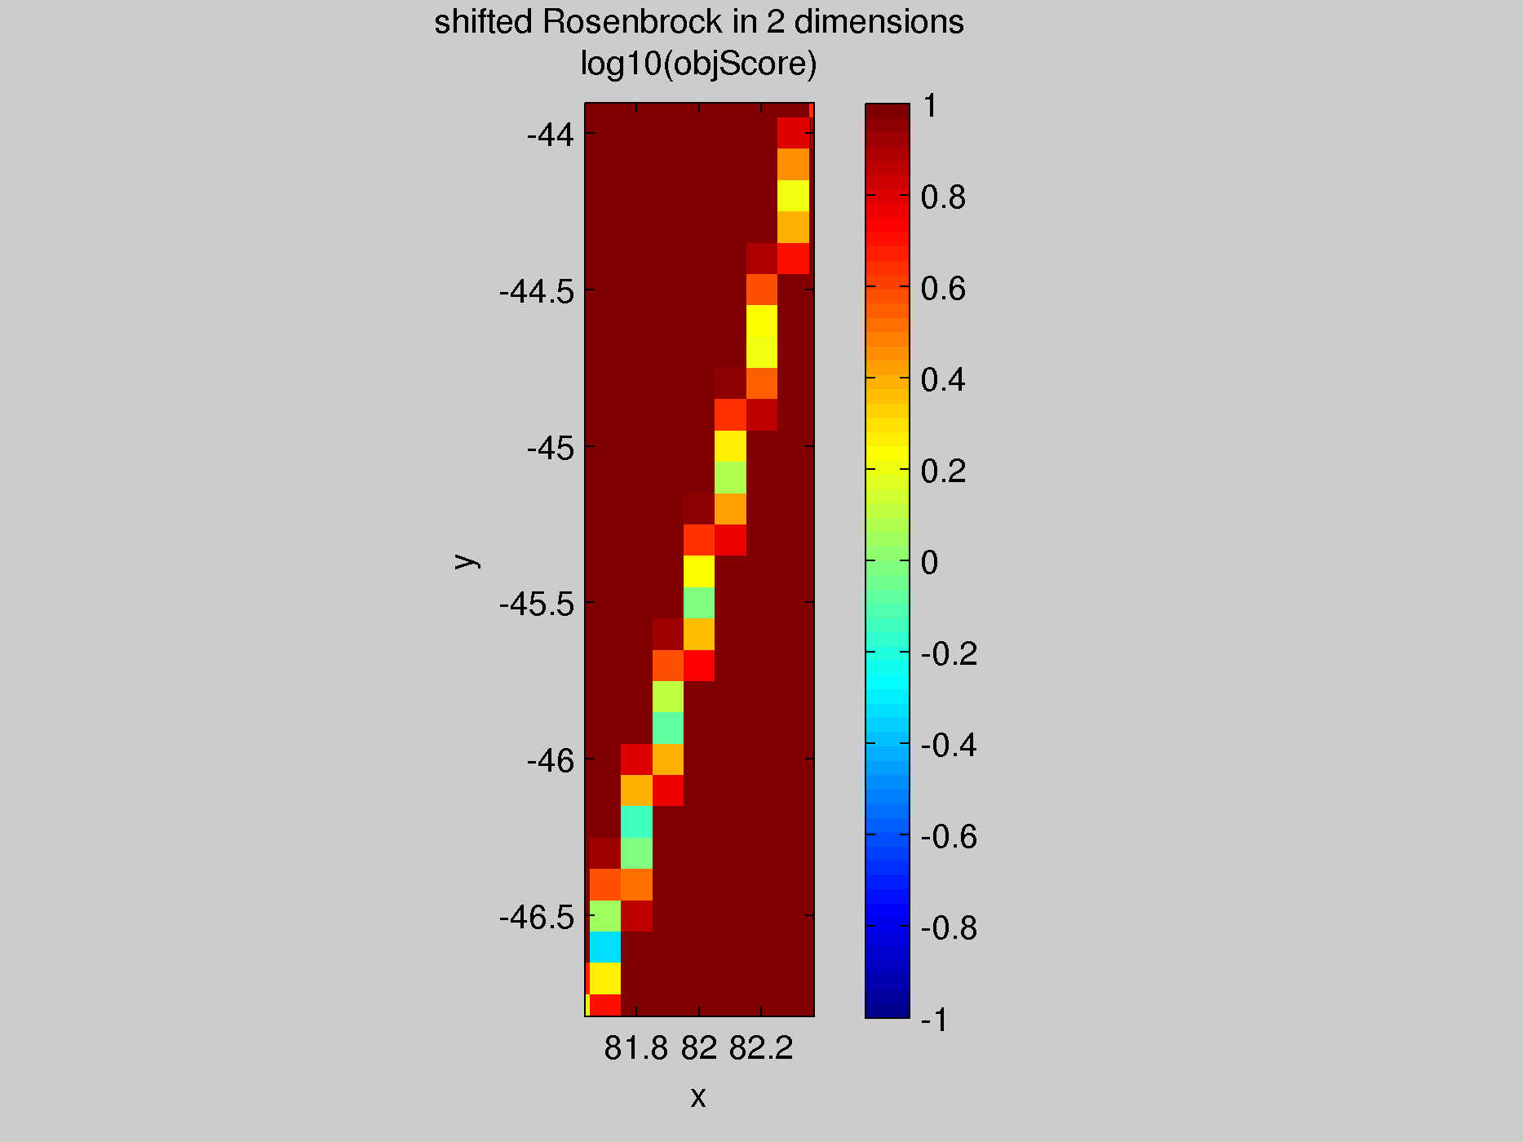
Differential Evolution
shifted Rosenbrock
2-D
constrained parameter space: [-100, 100]
response surface (4 million points)
local minima!

Slide 8
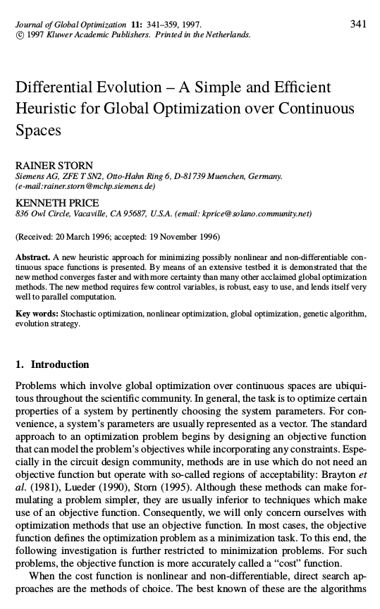
Differential Evolution
Storn & Price 1997
biology inspired
  mutation
  crossover
  selection
improve population, not point
no 1st, 2nd derivative needed

Slide 9
Differential Evolution
the principles
Legend
r1
population of points
(population of distances)
r3
r2

Slide 10
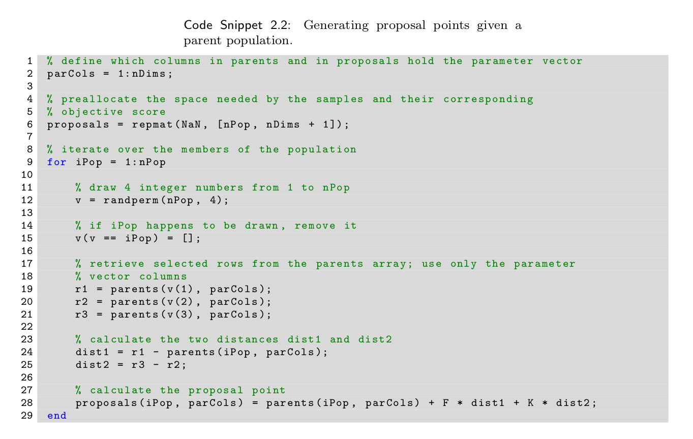

Slide 11
Differential Evolution
the principles
Legend
proposals generated
evaluate objective function
accept proposal if better than parent

Slide 12
Differential Evolution
the principles
Legend

Slide 13
Differential Evolution
the principles
Legend

Slide 14
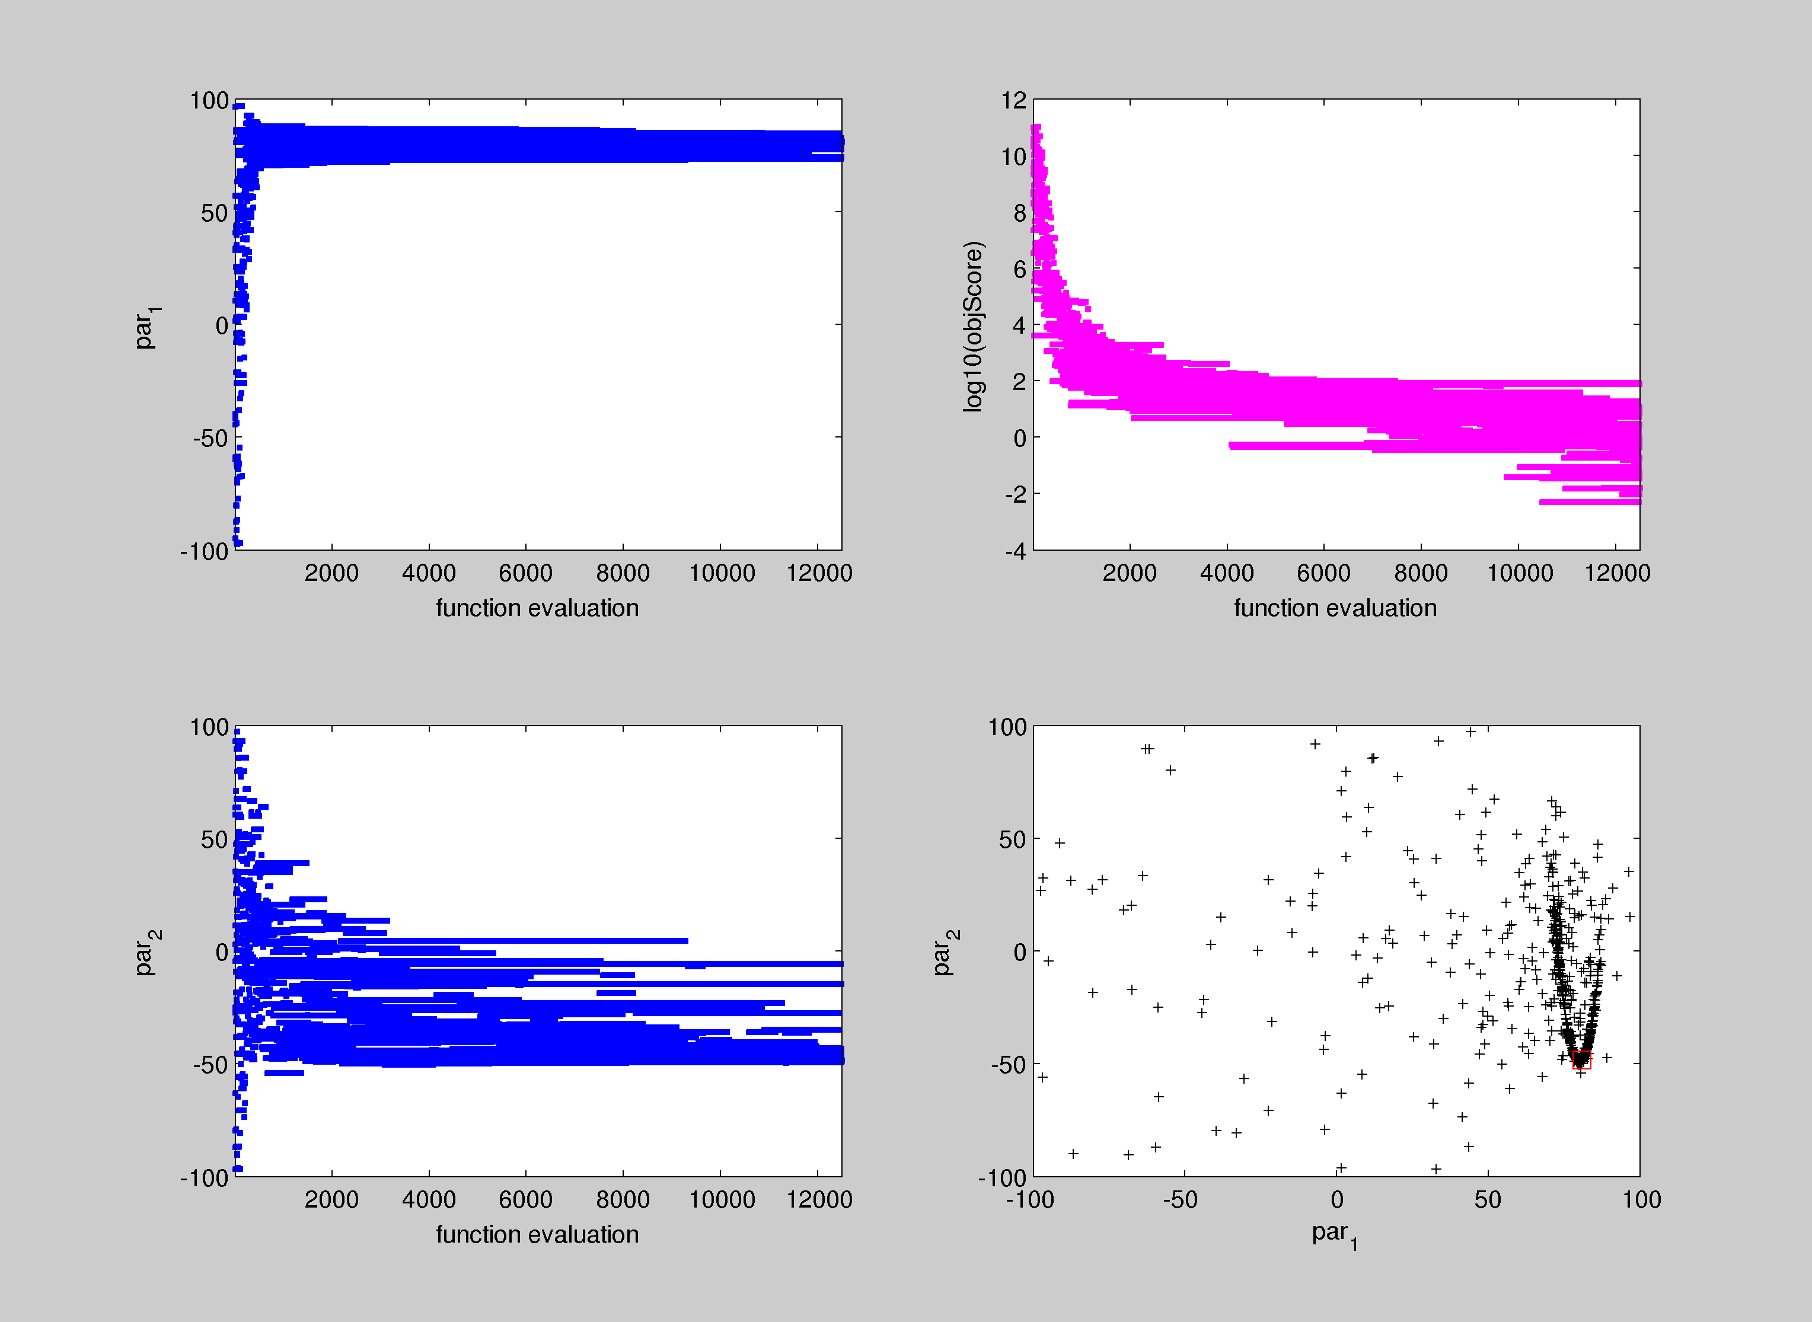
Differential Evolution
only 12500 function evaluations
(not 4 million)
better resolution near optimum
(much) better best score

Slide 15
Differential Evolution
Questions?
Hammer demo time!

