Slide 1
Heat Profile Comparison
b/w Mesh and Functional Expansion Tally in a Pin Cell
Joseph F. Specht IV
5/15/24

Slide 2
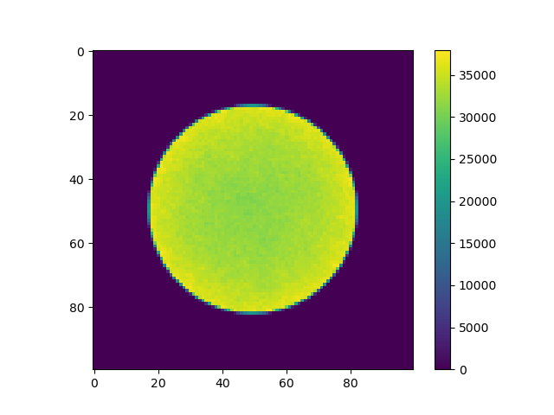
Overview
Modeling a pin cell using OpenMC
Comparison of heat distribution profiles between histogram tally (simple mesh) and functional expansion tallies (FETs)
Plotting recoverable energy production rate due to fission (kappa-fission)
Using Zernike Polynomials for functional expansion
Heat Map using a simple mesh tally with dimensions of 50x50.

Slide 3
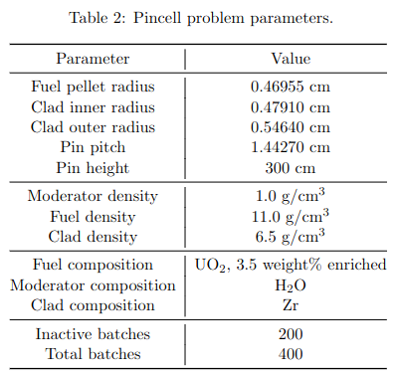
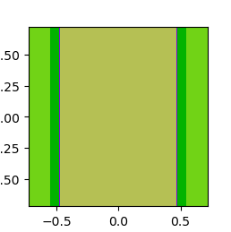
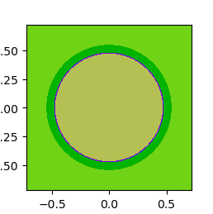
Pin Cell
Axial Cross Section:
[x] = cm, [z] = cm
Radial Cross Section:
[x] = cm, [y] = cm
Fuel
UO₂
Clad
Zr
Moderator
H₂O
Pin Cell Parameters [2]

Slide 4



Zernike Polynomials
Set of polynomials that are orthogonal over the unit circle (1 = x² + y²)
Even:
Odd:
Only for even n - m, otherwise R = 0
⍴ = radius
n,m∈ℤ
n≥m≥0
φ = azimuthal
angle
[3]

Slide 5
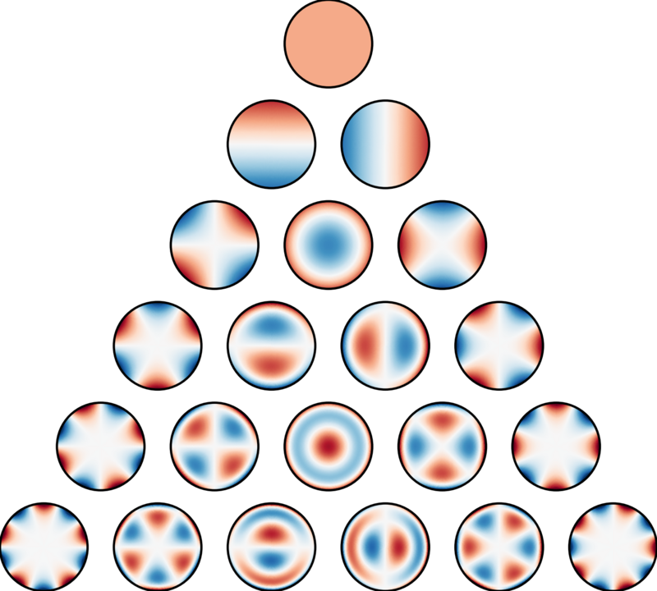
Zernike Polynomials
First 21 Zernike Polynomials [3]
ordered:
vertically by radial degree
horizontally by azimuthal degree

Slide 6
Heat Distribution Profiles

Slide 7
Simple Mesh Heat Map
Inactive Batches = 200
Total Batches = 400
(same for functional expansion)
Particles per Batch = 1000

Slide 8
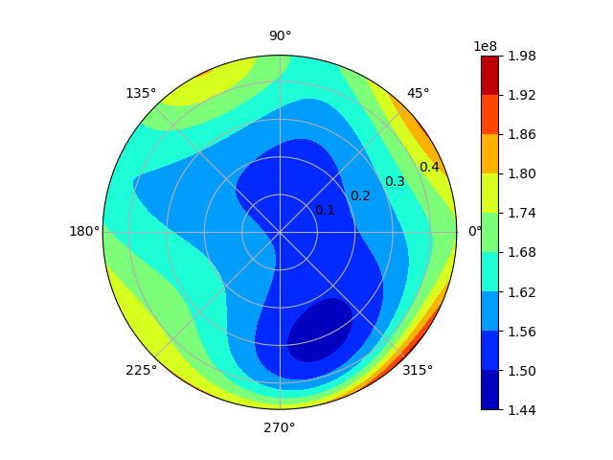
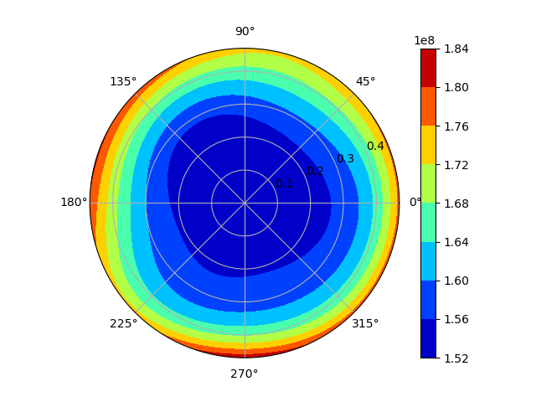
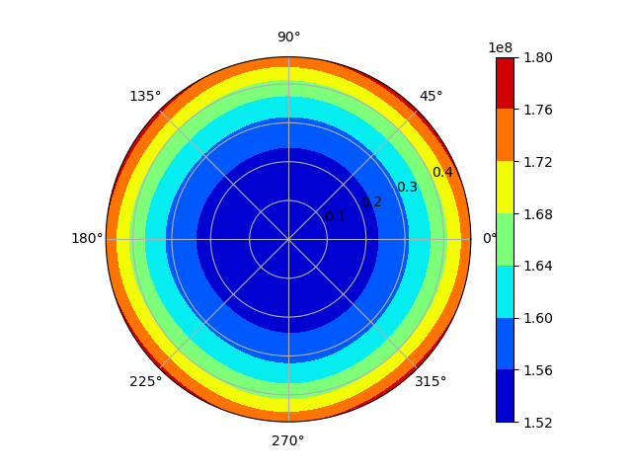
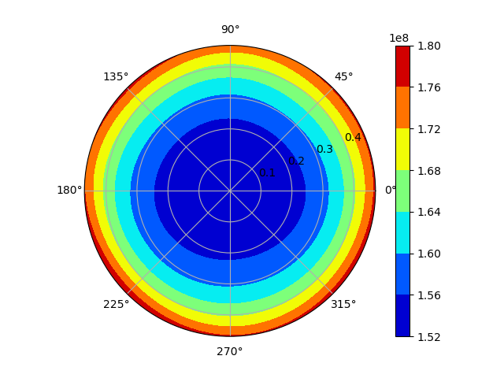
Order 5 Zernike FET
p = 100
p = 1,000
p = 10,000
p = 100,000

Slide 9
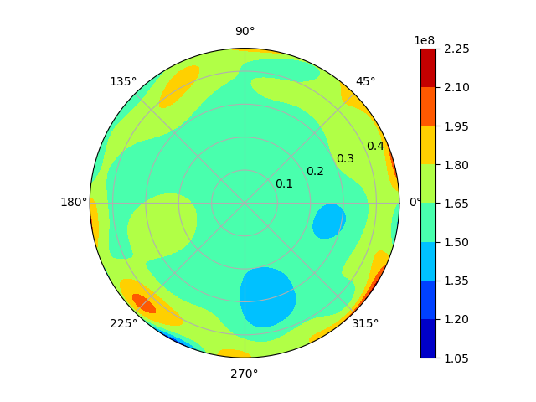
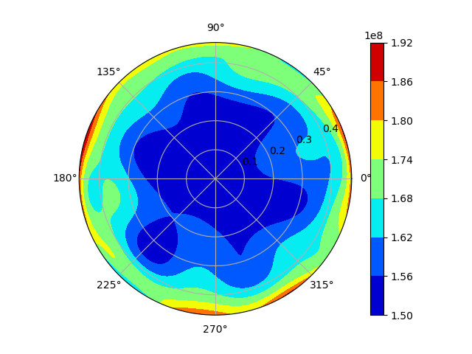
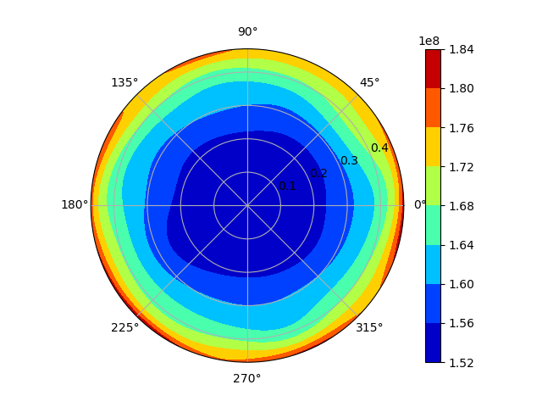
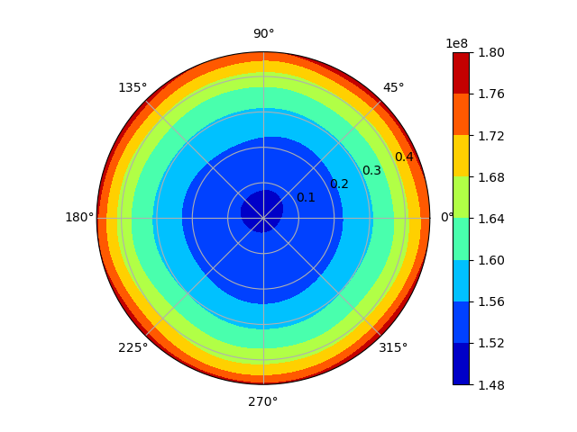
Order 10 Zernike FET
p = 100
p = 1,000
p = 10,000
p = 100,000

Slide 10
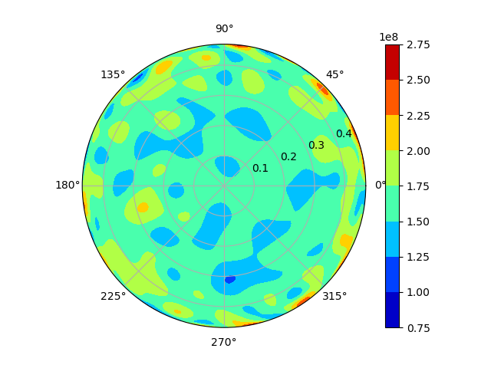
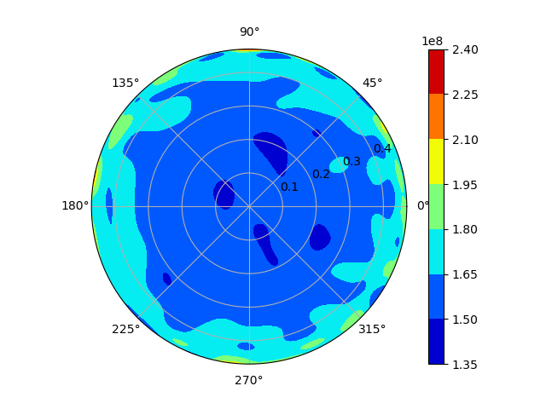
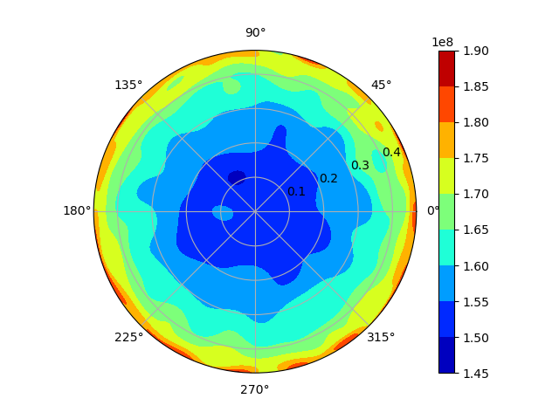
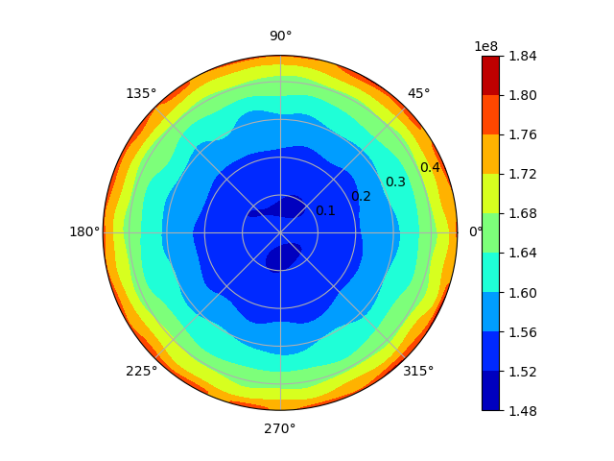
Order 20 Zernike FET
p = 100
p = 1,000
p = 10,000
p = 100,000

Slide 11
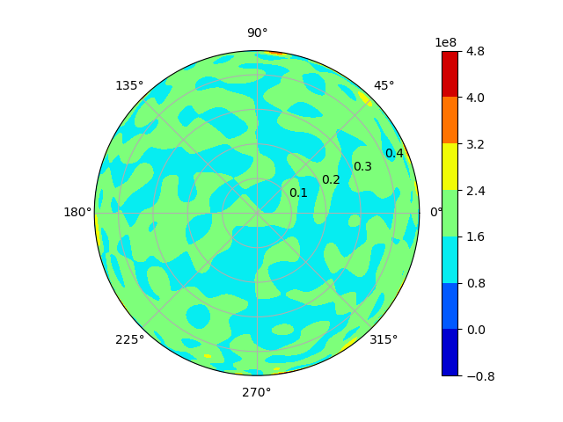
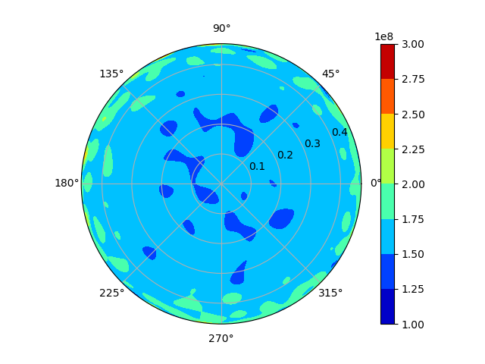
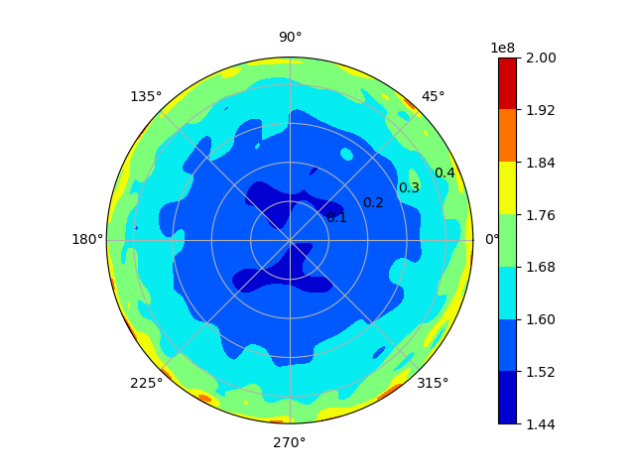
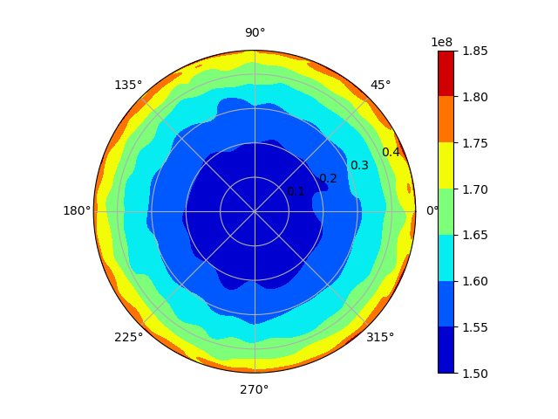
Order 30 Zernike FET
p = 100
p = 1,000
p = 10,000
p = 100,000

Slide 12
Comparison: Zernike (p=1e5) vs Mesh
50 x 50 Mesh
(p = 1e3)
o = 5
o = 20
o = 10
o = 30

Slide 13
Discussion

Slide 14
Heuristic Argument
Expected heat distribution is circular
Higher order Zernike Polynomials have much finer detail
not needed for such a simple heat distribution profile
Zernike Polynomials with higher order “steal” the counts from those with lower order
[3]

Slide 15
Types of Error
Two competing effects
statistical error
splitting counts
↑ as order ↑
truncation error
finite number of terms
↓ as order ↑
At o = 0
min statistical error
max truncation error
At o = ∞
max statistical error
min truncation error

Slide 16

Ratio of Errors
Ratio of increase in statistical error to decrease in truncation error for the n^{th} term
If ratio is:
≪1, include term
≫1, reject term
≅1, consider term
[1]

Slide 17
References
[1] Griesheimer, David P., et al. “Convergence properties of Monte Carlo functional expansion tallies.” Journal of Computational Physics, vol. 211, no. 1, 1 Jan. 2006, pp. 129–153, https://doi.org/https://doi.org/10.1016/j.jcp.2005.05.023.
[2] Novak, April. “NPRE 455: Computer Project 3.” Canvas, 8 Apr. 2024, canvas.illinois.edu/courses/43321/files/folder/Computer%20Projects/CP3.
[3] “Zernike Polynomials.” Wikipedia, Wikimedia Foundation, 16 Apr. 2024,
en.wikipedia.org/wiki/Zernike_polynomials.

Slide 18
Thank you!
Questions?

Slide 19
Extra Slides

Slide 20
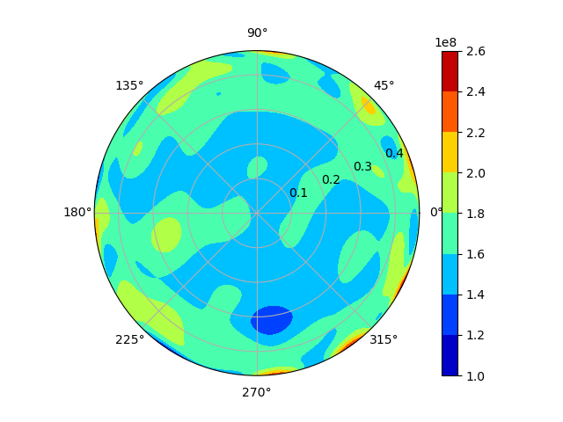
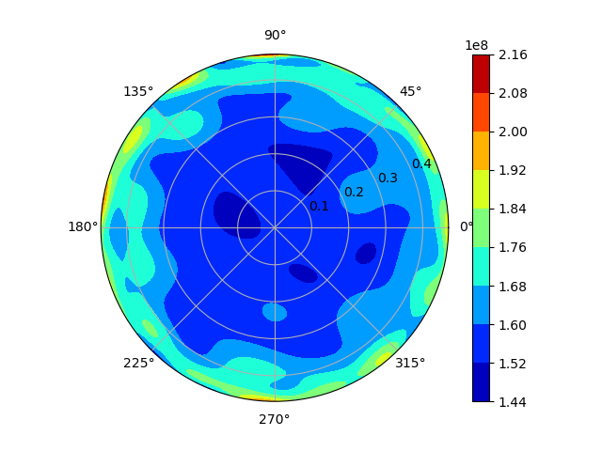
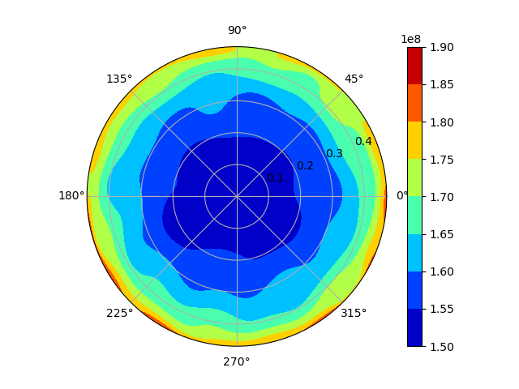
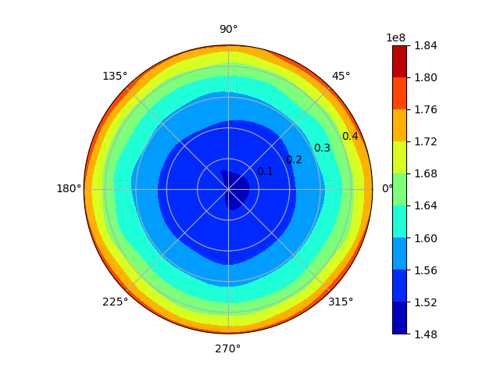
Order 15 Zernike FET
p = 100
p = 1,000
p = 10,000
p = 100,000

Slide 21
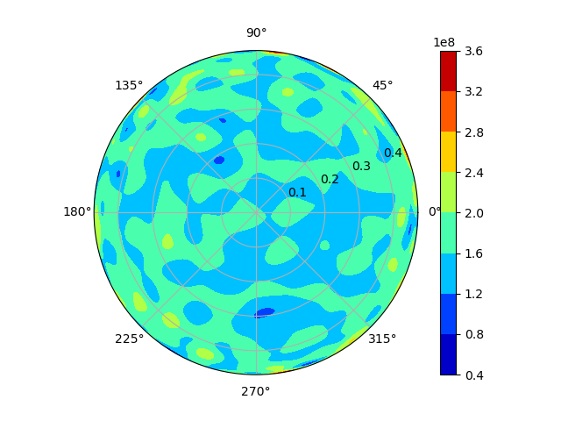
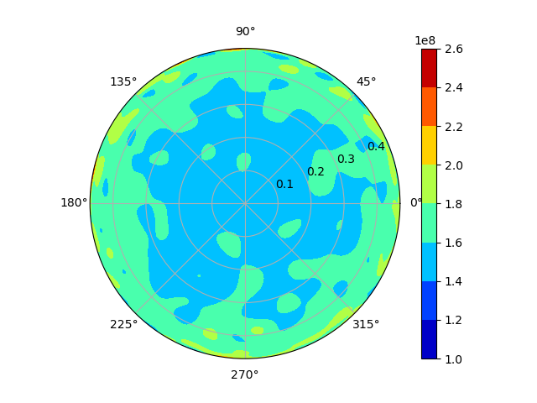
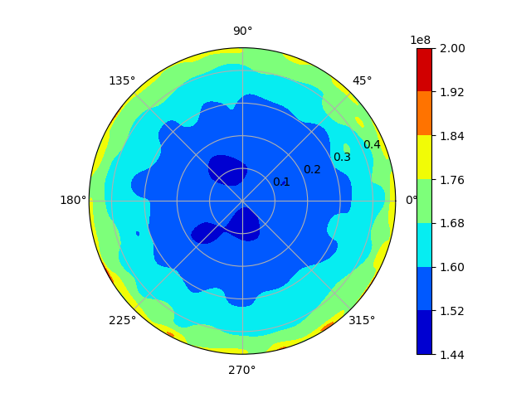
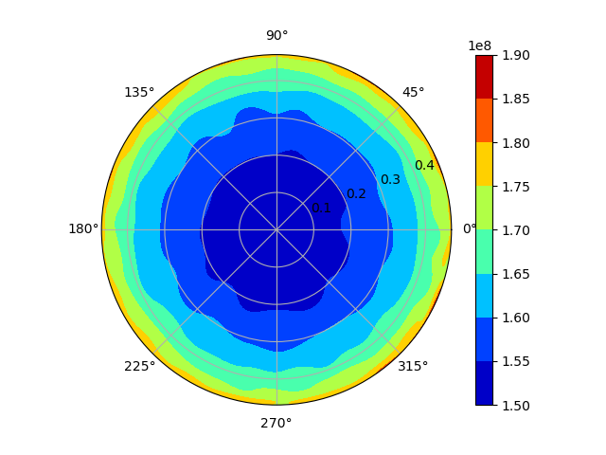
Order 25 Zernike FET
p = 100
p = 1,000
p = 10,000
p = 100,000

Slide 22
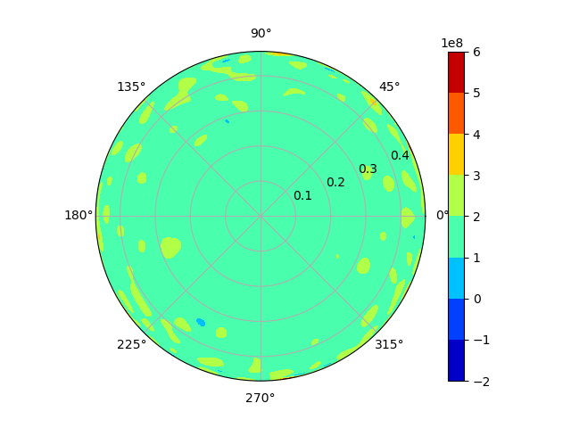

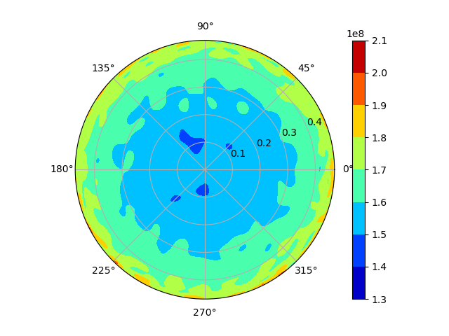
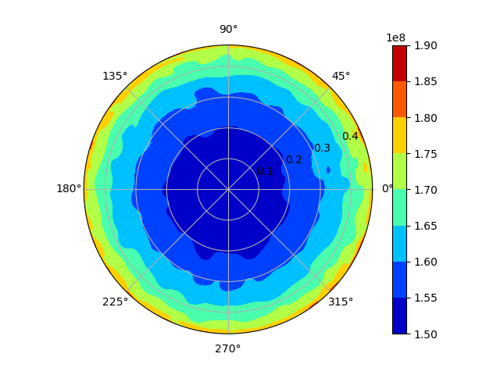
Order 35 Zernike FET
p = 100
p = 1,000
p = 10,000
p = 100,000

