Slide 1
Were home-purchase denials more common in lower-income Kansas neighborhoods?
Among Kansas home-purchase applications that received a lending decision in 2018–2025, were denial rates higher in census tracts below the area median income, even when comparing applicants in similar income bands?
Scott Person · DSCI 6883 · October 2026 · Source: FFIEC Home Mortgage Disclosure Act (HMDA) data, Kansas, 2018–2025. Unit is the application record, not the borrower.
Notes:
Hello class and professor Garcia. Scott Person here.
Home mortgages are one of the primary pathways for building wealth in the United States. They are heavily subsidized via the tax laws and lender support. Because we as a society invest and depend so much on these types of loans, they are also heavily regulated. The various banking regulating agencies collect data about mortgage applications and do a lot of analysis to ensure compliance with finance and anti-discrimination policies. One of the regulators' primary data sources is the Home Mortgage Disclosure Act data set. In this video we're going to be taking a look at a typical analytical question and analysis process.

Slide 2
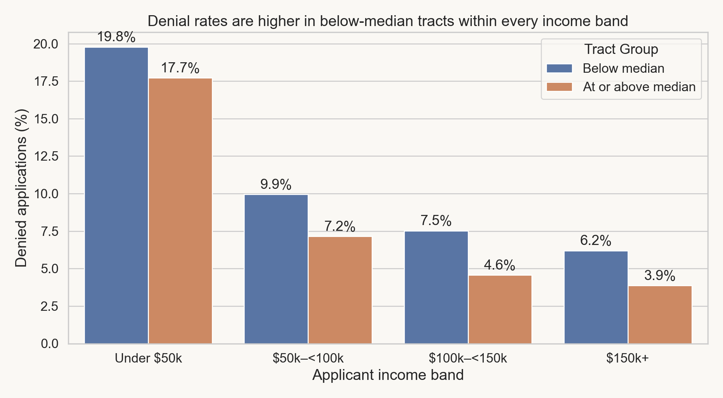
Below-median tracts: denials 2–3 points higher
Largest band: $50,000–<$100,000 applicants were denied 9.95% of the time in below-median tracts (53,448 applications) vs 7.15% at or above the median (75,120).
Gap is smallest in the under-$50,000 band (2.07 points) and largest at $100,000–<$150,000 (2.95 points).
Shows that denials differed, not why.
313,643 Kansas home-purchase application records with a lending decision (approved, approved not accepted, or denied), reported applicant income, and a positive tract-to-area-median income percentage. Tract groups split at 100% of area median. Source: FFIEC HMDA 2018–2025; author's analysis.

Slide 3
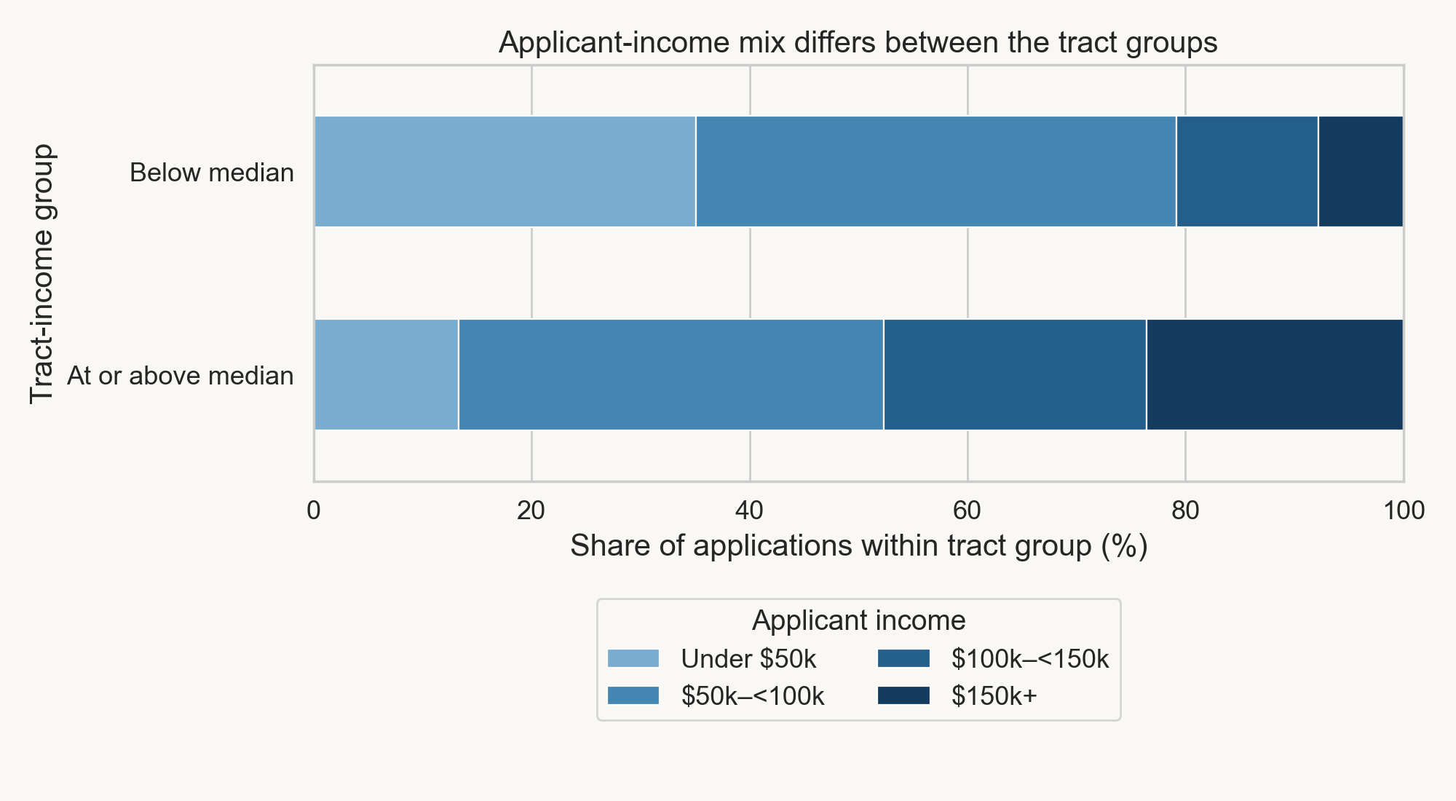
The tract groups drew different applicant mixes
Under $50,000 applicants: 35.08% of applications in below-median tracts vs 13.30% in tracts at or above the median.
$150,000 or more: 7.81% vs 23.55%.
Comparing within applicant-income bands makes the tract comparison more meaningful, though it does not control for every difference.
Shares are of application records within each tract group (313,643 retained records), not household-income statistics. Applicant income is the reported borrower income; tract income is the tract's percentage of the area median. Source: FFIEC HMDA 2018–2025; author's analysis.

Slide 4
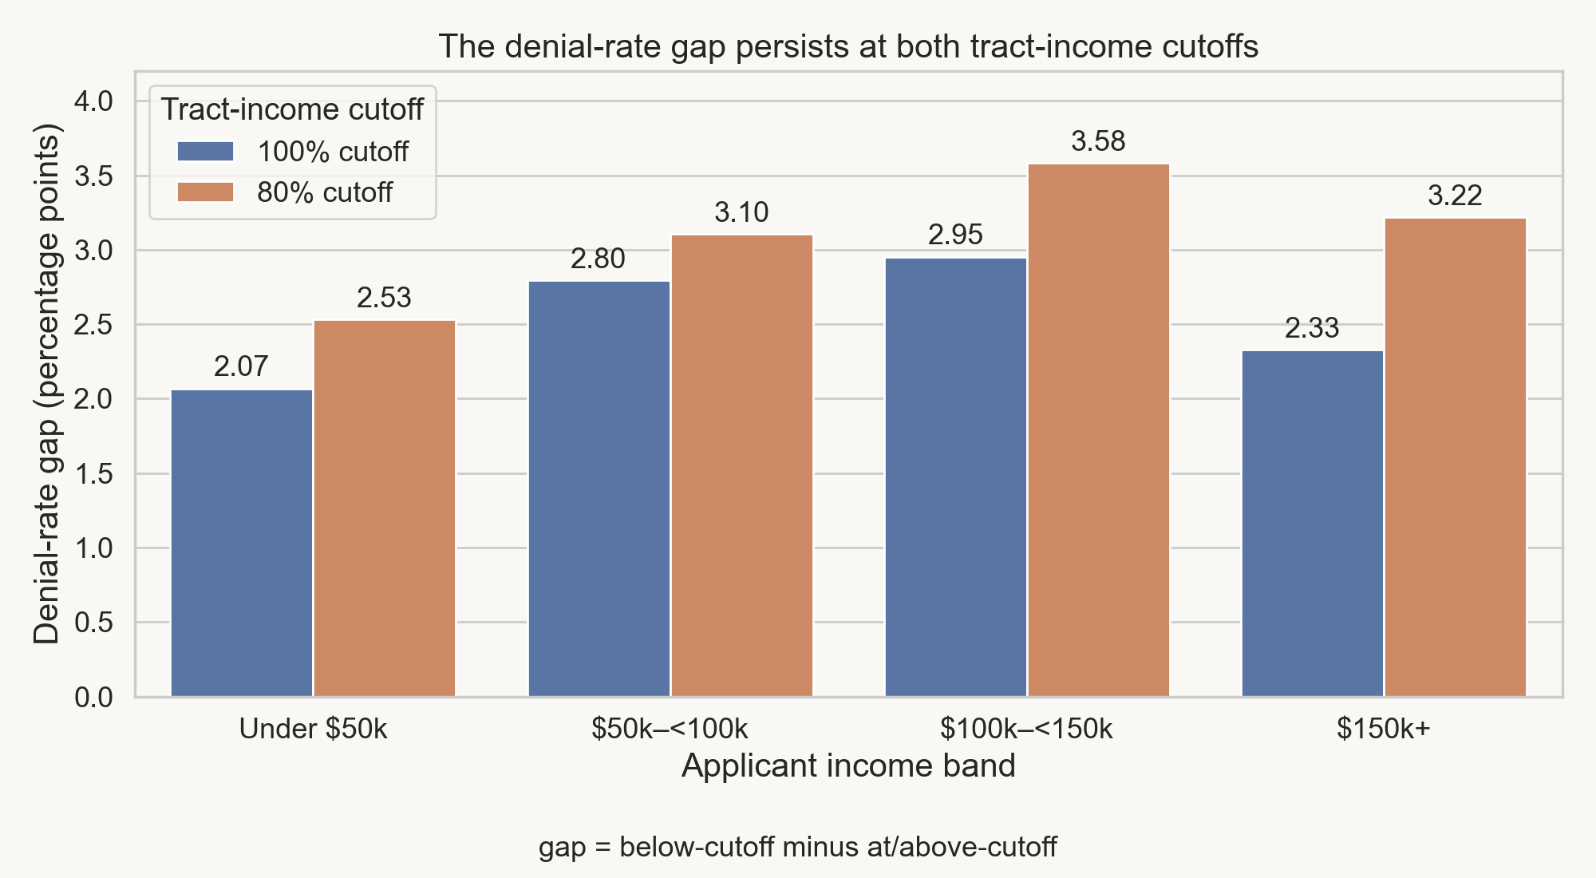
The gap holds at an 80% tract-income cutoff too
At the stricter 80% line the gap widens in all four bands, to 2.53–3.58 points.
The below-cutoff group shrinks from 121,238 applications (100% cutoff) to 49,271 (80% cutoff). These are two group definitions, not a before-and-after change.
The gap persists at both tested cutoffs; the check does not explain the cause.
Same 313,643 decided applications as the main comparison; only the tract-income threshold changes. Source: FFIEC HMDA 2018–2025; author's analysis.

Slide 5
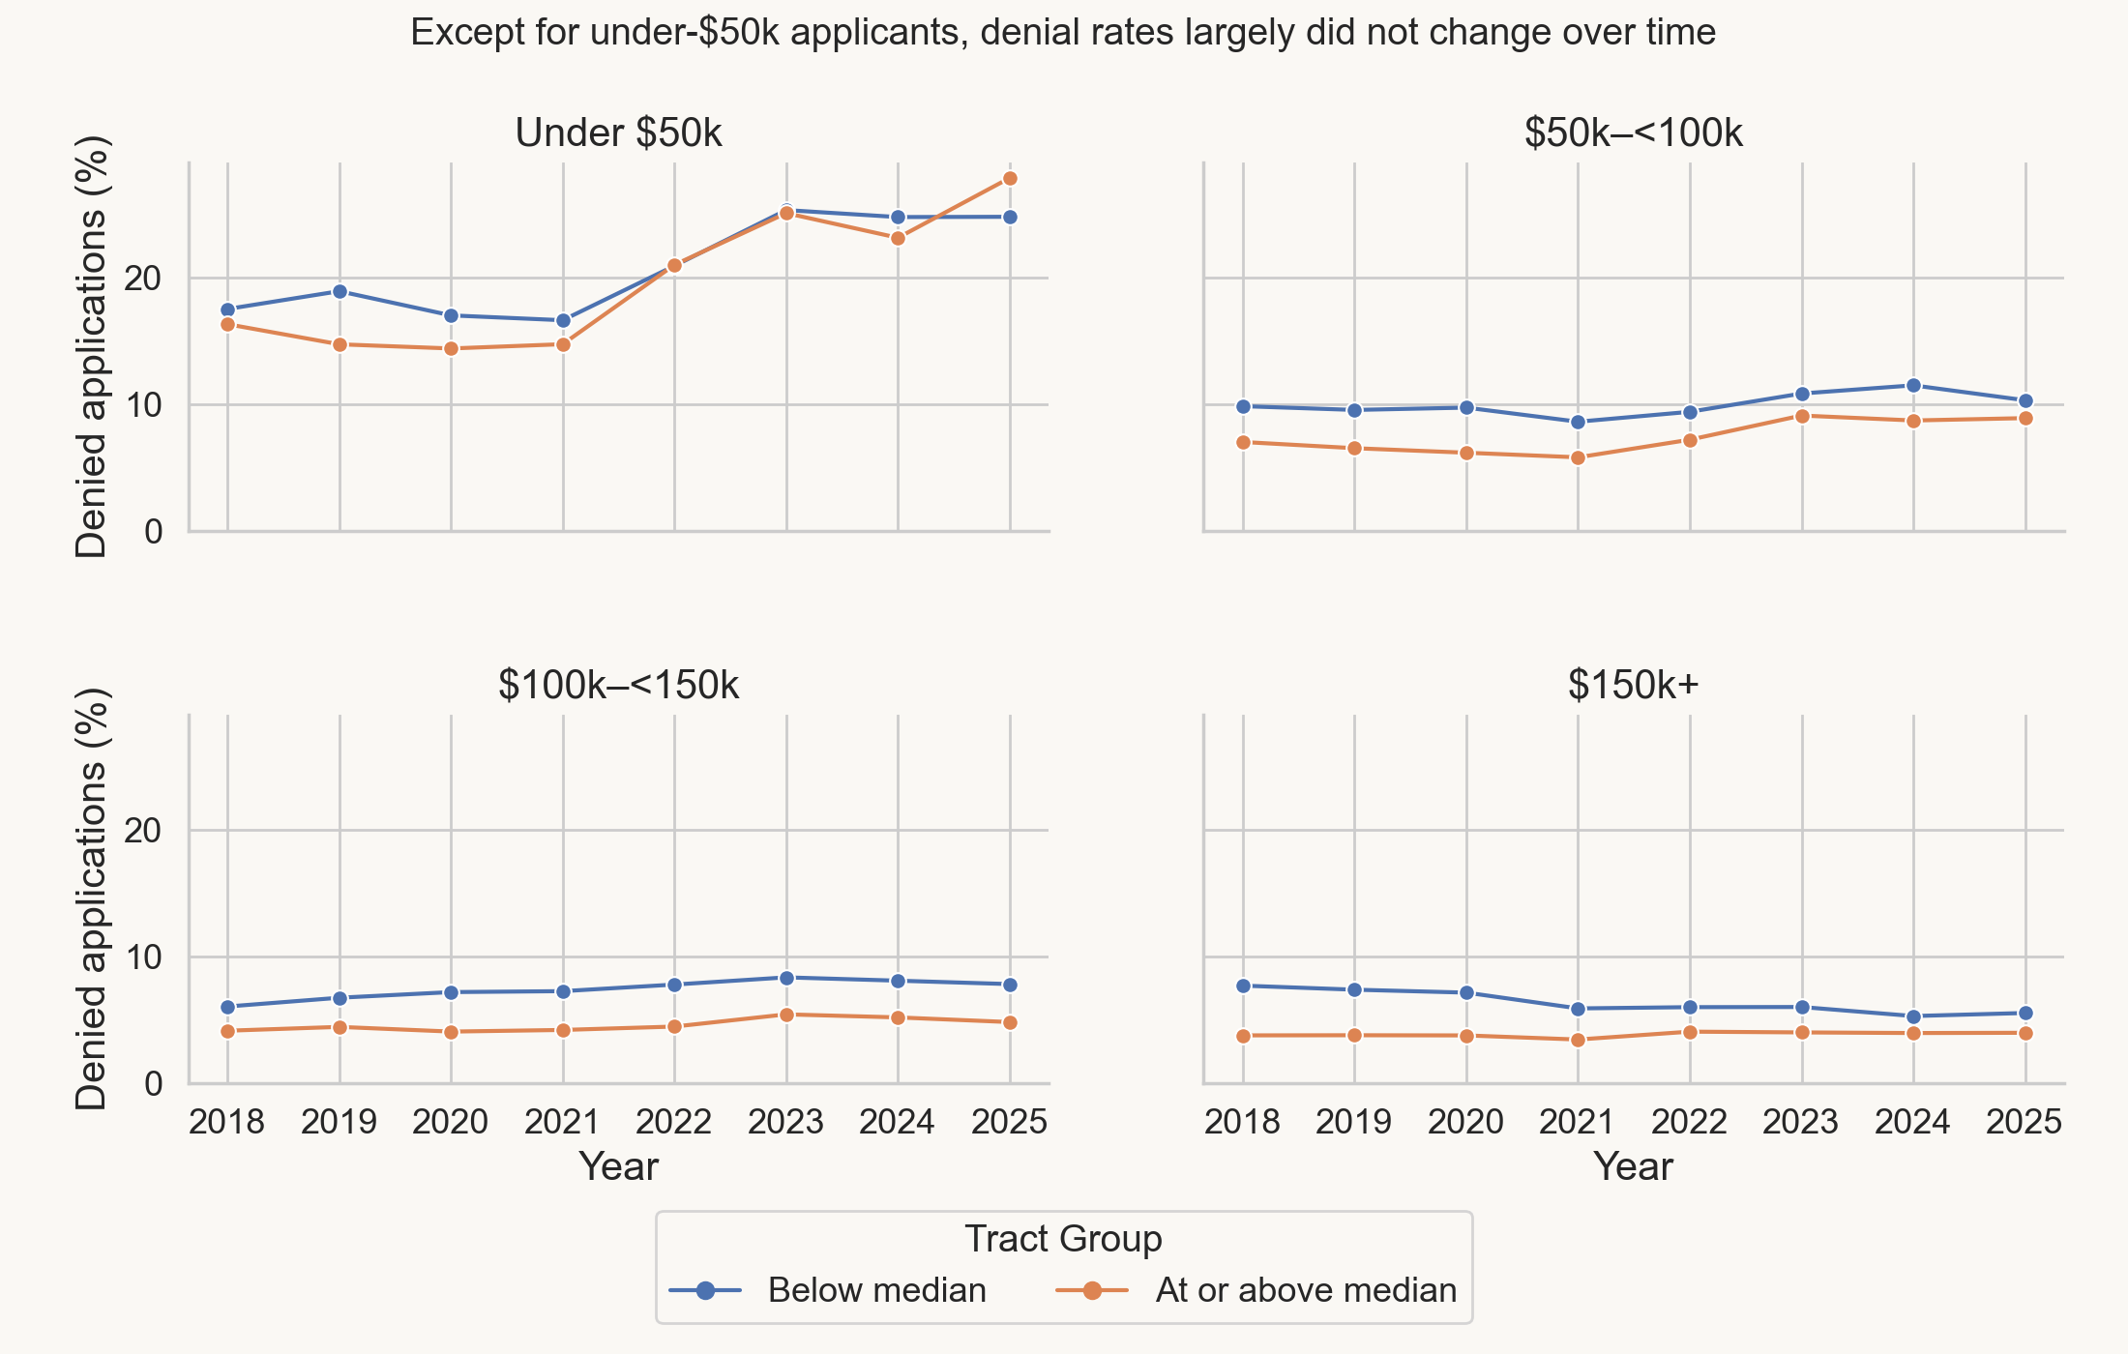
Under-$50,000 denials climbed after 2021
Combining both tract groups, the under-$50,000 denial rate rose from 15.92% in 2021 to 25.27% in 2023 and 25.83% in 2025.
Gap reversed in two years: below minus at/above was about -0.08 points in 2022 and -3.07 points in 2025.
Applicant mix and lending conditions may have changed; the fields analyzed here cannot isolate the reason.
Annual denial rates by tract group within each applicant-income band, 313,643 retained records. Interest rates are not analyzed: the field is missing or exempt for all denied records. Source: FFIEC HMDA 2018–2025; author's analysis.

Slide 6
467,521 source records became 313,643 compared
467,521
Source records in eight annual FFIEC Kansas home-purchase files, 2018–2025
335,302
Received a lending decision: approved, approved but not accepted, or denied
331,553
Have a positive tract-income percentage, so a tract group can be assigned
313,643
Also report applicant income: the final within-band comparison group
↓ Excluded 132,219 records outside the origination, approved-not-accepted, and denial outcomes
↓ Removed 3,749 records with a zero tract-income percentage; 1,773 of them were denied (47.3%)
↓ Removed 17,910 records with missing applicant income
The excluded zero-tract records were denied 47.3% of the time, far above the retained group; the result does not describe them.
Counts are sequential: each exclusion is measured against the step before it. Repeated identical rows were kept; they are not proven duplicates. Source: FFIEC HMDA 2018–2025; author's analysis.

Slide 7
The gap is real; its cause is not established
What the records show
Within each applicant-income band, below-median tracts had denial rates 2.07–2.95 points higher across 313,643 decided applications.
The gap holds at an 80% tract cutoff and in a named-metropolitan-area sensitivity comparison.
Annual exceptions exist: the under-$50,000 band's gap was about –0.08 points in 2022 and –3.07 in 2025.
What they do not establish
Why. Credit history, debt-to-income ratio, loan terms, and lender were outside the scope of this analysis. This association does not establish discrimination or a causal neighborhood effect.
Like-for-like applicants. Broad income bands hide variation inside each band.
Who is counted. Excluding missing-income and zero-tract records changes who the result describes.
Tract-income reference for non-metropolitan code 99999 not yet confirmed as uniform. Source: FFIEC HMDA 2018–2025; author's analysis.

Slide 8
Investigate the gap before intervening
Main result: within each pooled applicant-income band, Kansas home-purchase applications in below-median-income tracts were denied 2.07–2.95 percentage points more often (2018–2025). The pattern was not constant every year, and it describes only the 313,643 retained records.
Recommendation
Treat the recurring within-band gap as grounds for a deeper review, not a causal or fairness verdict.
Do not change lending policy on this analysis alone.
Next steps
Narrower applicant-income bands to test whether the gap survives within finer slices.
Add underwriting, geography, and lender fields (credit, debt-to-income, loan terms).
Investigate the under-$50,000 shift after 2021 and the excluded zero-tract population.
Source: FFIEC HMDA 2018–2025, Kansas home-purchase applications; author's analysis.

