Slide 1
Querying and Data Warehousing BUJ International

Slide 2
What is a Query
Command in SQL whose purpose is to get the DB to do something
Types
Data Definition Language (DDL) – Define DB Objects
Data Manipulation Language (DML) – Change data
Data Control Language (DCL) – Data access control

Slide 3
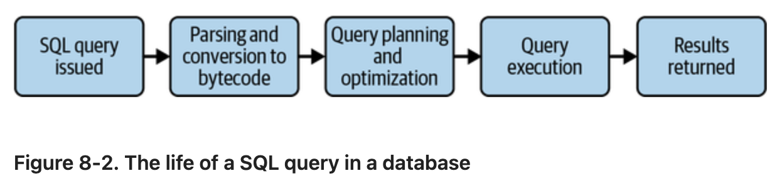
Life of a Query
(Reis & Housley, 2022, Figure 8-2)

Slide 4
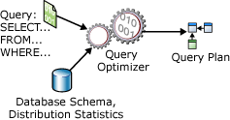
Role of Query Optimizers
Take a SQL query and information about the database and create the most efficient execution plan
(Microsoft, 2025)

Slide 5
Query Optimization
Execution plan
Table scans (bad)
Key lookups – indicate only partial index
Fat Arrows (SQL Server in particular) – lots of data
Indexing
Columns in WHERE clauses – in order of most to least commonly used
Columns used in joins
Reduce the amount of data
WHERE clause
CTEs/subqueries
Notes:
Lots of hocus pocus in optimizing queries – research and know how your particular database works.

Slide 6
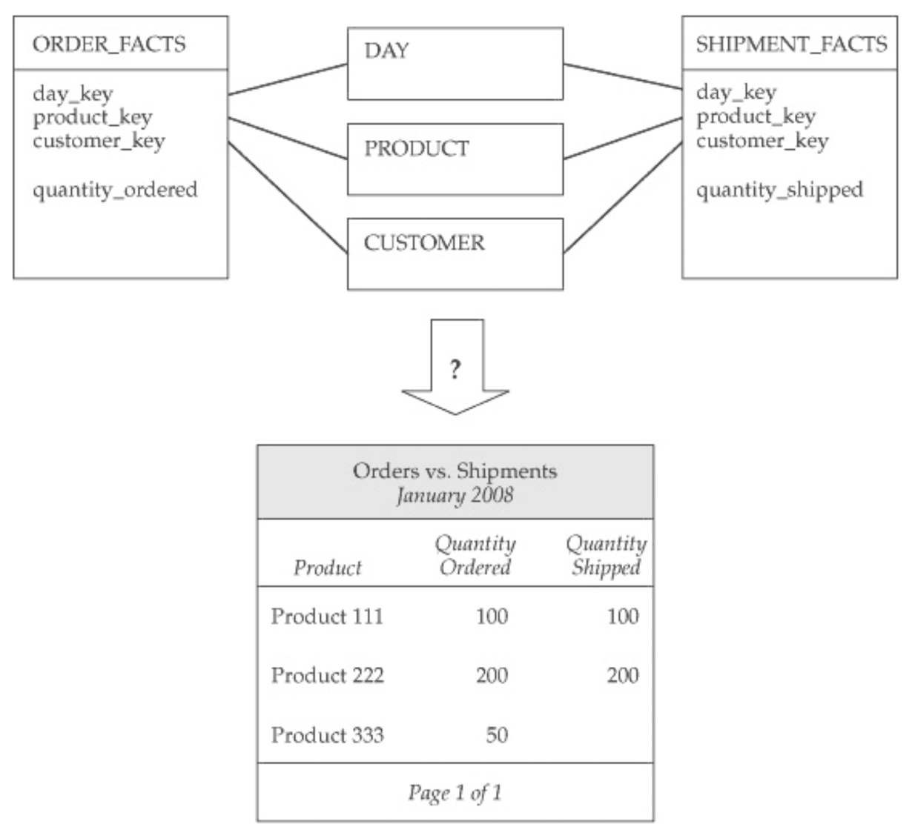
Star Schema
(Adamson, 2010, p. 71)

Slide 7
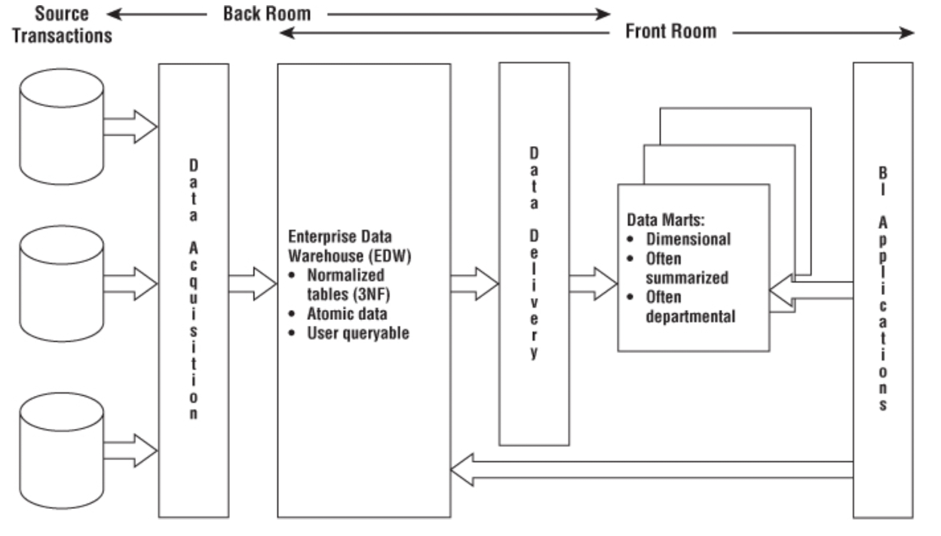
Inmon Corporate Information Factory
(Kimball & Ross, 2013, loc. 972)

Slide 8
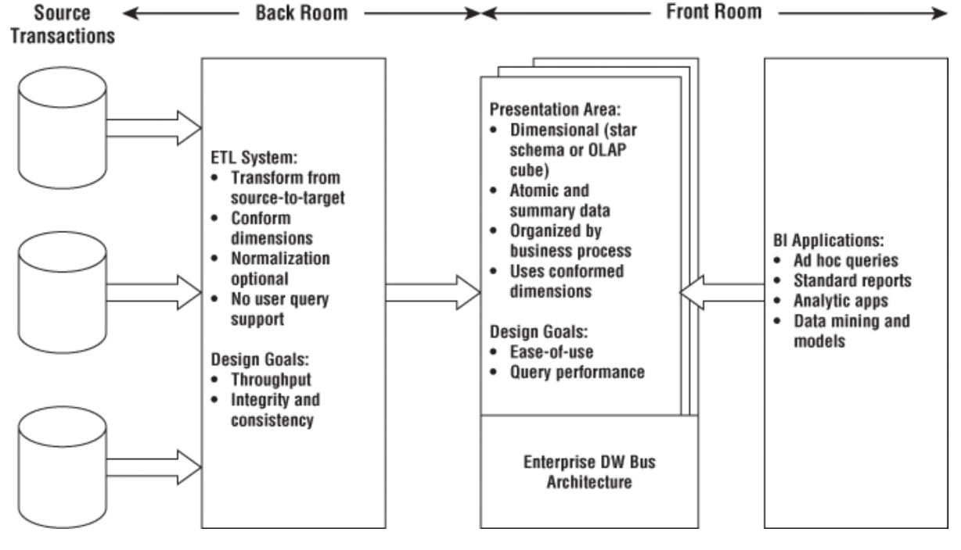
Kimball DW/BI Architecture
(Kimball & Ross, 2013, loc. 765)

Slide 9
External Considerations
Upstream
Extract coordination
Schema mutation
Make friends
Downstream
Requirements (!!!)
Data Quality
Anticipate future requirements (History)

Slide 10
Sources
Adamson, C. (2010). Star schema: The complete reference. McGraw-Hill.
Kimball, R., & Ross, M. (2013). The data warehouse toolkit: The definitive guide to dimensional modeling (3rd ed.). Wiley.
Microsoft. (2025). Query processing architecture guide. Microsoft Learn. https://learn.microsoft.com/en-us/sql/relational-databases/query-processing-architecture-guide
Reis, J., & Housley, M. (2022). Fundamentals of data engineering: Plan and build robust data systems. O'Reilly Media.

