Slide 1
Data Pipeline Solution
BUJ International
Scott Person

Slide 2
GOAL
Build a proof of concept for an
analytical data store on BigQuery
Powered by
Airbyte Extract + Load
dbt Transform
Dagster Orchestrate

Slide 3
ENTERPRISE DATA FLOW
1
2
3
SOURCE
RAW LAYER
TRANSFORMED
PostgreSQL
Source Database
BigQuery Raw
Ingested Data
BigQuery Transformed
Modeled Data
EL
Transform
Airbyte
dbt
Tables and Views
Transactional Data
Operational Systems
Raw Replicated Tables
Schema Mirroring
Append / Upsert
Star Schema Models
Business Logic
Analytics Ready
Orchestration dagster

Slide 4
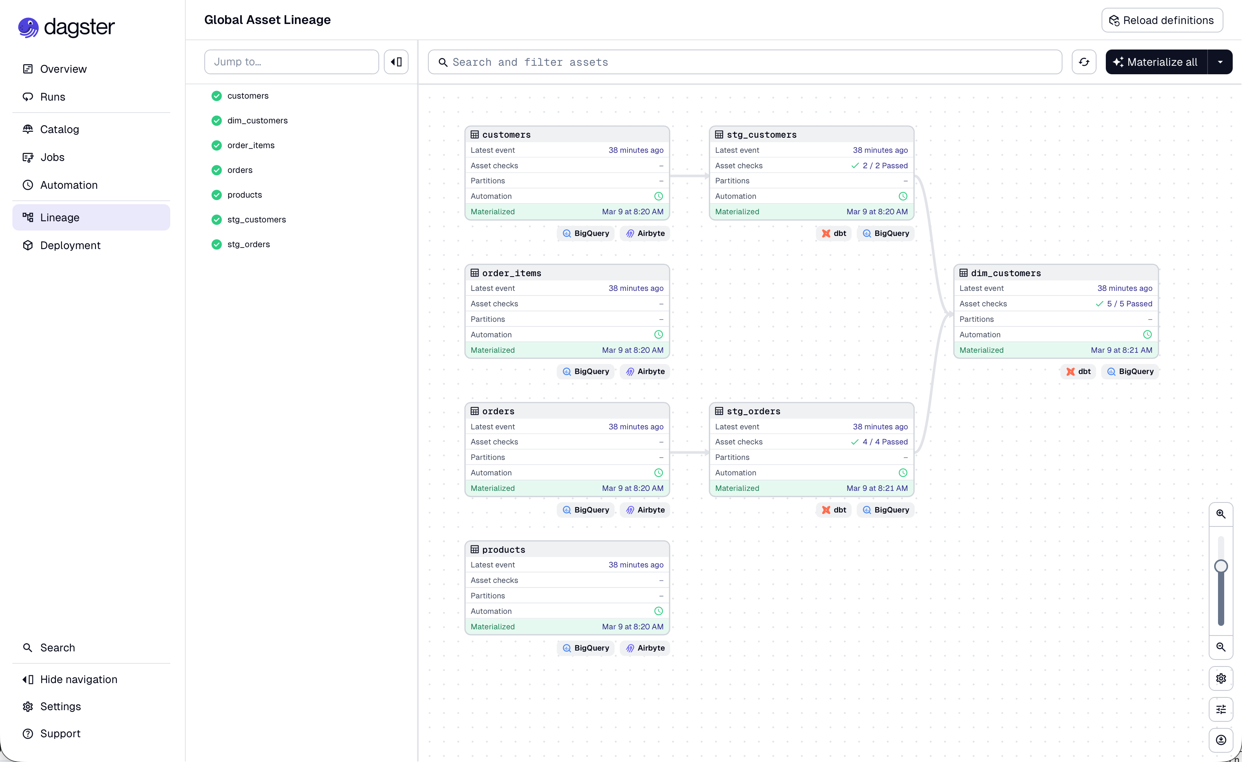
COMPLETE FLOW W/O FACT

Slide 5
BACKUP SLIDES

Slide 6
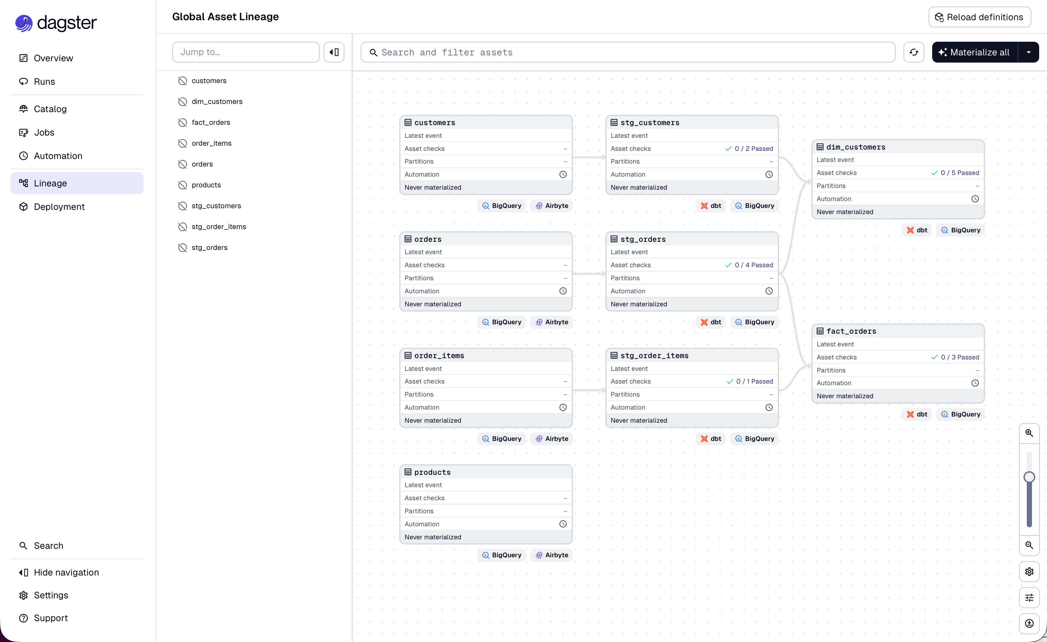
COMPLETE FLOW

